Slide 1
Introduction to nanomaterials and nanotechnology, historical developments. An overview of scope & applications of nanotechnology. Classifications and types of nanomaterials.

Slide 2

The new era of Nanotechnology is coming
www.n a n o r o b o t d e s i g n.com www.c a n b i o t e c h n e m s.com

Slide 3
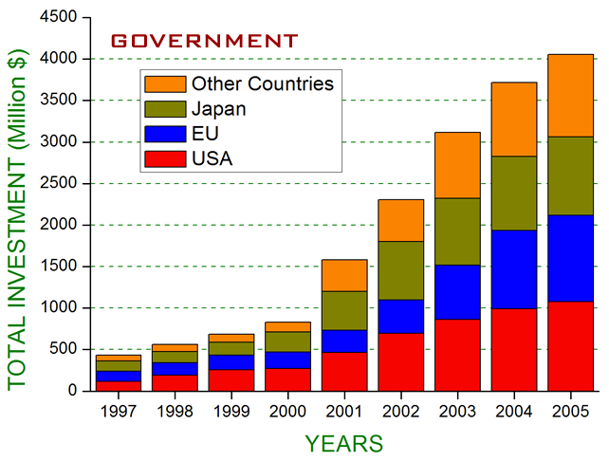
NANOTECHNOLOGY INVESTMENTS
Total Investment (world) in 2005: 6 Billion USD
European Union: 4.8 Billion Euro for 7th Framework Projects
South Africa: 170 million USD for next 3 years
Israel: 230 million USD for next 5 years
National Cancer Institute (USA): 143 million USD for next 5 years

Slide 4
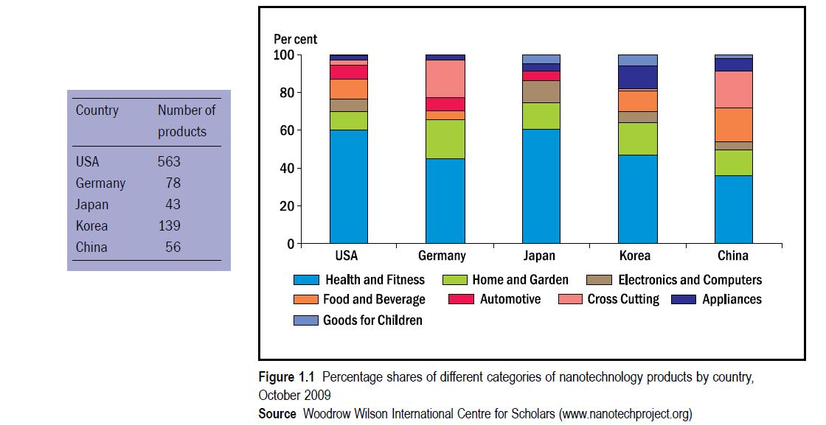

Slide 5
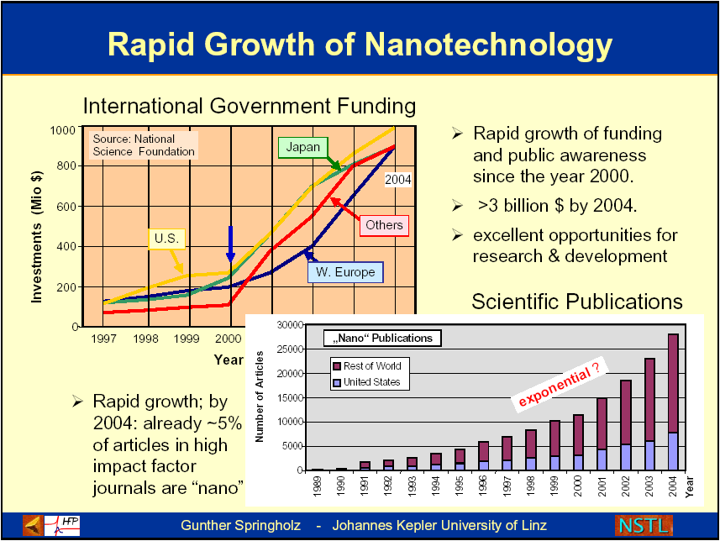

Slide 6
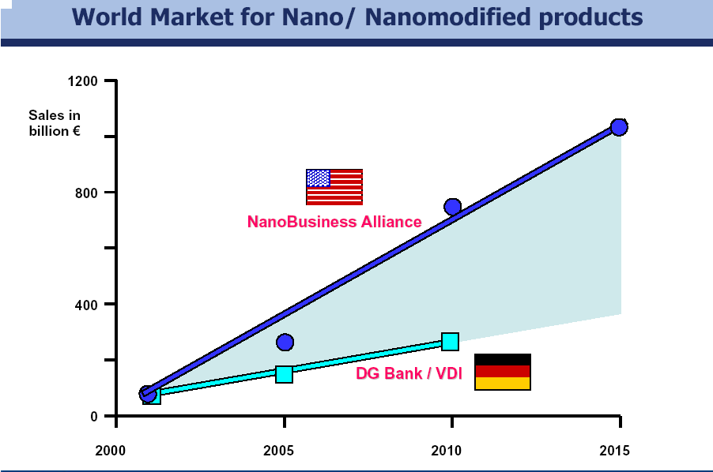

Slide 7
We All Should Care!
The Nanotechnology Revolution is Underway
New technologies and products:
~$1 trillion/year by 2015
Materials beyond chemistry: $340 B/y
Electronics: over $300 B/y
Pharmaceuticals: $180 B/y
Chemicals (catalysts): $100 B/y
Aerospace: ~$70 B/y
Tools: ~$22 B/y
New jobs: ~2 million
nanotechnology workers
from M.C. Roco, NSF

Slide 8
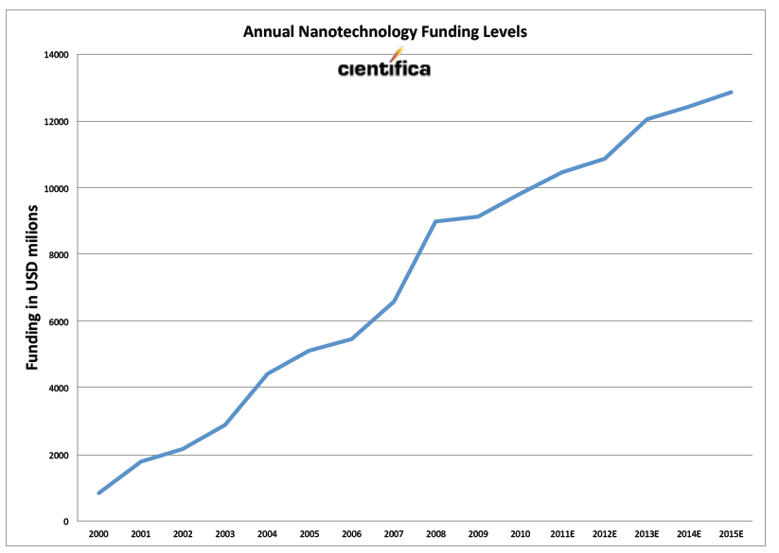

Slide 9
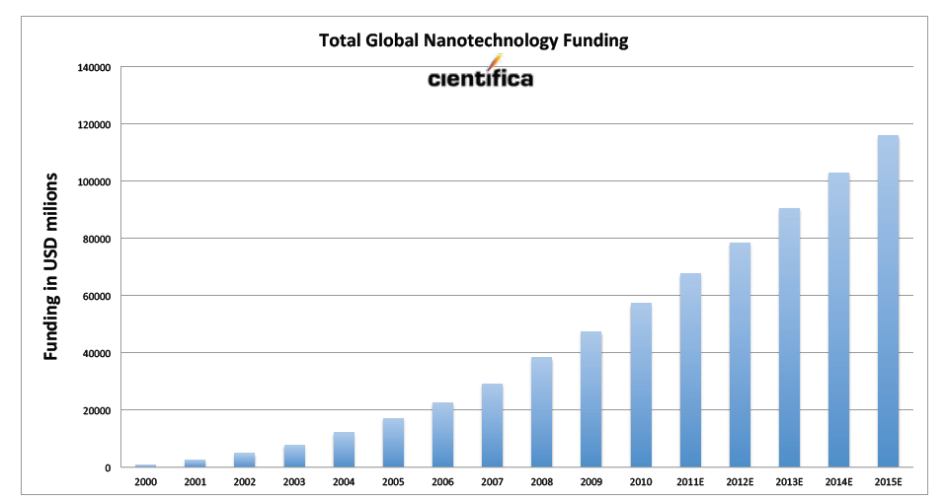

Slide 10
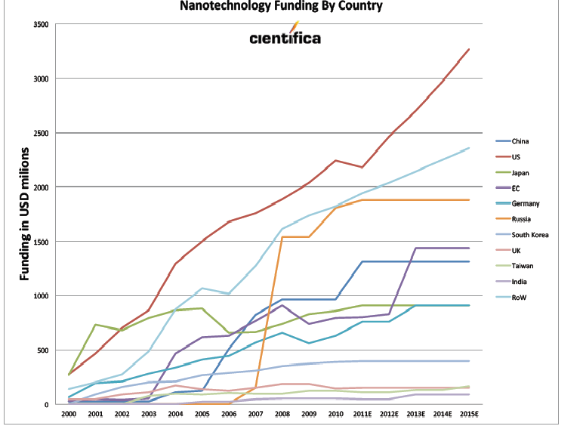

Slide 11
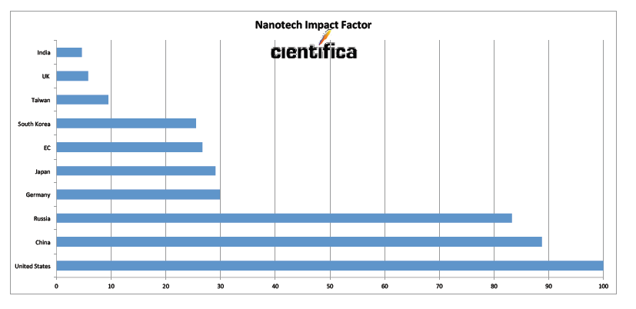

Slide 12
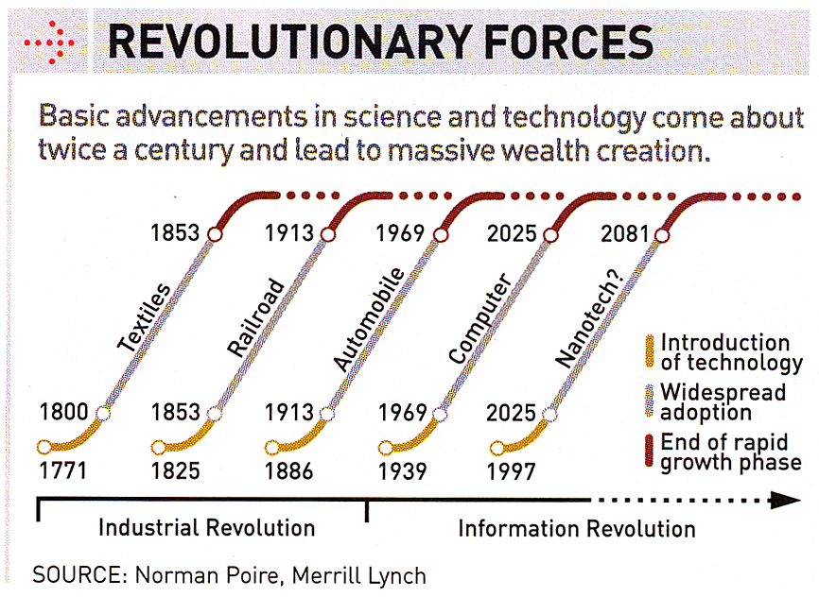
Revolutionary Technology Waves

Slide 13
What is Nano?
Oringin is from Greek word nannos,
    little old man, dwarf
Extremely Small, one-billionth
    1 Nanomater = 10⁻⁹ meter
    1 Micron = 1000 nm
    – From Webster Dictionary
Notes:
How small it is. Let’s use Webster dictionary

Slide 14
Definition of Nanotechnology
“Nanotechnology is the understanding and control of matter at dimensions of roughly 1 to 100 nanometers, where unique phenomena enable novel applications. Encompassing nanoscale science, engineering and technology, nanotechnology involves imaging, measuring, modeling, and manipulating matter at this length scale.”

Slide 15
Why Nanotechnology?
At the nanoscale, the physical, chemical, and biological properties of materials differ in fundamental and valuable ways from the properties of individual atoms and molecules or bulk matter.
Nanotechnology R&D is directed toward understanding and creating improved materials, devices, and systems that exploit these new properties.

Slide 16
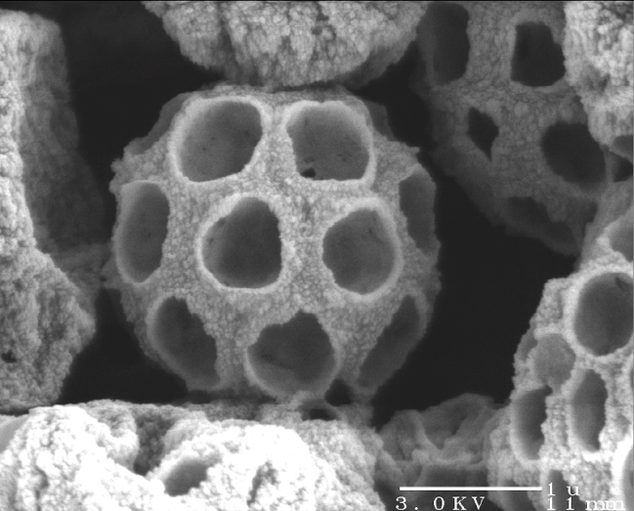
In Other Words….
Working at the atomic, molecular and supra-molecular levels, in the length scale of approximately 1 – 100 nm range, through the control and manipulation of matter at the atomic and molecular level in order to design, create and use materials, devices and systems with fundamentally new properties and functions because of their small structure.
Small photonic crystals: titanium dioxide micro-sphere 1-50 μm in diameter
Courtesy: National Science Foundation
Credit: S. Klein, F. Lange and D. Pine, UC Santa Barbara

Slide 17
Why Now?
Richard Feynman’s famous presentation “There’s Plenty of Room at the Bottom” was in the 1959 at the American Physical Society.
Here he asked:
Why can’t we manipulate materials atom by atom?
Why can’t we control the synthesis of individual molecules?
Why can’t we write all of human knowledge on the head of a pin?
Why can’t we build machines to accomplish these things?

Slide 18
Why Now?
New tools for atomic-scale characterization
New capabilities for single atom/molecule manipulation
Computational access to large systems of atoms and long time scales
Convergence of scientific-disciplines at the nanoscale

Slide 19
Benefits of Nanotechnology
“The power of nanotechnology is rooted in its potential to transform and revolutionize multiple technology and industry sectors, including aerospace, agriculture, biotechnology, homeland security and national defense, energy, environmental improvement, information technology, medicine, and transportation. Discovery in some of these areas has advanced to the point where it is now possible to identify applications that will impact the world we live in.”

Slide 20
Forbes Top 10 Nanotech Products--2003
High Performance Ski Wax
Breathable Waterproof Ski Jacket
Wrinkle-Resistant, Stain Repellent Threads
Deep Penetrating Skin Cream
World’s First OLED Digital Camera
Nanotech DVD and Book Collection
Performance Sunglasses
Nanocrystalline Sunscreen
High Tech Tennis Rackets
High-Tech Tennis Balls

Slide 21
Forbes Top 10 Nanotech Products--2004
Footwarmers
Washable Bed Mattress
Golf Balls and the “Nano” Driver
Nano Skin Care
Nanosilver Wound Dressing for Burn victims
Military-Grade Disinfectants
BASF Superhydrophobic Spray
Clarity Defender Automotive-Glass Treatment
Flex Power Joint and Muscle Pain Cream
3M Dental Adhesive

Slide 22
Forbes Top 10 Nanotech Products--2005
iPod Nano
Canola Active
O’Lala Foods Choco’la Chewing Gum
Zelens Fullerene C-60 Face Cream
Easton Sports Stealth CNT Bat
Casual Apparel-Nanotex
ArcticShield Socks- odor and fungus resistant
Behr NanoGuard Paint
Pilkington Active Glass
NanoBreeze Air Purifier

Slide 23
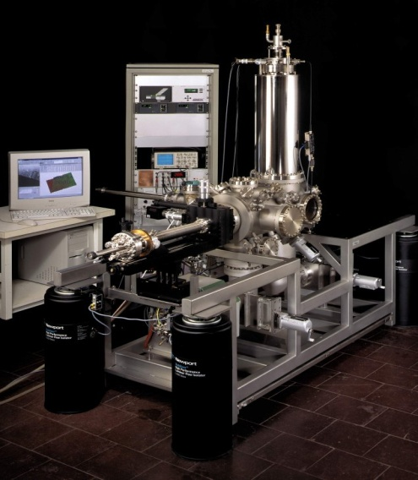
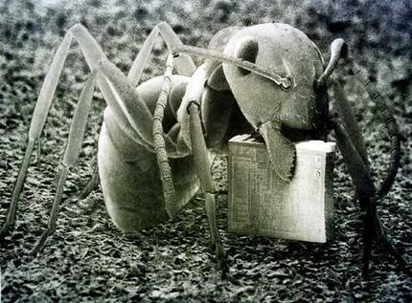
History of Nanotechnology
2000 Years Ago – Sulfide nanocrystals used by Greeks and Romans to dye hair.
1000 Years Ago (Middle Ages) – Gold nanoparticles of different sizes used to produce different colors in stained glass windows.
1974 – “Nanotechnology” - Taniguchi uses the term nanotechnology for the first time.
1981 – IBM develops Scanning Tunneling Microscope. This microscope evolved to allow the manipulation of individual atoms and molecules in the field of Nano technology.
1985 – “Buckyball” - Scientists at Rice University and University of Sussex discover C₆₀
1991 – Carbon nanotube discovered by S. Iijima

Slide 24

History
The first ever concept was presented in 1959 by the famous professor of physics Dr. Richard P.Feynman.
Invention of the scanning tunneling microscope in 1981 and the discovery of fullerene(C60) in 1985 lead to the emergence
of nanotechnology.
The term “Nano-technology" had been coined by Norio Taniguchi in 1974
There’s plenty of
room at the bottom

Slide 25
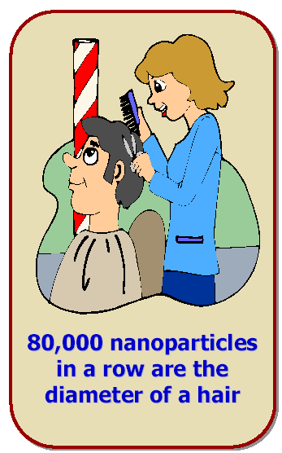
How small is the magnitude of
dimensions of a nano material ?

Slide 26
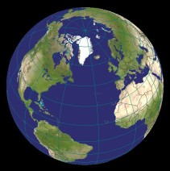

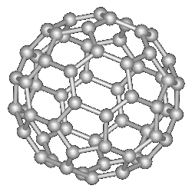
What is Nanoscale?
Fullerenes C₆₀
22 cm
0.7 nm
12,756 km
1.27 × 10⁷ m
0.22 m
0.7 × 10-9 m
10 millions times smaller
1 billion times smaller

Slide 27
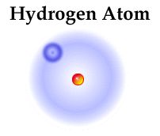
1 nanometer (nm) = 10 hydrogen atoms side-by-side

Slide 28


“Nano” in terms of relative size
Comparison of 1 meter
with 1 nm equals approximately the size of the earth compared with the size of dice
vs.

Slide 29
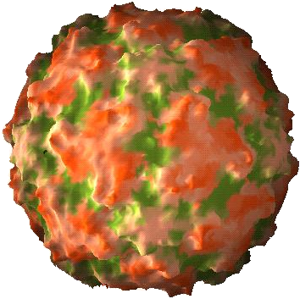
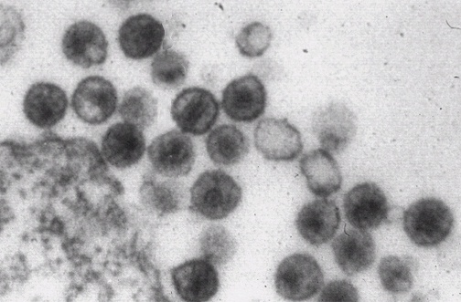
Naturally Nano
Human Rhinovirus
32 nm diameter
TEM Image

Slide 30
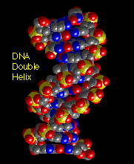
Especially Nano
DNA Double Helix
2 nm diameter

Slide 31

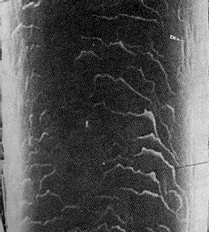

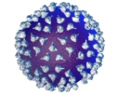
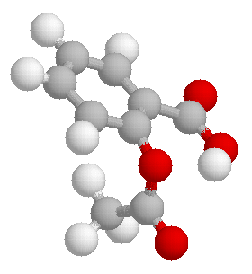
How small is a nanometer? (and other small sizes)
Start with a centimeter.
Now divide it into 10 equal parts.
Now divide that into 10 equal parts.
Now divide that into 100 equal parts.
Now divide that into 10 equal parts.
Finally divide that into 100 equal parts.
A centimeter is about the size of a bean.
Each part is a millimeter long. About the size of a flea.
Each part is 100 micrometers long. About the size (width) of a human hair.
Each part is a micrometer long. About the size of a bacterium.
Each part is a 100 nanometers long. About the size of a virus.
Each part is a nanometer. About the size of a few atoms or a small molecule.
1 cm
1 mm
100 μm
1 μm
100 nm
1 nm

Slide 32
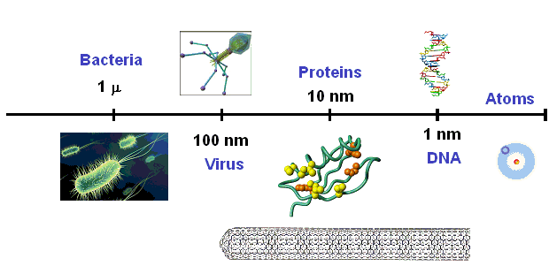
The Nanometer Size Scale
Nanotube

Slide 33


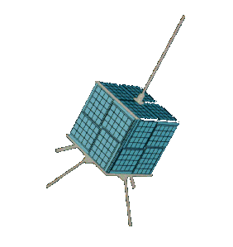

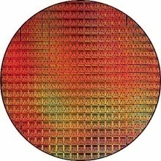
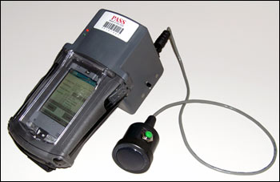
Why is Small Good?
Faster
Lighter
Can get into small spaces
Cheaper
More energy efficient
Different properties at very small scale

Slide 34
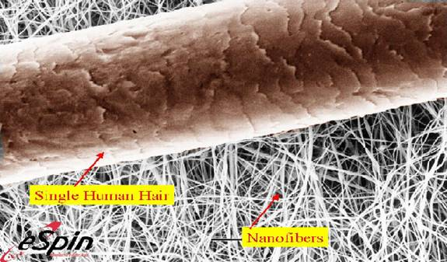
Compared to Human Hair
A Human Hair is about 100,000µm wide

Slide 35
Why Nano?

Slide 36
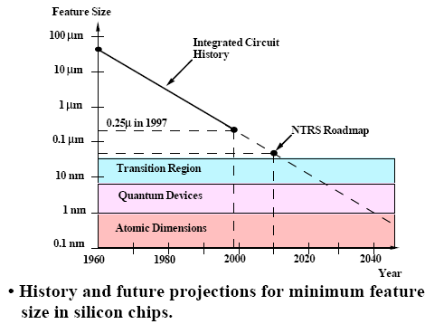
Integrated Circuits and Nanotech
The IC industry is approaching a period where nanotech approaches will be required to sustain technology growth
J.D. Plummer, M.D. Deal, and P.B. Griffin, “Silicon VLSI Technology – Fundamentals, Practice and Modeling” Prentice Hall, NJ

Slide 37
Nanotechnology deals with the creation of
USEFUL materials, devices and systems
through
control of matter on the nanometer length scale and exploitation of
NOVEL phenomena and properties
(physical, chemical, biological)
at that length scale

Slide 38
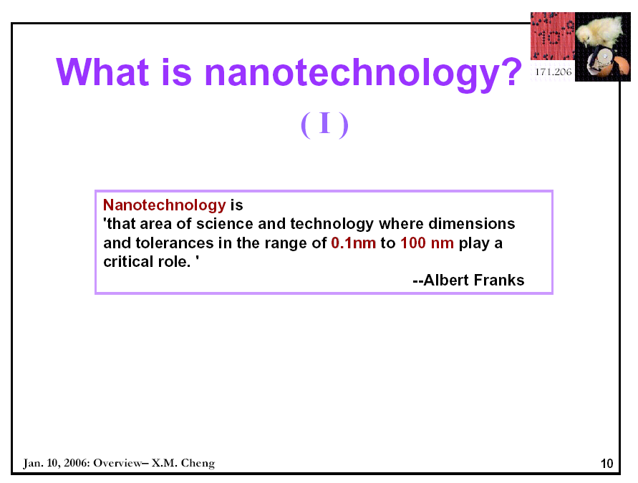

Slide 39
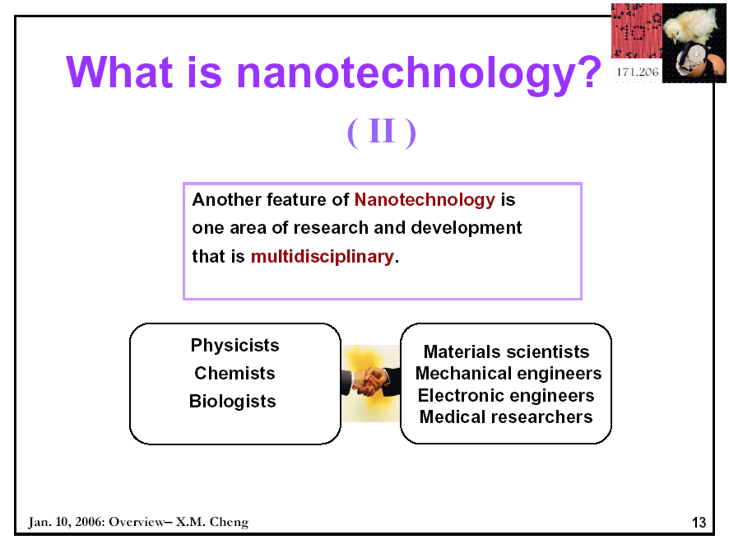

Slide 40
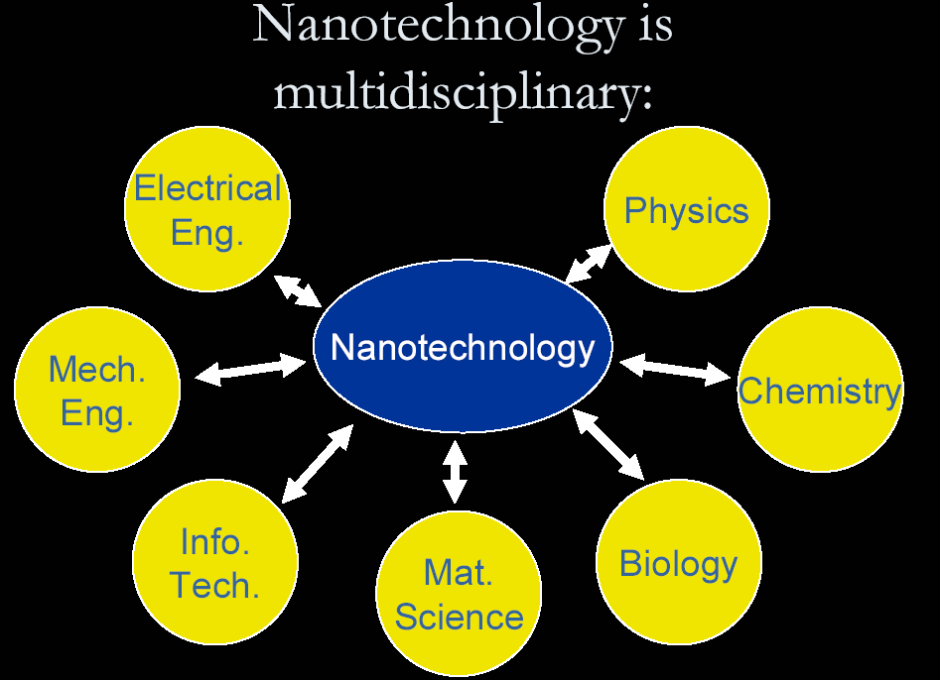

Slide 41
Nanotechnology is…
Science and technology on the scale of a nanometer--one billionth of a meter.
The ability to manipulate individual atoms and molecules, making it possible to build machines on the scale of human cells or create materials and structures from the bottom up with novel properties.
Capable of changing the way almost everything is designed and made: from computers to clothing; from sports equipment to space ships and satellites; from cars to cancer therapies; from bridges to paint; and even objects and devices not yet imagined.

Slide 42
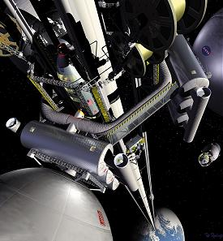
What is Nanotechnology?
The Space Elevator?
Ultra high strength materials allow tower to be built into space !(?)

Slide 43
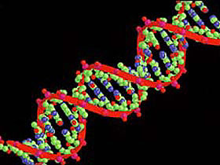
What is Nanotechnology?
DNA Computers in a beaker that vastly outperform our fastest supercomputers?

Slide 44
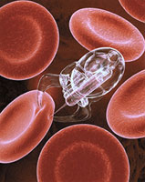
What is Nanotechnology?
Tiny machines in your body curing cancer?

Slide 45
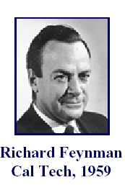
Founders of Nanotechnology
When it comes to Nanotechnology,
one must take into account the
pioneering contributions of Noble
laureates Richard Feynman
and Prof. Richard Smalley
It was Feynman who first proposed in 1959
that “There is plenty of room at the bottom”
Dr. Richard Smalley won the Nobel Prize
in Chemistry in 1996 for the discovery of
a fullerenes called Buckminsterfullerene

Slide 46
A Brief History
The history of nanotechnology reaches back to the late 19th century, when colloidal science first took root.
The first mention of some of the distinguishing concepts in nano-technology was in “There’s Plenty of Room at the Bottom”, a talk given by physicist Richard Feynman at an APS meeting in 1959.
The term “nanotechnology” was defined by Prof. N. Taniguchi (“On the Basic Concept of ‘Nano-Technology’,” Proc. Intl. Conf. Prod. Eng. Tokyo, Part II, JSPE, 1974.) as follows: “‘Nano-technology’ mainly consists of the processing of, separation, consolidation, and deformation of materials by one atom or one molecule.”
In the 1980s the basic idea of this definition was explored in much more depth by Dr. K. E. Drexler, who promoted the technological significance of nanoscale phenomena and devices through speeches and books.

Slide 47
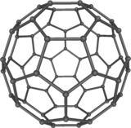

Nanotechnology and nanoscience got started in the early 1980s with two major developments: the birth of cluster science and the invention of the scanning tunneling microscope (STM).
This development led to the discovery of fullerenes and carbon nanotubes (1985 – 1991)
The synthesis and properties of semiconductor nanocrystals were studied. This led to a fast increasing number of metal oxide nanoparticles of quantum dots (QDs).

Slide 48
What are the materials / building blocks of nanotech?
Nanostructure
Size
Example Material or Application
Clusters, nanocrystals, quantum dots
Radius:
1-10 nm
Insulators, semiconductors, metals, magnetic materials
Other nanoparticles
Radius:
1-100 nm
Ceramic oxides, Buckyballs
Nanowires
Diameter 1-100 nm
Metals, semiconductors, oxides, sulfides, nitrides
Nanotubes
Diameter: 1-100 nm
Carbon, including fullerenes, layered chalcogenides

Slide 49
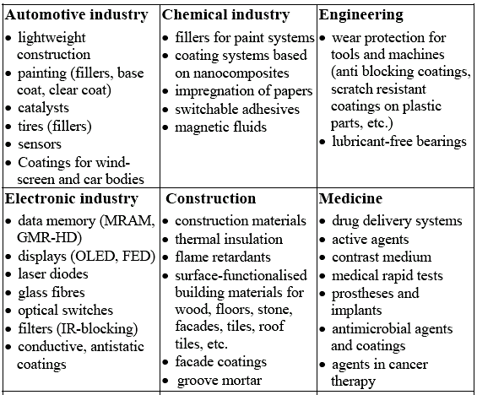
Applications of Nanotechnology

Slide 50
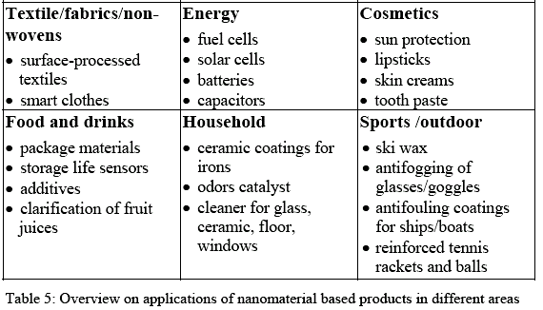
Applications of Nanotechnology

Slide 51
Are there any nanotechnologies in use today?

Slide 52







Nanotech Companies
Many of the usual suspects from among the Fortune 500:

Slide 53










Nanotech Companies
Many nano-industry specialists you probably don’t know:

Slide 54
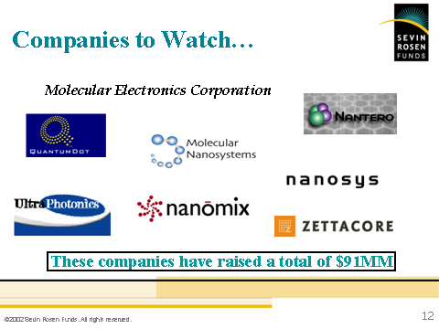

Slide 55
A few commercial / consumer
applications
Of
Nanotechnology

Slide 56


Slide 57

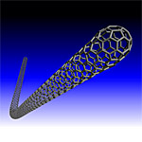
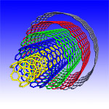

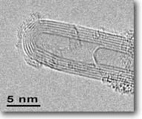
Nanotechnology in Sports Equipment
TENNIS RACKETS, GOLF CLUBS, BASEBALL and SOFTBALL BATS- all made with high strength, lightweight plastic composites that contain Carbon Nanotubes
Carbon nanotubes are stronger
than steel, lighter than feathers,
conducting or semi-conducting,
great thermal conductors, and
radiation hard

Slide 58

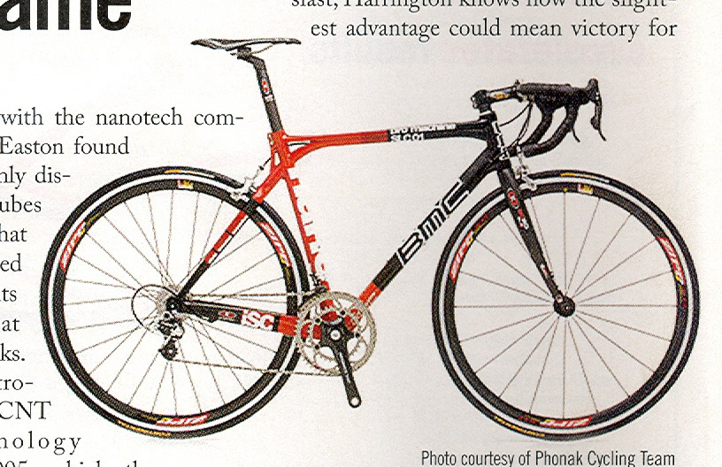
is already making today’s products:
  Lighter
  Stronger
  Faster
  Smaller
  More Durable

Slide 59


Nanotechnologies in Bed Sheets and Footware!
ICE CREAM and SLIPPERS both
benefit from NANOPARTICLES
Nanoparticles are particles that are only few nanometers in diameter. They do not behave like atoms (which are governed by quantum mechanics) and they do not behave like macroscopic materials (which are governed by Newtonian mechanics). They exist in the strange world between these extremes.
Nano-Teflon
and Silver
Nanoparticles

Slide 60
Nano Coatings
Self-cleaning
Scratch-resistant
Anti-icing and anti-fogging
Antimicrobial
UV protection
Corrosion-resistant
Waterproofing

Slide 61


Clothing Products
Water repellent shirts & pants
shirts and shoe inserts that keep you
cool in the summer and warm in the
winter
nano socks that don’t “stink” due to the
inclusion of nanotech materials
(nanosized sliver particles)
Wrinkle-resistant, stain-repellent threads
  Treated fabrics are not only wrinkle-proof but repel stains from perennial offenders like soda, coffee, wine and syrup, etc.
  Color-changing fabrics
  Thread developed for military but may soon be used by clothing companies.

Slide 62
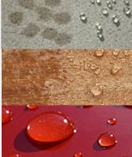
Fabrics/Textiles and
Surface Treatments

Slide 63
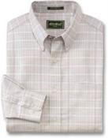


Anti Stain Coatings
In 2002, Eddie Bauer apparel became the first brand to employ Nano-Tex stain resistance technology in its designs. Nano-Tex has now expanded to bring stain resistance to fabrics and other interior finishes. Nano-Tex uses a process that bonds to each fiber, making textiles last longer, retain their natural feel and breathe normally.

Slide 64


Behr Paints Offers NanoGuard
Behr’s best line of paint uses nanoparticles to provide a long lasting, anti-fade, more durable house paint that also prevents mildew.

Slide 65

Automotive Paint – Mercedes-Benz
The 2007 Mercedes-Benz SL series cars sport a protective coating of nanoparticles that provides a three-fold improvement in the scratch resistance of the paintwork.

Slide 66
Nanolight of Norman
Nanolight, Inc.- Nanolight, Inc. is a high-tech company whose mission is to research and develop semiconductor nanofabrication techniques for implementation in cutting-edge infrared laser and detector systems. The company also assists others with product development efforts by providing epitaxial-related services and acting as a distributor for nanofabrication equipment.

Slide 67
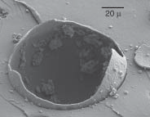
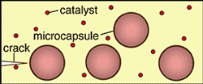
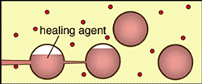
Self Healing Composites
Polymeric and composite materials are subject to weakening due to fatigue cracking. A self-healing composite has the potential to defend against material failure due to fatigue and to greatly improve product safety and reliability. Patent 6858659 - Office of Technology Management – University of Illinois Urbana Champian

Slide 68
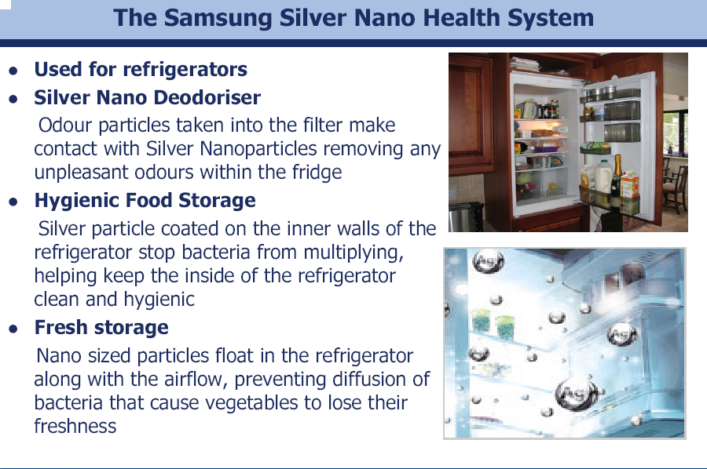

Slide 69
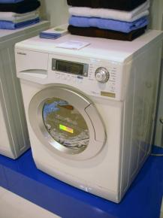
Samsung launches Silver Nano Wash system
that kills 99% of bacteria
Samsung’s Silver Nano Health
System has been applied to a
new range of front-loader
washing machines
A breakthrough function,
‘Silver Wash’, kills 99 percent of
bacteria in the wash load and
coats the clothes with
antibacterial protection which
lasts for up to 30 days

Slide 70


Slide 71


Slide 72

▪ FreshBox® is a newly developed antimicrobial
food container which is made by FinePolymer’s
unique nanotechnology.
FreshBox® shows
excellent antimicrobial
properties against various
bacteria and fungus
due to the effect of finely
dispersed nano-silver
particles and hence
it make a food fresh
longer compared with
conventional food containers.

Slide 73




Electronics Products
Faster and more powerful computers, palm pilots (blackberries), flash drives, digital cameras and displays, cell phones, LCDs, LEDs, MP3’s, electronic ink displays, thin film batteries, and flexible electronics to name a few. All of these applications are possible and affordable due to the ability to work effectively and efficiently at the nano-scale

Slide 74


Nanotechnology in Electronics
March 20, 2006
Applied Nanotech has signed a letter of intent to enter negotiations for a trial on CARBON NANOTUBE TVs with Da Ling, a Taiwanese contract manufacturer.
Under the proposed terms, Da Ling will invest $10 million on a pilot manufacturing facility to make carbon nanotube TVs based on Applied's technology. In these TVs, nanotubes shoot electrons at a screen to create a picture. Functionally, they are similar to traditional CRT (cathode-ray tube) televisions, which still provide the best picture, but are slim, like LCD (liquid crystal display) or plasma televisions.

Slide 75
What Other Nanotechnologies are Coming Soon?

Slide 76

Nanotechnology in Electronics
The next generation of CELL PHONES will utilize carbon nanotube technologies
The radio-frequency amplifiers used in cell phones are hot tungsten filaments, typically with power efficiencies of just 10 percent. They waste a lot of battery power.
Arrays of carbon nanotubes grown on silicon plates could replace radio-frequency amplifiers at a fraction of the power requirements.

Slide 77


Electronic Applications
Nanoelectronics:
SWNT transistors
Nano peapods:
memory devices
Smaller, Faster, Cheaper Computers:
What would happen if computers were as small
as a button? And cost only $5?

Slide 78


More Electronic Applications
Memory Chips
H₂ storage:
fuel cells

Slide 79


Other Applications
Healthcare Biosensor:
early detection of diseases
Nanotube sensors for
Chemical and biological agents

Slide 80





Gold nanoparticles, some coated with antibodies, that fluoresce and heat up can track and destroy cancer cells (University of Illinois, Georgia Tech, Rice, U. Texas, and UCSF)
Iron nanoparticles to clean poisons from water (Lehigh University)
Carbon nanotube transistor for future computer chips (Stanford)

Slide 81
Impact of Nanotechnology
• Computing and Data Storage
• Materials and Manufacturing
• Health and Medicine
• Energy
• Environment
• Transportation
• National Security
• Space exploration
Nanotechnology is an
enabling technology

Slide 82
Main categories of Nanomaterials from Applications point of View
Carbon based nanomaterials
Metals and alloys
Nanoceramics
Nanocomposites
Nano-glasses
Nano-polymers
Biological nanomaterials

Slide 83
Classification of Nanomaterials

Slide 84
Some 'Nano' Definitions
• Cluster
- A collection of units (atoms or reactive molecules) of
up to about 50 units
• Colloids
- A stable liquid phase containing particles in the 1-1000
nm range. A colloid particle is one such 1-1000 nm
particle.
• Nanoparticle or nanopowder
- A solid particle in the 1-100 nm range that could be an aggregate of crystallites or noncrystalline in nature
• Nanocrystal
- A solid particle that is a single crystal in the nanometer
range

Slide 85
Nanopowders

Slide 86
Fine Particle Technology
• Frequently encountered powders:
- Cement, fertilizer, face powder, table salt, sugar,
detergents, baking soda…
• Some products in which powder incorporation
is not obvious
- Paint, tooth paste, lipstick, mascara,
chewing gum, magnetic recording media,
floor coverings, automobile tires…
From: Analytical methods in Fine Particle Technology, Webb and Orr

Slide 87
Desirable Attributes of Nanoparticles
Nanometric size of powder particles leads to
• Tremendous increase in surface area-to-volume ratio
• Increase in the total number of atoms at the surface
- a 3 nm iron particle has 50% atoms on the surface
- a 10 nm particle 20% on the surface
- a 30 nm particle only 5% on the surface
• Increased reactivity and increased solubility
• Possible increase in hardness (ex: titanium nitride)
► This has an impact on increase in the number of
applications for metallic and ceramic powders

Slide 88
These changes can lead to different physical and chemical properties, depending on size
- Melting point
- Optical properties
- Bandgap
- Surface reactivity
- Specific heat
• Even when such nanoparticles are consolidated
into macroscale solids, new properties of bulk
materials are possible.
Example: enhanced strength levels

Slide 89
Melting Point Dependence on
Particle Size
• Lowering of the melting point is proportional to 1/r
• Δθ can be as large as couple of hundred degrees
when the particle size gets below 10 nm!

Slide 90

Surface to Bulk Atom Ratio
Spherical iron nanocrystals
J. Phys. Chem. 1996, Vol. 100, p. 12142

Slide 91

Effect on Melting Point
When the mean thermal displacement (d) of the
atoms becomes larger than some fraction of the
interatomic distance, the material melts
When the surface/volume ratio increases, the mean
displacement increase, and the melting point
decreases

Slide 92

The color of gold changes as the particle size changes at the nanometer scale.
Chad Mirkin, Northwestern University, in NYTimes article by K. Chang - 2005

Slide 93


Slide 94

Size dependence of Optical Properties

Slide 95

Nanomaterials in Catalysis
• Surface chemistry is important in catalysis
Nanostructured materials have some advantage in catalysis
▪ Huge surface area and hence large
proportion of atoms on the surface
▪ Enhanced intrinsic chemical activity
as size gets smaller which is
likely due to changes in crystal shape
(Ex: When the shape changes from
cubic to polyhedral, the number of
edges and corner sites goes up
significantly)

Slide 96
Nanoporous Materials
• Zeolite is the best example of nanoporous materials
which is used by petroleum industry as catalysts
• The effective surface area of a solid increases when it
becomes nanoporous; this improves catalytic effects
and adsorption properties
• How to make nanopores?
- lithography followed by etching
- ion beam etching/milling
- electrochemical techniques
- sol-gel techniques

Slide 97
Nanoparticles
Source: Wilson et al 2002
Application Particles required Nanotechnology advantages
Polishing Aluminum Faster rate of surface Slurries Oxide removal reduces
operating costs
Tin Oxide Better finishing due to
finer particles
Capacitors Barium Titanate Less material required
for a given level of capacitance
Tantalum High capacitance due to
reduction in layer
Alumina thickness and increased
surface area resulting
from smaller particle size

Slide 98
Application Particles required Nanotechnology advantages
Nanoparticles [cont.]
Catalysts Titanium Dioxide Increased activity due
to smaller particle size
Cerium Oxide Increased wear
Alumina resistance
Hard Coatings Tungsten Carbide Thin coatings reduce
Alumina the amount of material
required
Conductive Silver Increased conductivity,
Inks reduces consumption
of valuable metals

Slide 99
Nanoparticles (Cont.)
Source: Wilson et al 2002
Application Particles required Nanotechnology advantages
Pigments Iron Oxide Lower material costs, as
opacity is obtained with
smaller particles
Zirconium Silicate Better physical-optical
Titanium Dioxide properties due to
enhanced control over
particles
Structural Aluminium Improved mechanical
Ceramics Oxide properties
Aluminium Reduced production costs
Titanate due to lower sintering
Zirconium Oxide temperatures

Slide 100
Health related applications

Slide 101



Health and Medicine Products
Blood Analyser
  Tiny channels in a card filter white from red blood cells. When the card is popped into the analysing machine, it can come up with a white-cell count in 10 to 15 minutes. This could be important for HIV treatment.

Slide 102

• Effective and less expensive health care
using remote and in-vivo devices
Nanotube-based
biosensor for
cancer diagnostics
• New formulations and routes for
drug delivery, optimal drug usage
• More durable, rejection-resistant
artificial tissues and organs
• Sensors for early detection and prevention

Slide 103
Antimicrobial Effects of Silver
  Silver is known to be a potent antimicrobial agent
  Silver is effective against a broad range of aerobic,
  anaerobic, Gram-negative and Gram-positive bacteria,
  yeast, filamentous fungi and viruses
  Silver ions kill the micro-organisms instantly by
  blocking the cell respiratory pathways
  As per recent reports, Nanocrystalline silver
  is preferred to silver nitrate and silver sulfadiazane
  for treatment of wounds

Slide 104


Slide 105


Cosmetics Products
Skin care
  cosmetics containing nanocapsules
  Such cosmetics can deeply penetrate into the skin and don't degrade while on the shelf
Nanocrystalline Sunscreen
  Nano-dispersed zinc oxide provides broad-spectrum protection against UV rays
  Z-Cote produces a high-purity nanocrystalline zinc oxide, which allows the sunscreen to go on clear

Slide 106


Slide 107


Slide 108


Products with Protective Coatings
Glare-reducing and fog-resistant coatings for eyeglasses and windshields
Sunglasses
  To give the glasses antireflection and scratch-resistance functionality,
  Nanofilm deposits coating layers of
  150 nm are developed
No-wax car finish--for example,
by Mercedes

Slide 109
Nanostructured
materials

Slide 110

Nanostructured Bulk Materials
include:
Any material with nanostructured grain sizes (nm ordering)
Amorphous / glassy materials (atomic scale ordering)
Multilayer nanoscale thin films
Nanoporous materials
Nanocomposites having nano particles embeded in a matrix
Solids formed are crystalline, amorphous or polycrystalline

Slide 111


Slide 112

Classification scheme for NSM according to their
chemical composition and the dimensionality (shape)

Slide 113
Atomic arrangement in a crystalline material
A typical BCC Lattice

Slide 114


An interesting analogy
The interrelationship between a nanoparticle and its crystals is analogous to that between a country and its states.

Slide 115
What are Nanostructured Materials ?
♣ Materials with microstructural features (such as the grain size) of nanometric dimensions are termed as nanocrystalline or nanostructured materials
♣ Nanostructured materials are single or polycrystalline materials with a grain size below 100 nm (i.e. less than 0.1 micron)
♣ Because of their ultra fine grain size, a large volume fraction of atoms (about more than 50%) is located at the grain boundaries

Slide 116
Characteristics of NCMs
NCMs comprise of
‘crystal atoms’ (the nearest neighbour
configuration of which corresponds to
the lattice configuration i.e. BCC, FCC or
HCP)
&
‘boundary atoms’ (with nearest neighbour
configuration different from lattice
configuration)

Slide 117
Atomic arrangement in NCMs
Nanocrystalline materials (NCM) have a
different atomic structure from
Crystalline material
(which has long-range order)
Glassy or amorphous material
(which has short-range order)
Hard sphere model
of equiaxed nano-
crystalline material

Slide 118
Nature of Interfaces in NCM
Characteristics of the interfacial component in NCM are
considerably less
average atomic density
compared to that within
the crystal
wide distribution in
interatomic spacing
Properties of NCMs therefore differ from those of
crystalline and amorphous materials

Slide 119
Methods of Synthesis of Nanostructured Materials
Starting Phase | Techniques | Nature of Product
Vapour Liquid Solid | Inert gas condesation Physical vapour deposition and sputtering Plasma processing Chemical vapour deposition Chemical reactions Rapid solidification Electrodeposition Chemical reactions Mechanical attrition or High-energy milling Devitrification | 3D 1D 3D, 2D 3D 3D 1D,3D 3D 3D

Slide 120
Synthesis of Nanomaterials

Slide 121
Nanoscale Approaches and Fabrication
Top-down Approaches | Bottom-up Approaches
Create smaller objects using Larger objects | They arrange smaller components in to more complex.
Uses principles of molecular recognition | Layer-by-layer self assembly
121

Slide 122






Nanotechnology Applications
Carbon NanoTubes
Medicine
Information Technology
Nano Robots
Energy
OLED
NANO FILTERS
Aerogel
122
Nano Transistor
Nanorobot
Stinger: Targeted Drug Delivery

Slide 123
Two ways to produce nanomaterials
Top-down approach:
Chisel away the material to make
Nanoscale Objects
Bottom-up approach:
Assemble nanoscale objects out of
even smaller units such as the atoms
and molecules

Slide 124




Slide 125

Top down Approach in Producing Layered Structures
Microfabrication is a top-down technique for 1D nanostructures utilizing the following processes in sequential fashion:
  Film Deposition
    CVD, PVD
  Photolithography
    Optical exposure
  Etching
    Aqueous etching
Many of these techniques are useful, directly or indirectly in nanofabrication

Slide 126
Top-down fabrication

Slide 127


Bottom-up fabrication
“Self-assembly” of atoms and molecules (since top-down is very difficult for manufacturing at nanoscale level).
Use of chemical and biological processes.
Current day examples: Growth of nanowires from vapor, using gold nano-dot catalysts; Self-assembled monolayers (SAM) from solution.
Self-assembled organic monolayers for molecular transistors, etc. (Yale)
SEM showing the vertical growth of nanowires for electronic devices (Stanford)
More extreme example: Self-replicating robots.

Slide 128
Top down approach

Slide 129
High- energy Milling
or
Mechanical Alloying
- A Processing Route to produce
3D Nanostructured
Metallic and Composite Powders

Slide 130
Underlying principle:
Mechanical deformation of the micron size
powder particles under the conditions of
high stress and high strain rates ( ~ 10¹ to 10⁴ S⁻¹)
This amounts to introduction of lattice defects
such as dislocations produced by ‘pumping’ of
energy into the micron size powder particles
Reduction in the average grain size of powder
particles by a factor of 10³ – 10⁴ because of
creation of low- and high- angle grain boundaries
within the powder particles during mechanical
deformation processing

Slide 131
Mechanical Alloying or High – Energy Milling
▪ It is a top-down approach for production of
Nanocrystalline powders
▪ Developed by J. S. Benjamin in late 1960’s at
INCO Alloys International, USA
▪ Originally developed for ODS Fe, Ni, Al, Ti systems
▪ During MA the constituent powder particles are
repeatedly flattened, fractured and rewelded
▪ Milling device used may be stirred ball mill or
an attritor, planetary ball mill, shaker mill,
vibratory mill or conventional horizontal ball mill

Slide 132

Stages of Powder Evolution during
High- energy Milling

Slide 133


Slide 134
Reactive Milling (RM) or
Mechanochemical Synthesis
▪ Involves oxidation/reduction type of chemical
reactions
under ambient temperature conditions
▪ Starting materials may be Ag₂O and Cd, Sn or Zn
powders, respectively in stoichiometric amounts
▪ Milling time considerably less than conventional MA

Slide 135
Variation in Crystallite Size of
Elemental Silver with Milling Time

Slide 136
Bottom–up approach

Slide 137
Sol-gel process

Slide 138
Main Features of Sol-gel Technology
▪ Versatile process for making ceramic and glass materials
(powders, coatings, fibers… variety of forms).
• Involves converting from a liquid ‘solution’ to a solid ‘gel’
• Start with inorganic metal salts or metal alkoxides (called
precursors)
• Involves a series of hydrolysis and polymerization
reactions to prepare a colloidal suspension (sol)
• Next step involves an effort to get the desirable form
such as a thin film by spin or dip coating or casting
into a mold
• On further drying or heat treatment, the wet gel is
converted into desirable final product
•

Slide 139
Sol-gel Process
Mix the reactants
Hydrolysis and Condesation reactions
Sol
Gelification
Aging
Drying
Gel
Gel
Aerogel

Slide 140
Microemulsion process

Slide 141

Main features of microemulsion process
Components: surfactant, water and organic phase
Surfactant/Emulsifier reduces the interfacial energy
and the emulsion becomes thermodynamically stable
Thermodynamics: stable, even when centrifuged
Size of droplets: 10-100nm

Slide 142

model

Slide 143
Types of Dispersion
Type | Disperse phase | Continuous phase
Emulsion: o/w | Oil | Water
Emulsion: w/o | Water | Oil
Aerosol | Solid or liquid | air
Others | Multiple emulsion: w/o/w, o/w/o

Slide 144



Microemulsion synthesis procedure
Microemulsion containing
reactant A
Collision and coalescence
of droplets
Chemical reaction occurs
Microemulsion containing
reactant B

Slide 145
Variables of Microemulsion process
▪ Size of water droplets
▪ Types and concentrations of surfactants
    ▪ Concentration of dispersed/oil phase
▪ Mixing condition: Order of addition of oil,
surfactant and water phases
▪ Nature of precipitating agent
▪ Emulsifying temperature especially for
non-ionic surfactants
▪ Type of homogeniser/emulsifying equipment used

Slide 146
Advantages of Microemulsion Technique
Metal particles are reduced directly in microemulsion and can be used as a catalyst in suspension without further thermal treatment
A narrow particle size distribution can be obtained
The particle size can be controlled to a great extent
Bimetallic particles can be obtained at room temp

Slide 147

Representative Examples Of Nanoparticulate Metals Prepared by Microemulsion

Slide 148

Chemical self-assembly

Slide 149
Properties of Nanomaterials

Slide 150


Slide 151
Improvements in Material Properties
at Nano Level
Increased hardness & strength of metals and alloys
Enhanced ductility, toughness & formability of
ceramics
Superior soft magnetic properties (low coercivity &
high permeability)
Enhanced electrical conductivity in ceramics &
magnetic nanocomposites
Higher electrical resistivity in metal
Giant magnetoresistance (GMR) – drastic decrease
in electrical resistivity of materials on exposure to
magnetic field
Higher chemical activity in materials
Enhanced diffusivity & improved sinterability
due to short circuit diffusion paths

Slide 152


Strength / Hardness of Nanostructured
Materials with respect to grain size

Slide 153
Mechanical strength and hardness of nanostructured
metals & alloys is largely controlled by their grain size
Reducing the grain size to nanometric regime increases
the strength & hardness considerably
When the crystallites of a material are reduced to
the nanometer scale, there is an increase in the role
of interfacial defects: grain boundaries, triple junctions,
and elastically distorted layers
However, the Hall-Petch relation cannot be extrapolated
to very small grain sizes. At that low grain size the
dislocation pile-up containing large no. of dislocations
require stress exceeding even the theoretical strength

Slide 154


Slide 155
Superplasticity in
Ceramics & Nanostructured Alloys:
A significant increase in the elongation of a material
with increasing temperature without necking or
fracture is attributed to superplasticity
For example, superplastic behaviour in
Mg - 8.3wt%Al - 8.1 wt.%Ga alloy offered a maximum
elongation of 1080 % at 573 K at a high strain rate of
10⁻² S⁻¹
Nanocrystalline ceramics may be ductile,
as opposed to traditional ceramics

Slide 156
Diffusion & Crystal Growth in
Nanostructures:
Atomic transport in nanostructured materials differs
considerably from that in coarse- grained materials
In nanostructures the grain boundaries or the
crystal interfaces provide short-circuit diffusion paths
for high diffusivity
The high coefficient of interface diffusion in a severely
plastically deformed nanostructured material leads
to strong crystal growth (by providing driving force)
Abnormally large crystal growth in nanostructured
materials can be controlled by
▪ pinning the interfaces by addition of solute impurities
▪ addition of impurity related second phase particles
▪ presence of residual porosity

Slide 157

Dependence of surface, grain boundary and lattice
diffusion on temperature

Slide 158

Diffusion & Sinterability:
Nano materials can be sintered at lower
sintering temperatures because of their
Higher surface energy
Short diffusion paths
Low stability of interfaces
More efficient doping characteristics

Slide 159
Engineering applications

Slide 160
♣ Metals and ceramics, both bulk and
in the form of coatings, are generally
made up of crystals the size of which
are measured in micrometers or
microns
♣ Reducing the size of the crystals
to nano level can have quite dramatic
effects on the properties of the
bulk material, particularly their
mechanical properties

Slide 161
Bulk Nanostructured Materials
Titanium
Ti-Al alloys
Ti- transition metal alloys
Mg-Ni alloys
Fe-Cu-Nb-Si-B alloys
Fe- transition metal alloys (Co, Ni, Cr, Cu, Zr)
Al- transition metal alloys (Fe, Ni, Ti, Zr)
Al, Mg, Al-Mg alloys

Slide 162
Engineering Applications of
Nanocrystalline Materials
Structural applications:
Light weight-high strength metals & alloys of
Al, Mg and Ti with improved mechanical properties
Nano-nano and nano-micro composites between
metal & metal or metal & ceramic phases such as
TD- Ni, SAP, UO₂-S.S., WC- Co, TiC- Ni, SiC- Al,
TiN-AlN, MgO-SiC, Al₂O₃-SiC composites
Coatings with radically improved tribological
properties, high wear resistance, reduced friction,
improved corrosion resistance, etc.

Slide 163
Magnetic applications:
GMR materials for magnetic recording heads.
GMR comprise of small ferromagnetic single- domain
particles with randomly oriented magnetic axes in a
nonmagnetic matrix
Magnetic iron based alloys with reduced losses in
energy transmission, e.g. Fe-transition metal alloys
(with Co, Ni, Cr, Cu, Zr)
Fe-based soft magnetic materials containing Cu &
at least one element from Nb, W, Zr, Hf, Ti and Mo,
For example, Fe_{74.5-X}Cu_{X}Nb₃Si_{13.5}B₉

Slide 164
Electrical & energy related applications:
B, Bi, Cu, Co or Sn doped naoncrystalline ZnO for
applications as varistor
Nanocrystalline Fe-Silica materials having
nano size iron particles with enhanced
electrical conductivity
Hydrogen storage materials such as Mg₂Ni,
LaNi₅, Ti₃Al, Zr₇Ni₁₀, etc. and metal matrix
intermetallic dispersed composites

Slide 165
Some Examples of
Engineering Applications

Slide 166


Slide 167


Slide 168


Slide 169

Self-cleaning
concrete
  An exterior view shows U.S. architect Richard Meier's Jubilee Church, located in the Tor Tre Teste area of Rome
  It is made of self-cleaning concrete that helps keep the surface shiny white

Slide 170


Slide 171
Carbon nanotubes
A novel material

Slide 172







Carbon is the Stuff of Many Nanotechnologies
Diamond
Graphite
Fullerenes
Nanotubes

Slide 173



Nanotechnology in Soccer Balls?
A Soccer Ball is a perfect model for a molecule called Fullerene. Fullerenes are all-carbon molecules and an important component of nanotechnology.
=

Slide 174


Carbon Nanotubes
Buckminster Fullerene C₆₀
Smalley, Curl, Kroto. Nobel Prize

Slide 175
What’s the big deal about carbon nanotubes???
Amazing Mechanical Properties
Amazing Electrical Properties:
  Can be conductors or semiconductors
  Could be the building block of nanocomputing

Slide 176

CNTs are 100 times
stronger than steel
They are the best
electrical & thermal
conductors
discovered
CNTs have
highly porous
structure and hence
used in Hydrogen
Fuel Cells

Slide 177


Slide 178



CNT Polymer Composites

Slide 179


CNT Polymer Composites

Slide 180


Slide 181
Nanoelectronics

Slide 182
Nano Electronics and Computing
Molecular Electronics
DNA computing

Slide 183
What is Nanoelectronics?
A disruptive technology in which individual (and ordered assemblies) of nanometer-scale components function as active device elements
Promises devices that will provide significant cost advantages as well as performance increases in speed, power consumption, sensitivity, and device density
Enables new classes of devices and functionality
Notes:
Nanoelectronics is…
Nanoelectronics promises…
And Nanoelectronics enables…
New classes of devices: 1) high quantum efficiency, low-power, tunable, multi-color LEDs; 2) symmetrical, fast read/write (<1ns), low-power, high-density, NVRAM on flexible substrates; 3) quantum dot lasers; 4) others
These devices are expected to be low power, have switching speeds faster than 1ns, and could achieve integration levels of 1 trillion elements/cm.²
There are a number of important industry drivers for the development of nanoelectronic devices. These include…

Slide 184


Materials for Interconnects
Materials for Interconnects
Carbon Nanotubes
Aluminum
Copper
1999
When?
Resistivity of Al = 2.6 μΩ-cm
Resistivity of Cu = 1.7 μΩ-cm
Very low electrical resistivity of CNTs

Slide 185

Nanoelectronics approaches
A) Diodes and transistors based on metal and semiconductor nanowires; B) Carbon nanotube transistors;
C) FETs based on SAMs of small organic molecules; D) Large biomolecules as digital storage elements
Notes:
What is shown here is a graphic that I have borrowed from the journal Science, and it illustrates several different nanoelectronics approaches…
These approaches are segmented based on the type of nanometer-scale structure(s) used to fabricate the devices:
These categories include semiconductor and metal nanowires (as in Fig. A), carbon nanotubes (as in Fig. B), small organic molecules (as in Fig. C), large biomolecules (as in Fig. D), and quantum dots (as in Fig. E).
Companies presenting in this session are developing products based on four of these five approaches.
The first instantiations of these devices will most likely be fabricated via a hybrid approach that incorporates chemical assembly techniques with standard CMOS processing…

Slide 186
Characterization
of
Nanomaterials

Slide 187


Slide 188





Scanning Probe Microscopy
Atomic Force Microscopy

Slide 189
Concluding Remarks
• Nanotechnology is an enabling technology that will impact electronics and computing, materials and manufacturing, health, medicine, energy, transportation….
• Opportunities and rewards are great and hence, tremendous worldwide interest
• Integration of this emerging field into engineering and science curriculum is important to prepare the future generation of scientists and engineers

Slide 190


