Slide 1
BOILER DRAUGHT

Slide 2
DEFINITION
Boiler draught may be defined as the small difference between the pressure of outside air and that of gases within a furnace or chimney at the grate level, which causes flow of air/hot flue gases to take place through boiler.
The draught is necessary to force air through the fuel bed/ grate to aid in proper combustion of fuel and to remove the products of combustion
i.e. flue gases to the atmosphere after they have
given their heat to water being evaporated in boiler.

Slide 3
Draught also provides velocity to flue gases and so increases the heat transfer co-efficient in the boiler.
Thus draught is essentially required in a boiler and can be produced by a number of methods.

Slide 4
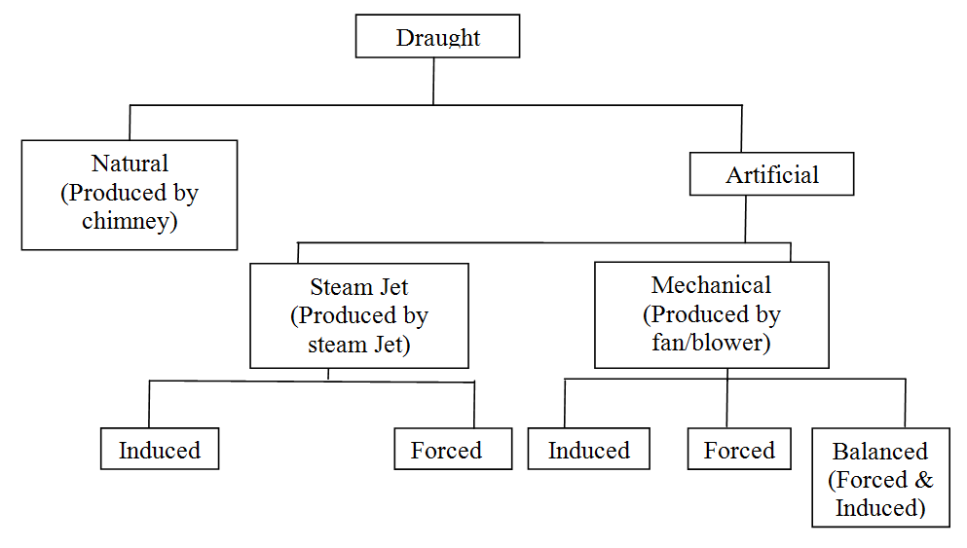

Slide 5
NATURAL DRAUGHT
Natural draught is obtained naturally by the use of a chimney.
Chimney is a conical shape vertical tubular steel or masonry or concrete structure having a large height.
The flue gases after transferring their heat in the boiler are guided by chimney to a considerable height in the atmosphere.
As chimney has a large height and is the only outlet from boiler, it remains filled by hot flue gases.

Slide 6
These exhaust gases, however have given their heat to water in the boiler, are still hotter than the boiler room air.
Due to this, the exhaust gases are lighter in weight than outside air and so lifts up naturally in the chimney and finally escape out in the atmosphere from top of the chimney.
As the flue gases lift up in the chimney, more gases from fuel bed flow towards chimney to take their place.
During this process, boiler and do the
they first flow through the
job of heating of water and
produce steam.

Slide 7
As flue gases flow through boiler and then to chimney, fresh air from outside naturally enters the boiler and help in burning of fuel and production of hot flue gases.
So, in this way, a small pressure difference is naturally created between the base of chimney and the air inlet point of boiler because of density difference between hot flue gases inside the chimney and fresh colder air outside.
This pressure difference is called natural draught,
because it is produced naturally.

Slide 8
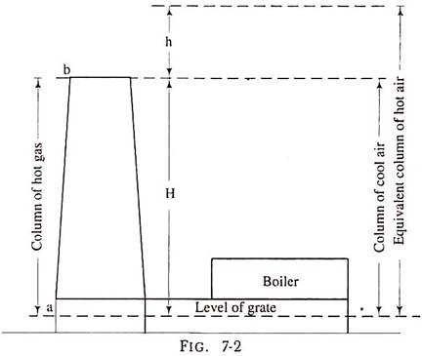

Slide 9
ARTIFICIAL DRAUGHT
When the draught is produced by some external agency i.e. mechanical fan/blower or by steam jet itself, it is called artificial draught.
In modern commercial boilers, more value of draught is required to increase the heat transfer co- efficient and hence the thermal efficiency.
So, artificial draught is must to use to overcome the flow resistance offered by large flue passages.

Slide 10
FORCED DRAUGHT
It is a positive pressure draught.
The fan is installed at the base of the boiler before grate which forces the outside air through fuel bed, furnace and air pre-heater and then flue gases through flue passage, economizer etc.
The enclosure for the furnace has to be very tightly sealed so that gases from the furnace do not leak out in the boiler house.

Slide 11
INDUCED DRAUGHT
In this system a fan or blower is located at or near the base of the chimney which creates a partial vacuum in the furnace and flue passage.
Thus the air and flue gases are drawn through the boiler due to comparatively higher pressure of outside air.
It is convenient to produce induced draught and like in forced draught, any type of fan/blower may be used.

Slide 12
BALANCED DRAUGHT
It is a combination of forced and induced draught.
Forced draught fan overcomes the resistance in air pre-heater and grate.
Induced draught fan overcomes draught losses through boiler, economizer and connecting flue passages etc.
Depending on the type of fuel burnt and type of boiler, the fan or blower used may be of any type as radial or axial etc.

Slide 13
ADVANTAGES OF MECHANICAL DRAUGHT
It is more economical and its control is easy.
Desired value of draught can be produced by mechanical means which cannot be produced by means of natural draught.
It increases the rate of combustion by which low
grade fuel can also be used.
It reduces the smoke level and increases the heat transfer co-efficient on flue gases side thus increases the thermal efficiency of boiler.
It saves the energy and the heat of flue gases can be best utilized by it.

Slide 14
DISADVANTAGES OF MECHANICAL DRAUGHT
Initial costs of mechanical draught system are high.
Running cost is also high due to requirement of electricity but that is easily compensated by the savings in fuel consumption.
Maintenance cost is also on higher side.
Noise level of boiler is also high due to noisy fan/blower etc.

Slide 15
STEAM JET DRAUGHT
It is a very simple and easy method of producing artificial draught without the need of an electric motor.
Steam under pressure is available in the boiler.
When a small portion of steam is passed through a jet or nozzle, pressure energy converts to kinetic energy and steam comes out with a high velocity.
This high velocity steam carries, along with it, a large mass of air or flue gases and makes it to flow through boiler.

Slide 16
Steam jet is directed towards a fixed direction and carries all its energy in kinetic form.
It creates some vacuum in its surroundings and so attracts the air of flue gases either by carrying along with it.
Thus it has the capacity to make flow of the flue gases either by carrying or inducing towards chimney.

Slide 18
FORCED STEAM JET DRAUGHT
Steam from the boiler after having been throttled to a gauge pressure of 1.5 to 2 bar is supplied to the jet or nozzles installed in ash pit.
The steam emerging out of nozzles with a great velocity drags air along the fuel bed, furnace, flue passage and then to the chimney.
Here steam jet is forcing the air and flue gases to flow through boiler hence it is forced steam jet draught.

Slide 19
INDUCED STEAM JET DRAUGHT
The jet of steam is diverted into smoke box or chimney.
The kinetic head of the steam is high but static head is low i.e. it creates a partial vacuum which draws the air through the grate, ash pit, flues and then to motor box and chimney.
This type of arrangement is employed in locomotive boilers.
Here steam jet is sucking the flue gases through boiler, so it is Induced Steam Jet Draught.

Slide 20
ADVANTAGES
It is quite simple and cheap.
It has the capability of using low grade fuels.
It occupies very less space.
Initial cost is low.
Maintenance cost is low.
Exhaust steam from steam engine or turbine can be used easily in Steam Jet Draught.

Slide 21
DISADVANTAGES
○
It can operate only when
some
steam is
generated.
Draught produced is very low.

Slide 22
DRAUGHT LOSSES
Loss due to the frictional resistance offered by flue gas passage to the flow of flue gases.
Loss due to bends in gas flow circuit, which also offer flow resistance.
Loss due to friction head in grate, economizer,
super heater etc.
Loss due to flow resistance offered by chimney.
Loss due to imparting some velocity to flue gases, which is required to increase heat transfer in boiler and also to throw away the flue gases from chimney.

