Slide 1


“Principle of Mineral Processing”

Slide 2
Chapter 4
Froth flotation : principles, reagents, collectors, modifiers and frothers,
process variables in floatation, Tailings disposal, Process integration and
Study of flow sheet for important minerals.

Slide 3
Flotation

Slide 4
Range for Particle Size for Wet
Separation Techniques
PHYSICAL PROPERTY
WET SEPARATION METHODS
Screens
Cyclones
Size,
Density,
Shape
Centrifuge
Sprial
Size, Density
Table
Mozley Table
Magnetic Susceptibility
Magnetic Separator
Wettability
Flotation
Selective
Flocculation
Surface Chemistry
1
10
100
1000
Microns

Slide 5
Flotation
Process of separating fine particles of different minerals from each other by floating certain minerals at or on water surface Mineral particles heavier than water maintained in suspension by action of surface tension forces Separation affected by – some solids adhere to air / gas /oil bubble introduced in the pulp and other solids adhere to water Wettable particles sink into water phase Particle adhering to air float as froth due to lower sp. gr.

Slide 6
Flotation
Floatability dependent on mineral surface and sp. Gravity Surface properties modified during flotation Mostly used for concentration of fines ( <150 microns) of sulphide minerals , oxide ores , non-metallic ores Facts : -Most minerals adhere to water in preference to air -some minerals adhere to air due to inherent property -Hydrocarbons & paraffins adhere to air -All minerals can be made to adhere to air or water by use of suitable agent

Slide 7
Types of Flotation
Froth Flotation - Based on the fact that hydrophilic particles are wetted by water whereas hydrophobic particles are wetted by air – air-solid aggregates are carried to the surface – forming a froth layer – Most common technique Film Flotation -Ground ore particles sprinkled into water surface – water repellent ( unwettable) particles remain on surface while water avid ( wettable) particles pass into water

Slide 8
Types of Flotation
Oil Flotation -Based on selsctive wetting of mineral particles by some oil such as Kerosene dispersed in water - particles of graphite covered with oil float on top Combined Flotation –Gravitational method -when the lifting power of air bubble is inadequate , particle –bubble agglomeration technique is employed –e.g. sulphide particles having coarse grains forming particle bubble complex of reduced specific gravity to float

Slide 9
Types of Flotation
Ion Flotation -This is a new flotation technique and differs from collection of particles by flotation -Process employed when ore is in aqueous solution as ions or colloidal suspension -Based on conversion to a product having hydrophobic sites which attach themselves to a bubble and collapse on reaching surface – resulting into a scum rather than froth -Ion flotation has great potential to treat leach solutions , dissolved minerals , sols & gels

Slide 10
Froth Flotation
Most important & versatile mineral processing technique Low grade & complex ore mining is economical now Used to achieve specific separations from complex ores such as -sulphides of copper ,lead , Zn , Ni , Pt and Gold –hosting mineral -oxides such as hematite , cassiterite , malachite , cerussite -non metallic ores such as fluorite , phosphates , fine coal

Slide 11
Froth Flotation
It is a physico-chemical separation utilising the difference in surface properties of valuable minerals & unwanted gangue minerals Theory of froth flotation is complex involving three phases – solid , water & froth with many sub processes & interactions and is not completely understood Mineral being separated undergoes three mechanism : -Selective attachment to air bubble ( true flotation ) -Entrainment in water which passes through froth -Entrapment between particles in froth - aggregation

Slide 12
Froth Flotation
The attachment of valuable minerals to air bubble is the most important mechanism by which majority of particles are recovered Separation efficiency between valuable mineral and gangue is also dependent on degree of entrainment and physical entrapment During froth flotation process , the agitator provides enough turbulence in the pulp phase to promote collision of particles and bubbles which result in attachment of valuable particles ( after reagent treatment ) to bubbles and transport to froth phase

Slide 13
Froth Flotation
Applicable to relatively fine particles because if they are too large , the adhesion between the particles & the bubble will be less than the particle weight When mineral is transferred to froth leaving the gangue in the pulp or tailing -Direct froth flotation When gangue is transferred to froth leaving the mineral in the pulp or tailing -Reverse froth flotation The function of froth phase is reduce the recovery of entrained material while retaining the attached valuable particle

Slide 14
Froth Flotation

Slide 15
Flotation

Slide 16
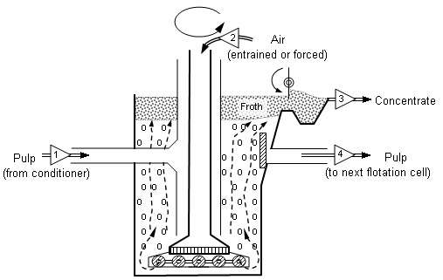
Flotation

Slide 17
Physical Chemistry of Flotation
The real surface property of minerals is the CHEMICAL & CRYSTALLOGRAPHIC capability to interact with organic ions Physical chemistry includes various aspects such as - 1) Surface modification : -It is considered as rebalancing between hydrated complex ions & charged lattice points -If polar strength of water molecules aided by pH is more than attraction binding of mineral ion into its crystal lattice , ion will hydrate and pass into aqueous phase.

Slide 18
Physical Chemistry of Flotation
Mineral Particle surface not homogeneous due to various defects – It will have both hydration prone & water repellent charged points available Surface of mineral must be clean to react with chemicals If surface contaminated with oil ,tightly adherent slimes , iron stains etc , remedial measures like dispersing agent / pH control required for effective flotation treatment Some minerals exhibit inherent or native floatability which is fundamental characteristic of crystal having no ions at the surface

Slide 19
Physical Chemistry of Flotation
2) Surface Energy of particle Adsorptive property of mineral are affected by crystal structure which result in different response to hetropolar surfactants In a crystal lattice of mineral , energy difference between atoms at surface and inside body of lattice Particles having high lattice energy ( Silica ,Alumina ) more resistant to chemical change /activation by flotation. NaCl with low activation energy readily ionised and soluble in water

Slide 20
Physical Chemistry of Flotation
However , the available reaction energy of surface atoms depends on neighbouring atoms as well as atom layers beneath them . As a result some energy of atoms unused – Free Surface Energy – Unsaturated bonds available The magnitude of this energy ( for liquid it is surface tension) determines the nature & ability of mineral surface to react with water and reagents dissolved in it The force determining the ability to attract external ions is the surface energy of a particle

Slide 21
Physical Chemistry of Flotation
3) Surface Activation In flotation , activation refers to causing of selective reaction on surface of mineral usually resulting in attraction into air-water interface Due to activation – particles drawn into rising bubble –reagents used for this property –Activators Activators and depressants (surfactants) usually consist of inorganic ions which affect the adsorptive power
Oxygen is adsorbed from water in preference to other gas

Slide 22
Physical Chemistry of Flotation
Surfactant is fixed after adsorption of oxygen pH ( H-ions) promotes an attracting potential at the surface of each mineral Maximum adsorption of collector molecules is found at the iso electric point of a mineral – point of zero charge on the the surface – determined in relation to pH value Electric equilibrium is disturbed by transferring one type of ion ( +/-) to make surface charged – Ions of opposite charge do not escape the lattice now & ions present in the solution drawn nearer to surface to balance – Double Electric layer

Slide 23
Flotation –Electrical Double Layer
All particles in the suspension exert mutual attraction force i.e. Van der Waals’ force which are effective only at a very close range Normally , the adhesion due to these forces is prevented by the presence around each particle of an electrically charged atmosphere which generates repulsion forces between particle approaching each other The electrical charges on the particle will be of same sign -for pH > 4 , negative charge on the surface -for pH < 4 , positively charged surface

Slide 24
Flotation –Electrical Double Layer
Electrolytes having an opposite charge to the particles cause neutralisation when dispersed in the system , thus , allowing the particle to adhere as a result of Van der’s attractive force Inorganic salts having cation such as Al(+++), Ca(++) –lime , Fe(+++) , H2SO4 used for coagulation Most pronounced coagulation occurs when particles have zero charge in relation to suspending medium i.e. ZETA potential equal to 0 existing at the electrical double layer at the surface of a particle.

Slide 25
Flotation –Electrical Double Layer
The surface shown has –ve charge such that positive ions from solution will be attracted forming a bound layer of +ve Ions and a diffuse layer of these ions until concentration equilibrium is attained.
Bound layer
-
-
-
-
-
-
++++++
- + +
+ - -
+ + -
-
+ + -
-
+ - -
-
+
-
-
Surface of particle
Diffuse layer
Electrical potential
Zeta potential
Plane of shear

Slide 26
Flotation –Electrical Double Layer
These layers ( B +D) of ions close to surface constitute Electrical Double Layer. When a particle moves in the liquid , shear takes place between the bound layer ( moving with particle) and diffuse layer , potential at the shear plane – Zeta potential The magnitude of Zeta potential depends on surface potential and concentration of counter –ion charge In general , greater the counter –ion concentration , lower is the zeta potential

Slide 27
Physical Chemistry of Flotation
There is electrokinetic potential difference between the inner & outer layer ions( more mobile ) is set up – Zeta Potential With change in Zeta potential ( magnitude & sign ) , reagent ions penetrate to the inner layer and adsorption to mineral surface is affected –Xanthates affect the potential of conducting minerals Flotation property of minerals is tested in terms of surface hydration -the attraction of water dipoles to the surface lattice points is due to free atomic / molecular force - hydration influences solubility of minerals

Slide 28
Physical Chemistry of Flotation
4) Reaction between Water & Mineral Wetting of mineral surface – adsorption of water ions and molecules on mineral –water interface The hydrated skins are formed when the bond energy between water dipoles and the mineral surface exceeds the bond strength between water dipole themselves Water –avid ( Hydrophilic) mineral surface has unsaturated ionic or atomic bonds predominant Water-repellent – Unsaturated molecular bonds

Slide 29
Physical Chemistry of Flotation
Ionic bond in minerals having oxygen bearing anion is stronger than in case of sulphides – as a result water dipoles on sulphide surface less firmly attched Mineral surface may also react with gases like Oxygen – action of oxygen is to render mineral water repellent property 5)Solubility of mineral in water The dissolution of mineral in water – result of reaction between water & mineral particles Direct reaction of water molecules on mineral surface in a

Slide 30
Physical Chemistry of Flotation
pulp may lead to breakdown of their crystal lattice resulting into separate hydrated ions which forms ionic solution On dissolution of mineral in water , crystal lattice energy of the mineral is absorbed by solution and at the same time ion hydration energy is given off. The difference between the two energy is the heat of solution of mineral in water. Minerals dissolve in water when ion hydration energy is more than the crystal lattice energy Hydration energy increases slower than lattice energy with increase in valency –solubility reduced with valency increase

Slide 31
Physical Chemistry of Flotation
Hence , sulphides & oxides of bivalent metals are much less soluble in water than corresponding mono valent metal compounds 6) Reaction between sulphide & dissolved oxygen in water It is very important in flotation process as oxygen may cause changes in composition of mineral surface by chemical action In presence of water , action of oxygen on sulphide minerals causes oxidation into sulphates which is more soluble Smaller particles of minerals more prone to oxidation

Slide 32
Physical Chemistry of Flotation
Presence of CO2 dissolved in water also affect composition of mineral surface – carbonates can form sulphates – pH change 7) Reaction between mineral surface & dissolved components These reactions may be considered as the adsorption of electrolytes dissolved in water on the solid –liquid interface These electrolytes may be either added to the pulp or formed in it due to mineral going into the solution There are different types of adsorption on the surface -

Slide 33
Physical Chemistry of Flotation
a) Molecular Adsorption Also known as non-polar adsorption in which adsorbent ( mineral particle) takes up equal amount of cations & anions from solution – State of electrical neutrality on the phase boundry is unchanged Weak electrolyte adsorbed on the solid phase as molecule due to poor dissociation Mineral acids ( H-ions ) are adsorbed more easily than their alkaline salt

Slide 34
Physical Chemistry of Flotation
b) Ionic Adsorption Also known as polar adsorption in which ions of same sign are transferred between solution & solid phase resulting in unchanged surface charge c) Specific Adsorption It is selective uptake of anions or cations from solution by solid phase resulting into formation of difference in potential on the interface leading to double electric layer formation The ions of similar dimension are adsorbed at mineral phase

Slide 35
Physical Chemistry of Flotation
The adsorption of potential determining ions common to mineral crystal lattice A crystal immersed in a solution containing ions similar to its own , will actively adsorb one or another of these ions resulting in an increase of its electro kinetic potential For example – - AgI crystal will selectively adsorb Ag ions from AgNO3 solution and Iodide ions from KI solution

Slide 36
Physical Chemistry of Flotation-Wettability

Slide 37
Physical Chemistry of Flotation -Wettability
The forces tending to separate a particle and a bubble exist The tensile forces lead to the development of an angle between the mineral surface and bubble surface At equilibrium , Y s/a = Y s/w + Y w/a cos Ѳ where Y is the surface energies are between different surfaces & Ѳ is the contact angle The force required to break the particle-bubble interface is called the ‘work of adhesion – Ws/a’ and is equal to the work required to separate the solid-air interface and produce separate air-water and solid-water interfaces

Slide 38
Physical Chemistry of Flotation -Wettability
Ws/a = Y w/a + Y s/w –Y s/a combining both the equations , we get Ws/a =Yw/a ( 1-cos Ѳ) So , greater the contact angle , greater the work of adhesion between particle and bubble , hence more resilient to disruption . Hydrophobicity of mineral increases with contact angle and are called Aerophilic ( floatable) Most minerals are not water –repellent in their natural state , hence reagents are required

Slide 39
Physical Chemistry of Flotation -Wettability
Free Energy Change for Flotation
(Young-Laplace Equation)
γ_{LG}
GAS
ΔG_{FLOT} = γ_{SG} - γ_{SL} - γ_{LG}
LIQUID
γ_{SG}
γ_{SL}
SOLID
Since
γ_{LG} Cos θ = γ_{SG} - γ_{SL}
ΔG_{FLOT} = γ_{LG} (Cos θ – 1)
Where: γ_{SG}, γ_{SL}, γ_{LG} = Interfacial Tensions
Flotation Spontaneous for Finite θ

Slide 40
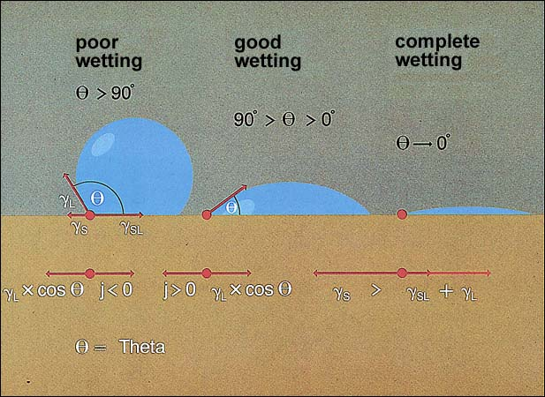
Physical Chemistry of Flotation -Wettability
Water droplet

Slide 41
Physical Chemistry of Flotation
Surface property of mineral dependent on capability of interacting with particular organic ions resulting in thin layer ( monomolecular layer ) attached to mineral surface This condition results in lower work of adhesion ( high surface tension ) and recognised as Wettability - measured in terms of contact angle at an interaction with air-water interface Contact angle ( zero - fully wettable ), 180 deg for unwettable Wetting -adsorption of water ions & molecules on mineral -water interface

Slide 42
Types of Mineral – Surface Property
All minerals are classified into POLAR or NON POLAR types according to their surface characteristics Non polar mineral surface -characterised by molecular bond forces –weak covalent bond -mineral surfaces do not attach readily to water dipoles , hence hydrophobic e.g. Graphite, Sulphur , Molybdenite , Diamond , Coal Contact angle between 60 to 90 deg , natural floatables

Slide 43
Types of Mineral – Surface Property
Polar Mineral surface -Minerals with strong ionic surface bonding -Exhibit high free surface energy at polar surface - Polar surface react strongly with water molecules – Hydrophilic type Polar minerals subdivided based on magnitude of polarity Gp 1 -Galena , covellite , Chalcopyrite, Native Au, Ag - weakly polar due to covalent bonding

Slide 44
Types of Mineral
Gp 2 -Baryte , Gypsum Gp 3 -Malchite , Azurite – rendered hydrophobic by sulphadisation of mineral surface in alkaline media Gp 4 – Hematite , Magnetite , Illmenite Gp 5 – Quartz, Zircon , Feldspar In general , degree of polarity increases from sulphide minerals through sulphates to carbonates, Halides , phosphates , Oxides –Hydroxides and finally silicates & quartz

Slide 45
Physical Chemistry of Flotation
In general, chemical groups or surfaces with any charge (ionic, dipole) are hydrophilic and will bond with water molecules but those with neutral (zero charge) are hydrophobic and will be repelled by water. Collectors have a polar (charged) head group and a non-polar (neutral) group or chain. They adsorb on mineral surfaces with their polar group attached to the mineral surface and the non-polar hydrophobic group exposed to the aqueous solution.
In general, chemical groups or surfaces with any charge (ionic, dipole) are hydrophilic
and will bond with water molecules but those with neutral (zero charge) are
hydrophobic and will be repelled by water.
Collectors have a polar (charged) head group and a non-polar (neutral) group or chain.
They adsorb on mineral surfaces with their polar group attached to the mineral surface
and the non-polar hydrophobic group exposed to the aqueous solution. Water is
strongly and extensively hydrogen-bonded to other water molecules. The hydrophobic
group disrupts some of this hydrogen bonding causing the mineral-collector to be
repelled by water and attached to bubbles. This repulsion by water also induces
aggregation of hydrophobic surfaces; minerals and colloidal metal-collector ppts
In some cases activators, which are meant to adsorb on specific minerals, are added to
enhance the attraction between the polar group and the mineral surfac

Slide 46
Physical Chemistry of Flotation
Water is strongly and extensively hydrogen-bonded to other water molecules. The hydrophobic group disrupts some of this hydrogen bonding causing the mineral-collector to be repelled by water and attached to bubbles. This repulsion by water also induces aggregation of hydrophobic surfaces In some cases activators, which are meant to adsorb on specific minerals, are added to enhance the attraction between the polar group and the mineral surface
In general, chemical groups or surfaces with any charge (ionic, dipole) are hydrophilic
and will bond with water molecules but those with neutral (zero charge) are
hydrophobic and will be repelled by water.
Collectors have a polar (charged) head group and a non-polar (neutral) group or chain.
They adsorb on mineral surfaces with their polar group attached to the mineral surface
and the non-polar hydrophobic group exposed to the aqueous solution. Water is
strongly and extensively hydrogen-bonded to other water molecules. The hydrophobic
group disrupts some of this hydrogen bonding causing the mineral-collector to be
repelled by water and attached to bubbles. This repulsion by water also induces
aggregation of hydrophobic surfaces; minerals and colloidal metal-collector ppts
In some cases activators, which are meant to adsorb on specific minerals, are added to
enhance the attraction between the polar group and the mineral surfac

Slide 47
Covalent Bonds
The simplest covalent bond is that in H₂
  the single electrons from each atom combine to form an electron pair
  the shared pair functions in two ways simultaneously; it is shared by the two atoms and fills the valence shell of each atom
The number of shared pairs
  one shared pair forms a single bond
  two shared pairs form a double bond
  three shared pairs form a triple bond

Slide 48
Polar and Nonpolar Covalent Bonds
Although all covalent bonds involve sharing of electrons, they differ widely in the degree of sharing
We divide covalent bonds into
  nonpolar covalent bonds
  polar covalent bonds

Slide 49
Polar Covalent Bonds
Bond dipole moment (μ):
  a measure of the polarity of a covalent bond
  the product of the charge on either atom of a polar bond times the distance between the nuclei
  Table 1.7 shows average bond dipole moments of selected covalent bonds

Slide 50
Polar and Nonpolar Molecules
To determine if a molecule is polar, we need to determine
  if the molecule has polar bonds
  the arrangement of these bonds in space
Molecular dipole moment (μ): the vector sum of the individual bond dipole moments in a molecule
  reported in debyes (D)

Slide 51
Polar and Nonpolar Molecules
these molecules have polar bonds, but each has a zero dipole moment

Slide 52
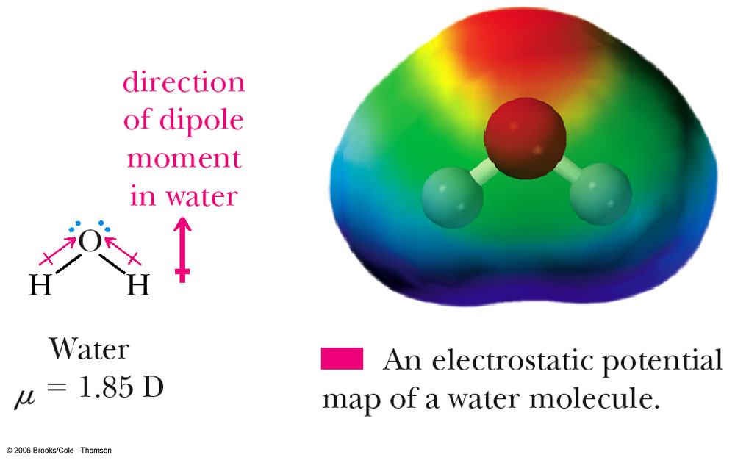
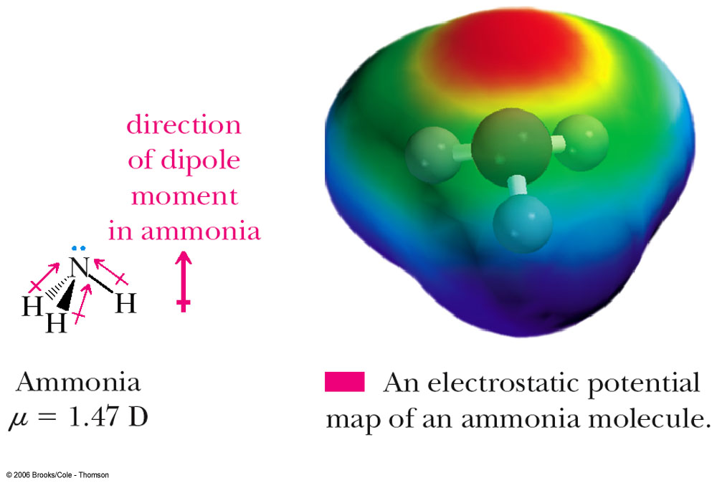
Polar and Nonpolar Molecules
these molecules have polar bonds and are polar molecules

Slide 53
Polar and Nonpolar Covalent Bonds
  an example of a polar covalent bond is that of H-Cl
  the difference in electronegativity between Cl and H is 3.0 - 2.1 = 0.9
  we show polarity by using the symbols δ+ and δ-, or by using an arrow with the arrowhead pointing toward the negative end and a plus sign on the tail of the arrow at the positive end

Slide 54
Flotation Variables
Effect of size & shape of minerals -strong water repellent & low sp. gr. minerals can be floated in bigger size ( coal 1.5 to 2 mm). Most common size 0.1 to 0.02 mm for flotation , flaky minerals easily floated Mineral surface & crystal lattice -Various faces of crystal with different surface energy levels absorb water or reagents to different extents -Adsorption affected by presence of lattice defects , cracks -Isomorphism ( mutual substitution of atoms /ions in lattice forming solid solution) impurities during mineral formation vary a lot affecting reaction of reagent

Slide 55
Flotation Variables
Effect of pulp density & temperature -affecting aeration & floatability , higher temp. improves flotation but reduces selectivity Effect of Process water composition -Mill / process water from river has Na,K,Ca,H,Cl,SO4 ions affecting pH alongwith other impurities oil , grease, minerals -Ions & impurities react chemically with reagents -Effect more pronounced in non-sulphide minerals ( oxides, silicates) with soaps & fatty acids Effect of reagent feeds – quantity , sequence & quality Sequence – regulator ( pH), depressents, collector, frother

Slide 56
Flotation Reagents
For selective & efficient separation by altering the surface properties of minerals to either make water avid or water repellent Common reagents Organic , inorganic compounds, acids, alkalis, salts Reagents – Collectors , Frothers, Modifiers ( regulators) based on their function in flotation Adsorption ( chemical or physical ) -Reagents attach to the surface of either air bubble or mineral particles after interaction of electrical forces between the adsorbent & the reagent , accompanied by decrease in free energy of system & heat release

Slide 57
Flotation Reagents -Mechanism
Physical adsorption – adsorbed substance & mineral lattice , two different systems –bond with crystal lattice results due to forces of inter molecular attraction –weak bond , even distribution Chemical adsorption – transition of electrons from adsorbed atom to lattice or vice versa – strong bond, highly selective in action , first attached to most active position Attachment of reagent to Air bubble – surface active substance introduced concentrate at air-water interface by physical adsorption giving rise to hetero polar molecular structures having non polar hydrocarbon group & polar group ( carboxyl & hydroxyl). Water dipoles work with polar group.

Slide 58
Flotation Reagents
-Non polar hydrocarbon group does not react and ejected into air -Activity between polar groups of surface active molecules & water dipoles result into hydration Attachment of reagents in a double electric layer ( anions & cations from solution)–physical adsorption of reagent in outer skin and chemical adsorption in the inner skin Attachment of reagent to minerals as surface compounds – atoms or ions in the mineral crystal lattice are the links with ions or atoms getting attached to the lattice – surface compound formation is chemical adsorption and highly selective – Ion exchange adsorption -common in flotation

Slide 59
Flotation Reagents
The mineral particles can only attach to air bubbles if they are to some extent water-repellent or HYDROPHOBIC Having reached the surface of mineral particle , air bubbles can continue support if mineral particle can form stable froth , otherwise they will burst To achieve these conditions , numerous types of chemical compounds known as Flotation Reagents are used. The activity of mineral surface in relation to flotation reagents in water depends on the forces which operate on particle surface

Slide 60
Flotation Reagents
ACTIVATORS: enhance the flotation by collectors that will
not float in their absence e.g. calcium activated flotation of
Quartz using oleate
DEPRESSANTS: prevent the adsorption of collectors and
thereby retard flotation (also by masking the nonpolar part
of the adsorbed collector) e.g. starch, polymers, dextrin
DEACTIVATORS: prevent activation by forming an inert
stable specie with the activator molecules
FROTHERS: induce the desired froth stability during flotation

Slide 61
Flotation Reagents -Collectors
Also called promotors – organic substances – act selectively on surface of minerals – form thin coating by adsorption /adhesion to render them water repellent / air adherent Features – complex molecular composition , asymmetrical structure , consisting of polar and non polar groups Non polar part – hydrocarbon ( CnHm)or chain , no reaction with water dipoles due to covalent atoms presence – water repellent properties Polar group – during flotation , adsorbed on mineral surface while non polar is oriented outwards which makes mineral water repellent

Slide 62
Flotation Reagents -Collectors
Classification based on ability to dissociate into ions in aqueous solution & activity of anion & cation taking part in reaction on mineral surface Ionising collectors – compounds which dissociate into ions in water -Anion collector –Anion of these compounds render the mineral water repellent while cations do not take part in reagent /mineral reactions ,most widely used , strong attachement e.g Xanthates -Cation Collectors – water repellent ions , anions of the collectors are halide /hydroxyl which do not take part in reaction ,weakly attached , e.g Amines & ammonium salt

Slide 63
Flotation Reagents -Collectors
Sodium ethyl xanhate has anion as hydrocarbon non polar radical and a connected polar group. Although the cation ( Na or K) plays no part in the reaction leading to mineral hydrophobicity, but sodium form of alkyle xanthates Collectors can adsorb on the substrate due to: Hydrogen bonding Electrostatic interaction Chemical bonding Hydrophobic bonding The nonpolar end should orient towards the bulk solution

Slide 64
Flotation Reagents -Collectors
Collector adsorption on mineral surface Non polar grp Polar group Structure of sodium Oleate- collector – hydrocarbon as non polar radical part of molecule H H S H----C----C---O---C S Na
Anion Cation
Mineral
H
H
Non Polar
Polar

Slide 65
Flotation Reagents -Collectors
Non polar & other collectors -Insoluble in water and and do not dissociate into ions -covalent bonds between atoms , do not react with water dipoles -Render mineral water –repellent by covering its surface with a thin film -These are hydrocarbon liquids ( kerosene,diesel etc) Choice of collector for a specific process – determined by experience & expeiments

Slide 66
Flotation Reagents -Frothers
Reagents added to produce stable froth to hold mineral particle until it is removed from cell These are surfactants of low solubility & low surface tension which increases the life of bubble Frothes are hetropolar surface active substances which are adsorbed at air-water interface to its surface activity After mineral particles surface rendered water repellent , presence of frothers keep air-bubble dispersed and increase stability of flotation froth Frother adsorption layer increases bubble resistance to external forces , reduce bubble movement for better reaction

Slide 67
Flotation Reagents -Frothers
Factors affecting the action of frothers : -With low frother concentration , dispersion of bubble effective -Reagents having collector as well as frother properties make flotation difficult – Frothers with no collectors properties preferred -Proportion of frother & collector -Temperature effects no. of water dipoles combining the polar group Types of Frothers : -Pine oil ( sulphide mineral), Eucalyptus oil(Oxide Mineral)

Slide 68
Flotation Reagents -Modifiers
Known as regulators or conditioners For intensifying the specific action of collector on mineral surface ie to decrease or increase water repellent action In presence of regulators , collector activates specific mineral required to pass in the froth Mechanism : -Net effect in terms of wetting ( surface hydration ) and drying out ( air avidity for attachment of particles to air-bubble) forces on mineral particles

Slide 69
Flotation Reagents -Modifiers
Replacement of gas by liquid ( or vice versa) on solid surface – net decrease in interfacial free energy of system Modifiers act on surface of specific mineral and change its chemical composition for better interaction of collector & mineral e.g. CuSO4 reacting with ZnS to form CuS on the surface of sphalerite and thus attachment of xanthate on ZnS increases These can create adverse condition by detaching collector from mineral surface leading to poor flotation ( depression effect) e.g Na2S leads to detachment of xanthate from surface of galena and other non ferrous sulphide

Slide 70
Flotation Reagents -Modifiers
Direct effect on stability of hydrated layer near mineral surface altering its floatability e.G K2Cr2O7 gets adsorbed on galena surface which are free from collector and thus hydrate decreasing the floatability Types of modifiers : Variety of organic & inorganic chemicals –salts,acids,alkalis, elctrolytes Activators –generally in organic compounds , change in chemical composition of mineral surface layer – exchange adsorption between activator ions & mineral ions

Slide 71
Flotation Reagents -Modifiers
-Reduce surface hydration –increase amount of collector , ions of collector & activator are opposite e.g CuSO4 for sphalerite, pyrite, quartz Depressors –supressors opposite effect of activators e.G Na2S & water soluble sulphides for sulphide & oxide minerals , Cyanides for copper & Zn minerals pH regulators –flotation is effected by pH as H+ and OH- alter the mineral surface hydration due to their adsorption on mineral surface – different minerals have different critical pH

Slide 72
Flotation Reagents -Modifiers
-Acid media ( pH <7) for oxide mineral and alkaline media ( pH >7) for sulphide minerals e.g. Na2CO3, NaOH, H2SO4, HCl Dispersing agent -to disperse the fines ( masking slimes) from mineral surface e.g. Sodium Silicate Wetting Agents- To increase hydration and reduce floatability, proper wetting of gangue material – e.g. Sodium silicate , aerosol Resurfacing agents – plate / resurface selected mineral by promoting the adsorption of hydrophobic hydro carbon group to preferred lattice points

Slide 73
Flotation Practice
Basic steps in Flotation Process – Pulp preparation , Conditioning , aeration to obtain froth Pulp preparation -Sizing -correct wet grinding to suitably floatable and liberated size ( <300 microns), coal ( 1 mm) being light , metal sulphide ( 200 -300 microns) -Pulp density – Thick pulp is preferred for stabilised froth during roughing flotation & dilute pulp in cleaning operation e.g. Chalcopyrite , Galena – Roughing operation at 30-50% pulp density carried out while cleaning is done at 30-8% pulp density

Slide 74
Flotation Practice
Density of pulp plays an important role in flotation It depends on mineral density & particle size Upto a certain range of pulp density , less reagent & less stirring power required to keep the particle suspended A thick pulp is preferred for stabilised froth The working principle of flotation is to carry out roughing flotation in thick pulp and cleaning operation in dilute pulp to get high concentrate

Slide 75
Flotation Practice
The operation grinding and reconcentration can be repeated as many times as requiredfor maximum recovery.

Slide 76
Flotation Practice
Conditioning is an operation in which pulp is continuously contacted for an optimum time with appropriate reagents at different stages to provide conditioned pulp giving the best results in flotation Various functions carried out during conditioning -Slime coatings formed on mineral surface should be dispersed -Compounds in the pulp preventing flotation of desired mineral should be rendered ineffective -Activation of desired minerals

Slide 77
Flotation Practice
Creation of conditions favourable for selective coating by collector on desired minerals Closure of porus surface to minimise consumption of collector Passivation of ions undesirable in the reaction Resurfacing of non –floating or weakly –floating minerals desired in the froth Finally the stabilisation of correctly mineral loaded bubbles by adding frother

Slide 78
Flotation Practice
Conditioning efficiency depends on –complete mixing & dispersion of reagents through out the pulp , time of contact The conditioning steps , concentration , amount of reagents and time are worked out in laboratory and applied in the plant. Steps during conditioning To depress the slimes since they adsorb expensive reagents , contaminate froths, give problem in settling of pulp -Preventive method - either slime removal before grinding or collector is added in the grinding circuit before slime coating

Slide 79
Flotation Practice
Next step is to add required amount of reagent with proper mixing – Readily soluble reagents like soda ash disperse quickly In treating sulphide ores , lime can be added as a slurry to the grinding circuit to produce required pH Relatively insoluble oils should be throroughly mixed When there is chance of reaction of reagents with each other , instead of with minerals , reagents are used in successive steps

Slide 80
Flotation Practice
For example -Activation of sphalerite by CuSO4 should be completed before pulp is transferred to Xanthate ( (C2H5OCS2Na –sod ethyl Xanthate) conditioning tank Otherwise reaction between copper & xanthate will result into an ineffective reagent Since action of collector mainly depends on pH of pulp but further specific conditions may be required before addition of collector – in order to increase difference between aerophilic and hydrophobic mineral surfaces

Slide 81
Flotation Practice
Aeration -Conditioned pulp is agitated in flotation machine of suitable size & design , air admitted forms bubbles which collect mineral particles , mineralised bubbles collect as froth on top -The froth can be discharged into launder with scraper -In plant practice, a series of flotation cells ( 10-12 nos.) employed where pulp is continuously pumped from one cell to next for repeated treatment -The pulp discharging from the last cell is barren and can be discarded

Slide 82
Flotation Practice
Extent of aeration depends on size , number and even distribution of air-bubbles in the pulp Pulp aeration determines flotation machine output , grades of product and the reagent consumption In mechanical type cells - bubble size 1 mm dia generated – frother is needed In pneumatic type cells - bubble size 2.5-4 mm dia The amount of air-bubbles in the pulp is proportional to air entering the flotation cell

Slide 83
Flotation Practice
Amount of air bubbles V (%) = 100 * t*Qa/Qb t=time spent by bubble in the pulp Qa= air flow in m3/sec Qb= capacity of chamber in m3 The air must remain in the pulp for long time which can be achieved by -effective air dispersion -sufficient pulp layer thickness and turbulent motion The formation of small bubbles is intensified by addition of frother

Slide 84
Flotation Machines
Flotation machines or cells – flotation process carried out Important Features -Aeration of pulp should be complete without letting too large bubbles -Solid should be distributed evenly without settling -Machine should work continuously -Removal of mineralised froth ( float) and tailings (sink) by separate channels -Periodic discharge of accumulated undesired material

Slide 85
Types of Flotation Machines
Classification based on - Pulp flow - Method of pulp aeration Machines based Pulp flow Trough type – Feed one end , tailings other end , froth flows over trough sides into channels Through –flow machines- divided into compartments – partition makes compartment open at top & bottom open , pulp level same Chamber type – separate chambers – different pulp level

Slide 86
Types of Flotation Machines
Machines based on method of aeration -Mechanical type ( self aerating & mechanically agitated ) – consists of mixing chamber , impeller which draws in air , flotation tank in which bubbled pulp in injected e.g. Denver cell , Massco, Knapp -Pneumatic type flotation machines –air is blown to aerate as well as agitate the pulp , compressed air from bottom , feed from one end and tailing exits at the other end , concentrate ( as froth) overflows into launder

Slide 87
Denver Flotation Cell
Machine should ensure -aeration of pulp to produce bubble -distribution of solids -removal of mineralised froth ( float) and tailings(sink) -continuous operation -pulp level and height of froth controllable

Slide 88
Column Flotation Cell
This is simplest pneumatic type of flotation machine with minimum floor space & maintenance , air admitted through distributer Suitable for dilute pulp mixing Advantages : -min gangue entrainment in froth -more bubble residence time -improved selectivity -Energy efficient Easy operation control

Slide 89
Flotation System

Slide 90
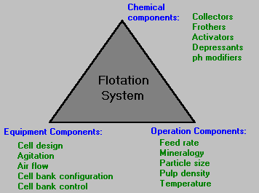
Flotation System

Slide 91
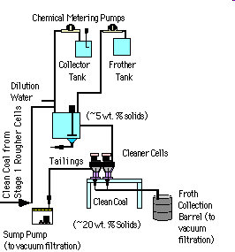
Coal Flotation Scheme

Slide 92
Flotation Schemes
Generally not possible to obtain high grade concentrate in one single stage As minerals to be separated have identical properties , more than one product needed , separation not complete in complex ores Different schemes based on flotation properties of ore , grade of concentrate required, economics of the process Flotation scheme based on number of stages Scheme based on number of flotation cycles Flotation scheme based on number of products

Slide 93
Flotation Practices
Recovery of same mineral from different ore bodies require different conditions of flotation due to small difference in crystal structure & chemical constituents of minerals affect the properties of mineral to be recovered . Different schemes for specific ore and not to the mineral Various steps in flotation : -Grinding of ore in water ( 200 micron ) -Dilution of pulp to required 25-45 % pulp density - Addition of small quantity of reagents to modify the surface

Slide 94
Flotation Practices
-Addition of collector in optimum amounts -Addition of frother to stabilise the froth -Aeration of pulp in a suitable flotation cell -Removal of mineral –bearing froth from aerated pulp Objectives of flotation -flotation of one or more mineral – copper concentrate -Depression of one /more gangue –for cleaning bulk conc.

Slide 95
Flotation Practices
Flotation of sulphides -excellent flotation properties sequence- selective ( most water repellent mineral removal first) OR collective-selective flotation ( valuable minerals separated into froth and then separated) scheme employed -Xanthates as collector, Pine oil as frother Flotation of Oxidised & Mixed Non Ferrous ores - -Carbonates , sulphates , hydrates of Cu,Zn ,Pb -Flotation consists of reaction of Na2S or (NH4)2S followed by flotation with collectors & frothers used for sulphides

Slide 96
Tailings Disposal
The disposal of mill tailings is a major environmental problem with the increase in processing of low-grade deposits Apart from visual effect on the landscape of tailing disposal , major ecological effect is usually water pollution - contaminants like heavy metals , reagents , sulphur compounds Waste must be disposed of in both an environmentally acceptable and economically viable manner Nature of tailings varies widely & transported as dry material or slurry

Slide 97
Tailings Disposal -Methods
Discharge of tailings into rivers & streams Dumping of coarse dewatered tailings on to a land Reprocessing to recover values or use them as product Filling of mined –out areas by coarse mill tailings in underground mines - Back fill methods not applied for large quantitiy For operation close to sea , submarine tailing disposal – can affect the deep sea ecosystem

Slide 98
Tailings Disposal -Methods
Tailings Dams – economically advantageous but impose limits on site selection Type of tailings embankment depends on water clarificatin , tailings properties & stability , foundation , environmental conditions Tailing dams may be built across river valleys or multi-sided dam walls of valley On flat or gently sloping ground , ponds are built with walls on all sides

Slide 99
Tailings Disposal -Methods
Most serious problem associated with the disposal of tailings is the release of polluted water Main effects of pollution due to effluent pH , heavy metals ( Cu, Pb, Zn –lethal to fish life ) , chemical reagents Tailings are often treated with lime to neutralise acids & precipitate heavy metals as insoluble hydroxides Important factor for pollution control – Removal of surplus water from dam to avoid dam failures Recycling of decant water in mill -interference in flotation –water treatment

Slide 100
Flowsheet for Mineral beneficiation

Slide 101
Flowsheet – Bauxite Refining

Slide 102
Flowsheet – Bauxite Refining

Slide 103
Gold Extraction at Kolar Gold fields

Slide 104
Gold Extraction at Kolar Gold fields

Slide 105
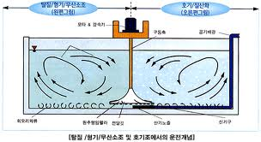
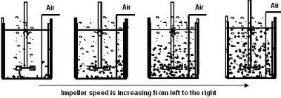
Gold Extraction in India
PACHUCA tanks are air-agitated slurry reactors used as leaching vessels for the extraction of nonferrous metals like uranium, gold, zinc, and copper. These tanks are operated with slurries containing 50 to 60 wt pct solids.

Slide 106

Magnetism
Magnetism is the force of attraction or repulsion of a magnetic material due to the arrangement of its atoms, particularly its electrons.

Slide 107
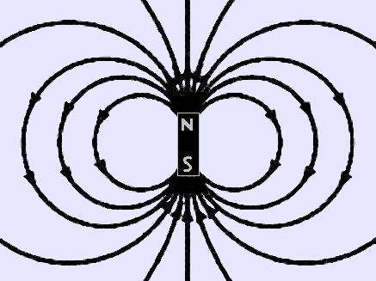
The ends of a magnet are where the magnetic effect is the
strongest. These are called “poles.” Each magnet has
2 poles – 1 north, 1 south.

Slide 108

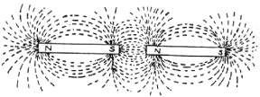
Like repels like…
Opposites attract!

Slide 109
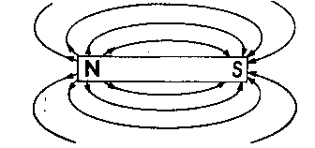
If you cut a magnet in half,
you get 2 magnets!

Slide 110
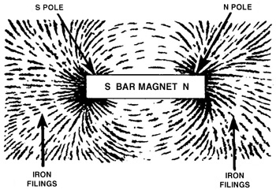
Magnetic Fields
The region where the magnetic forces
act is called the “magnetic field”

Slide 111
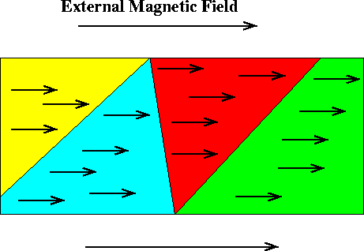
When an unmagnetized substance is placed in a magnetic
field, the substance can become magnetized.
This happens when the spinning electrons line up in the
same direction.

Slide 112

An unmagnetized substance looks like
this…

Slide 113

While a magnetized substance looks
like this…

Slide 114

The Earth is a magnet:
Geographic North Pole
It exerts magnetic forces and is surrounded by a
magnetic field that is strongest near the
North and South
magnetic poles
Magnetic South Pole
Magnetic North Pole
Geographic South Pole

Slide 115
Magentic Separation
By combination of various forces of magnets with gravitational and frictional forces , it is possible to separate various mineral fractions The field around magnet exerts a force called magnetic field When a material placed in the magnetic field , it is subjected to either attraction or repulsion In magnetic separation , magnetic susceptibility of certain minerals is taken advantage of Some are strongly magnetic , others are weakly magnetic

Slide 116
Magentic Separation
Degree of magnetic susceptibility differentiate strongly & weakly magnetic materials into separate products It is the ratio of the intensity of magnetisation produced in the material to magnetic field which produces the magnetisation Ferromagnetic materials have very high susceptibility to magnetic forces and retain some magnetism when reomoved from the field Other factors affecting the separation – size, specific gravity , freedom of movement

Slide 117
Mechanism of Magentic Separation
Unit of measurement of Magnetic flux density or induction (B) Number of lines of force passing through unit area of material – Tesla (T) Magnetizing force which induces lines of force through a material is called Field Intensity ( H) , its unit is Amp/metre 1 Amp /metere = 4 * pi * 10⁻⁷ T Intensity of magnetisation ( M) of material is related as B = μo ( H+M) , μo = permeability of free space M = 0 & very low in air

Slide 118
Mechanism of Magentic Separation
So B = μoH So , flux density is almost equal to field intensity However , when dealing with magnetic field inside materials, the value of induced flux density will be much higher than field intensity Magnetic susceptibility S = M/H Combining both equations , B = μo H ( 1+S) = μμo H Where μ = 1+S = dimensional number as relative permeability

Slide 119
Magentic Separation
Paramagnetic mineral ( Hematite) – slight tendency to line up parallel to lines of force – magnetic susceptibility ( K) positive & small Ferromagnetism ( Magnetite)– K large & positive , strong tendency to line up parallel to lines of force of magnetic field - Ferrites ( Diamagnetic mineral ( Quartz) – repelled from field along lines of magnetic field to smaller field intensity - not in use Attracted particles deflected from others in moving stream,

Slide 120
Mechanism of Magentic Separation
At low intensity , strongly magnetic minerals can be separated from weakly or non magnetic minerals On achieving maximum magnetisation , a particle is said to be saturated. Ferro magnetic materials ( magnetite , ferro-silicon ) become saturated at normal field strength

Slide 121
Magentic Separation
Many high-intensity magnetic separators use Iron Cores and frames to produce desired magnetic flux & field Iron saturates magnetically at about 2-2.5 T The capacity of magnet to lift a particular mineral is dependent not only on value of field intensity but also ‘Field Gradient’ i.e. rate at which field intensity increases towards magnet surface In order to generate a given lifting force , production of high field gradient and high intensity is important aspect of separator design

Slide 122
Magentic Separation
Design Aspect -Provision of high intensity field with steep field strength gradient -In uniform flux , magnetic particles will orient themselves but will not move along lines of flux -In converging field , tapering of pole concentrate magnetic flux – thus there is steep field gradient across gap due to difference in intensity

Slide 123
Magentic Separation –Design Aspect
Another method of producing high field gradient is by using a pole which is constructed of alternate magnetic and non magnetic laminations Provision for varying the intensity – Current changes done in electromagnetic separators while in permanent magnet , inter pole distance is varied Belt or drum speed is to be regulated for feeding particle

Slide 124
Magentic Separation –Design Aspect
Agglomeration of small particles can occur if the field is concentrated as particles under high field gradient behave as magnet and attract each other These magnetic flocs can entrain gangue which bridges the gap between magnetic poles –reducing efficiency of separation Flocculation is reduced by keeping mono layer / by passing the material through consecutive magnetic field having reversal of polarity Provision for magnetic particles to be attracted to pole-pieces followed by conveying device

Slide 125
Magentic Separation
Factors for magnetic separation -thin layer of particles moving through consecutive magnetic fields with successive reversal of their polarity. This arrangement causes ferromagnetic particle to respond by turning through 180 deg -magnetic field arranged with min air gap for effective removal of strong magnetic particle first -Moisture content less than 0.5 % -Machine should provide scrubbing action by pole reversal to free entrained gangue

Slide 126
Types of Magentic Separator
Classified into Low and High Intensity machines with Dry & wet type of feeds Low intensity separators are used to treat ferro magnetic materials and some highly paramagnetic minerals Dry low intensity magnetic separation confined to concentration of coarse sands which are strongly magnetic For particle size < 0.5 cm range , wet separators are used Low-intensity wet separators used in DMS to purify magnetic medium and concentrate ferromagnetic sands

Slide 127
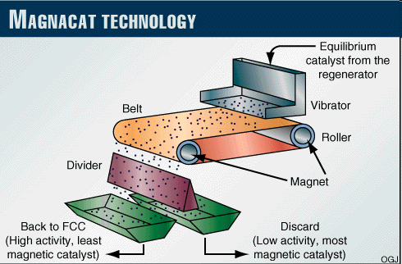
Magentic Separation
Dry Belt Magnetic Separator – poles arranged one above other , upper one with wedge while lower one flat e.g concetration of Zn-Pb-Fe sulphides, Magnetite ore
https://www.youtube.com/watch?v=zlwpEzcamcc

Slide 128
Magentic Separation
Drum Separator – ( 600 G , +6 mm size) "Ore-agitating" type of separator because the magnetic particles (which are little magnets themselves) reorient and flip 180° as they pass by the fixed internal magnets of alternating Polarity.

Slide 129
Types of Magentic Separator
Wet Drum separators –most common machines for cleaning the medium in DMS circuits Essentially consist of 3-6 stationary magnets of alternating polarity Initially drum separators employed electromagnet but now permanent magnets are used utilising ceramic magnetic alloys which retain their intensity for long time Separation is by ‘Pick up’ principle – magnetic particles lifted by magnets , pinned to drum and conveyed out of field

Slide 130
Types of Magentic Separator
Water introduced to provide current which keeps the pulp in suspension Concurrent Type – concentrate is carried forward by drum and passes through a gap where it is compressed and dewatered before leaving the separator
Feed
Concentrate discharge

Slide 131
Types of Magentic Separator
Counter Current separator –where feed flows in the opposite direction to rotation –for high solid loading Used for roughing operation where extremely clean concentrate not required with low loss of magnetic material
Feed
oveflow
Concentrate discharge
Underflow

Slide 132
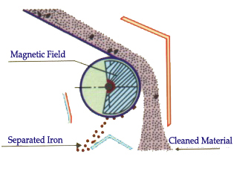
Dry Magentic Separation
The purpose of causing the particles to flip
-To permit smaller non-magnetic particles which are entrapped within floccules of the magnetic particles to separate
- fall out during reorientation of the particles for better separation

Slide 133
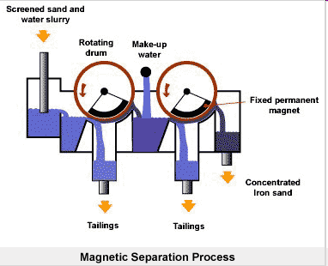
Wet Magentic Separation
Wet Magnetic Separator – Pulp having magnetic particle are lifted by magnet ( belt / drum) – The belt /drum dipped inside the pulp

Slide 134
Advances in Magentic Separation
Newly developed magnetic separators associated with advantage :
Saving in magnets ,
Higher capacity
Elimination of problems with electromagnets ( coil failure & constant power)
High Speed Dry Drums
–treat wide range of size of iron ore & slag with drum linear speed 100-500 m/min
-introducing centrifugal force factor in addition to gravity & magnetic attraction

Slide 135
Advances in Magentic Separation
High intensity Dry & Wet magnetic separator
-For very weakly paramagnetic minerals for intensity field
-Magnetic intensities in the range 12000-20000 G electromagnet)
-1,50,000 G (super conducting magnet ) used to separate weakly magnetic minerals such as :
Hematite, Ilmenite , ores of Cr, Mn, W etc from silica, clay, zircon

Slide 136
Advances in Magentic Separation
High intensity Dry Magnetic separator – IRM ( induced Roll Magnetic Separator)
-Widely used to treat beach sand , tin Ores, Glass Sand , phosphate rock
Gap between pole & roll decreased for more weakly magnetic products
Setting of splitter plates cutting into trajectory important
Not suitable for < 75 micron

Slide 137
Induced Roll Separator

Slide 138
WHIMS – Jones Separator

Slide 139
WHIMS – Jones Separator
Actual separation takes place in plate boxes which are on periphery
Feed , a mixed slurry, flows into plate boxes
The feebly magnetic particles are held by plates where as remaining non magnetic slurry passes straight through plate boxes and collected in a launder
Before leaving magnetic field , entrained non magnetics are washed out by low pressure water – Middlings
When plate boxes reach a point midway between two poles ( field zero) , magnetic particles washed out by water spray

Slide 140
WHIMS – Jones Separator
Preferable particle range 20 Microns up to 1 mm
It provides very high magnetic fields at low energy consumption,
The gaps between the grooved plates keep their identical dimensions for long operation time, generating a uniform magnetic force, essential for selective separation.
Vertically unhindered flow minimises the possibility of blockage of the gaps by ferro magnetic parts with high magnetic susceptibility.
Yielding high throughput rates in a compact machine, guarantees low operating and maintenance cost.

Slide 141
WHIMS – Jones Separator
Typical applications
-Producing a magnetic concentrate
e.g. Hematite, Pyrrhotite, Ilmenite, Ores of Chromium, Manganese, Tungsten, Zinc, Nickel, Tantalum/Niobium, Molybdenum
-Upgrading by the removal of impurities when the non-magnetic mineral is the required product.
e.g. Glass-sand, Clay, Talc, Kaolin, Feldspar, Coal, Fluorspar, Baryte, Graphite, Bauxite etc.

Slide 142
WHIMS – Jones Separator
Typical applications
-Pre concentration for additional treatment by a different process
e.g. scavenging from subgrade deposits of tailings and
minerals of :
Uranium, Gold, Platinum, Chromium, Manganese, Iron, Slags, Residues etc.

Slide 143
Electrical Separation
Good Conductors
-Native metals ( Au, Ag,Cu ) ,Sulphides (Galena , Chalcopyrite) , Minerals ( Graphite, Tellurides)
Poor Conductors
Gangue , Calcite , gypsum , Granite
Separation
- It is based on the principle that two bodies having same electrical charge will repel each other and vice versa

Slide 144
Electrical Separation
Therefore if mixture of good & poor conducting particles in neutral state is fed upon highly charged conducting surface
-conducting particles will receive similar charge as of the surface and will be repelled
-non conducting particle reluctant to receive the charge , thus not repelled readily
Two minerals with difference in conductivity will effect separation
Electrical separation is applicable in dry conditions for small particles

Slide 145
Electrical Separation
Mechanism of Electrical Separation
It is based on ability of minerals to capture or lose electron and then be attracted or repelled by other bodies when exposed to high voltage
Static electricity employed for separation is defined as the electrical charge fixed temporarily on charged body
The charge on particles may be acquired by
-Conductance , ion bombardment ( gaseous)
-Friction , thermal strain , light

Slide 146
Electrical Separation
Charging by Conductance
When two types of particles placed between positive & negative electrodes resting on positive electrode
non conducting particle will receive equal charges from both the electrodes and will remain neutral
-Conducting particles having negative charge will be neutralized first and then acquire positive charge
Charging by Ion Bombardment
-mineral particles pass through ionised gas

Slide 147
Electrical Separation
- One of the ionic species of particle captures ions from gas and become charged
-resulting charged particles are contacted by electrode or ground surface , only non conductors retain their charge
Charging of particles by friction – electrons transfer by rubbing two compounds
Charging by thermal strains – Crystals may give rise to local areas of opposite charge – pyro electric effect

Slide 148
Electrical Separation
Charging of particles by light – photo electric effect – incident light or Xray cause emission of electron due to which particle acquire positive charge
Forces applied in electrostatic separation are small
- Can be used to treat particles of low sp. gr. with high ratio of surface to weight ( particle size <3 mm)
Factors affecting conductivity of minerals
a) Surface condition
-A hydrophobic surface has a decreased conductivity due to less affinity for adsorbed water

Slide 149
Electrical Separation
-mineral surface conditioning similar to flotation is done
-A selective conductivity can be produced by reagents like BaCl2 , HF , NaCN < CuSO4 by absorbing humidity
Temperature –heating of mineral upto 600 deg C improves conductivity

Slide 150
Electrical Separation
Type of material - Electron mobilities increase in all materials with strength of applied field
-conductors - metallic or ionic bond -electrons highly mobile
-Insulators or dielectrics having electron mobility very low
-semiconductors –in between conductors & insulators
Sp Gr and size – heavy sulphide mineral upto 3 mm , coke upto 25 mm , min treatable size is 50 microns
Separation process based on – conductivity , electric polarisation , dielectric constants , photoconductivity

Slide 151
Electrical Separation
In industry , based on electrical conductivity
Electrostatic separation –mineral particles are charged by induction /conduction / friction – charged particles pass through high intensity electric field and deflected as per sign of charge , separation is made in air
High Tension Separation – separations made using a corona discharge device -high tension separation using ion bombardment -air ionised and attracted towards grounded body where ions discharged - mineral particles entering electrical field are bombarded by ions from which they acquire negative charge -

Slide 152
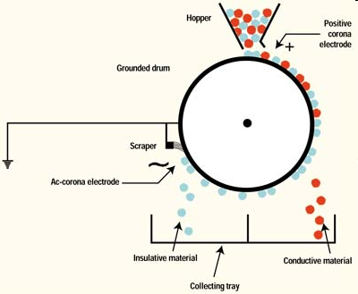
Electrostatic Separator
Roll type electrostatic separator –electrical spray sprinkle charge on particles - conducting particles will lose their charge by passing them to grounded roll and fall undeflected – non conducting particles acquire a charge and induce the opposite charge to roll and stick to it – these are then scrapped off

Slide 153
High tension electrostatic Separator
High Tension electrostatic separator
– for coarse particle
–potential between electrode is limited by corona
– spark over voltage is proportional to density of gas –
Hence temperature is developed
– highest in N2 then air, CO2, O2,H2 , electrode in form of knife edge , wire, or bars with projecting edge

Slide 154
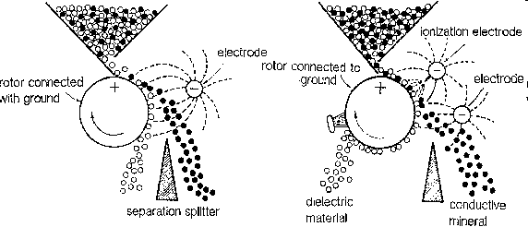
High tension electrostatic Separator

Slide 155
Electrical Separators
High Tension Electrostatic separator applications
–Removal of fine dust from air or gas
–air passed between negatively charged wire electrodes and
earthed or positively charged collecting plates ( electrodes )
– particles ionised and periodicallly shaken down into hoppers
- Separation of titanium beach sands ( ilmenite, rutile, Zircon)

Slide 156
Apparatus for Dielectric Separation

Slide 157
Electrical Separators
Dielectric Separation
-based on difference in dielectric constants of minerals
-two electrodes ( one earthed to a high voltage ie 20 KV, 50 mA dc ) and a dielectric bed of material through which pulp is passed
-Capture of particles having high dielectric constant and discharging away the particles of low dielectric constant from the system being in liquid
- Removal of field and recovery of particles of high dielectric constants by washing dielectric bed

