Slide 1


Effect of Alloying Element in Iron- Carbide Phase Diagram
Powerpoint Templates
Powerpoint Templates _{Page 1}

Slide 2
Effects of alloying elements
→Alloying elements have significant effect on the iron-iron carbide equilibrium diagram
→The effect of the alloying element in the steel may be one or more of the following:
It may go into solid solution in the iron,
enhancing the strength.
Hard carbides associated with Fe,C may be formed.
It may form intermediate compounds with iron, e.g. FeCr (sigma phase), FeW.
It may influence the critical range in one or
more of the following ways:
Powerpoint Templates
Page 2

Slide 3
Effects of alloying elements
Alter the temperature. For e.g, 3% Ni lowers the Ac points some 30°C, while 12% Cr raises the Ac1, temperature to about 800°C
Alter the carbon content of the eutectoid: The C content of the pearlite in a 12% Cr steel is 0.33%, as compared with 0.87 in an ordinary steel. Ni also reduces the amount of C in the pearlite and consequently increases the volume of this constituent at the expense of the weaker ferrite.
Alter the “critical cooling velocity”, which is the minimum cooling speed which will produce bainite or martensite from austenite.
Powerpoint Templates
Page 3

Slide 4
Effects of alloying elements
→ Some alloying elements will widen the temperature range through which austenite is stable while other elements will constrict the temperature range.
→ Combinations of elements can be chosen so that the volume change is reduced and also the risk of quench cracking.
→ It may have a chemical effect on the impurities. Under suitable slag conditions vanadium, in quite small quantities, "cleans" the steel and renders it free from slag inclusions. Manganese and zirconium form sulphides.
→ Some elements (like Al, Cr, Si, Cu) tends to produce adherent oxide film on steel which resist
Powerpoint Templates
corrosion and oxidation at elevated temps.
Page 4

Slide 5
Effects of alloying elements
→ Creep strength may be increased by the presence of a dispersion of fine carbides, e.g. molybdenum.
→ It may render the alloy sluggish to thermal changes, increasing the stability of the hardened condition and so producing tool steels which are capable of being used up to 550°C without softening and in certain cases may exhibit an increase in hardness.
Powerpoint Templates
Page 5

Slide 6
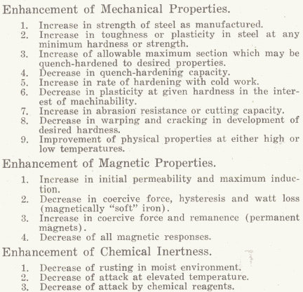
Why we do alloying in steel?
Powerpoint Templates
Page 6

Slide 7
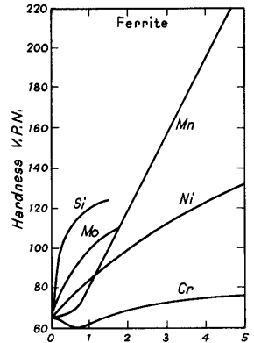
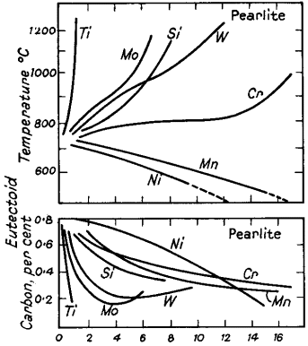
Effect of alloying elements
Fig. – Effect of alloying elements on eutectoid temp. and
Fig. – Effect of alloying elements on hardness of steel
Powerpoint Templates
Page 7
C content

Slide 8
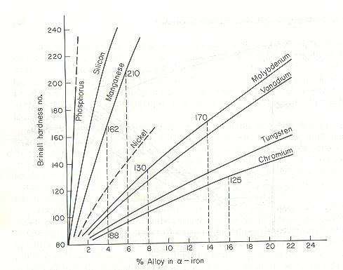
Effect of alloying elements
Powerpoint Templates

Slide 9
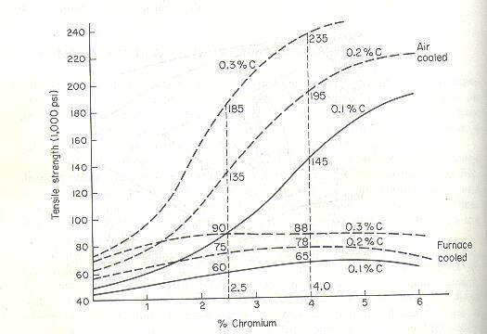
Effect of alloying elements
Fig. – Effect of different % of C in the presence of Cr in steel
Powerpoint Templates

Slide 10
Effect of alloying elements
Table I – Effect of alloying on critical cooling speed on steel
Carbon, % | Alloying Element, % | Cooling Speed to form Martensite, °C per sec (650°C)
0.42 | 0.55 Mn | 550
0.40 | 1.60 Mn | 50
0.42 | 1.12 Ni | 450
0.40 | 4.80 Ni | 85
0.38 | 2.64 Cr | 10
Powerpoint Templates

Slide 11
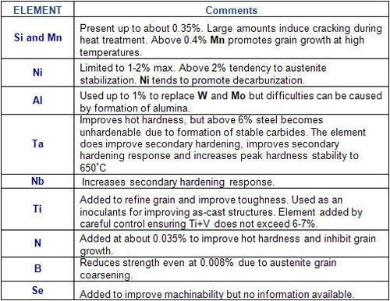
General Trends of alloying
Powerpoint Templates

Slide 12
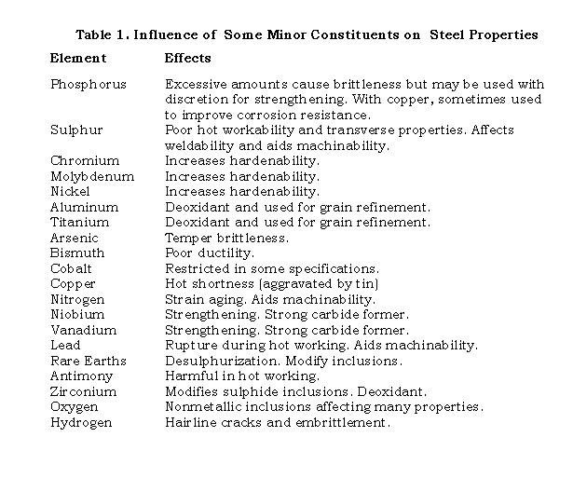
General Trends of alloying
Powerpoint Templates
Page 12

Slide 13
Classification of alloying elements
Elements which tend to form carbides. Cr, W, Ti, Cb, V, Mo, Zr and Mn. Generally carbide formers are also ferrite formers. M₂₃C₆, M₆C, etc. The mixture of complex carbides is often referred to as cementite.
Elements which tend to graphitise the carbide. Si, Co, Al and Ni. Only a small proportion of these elements can be added to the steel before graphite forms during processing, with attendant ruin of the properties of the steel. Their presents makes the carbides unstable.
Elements which tend to form nitrides. All carbide forming elements are also nitride former.
Powerpoint Templates

Slide 14
Classification of alloying elements
Elements which tend to stabilise austenite. Mn, Ni, Co and Cu. These elements alter the critical points of iron in a similar way to carbon by raising the A4 point and lowering the A3 point, thus increasing the range in which austenite is stable, and they also tend to retard the separation of carbides.
Elements which tend to stabilise ferrite. Cr, W, Mo, V and Si.
Powerpoint Templates

Slide 15
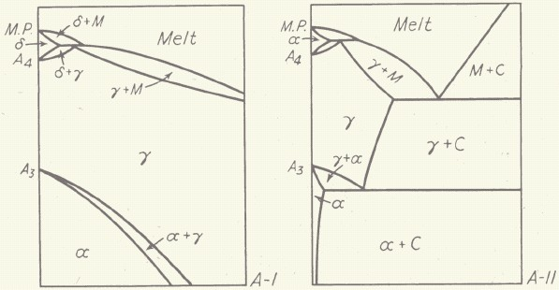
Austenite/Ferrite Stabilizers
→ Different elements have solubilities in alpha and gamma iron
→ Binary phase diagram is used to explain
Powerpoint Templates

Slide 16
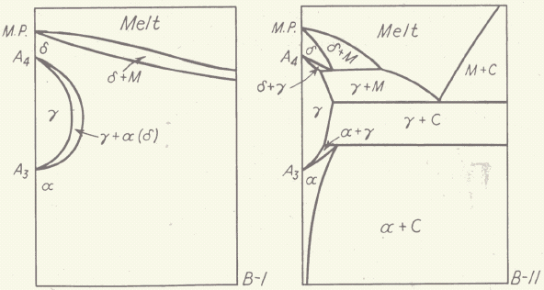
Austenite/Ferrite Stabilizers
Figs. – Two types of phase equilibrium diagrams for Fe
Powerpoint Templates

Slide 17
Ferrite Stabilizers
→Al, Cr, Si, Mo, W, P, are ferrite stabilizers, they tend to form solid solution with alpha iron
→ They have greater solubility in ferrite – BCC
→ Generally have similar BCC structure
→ They decrease the amount of C present in γ-Fe
→ Favors formation of free carbides in steel
→ The ferrite form is Delta ferrite since it can exists from melting point to room temp.
Powerpoint Templates

Slide 18
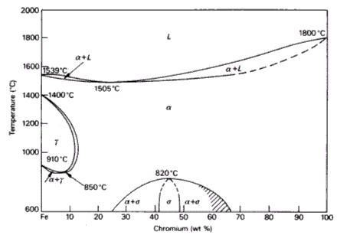
Ferrite Stabilizers
Powerpoint Templates

Slide 19
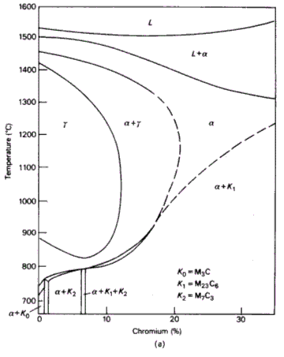
Ferrite Stabilizers
Fig. - Effect of C on Fe-Cr diagram
Powerpoint Templates

Slide 20
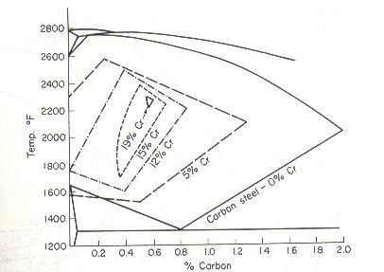
Ferrite Stabilizers
Fig. – Effect of Cr on critical temp. and γ phase transformation in steel
Powerpoint Templates
Page 20

Slide 21
Austenite Stabilizers
→Ni, Mn, Co are austenite stabilizers, they tend to form solid solution with gamma iron
→ They have greater solubility in austenite
→ They have FCC crystal structure
→ They do not combine with C present in γ to form simple or complex carbide, therefore C remains in the solid solution in the γ
→ 13% Mn steels are austenitic at room temp. called Hadfield Steel.
→ C and N are also austenite stablizers (interstitial solutes in fcc)
Powerpoint Templates

Slide 22
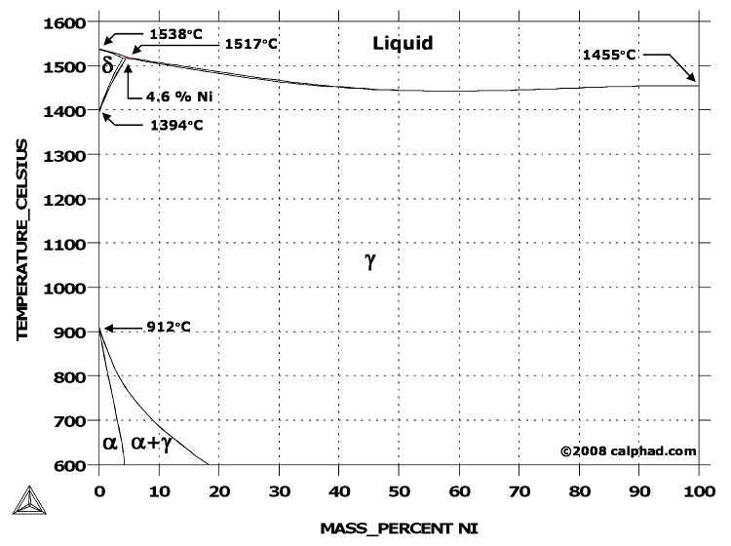
Austenite Stabilizers
Powerpoint Templates

Slide 23
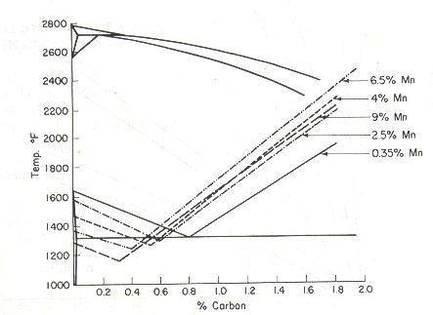
Austenite Stabilizers
Fig. – Effect of Mn on critical temp. and γ phase transformation in steel
Powerpoint Templates
Page 23

Slide 24
Schaeffler diagram
→ Schaeffler and Delong diagrams are used to predict structure on the basis of alloying elements
→ Plots the compositional limits at room temperature of austenite, ferrite and martensite, in terms of nickel and chromium equivalents
→ The Cr and Ni equivalent can be empirically determined as:
Cr equivalent = (Cr) + 2(Si) + 1.5(Mo) + 5(V) + 5.5(Al) + 1.75(Nb) + 1.5(Ti) + 0.75(W)
Ni equivalent = (Ni) + (Co) + 0.5(Mn) + 0.3(Cu) +
25(N) + 30(C)
Powerpoint Templates
Page 24

Slide 25
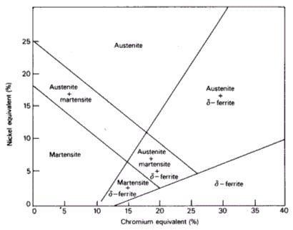
Schaeffler diagram
Powerpoint Templates

Slide 26
Modified Schaeffler diagram
→ Delong modified the schaeffler diagram
→ Ferrite no. is also plotted on schaeffler diagram
→ Effect of nitrogen was also taken into account
→Widely use in predicting phase-structure in weld metal
→ Also include calculation of volume and composition of carbide phase
Powerpoint Templates

Slide 27
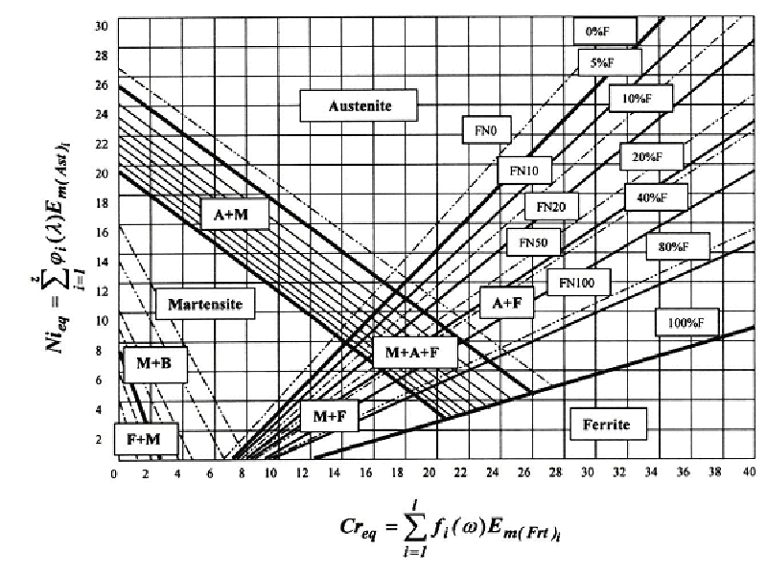
Modified Schaeffler diagram
Page 27
Powerpoint Templates

Slide 28
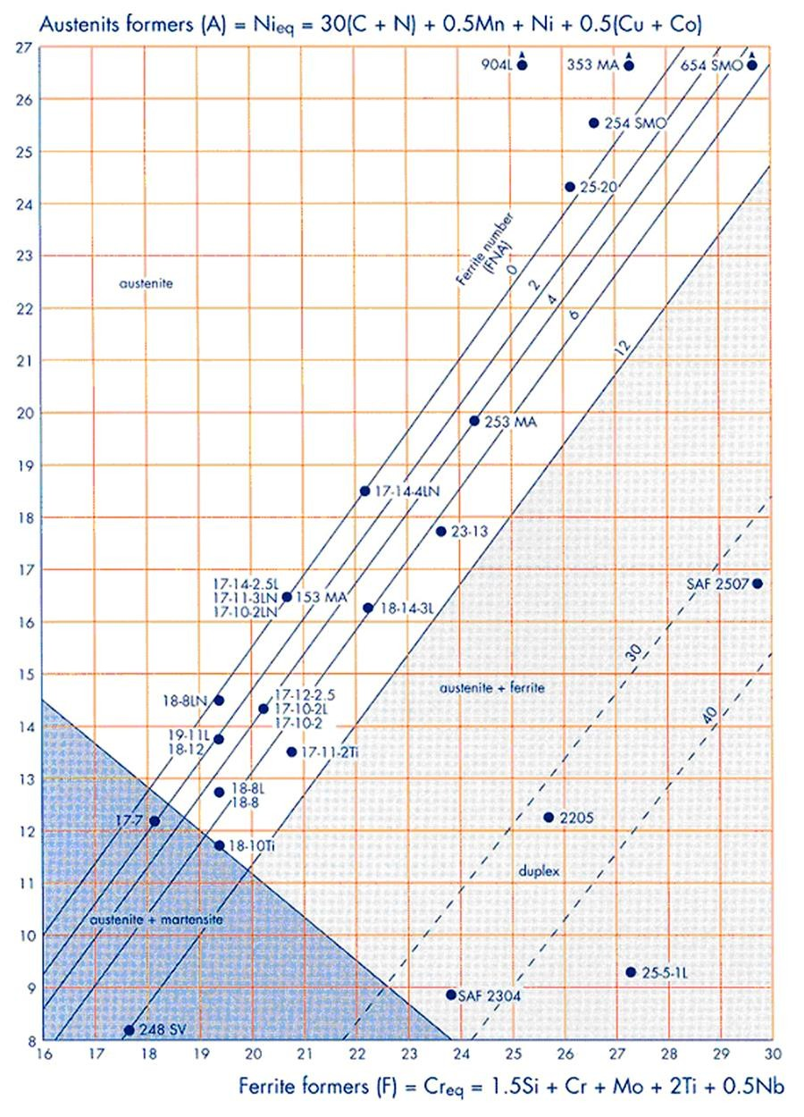
Schaeffler-Delong diagram
FN = Ferrite No.
Low %ferrite leads to solidification cracking in weld metal, but low
%ferrite render SS more corrosion resistant
Powerpoint Templates

Slide 29
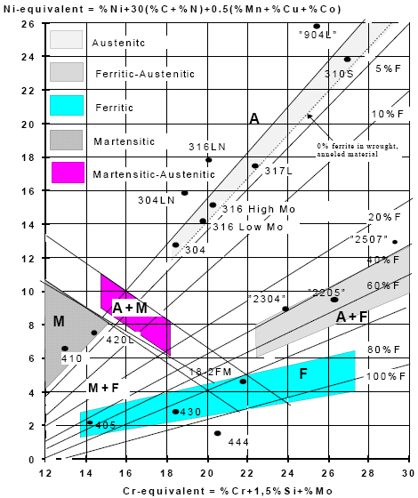
Schaeffler-Delong diagram
Powerpoint Templates

Slide 30
Modified Schaeffler diagram
→ FN can be roughly determine by: FN = 3.34 Cr_{eq} – 2.46 Ni_{eq} – 28.6
--> FN between 3-7 (max.) is preferred
→Solidification mode of S.S. during casting or welding can be predicted roughly as under:
→ Cr_{eq}/Ni_{eq} < 1.5
→ Cr_{eq}/Ni_{eq} > 2.0
(Austenitic) (Ferritic)
→ In b/w 1.5 and 2.0 is the mixed structure
Powerpoint Templates

