Slide 1
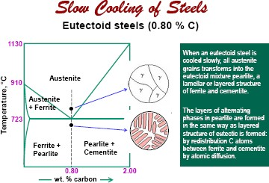

Slide 2
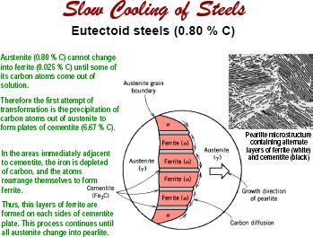

Slide 3
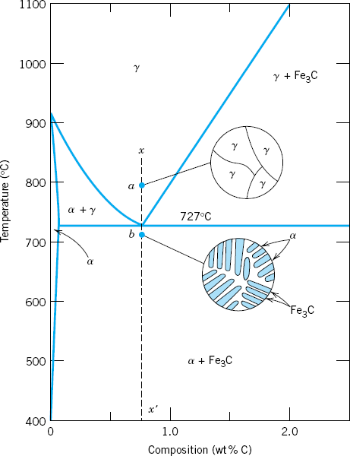
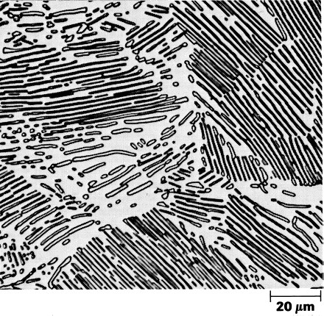
γ ⎯⁷⎯²⁷⎯^{C} → α + Fe C
Eutectoid Reaction
o
cool
3
0.77 0.02 6.67
Pearlite
Red Tie Line below eutectoid temp
Amount of phases in Pearlite
0 .77 − 0 .02 0 .75
^{f} F C
= =
= 0 .11
3
6 .67 − 0 .02 6 .65
6 .67 − 0 .77 5 .90
^{f} Ferrite
= =
= 0 .89
6 .67 − 0 .02 6 .65

Slide 4
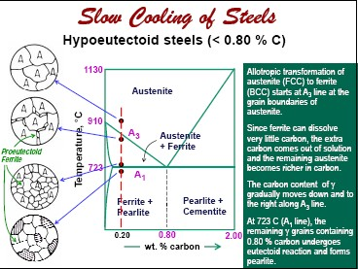

Slide 5
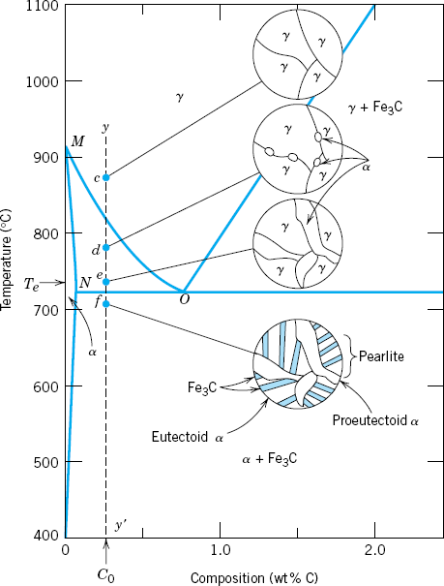
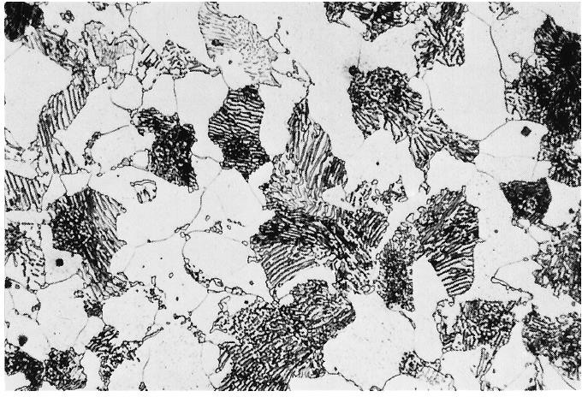
Proeutectoid Ferrite
Pearlite
Microsructure of a hypoeutectoid
steel, 0.38 wt% C
0 .77 − 0 .38 0 .39
^{f} proeutecto id − ferrite
= = = 0 .52
0 .77 − 0 .02 0 .75
^{f}pearlite ^{below T}E ^{= f}austenite ^{above T}E
Tie-Line above the eutectoid
f
₌ 0 .38 − 0 .02 ₌ 0 .36 _{= 0 .48}
pearlite
0 .77 − 0 .02 0 .75
₌ 6 .67 − 0 .38 ₌ 6 .29 _{= 0 .94}
f
Total − ferrite
temperature T
6 .67 − 0 .02 6 .65
E
0 .38 − 0 .02 0 .36
^{f} eutectoid − Cementite
= =
= 0 .06
6 .67 − 0 .02 6 .65

Slide 6
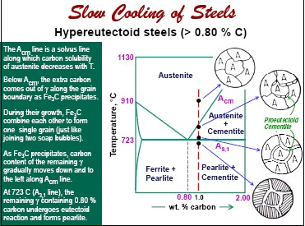

Slide 7
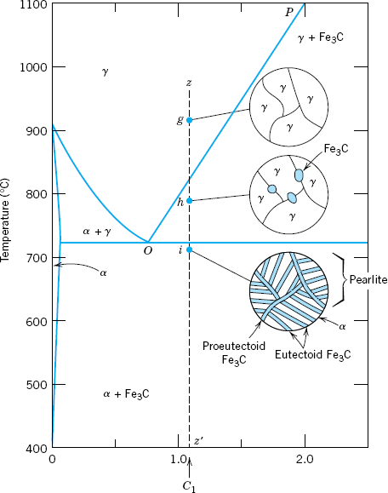
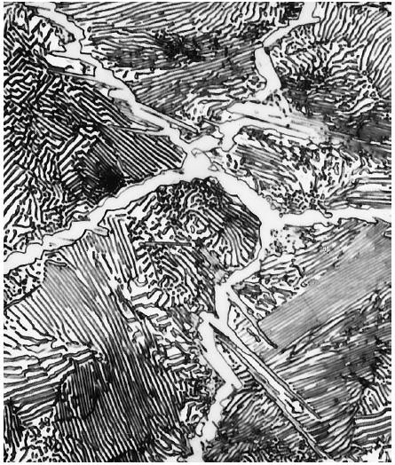
Proeutectoid
Cementite
Pearlite
Microstructure of a hypereutectoid steel, 1.4 wt% C
^{F}proeutectoid cementite^{=f}cementite ^{above T}E
f
=
1 .4 − 0 .77
= ^{0 .63} = 0 .11
proeutecto id − cementite
6 .67 − 0 .77 5 .90
6 .67 − 1 .4 5 .27
1.4 − 0.8 0.6
^{f} pearlite
= = = 0 .89
6 .67 − 0 .77 5 .90
^{f} proeutecto id cementite
=
=
= 0.10
6.67 − 0.8 5.87
f
=
6 .67 − 1 .4
= ^{5 .27} = 0 .79
Total − cementite
6 .67 − 0 .02 6 .65
1 .4 − 0 .02 1 .38
^{f} eutectoid − ferrite
=
=
= 0 .21
6 .67 − 0 .02 6 .65

Slide 8
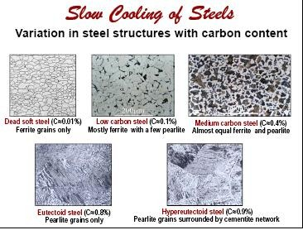

Slide 9
Phases in Fe-C system
Phase | Symbol | Description
Liquid | L | Liquid solution of Fe and C
δ-Ferrite | δ | Interstitial solid solution of C in δ-Fe (high temperature bcc phase)
Austenite | γ | Interstitial solid solution of C in γ-Fe (FCC phase of Fe)
Ferrite | α | Interstitial solid solution of C in α-Fe (room temperature bcc phase)
Soft and Ductile
Intermetallic compound of Fe and C (orthorhombic system) Hard and Brittle
Cementite
Fe₃C

Slide 10
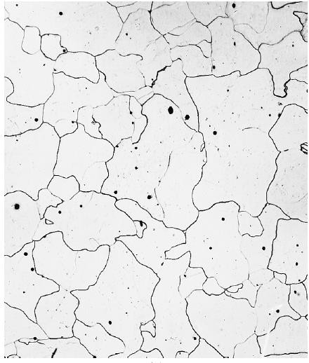
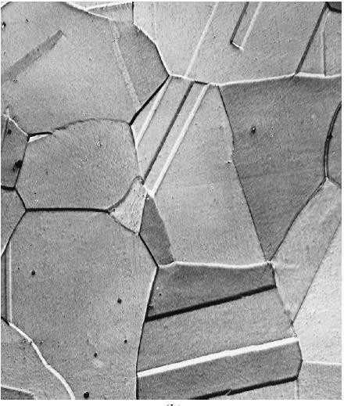
Ferrite
Austenite

Slide 11
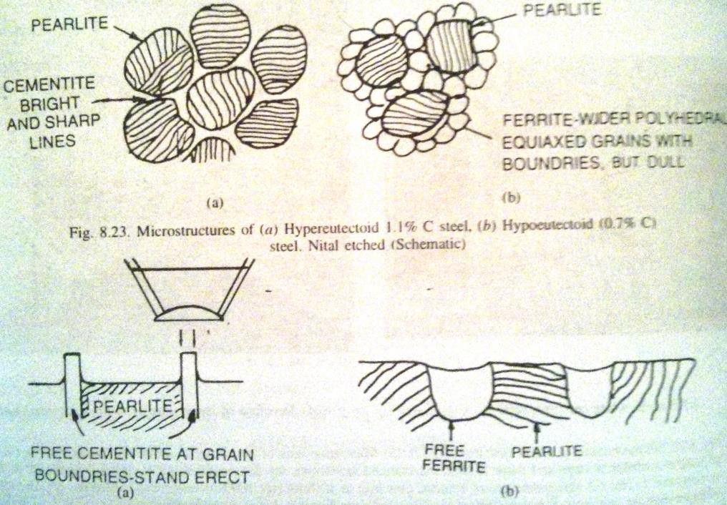
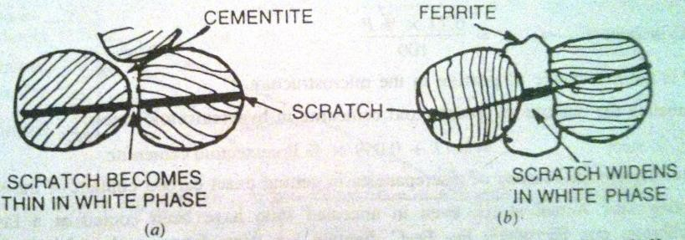
Proeutectoid Ferrite Vs Proeutectoid Cementite
 | If the carbon content of steels is much far away from eutectoid carbon, distinction can be made very easily. Both of them appear white, but cementite is present as a network at GBs of pearlite, where as ferrite is present as equiaxed polyhedral grains (with grain boundaries between ferrite grains) at the GBs of pearlite. If carbon content is around eutectoid composition, then it becomes difficult to distinguish between the two. Following methods can be used to differentiate between the two,
 | Criteria | Proeutectoid Ferrite | Proeutectoid Cementite
 | Shapes of the phases | Appears as grains, which are wide, polyhedral and have GBs in between themselves | Are much thinner, network of needles or platelets and bounded by sharp lines
 |  | Looks very wide white grains but dull in nature because of their etching characteristics | Looks much brighter and sharp because of its hardness and etching characteristics
 | Relative Hardness | It is very soft (~95VPN) | It is very hard (~1000VPN)
 | Scratch Test on polished and etched surface | Scratch becomes wider when entering this phase | Scratch becomes thin when entering this phase

Slide 12
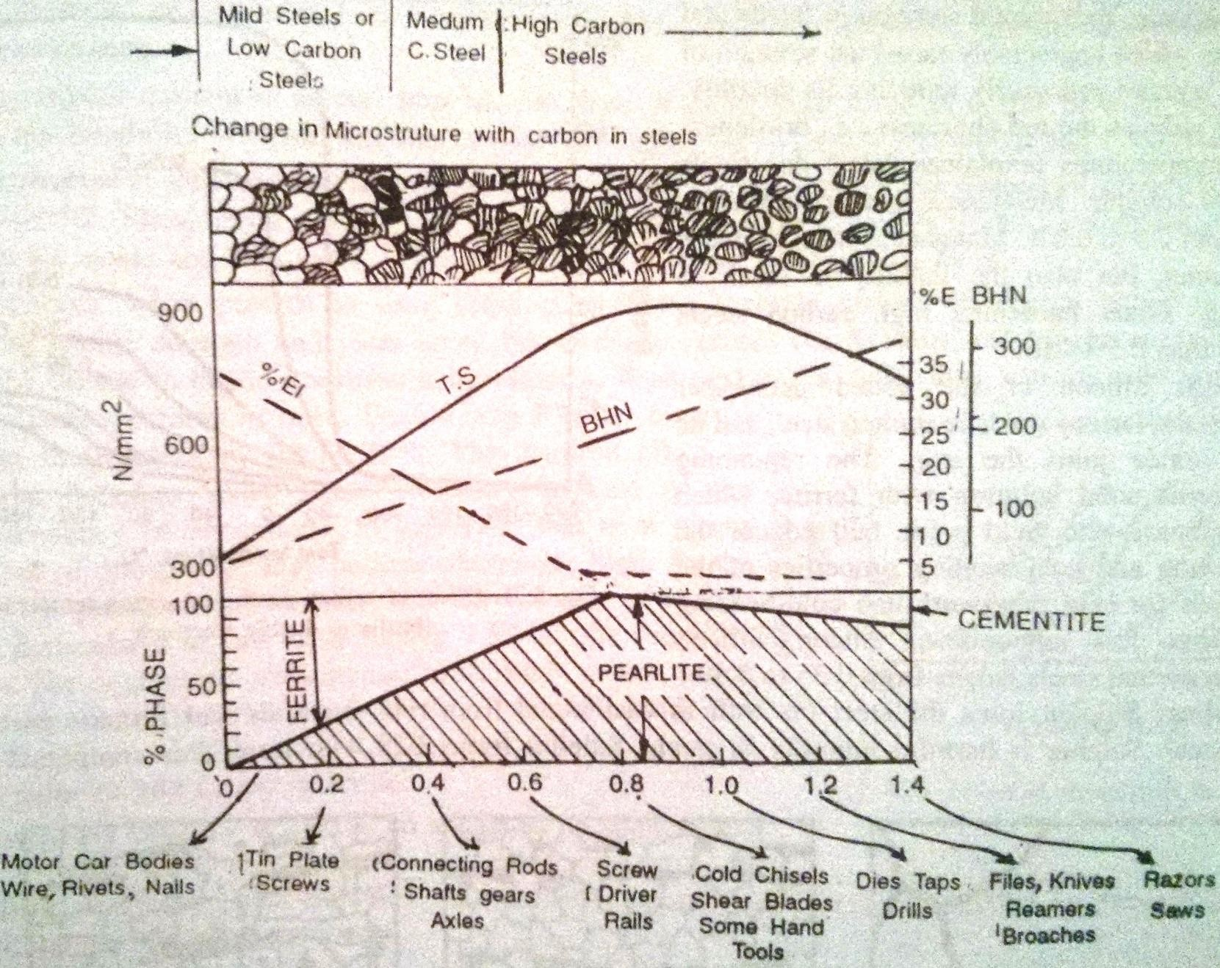
Mechanical Properties as a function of Carbon

Slide 13
Classification of Steels
Steel is an interstitial solid solution of carbon in iron.
Theoretically steel has a maximum of 2.11% carbon.
In practice, the amount of carbon rarely exceeds 0.8%
They can be classified based on:
  Type of deoxidation practices,
    Rimmed Steel
    Capped Steel
    Semi-killed Steel
    Killed steel
  Grain-coarsening characteristics
    Fine grained steels
    Coarse grained steels
  Based on carbon content
    Plain carbon steels (less than 2.11% carbon and negligible amounts of other residual elements)
      Low Carbon (less than 0.25% carbon)
– Med Carbon (0.25% to 0.55%)
      High Carbon (0.55% to 2.11%)
    Low Alloy Steel
    High Alloy Steel
    Stainless Steels (Corrosion-Resistant Steels) – contain at least 10.5% Chromium
Most important classification is based on the carbon content,

Slide 14
Classification of Steels
AISI - SAE Classification System AISI XXXX
  American Iron and Steel Institute (AISI) & Society of Automotive Engineers (SAE) have cooperated together.
  Classifies alloys by chemistry
  Prefix to the four digit number indicates the method used in steel making.
    A = Alloy steel, basic open-hearth
    B = Carbon steel, acid bessemer
    C = Carbon steel, basic open-hearth
    D = Carbon steel, acid open-hearth
    E = Electric furnace steel
  4 digit number
  1st number indicates the type of steel
  2nd number indicates the relative percent of main alloying element.
  last two numbers approximate amount of carbon (expresses in 0.01%)
First Digit (from left) | Type of Steel | First Digit (from left) | Type of Steel
1 | C-Steel | 6 | Cr-V Steel
2 | Ni-Steel | 7 | W-Steel
3 | Ni-Cr Steel | 8 (Triple alloy steel) | Ni-Cr-Mo (low) Steel
4 | Mo Steel | 9 | Si-Mn Steel
5 | Cr Steel

Slide 15
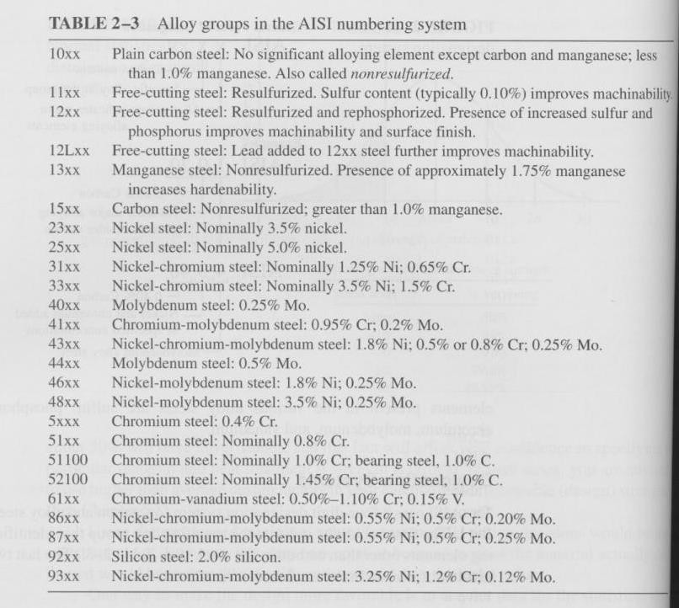

Slide 16
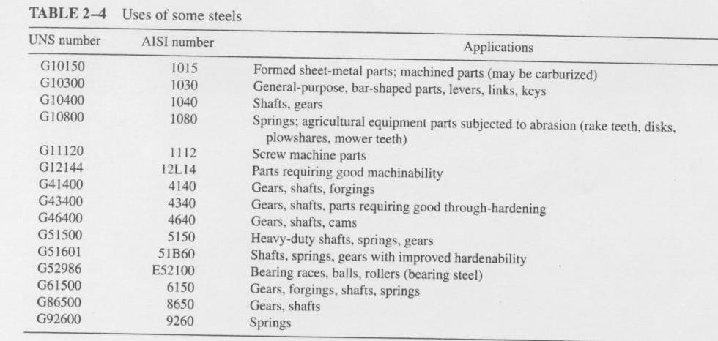
AISI/SAE most common, also have Unified Numbering System (UNS) and ASTM

Slide 17
Plain Carbon Steel
Lowest cost
Should be considered first in most application
3 Classifications
  Low Carbon Steel
    Less than 0.25% Carbon
    Low strength, good formability and weldability
    Lacks hardenability (Difficult to harden). If wear is a potential problem, can be carburized (diffusion hardening)
    Most stampings made from these steels.
    E.g. - AISI 1008, 1010, 1015, 1018, 1020, 1022, 1025
  Medium Carbon Steel
    0.25% to 0.55% Carbon
    Have moderate to high strength (hence good toughness) with fairly good ductility
    Poor Hardenability (typically limited to water quench)
    Can be used in most machine elements
    E.g. - AISI 1030, 1040, 1050, 1060*
  High Carbon Steel
    Greater than 0.55% carbon to 2.11% carbon
    Have high strength, lower elongation, low formability
    High hardness and wear resistance
    Can be quench hardened but overall poor hardenability (quench cracking occurs)
    Used in applications where surface subject to abrasion – tools, knives, chisels.
    AISI 1080, 1095

Slide 18
Alloy Steel
Other elements (besides carbon) can be added to iron to improve mechanical property, manufacturing, or environmental property.
Example: sulfur, phosphorous, or lead can be added to improve machine ability.
  Generally want to use for screw machine parts or parts with high production rates!
  Examples: 11xx, 12xx and 12Lxx

Slide 19
Alloy Steel
Again, elements added to steel can dissolve in iron (solid solution strengthening):
  Increase strength, hardenability, toughness, creep, high temp resistance.
Alloy steels grouped into low, med and high-alloy steels.
  High-alloy steels would be the stainless steel groups.
  Most alloy steels you’ll use fall under the category of low alloy.

Slide 20
Alloy Steel
What classifies a steel as an Alloy Steel?
– > 1.65%Mn, > 0.60% Si, or >0.60% Cu
Most common alloy elements:
  Chromium, nickel, molybdenum, vanadium, tungsten, cobalt, boron, and copper.
Low alloy: Added in small percents (<5%)
  increase strength and hardenability
High alloy: Added in large percents (>20%)
  i.e. > 10.5% Cr = stainless steel where Cr improves corrosion
resistance and stability at high or low temps

Slide 21
Alloying Elements used in Steel
Manganese (Mn)
combines with sulfur to prevent brittleness
>1%
  increases hardenability
11% to 14%
  increases hardness
  good ductility
  high strain hardening capacity
  excellent wear resistance
Ideal for impact resisting tools

Slide 22
Sulfur (S)
Alloying Elements used in Steel
Imparts brittleness
Improves machineability
Okay if combined with Mn
Some free-machining steels contain 0.08% to 0.15% S
Examples of S alloys:
– 11xx – sulfurized (free-cutting)

Slide 23
Alloying Elements used in Steel
Nickel (Ni)
Provides strength, stability and toughness,
– 2% to 5%
  typically used in combination with Chromium and Molybdenum
  12% to 20% Nickel AND low amounts of Carbon
  possess great corrosion resistance
Examples of Ni alloys:
– 30xx – Nickel (0.70%), chromium (0.70%)
– 31xx – Nickel (1.25%), chromium (0.60%)
– 32xx – Nickel (1.75%), chromium (1.00%)
– 33XX – Nickel (3.50%), chromium (1.50%)
  Invar
    contains 36% Ni
    virtually no thermal expansion
    used for sensitive measuring devices

Slide 24
Alloying Elements used in Steel
Chromium (Cr)
Usually < 2%
increase hardenability and strength
Offers corrosion resistance by forming stable oxide surface
typically used in combination with Ni and Mo
– 30XX – Nickel (0.70%), chromium (0.70%)
  5xxx – chromium alloys
  6xxx – chromium-vanadium alloys
  41xxx – chromium-molybdenum alloys
Molybdenum (Mo)
Usually < 0.3%
increase hardenability and strength
Mo-carbides help increase creep resistance at elevated temps
  typical application is hot working tools

Slide 25
Alloying Elements used in Steel
Vanadium (V)
Usually 0.03% to 0.25%
increase strength
  without loss of ductility, elastic limit, yield point, and impact strength
Tungsten (W)
helps to form stable carbides
increases hot hardness
  used in tool steels

Slide 26
Alloying Elements used in Steel
Copper (Cu)
0.10% to 0.50%
increase corrosion resistance
Reduced surface quality and hot-working ability
used in low carbon sheet steel and structural steels
Silicon (Si)
About 2%
increase strength without loss of ductility
used in structural steels and spring steels
enhances magnetic properties

Slide 27
Boron (B)
Alloying Elements used in Steel
for low carbon steels, can drastically increase hardenability
improves machinablity and cold forming capacity
Aluminum (Al)
deoxidizer
0.95% to 1.30%
produce Al-nitrides during nitriding

Slide 28
Selecting Steels
High-Strength Low-Alloy Structural Steel
Microalloyed Steel
Free-Machining Steel
Bake-Hardenable Steel Sheet
Precoated Steel Sheet
Electrical and Magnetic Applications
Maraging Steel
High-Temperature Steel
Stainless Steel
Tool Steel

Slide 29
Corrosion Resistant Steel
Stainless Steels (Corrosion-Resistant Steels) – contain at least 10.5% Chromium
  trade name
AISI assigns a 3 digit number
  200 and 300 … Austenitic Stainless Steel
    nonmagnetic
    high formability
    very high corrosion resistance
    twice the cost of ferritic S.S.
  400 … Ferritic or Martensitic Stainless Steel
    poor ductility and formability
    lowest cost S.S.
  500 … Martensitic Stainless Steel
    high strength
    1.5 times the cost of ferritic S.S.

Slide 30
Tool Steel
Refers to a variety of carbon and alloy steels that are particularly well-suited to be made into tools.
Characteristics include high hardness, resistance to abrasion (excellent wear), an ability to hold a cutting edge, resistance to deformation at elevated temperatures (red-hardness).
Tool steel are generally used in a heat-treated state.
High carbon content – very brittle

Slide 31
Tool Steel
AISI-SAE tool steel grades[1]
Defining property | AISI-SAE grade | Significant characteristics
Water-hardening | W
Cold-working | O | Oil-hardening
 | A | Air-hardening; medium alloy
 | D | High carbon; high chromium
Shock resisting | S
High speed | T | Tungsten base
 | M | Molybdenum base
Hot-working | H | H1-H19: chromium base H20-H39: tungsten base H40-H59: molybdenum base
Plastic mold | P
Special purpose | L | Low alloy
 | F | Carbon tungsten
Classification
Letters pertain to significant characteristic
W,O,A,D,S,T,M,H,P,L,F
E.g. A is Air-Hardening
medium alloy
Numbers pertain to material type
1 thru 7
E.g. 2 is Cold-work
An A2 is an Air-Hardenable, Cold-worked material.

Slide 32
Effect of Minor Alloying on Properties of Steels
Sulfur:

