Slide 1
Why Phase Diagrams?
Properties of the material are dependent on Number, amount, type and form of the phases present.
Study of phase relationships becomes very important.
Factors affecting the state of material depend on conditions like composition, temp and pressure.
Equilibrium diagram/Constitutional diagrams/Phase diagram is a map which gives relationship between phases in equilibrium in system as a function of temp, composition and pressure.
It can give us the blueprints of the alloy system and the kind of heat treatment needed to develop their properties to the best effect and which heat treatment should be avoided.
It gives us the most stable states of a metal/alloy i.e. phases which have lowest
free energy under very slow cooling/heating.

Slide 2
Concept Check
System – may consist of a substance (many), which are completely isolated from the surroundings. (The substance can only react with each other).
  It is subjected to changes in composition, temp, pressure or total volume. It can consist of any type of matter (solid/liquid/gas/combination), one element(s)/compound(s).
Equilibrium – is the state of minimum free energy under any fixed set of conditions of composition, temp,
pressure and total volume.
  Even the slightest change in any of these conditions can lead to increase in the free energy.
Components – refers to the smallest number of stable individual substances which describe completely the chemical composition of the system. It can be elements, ions, or compounds.
  Ice-water-steam system, H₂O is the only component,
  NaCl-KCl system, two components in spite of three elements (as stable over same temp and pressures)
  In metallic alloys, truly stable compounds (FeO, MnS, Cu₂O etc) are considered to be components, not intermetallic compounds because they invariably decompose into their component elements (Cu-Zn)
  In metallic systems, the number of components is simply the number of different chemical elements present in the system. Binary alloy system (Fe-C system, actually Fe-Fe₃C), ternary system (Ni-Al-Cr), quaternary system (Ni-Al-Cr-Co), quinary system (Al-Cu-Si-Mn-Mg)
Phases –is a physically-distinct, chemically homogeneous and mechanically separable region of a system.
  Three states of matter (ice, water and steam) – same composition but physical state different so 3 phases
  α-Fe and γ-Fe , both solid, pure Fe but different crystal structure so 2 phases
  Mixture of oil and water, different phases because they can not mix completely.
  Solution of salt in water – single phase, Solid solution – single phase,

Slide 3
Phase Rule
Degree of Freedom – is the number of independent variables whose values must be stated to define exactly the conditions of the system.
  It represents the number of external and internal variables such as temp, pressure and concentration of the components, which can be changed independently without changing the number of phases in the system.
Phase rule truly applies only to the systems which are under conditions of true equilibrium.
In industrial practices, equilibrium conditions are often not followed so phase rule does not apply then.
Gibb‟s phase rule expresses the changes in the number of phases in an alloy under equilibrium conditions.
  Used to check the accuracy of the constitutional diagrams
  Rationalizing the behavior of alloys for which diagrams are not available.
  There can be no exceptions to the phase rule.
Rule is stated as, F = C – P + 2
  F = Number of degrees of freedom possessed by the system
  C = Number of components present in the system
  P = Number of phases present in the system

Slide 4
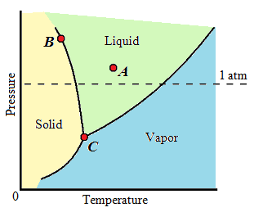
Unary Diagrams
Consider a unary phase diagram in which the lines divide the solid, liquid, and vapor phases. Depending on the temp and pressure, there may be one, two, or even three phases present at any one time.
Point A – Point A in the phase diagram is all liquid, and the number of components C is one and the number of phases P is one. The phase rule gives:
F = C − P + 2 = 1 − 1 + 2 = 2
There are two degrees of freedom. This implies that within limits, the pressure and temp can be changed
independently or together, and point A will still be in an all-liquid portion of the diagram.
Point B – Point B is at the boundary between the solid and liquid portions of the diagram. The number of components C is still one, but at point B the solid and liquid coexist, and the number of phases P is two. From the phase rule,
F = C − P + 2 = 1 − 2 + 2 = 1
There is only one degree of freedom. So, if the temp is changed, the pressure is adjusted automatically in order to remain on the boundary where the liquid and solid coexist. On the other hand, if the pressure is fixed, the phase diagram can indicate the required temp in order for solid and
liquid to coexist.
Point C – At point C, solid, liquid, and vapor coexist. While the number of components is still one, there are three phases. The number of degrees of freedom is then:
F = C − P + 2 = 1 − 3 + 2 = 0
There are zero degrees of freedom; all three phases coexist only if
both the temp and the pressure are fixed. This is the triple point.

Slide 5
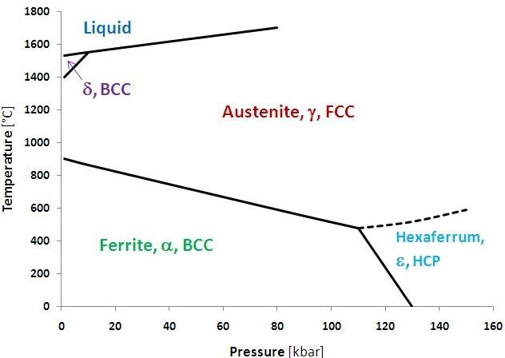
Unary Diagram for pure Iron
Equilibrium diagrams are classified on basis of number of components in the system,
  Single component system – Unary diagrams
  Two component system – Binary diagrams
  Three component system – Ternary diagrams
No composition variable in unary diagrams. Only two variables are temp & pressure.
By applying the phase rule, we see that single phase equilibrium can be observed in an area.
Two phase equilibrium is possible only along phase boundaries.
Three phase equilibrium exists only for a fixed value of pressure and temp. If the P/T is changed, one or two phases will disappear.

Slide 6
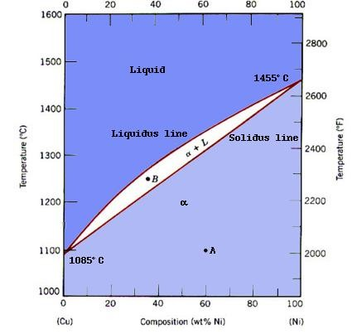
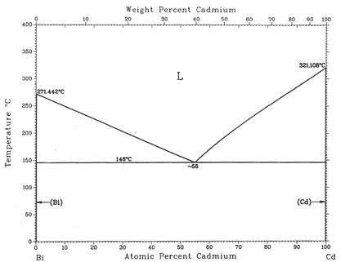
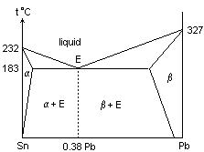
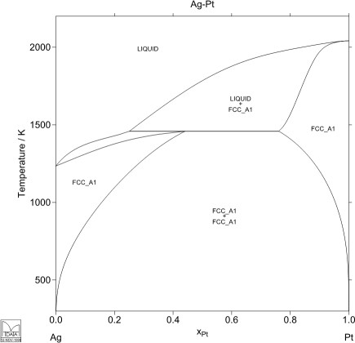
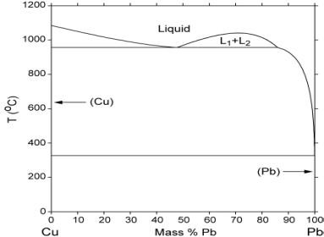
Binary Diagrams (Two Component System)
Composition will become a variable as mixing can be done in any proportion.
Usually pressure is kept constant at 1 atm, because the variation in pressure results in insignificant effect on equilibrium. (Helps to make 2D figure).
As pressure and vapor phases are ignored, phase rule becomes, F = C – P + 1
Thus, phase diagram is a map which shows at a glance the phases which exist in equilibrium for any combination of temp and alloy composition.
Depending on the nature of two elements involved, several type of binary equilibria can occur.
Two components are completely soluble in the liquid state and
  Type I – completely soluble in solid state (Isomorphous System/Solid Solutions
– Cu-Ni)
  Type II – completely insoluble in solid state (Eutectic System – Bi-Cd)
  Type III – partially soluble in solid state (Eutectic System)
  Type IV – illustrate peritectic reaction
  Type V – show syntectic reaction
Two components are partially soluble in the liquid state (Monotectic reaction)
Two components are insoluble in liquid as well as solid state (Think of oil and water)
Diagrams showing solid state transformations
  The eutectoid reaction
  The peritectoid reaction

Slide 7
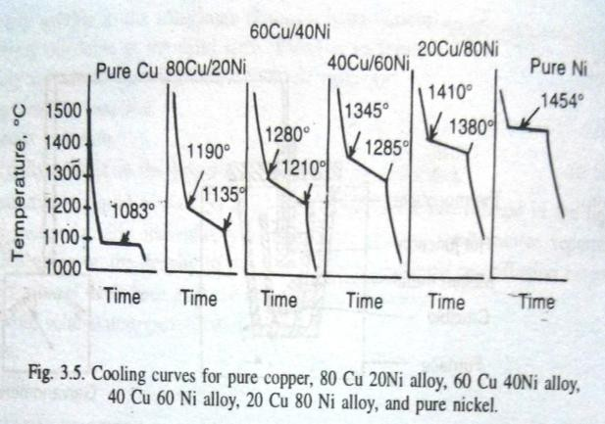
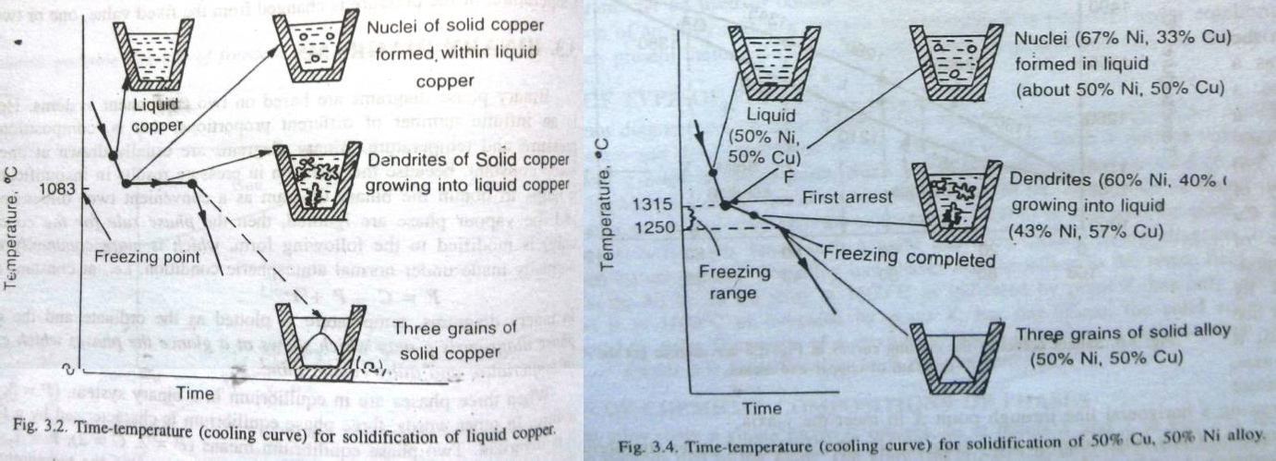
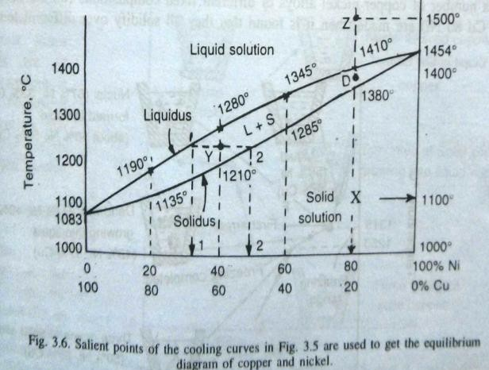
Type – I Solid Solution Systems
When two solids are completely soluble in solid and liquid state.
Called isomorphous system as only one type of crystal structure is obtained by forming substitutional solid solution.
Example – Cu-Ni system. Solidification in Cu Vs 50%Cu-50%Ni alloy
Continuous change in composition of solid and liquid , during equilibrium solidification is possible because diffusion occurs rapidly at high temp.
Different alloy compositions solidify over different range of temps. Appropriate point if taken from series of cooling
curves to plot an equilibrium diagram.
Upper line by connecting points at which freezing starts → liquidus
Lower line by connecting points at which freezing ends → solidus
Area above → liquid solution, area below → solid solution
Between the lines → two-phase region, mixture of liquid and solid solution
Phase rule – Invariant point (freezing point of Cu/Ni): F = 1 – 2 + 1 = 0
Bivariant point (single phase region): F = 2 – 1 + 1 = 2
Univariant point (two-phase region): F = 2 – 2 + 1 = 1 (1 independent, 2 dependent)
Composition of solid, liquid and temp

Slide 8


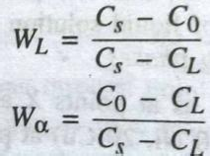
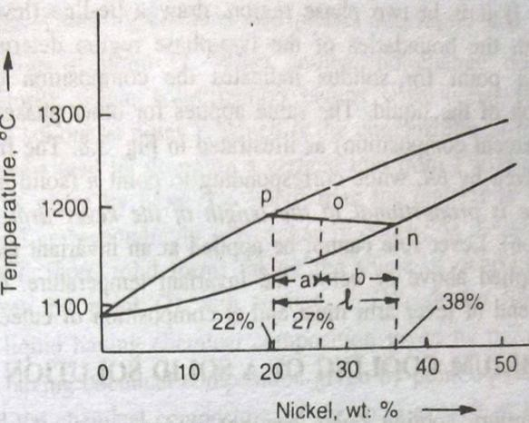

Prediction of Phases (Type, Composition & Amount)
Type is easy to find with temp & composition, locate a point in the diagram.
Composition of a single phase is same as that of alloy. Composition of phases in two-phase region can be found out by drawing a tie-line at specific temp (intersection at solidus and liquidus line give the composition of solid and liquid phase respectively.
Amount of phases is predicted by using Lever Rule.
An alloy with a single phase (point Z), weight of the phase is equal to the weight of the alloy.
Lever rule is used to find the amount of phases in only two-phase regions of binary equilibrium diagrams (based on conservation of mass). [Can be applied for two solid phases under equilibrium as well]
Total weight of metal B in alloy must be equal to its combined weight in liquid and solid phases.
Let W_{α} and W_{L} be the fractional amounts of weight of solid and liquid. By conservation of mass, sum of fractional amounts be equal to unity.
Also, mass of metal B distributed in two phases must be equal to total metal B in overall alloy. ┘
Fractional amount of liquid by weight as,
Fractional amount of solid by weight as,
In a simple way, it can be rewritten as,
  Fraction of solid,
  Fraction of liquid,
Expression for Lever Rule
Lever rule states that the relative amount of a given phase is proportional to the length of the lever arm on the opposite side of the alloy point of the lever.
  Weights of two phases will balance, so we get
  Amount of solid × its lever arm = Amount of liquid × its lever arm.

Slide 9
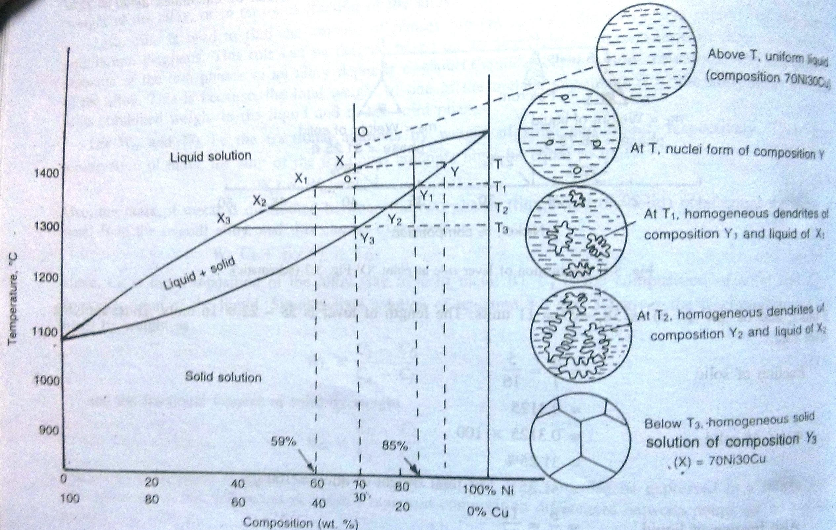
Equilibrium Cooling in a Solid Solution Alloy
Equilibrium cooling/heating means extremely slow rate.

Slide 10
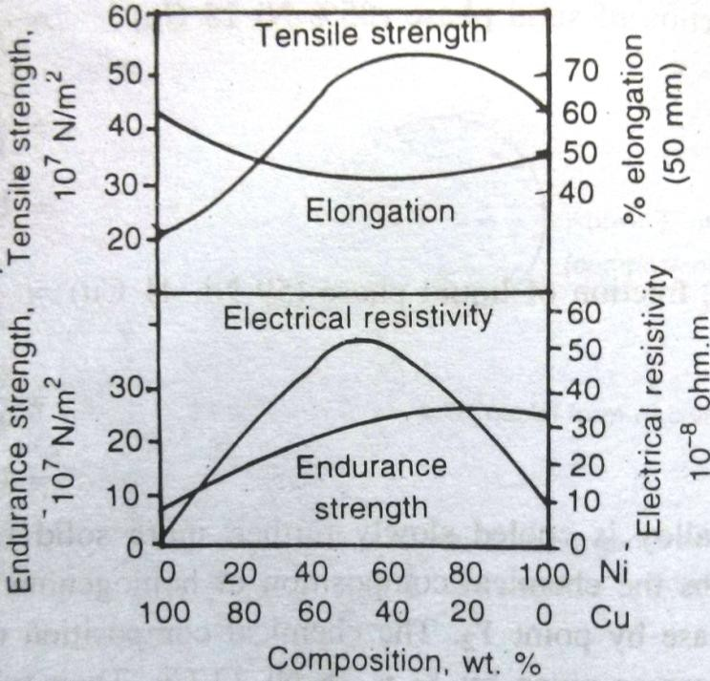
Conclusions from Equilibrium Cooling
Solid solution freezes over a range of temp. As temp decrease, amount of solid increase, amount of liquid decreases.
As tempp drops from T to T₃, composition of liquid varies along liquidus i.e. from X to X₃. Composition of solid varies along solidus i.e. from Y to Y₃.
As temp drops, more and more solid forms, there must be a continuous change of composition taking place in the already formed solid, because the composition of the solid changes from nuclei to dendrite to the extended dendrite. This can occur if diffusion takes place continuously, where Ni moves from centre to outwards and Cu move inwards.
The importance of diffusion of atoms becomes more clear, when the alloy attains temp T₃, when last traces of liquid (38%Ni-62%Cu) solidify at the crystal
boundaries and get immediately absorbed by diffusion so that solid as a whole becomes homogeneous and of composition 70%Ni-30%Cu.
Variation in properties of industrial Cu-Ni alloys as the chemical compositions of the solid solution changes from
100% Cu to 100% Ni.
Properties such as tensile strength, hardness, yield strength, electrical resistivity show a maximum, while ductility shows a minimum.

Slide 11
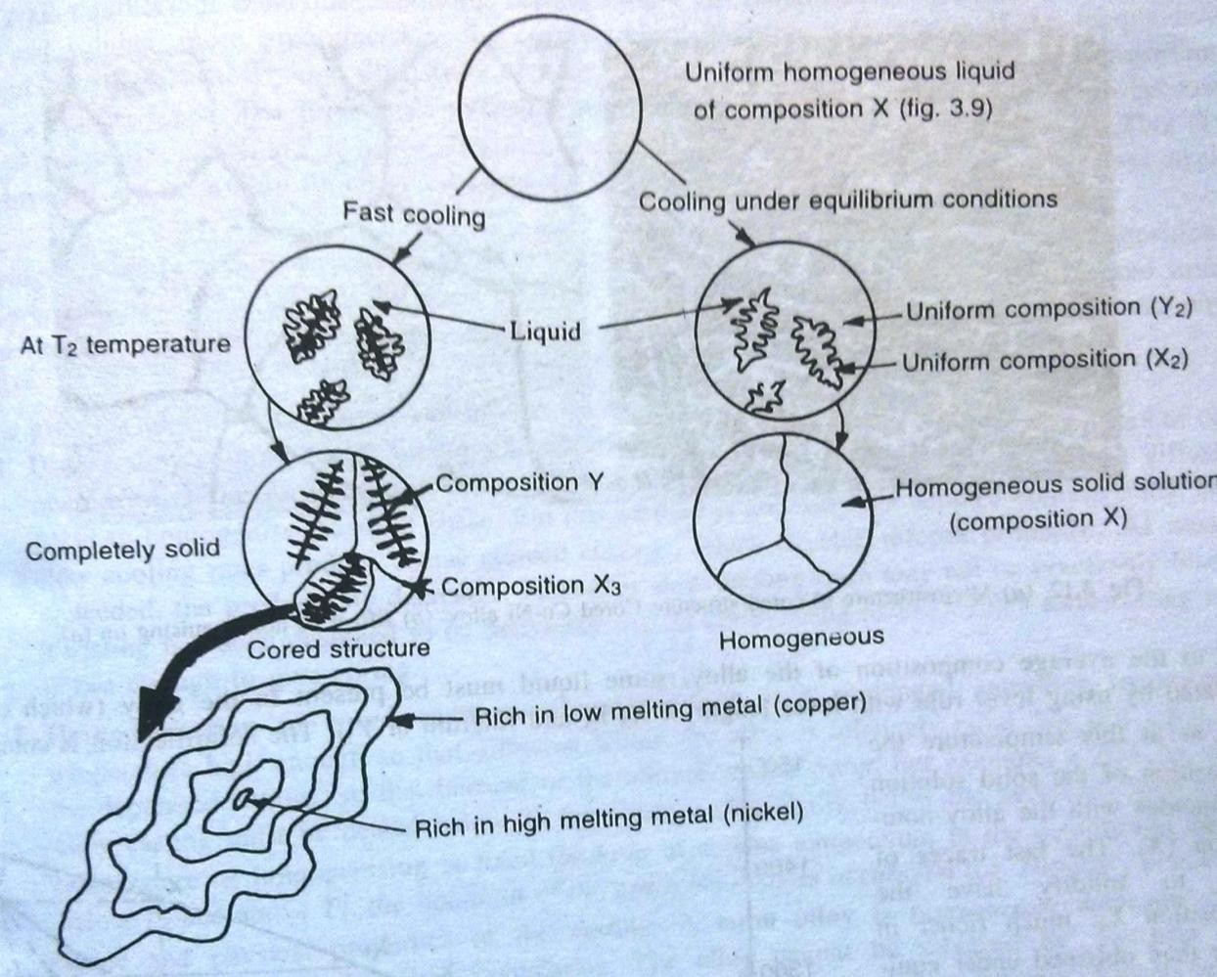
Coring in Solid Solutions
Under actual industrial conditions, rate of solidification is way faster than rate of diffusion, so system does not attain uniformity and equilibrium.
This variation of more Cu than equilibrium content from the core of the dendrite to the interdendritic space is called dendritic-segregation, which on a microscopic scale is called coring.
Problem can be solved by,
Use of slow cooling rates i.e. close to equilibrium cooling rates (Not favored generally because coarse grained castings are inferior in properties).
Homogenization of cored castings
i.e. prolonged annealing treatment at high temp so that diffusion within alloy takes place. Temp is chosen carefully to avoid “burning”, which occurs near solidus temp when grain boundaries melt locally and oxidation takes place. Burnt alloy is permanently damaged and can not be salvaged by any heat/mechanical treatment.

Slide 12
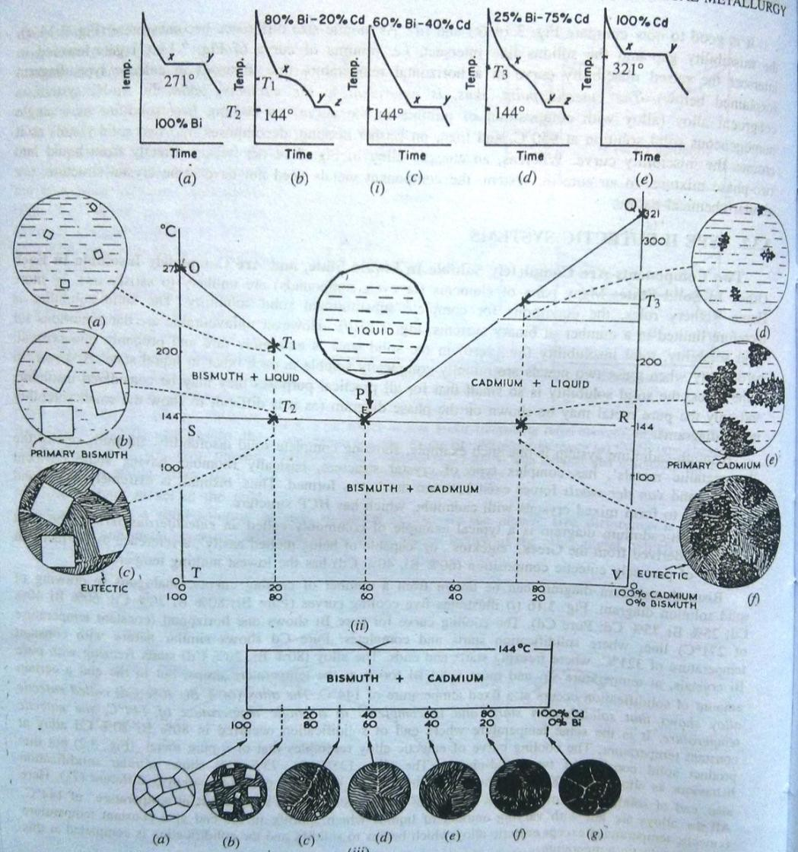
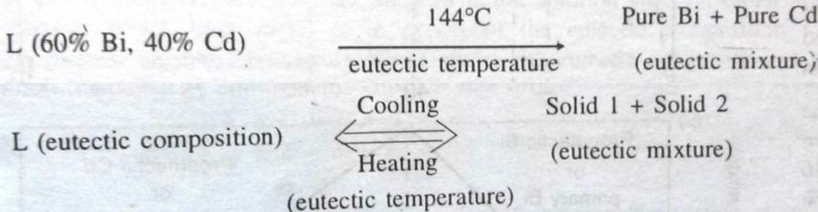
Type – II Eutectic Systems
Two components are completely soluble in liquid state and are completely insoluble in solid state.
Practically insolubility in solid state is non-existent, particularly when they are soluble in liquid state. However, in some cases, solubility in solid state is so low that it can be considered as insoluble.
Eutectic is derived from Greek word “Eutektos” meaning „capable of melted easily‟.
The alloy (60%Bi-40%Cd) called eutectic alloy shows that solidification takes place at a single temp of 144°C, eutectic temp.
Cooling curve of eutectic alloy resembles that of a pure metal, but product contains two solid-phases.
OPQ – liquidus line, P – eutectic point, OSPRQ –
solidus line.
Alloy to the left of P – hypoeutectic alloys, alloy to the right of P – hypereutectic alloys.
The change of a liquid solution of eutectic composition on cooling into two different solids at a constant eutectic temp, is called the eutectic reaction.

Slide 13
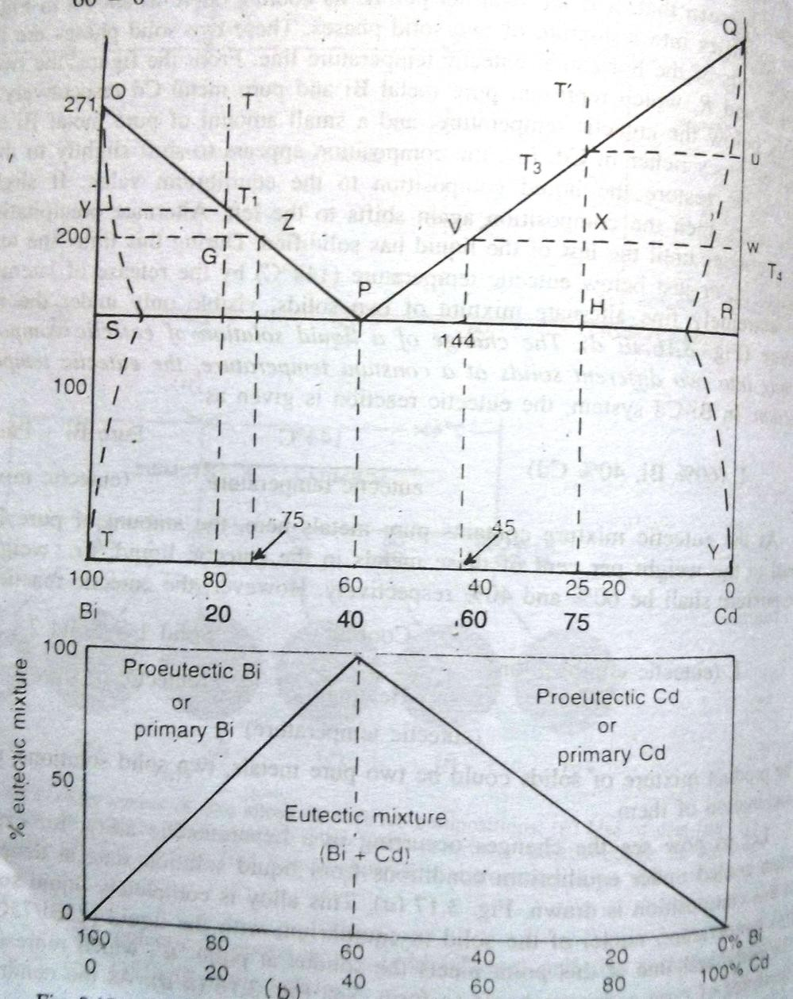
Application of Lever & Phase Rule to Eutectic Mixture
Lever rule to find weight% at several points in the diagram.
Phase rule at eutectic point,
  F = C – P + 1 = 2 – 3 + 1 = 0
  It is an invariant point.
In two phase region,
  F = C – P + 1 = 2 – 2 + 1 = 1
  One independent variable

Slide 14
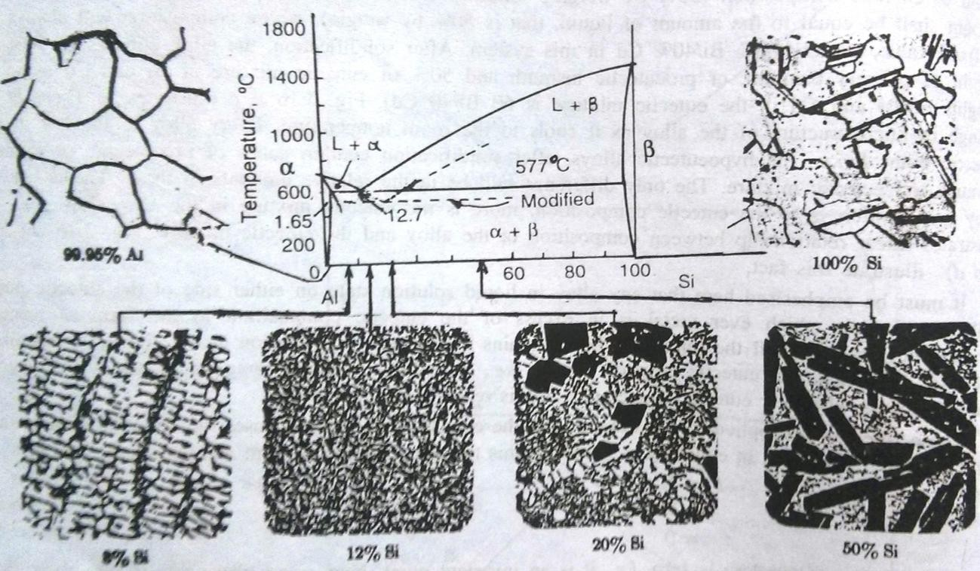
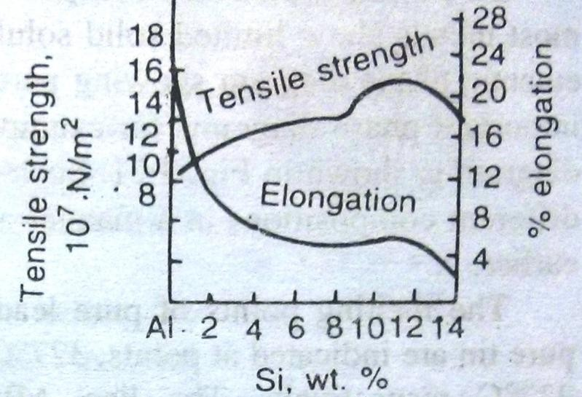
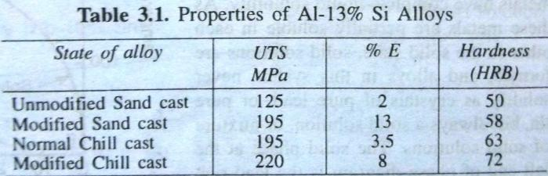
Al-Si Eutectic Diagram
Important casting alloy because of high fluidity due to large volumes of eutectic.
Max solid solubility of Si in Al – 1.65%, Eutectic composition – 12.7% Si.
At 99.95%Al: equiaxed grains of pure Al
Al–8%Si: dendrites of proeutectic Al in the eutectic mixture.
Al–12%Si: eutectic mixture with Si appearing as needle like fine structure in a continuous Al matrix.
Al–20%Si & Al–50%Si: within the eutectic mixture, proeutectic Si almost appears in geometric shapes because Si is non-metallic properties with diamond cubic structure.
Finer eutectic mixture → improvement in both ductility and tensile strength (Chilled casting).
Modifier added to reduce eutectic temp to produce finer eutectic mixture

Slide 15
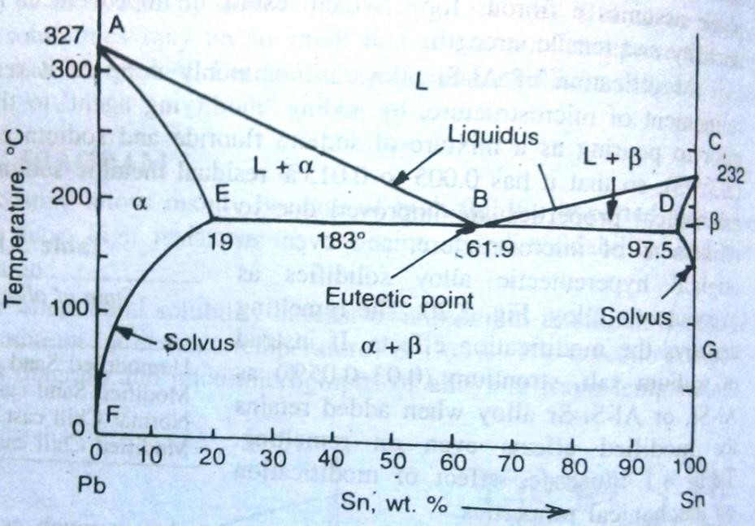
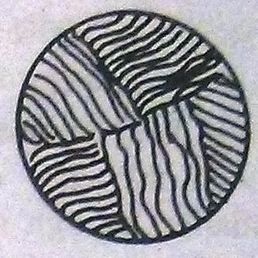
Type- III Eutectic System
Two components are completely soluble in liquid and partially soluble in solid state.
Most common type of phase diagrams, Pb-Sn, Cu-Ag, Pb-Sb, Cd-Zn, Sn-Bi etc.
ABC – liquidus line, CDBEA – solidus line
Complete liquid solubility so liquid all above liquidus, partial solubil;ity leads to solid solutions, so
never a formation of Pb/Sn pure crystals.
α – solid solution of Sn in Pb (Pb-rich), β – solid solution of Pb in Sn (Sn-rich).
As these solid solutions exist near the axes, al;so called terminal solid solutions/primary solid solutions.
The maximum solubility of the solute decreases in the primary metal as temp decreases (along lines
EF & DG), these are called solvus lines. (indicates the max solid solubility as a function of temp)
L → α + β
(61.9%Sn, 38.1%Pb) (19%Sn, 81%Pb) (97.5%Sn, 2.5%Pb)
183°C Eutectic mixture
Fine mixture of α and β is called eutectic mixture.
Eutectic mixture of two pure metals and solid solutions looks similar.

Slide 16
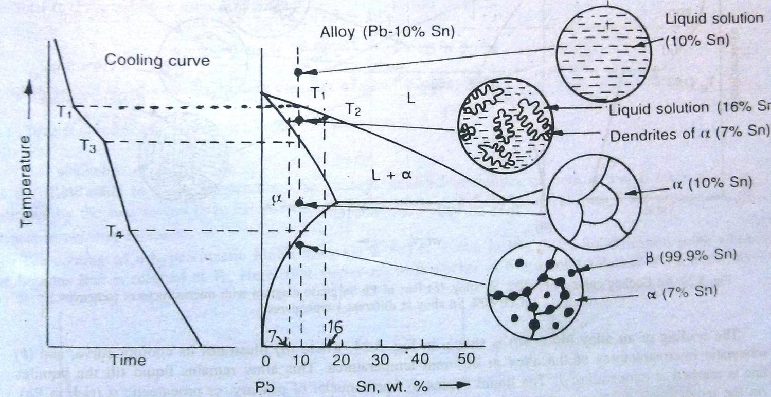
Cooling of a Hypoeutectic Alloy (Sn < 61.9%)
Above T1, alloy is in liquid solution
At T1, nuclei of α (rich in Pb) begin to freeze.
As temp decreases, more α freezes as dendrites.
At T2, we can calculate amounts of two phases with their compositions by applying the Lever rule.
At T3, the alloy has 100% α (10%Sn-90%Pb)
At T4, α is saturated with Sn. As temp decreases, α starts rejecting Sn as solid solution β.
More and more β gets rejected out of α, mainly at high energy areas such as, grain boundaries. Some of it precipitates inside the grains of α as inclusions, or defects.

Slide 17
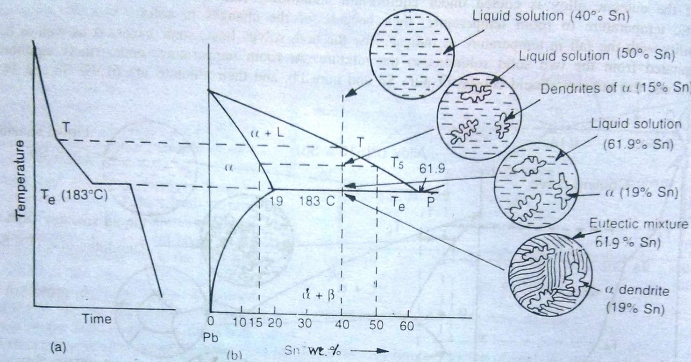
Cooling of an Alloy (40% Sn)
Above T, alloy is in liquid solution
At T, nuclei of primary or proeutectic α (rich in Pb) begin to freeze.
As temp decreases, more α solidifies as dendrites.
At T5, we can calculate amounts of two phases with their compositions by applying the Lever rule.
As temp decreases, more α solidifies & composition of liquid gets richer in Sn following the liquidus line, until the
composition of L reaches eutectic composition P.
As liquid is at eutectic point, liquid solidifies to give fine & intimate mixture of α & β.
As alloy cools to room temp, solid solubilities decreases following solvus lines, some excess α & β precipitate out. But amounts are small so can be ignored.

Slide 18
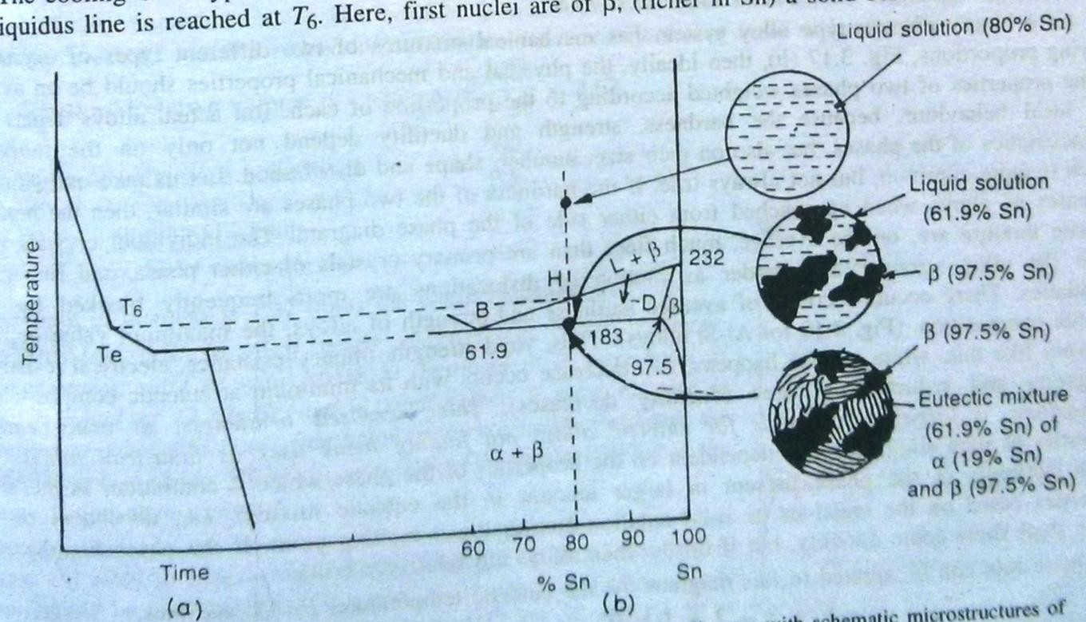
Cooling of a Hypereutectic Alloy (80% Sn)
At T6, first nuclei of primary or proeutectic β (rich in Sn) begin to freeze.
As temp decreases, more β solidifies as dendrites.
At any temp, we can calculate amounts of two phases with their compositions by applying Lever rule.
As temp decreases, more β solidifies & composition of liquid gets richer in Pb following the liquidus line, until the composition of L reaches eutectic composition B.
As liquid is at eutectic point, liquid solidifies to give fine & intimate mixture of α & β.
As alloy cools to room temp, solid solubilities decreases following solvus lines, some excess α & β precipitate out. But amounts are small so can be ignored.

Slide 19
Properties of Eutectic-type Alloys
Ideally, mechanical mixture of two different types of crystals in varying proportion should produce average of the mechanical and physical properties.
But actual alloys depart from this ideal behavior. Because the properties also depend on size, shape and distribution of the phases.
Individual crystals in a eutectic mixture are, usually finer in size, and finer grains make the alloy stronger and harder as motion of dislocations is frequently blocked by the grain boundaries.
Hardness and strength at the eutectic composition is maximum and hence, yield strength, impact resistance, electrical resistance etc increases. Whereas elongation, ductility decreases.
Increases brittleness results in less industrial applications for eutectic alloys.

Slide 20
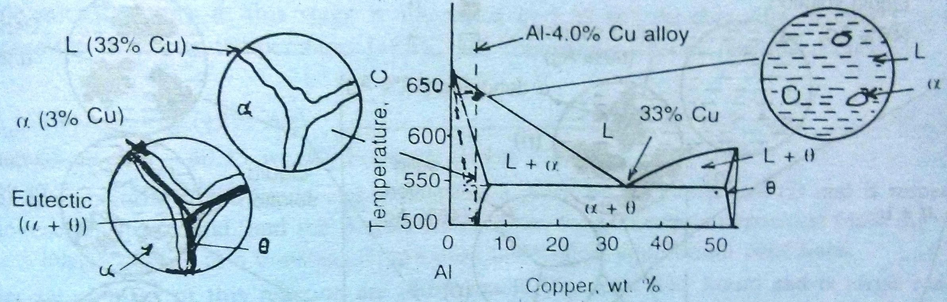
Non-Equilibrium Cooling in Eutectic Systems
Causes two main effects,
Coring – Because of rapid cooling, no time for diffusion to occur which leads to coring. E.g. – Al – 4%Cu shows coring with core having 0.5%Cu whereas surface shows 5.5%Cu content.
Formation of eutectic as a result of coring – Al – 4%Cu on equilibrium cooling should show single phase α. But rapid cooling shifts the solidus line to the left and hence we have around 5 to 10% liquid at eutectic temp and composition which transforms to eutectic mixture below eutectic temp.
The eutectic mixture is along the grain boundaries and presence of a brittle phase Ө, makes the alloy brittle and also increases the corrosion of the alloy.
To avoid this, homogenization annealing is done at 540°C to remove coring.

Slide 21
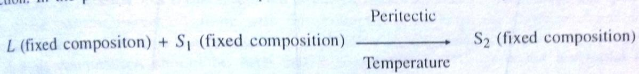
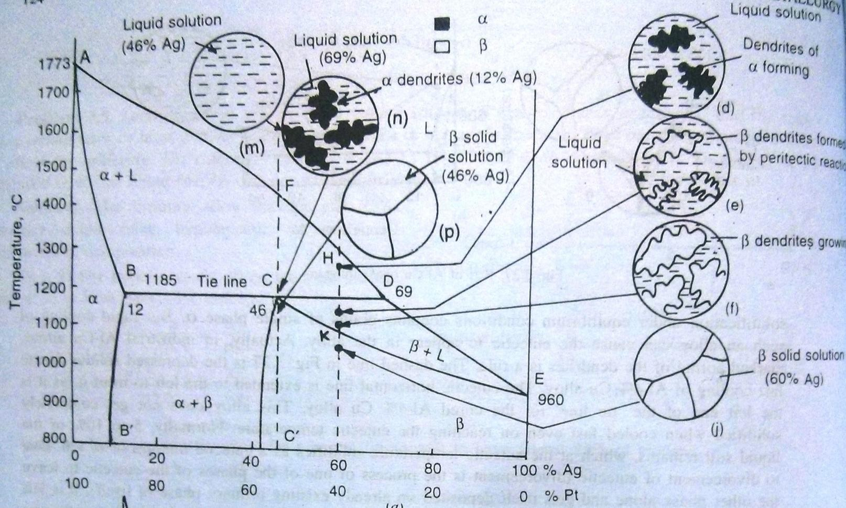
Type IV System with Peritectic Reaction
Peritectic reaction occurs when two metals are completely soluble in liquid phase, partially soluble in solid phase and their melting points are vastly different from each other.
Liquid phase reacts with a solid phase to form a new and different solid phase.
E.g. – Fe-C, Cu-Zn, Pt-Ag etc
Solidus – ADE, Liquidus - ABCE

Slide 22
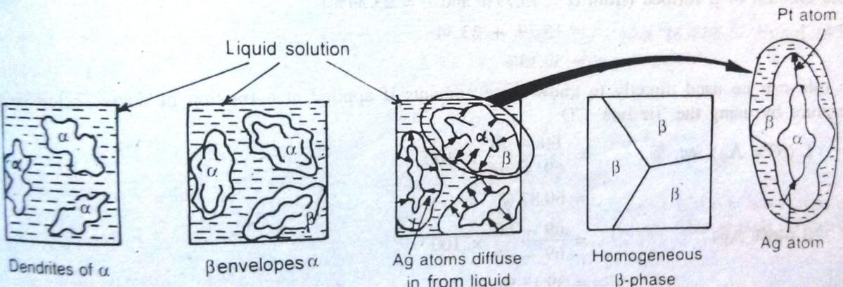
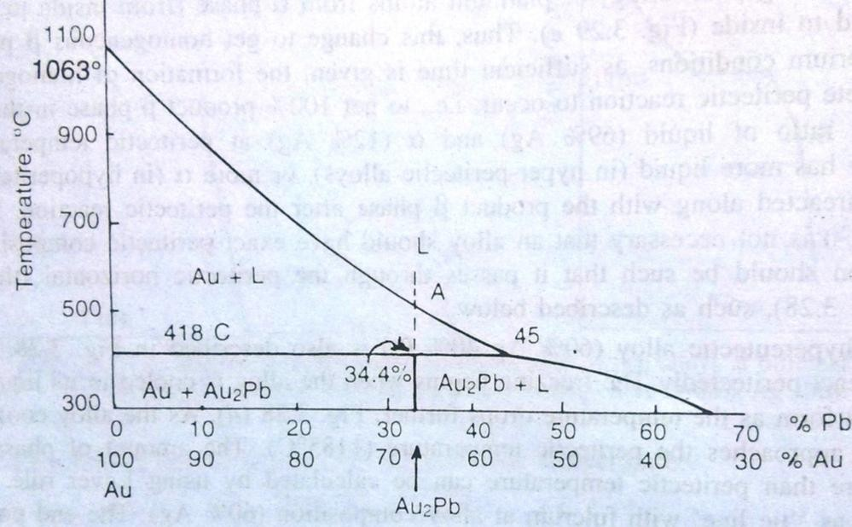
Cooling of a Peritectic-alloy
The liquid and α phase react to produce β phase. Β phase forms at the surface of α-dendrites by enveloping it.
Growth of β-phase happens by diffusion of Pt atoms from α to β and of Ag from liquid to α.
This change to get homogeneous β phase takes a long time.
Usually peritectic reaction leads to formation of intermetallic compound of fixed composition.

Slide 23
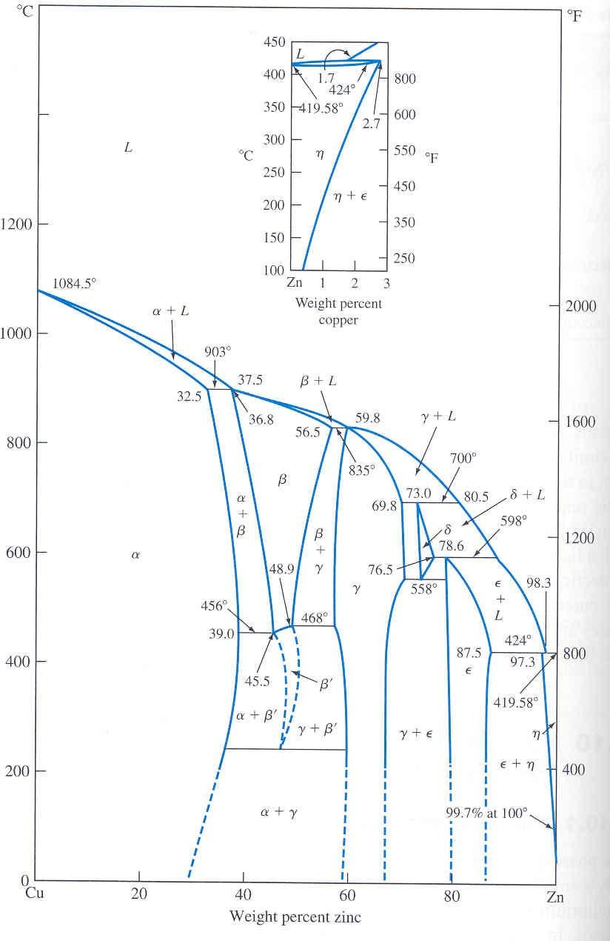
Intermediate Phases and Compounds
Terminal phases: Phases occur at the end of phase diagrams.
Intermediate phases: Phases occur in a composition range inside phase diagram.
  Examples: Cu-Zn diagram has both terminal and intermediate phases.
  Five invariant peritectic points and one eutectic point.
  Chemical composition of these phases are intermediate between the two pure metal, but crystal structure are different from pure metal, which distinguishes them from primary solid solutions.
  If the phase has a fixed composition, then it is also called intermetallic compound.

Slide 24
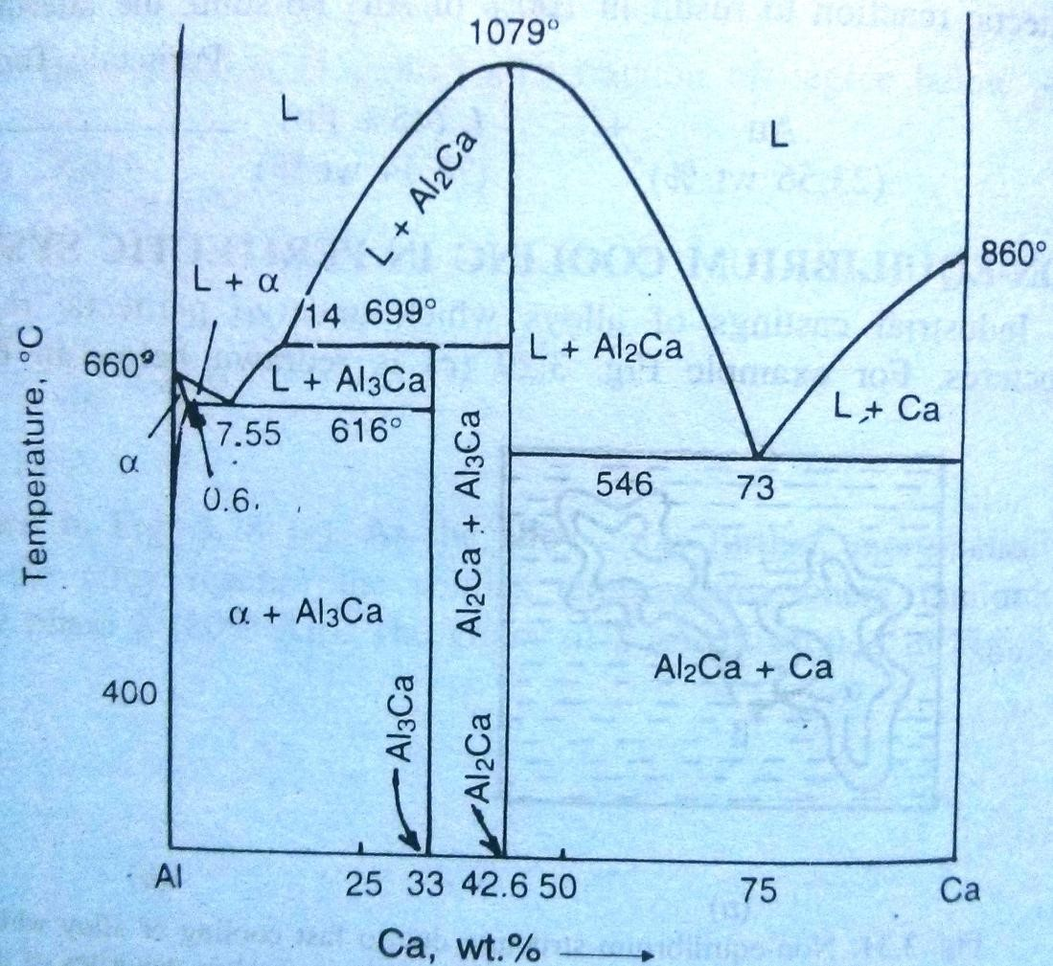
Types of Intermediate Phases
Two types:
  Incongruently melting intermediate phases
    Such a phase on heating, changes into two different phases, normally a solid and liquid. Phase Al₃Ca is an example for the same.
Congruently melting
intermediate phases
  Such a phase on heating, melts just like a pure metal (i.e. at a constant temp to produce liquid).
  Such phase divides phase diagram into two sections.
  Phase Al₂Ca is an example for the same.

Slide 25
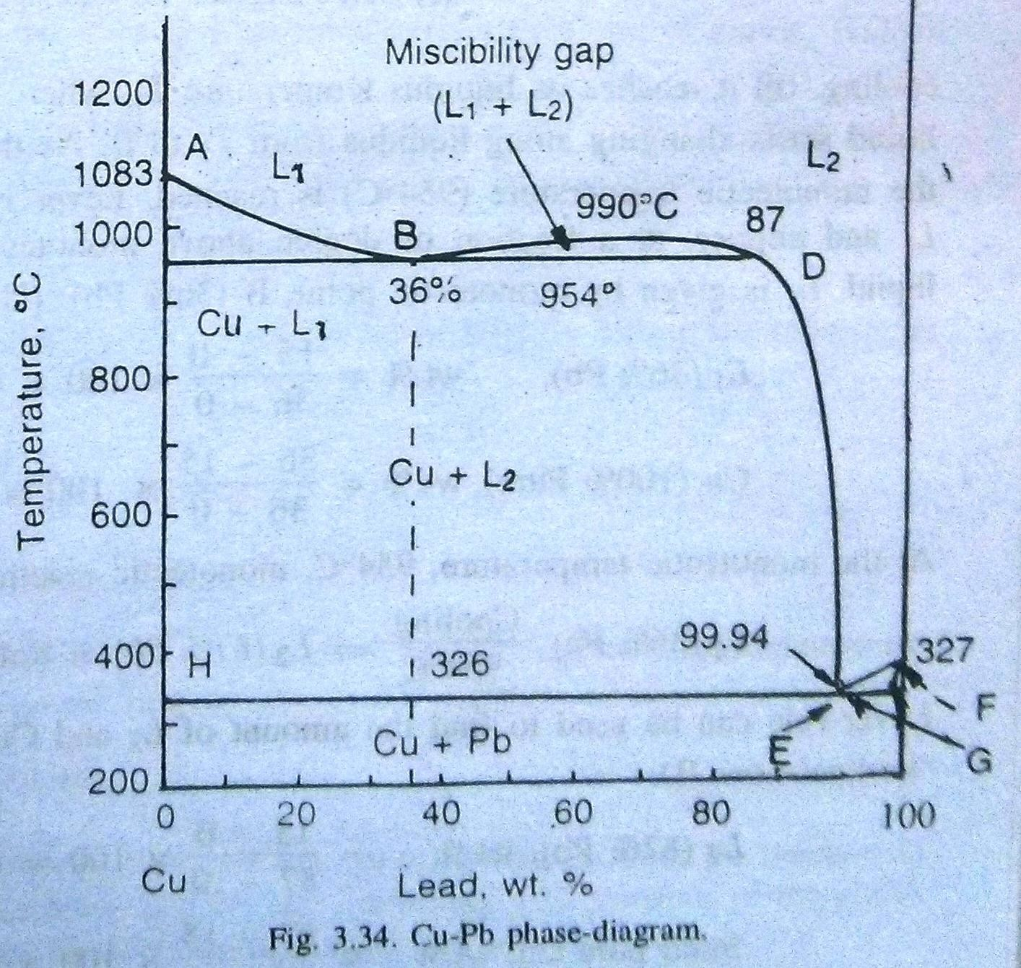
Type V – Monotectic Reaction
Two components are partially soluble in liquid state. Some liquid solutions are insoluble over a certain composition range.
Liquid phase transforms into solid phase and another liquid. L₁ → α + L₂
E.g. – Cu-Pb system, between 36% and 87%Pb, two liquids are present which are immiscible in each other showing the miscibility gap.
Liquidus – ABCDEF, solidus
– AHEGF
Point B is a monotectic point.
These are always associated with miscibility
gap.

Slide 26
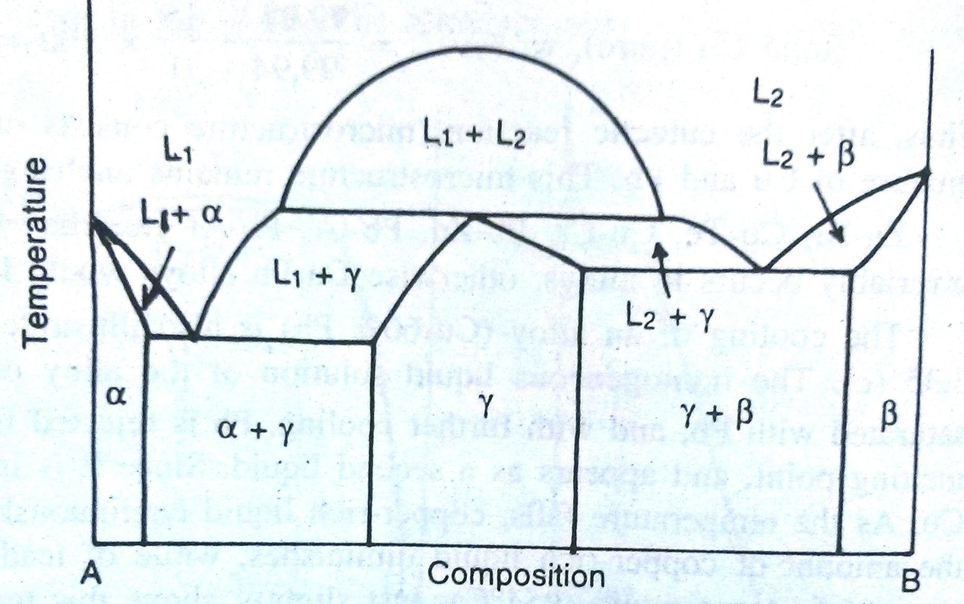
Syntectic Reaction
In some rare systems, liquid of fixed composition reacts with another liquid of fixed composition to result in a solid. L₁ + L₂ → α
E.g. – Na-Zn is a rare syntectic system, but no useful alloys exist in this.

Slide 27
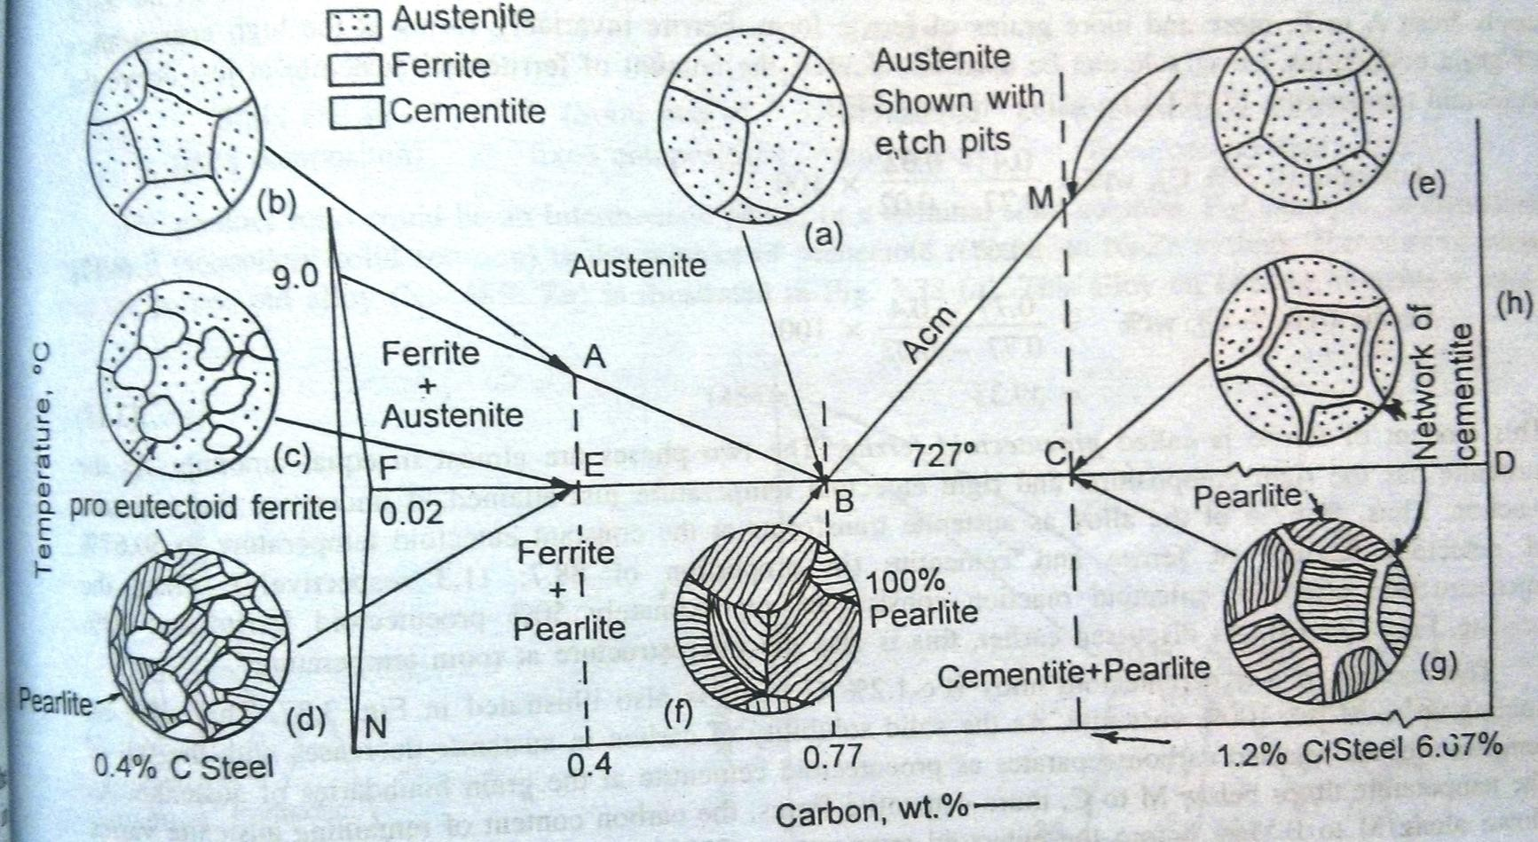
Solid State Transformations – Eutectoid Reaction
Eutectoid Reaction: A three-phase reaction by which, on cooling, a solid transforms into two other solid phases at the same time. Solid-phase 1 → Solid-phase 2 + Solid-phase 3
Origin solid decomposes into two new solid phase. Need diffusion of solute atoms.
Similar as Eutectic Structure, but involves solids on a finer scale.
E.g. – Ag-Cd, Ag-Ga, Al-Mn, Be-Cu, Cu-Zn, Cu-Sn, Su-Si, Su-Sb, Fe-C etc.
„oid‟ represents that parent phase was a solid solution and not a liquid one.

Slide 28
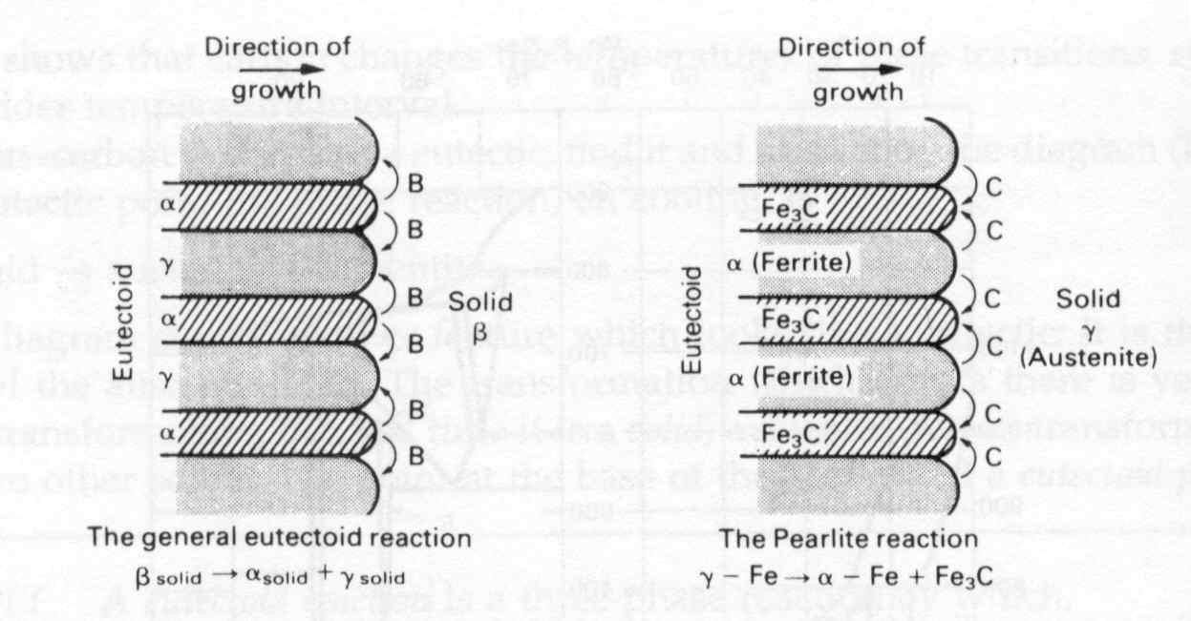
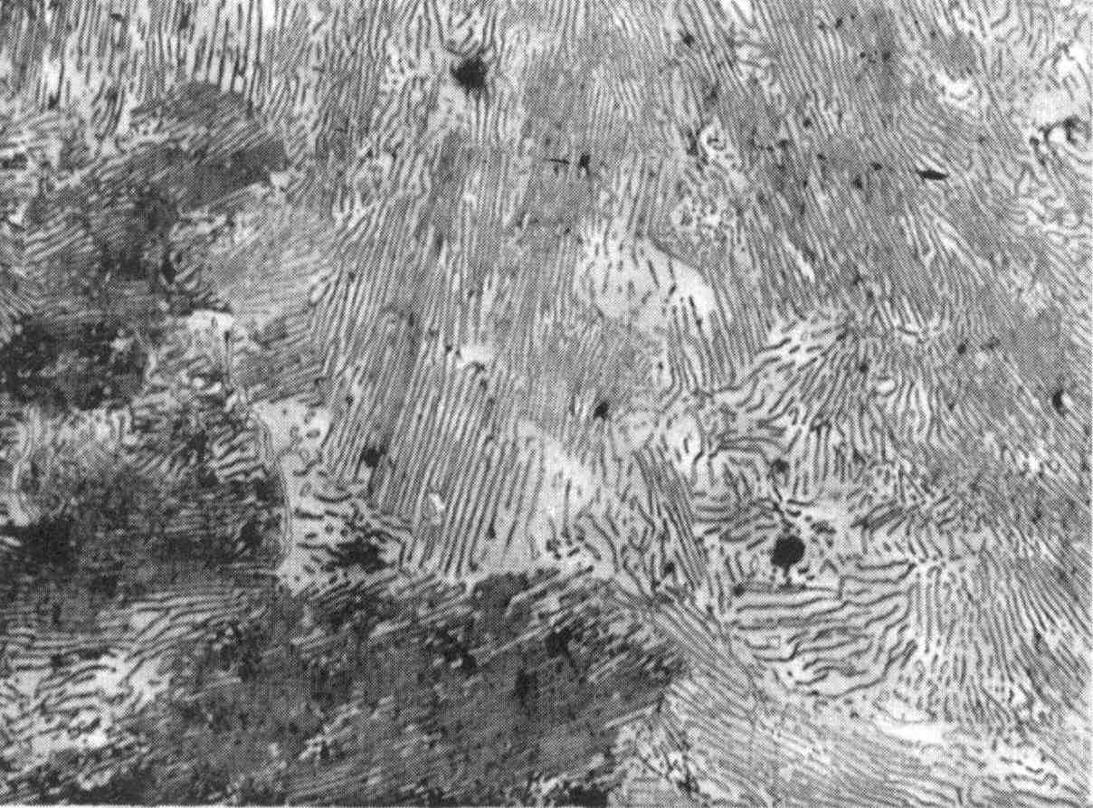
Eutectoid Reaction
Eutectoid composition – 0.77%C
Eutectoid temp – 727°C
Austenite → Ferrite
+ Cementite
γ (0.77%C) →
α (0.02%C) + Fe₃C (6.67%C)
Pearlite in a plain-carbon steel,
0.05mm

Slide 29
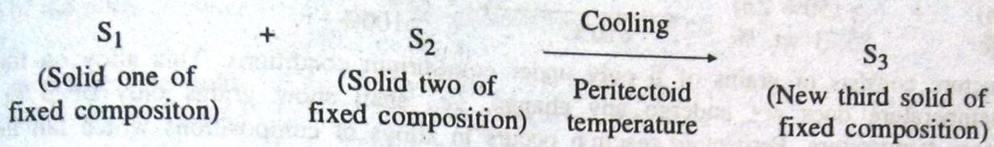
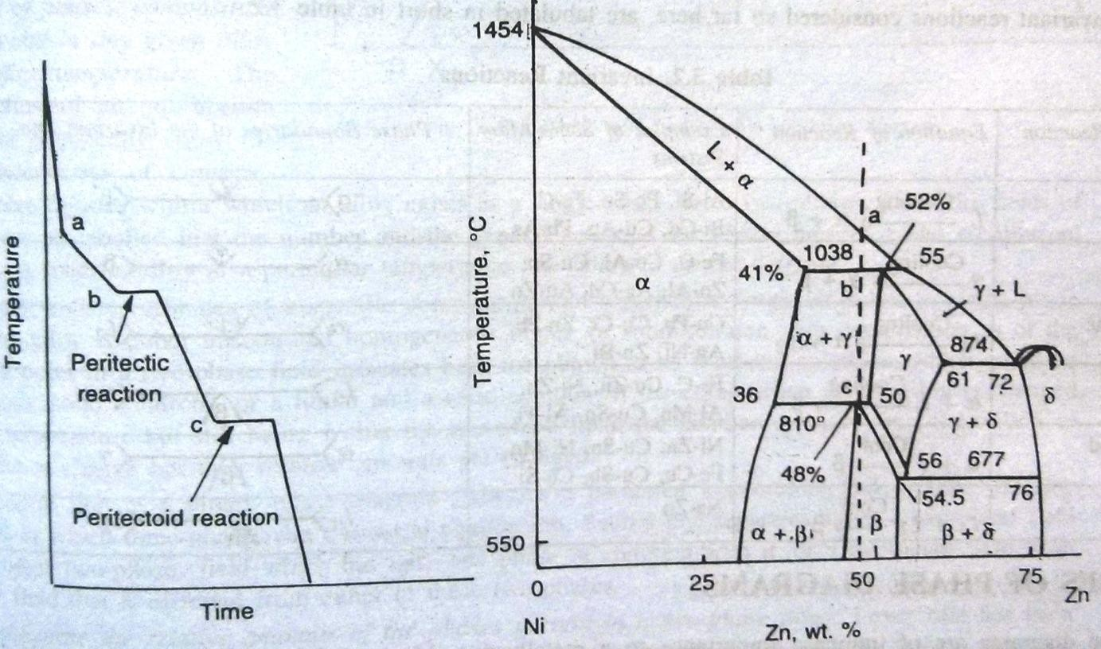
Peritectoid Reaction
This is relatively uncommon reaction, can be seen in Ni-Zn, Fe-Cb, Cu-Sb, Cu-Sn, Ni-Mo, Ni-Si, Fe- Au systems.
It is similar to peritectic reaction but only for solid solutions.
Microstructure consists of only β grains under equilibrium conditions.

Slide 30
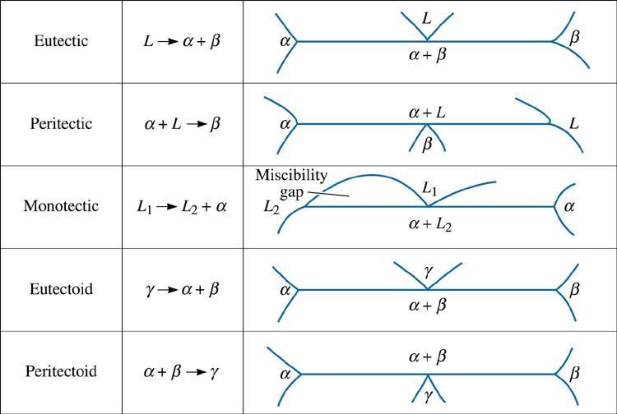
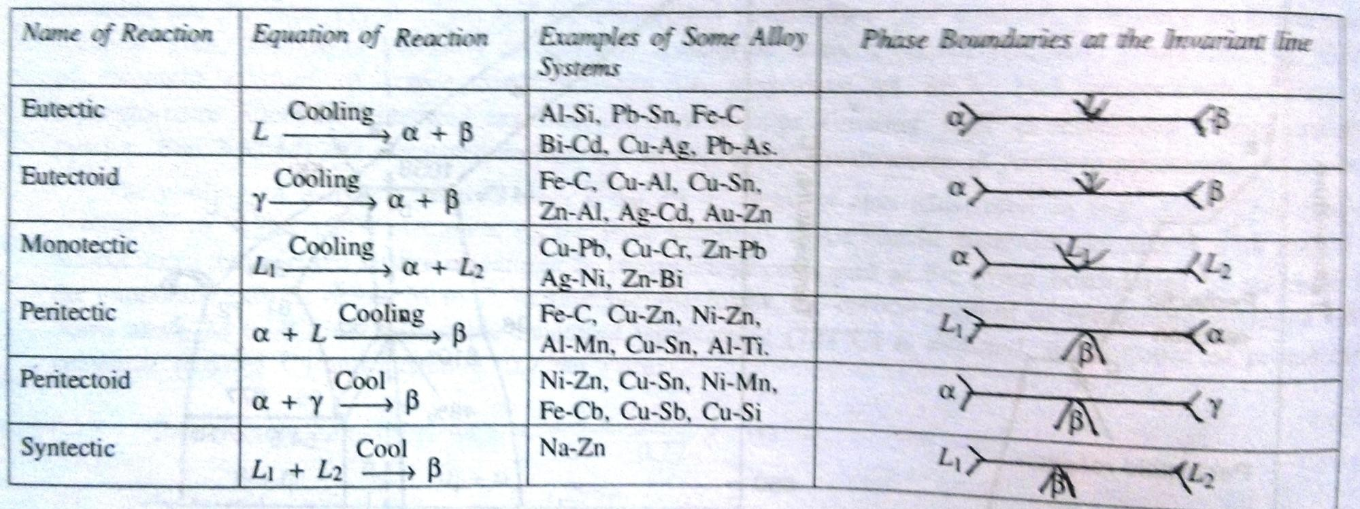
Invariant Reactions

Slide 31
Uses of Phase Diagrams
To predict temp at which freezing/melting begins, or ends for a specific alloy.
To predict safe temp for working, or heat treatment. (Temp of hot working/heat treatment is kept around 30°C lower than solidus line. Higher than that leads to partial melting, called burning of an alloy)
To determine the number, types, composition of phases present in an alloy at a specific temp.
To calculate the relative amounts of phases present in a two-phase alloy
To predict the microstructure of an alloy at any given temp
To predict possible heat treatment which can be given.
To choose the composition to develop best properties.

Slide 32
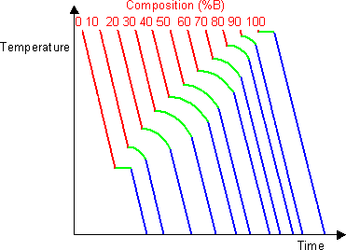
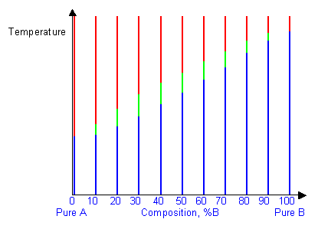
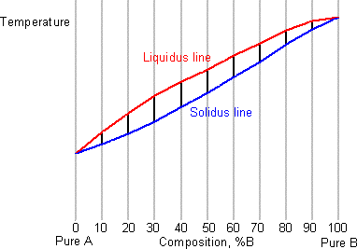
Determination of Phase Diagrams
No phase diagram is considered reliable until similar finding is observed through at least two independent methods and it doesn‟t violate the phase rule.
By taking a series of cooling curves for the same system over a range of compositions the liquidus and solidus temperatures for each composition can be determined allowing the solidus and liquidus to be mapped to determine the phase diagram.
Thermal Analysis
Dilatometry
Metallographic Methods
X-ray Diffraction Methods
Electrical-resistivity Methods

Slide 33
Limitations of Equilibrium Diagrams
Phase diagrams can only show equilibrium state of alloys. Alloys under industrial practices are hardly cooled under equilibrium conditions.
Phase diagrams only give us the information about the constitution of the alloy,
i.e. number of phases present, but not the structural information, i.e. size, shape and distribution of the phases, which affects the mechanical properties of the alloy.
  E.g. – If β phase, in a mixture of α & β, is in small amounts and is distributed inside the α grains, then mechanical properties shall be governed by α phase. But if the β phase is present along the grain boundaries of α, then the strength and ductility of the alloy will be dictated by β-phase.
Phase diagrams do not indicate if high temp phase can be retained at room temp by fast quenching.
Phase diagrams do not indicate whether a particular transformation can be suppressed, and what should be the cooling rate in order to avoid the transformation.
They do not indicate the rate at which the equilibrium shall be attained.

Slide 34
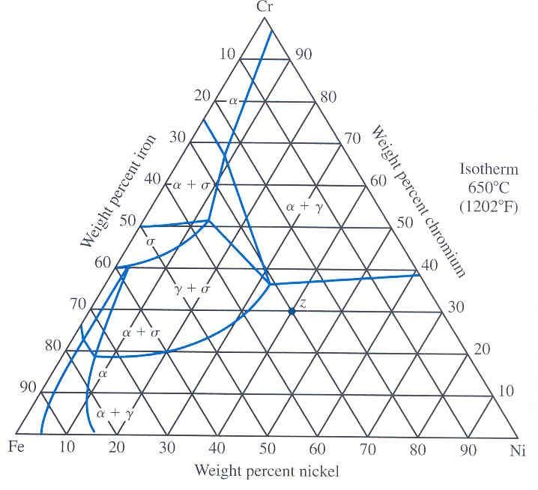
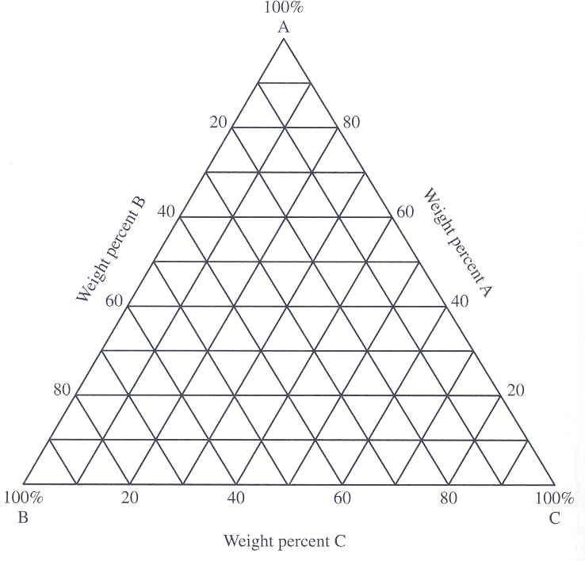
Ternary Phase Diagrams
Three components
Constructed by using a equilateral triangle as base.
Pure components at each end of triangle.
Binary alloy composition represented on edges.
Temperature can be represented as uniform throughout the Whole Diagram i.e. Isothermal section.
Example:- Iron-Chromium-Nickel phase diagrams.
Isothermal reaction at 650⁰C for this system
Composition of any metal at any point on the phase diagram can be found by drawing perpendicular from pure metal corner to opposite side & calculating the % length of line at that point

Slide 35
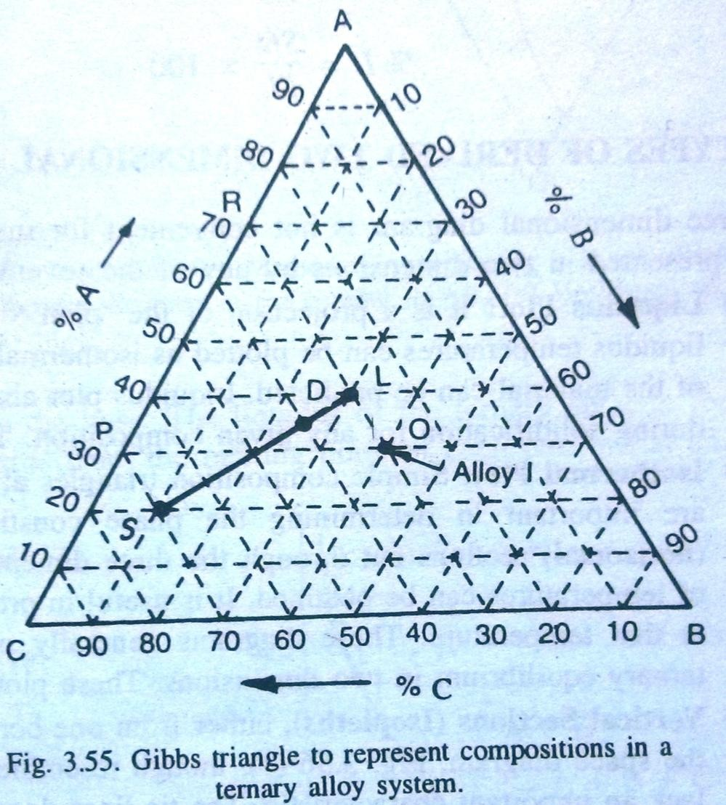
Ternary Diagrams
Vertex of the triangle represents one pure component A, B or C.
Points of binary alloys lie on the sides of the triangle.
A point inside the triangle represents a ternary alloy.
Alloys represented by the points of a line parallel to one of the sides of the triangle have a constant composition of the component present at the opposite corner of the triangle.
What will be the composition of alloy, I?
  30%A, 40%B, 30%C.
Point S:
  20%A, 10%B, 70%C
Point L:
  40%A, 30%B, 30%C
Point D:
  35%A, 25%B, 40%C

Slide 36
Important things to Remember..
Liquidus : The line (or lines) on a phase diagram above which only liquid is present. Technically it is "the locus of temperatures above which only liquid is stable".
Solidus : The line (or lines) on a phase diagram below which only solid is present.
Technically it is "the locus of temperatures below which only solid is stable".
Solvus - The line separating the field of a solid from another solid.
Eutectic point - the point on a phase diagram where the maximum number of allowable phases are in equilibrium. When this point is reached, the temperature must remain constant until one of the phases disappears. A eutectic is an invariant point.
Eutectic Reaction: A three-phase reaction, by which, on cooling, a liquid transforms into two solid phases at the same time. L → α + β
Eutectoid Reaction: A three-phase reaction by which, on cooling, a solid transforms into two other solid phases at the same time.

Slide 37
Fe-Cementite diagram
Eutectic
L → γ + Fe₃C
Peritectic
L + δ → γ
L
1493ºC
δ
L + γ
γ
2.06
1147ºC
Eutectoid
γ → α + Fe₃C
γ + Fe₃C
723ºC
α
T →
Fe
4.3
%C →
Fe₃C
0.16 0.8
6.7

