Slide 1
Introduction, solid Solution, Types of solid solution, Hume-Rothery Rules for Primary Substitutional Solid Solubility, Types of Interstitial Voids, Chemical compounds versus solid solution, Intermediate Phases, Polycrystalline Materials, Grain Size, Measurement of Grain Size, Multiple –Phase Alloys. Intermetallic compounds.
Solidification of Metals & Alloys:
Structure of Liquid Metals, Energetic of Solidification, Nucleation and growth phenomena, Homogenous & Heterogeneous Nucleation, Growth of Solid, Smooth or Stable interface growth, Temperature Inversion in pure Metals, Segregation, Porosity. Numericals.

Slide 2
Reference Books
Sidney H. Avner, “Introduction to Physical Metallurgy”, 2nd Edition, Tata Mcgraw-Hill Edition (Chapter-5)
R.E. Reed-Hill and R. Abbaschian, “Physical Metallurgy Principles”, 3rd
Edition, PWS Kent Publishing Company
M. F. Ashby and D. R. Jones, “Engineering Materials 2”, Butterworth- Heinemann Publishers
William D. Callister, Jr. and David G. Rethwisch, “Materials Science and Engineering : An Introduction”, 8th Edition, John Wiley & Sons, Inc.

Slide 3
Why are most of the materials that are useful in engineering are crystalline to a very good approximation?
The preferred structures of solids at low temperature are those that minimize the energy.
The low-energy atomic configurations are almost invariably crystalline since the regular pattern of the crystal lattice repeats whatever local configuration is most favorable for bonding.
Why the crystal is imperfect?
While a perfect crystalline structure may be preferred energetically, at least in the limit of low temperature, atoms are relatively immobile in solids
So kinetics point of view, difficult to avoid imperfections into the crystal during its growth, processing or use.

Slide 4
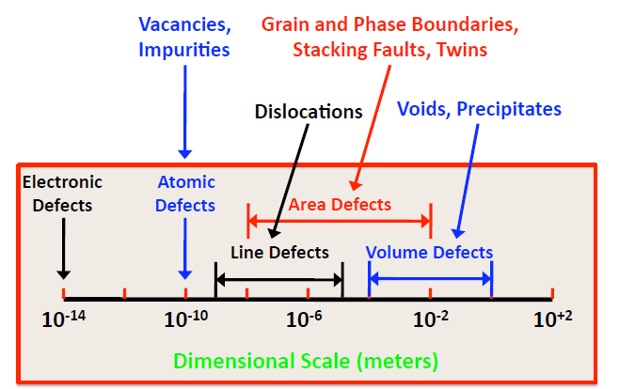
Types of Defects
Defects
Point Defects
Vacancy
Self Interstitial
Frenkel Schottky Impurities Excitons
Line Defects Edge Dislocation Screw Dislocation
Surface Defects External Surface Grain Boundaries Stacking Faults
Volume Defects Porosity Precipitates Foreign Inclusions

Slide 5
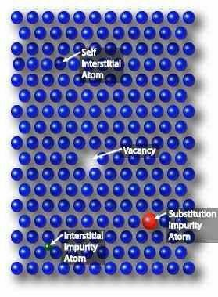
Point Defects
Localized disruptions in the lattice involving one or more atoms.
All real materials have point defects. More can be
added intentionally.
Affect material properties because they affect slip – they make it hard for dislocations to move .
Classes of point defects:
  Intrinsic defects
    Vacancy
    Self Interstitial
  Extrinsic defects
    Substitutional
    Interstitial
  In Ordered Compound crystals
    Frenkel
    Schottky

Slide 6
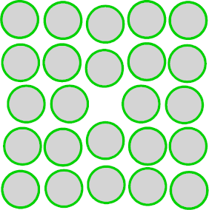
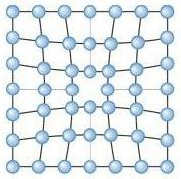
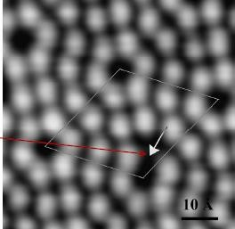
Intrinsic Defects : Vacancies
Scanning Tunnelling Micrograph
of Si (111)-type surface plane
Vacant atomic sites in a structure
In most cases diffusion (mass transport by atomic motion) - can only occur because of vacancies. Their most pronounced effect is to govern the migration of atoms on the crystal lattice (solid state diffusion). In order for an atom to move easily from one crystal lattice site to another the target site must be vacant

Slide 7
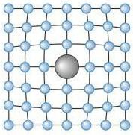
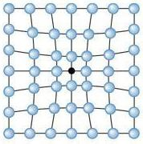
Extrinsic Defects – Solid Solutions
Solid solutions are made of a host (the solvent or matrix) which dissolves the minor component (solute). The ability to dissolve is called solubility.
  Solvent: in an alloy, the element or compound present in greater amount
  Solute: in an alloy, the element or compound present in lesser amount ( material that is dissolved)
  Solid Solution:
    Simply a solution in solid state
    Homogeneous mixture
    maintain crystal structure
    contain randomly dispersed impurities (substitutional
or interstitial)
Distortion of the lattice will interfere with the movement of dislocations on slip planes and will increase the strength of the alloy → Reason for strengthening of a metal by alloying

Slide 8
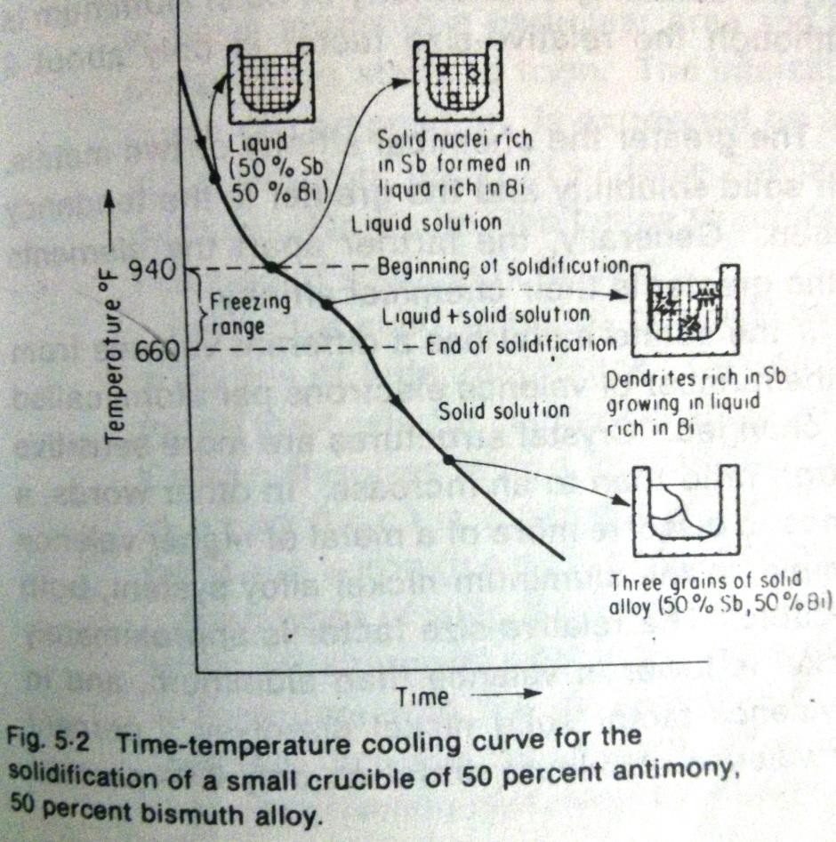
Sugar + Water
Three Conditions for a Solution
  Unsaturated – If the solvent is dissolving less of the solute than it should dissolve at a given temperature and pressure
  Saturated – If the solvent is dissolving the limiting amount of the solute
  Supersaturated – If the solvent is dissolving more of the solute than it should, under equilibrium conditions. (Unstable – Given enough time or energy, solution tends to become stale by rejecting or precipitating the excess solute)
Most solid solutions solidify over a range of temperature. That temperature may be higher or lower than the freezing point of the solvent or solute.
  Freezing point of antimony– 1170^{O}F (632^{O}C)
  Freezing point of bismuth – 520^{O}F (271^{O}C)

Slide 9
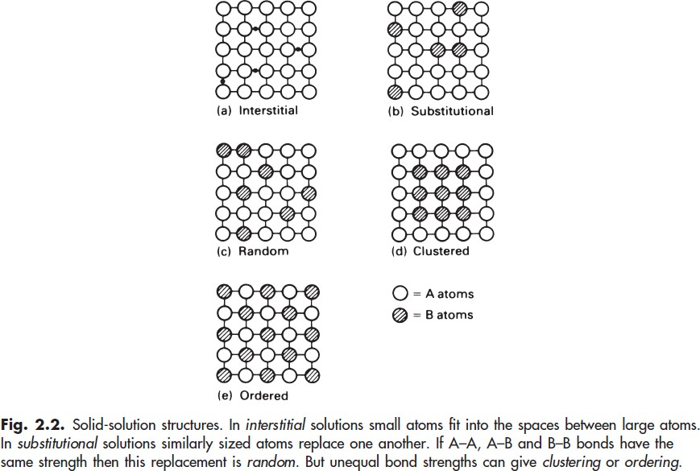
Types of Solid Solutions
If size of B << size of A
If size of B ~ size of A
E.g. – Brass, Cupronickel
If the strength of A-A, B-
B and A-B are same
If the strength of A-A, B-
B > A-B
If the strength of A-B >
A-A, B-B
* From Book Engineering Materials by Ashby

Slide 10
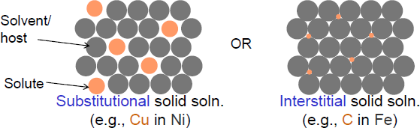

Types of Solid Solutions
Two outcomes if impurity (B) added to host (A):
Solid solution of B in A (i.e., random dist. of point defects)
A solid solution forms, if the crystal structure is maintained and no new structure is formed.
Solid solution of B in A plus particles of a new phase (usually for a larger amount of B)

Slide 11
Substitutional Solid Solution
Conditions for substitutional solution formation (Hume-Rothery rules)
 | Cu-Ni | Pb-Ni
∆ (atomic radii) <15% | Yes (2.34%) | No (28.57%)
Same crystal structures | Yes (FCC) | No (Pb–FCC; Ni–BCC)
Similar electronegativities (∆E ≤0.6, preferably ≤ 0.4) | Yes (0.0) | Yes (0.2)
Same valence (if multivalent, valency of solute > solvent) | Yes (2+) | No (Pb–2+ , 4+; Ni –1+)
 | Complete solid solution | Limited solid solution

Slide 12
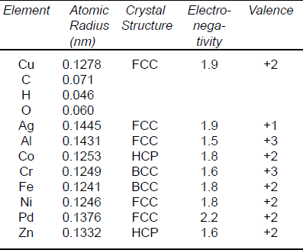
Application of Hume-Rothery Rules
Would you predict Al or Ag to dissolve in Zn?

Slide 13
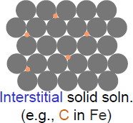
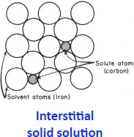
Interstitial Solid Solution
These are formed when atoms of small atomic radii fit into the spaces or interstices of the lattice structure of the larger atoms
Atoms < 1 Å likely (Hydrogen, boron, carbon, nitrogen and oxygen)
Normally have very limited solubility. But their mobility is large and the effect on the properties is also more than expected.
E.g. – Carbon in iron, Steels.
– Maximum solubility of carbon in γ – iron is 2.0% at 1147^{O}C and in α – iron is only 0.025% at 727^{O}C

Slide 14
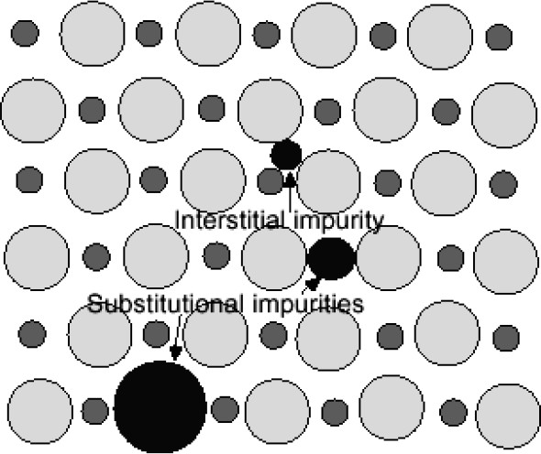
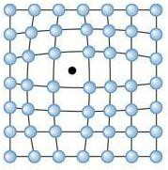
Impurities
Impurities - atoms which are different from the host
Usually smaller atoms (carbon, nitrogen, hydrogen, oxygen) are called interstitial impurities.
  All real solids are impure. Very pure metals 99.9999% - one impurity per 10⁶ atoms
May be intentional or unintentional,
  Alloys - deliberate mixtures of metals
    Sterling silver is 92.5% Ag – 7.5% Cu alloy. Stronger than pure silver.
    ‘Duralumin’ – an alloy of Al and Cu; stronger than pure Al.
    Carbon added in small amounts to iron makes steel, which is stronger than pure iron. Sulphur remained in steel due to difficulties in synthesis.
  Doping silicon to change its electrical properties.

Slide 15
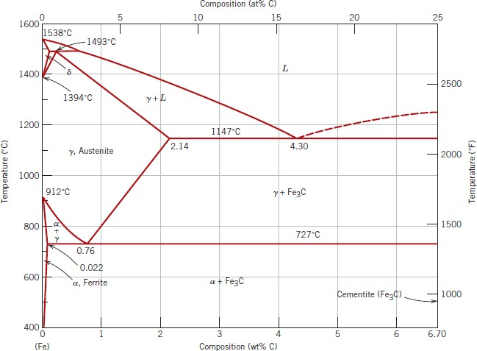
Why are steels so much stronger?
Interstitial solid solution of C in α-Fe.
  Slow cooling Austenite → Ferrite and Cementite (diffusion controlled)
  Fast cooling, diffusionless metastable phase, tetragonally distorted BCC Fe with C in octahedral interstitials, Martensite (BCT) (hardening of steel)
Size (Impurity atoms) > Size (Interstitial sites) →  Introduce lattice strains.

Slide 17
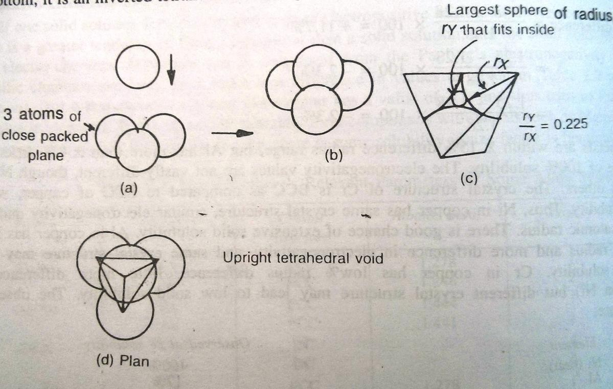
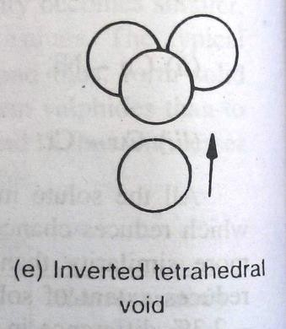
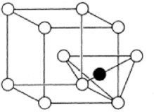
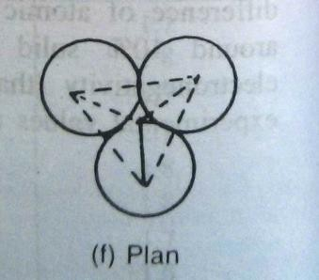
Types of Interstitial Voids
When same sized balls are packed in three dimensions, void spaces present between the spheres are called interstitial voids
Tetrahedral Void
  Void forms when an atom is put in the valley formed by three spheres of closed packed plane.
  If the atom is put on top of the three atoms – Upright tetrahedral void
  If the atom is put from the bottom – Inverted tetrahedral void
  Name is derived from the fact that a tetrahedron is formed by joining the centers of the atoms.

Slide 18
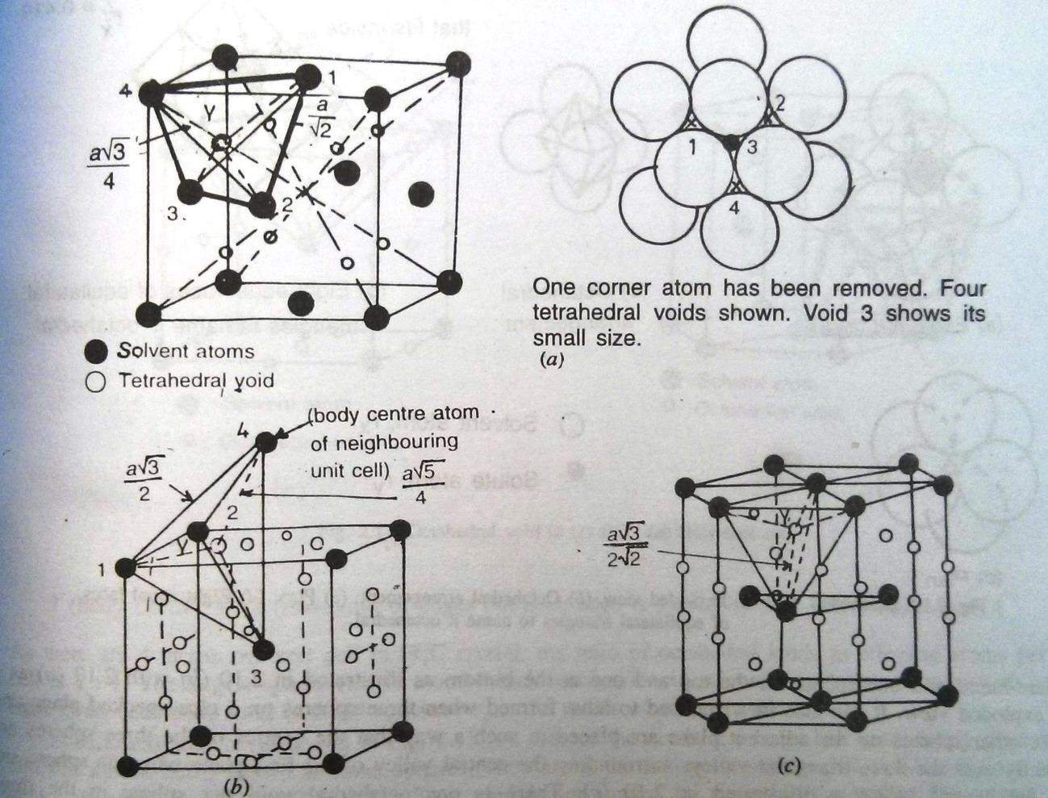
Tetrahedral Void
FCC
  Tetrahedral voids = 8
– Located at (1/4,1/4,1/4), (3/4,3/4,3/4) on the body diagonals
  Ratio of voids to atoms
= 2:1
BCC
  Tetrahedral voids = 12
– Located at (1/2,1/4,0) on the faces of the cube
HCP
  Tetrahedral voids = 12
  Ratio of voids to atoms
= 2:1

Slide 19
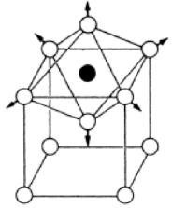
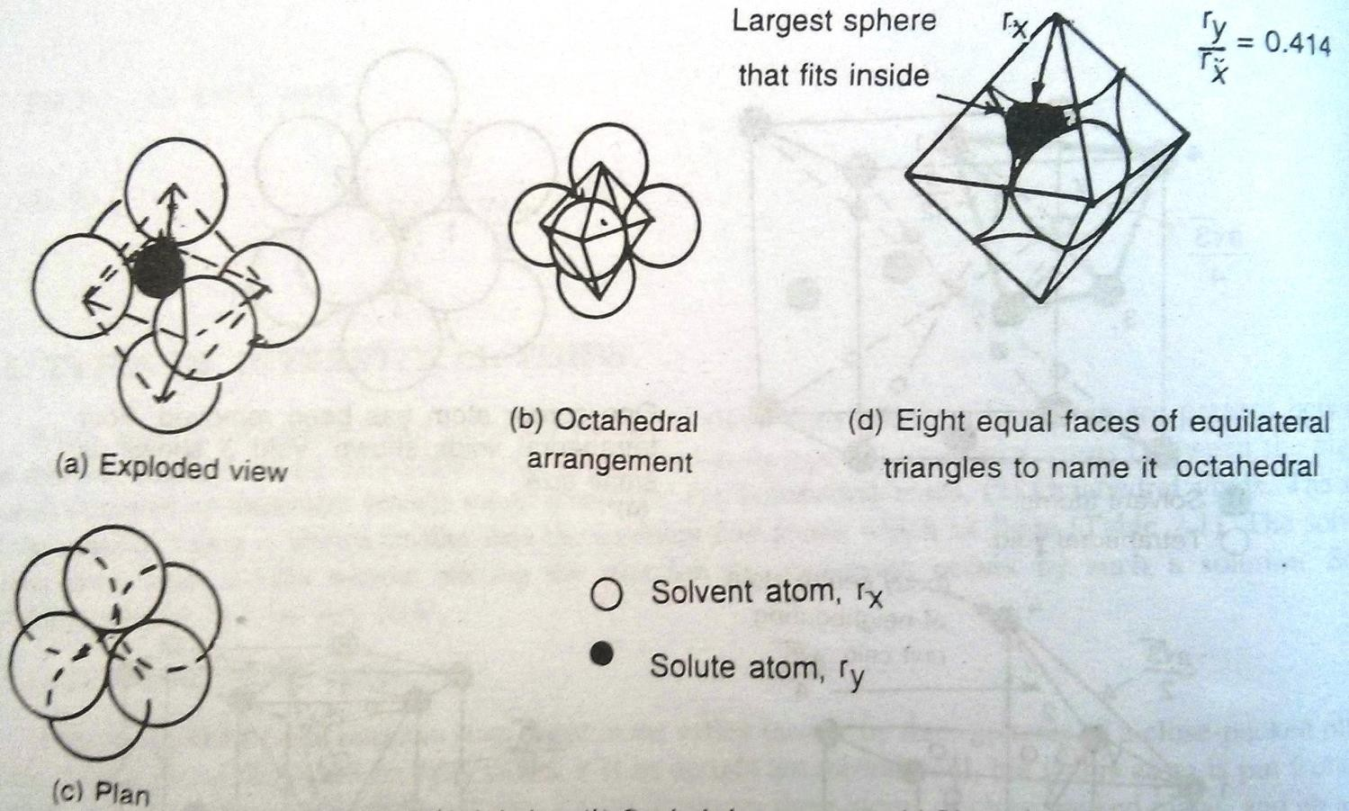
Octahedral Void
Surrounded by six solvent atoms at six corners of a regular octahedron
Four atoms are square-based and one on top and one at the bottom

Slide 20
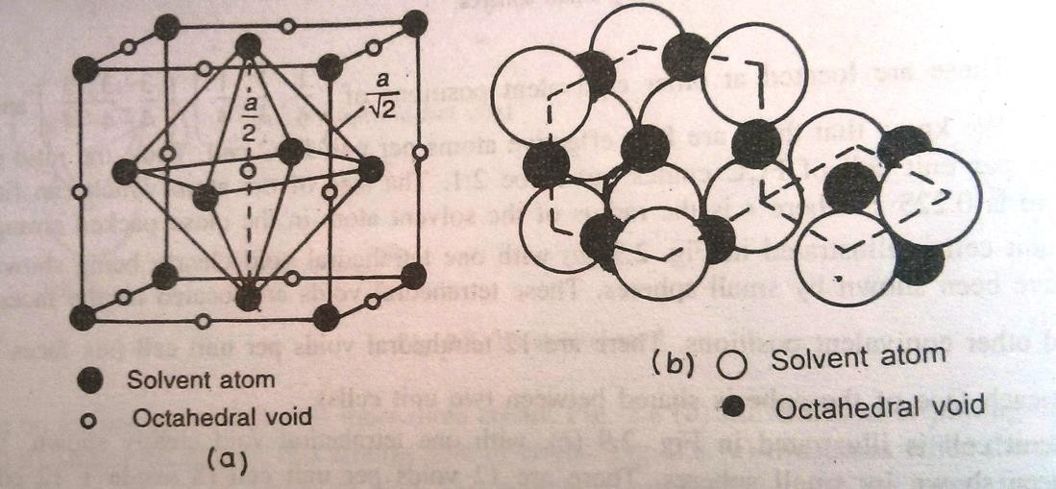
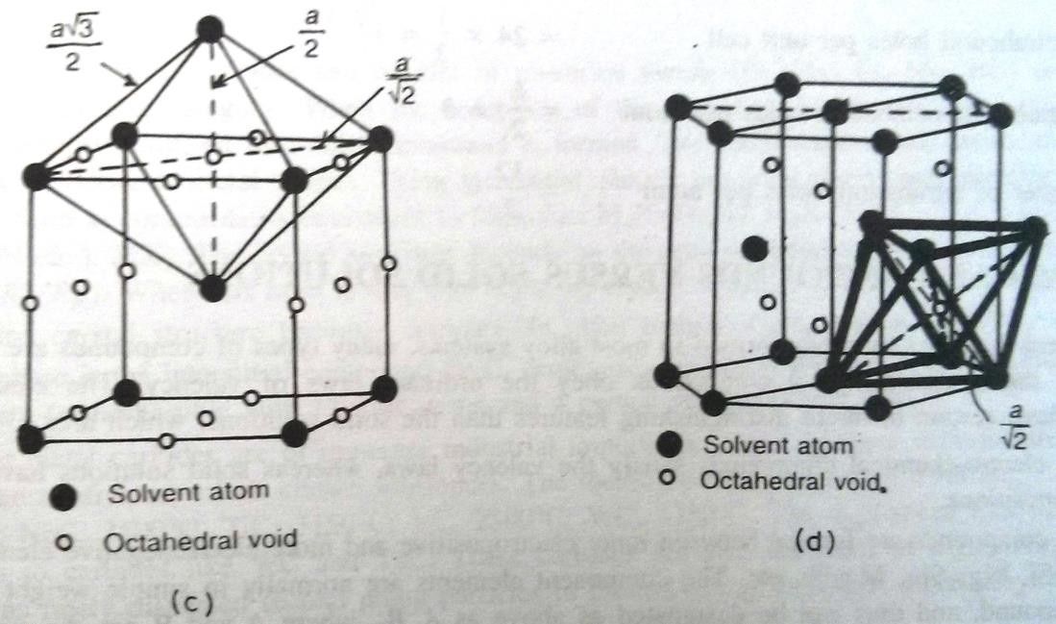
Octahedral Void
FCC
  Octahedral voids = 1+12*1/4 = 4
  Located at (1/2,1/2,1/2) body center
and (0,0,1/2) on the edges
  Ratio of voids to atoms = 1:1
  Largest sphere that can fit = 0.414*radius
BCC
  Tetrahedral voids = 6*1/2+12*1/4 = 6
  Located at (1/2,1/2,0) center of the face and (0,0,1/2) mid-point of edges
  Compressed octahedral sites so Size(Octahedral) < (SizeTetrahedral)
HCP
  Tetrahedral voids = 6
  Ratio of voids to atoms = 1:1

Slide 21
Chemical Compounds Vs Solid Solutions
Many types of compounds are formed apart from sold solutions but only electrochemical compounds follow the laws of valency
Differences:
  They satisfy the valency laws, whereas solid solutions have a range of compositions.
  They are formed between more electropositive and more electronegative elements. So can be designated as A_{x}B_{y} where x, y are integers and A, B are elements. Solid solutions have a range of solubility so cant be designated. E.g. – Mg₂Si, Mg₃Sb₂, Mg₂Pb etc.
  Crystal structure of the compound is different than the crystal lattices of the elements forming the compound. Solid solutions have same crystal structure as that of the solvent element.
  Properties of the compounds are much different than that of elements in them. Essentially non-metallic, brittle and bad conductors of electricity. Solid solutions are of metallic nature and little different than the solvent element.
  Compound has a constant high melting point. Solid solutions melt over a range of temperatures and melting point is usually less than that of solvent.

Slide 22
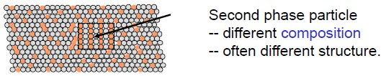
Intermediate Phases
Solid solution of B in A plus particles of a new phase (usually for a larger amount of B)
Second phase is the intermediate phase.
  Has an intermediate composition between A and B
  Different crystal structure than both A and B
  E.g. – Beta-brass has BCC structure, different from Cu (FCC) and Zn (HCP)
  Some of them with fixed composition are called intermetallic compounds
Classification based on their structures,
  Interstitial Compounds
  Electron Compounds
  Defect Phases
  Electrovalency Compounds
  Laves phases

Slide 23
Interstitial Compounds
When solubility of the interstitial solid solution forming element exceeds the solubility limit, interstitial compound is formed.
Carbides, nitrides, hydrides and borides of transition metals (Fe, Mn, Cr, Mo etc) are important
group of phases.
These usually form at compositions equivalent to formulae: M₄X (Fe₄N), M₂X (Mo₂C, W₂C), MX (VC, WC, TiC, NbC, TiN etc.), MX₂.
Crystal structure depends on the ratio of radius of interstitial atom to solvent metal atom.
  When this ratio < 0.59, the crystal structure is FCC, CC and HCP.
  When this ratio > 0.59, the crystal structure becomes very complex.
    In plain carbon steels, ratio of R_{C}/R_{Fe} = 0.63, the intermediate phase is cementite Fe₃C, which has metallic properties but a complex crystal structure (orthorhombic with 12 iron and 4 carbon atoms per unit cell)
Transition metal carbides are very important from industry perspective due to their hardness and refractory properties.
Melting points of TaC - 3800°C, ZrC - 3500°C, NbC - 3500°C, TiC - 3150°C, VC - 2800°C, WC
- 2750°C.

Slide 24
Electron Compounds (Hume Rothery Compounds)
In many alloys, phases of similar crystal structure are formed at the same ratios of valence electrons to atoms.
These ratios are 3/2, 7/4 and 21/13.
Electron/atom ratio = 3/2
  BCC (beta brass) structure: Electron/atom ratio = 3/2 CuZn, AuZn, CuBe, FeAl.
  Complex-cubic structure; ratio = 3/2
Ag₃Al, Au₃Al, Cu₅Si
  HCP structure; ratio = 3/2
AgCd, Ag₇Sb
Electron/atom ratio = 7/4
  HCP (ε-brass) structure
CuZn₃, AgZn₃, Cu₃Sn, CuBe₃
Electron/atom ratio = 21/13
  Complex cubic (γ-brass)
Cu₅Zn₈, Ag₅Zn₈
Change of crystal structure for Cu (FCC) with addition of Zn gradually?

Slide 25
Defect Phases
These are intermetallic phases which in certain ranges of concentration develop unusually high number of vacancies.
In Ni-Al system, with 54% Al content, unusually high vacancies of 8% are observed.
These are very important → Large vacancy concentration → Helps in process of diffusion
Electrovalency Compounds
These are basically the same compounds that satisfy the Hume-Rothery rule for valancy requirement.
High valence element will dissolve in low valency element.
Laves Phases
These phases are based on chemical formula AB₂.
E.g. – MgCu₂, MgZn₂, MgNi₂, AgBe₂, CaMg₂, TiFe₂.
These exist because the difference in atomic size is about 22.5%, and thus can pack in crystal structures of higher coordination number than the common maximum, 12.
Higher coordination number is possible due to free electron bond.
Sigma phases are found in heat resistant alloys and high alloy steels
E.g. – FeCr, FeW, Mn₃V, CoCr.

Slide 26
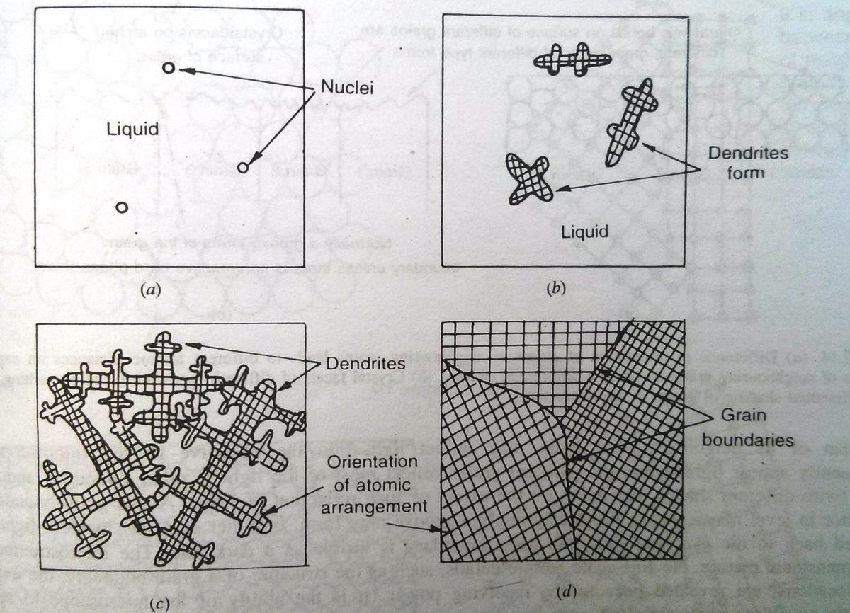
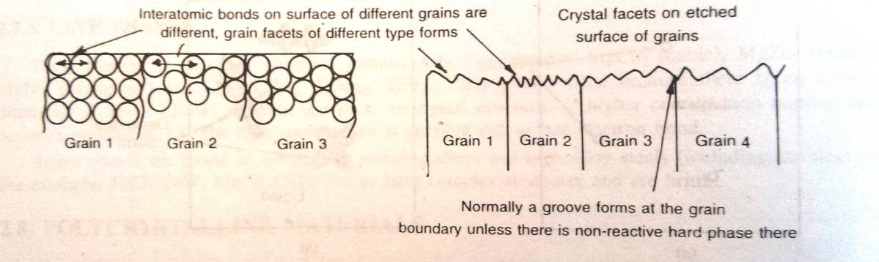
Polycrystalline Materials
Engineering materials are usually polycrystalline.
Nucleation sites increased by the mould walls, touching any surface, impurities etc.
If a pure metal is cooled slowly, solidification occurs in two stages
  Nucleation
  Growth of nucei
Each crystal of the polycrystalline solid is called a grain, and its interface with the neighboring grain is a grain boundary.
If the surface is etched, all differently oriented grains will show different shades as etchant reacts with different planes differently.
Imperfection in Solids 28

Slide 27
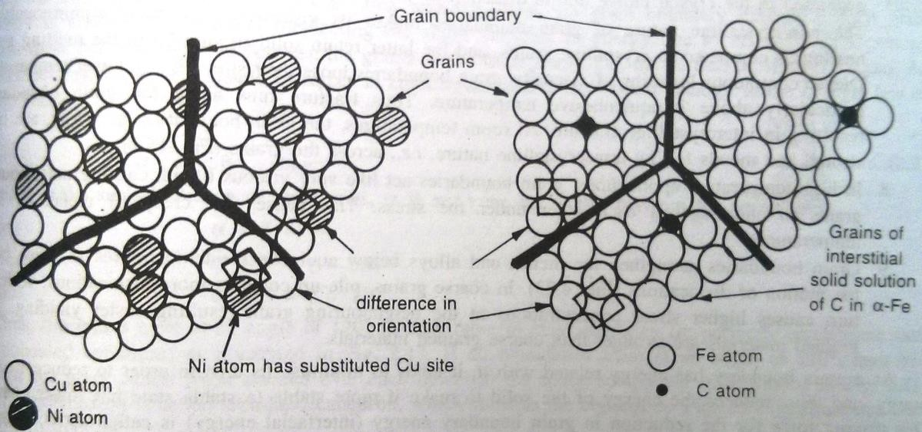
Grain Boundary (GB)
As the atoms at the GBs are displaced from the normal lattice sites, they have more energy → more reactive
A grove at the GBs when etching
If a new phase has to form, preferably it will form at GBs because these high energy atoms will rearrange
easily.
Impurity atoms are preferably present at GBs because they can easily fit in the vacant areas without producing elastic strains
Source and sink of vacancies is GB. Vacancies can diffuse to them or be created due to diffusion
Faster diffusion through GBs because of presence of vacancies
Primary reason behind creep in metals. At high temp, GB act like viscous liquid allowing grains to slide past each other under stress.
At room temp, GBs strengthen the
metal/alloy as they block the motion of dislocations. Finer grained materials stronger than coarse grained materials.

Slide 28
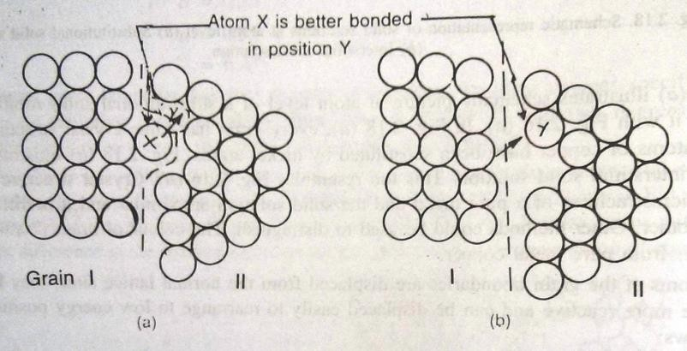
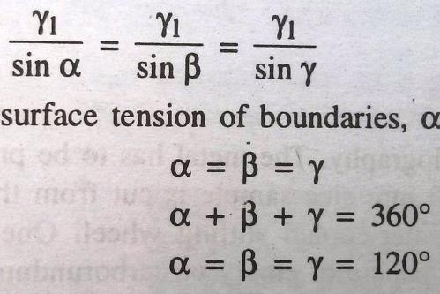
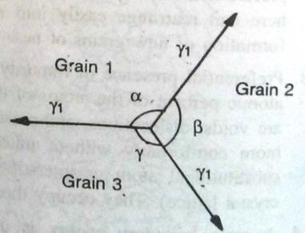
Grain Boundary Energy (GBE)
System will always try to minimize the GBE. (Thermodynamics)
Minimize the GB area to do that. This driving force for the reduction in GBE is called the surface
tension (J/m²)
Normally GBs have irregular shape, but under the force of surface tension, GB will try to straighten itself.
Thus, the grains meet each other at 120° (polyhedron also called tetra-kaidecahedron) in an ideal
condition i.e. perfect equilibrium and fully annealed condition.

Slide 29
Grain Size
It is the avg diameter of a grain revealed in a 2D section
  Worked and heat treated metals – 0.01 to 0.1mm diameter (fine)
  As-cast metals – 0.1 to 10mm diameter (coarse)
Grains are usually invisible because of oxide film on the surface, or by the mirror glitter of the surface
Specimen has to be prepared to observe GBs using metallography
  10x10x10 mm size sample is cut from the metal without disturbing the microstructure
  One surface is repeatedly polished using successively finer grades of abrasive papers of emery or carborundum
  Final polishing with soft moist velvet cloth with a polishing paste (fine alumina, magnesia or diamond dust) to
a mirror scratch-free finish
  Specimen is then etched using an etching agent
  Specimen is immersed or swabbed with the reagent will the surface is discolored
  Reagent is then washed off, first with water and then with alcohol
  Surface is dried in warm air
  Observe it under the metallurgical optical microscope
  Reagent reacts with the GBs to create the grooves which are seen as dark lines under microscope
Two methods to determine the size of the grains
  ASTM Standard and British Standard Grain Size Number
  Heyn’s Intercept Method

Slide 30
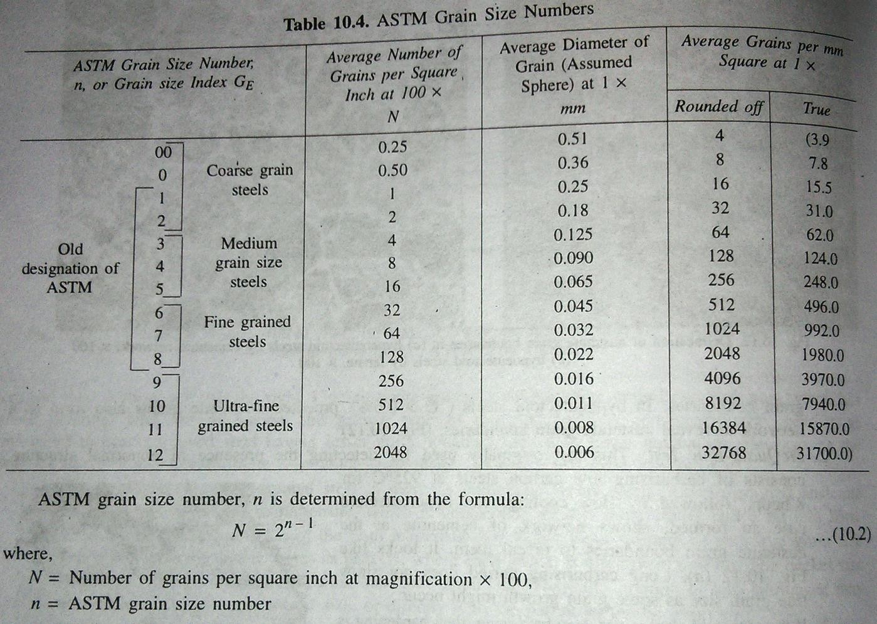
ASTM Standard and British Standard Grain Size Number
For equiaxed grains
Magnification at 100x
Use an eyepiece with predetermined grain sizes from 1 to 8 and overlap it with your microstructure

Slide 31
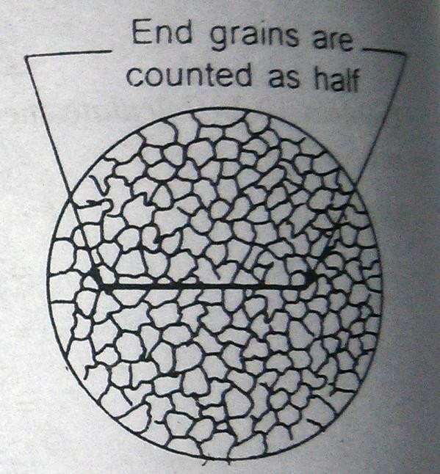
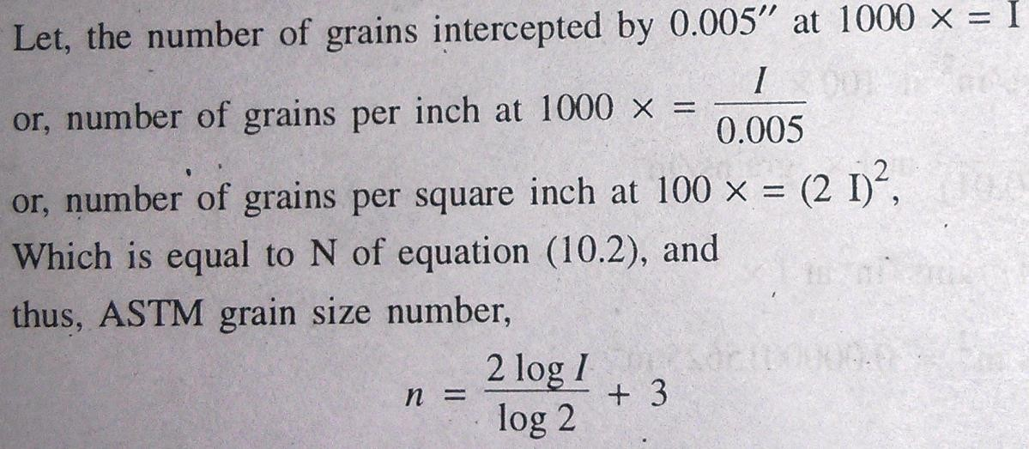
Heyn’s Intercept Method
When grains are not equiaxed.
Count the number of intercepting grains ona 0.005 inch line at 1000x magnification
Avg of 10 readings on a single sample

Slide 32

Polycrystalline Materials
Engineering materials are usually polycrystalline.
Nucleation sites increased by the mould walls, touching any surface, impurities etc.
If a pure metal is cooled slowly, solidification occurs in two stages
  Nucleation
  Growth of nucei
Each crystal of the polycrystalline solid is called a grain, and its interface with the neighboring grain is a grain boundary.
If the surface is etched, all differently oriented grains will show different shades as etchant reacts with different planes differently.

Slide 33
Solidification
Liquid solidifies below its freezing temperature
Castings – are when metals are solidified into final shape directly
Ingots – are when some other shapes are produced, which can be shaped to required shape (by plastic deformation)
Structure produced i.e. grain size and grain shape affects the final properties so very essential to
understand the mechanism of transformation of liquid to solid metal i.e. solidification

Slide 34
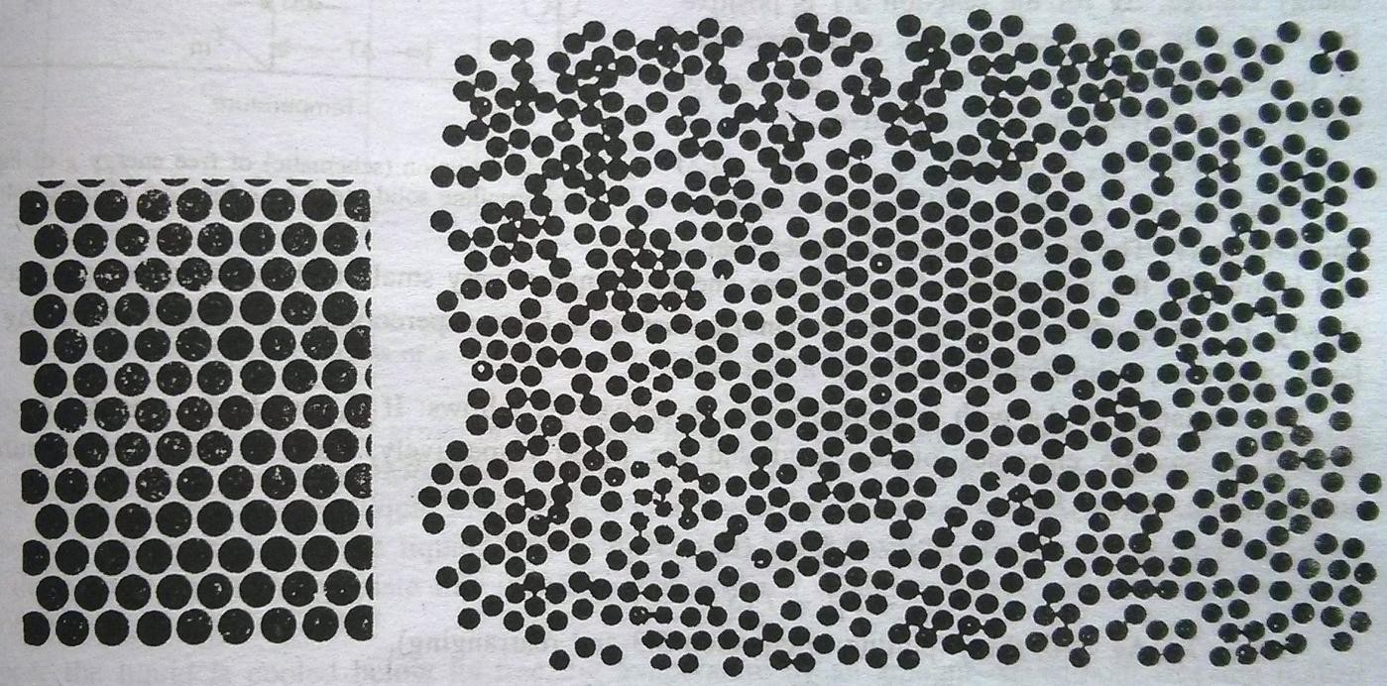
Structure of Liquid Metals
When a crystalline solid melts, basically the rigidity (resistance to shear stress) of the solid changes to fluidity (resistance to shear stress is negligible) of the liquid
XRD confirms that solids have atoms arranged in specific pattern over long distances.
Atoms in liquid are arranged in an ordered manner over short-distances, but lack long-ranged ordering.
Due to the increased number of defects like vacancies, interstitials, dislocations etc. Hence, higher atomic
diffusion rates in liquids → electrical and thermal conductivities attain a common value.
When the liquid approaches freezing temperature, the degree of short-range order increases resulting in larger clusters of atoms in which atoms are packed in the same order as in solids.
Liquids phase can be viewed as a dense gas which is held together by attractive forces between atoms.

Slide 35
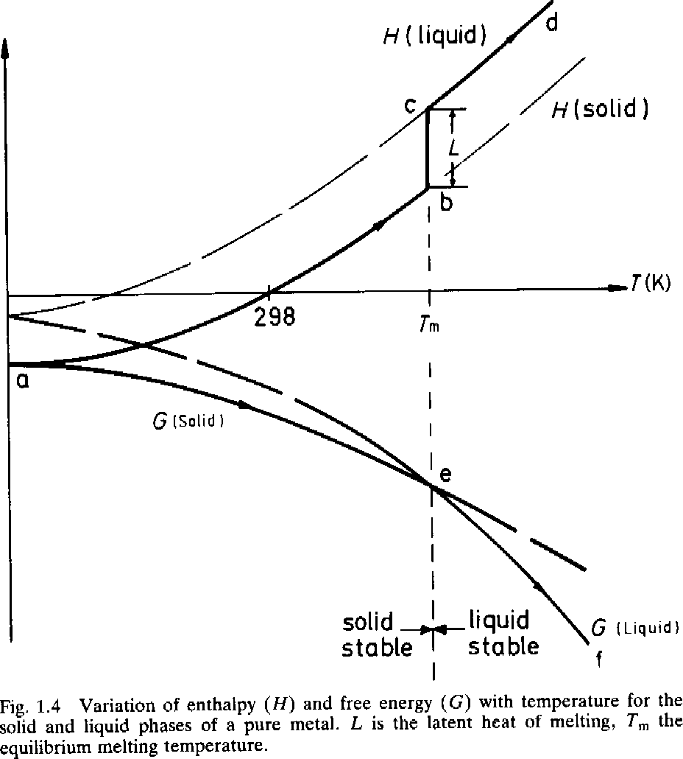
Melting of a pure solid
At all temperatures enthalpy of the liquid state is higher than that of the solid state
Liquid has higher entropy than the solid and therefore rate of decrease of G with T is higher for liquid than that for solid
For T > T_{m}, G(liquid) < G(solid)
At T = T_{m}, dG = 0, G(liquid) = G(solid)

Slide 36
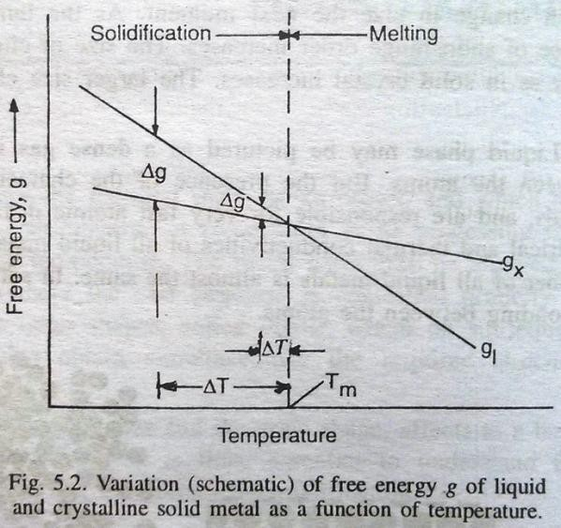

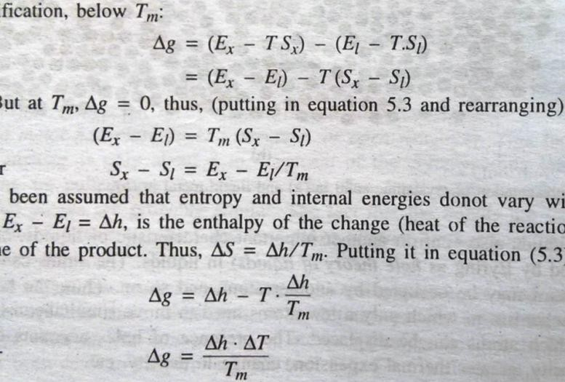
Energetics of Solidification
At any temp, most stable state thermodynamically is the one with lower free energy.
Equilibrium temp for transition between two states is the temp at which they have the same free energy
∆G = ∆H – T∆S
Example: For a pure metal X, Liquid (L) → Solid (X)
At T_{m}, ∆G = 0.
When T > T_{m}, g_{x} – g_{l} (∆G) > 0.
When T < T_{m}, g_{x} – g_{l} (∆G) < 0.

Slide 37
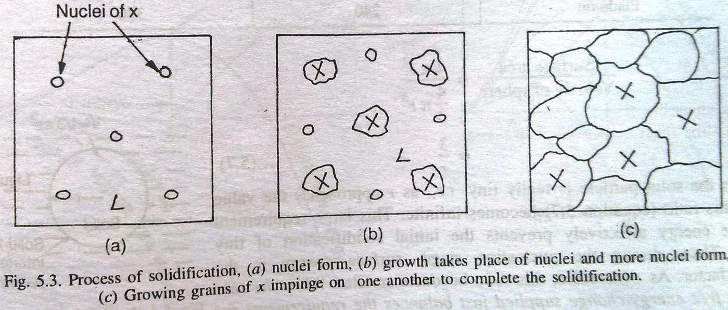
Nucleation and Growth
Once the temp is below freezing temp, solid is the stable phase. Will the solid appear and liquid disappear?
Nucleation – Formation of small stable crystalline particles of solid metal X from liquid metal called, nuclei.
Growth – Increase in the size of these stable nuclei particles by joining the crystalline structure from liquid metals.
Eventually they impinge on one another until all the liquid is solidified → resulting in a polycrystalline material.
When a metal particle has solidified, a new interface is created between liquid and particle. This interface has a positive energy i.e. energy has to be supplied during the solidification to create the interface. So it’s a barrier to process of freezing.

Slide 38
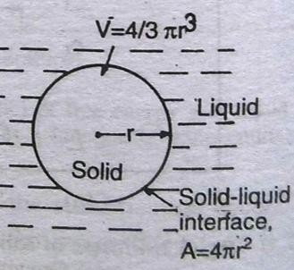
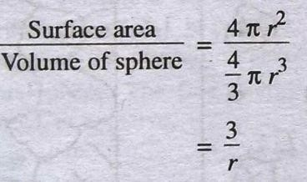
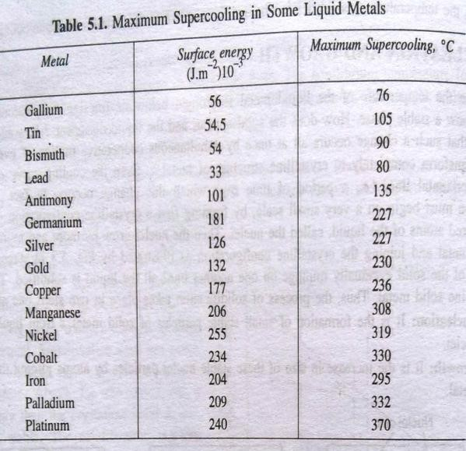
Supercooling
Suppose, the liquid is cooled below its freezing temp by ∆T without freezing (supercooling), liquid has a free energy higher than solid by ∆g per unit volume. This extra free energy is expected to contribute to the creation of the interface between solid and liquid → stability of nuclei.
Liquid metals, have to be cooled far below their freezing temp to begin the process of solidification.
Difference in volume free energy helps to create the interface between tiny solid formed and the liquid.
But, the tiny solid has a large surface area to volume ratio, so less volume free energy available to create the interface area, so it is unstable.
As, r approaches zero, ratio becomes infinite, hence system prevents initial solidification of tiny particles.
As r increases, the ratio becomes smaller.
When the rate of volume free energy-change supplied just balances
the requirement for the creation of surface, the particle is said to be nucleated.
Once particle is nucleated, it grows with a continuous decrease of total energy.
Two types of nucleation:
  Homogeneous Nucleation
  Heterogeneous Nucleation

Slide 39



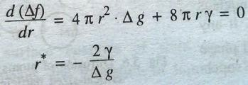
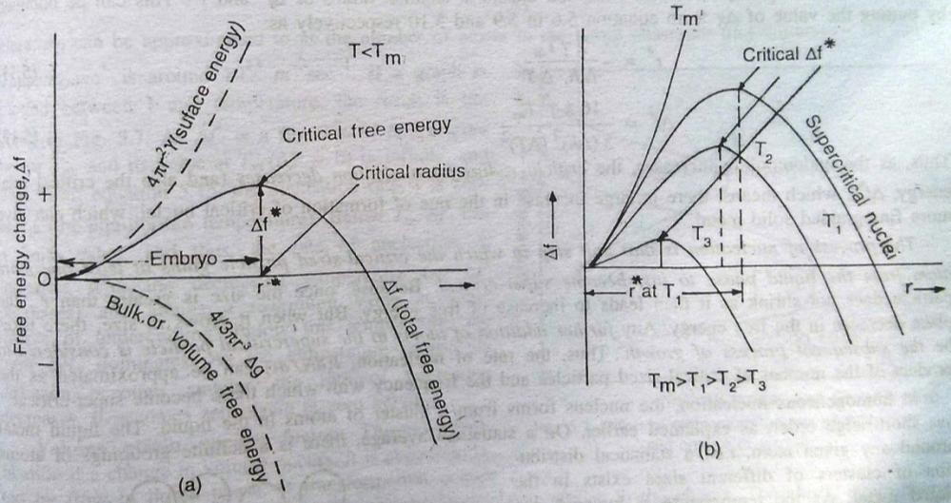

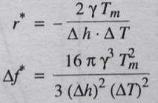

Homogeneous Nucleation
The energy difference between the liquid and solid is the volume free energy, ∆g per unit volume which is the driving force behind solidification
Assume that a slid nucleus with radius, r is formed. Then, The volume free energy change associated =
and the surface energy required to create the area =
Nucleation is controlled by two factors,
  Free energy change associated with change from L → S
  Surface energy of the new solid formed
Hence, the total free energy change, (In the plot)
At the critical stage, the total free energy of the system decreases at the same rate whether the nucleus grows or shrinks from this size r*.
Value of r* can be obtained by operating derivative = 0
Hence, ∆f*, the nucleation barrier,
If r < r*, nucleus dissolves (↓ Energy) called embryos If r > r*, nucleus grows (↓ Energy) called nuclei
Plot of ∆f Vs r shows that as ∆g becomes more –ve, Critical condition occurs at lower ∆f* and r*.
Putting the value of ∆g, we get, As undercooling ↓, r* & ∆f* ↑

Slide 40
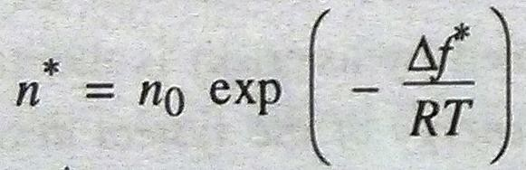
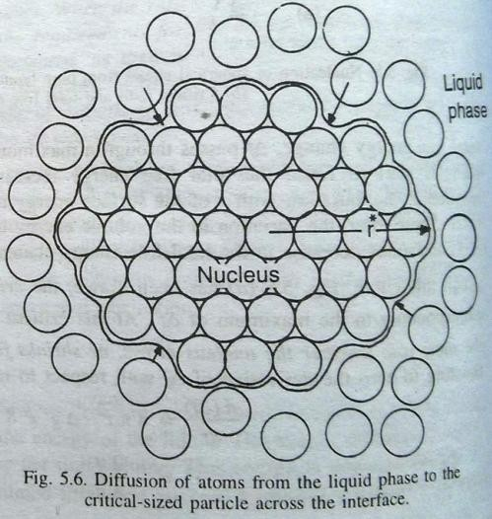
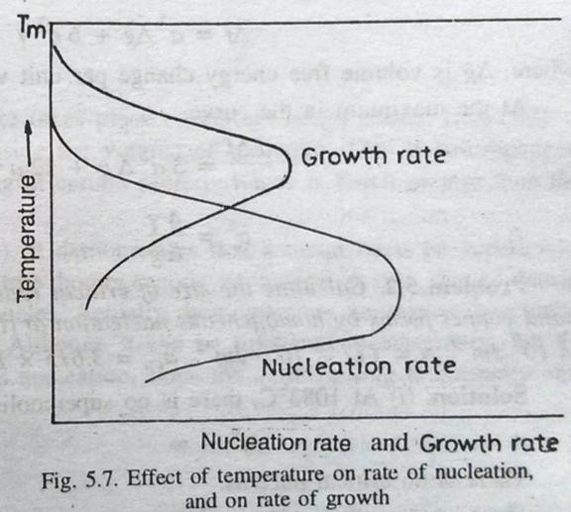
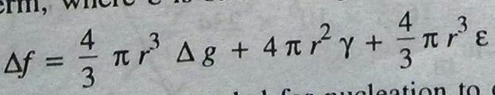
Homogeneous Nucleation
The process of nucleation is that unit step in which critical sized nucleus gains one more atom to become super-critical. Any further addition to the supercritical nucleus is considered to be the process of growth.
Maxwell-Boltzmann statistics can e used to estimate the number of critical-sized particles in the liquid phase.
Let, the total number of particles per unit volume of liquid phase be n₀, then the number of critical-sized particles n* can be given by,
Volume strain energy factor – If due to a phase change, volume change occurs then +ve elastic strain energy will inhibit the nucleation and hence, equation for free energy will become,

Slide 41


Heterogeneous Nucleation

Slide 42







Heterogeneous Nucleation
Homogeneous nucleation is a difficult process and almost never happens in industry.
Nucleation occurs either on a nucleating substance floating such as inclusions of foreign particles, or on the walls of the container.
If a solid embryo forms on the wall as a spherical cap, then by balancing the interfacial energies, we get
Contact angle θ depends on three surface energies.
As the contact angle changes from 0° to 180°, term in bracket changes from 0 to 1.
– If θ = 180°, cos180° = -1, solidifying solid makes a point contact with mould wall, then role
so wall doesn’t play a
If θ = 0°, cos0° = 1, solid completely wets the mould wall, then so no barrier for heterogeneous nucleation. Can start at freezing temp
If θ = 90°, cos90° = 0, then still hemi-spherical solid is effective, barrier is half.
As θ ↓, r*_{het} ↓, so particular inoculant can be chosen to reduce the θ (low γ_{sm}) [Artificial rain – seeding the clouds with AgI/NaCl, Also seeding graphite with Ni to get diamonds]

Slide 43






Growth of Solid
Growth is the increase in the size of the nucleus after nucleation.
Usually occurs by thermally activated jump of atoms from liquid to solid phase.
 | K_{m}/K_{f} = Accomodation Factor
For the interface to move, it must be below freezing temp. Growth rate is thus a function of the amount of undercooling. The growth rate is also dependent on the nature of temp gradient in-front of the interface.
Two types of temp gradients
  Temp in the liquid rises ahead of the interface, i.e.
+ve temp gradient
  Temp falls ahead of the interface, i.e.
–ve temp gradient/ temp inversion.

Slide 44


Smooth or Stable Interface-Growth
When liquid ahead has +ve temp gradient, heat is lost by flowing from right to left i.e. latent heat of fusion is lost by conduction through solid.
Under this condition, smooth interface is stable, moving into liquid as a unit
Interface may have steps with some having close-packed planes and some loose
packed planes.
Most advanced portions of solid interface will be loose-packed planes (high accommodation factor), while most retarded portions will be close-packed planes (low accommodation factor)

Slide 45


Temperature Inversion and Dendritic Growth
When temp falls in the liquid ahead of the interface, dendritic growth (treelike) occurs, happens when supercooling is large → any part that that grows ahead of the interface is in a region with lower temp liquid → spikes growing into liquid → rapid growth
Spikes remain isolated because release of latent heat raises temp of the immediate surrounding liquid → retards growth of formation of similar projections → spikes are at almost equal spacing growing parallel to each other
These primary arms of dendrite grow in certain crystallographic direction called dendritic growth direction depending on crystal structure of metal
Temp @ YY (T₁) > Temp @ XX (T₂) → temp inversion ┴ primary arms → formation of secondary arms at regular intervals
Similarly, tertiary arms are formed on the secondary
arms of dendrites
As the dendrites grow in length, they grow in thickness too, finally each dendrite results in a single crystal after the solidification
Size of dendrites is characterized by distance
between the secondary dendrite arms
Rapidly freezing casting →less time for heat conduction → finer extensive dendritic network → lower secondary dendrite arm spacing (SDAS)

Slide 46


Dendritic Growth in Pure Metals
The driving force is temp inversion i.e. liquid ahead of the interface should be sufficiently supercooled At the interface, heat of fusion is released → raising of the temp at the interface Temp falls to the left as it is the direction of heat conduction, and temp falls to the right as it is a natural direction for the release of latent heat of fusion → leading to temp inversion To get complete dendritic freezing, a large supercooling (100°C) is needed to counteract the effect of latent heat of fusion released as the dendrite grows, and still maintain supercooled liquid ahead But it is difficult to get such undercooling because heterogeneous nucleation takes place Usually, 10% of the pure metal can solidify dendritically, but the
latent heat of fusion overcomes the thermal supercooling resulting in a +ve temp gradient → leading to further solidifcation by smooth interface i.e. the contour of the interface produced by dendritic growth is maintained for it to grow at a constant speed. Dendritic fraction in a pure metal is given by, where C = specific heat of the liquid

Slide 47



Dendritic Growth in Alloys
Dendritic growth in alloys can be through
  Thermal supercooling
  Constitutional supercooling
Constitutional Supercooling – happens due to their constitution, when a solid freezes with a composition different from that of liquid from which it forms
Alloys have separate curves for solidus and liquidus in a phase diagram
Assume a liquid with composition “l” at T₁→solid of composition “k” forms (rich in A)→liquid gets enriched in B, as temp falls to T₂ →solid “m”, liquid becomes B enriched “n”→ happens until steady state is reached at T₃→solid of original composition “l”→ beyond this point liquid is ale to freeze a solid of the original alloy.
At the interface, there is sudden increase of B in the composition of liquid, then decreasing exponentially to the original composition after distance “x”. Shape of distance x depends on rate of freezing & rate of diffusion of atoms

Slide 48

Constitutional Supercooling
When the liquid metal is poured in a mould, freezing starts from mould-wall as heat is removed
through the wall.
Thus, temp is lowest at the wall and rising gradually towards the center of the mould.
Increase in the temp can be assumed to be linear with the distance, but the freezing point of the distance from the interface is a curve.
Effectively, this liquid of “x” thickness has the actual temp lower than the freeing point → efficiently
supercooled.
Amount of supercooling increases as one moves from interface towards inside the liquid, this is called constitutional supercooling → due to the constitution/due to the concentration gradient in the liquid in-front of the interface.
The driving force for dendritic freezing is large amount of supercooled liquid ahead of the interface but this effect of thermal supercooling is wiped off with latent heat of fusion → constitutional supercooled layer (x) has to be large to obtain dendritic freezing

Slide 49


Freezing of Ingots
Large tonnage of molten metals are cast as ingots by pouring into moulds, steel ingots weigh 6 to 8 tons.
Chill Zone – thin dendritic layer of frozen metal, consisting of small equiaxed grains with random orientation. Stable nuclei form on mould wall & in the supercooled liquid layer. Rate of nucleation ↑, so avg size of grains ↓. Large amount of latent heat has to e dissipated, hence rate of growth is low making the grains small. If the heat removal is rapid and amount of liquid is small, chill zone can form in whole liquid.
Columnar Zone – Some of the chill zone grains have axes of dendrites normal to the mould-wall, and some with angle to the wall→grains with normal dendrite axes out-grow others due to levels of supercooling (because less at an angle). Zone contains large long grains, crystallographically oriented with their dendritic directions parallel to the heat flow direction.

Slide 50


Freezing of Ingots
When grains in chill zone form, latent heat produced changes the temp distribution → leading to temp inversion ahead of the interface → promotes dendritic growth → columnar grains, as heat is removed fast → growth dominates nucleation.
In pure metals only thermal supercooling can be observed so, dendritic growth leads to +ve temp gradient ahead of columnar grains → leading to stable interface → columnar grains continue to grow to the center of the ingot
→ no central equiaxed zone
In alloys, can obtain constitutional supercooling as well → interface always has supercooled liquid ahead →
columnar grains grow completely by dendritic freezing
Central Equi-axed Zone – Large number of small equiaxed grains nucleate heterogeneously and grow throughout the liquid. As freezing continues, small grains crowd together until finally they stop columnar grains growth. Each of these floating grains grow dendritically due to temp inversion and hence they have random orientation
Two reasons for the formation of the central equiaxed grains,
  Constitutionally supercooled layers overlap at the centre as the opposite solid-liquid interfaces approach each other → large constitutional supercooling results → independent nucleation and growth of nuclei
  Initial dendrites formed on the grains of chill zone torn off due to initial convective currents. These fragments are swept into the center, which are the nucleating source for the formation of equiaxed grains.

Slide 51
Facts about Freezing of Ingotss
Sometimes chill zone can be missing in ingot structure,
  If liquid metal is highly super-heated → causing the melting of the chill zone formed
  If the ingot mould had been preheated.
  This leads to formation of columnar grains from the mould wall, such an ingot is
mechanically weak.
Large sized long columnar grains are normally not desired.
  Interdendritic regions are weak areas for brittle failure to occur.
Central equiaxed zone is very desirable.
  The absence in pure metals can cause hot shortness.

Slide 52
Segregation
Liquid alloy can be homogeneous but resulting solid invariably varies in composition from one point to another →
called segregation
Types of segregation,
Normal segregation
  Direct consequence of rejection of solute at the interface because it is more soluble in liquid than in solid. Liquid becomes richer in solute as freezing continues → solidifying in the end at the center if the ingot
  Occurs more often when direction of growth is inwards (columnar zone), also called macro-segregation.
Gravity segregation
  Gravity can cause difference in composition in the upper and lower parts of the casting. By vertical motion of
the enriched lighter layer/by sinking of the equiaxed crystals based on its density w.r.t. surrounding liquid
Micro-segregation
  It is localized type of segregation in which the composition of the crystal varies from center to periphery, then the crystal is said to be cored.
  Equiaxed central zone nucleate with composition of initial concentration of alloy, but as liquid changes composition due to rejection of solute, crystals formed have cored structure. Metallography can reveal this.
Inverse segregation
  Some cases show maximum solute content at or near the surface of the ingot.
  Two methods by which it can happen are, 1) Space between mould and metal surface (because of differential contraction) creates a suction that pulls the inside solute enriched liquid towards the surface, 2) If large amount of gas is evolved near the end of freezing, it pushes the inner solute rich liquid through the interdendritic channels to the surface. (E.g. – “Tin Sweat” due to evolution of large amount of H gas which pushes tin-rich liquid to the surface and solidifies there as white alloy.

Slide 53


Porosity
Pores, voids and blow holes are defects in solid castings.
Voids are agglomeration of vacancies.
Pores are discontinuities in solid parts.
Factors for such defect formation:
Evolution of dissolved gas at the liquid-solid interface.
  Gases usually dissolve more in liquid than solid metals.
  Rapid decrease of solubility of H as liquid Cu transforms into solid.
  Gas bubbles may adhere to the interface at specially favorable points such as GBs.
  How to avoid this? By applying pressure on the liquid phase so that gas remains dissolved. H Pressure die-casting.
  If the top of the casting has not solidified, then the bubbles can escape into the atmosphere. But if it is solidified and the rate of growth of bubbles is lower than rate of sold growing around it, then the bubble gets trapped inside the casting and to reduce the surface area takes up a spherical shape, called blow-hole. If the rate of growth of bubbles is higher than rate of solidification, then warm-holes are formed (elongated in the heat-flow direction).
Effect of shrinkage – Decrease in volume that occurs during freezing in most metals.
  When the liquid freezes, shrinkage pores are formed.
  Special type of shrinkage porosity, called interdendritic porosity takes place if highly superheated liquid is poured in the ingot mould. (Chilled zone gets melted due to the superheated liquid and columnar zone gets formed on the wall, so possible to have liquid in the interdendritic space. The shrinkage due to freezing will suck this liquid in the interior.
  Effect of shrinkage and evolution of gas can combine to give fine size pores in the ingot. If the liquid is enclosed with solid-parts, then the fine size pores agglomerate to form a single bubble. Single pores in the sealed-off region. Without gas evolution, same amount of shrinkage would have formed as a large number of much smaller pores.

