Slide 1
Unit 4 – Coating from Vapor Phase
PVD, CVD, Various Methods Used, Mechanism, Important Reactions Involved, and Applications
Reference: Fabrication Engineering at the Micro and Nanoscale by Stephen A. Campbell

Slide 2
Physical Vapour Deposition(PVD)
Introduction
1.Physical vapour deposition (PVD) is fundamentally a vaporisation coating technique, involving transfer of material on an atomic level. It is an alternative process to electroplating
2.The process is similar to chemical vapour deposition (CVD) except that the raw materials/precursors, i.e. the material that is going to be deposited starts out in solid form, whereas in CVD, the precursors are introduced to the reaction chamber in the gaseous state.
Working Concept
PVD processes are carried out under vacuum conditions. The process involved four steps:
1.Evaporation
2.Transportation
3.Reaction
4.Deposition

Slide 3
Evaporation
During this stage, a target, consisting of the material to be deposited is bombarded by a high energy source such as a beam of electrons or ions. This dislodges atoms from the surface of the target, ‘vaporising’ them.
Transport
This process simply consists of the movement of ‘vaporised’ atoms from the target to the substrate to be coated and will generally be a straight line affair.
Reaction
In some cases coatings will consist of metal oxides, nitrides, carbides and other such materials.
In these cases, the target will consist of the metal.
The atoms of metal will then react with the appropriate gas during the transport stage.
For the above examples, the reactive gases may be oxygen, nitrogen and methane.
In instances where the coating consists of the target material alone, this step would not be part of the process.

Slide 4
Deposition
This is the process of coating build up on the substrate surface.
Depending on the actual process, some reactions between target materials and the reactive gases may also take place at the substrate surface simultaneously with the deposition process.
The component that is to be coated is placed in a vacuum chamber. The coating material is evaporated by intense heat from, for example, a tungsten filament.
An alternative method is to evaporate the coating material by a complex ion bombardment technique.
The coating is then formed by atoms of the coating material being deposited onto the surface of the component being treated.

Slide 5
Variants of PVD include, in order of increasing novelty:
Evaporative Deposition: In which the material to be deposited is heated to a high vapor pressure by electrically resistive heating in "high" vacuum.
Electron Beam Physical Vapor Deposition: In which the material to be deposited is heated to a high vapor pressure by electron bombardment in "high" vacuum.
Sputter Deposition: In which a glow plasma discharge (usually localized around the "target" by a magnet) bombards the material sputtering some away as a vapor.
Cathodic Arc Deposition: In which a high power arc directed at the target material blasts away some into a vapor.
Pulsed Laser Deposition: In which a high power laser ablates material from the target into a vapor.

Slide 6
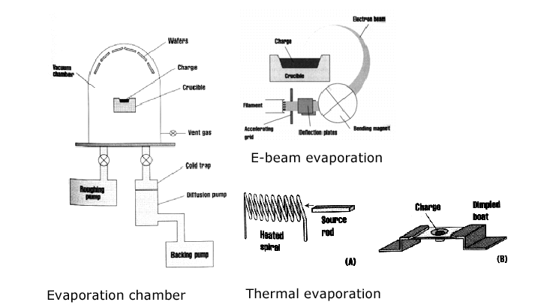
Physical vapor deposition (PVD)
The physical vapor deposition technique is based on the formation of vapor of the material to be deposited as a thin film. The material in solid form is either heated until evaporation (thermal evaporation) or sputtered by ions (sputtering). In the last case, ions are generated by a plasma discharge usually within an inert gas (argon). It is also possible to bombard the sample with an ion beam from an external ion source. This allows to vary the energy and intensity of ions reaching the target surface.

Slide 7
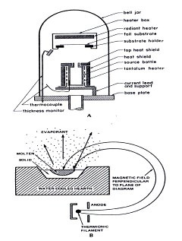
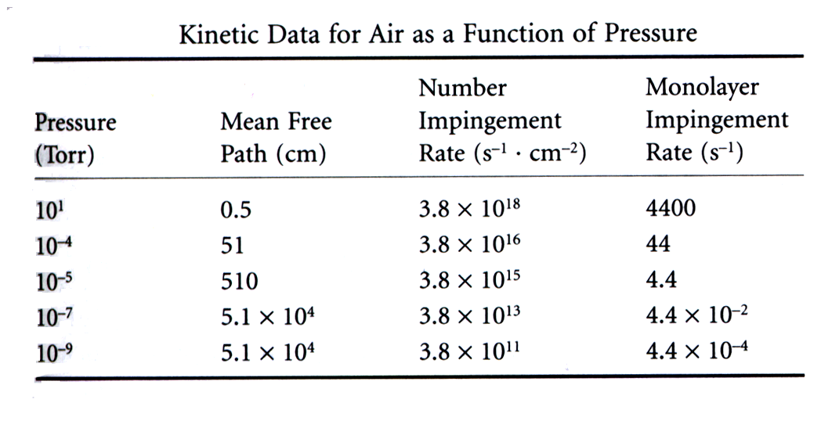
Physical vapor deposition (PVD): thermal evaporation
The number of molecules
leaving a unit area of evaporant
per second
6

Slide 8
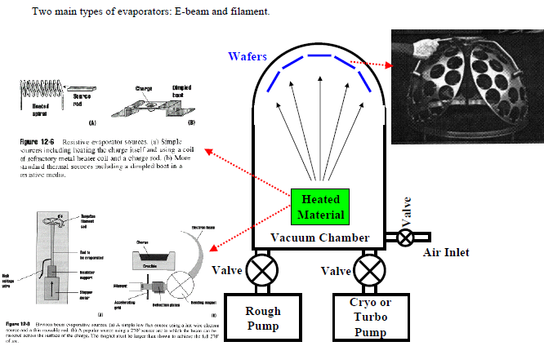
Resistive evaporation source using (a) coil of refractory metal heater and a charge rod and (b) Standard thermal source including a dimpled boar in a resistive media
Electron beam evaporative sources (a) low flux source using a hot wire electron and a thin movable rod and (b) 270º source arc in which beam can raster across the surface of charge by a magnet
PVD uses mainly physical processes to produce reactant species in the gas phase and to deposit films
In evaporation, source material is heated in high vacuum chamber (P<10⁻⁵ torr)
Mostly line of sight deposition since pressure is low
Deposition rate is determined by emitted flux and by geometry of the target and wafer holder

Slide 9
Physical vapor deposition (PVD): thermal evaporation
This is the relation between vapor pressure of
the evaporant and the evaporation rate. If a high
vacuum is established, most molecules/atoms will reach
the substrate without intervening collisions. Atoms and
molecules flow through the orifice in a single straight
track,or we have free molecular flow :
The fraction of particles scattered by collisions
with atoms of residual gas is proportional to:
The source-to-wafer distance must be smaler (e.g, 25 to 70 cm)

Slide 10
Physical vapor deposition (PVD): thermal evaporation
From kinetic theory the mean free path relates
to the total pressure as:
Since the thickness of the deposited film, t, is proportional
to the cos β, the ratio of the film thickness shown in the
figure on the right with θ = 0° is given as:

Slide 11
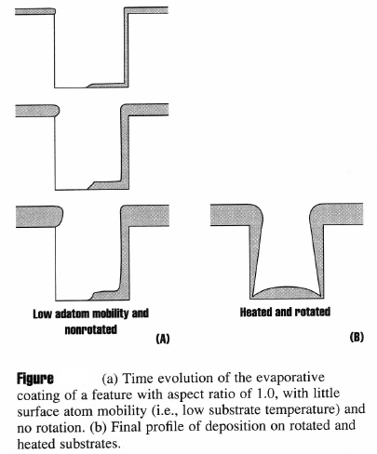
Evaporation Step Coverage
The step coverage of evaporated films is poor
due to the directional nature of the evaporated material (shadowing) (see figure 12-5). Heating (resulting in surface diffusion) and rotating the substrates (minimizing the shadowing) help with the step coverage problem, but evaporation can not form continuous films for aspect ratios (AR=step height/step width or diameter) greater
than 1.
We need a less directional metalization
scheme====> Higher pressures!

Slide 12
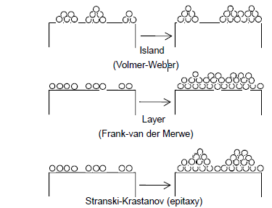
Thin Film Growth Modes

Slide 13
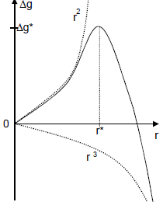
Homogeneous Nucleation
Spontaneous nucleation in gas phase
  no surface, dust, charge, etc.
  undesirable in practice -> polycrystals
If solid has vapor pressure P∞ & pressure of vapor above solid is P
  If P= P∞, vapor does not condensate, solid does not evaporate
  If P> P∞, vapor condenses
PV = NRT = nkT (where N=number of moles, R=gas constant, n=number of molecules,
k=Boltzman constant)
When vapor condenses, Energy change,
ΔG_{v} =Gibbs free energy of formation and is negative
As atoms add to the nucleus, it grows with the release of free energy and solid-vapor interface grows resulting in increase in free energy σ/unit area
Total increase in energy: ΔG_{homo} = (4/3)πr³ΔG_{v}+4πr²σ;
Max. at r* = -2σ/ΔG_{v;} ΔG*=(16π/3) (σ^{3/}ΔG_{v}²)
For nucleus r<r*, ΔG decrease by breaking up
For nucleus r>r*, ΔG decreases by growth
If P/P∞ is large, i.e. high supersaturation, ΔG_{v} increases and r* decreases
Note: As r* -> r_{atomic}, values of σ, surface concept can not be used

Slide 14
Heterogeneous Nucleation
deposition
re-evaporation
Introduce substrate, dust etc. in vapor
Consider adatoms on substrate, N_{ad}/unit area
N↓
N↑
N_{ad}
re-evaporation probability: W=ν exp (Q_{ad}/kT)
Where Q_{ad}=binding energy to substrate (negative)
Re-evaporation rate: N↑=N_{ad} ν exp (Q_{ad}/kT)
At steady state: N↑=N↓ -> N_{ad}=(N↓/ν) exp (-Q_{ad}/kT)
Residence time, τ=W⁻¹=ν⁻¹ exp(Q_{des}/kT); where, Q_{des}= desorption energy (positive)
Substrate
Adsorption rate: Assuming only adatom population with no further interaction
If N↓→0(deposition stopped), N_{ad}→0 (all eventually re-evaporated)
  Adsorption rate: dN_{ad}/dt = N↓ - N↑ = N↓ - N_{ad}/τ
  dN_{ad}/ (N↓τ - N_{ad})= dt/τ
  On integrating, N_{ad}(t) = N↓τ(1-exp-t/τ) ; For N_{ad}=0 at t=0
  For τ<<t, N_{ad}(t) =N↓τ (i.e. independent of time for weak physical adsorption)
  For τ>>t, N_{ad}(t) =N↓t (i.e. complete condensation for strong adsorption or initial transient)

Slide 15
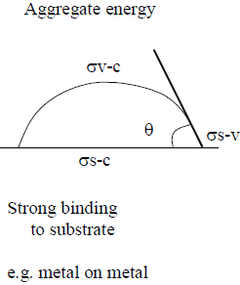
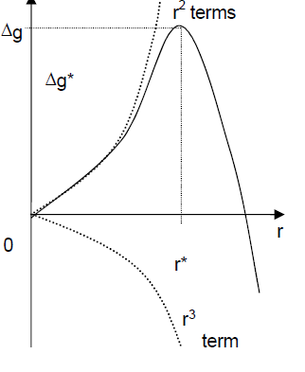
Heterogeneous Nucleation: Surface Diffusion
Surface diffusion of adatoms by distance X from point of impact
X=(2Dτ)^{1/2} = (2D)^{1/2}ν^{-1/2}exp(-Q_{ad}/2kT); Where, D=surface diffusivity = a²νexp(Q_{diff}/kT)
X=2^{1/2}aexp-((Q_{diff} +Q_{ad})/2kT); Where, a=interatomic distance
When adjacent nuclei separation < X; no further nuclei created -> all atoms join existing nuclei
Capillary Model
  For island clusters with ІQ_{ad}І >> kT (cold substrate/metal on metal)
  N ↑small & N_{ad} large, interatomic collisions > clustering
  ΔG=a₃r³ΔG_{v}+a₁r²σ_{V-C}+a₂r²σ_{S-C}-a₂r²σ_{S-V}
  Where DG = Free energy of condensation (negative)=(kT/V)ln(N↓/N↑); V=molecular volume)
  On differentiating; ΔG/∂r = 3a₃r²ΔG_{v}+2a₁rσ_{V-C}+2a₂r(σ_{S-C}-σ_{S-V}) and equating to 0 at r* = critical radius; ΔG* = [4(a₁σ_{V-C}+a₂σ_{S-C}-a₂σ_{S-V})]/(27a₃²ΔG_{v}²)
  = [4π(σ_{V-C}³)3ΔG_{v}²](2+cosθ)(1-cosθ)² For spherical cap nucleus
  r*=[-2(a₁σ_{V-C}+a₂σ_{S-C}-a₂σ_{S-V})]/3a₃ΔG_{v}
  = -2σ_{V-C}/ΔG_{v}

Slide 16
Spherical Cap: General Trend
Weak substrate binding, q large; e.g. Au on glass
High supersaturation ratio (N↓/N↑ → small r* (e.g. low vapor pressure material) (e.g. W), cold substrate, high deposition rate, strong substrate adhesion; Continuity reached early (many small islands)
ΔG_{v} large, r* →0, No nucleation barrier, monolayer formation (or σ_{s-v} high
So, σ_{c-v} +σ_{c-s} ~ σ_{s-v})
d) ∂r*/ ∂T)_{N↓} > 0; ∂r*/ ∂N↓)_{T} <0
but large ΔN↓ required for significant Δr*
Charging effects on nucleation: No initial barrier to nucleation; only barrier to growth
Field enhances coalescence, field can inhibit nucleation or enhance nucleation
Surface defects increase ΔG* and r* but less atoms/critical nucleus
Nucleation Rate
Adatom residence time, τ = ν⁻¹ exp(Q_{des}/kT); where, Q_{des}= desorption energy (positive)
Nucleation rate N^{R} = N*A*ω; where N*=exp(-ΔG*/kT); n_{s}=nucleation site density,
A*=2πr*a_{o}sinθ; ω=τN↓D; N^{R} = 2πr*a_{o}sinθ PNA/(2πMRT)^{1/2}n_{s}exp(E_{des}-E_{diff}-ΔG*)/kT (Rate of creation super critical nucleus

Slide 17
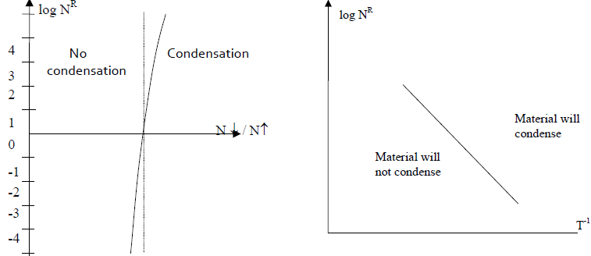
Nucleation Rate-Contd.
Note: N^{R} α exp-ΔG*/kT
ΔG* α ΔG_{V}⁻²
ΔG_{V} α ln(N↓/N↑)
lnN^{R} α [ln(N↓/N↑)]²
(N↓/N↑) = super saturation ratio

Slide 18
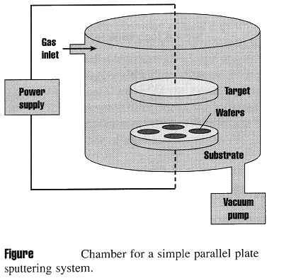
Sputter Deposition
A plasma at higher pressure is used to “knock” metal atoms out of a target. These energetic atoms deposit on a wafer located near the target. The higher pressure produces better step coverage due to more random angled delivery. The excess energy of the ions also aids in increasing the surface mobility
Uses plasma to sputter target, dislodge atoms and deposit on wafers to form film.
Higher pressures than evaporation (1-100 torr)
Better at depositing alloys and compounds than evaporation
Plasma contains Ar positive ions, electrons, and neutral Ar atoms
Threshold energy:
Where
Advantages: Better step coverage, less radiation damage than E-beam evaporation, easier to deposit allots
Disadvantages: Some plasma damage including implanted Ar, Good for ohmics but not Schottky diodes

Slide 19
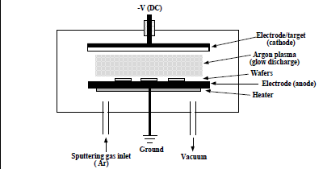
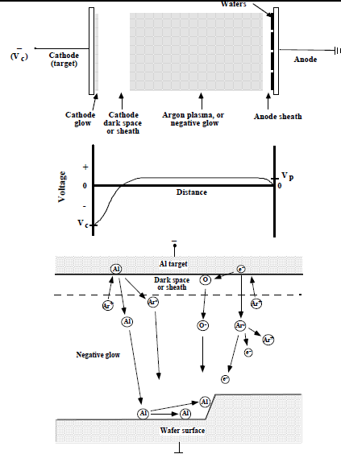
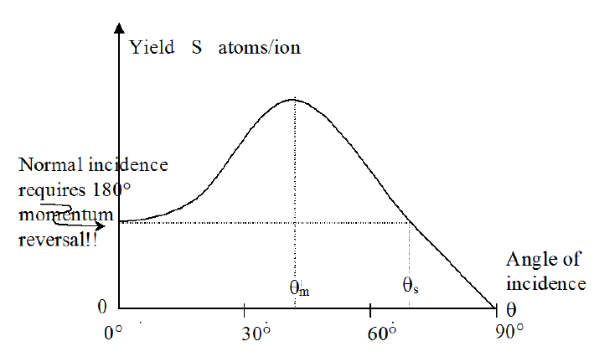
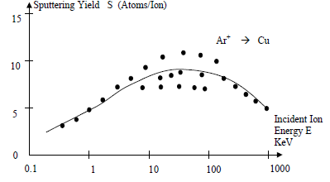
DC Sputter Deposition - Working Principle
Most of voltage drop of the system (due to applied DC voltage, Vc) occurs over cathode sheath
Ar+ ions are accelerated across cathode to the negatively cathode, striking the electrode and sputtering off atoms. These atoms travel through plasma and deposit on wafers sitting on anode.
Rate of sputtering depends on the sputtering yield, Y, defined as number of atoms or molecules ejected from the target per incident ion
Y is a function of energy and mass of ions, and the target material. It is also a function of incident angle.

Slide 20
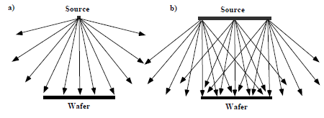
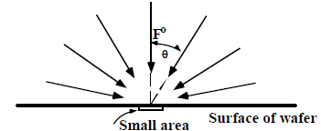
Isotropic flux arrival
Non-Isotropic flux arrival
Sputtering targets are generally large and provide a wide range of arrival angles in contrast to a point source
Arrival angle distribution generally described by a cos^{n}θ (i.e. normal component of flux striking the surface determines the deposition or growth rate
Size and type of source, system geometry and collisions in gas phase play an important in distribution of arrival angle.

Slide 21
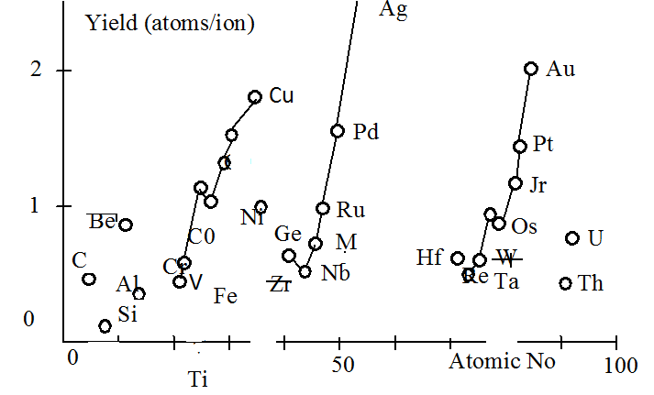
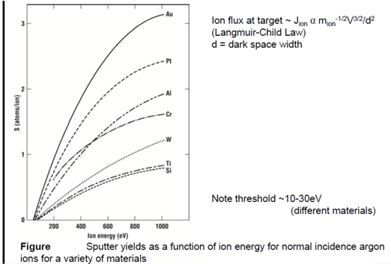
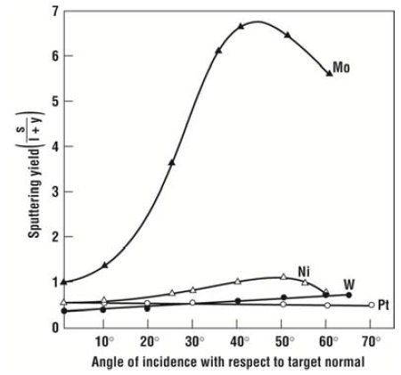
Factors Affecting Sputtering Yield
Yield vs. Target
Yield vs. Ion energy
Yield vs. angle of incidence

Slide 22
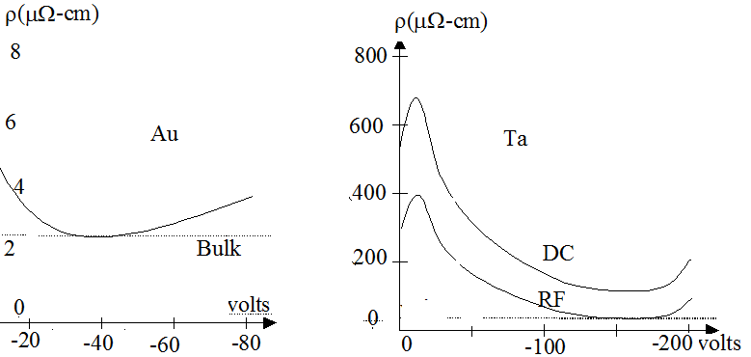
Effect of Substrate Bias
Substrate biasing reduces the yield (i.e. lower deposition rate)
Substrate biasing helps in good adhesion with the substrate during initial stage of deposition; subsequently biasing voltage is switched off.
Sputter surface cleaning also helps to improve adhesion of coating with the substrate.

Slide 23
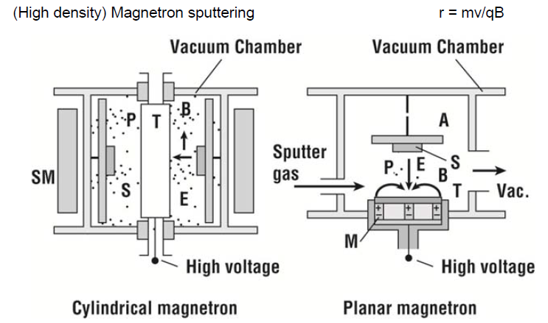
Cylindrical and Planar Magnetron
T: Target, P: plasma; SM: solenoid; M: magnet; E:electric field; B: magnetic field

Slide 24
The main difference is that the power used in RF sputtering is AC, while that in DC sputtering is DC. Basically, during DC sputtering, the working gas will be ionized. As a result, many positive ions will be produced within the chamber and accumulate on the surface of target If the conductivity of target you sputtering is not very good.

Slide 25
The use of DC in a plasma requires electrically conductive electrodes. If one or both of the electrodes are non-conductive, e.g. when the glow discharge is used for the deposition of dielectric films, where the electrodes become gradually covered with insulating material, the insulator would charge up and terminate the discharge.

Slide 26
The use of an alternative current AC power source can alleviate this problem because positive charges accumulated during one half-cycle can be neutralized by electron bombardment during the next cycle. The frequencies generally used for these alternating voltages are typically in the radiofrequency (RF) range (1 kHz–103 MHz; with a most common value of 13.56 MHz

Slide 27
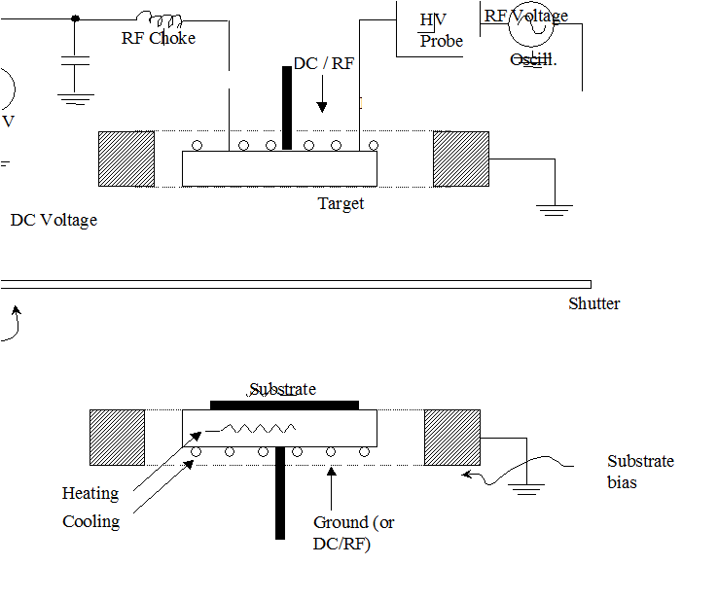
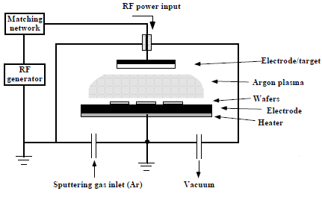
RF Sputter Deposition
For DC sputtering, target electrode is conducting
To sputter dielectric materials use RF power source
Due to slower mobility of ions vs., electrons, the plasma biases positively with respect to both electrodes (DC current = 0); Therefore, continuous sputtering.
When electrodes areas are not equal, field must be higher at the smaller electrode (higher current density) to maintain overall current continuity
Thus by making the target electrode smaller, sputtering occurs “only” on the target. Wafer electrode can also be connected to chamber walls, further increasing V₂/V₁

Slide 28
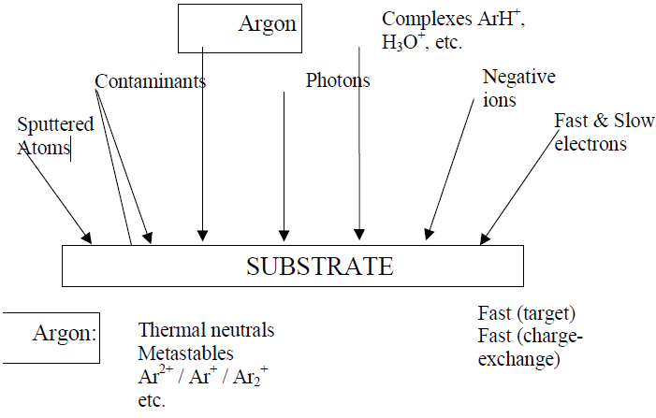
Sputtering Contamination

Slide 29
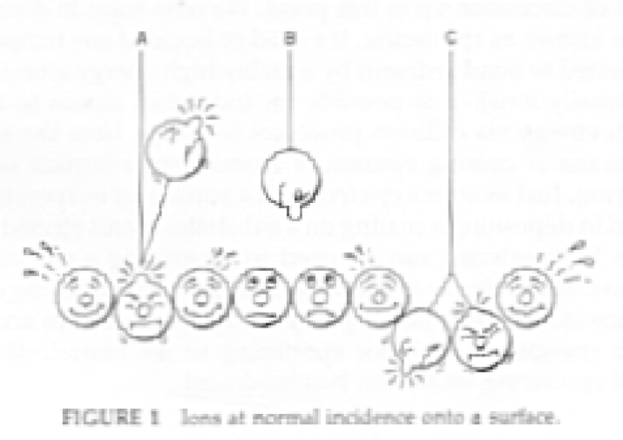
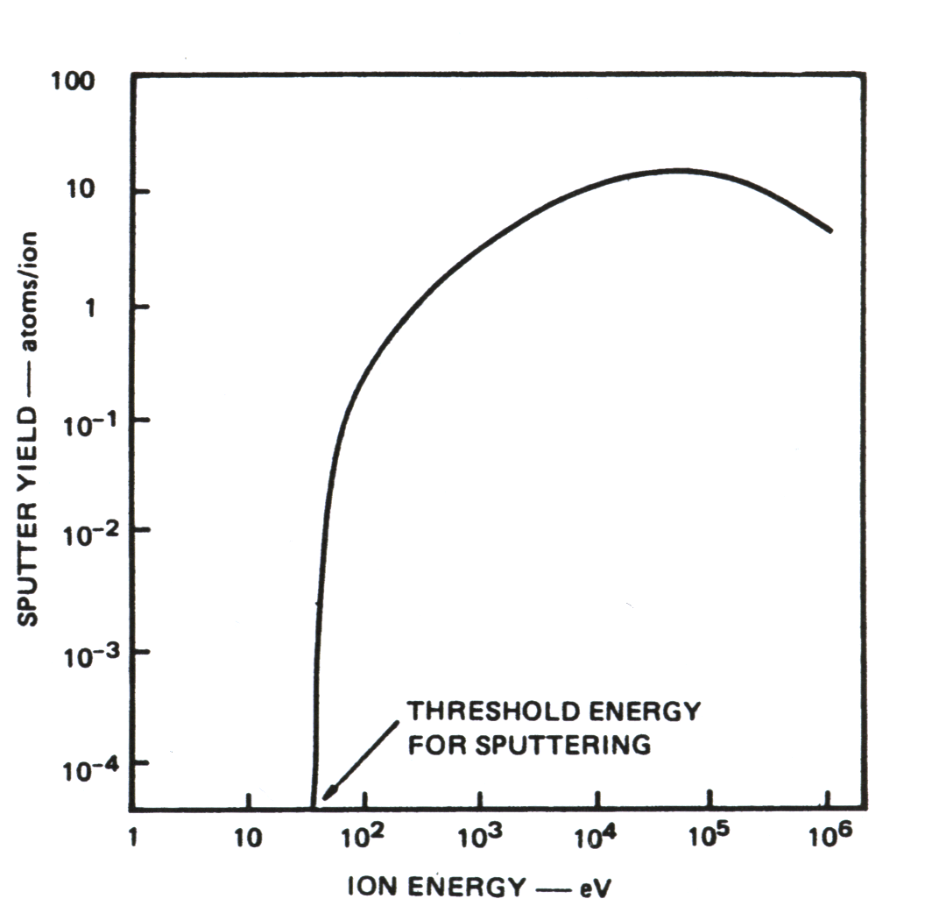
Physical vapor deposition (PVD): sputtering
Momentum transfer
-V working voltage
- i discharge current
- d, anode-cathode distance
- P_{T}, gas pressure
- k proportionality constant

Slide 30
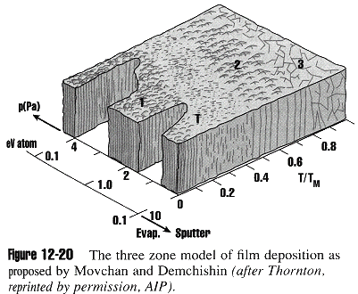
Sputtered Film Characteristics
Porous and/or amorphous -> results from poor surface mobility due to low temperature, low ion energy (Low RF power/DC bias or higher pressures, less acceleration
T (transition)-Zone: small grain polycrystalline, dense, smooth, and high reflectance results from higher surface mobility due to higher temperature or ion energy
Further increases in surface mobility results in columnar grains that have rough surfaces and poor coverage
Still further increase in surface mobility result in large (non-columnar) grains. These grains can be good for diffusion barriers (less grain boundary diffusion due to fewer grains) but pose problems for lithography due to light scatter off of large grains and tend to be more rigid leading to more failures in electrical lines.

Slide 31
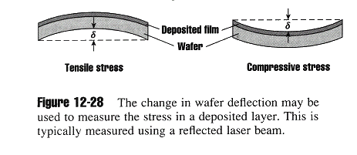
Film Stresses
Film stress can result in wafer bowing (problem with lithography), film cracking or peeling.
1) Extrinsic stress (force acting on the wafer due to sources external to the deposited film)
Thermal induced stress
Y: Young’s modulus, α: thermal expansion coefficient, ν: Poisson’s ratio
2. Intrinsic Stress (forces acting on the wafer due to sources internal to the deposited film) such as differences in atomic spacing, variation in grain orientation or size, grain growth during depositing and implanted trapped gaseous impurities such as Ar.
Both these stresses can lead to a bowed wafer with deflection δ given by:
Where, D=wafer thickness, t=film thickness, R=radius of the wafer bow

Slide 32
Evaporation and Sputtering: Comparison
 | Evaporation | Sputtering
Rate | 1000 atomic layers/sec (e.g. 0.5μm/min. for Al) | 1 atomic layer/sec
Choice of materials | Limited | Almost unlimited
Purity | Better (no gas inclusions, very high vacuum) | Possibility of incorporating impurities (low medium vacuum range)
Substrate heating | Very low | Unless magnetron is used substrate heating is substantial
Surface damage | Very low, with e-beam x-ray damage is possible | Ionic bombardment damage
In-situ cleaning | Not an option | Easily done with sputter etch
Alloy compositions, stochiometry | Little or no control | Alloy composition can be tightly controlled
X-ray damage | Only with e-beam evaporation | Radiation and particle damage is possible
Changes in source material | Easy | Expensive

Slide 33
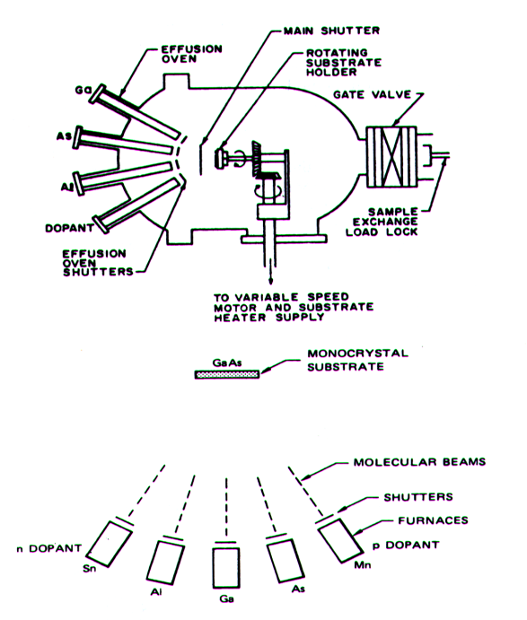
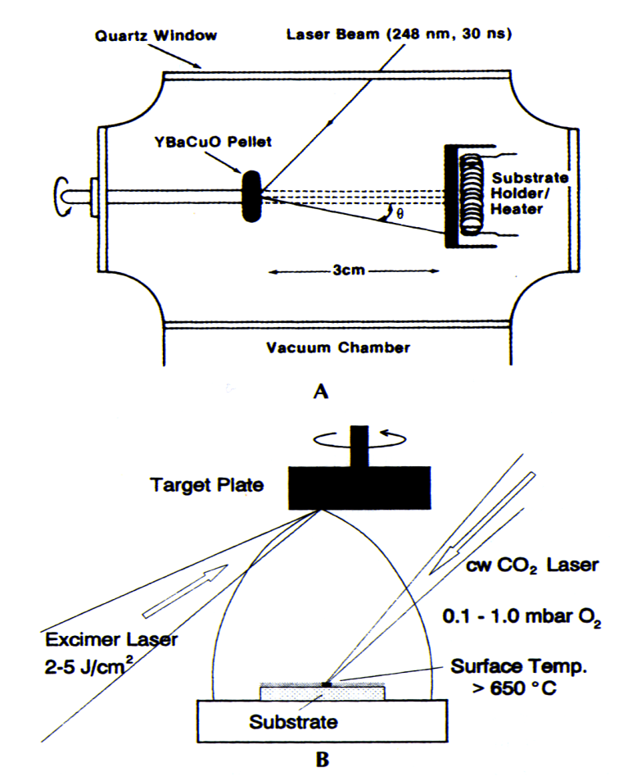
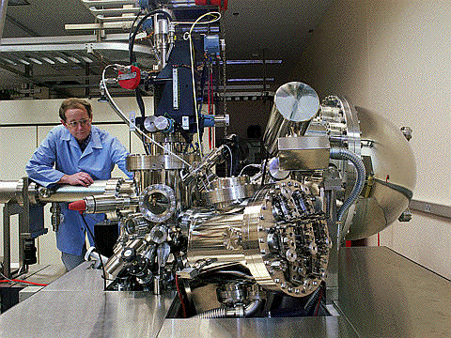
Physical vapor deposition (PVD): MBE, Laser Ablation
MBE (Molecular beam epitaxy)
  Epitaxy: homo-epitaxy (1 material) hetero-epitaxy (2 or more materials)
  Very slow: 1µm/hr
  Very low pressure: 10⁻¹¹ Torr
Laser sputter deposition
  Complex compounds (e.g. HTSC (high temp. super conductor, biocompatible ceramics)
-

Slide 34
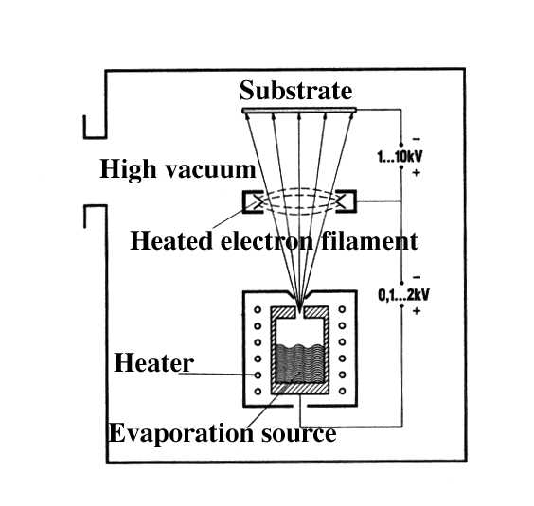
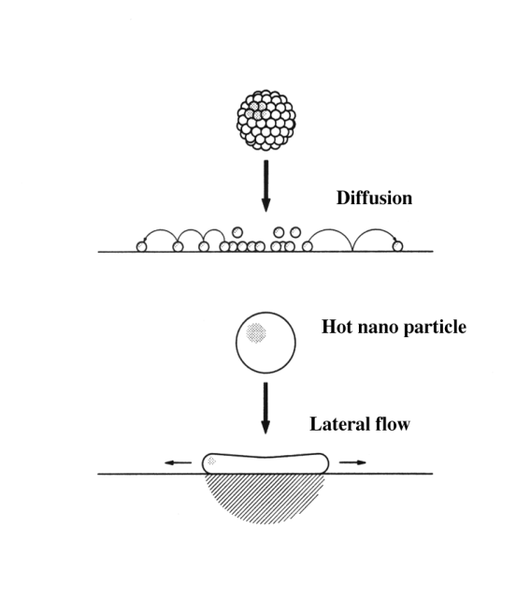
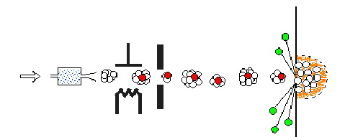
Physical vapor deposition (PVD): Ion cluster plating
Ionized cluster: it is possible to ionize atom clusters that are being evaporated leading to a higher energy and a film with better properties (adherence, density, etc.).
  From 100 mbar (heater cell) to 10⁻⁵ to 10⁻⁷ mbar (vacuum)--sudden cooling
  Deposits nanoparticles
Combines evaporation with a plasma
    faster than sputtering
    complex compositions
    good adhesion

Slide 35
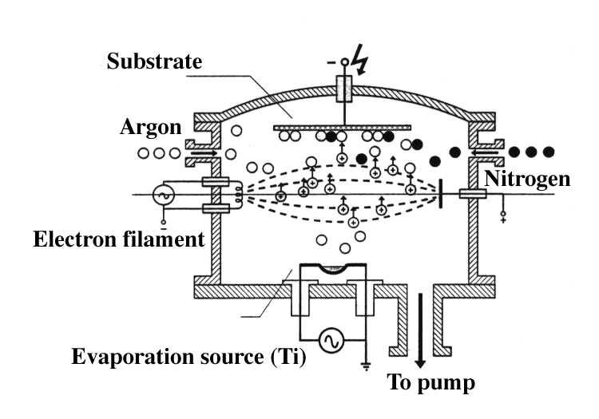
Physical vapor deposition (PVD):Ion cluster plating and ion plating
Gas cluster ions consist of many atoms or molecules weakly bound to each other and sharing a common electrical charge. As in the case of monomer ions, beams of cluster ions can propagate under vacuum and the energies of the ions can be controlled using acceleration voltages. A cluster ion has much larger mass and momentum with lower energy per atom than a monomer ion carrying the same total energy. Upon impact on solid surfaces, cluster ions depart all their energy to an extremely shallow region of the surface. Cluster plating material is forced sideways and produces highly smooth surfaces.
Also individual atoms can be ionized and lead to ion plating (see figure on the right, example coating : very hard TiN)

Slide 36
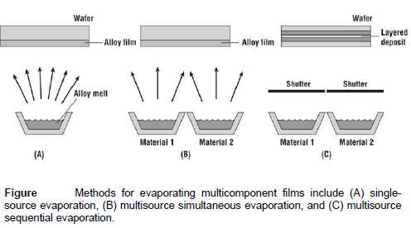
Alloy Deposition

Slide 37
Summary of Merits and Demerits of evaporation methods
Method | Merits | Demerits
E-Beam Evaporation | 1. high temp materials 2. good for liftoff 3. highest purity | 1. some CMOS processes sensitive to radiation 2. alloys difficult 3. poor step coverage
Filament Evaporation | 1. simple to implement 2. good for liftoff | 1. limited source material (no high temp) 2. alloys difficult 3. poor step coverage
Sputter Deposition | 1. better step coverage 2. alloys 3. high temp materials 4. less radiation damage | 1. possible grainy films 2. porous films 3. plasma damage/contamination

Slide 38
Importance of PVD Coatings
PVD coatings are deposited for numerous reasons. Some of the main ones are:
Improved hardness and wear resistance
Reduced friction
Improved oxidation resistance
The use of such coatings is aimed at improving efficiency through improved performance and longer component life.
They may also allow coated components to operate in environments that the uncoated component would not otherwise have been able to perform.

Slide 39
Advantages
Materials can be deposited with improved properties compared to the substrate material
Coating temperature is below the final heat treating temperature
Small, precisely reproducible coating thickness
High wear resistance
Low frictional coefficient
Almost any type of inorganic material can be used as well as some kinds of organic materials
The process is more environmentally friendly than processes such as electroplating
Disadvantages
It is a line of sight technique meaning that it is extremely difficult to coat undercuts and similar surface features
High capital cost
Some processes operate at high vacuums and temperatures requiring skilled operators
Processes requiring large amounts of heat require appropriate cooling systems
The rate of coating deposition is usually quite slow

Slide 40
Applications
PVD coatings are generally used to improve hardness, wear resistance and oxidation resistance.
Thus, such coatings use in a wide range of applications such as:
Aerospace
Automotive
Surgical/Medical
Dies and moulds for all manner of material processing
Cutting tools
Fire arms 4040

Slide 41
Summary of Key Ideas
• Thin film deposition is a key technology in modern IC fabrication.
• Topography coverage issues and filling issues are very important, especially as
geometries continue to decrease.
• CVD and PVD are the two principal deposition techniques.
• In PVD systems arrival angle distribution is very important in determining
surface coverage. Shadowing can be very important.
• A wide variety of systems are used in manufacturing for depositing specific
thin films, e.g. magnetron sputtering.
• Advanced simulation tools are becoming available, which are very useful in
predicting topographic issues.
• Generally these simulators are based on physical models of mass transport and
surface reactions and utilize parameters like arrival angle and sticking
coefficients from direct and indirect fluxes to model local deposition rates.
• Thin film stress can be due to differential CTEs, impurities, and grain growth.

Slide 42
CVD-Overview
What is CVD?
Types of CVD
  MO-CVD, PE-CVD, etc
CVD process / applications

Slide 43
What is CVD Process?
Chemical Vapor Deposition is the formation of a non-volatile solid film on a substrate by the reaction of vapor phase chemicals (reactants) that contain the required constituents.
The reactant gases are introduced into a reaction chamber and are decomposed and reacted at a heated surface to form the thin film.

Slide 44
CVD Process Applications
Microfabrication processes widely use CVD to deposit materials in various forms, including: monocrystalline, polycrystalline, amorphous, and epitaxial. These materials include: silicon, carbon fiber, carbon nanofibers, filaments, carbon nanotubes, SiO₂, silicon-germanium, tungsten, silicon carbide, silicon nitride, silicon oxynitride, titanium nitride, and various high-k dielectrics. The CVD process is also used to produce synthetic diamonds.

Slide 45
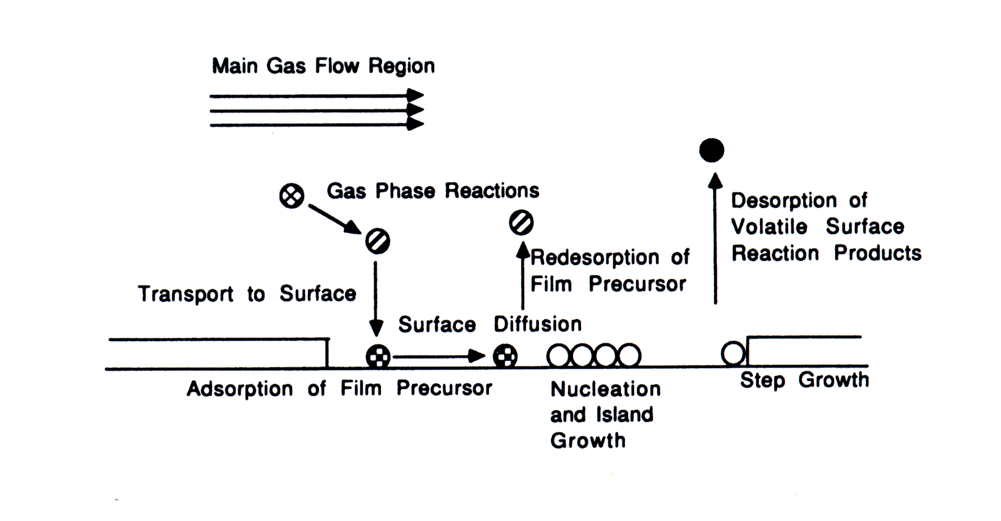
Chemical vapor deposition (CVD): reaction mechanisms
Mass transport of the reactant in the bulk
Gas-phase reactions (homogeneous)
Mass transport to the surface
Adsorption on the surface
Surface reactions (heterogeneous)
Surface migration
Incorporation of film constituents, island formation
Desorption of by-products
Mass transport of by-produccts in bulk
CVD: Diffusive-convective transport of depositing species to a substrate with many intermolecular collisions-driven by a concentration gradient
SiH₄
SiH4
Si

Slide 46
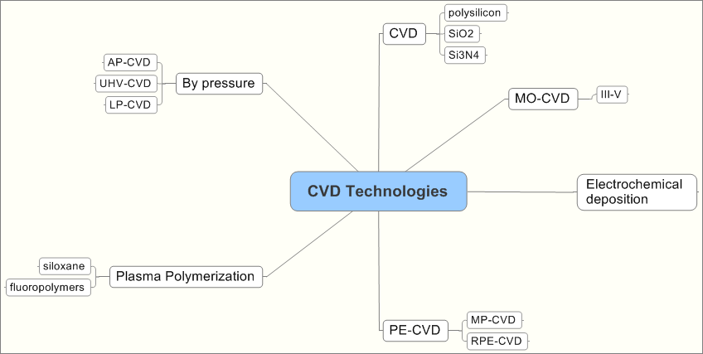
Family of CVD Technologies

Slide 47
Chemical Vapor Deposition
CVD => Chemical Vapor Deposition
PE-CVD => Plasma Enhanced CVD
MO-CVD => Metal Organic CVD
Atmospheric pressure CVD (AP-CVD)
Low-pressure CVD (LP-CVD)
Ultrahigh vacuum CVD (UHV-CVD)
Aerosol assisted CVD (AA-CVD)
Direct liquid injection CVD (DLICVD)

Slide 48
Other Types of Chemical Vapor Deposition
Atomic layer CVD (ALCVD)
Combustion Chemical Vapor Deposition (CCVD)
Hot wire CVD (HWCVD)
Hybrid Physical-Chemical Vapor Deposition (HPCVD)
Rapid thermal CVD (RTCVD)
Vapor phase epitaxy (VPE)

Slide 49
Chemical vapor deposition (CVD): reaction mechanisms
Energy sources for deposition:
  Thermal
  Plasma
  Laser
  Photons
Deposition rate or film growth rate
Laminar flow
(U)
δ(x)
(Fick’s first law)
L
dx
(Boundary layer thickness)
(gas viscosity η, gas density ρ, gas stream velocity U)
(Dimensionless Reynolds number)
(by substitution in Fick’s first law and Δx=δ)

Slide 50
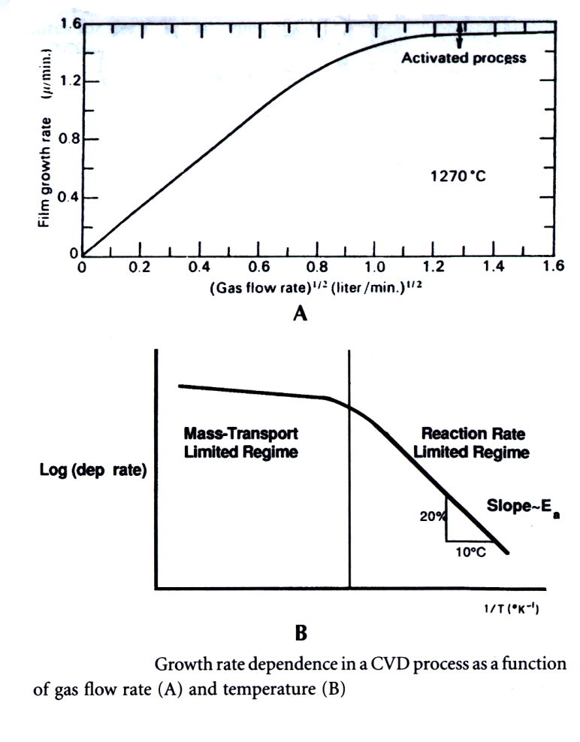
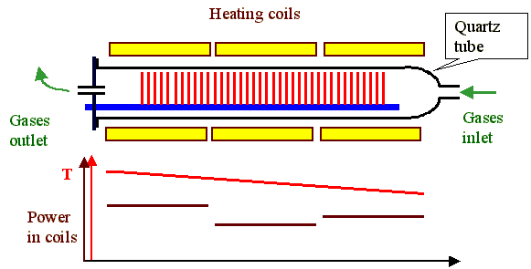
Chemical vapor deposition (CVD)
: reaction mechanisms
Mass flow controlled regime (square root of gas velocity)(e.g. AP CVD~ 100-10 kPa) : FASTER
Thermally activated regime: rate limiting step is surface reaction (e.g. LP CVD ~ 100 Pa----D is very large) : SLOWER

Slide 51
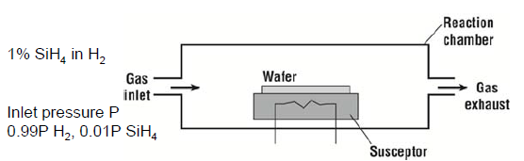
Basic CVD Concept
Example: Si deposition by CVD (assume atmospheric pressure (APCVD)
Silane: SiH₄(g) ↔ SiH₂(g) + 2H(g);
Reaction constant:
SiH₂(g) ↔ SiH₂(a); SiH₂(a) ↔ Si(s) + H₂(g) (a: adsorbed; s: solid)
Where f’s: flow rates
A simple prototype thermal CVD reactor

Slide 52
CVD Reactions
Pyrolysis: Thermal decomposition
SiH₄(g) →Si(s) + 2H₂(g)
SiH₂Cl₂(g)→ Si(s) + 2HCl(g)
CH₄(g)→C(diamond/graphite)+2H₂(g)
Ni(CO)₄(g)→Ni(s) + 4CO(g)
Oxidation:
SiH₄(g) + 2O₂(g)→SiO₂(s) + 2H₂O(g)
3SiH₄(g) + 4NH₃(g)→Si₃N₄(s) + 12H₂(g)
Hydrolysis:
2AlCl₃(g) + 3H₂O(g)→ Al₂O₃(s) + 6HCl(g)
Reduction:
WF₆(g) + 3H₂(g)→ W(s) + 6HF(g)
Displacement:
Ga(CH₃)₃(g) + AsH₃(g)→GaAs(s) + 3CH₄(g)
ZnCl₂(g) + H₂S(g) → ZnS(s) + 2HCl(g)
2TiCl₄(g) + 2NH₃(g) + H₂(g) → TiN(s) + 8HCl(g)

Slide 53
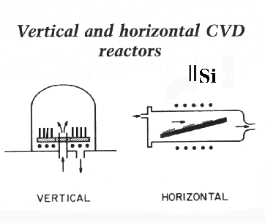
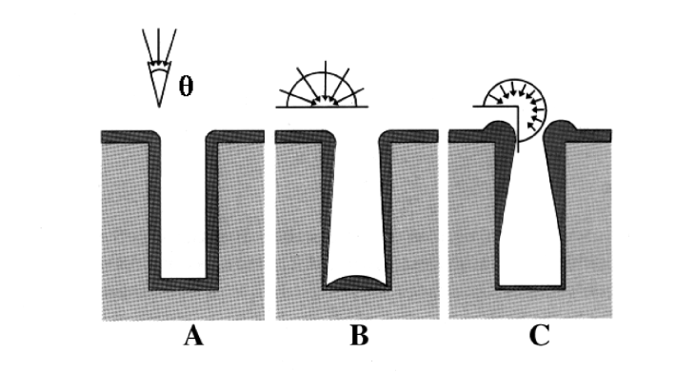
Chemical vapor deposition (CVD): step coverage
Step coverage, two factors are important
  Mean free path and surface migration i.e. P and T
  Mean free path: λ =
0
z
θ=180
θ is angle of arrival
0
θ=90
0
α
θ=270
w

Slide 54
Chemical vapor deposition (CVD) : overview
CVD (thermal)
  APCVD (atmospheric)
  LPCVD (<10 Pa)
  VLPCVD (<1.3 Pa)
PE CVD (plasma enhanced)
Photon-assisted CVD
Laser-assisted CVD
MOCVD

Slide 55
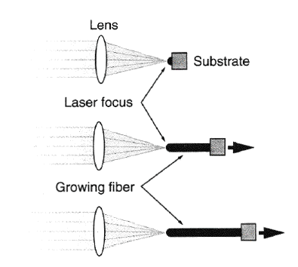
Chemical vapor deposition (CVD) : L-CVD
The L-CVD method is able to fabricate continuous thin rods and fibres by pulling the substrate away from the stationary laser focus at the linear growth speed of the material while keeping the laser focus on the rod tip, as shown in the Figure . LCVD was first demonstrated for carbon and silicon rods. However, fibers were grown from other substrates including silicon, carbon, boron, oxides, nitrides, carbides, borides, and metals such as aluminium. The L-CVD process can operate at low and high chamber pressures. The growth rate is normally less than 100 µm/s at low chamber pressure (<<1 bar). At high chamber pressure (>1 bar), high growth rate (>1.1 mm/s) has been achieved for small-diameter (< 20 µm) amorphous boron fibers.

Slide 56
Plasma Enhanced CVD
  Microwave plasma-assisted CVD (MP-CVD)
Plasma-Enhanced CVD (PE-CVD)
Remote plasma-enhanced CVD (RPE-CVD)

Slide 57
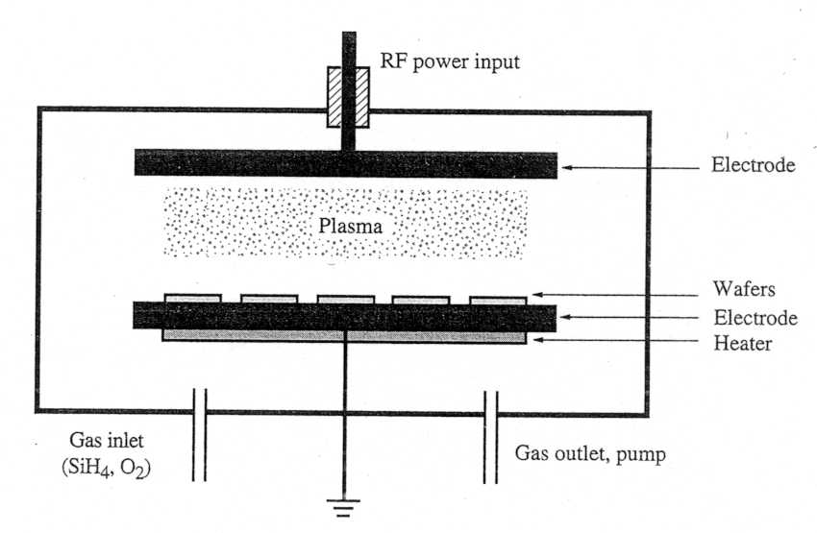
Plasma Enhanced (PE)CVD
As the flow of thermal energy gets more constrained while more layers are added for multi-layer metallization, we want to come down with the temperature for the oxide ( or other) CVD processes. One way for doing this is to supply the necessary energy for the chemical reaction by ionizing the gas, thus forming a plasma.

Slide 58
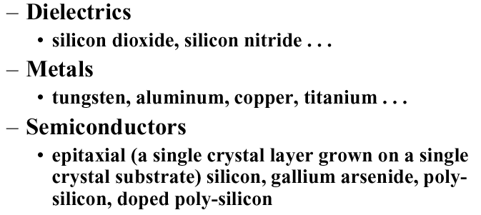
Applications of CVD

Slide 59
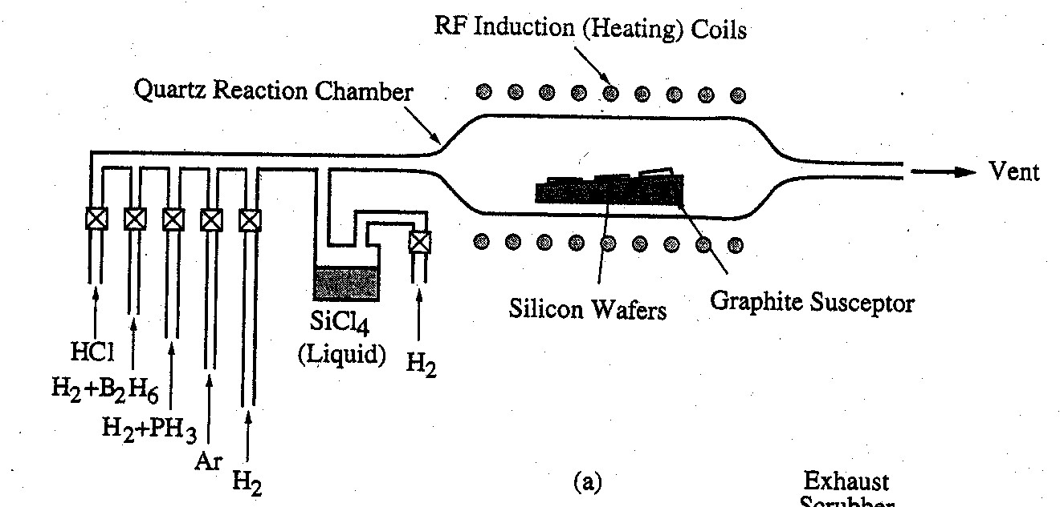
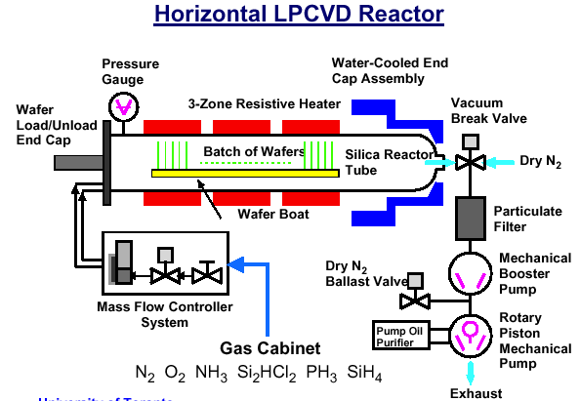
CVD Reactors
Horizontal APCVD Reactor

Slide 60
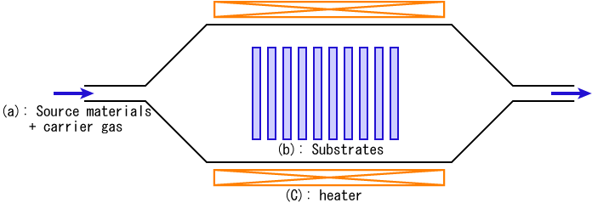
Thermal CVD Reactor
Chemical Vapor Deposition Apparatus

Slide 61



Chemical Vapor Deposition

Slide 62
CVD Growth Model

Slide 63
Comparison
CVD Process | Advantages | Disadvantages | Applications
APCVD | Simple, Fast Deposition, Low Temperature | Poor Step Coverage, Contamination | Low-temperature Oxides
LPCVD | Excellent Purity, Excellent Uniformity, Good Step Coverage, Large Wafer Capacity | High Temperature, Slow Deposition | High-temperature Oxides, Silicon Nitride, Poly-Si, W, WSi₂
PECVD | Low Temperature, Good Step Coverage | Chemical and Particle Contamination | Low-temperature Insulators over Metals, Nitride Passivation

Slide 64
Silicon CVD ‘Epitaxy’
When SiH₄ gas is used in a CVD reactor, a Si layer is deposited on the wafer surface. The size of the crystallites depends on the deposition temperature.
At high enough temperature, the ad-atoms have enough kinetic energy to move on the surface and align themselves with the underlying Si.
This is an epitaxial layer, and the process is called Epitaxy instead of CVD.
At lower deposition temperatures, the layer is poly-crystalline Si (consisting of small crystallites)

Slide 65

Silicon Epitaxy Process
The chemical reaction that produces the Si is fairly simple:
SiCl_{4(g)}+2H_{2(g)}=(1000-1200ºC)=Si_{(s)}+4HCl_{(g)}
Instead of SiCl₄ you may want to use SiH_{X}Cl_{4-X}

Slide 67
CVD Used in Semiconductors
Layer
Reaction equations
Temperature (ºC)
SiO₂
LTO
TEOS
HTO
SiH₄ + O₂ -> SiO₂ + 2H₂
Si(OC₂H₅)₄ -> SiO₂ + gas.RP
SiCl₂H₂ + N₂O -> SiO₂ + 2N₂ + 2HCl
SiH₄ + CO₂+H₂ -> SiO₂ + gas.RP
400-450
650-700
850-900
850-950
Si₃N₄
3SiH₂Cl₂ + 4NH₃ -> Si₃N₄ + 6HCl + 6H₂
700-900
Polysilicon
SiH₄ -> Si + 2H₂
600-650
Tungsten
selective
blanket
2WF₆ + 3Si -> 2W + 3SiF₄
WF₆ + SiH₄ -> W + SiF₄ + 2HF + H₂
300
400-450

Slide 68
Silicon Oxide CVD Process
There are several possibilities, one is
SiH₂CI₂ + 2NO₂ = (900 °C) = SiO₂ + 2HCI + 2N₂
While this reaction was used until about 1985, a better reaction is offered by the "TEOS" process.
Si(C₂H₅O)₄ = (720 °C) = SiO₂ + 2H₂O + C₂H₄.
Si(C₂H₅O)₄ has the chemical name Tetraethylorthosilicate

Slide 69
MO-CVD
A technique for growing thin layers of compound semiconductors in which metal organic compounds, having the formula MR_{x}, where M is a group III metal and R is an organic radical, are decomposed near the surface of a heated substrate wafer, in the presence of a hydride of a group V element. Abbreviated MOCVD.

Slide 70
MO-CVD: Trimethylgallium (TMG) + Arsine (AsH₃)=> GaAs
The various techniques of growing epitaxial layers from the vapor phase can be divided roughly into two categories depending on whether the species are transported physically or chemically from the source to the substrate. In the physical transport techniques (Physical Vapor Deposition - PVD), the compound to be grown or its constituents are evaporated and subsequently transported through the relevant reactor toward the substrate. In the chemical transport techniques (Chemical Vapor Deposition - CVD), volatile species containing the constituent elements of the layer to be grown are produced first in- or outside the reactor and transported as streams of vapor towards the reaction zone near the substrate. These gaseous species subsequently undergo chemical reactions or dissociate thermally to form the reactants which participate in the growth of the film. The practical demand to decrease the growth temperature generated an intensive development trend of CVD processes based on metal organic compounds, decomposing at lower temperatures. This process is referred to as Metal Organic Chemical Vapor Deposition (MOCVD) or Organometallic Vapor Phase Epitaxy. The classical example is the growth of GaAs from Trimethylgallium (TMG) and Arsine (AsH₃). In our laboratory we apply this technique to grow GaN from TMG and Ammonia. However, this technique is based on a very precise control of the gas flow as can be estimated from the look into the gas mixing cabinet.

Slide 71

Planetary MOCVD reactor in an industrial setup (Photo courtesy of Aixtron)

Slide 72

Metal Organic Vapor Phase Epitaxy MO-VPE
Metal organic vapor phase epitaxy (MOVPE), also known as organometallic vapor phase epitaxy (OMVPE) or metal organic chemical vapor deposition (MOCVD), is a chemical vapour deposition method of epitaxial growth of materials, especially compound semiconductors, from the surface reaction of organic compounds or metalorganics and metal hydrides containing the required chemical elements. For example, indium phosphide could be grown in a reactor on a substrate by introducing Trimethylindium ((CH₃)₃In) and phosphine (PH₃). Formation of the epitaxial layer occurs by final pyrolysis of the constituent chemicals at the substrate surface. In contrast to molecular beam epitaxy (MBE) the growth of crystals is by chemical reaction and not physical deposition.

Slide 73
PE-CVD
Plasma-enhanced chemical vapor deposition (PECVD) is a process used to deposit thin films from a gas state (vapor) to a solid state on a substrate. Chemical reactions are involved in the process, which occur after creation of a plasma of the reacting gases. The plasma is generally created by RF (AC) frequency or DC discharge between two electrodes, the space between which is filled with the reacting gases

Slide 74

PE-CVD Apparatus
Thermal - chemical vapor deposition
A thermal-CVD system was built for carbon nanotubes production via gas phase or on substrate surface. The sketch of thermal-CVD system consists of quartz tube furnace which can operate till 1200 degree centigrade. The sketch of our equipment is shown in figure 1. Main advantages of a thermal-CVD are: the absolute ability for mass production of nanotubes material and the controllable growth of carbon nanotubes at a specific location on a substrate for incorporation in electronic device.
Plasma Enhanced - chemical vapor deposition
A controllable method for carbon nanotubes production is plasma enhanced-CVD. Such a system is often used to grow free standing vertically aligned MWCNT. The set-up which our laboratory is equipped with is a glow discharged type. Briefly, two electrodes are placed in a stainless-steel chamber. The grounded cathode plays the role of a substrate holder and Ohmic heater. On the anode is applied aprox.400V.
Advantages:
Significantly lower process temp. are possible than for CVD
Precise coatings
Disadvantages:
Only limited suitability for bore holes, slots etc.

Slide 75

Low Pressure RF Plasma for PECVD of TiO2 on Plastics

Slide 76
CVD Coatings and their properties.
CVD Coatings containing | On to various substrates | Properties
Chromium | Solid solution alloys (i) with Iron, Nickel and Cobalt (ii) on Iron as carbides and nitrides | (i) Corrosion / oxidation resistance (ii) Wear / corrosion resistance
Aluminium | As Aluminides with Iron, Cobalt and Nickel | High temperature oxidation resistance
Boron | As Borides with Iron, Cobalt and Nickel | Wear / erosion resistance
Silicon | As Silicides with Iron, Tungsten and Molybdenum | High temperature oxidation resistance
Titanium | As Carbides, nitrides and carbonitride on ferrous and non-ferrous alloys | Wear resistance
Manganese | Solid solution alloys on carbon steels | Wear resistance

Slide 77
Advantages of CVD
Can be used for a wide range of metals and ceramics
Can be used for coatings or freestanding structures
Fabricates net or near-net complex shapes
Is self-cleaning—extremely high purity deposits (>99.995% purity)
Conforms homogeneously to contours of substrate surface
Has near-theoretical as-deposited density
Has controllable thickness and morphology
Forms alloys
Infiltrates fiber preforms and foam structures
Coats internal passages with high length-to-diameter ratios
Can simultaneously coat multiple components
Coats powders

Slide 78
Applications
CVD processes are used on a surprisingly wide range of industrial components, from aircraft and land gas turbine blades, timing chain pins for the automotive industry, radiant grills for gas cookers and items of chemical plant, to resist various attacks by carbon, oxygen and sulphur.
Some important applications are listed below.
Surface modification to prevent or promote adhesion
Photoresist adhesion for semiconductor wafers Silane/substrate adhesion for microarrays (DNA, gene, protein, antibody, tissue)
MEMS coating to reduce stiction (static friction)
BioMEMS and biosensor coating to reduce "drift" in device performance
Promote biocompatibility between natural and synthetic materials Copper capping Anti-corrosive coating

