Slide 1
UNIT 4
REACTION KINECTICS

Slide 2
Reaction kinetics
Thermodynamic principles help us determine the direction in which a given reaction proceeds
But it cannot give information on rate at which reaction takes place
Reaction Kinetics studies the rate at which a chemical process occurs.
It also helps understand the factors that govern the rate of raction
It also sheds light on the reaction mechanism (exactly how the reaction occurs).

Slide 3
Outline: Kinetics
Reaction Rates | How we measure rates.
Rate Laws | How the rate depends on amounts of reactants.
Integrated Rate Laws | How to calc amount left or time to reach a given amount.
Half-life | How long it takes to react 50% of reactants.
Arrhenius Equation | How rate constant changes with T.
Mechanisms | Link between rate and molecular scale processes.

Slide 4
Factors That Affect Reaction Rates
Concentration of Reactants
As the concentration of reactants increases, so does the likelihood that reactant molecules will collide.
Temperature
At higher temperatures, reactant molecules have more kinetic energy, move faster, and collide more often and with greater energy.
Catalysts
Speed up reaction by changing mechanism.

Slide 5
Reaction Rates
Rxn Movie
Rates of reactions can be determined by monitoring the change in concentration of either reactants or products as a function of time. Δ[A] vs Δt

Slide 6
Reaction Rates
C₄H₉Cl(aq) + H₂O(l) ⎯⎯→ C₄H₉OH(aq) + HCl(aq)
[C₄H₉Cl] M
In this reaction, the concentration of butyl chloride, C₄H₉Cl, was measured at various times, t.

Slide 7
Reaction Rates
C₄H₉Cl(aq) + H₂O(l) ⎯⎯→ C₄H₉OH(aq) + HCl(aq)
Average Rate, M/s
The average rate of the reaction over each interval is the change in concentration divided by the change in time:
dC/dt ( C –conc. of one of substances )

Slide 8
Reaction Rates
C₄H₉Cl(aq) + H₂O(l) ⎯⎯→ C₄H₉OH(aq) + HCl(aq)
Note that the average rate decreases as the reaction proceeds.
This is because as the reaction goes forward, there are fewer collisions between reactant molecules.

Slide 9
Reaction Rates
C₄H₉Cl(aq) + H₂O(l) ⎯⎯→ C₄H₉OH(aq) + HCl(aq)
A plot of concentration vs. time for this reaction yields a curve like this.
The slope of a line tangent to the curve at any point is the instantaneous rate at that time.

Slide 10
Reaction Rates
C₄H₉Cl(aq) + H₂O(l) ⎯⎯→ C₄H₉OH(aq) + HCl(aq)
The reaction slows down with time because the concentration of the reactants decreases.

Slide 11
Reaction Rates and Stoichiometry
C₄H₉Cl(aq) + H₂O(l) ⎯⎯→ C₄H₉OH(aq) + HCl(aq)
In this reaction, the ratio of C₄H₉Cl to C₄H₉OH is 1:1.
Thus, the rate of disappearance of C₄H₉Cl is the same as the rate of appearance of C₄H₉OH.
-Δ[C₄H₉Cl]
Δt
Δ[C₄H₉OH]
Δt
Rate =
=

Slide 12
Reaction Rates and Stoichiometry
What if the ratio is not 1:1?
H₂(g) + I₂(g) ⎯⎯→ 2 HI(g)
Only 1/2 HI is made for each H₂ used.

Slide 13
Concentration and Rate
Each reaction has its own equation that gives its rate as a function of reactant concentrations.
⇒ this is called its Rate Law
To determine the rate law we measure the rate at different starting concentrations.

Slide 14
Concentration and Rate
Compare Experiments 1 and 2: when [NH₄⁺] doubles, the initial rate doubles.

Slide 15
Concentration and Rate
Likewise, compare Experiments 5 and 6: when [NO₂⁻] doubles, the initial rate doubles.

Slide 16
Concentration and Rate
This equation is called the rate law, and k is the rate constant.

Slide 17
Rate Laws
A rate law shows the relationship between the reaction rate and the concentrations of reactants.
For gas-phase reactants use P_{A} instead of [A].
k is a constant that has a specific value for each reaction.
The value of k is determined experimentally.
“Constant” is relative here-
k is unique for each rxn
k changes with Temp

Slide 18
Rate Laws
Exponents tell the order of the reaction with respect to each reactant.
This reaction is
First-order in [NH₄⁺]
First-order in [NO₂⁻]
The overall reaction order can be found by adding the exponents on the reactants in the rate law.
This reaction is second-order overall.

Slide 19
Reaction Rates
To generalize, for the reaction
aA + bB
cC + dD
Reactants (decrease)
Rate equation = -dCA/dt = k. (CA)^a*(CB)^b= -dCB/dt
Where k is velocity or rate constant
“The order of reaction is defined as sum of exponents of concentration terms ( a+b) in the rate equation.”

Slide 20
Integrated Rate Laws
Consider a simple 1st order rxn: A → B
Differential form:
How much A is left after time t? Integrate:
Applying boundary limits
{ln [A] } 0 to t = - k ( t-0)

Slide 21
Integrated Rate Laws
The integrated form of first order rate law:
Can be rearranged to give:
Or At/Ao = e^ ( -kt)
[A]₀ is the initial concentration of A (t=0).
[A]_{t} is the concentration of A at some time, t, during the course of the reaction.

Slide 22
Integrated Rate Laws
Manipulating this equation produces…
…which is in the form
y = mx + b

Slide 23
First-Order Processes
If a reaction is first-order, a plot of ln [A]_{t} vs. t will yield a straight line with a slope of -k.
From the graph, rxn order is determined
Also reaction rate is proportional to a single concentration term for 1st order rxn

Slide 24
First-Order Processes
Consider the process in which methyl isonitrile is converted to acetonitrile.
CH₃NC
CH₃CN
How do we know this is a first order rxn?

Slide 25
First-Order Processes
CH₃NC
CH₃CN
This data was collected for this reaction at 198.9°C.
Does
rate=k[CH₃NC]
for all time intervals?

Slide 26
First-Order Processes
When ln P is plotted as a function of time, a straight line results.
The process is first-order.
k is the negative slope: 5.1 × 10⁻⁵ s⁻¹.

Slide 27
Second-Order Processes
Sum of exponents of concentration terms is TWO
Similarly, integrating the rate law for a process that is second-order in reactant A:
A + B > C + D
-dCa/dt = -dCb/dt=kCa*Cb
On integrating d[A]/ [A]^2 = k dt and putting boundary limits
We get { 1/ [A] } 0 to t = k (t-0)
Rearrange, integrate:
y = mx + b
also in the form

Slide 28
Second-Order Processes
So if a process is second-order in A, a plot of 1/[A] vs. t will yield a straight line with a slope of k.

Slide 29
Determining rxn order
The decomposition of NO₂ at 300°C is described by the equation
NO₂ (g)
NO (g) + 1/2 O₂ (g)
and yields these data:
Time (s) | [NO₂], M
0.0 | 0.01000
50.0 | 0.00787
100.0 | 0.00649
200.0 | 0.00481
300.0 | 0.00380

Slide 30
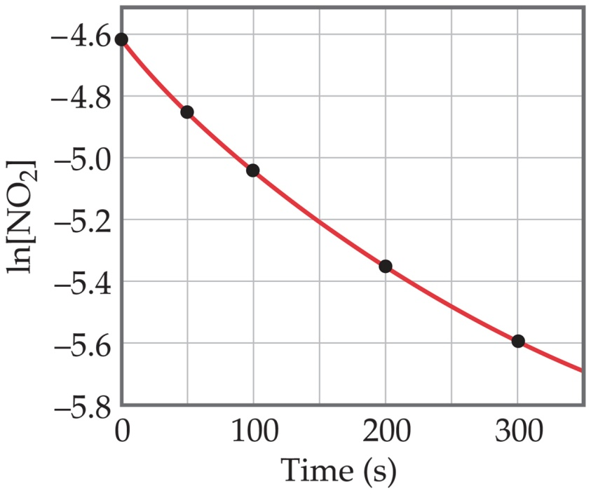
Determining rxn order
Graphing ln [NO₂] vs. t yields:
The plot is not a straight line, so the process is not first-order in [A].
Time (s) | [NO₂], M | ln [NO₂]
0.0 | 0.01000 | -4.610
50.0 | 0.00787 | -4.845
100.0 | 0.00649 | -5.038
200.0 | 0.00481 | -5.337
300.0 | 0.00380 | -5.573
Does not fit:

Slide 31
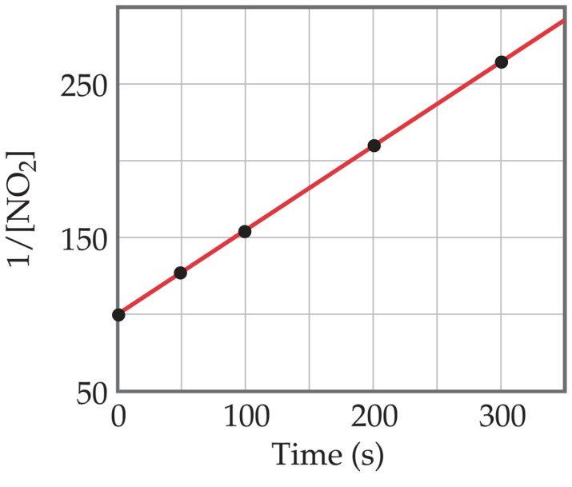
Second-Order Processes
A graph of 1/[NO₂] vs. t gives this plot.
This is a straight line. Therefore, the process is second-order in [NO₂].
Time (s) | [NO₂], M | 1/[NO₂]
0.0 | 0.01000 | 100
50.0 | 0.00787 | 127
100.0 | 0.00649 | 154
200.0 | 0.00481 | 208
300.0 | 0.00380 | 263

Slide 32
Half-Life
Half-life is defined as the time required for one-half of a reactant to react.
Because [A] at t_{1/2} is one-half of the original [A],
[A]_{t} = 0.5 [A]₀.

Slide 33
Half-Life
For a first-order process, set [A]_{t}=0.5 [A]₀ in integrated rate equation:
Substituting value of ln 2
0 – 0.693 = - k t _{1/2}
ln 0.5 = - k t _{½}
ln ½ = - k t _{½}
ln 1 – ln 2 = - k t _{½}
NOTE: For a first-order process, the half-life does not depend on [A]₀.

Slide 34
Half-Life- 2nd order
For a second-order process, set
[A]_{t}=0.5 [A]₀ in 2nd order equation.

Slide 35
Outline: Kinetics
 | First order | Second order | Second order
Rate Laws
Integrated Rate Laws |  |  | complicated
Half-life |  |  | complicated

Slide 36
Molecularity
Elementary reactions are classified according to their molecularity.
The number of reacting species, which are involved in simultaneous collision to bring about a chemical reaction is called the molecularity of the reaction.
In a unimolecular reaction, a single molecule shakes itself apart or its atoms into a new arrangement.
Example :
Decomposition of NH₄NO₂ to N₂ and 2 H₂O

Slide 37
Molecularity
Bimolecular reactions involve the collision of pair of molecules.
Bimolecular reactions are common.
Example :
Oxidation of nitric oxide by ozone
Molecularity differs from order of a reaction.
Molecularity is defined for elementary reactions where as order corresponds to the overall reaction.

Slide 38
Molecularity
The overall reaction might involve one elementary reaction or it might involve a sequence of elementary reactions (a sequence of elementary reactions denotes a complex reaction).
If a reaction exhibits second order kinetics, it is not necessary that the mechanism of the reaction involves bimolecular collision.
The reaction might involve a sequence of steps, where the molecularity of one step might be different from another step.

Slide 39
 | Order of reaction | Molecularity
1. | It is experimentally determined quantity. | It is theoretical concept.
2. | It is obtained from the rate for the over-all reaction. | It is calculated on the basis of rate determining step in the proposed reaction mechanism.
3. | It may have whole number, zero and even fractional value. | It is always a whole number and never zero or fraction.
4. | It cannot be obtained from balanced or stoichometric equation. | It can be obtained from balanced equation of single reaction of known mechanism.
5. | It does not give any information about the reaction mechanism; through it can give some suggestion. | It reveals some fundamental facts about the reaction mechanism.
6. | It is equal to the sum of the exponents of the molar concentration of the reactants in the rate equation. | It is equal to the minimum number of species taking part in a single rate-determining step of chemical reaction.
7. | Its magnitude can change, when the condition of the reaction are altered. Thus, when one reactant is taken in large excess, the resultant order of reaction is different. | It represents rate-determining step only and it undergoes no change, when the conditions of the reactions are altered.

Slide 40
Temperature and Rate
Generally, as temperature increases, so does the reaction rate.
This is because k is temperature dependent.

Slide 41
Reaction kinetics
Reactions close to Equilibrium
For reaction far from equilibrium ( free energy difference between reactants and products negative ) , rate depends on concentration of reactants
In such situation backward reaction is unimportant
For a reaction close to equilibrium , rate depends on both forward & backward
For example , If the reaction A = B is close to eqbm.
Then Vf= KfC(A) & Vb=KbC(B) , Kf & Kb –rate constants

Slide 42
Reaction kinetics
Vf & Vb are forward & backward velocities
So at equilibrium Vf=Vb
kf/kb = C(B)/C(A) = K ( equilibrium constant)
Overall rate for ‘A’ consumption
-dC(A)/dt = Vf-Vb = kf( CA-CB/K)
Effect of Concentration on Reaction Rate
Reaction A + B > C+D
As we know Vf= kf[A]*[B] & Vb=kb[C]*[D]

Slide 43
Reaction kinetics
At equilibrium Vf = Vb
K = kf /kb = [C]*[D] / [A]*[B]
Effect of temperature on Reaction Rate
As per Arrhenius Equation for rate constant
ln kf= -Ea/RT +constant
Ln kb =Ea1/ RT =constant
k ( rate constant ) = A e^ ( -Ea/RT)
Ea = activation energy a molecule acquires to react with other

Slide 44
The Collision Model
In a chemical reaction, bonds are broken and new bonds are formed.
Molecules can only react if they collide with each other.
Furthermore, molecules must collide with the correct orientation and with enough energy to cause bond breakage and formation.

Slide 45
Activation Energy
In other words, there is a minimum amount of energy required for reaction: the activation energy, E_{a}.
Just as a ball cannot get over a hill if it does not roll up the hill with enough energy, a reaction cannot occur unless the molecules possess sufficient energy to get over the activation energy barrier.

Slide 46
Reaction Coordinate Diagrams
It is helpful to visualize energy changes throughout a process on a reaction coordinate diagram like this one for the rearrangement of methyl isonitrile.

Slide 47
Reaction Coordinate Diagrams
It shows the energy of the reactants and products (and, therefore, ΔE).
The high point on the diagram is the transition state.
The species present at the transition state is called the activated complex.
The energy gap between the reactants and the activated complex is the activation energy barrier.

Slide 48
Maxwell–Boltzmann Distributions
Temperature is defined as a measure of the average kinetic energy of the molecules in a sample.
At any temperature there is a wide distribution of kinetic energies.

Slide 49
Maxwell–Boltzmann Distributions
As the temperature increases, the curve flattens and broadens.
Thus at higher temperatures, a larger population of molecules has higher energy.

Slide 50
Maxwell–Boltzmann Distributions
If the dotted line represents the activation energy, as the temperature increases, so does the fraction of molecules that can overcome the activation energy barrier.
As a result, the reaction rate increases.

Slide 51
Maxwell–Boltzmann Distributions
This fraction of molecules can be found through the expression:
where R is the gas constant and T is the temperature in Kelvin .

Slide 52
Arrhenius Equation
Svante Arrhenius developed a mathematical relationship between k and E_{a}:
where A is the frequency factor, a number that represents the likelihood that collisions would occur with the proper orientation for reaction.

Slide 53
Arrhenius Equation
Taking the natural logarithm of both sides, the equation becomes
1
RT
y = mx + b
When k is determined experimentally at several temperatures, E_{a} can be calculated from the slope of a plot of ln k vs. 1/T.

Slide 54
Outline: Kinetics
 | First order | Second order | Second order
Rate Laws
Integrated Rate Laws |  |  | complicated
Half-life |  |  | complicated
k(T)

Slide 55
Theory of Absolute reaction rate
It is proposed by H Eyring which assumes that :
-when two reactants come together with sufficient energy to react , they form an activated complex which breaks up immidiately to give products
i.e. Reactants >> Activated complex >> Products
As per figure , there is change in potential energy during formation of products from reactants
Ea is additional energy which reactant molecules must acquire to form activated complex.

Slide 56
Theory of Absolute reaction rate

Slide 57
Theory of Absolute reaction rate
Ea of reactants come from kinetic & vibrational energies of colliding molecules
It is assumed that activated complex ( even with short life) is in equilibrium thermodynamically with reactants
So the rate of chemical reaction is the number of activated complex decomposing into products
The decomposition rate of activated complex is independent of nature of reaction or complex.

Slide 58
Theory of Absolute reaction rate
As per the fig , free energy of activation & delta E is considered as free energy change of the reaction
Significance of Activation energy
A reaction for which driving force is large ( delta G large & negative) can still occur at a slow rate if it has large activation energy
The reaction rate becomes faster with increase in temperature

Slide 59
Types of Reaction
Homogeneous Reactions
These reactions take place in a single phase ie gaseous , liquid or solid i.e. reactions between molecules in or liquid solution
Heterogeneous Reactions
It involves more than one phase – characterised by presence of interface
Sulphide roasting – gas & solid reaction

Slide 60
Types of Reaction
Between two immiscible fluids – slag / metal reactions
Between solid & liquid phase – leaching
Between solid / solid – carbothermic / metallothermic ( TiO2 /Al) reduction of oxide
Between liquid & gas – distillation
These reactions take place at interface between phases

Slide 61
Types of Reaction
Reacting species to be transported to the interface and product species carried away from it
In solid , such mass transfer is through ‘Diffusion’ which involves movement of atoms along the concentration gradient
In fluids , each element moves in the direction of flow ( laminar flow)
In case of turbulent flow , elements may move at right angle to direction of flow due to eddies generated

Slide 62
Reaction Mechanisms
The sequence of events that describes the actual process by which reactants become products is called the reaction mechanism.
Reactions may occur all at once or through several discrete steps.
Each of these processes is known as an elementary reaction or elementary process.

Slide 63
Reaction Mechanisms
The molecularity of a process tells how many molecules are involved in the process.
The rate law for an elementary step is written directly from that step.

Slide 64
Multistep Mechanisms
In a multistep process, one of the steps will be slower than all others.
The overall reaction cannot occur faster than this slowest, rate-determining step.

Slide 65
Slow Initial Step
NO₂ (g) + CO (g) ⎯⎯→ NO (g) + CO₂ (g)
The rate law for this reaction is found experimentally to be
Rate = k [NO₂]²
CO is necessary for this reaction to occur, but the rate of the reaction does not depend on its concentration.
This suggests the reaction occurs in two steps.

Slide 66
Slow Initial Step
A proposed mechanism for this reaction is
Step 1: NO₂ + NO₂ ⎯⎯→ NO₃ + NO (slow)
Step 2: NO₃ + CO ⎯⎯→ NO₂ + CO₂ (fast)
The NO₃ intermediate is consumed in the second step.
As CO is not involved in the slow, rate-determining step, it does not appear in the rate law.

Slide 67
Fast Initial Step
The rate law for this reaction is found (experimentally) to be
Because termolecular (= trimolecular) processes are rare, this rate law suggests a two-step mechanism.

Slide 68
Fast Initial Step
A proposed mechanism is
Step 1 is an equilibrium-
it includes the forward and reverse reactions.

Slide 69
Fast Initial Step
The rate of the overall reaction depends upon the rate of the slow step.
The rate law for that step would be
But how can we find [NOBr₂]?

Slide 70
Fast Initial Step
NOBr₂ can react two ways:
With NO to form NOBr
By decomposition to reform NO and Br₂
The reactants and products of the first step are in equilibrium with each other.
Therefore,
Rate_{f} = Rate_{r}

Slide 71
Fast Initial Step
Because Rate_{f} = Rate_{r} ,
k₁ [NO] [Br₂] = k₋₁ [NOBr₂]
Solving for [NOBr₂] gives us
k₁
k₋₁
[NO] [Br₂] = [NOBr₂]

Slide 72
Fast Initial Step
Substituting this expression for [NOBr₂] in the rate law for the rate-determining step gives

Slide 73
Catalysts
Catalysts increase the rate of a reaction by decreasing the activation energy of the reaction.
Catalysts change the mechanism by which the process occurs.

Slide 74
Catalysts
One way a catalyst can speed up a reaction is by holding the reactants together and helping bonds to break.

Slide 75
Enzymes
Enzymes are catalysts in biological systems.
The substrate fits into the active site of the enzyme much like a key fits into a lock.

