Slide 1
Unit 3 – Metallic Coating
Surface pretreatments, Hot dipping, Galvanizing, Electrolytic and Electroless plating of important metals and alloys, testing/evaluation of surface properties.

Slide 2
Introduction – Metallic Coating
Metallic coating can be applied on metals and non-metals
Methods
Electroforming
Hot Dipping
Electroless plating
Metal spraying (wire spraying, powder spraying)
Vacuum metallizing
High velocity oxygen fuel spraying (HVOF)
Galvanizing
Hot dip galvanizing
Flow galvanizing
Sherardizing (vapor phase)
Electroplating galvanizing
Cold dip galvanizing
Electroplating (Zn, Ni, Au, Cr, Sn, Ni-Co alloy plating)
Barrel plating
Rack plating
Strip plating

Slide 3
Hot Dipping
Metal is immersed in the molten bath of another metal.
Melting point of metal to be coated > coated metal
Common substrate material: Steel and iron
Common coating material: Zn, Al, Sn, and Pb
Working principle: Forming transition layer(s) of varying alloy compositions.
Next to the substrate are normally intermetallic compound(s) of two metals followed by solid solution alloys at the exterior
Presence of transition layer provides excellent adhesion of the coating.
Light coatings are used in less severe corrosion environment; Heavy coatings (e.g. Zn coating weights up to 350-900 g/m² is used for outdoor use in severely corrosive environment.
Metallic coated steel may be given a subsequent surface treatment to further enhance the performance of the metallic coating
Chemcal passivation, oil, thin organic coating

Slide 4
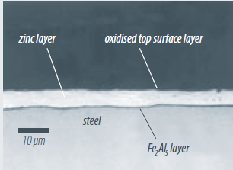
Hot Dip Galvanized Steel
Consists of steel substrate with Zn coating, which is applied in a continuous hot dip process using a bath of molten Zn at ~ 450ºC. Steel piece is immersed in molten Zn for several minutes.
They offer very good corrosion resistance due to the cathodic and barrier protection provided by Zn coating
Bright metallic appearance
Good forming properties
Galvanized steel consists of three layers:
Thin intermetallic layer of Fe₂Al₅ of ~100nm thickness at the steel-coating interface
Zn coating layer of varying thickness
Oxidized Al enriched layer of ~50nm thickness on the top
Applications
Structural profile for building, panels
and structures for domestic appliances,
metal furniture etc.

Slide 5
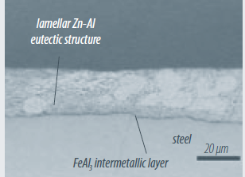
Hot Dip Coating – Contd.
Steel with Zn-Al coating
This coating has ~95%Zn and 5%Al.
Microstructure consists of Zn dendrites surrounded by eutectic. At the interface with the steel, there is a very thin FeAl₃ layer < 100nm thickness
Provides excellent flexibility and is suitable for the production of difficult to make work piece
General corrosion resistance is very good (twice that of standard galvanized steel)
Applications:
Doors and garages, HVAC-equipment,
washing machines, swimming pools

Slide 6
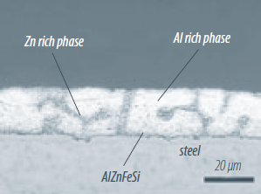
Hot Dip Coating – Contd.
Steel with Al-Zn coating
55Al-43.4Zn-1.6Si Alloy
Microstructure consists of Al rich dendrites (80% vol.) and Zn rich interdendritic zones (20% vol.) containing Si rich particles. At interface with the steel, there is an intermetallic layer of AlZnFeSi (1-2μm thick)
Excellent corrosion resistance due to barrier effect of Al and sacrificial protection of Zn.
Silver metallic color, which is preserved over time without becoming dull due to the formation of thin aluminum oxide layer on the top.
Good corrosion resistance at high temp., good abrasion resistance, high surface hardness and good thermal and light reflectivity
Applications:
Outdoor construction applications such as
as roofing, silo cladding and profiling,

Slide 7
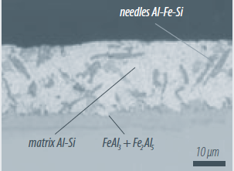
Hot Dip Coating – Contd.
Steel with Al-Si coating
Continuous process and substrate gets coated on both sides.
Coating composition is 90%Al and 10%Si
High resistance to oxidation at high temp. Presence of Si, allows it to be used as high as 550ºC.
In contact with oxygen, a passive layer of aluminum oxide forms that gets renewed when the film is damaged
Provides good resistance to chemical corrosion
Applications:
Exhaust systems, thermal shields, heating equipment, boiler, frying pans, barbecues, baking trays.

Slide 8
Hot Dip Coating – Contd.
Steel with Al coating
Coated with pure Al and consequently considerable Al-Fe intermetallic layer is formed at the interface
Good resistance to high temperatures and against aggressive combustion products makes it suitable for power generation plants and petrochemical industries
Applications:
Culverts, chimney ducts, housing for heating, ventilation, and air conditioning equipments, pipe cladding, tanks.

Slide 9
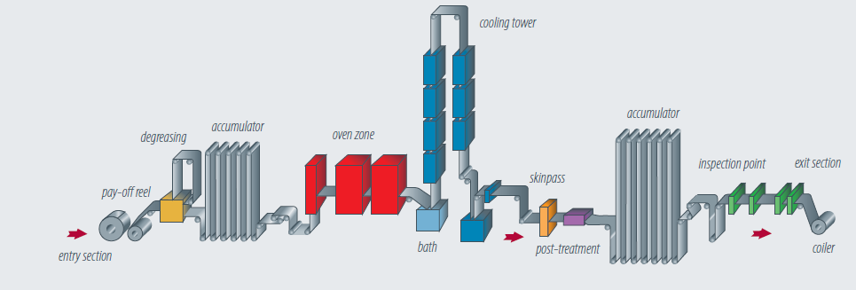
Hot Dip Coating Process
Hot dip coatings are applied continuously to a steel strip by passing substrate through a bath of molten metal.
Layout consists of:
Entry
Central section (annealing, metallic coating application, surface treatments)
Exit

Slide 10
Hot Dip Coating Process – Contd.
Two accumulators or looping towers are sued to separate three section and ensure continuity of the process from entry to exit.
Entry section
Steel coils are mounted on a pay-off decoiler. In continuous process, head of the decoiler is welded to the tail of the coil in process
After cold reduction, residual film of lubricating oil must be removed before annealing to ensure that coating adheres perfectly to the steel substrate. Oil film is removed in an alkaline degreasing tank or sometimes burnt off by open flame burners in the preheating zone of the annealing section
Central section:
During annealing, severely cold reduced microstructure will recrystallize
Preheating
Holding
Controlled cooling
Inside annealing zone, steel is prevent from oxidation by using a hydrogen-nitrogen mixture and burners are usually radiant type to avoid flame contact with the surface.
Annealing time is managed to meet desired properties
At the end of cooling zone, steel is cooled down to appropriate temp. with respect to the molten metal temp.

Slide 11
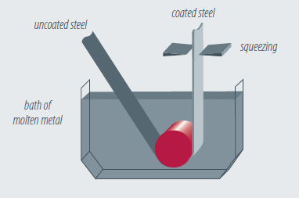
Hot Dip Coating Process – Contd.
Metallic coating application
Once the steel strip has reached the required temperature, it is immersed in a bath of molten metal. When the strip leaves the bath, it is coated with thick layer of molten layer.
A set of air or nitrogen knives, located above the bath adjusts coating weight.
Exit section
Hot dip coating lines are equipped
with a tension leveller and/or
temper mills to ensure good surface
Finish. A trimmer may be included, if
Needed.
Oil may be applied before the strip is coiled

Slide 12
Electrogalvanizing Process
Electrogalvanized coatings are applied continuously to steel strip by passing the substrate through an electroplating bath
Two accumulators are used as buffers when the entry or exit section is stopped
Layout of a continuous electrogalvanizing line consists of:
Entry
Central section (surface preparation and coating)
Exit
Entry
Steel coils are mounted on a decoiler and incoming coil is welded to the tail of coil being processed.
Coils come either from the batch annealing or continuous annealing line.
Coils are processed on a skinpass line

Slide 13
Electrogalvanizing Process – Contd.
Central Section
Surface preparation: Oil film is removed in hot electrolytic alkaline degreasing tank; followed by dip-pickled in a bath of HCl or H₂SO₄ acid and rinsed again.
Electroplating cells: Steel strip is passed through several electrolytic cells successively. In each cell, electric current flows through a Zn solution from an anode to a cathode; Conductor roll is in contact with the steel strip.
Anodes: 1) soluble (made of Zn slabs, requiring replacement as they are consumed) and 2) insoluble (made of lead or lead alloys or platinized Ti; requires continuous replenishment of Zn in the electroplating solution by adding ZnSO₄. ZnCl2 solution is used with soluble anode; ZnSO₄ can be used with either soluble or insoluble anodes
Electroplating cell can be vertical/horizontal or radial. Each cell will transfer Zn on to the coil till the desired thickness is achieved.
Rinsing: After electrogalvanzing, strip is rinsed in several stages and the last rinsing tank consists of de-ionized water. Final stage is air drying
Additional surface treatments such as phosphating, chemical passivation or powder painting, orgainic coating may be applied (if needed).
Exit section: Oiling and side trimmer may be carried out (if needed) and strip gets coiled

Slide 14
Galvanized Coating Defects
Factors affecting hot dip galvanized coatings
Size and shape of the work piece
Zn freezes at 420ºC and Zn bath is maintained at ~450ºC; So, there is very little superheat in molten Zn as steel is withdrawn from the bath. Thicker sections will retain their heat longer and promote better drainage of molten Zn from their surface than thinner section. Angle at which steel can be withdrawn will influence the drainage characteristics. One-dimensional items that are short enough to dip vertically will produce smoother and more uniform coatings than 2D or 3D items.
Steel chemistry
Rate at which molten Zn reacts with steel to form galvanized coating depends on composition. Pure iron has very poor reaction rate. High Si levels (>0.2%) may result in dull or matt gray or blotchy appearance. High P leveles can give rise to dark gray or brown coating that are prone to delamination
Surface condition
Rougher surface have higher area and thus generate thicker galvanized coating
Hot rolled sections produce 30-50% thicker coating than cold rolled surface
Galvanized coating follows the surface profile of surface defects such as pitting.
Design
Inaccessible surfaces will not be galvanized, unless pre-treatment chemicals can penetrate to all surfaces.
If molten Zn can not completely drain from the sample, Zn puddles will freeze in pockets and cause problems.
Items need to be suspended during galvanizing. Eliminating touch marks from wire improves coating quality
Dimension of the item must be such that it allows adequate withdrawal angles. Double dipping of the item will frequently produce a better quality than single dipping.

Slide 15
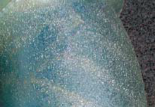
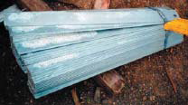
Galvanized Coating Defects – Contd.
Metallurgy of the galvanizing process
Prior to galvanizing, steel is chemically pre-treated by immersing the item in zinc ammonium chloride (ZAC) preflux solution. This results in the formation of thin film of ZAC crystal on steel surface
When steel is immersed in molten Zn, ZAC gets oxidized to form ZnCl₂ and ZnO, which are lighter than Zn and it floats. This is called Zn ash.
Zn bath becomes saturated with Fe in solution (typically ~250 parts of Fe ppm at temp. Overtime, Zn-Fe crystals settles to the bottom of the bath and forms dross, which must be periodically removed with special equipment.
Molten Zn surface is always oxidizing and stay floated.
Presence of ash and dross may have following effects:
If item comes in contact with dross layer, it can form rough, lumpy deposit
Ash may stick to the surface of Inaccessible area of items
If the rate of withdrawal varies or stops during withdrawal, oxide lines may appear causing variations in the shiny appearance of the coating
Dross crystals may be trapped in the galvanized coating, resulting in gritty appearance
White rust formed for being left wet after galvanizing
Dross dimples

Slide 16
Galvanized Coating Defects – Contd.
Steel defects
Galvanized coating does not cover up the defect but may highlight the surface flaw.
Surface roughness plays an important role; rougher surface reacts vigorously than smoother surface. Abrasive blasting is a way to increase coating thickness for heavy duty applications
Hot dip galvanized coating tends to be thicker at edges because crystal in alloy layer have more room to grow. So, rolling defects get highlighted by coating
Small particles or silvers of steel can be rolled into the steel surface. Zn will react faster with loosely attached silvers resulting in pimply appearance
Cold working may result in stress lines and galvanizing show it up as striations
Galvanizing weld can degrade the aesthetic look due to thicker and thinner section and difference in chemistry

Slide 17
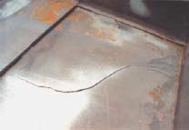
Galvanized Coating Defects – Contd.
Embrittlement
Rarely encountered with structural grade steels; However, high-strength grades or inappropriate fabrication techniques can lead to embrittlement problems with galvanized steel
Three types of embrittlement in hot dip galvanizing process
Hydrogen embrittlement
Steel with YS> 800 Mpa are susceptible to hydrogen emrbittlement
H atoms from acid pickling process penetrates along grain boundries can cause brittle fractures. Pre and Post galvanizing treatments are available to eliminate the risk of hydrogen embrittlement
Strain-age embrittlement
Caused by excessive cold working of steel prior to galvanizing, bending seel through tight radius, re-bending already cold worked steel, hole punching through thick sections
Heat from the galvanizing process accelerates embrittlement
Liquid metal embrittlement
Molten Zn penetrates grain boundaries of steels and may fracture under load.
Some grades of stainless steels and mild steels are susceptible to liquid metal embrittlement
If stainless steel component is required, mechanical attachments after galvanizing is strongly recommended .
Distortion
Three major reasons for distortion during galvanizing:
Thickness and shape of the section being galvanized. Thin plates are more prone to distortion due to differential heating and cooling of sections
Design of the fabrication with respect to location of welds, symmetry, and fabrication stresses present prior to galvanizing
The way the work is handled during galvanizing

Slide 18
Galvanized Coating Defects – Contd.
Blowouts and Bleeding
Molten Zn is about 30ºC above its melting point, at which viscosity of the molten metal limits its ability to penetrate small cavities and crevices, and gaps less than 1 mm in width may not allow penetration by the molten Zn
When the item enters the galvanizing bath, any moisture trapped in crevices will rapidly boil and eject steam, resulting in blowouts because it will limit reaction of Zn with steel.
In unsealed overlapped surfaces, bleeding will occur. This is commonly referred as acid staining. Stains are caused by flux residues that have been desiccated by the heat of the galvanizing process, rehydrating from the contact with moisture from atmosphere.
Flaking
Flaking of galvanized coating occurs on reactive steels, which produce thick coating (300-500μm). These coatings are inflexible and differential expansion or contraction may cause flaking. In addition, impact or point pressure due to mishandling can cause localized flaking.
Flaking may be minimized by quick cooling of the item as it exits the galvanizing bath. In addition, careful design is required to ensure entry and exit of the item from the bath.

Slide 19
Galvanized Coating Defects – Contd.
White Rust
Zn coating depends on the development of inert complex carbonate oxide films for its excellent atmospheric corrosion resistance.
When freshly galvanized steel is exposed to pure water, Zn will react with water to form zinc hydroxide (white deposit). If Zn surface remains wet, water will continue to react with Zn and can severely damage the coating
Most galvanizers post-treat items with a chromate solution during the quenching process, which provides short term passive film on the Zn surface.
Exposure to sea water will also rapidly promote white rust. It is recommended to wash down with fresh water after each salt water immersion
Pinholing
Welded beams and heavier sections assembles by arc welding may show small pinholes along weld bead. Pinholes form due slag particles being fused to the weld surface.
Puddling, dross, and splatter
Puddling is caused by poor drainage, dross caught in an item and splatter from the Zn bath ending up in or on the galvanized surface.
Removal of dross is possible during inspection process and puddling can be eliminated by proper design.

Slide 20
Conclusion
Except blowouts and bleeding and where galvanized coating is missing, most defects have no effect on the durability of coating. Some of these defects may enhance life because they help in deposition of Zn or residues

Slide 21
Electrolytic and Electroless Processes

Slide 22
What is Electroplating?
An electrochemical process where metal ions are transferred from a solution and are deposited as a thin layer onto surface of a cathode.
The setup is composed DC circuit with an anode and a cathode sitting in a bath of solution that has the metal ions necessary for coating or plating
Electroplating can enhance;
Chemical properties---increase corrosion resistance
Physical properties---increase thickness of part
Mechanical properties---increase tensile strength & hardness

Slide 23
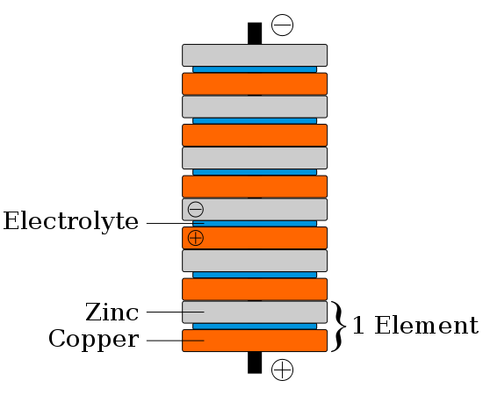
History
In 1800 Alessandro Volta created the “voltaic pile”
Was the first galvanic cell able to produce a stead flow of electrical current
Stack of copper and zinc discs separated by cloth soaked in saline solution (electrolyte)
Wikipedia.org
Wikipedia.org

Slide 24
History
Scientists now able to apply constant current electricity to their experiments
In 1805, Italian chemist Luigi Brugnatelli, successfully electroplated silver medals with gold
Brugnatelli's inventions were kept secret by the French Academy of Sciences and did not become used in general industry until English and Russian scientists independently discovered technique 35 years later
1940 first patent for electroplating awarded, and soon factories in England were mass producing silver plated items, including teapots, brushes and utensils
Wikienergia.com
www.dinendecor.com/

Slide 25
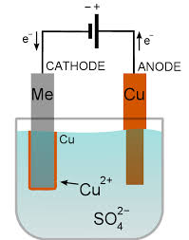
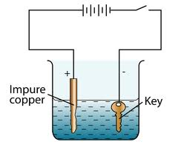
Electrolytic (Electro-Chemical) Plating – Working Principle
Metal ions in an electrolyte solution are deposited onto a cathode (work piece to be coated) and anode is generally made of metal being plated; so it serves as a source of coating metal.
Direct current from an external power source is passed through electrolyte solution.
Electrolyte is an aqueous solution of acids, bases or salts. Electrolyte conducts electric current by the movement of plate metal ions in solution.
For optimum results, parts must be chemically cleaned.
Working principle is based on Farady’s law
Mass of substance liberated in electrolysis I (current passed through the cell)
Mass of material liberated electrochemical equivalent (mass of element in gms transported by 1 coulomb of electricity.
V = Kit ; V = Vol. of metal plated, t = time , K = constant depending on electrochemical equivalent and density of electrolyte
Anode reaction (can be either inert or sacrificial)
M→M^{n+} + ne⁻
Cathode reaction
M^{n+} + ne⁻→ M

Slide 26
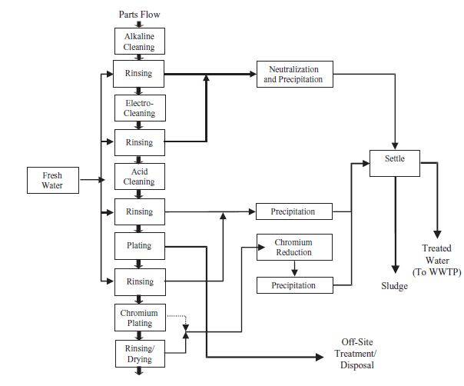
Process Flowsheet of a Typical Electroplating Process

Slide 27
Current Source
Direct Current Electrodepositon
Battery or rectifier (which currents AC to DC) provides necessary current
Geometrical shape and contour affect coating thickness. In general, parts with sharp corners tend to have thicker coating on outside and thinner ones in the recessed areas. This is because DC current flows densely to sharp edges than to less accessible recessed areas.
Judicial placement of anodes and modification of current density are required to overcome thickness irregularities
Pulse plating
Pulsed current can be unipolar or bipolar. Pulses can be superimposed on a DC feed.
Metal deposition occurs in cathodic pulse period, with a limited amount of metal being redissolved in the anodic period. Repeated deposition and partial redissolution may improve the morphology and physical properties of the deposit.
Lased-Induced Metal Deposition
A focused laser beam is used to accelerate the deposition process. Experiments have shown that deposition rate can be increased by 1000 times by passing focused laser beam through a hole in the anode through electrolyte on the cathode surface

Slide 28
Electrolyte
Types of electrolytes: Water solution of acids, bases, and metal salts, certain pure liquid, molten salts, and sometime gases may act as electrolyte at high temp. and pressure.
In addition to metal salts, electrolytes contain some additives to increase electrical conductivity, increase bath stability, activating surface (surfactants or wetting agents), improving leveling or metal distribution, optimizing chemical, physical properties of the coating.
Properties of electrolyte
Electrical conductance: Inorganic or organic salts, acids, or alkalis can be used to increase conductivity. Conductivity of an electrolyte is a function of the degree of dissociation, mobility of individual ions, temperature and viscosity, and electrolyte composition.
Covering power: It describes the extent to which an electrolyte can cover the entire surface of workpiece with reasonable thickness. Covering power is influenced by nature of substrate surface, electrolyte composition, temperature, viscosity, and current density
Macrothrowing power
It predicts the ability of an electrolyte to lay down plating of uniform thickness
A good covering power is a prerequisite for good macrothrowing power.
Other factors affecting macrothrowing power are: current distribution, current density, electrolyte conductance, electrolyte composition, electrolyte agitation

Slide 29
Methods of Electroplating
Selection of electroplating equipment depends upon workpiece size, geometry, throughput requirements, electrolyte, and metal to be plated.
Main methods are:
Barrel plating (Mass plating) for nuts and bolts
It is done by rotating barrels, which are oriented either horizontally or at 35º. Many small parts can be coated in one batch.
Electrical contacts are maintained through the tumbling action of parts themselves and by means of an externally conductor that projects the barrel
Limitations: tumbling action may damage the soft metal parts, threads, sharp edges.
Rack plating (Batch plating)
Racks are made of heavy gauge copper wire formed into suitable shape for holding the workpiece , which are hanged on hooks held by clips. Racks are themselves coverd with insulating material except the location where workpiece make contact.
Useful for large, heavy, and complex shape
Strip plating (Continuous plating)
A continuous strip is pulled through the plating solution. Long wires, small sheets can be plated by this method.
High production rate
Only specific location can be platted. Example: electrical contact point plated with gold or silver
In-Line plating
Integrate the plating and finishing processes into a main production line.
Exclude pretreatment steps, significant reduction in material, chemical, and energy consumption, and waste discharge

Slide 30
Common Electroplating Metals
Zn platting
Zn plated steels – fasteners wire goods, electric switch boxes, sheet metal wiring galvanization.
Provide high resistance to corrosion
Ni plating
Corrosion resistance and decorative purpose
Brass, steel, Zn die casting are plated with Ni
Automotive trims are platted
Au plating
Common substrate – Ag and Cu
Provides aesthetic look, corrosion resistance, highly electrically conductive layer used in electrical connectors and printed circuit boards.
On copper substrate, Cu atoms tend to diffuse through Au plating causing tarnishing of its surface and formation of oxide/sulphide layer. To prevent this, a barrier metal like Ni is applied before Au plating on Cu substrate
Cr plating
Chrome plating is a finishing treatment for decorative purpose
It is usually done over Ni plating on steels.
Uses: metal furniture, automotive trims
Hard chromium plating provides wear resistance

Slide 31
Common Electroplating Metals – Contd.
Sn plating
Used for ferrous and non-ferrous metallic substrates
Non-toxic, ductile, and corrosion resistance
Used in food packaging, electronic industry because of its ability to protect the base metal from oxidation
Alloy plating
Two metals are electroplated simultaneously. Example – Ni-Co, Au-Cu-Cd, Zn-Co, Zn-Fe, Zn-Ni, brass (Cu-Zn), bronze (Cu-Sn), Sn-Zn, Sn-Ni, Sn-Co
Unusual Metal Coating
Easily platable from aqueous solution but not widely used: As, Sb, Bi,Mn, and Re
Platable from organic electrolyte: Al
Platable from fused salt electrolyte: Ti, Zr, Hf, V, Nb, Ta, Mo, and W

Slide 32
Electroless Deposition (Autocatalytic Plating)
The term “Electroless” is somewhat misleading…There are no external electrodes but charge transfer is involved in the process
Special type of electroplating – Electroless deposition also known as autocatalytic plating or chemical deposition
Electroless plating uses a redox reaction to deposit metal on an object without the passage of an electric current
Brenner and Riddell invented electroless Ni Plating in 1946
This reaction takes place only on a catalytic surface. Once deposition is initiated, metal deposition must itself be catalytic for deposition to continue.
Not all metal can be deposited autocatalytically.
Reducing agents are usually more expensive electron sources.
Advantages: Metal can be deposited on nonconductive surfaces such as plastics, glass, or ceramics. Pretreatments are required to activate these surfaces. Example: Metallizing of printed circuit board. Deposits are laid down on the substrate with no excess buildup on projection or edges (i.e. perfect throwing power)
Used for depositing: Ni, Co, Pd, Cu, Au, Ag and alloys containing metals+P or B

Slide 33
Salient Feature of Electroless Plating
Its throwing power is essentially perfect, with no excessive buildup on edges and projections.
Deposits may be less porous than electroplating; hence have better corrosion resistance
Power supplies, electrical contacts are not required
It is a necessary step in plating on nonconductors such as plastics.
Some electroless plating have unique magnetic properties

Slide 34
Example
Electroless technologies have been used for many decades. They involve reduction of a complexed metal using a mild reducing agent, typically formaldehyde. For example, mirrors can be manufactured using this reaction:
R-CHO + 2 [Ag(NH₃)₂]OH 2 Ag(s) + RCOONH₄ + H₂O + 3 NH₃
where R is an organic group or hydrogen. The reaction deposits a shiny coat of elemental silver on the walls of the container.

Slide 35
Problem
If you examine the reaction above you'll realize that conventional electroless plating isn't exactly a "green" technology. Chelated metals and formaldehyde in wastes are toxic (formaldehyde is a known carcinogen).
* Chelation involves the formation or presence of two or more separate coordinate bonds between multiple bonded) ligand and a single central atom.

Slide 36
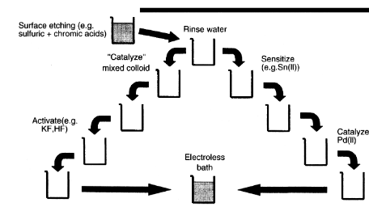
Electroless Plating Process Flowsheet
Autocatalytic plating is defined as deposition of a metallic coating by a controlled chemical reduction that is catalyzed by metal or alloy being deposited.
Chemical reducing reagents include: NaH₂PO₂ (for Ni and Cu deposition), formaldehyde-especially for Cu-hydrazine, borohydrides, amine boranes, and some of their derivatives.
Surface preparation is very important as it may affect porosity in coating. Residue from cleaner and deoxidizers may create inactive spots that will not initiate electroless deposition.
Electroless deposition requires: 1) cleaning, 2) surface modification, 3) sensitization and catalyzing , and 4) activation (acceleration) (Rinsing is required between each step)

Slide 37
Nucleation
Density of nucleation sites on the catalyzed substrate determines the adhesion properties of the end-product films.
Growth initiation upon the catalytic sites is a probabilistic process by nature; hence metal island density and island size distribution are time dependent functions during the immersion period in metallizing bath.
Electroless Ni is deposited using variety of sensitizing solutions and catalytic solution

Slide 38
Electrochemical deposition: electroless
Electroless metal displacement
Electroless sustainable oxidation of a reductant
Metal salt (e.g.NiCl₂)
Reductant (e.g.hypophosphite)
Stabilizer:bath is thermodynamically unstable needs catalytic poison (e.g. thiourea)
Complexing agent : prevent too much free metal
Buffer: keep the pH range narrow
Accelerators: increase deposition rate without causing bath instability (e.g. pyridine)
Deposition on insulators (e.g. plastics): seed surface with SnCl₂/HCl
1. Zn(s) + Cu ²⁺(aq) ------> Zn ²⁺(aq) + Cu(s)
2. Reduction (cathode reaction) :
Ni⁺² + 2e⁻ —> Ni
Oxidation (anode reaction):
H₂PO ²⁻ + H₂O—> H₂PO₃⁻ +2H⁺ +2e⁻ ------------------------------------------
Ni⁺² + H₂PO₂⁻ + H₂O —> Ni + H₂PO₃⁻ + 2H⁺
e.g. electroless Cu: 40 µmhr⁻¹
Cu

Slide 39
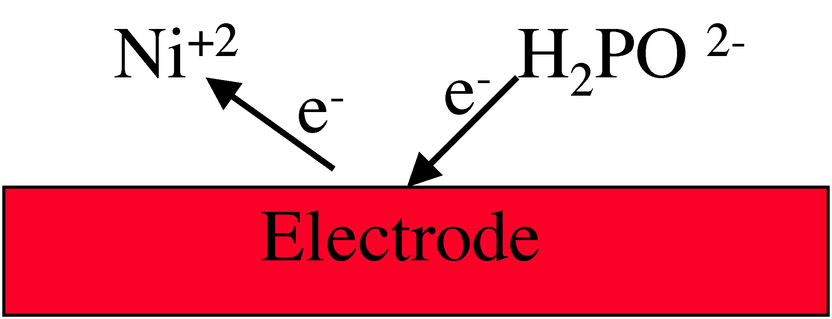
Electrochemical deposition: electroless
Evan’s diagram: electroless deposition is the combined result of two independent electrode reactions (anodic and cathodic partial reactions)
Mixed potential (E_{M}): reactions belong to different systems
i_{deposition} = i_{a} = i_{c} and I=A x i _{deposition}
Total amount deposited: m _{max}= I t M/Fz (t is deposition time, Molecular weight, F is the Faraday constant, z is the charge on the ion)
CMOS compatible: no leads required
+
Evan’s diagram
-
F= 96,500 coulombs=1, 6 10 ⁻¹⁹ (electron charge) x 6. 02 10 ²³ (Avogadro’s number)

Slide 40
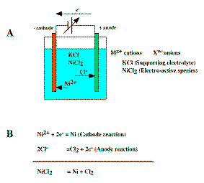
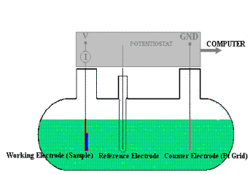
Electrochemical deposition :electrodeposition-thermodynamics
Electrolytic cell
Au cathode (inert surface for Ni deposition)
Graphite anode (not attacked by Cl₂)
Two electrode cells (anode, cathode, working and reference or counter electrode) e.g. for potentiometric measurements (voltage measurements)
Three electrode cells (working, reference and counter electrode) e.g. for amperometric measurements (current measurements)

Slide 41
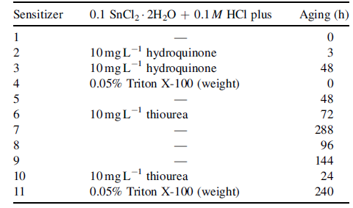
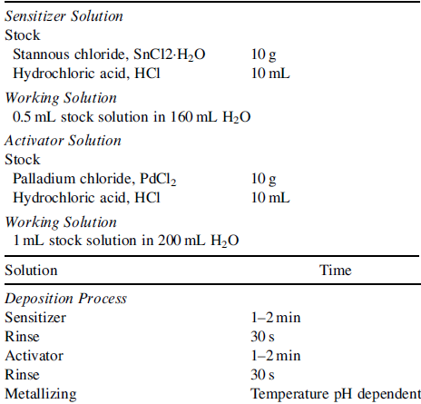
Sensitizing Solution
Electroless Ni Coating
Suggested Practical Schemes
Catalytic Solution
A
B

Slide 42
Metallizing Principles
Chemical reducing agent in solution supplies electrons for converting metal ions to metal form on catalytic surface
M²⁺ + 2e⁻ (supplied by reducing agent) → M
Catalytic surface is the only point where this reaction takes place. Therefore, once the deposition starts, the deposited metal must also be catalytic for the deposition to continue.
Progress of electroless deposition is linear in time
Nucleation starts at specific activation sites and its growth forms island around these sites. Islands grow in size till they merge and form a continuous film.
Reduction of Ni
First anodic stage is the dehydrogenation of the reductant. In alkaline media following anodic stages are recognized:
Dehydrogentaion, RH → R+H
Oxidation, R+OH⁻ → ROH + e⁻
Recombination, H+H → H₂
Oxidation, H+OH⁻ → H₂O + e⁻
In alkaline media, following two cathodic stages are recognized:
Metal deposition, M^{n+} + ne⁻ → M
Hydrogen evolution, 2H₂O + 2e⁻ → H₂O + 2OH⁻
In acidic media, following two cathodic stages are recognized:
Oxidation, H → H⁺ + e⁻
Hydrogen evolution, 2H⁺ + 2e⁻ → H₂

Slide 43
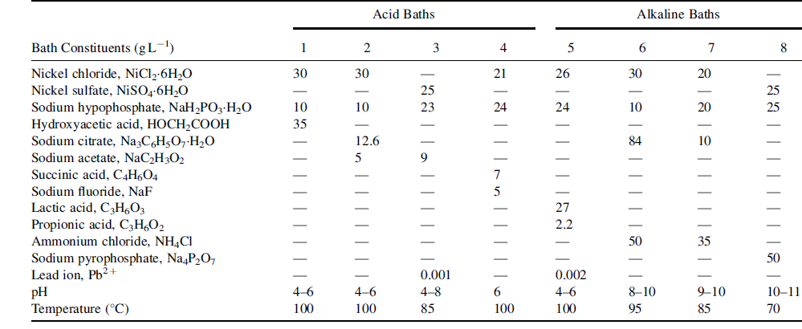
Electroless Ni Plating Bath Composition
Acidic Bath | Alkaline Bath
Result in coating with high P content (up to 25 at% P at pH 4) | Result in coating with low P content (~1 at% P in alkaline range)
Film tend to have tensile stress | Film tends to produce compressive stress
Film exhibit good adhesion to steel | Relatively weak adhesion
Relatively lower deposition rate, good stability | Higher deposition rate, decreased stability
For high reliability and repeatibility of process, maintain constant pH during deposition

Slide 44
Bath for Electroless Ni Coating
Deposition rate increases exponentially with temp.
Bath temp. must be above 60ºC; however, bath temp. > 90ºC is rarely employed to avoid plate-out or bath decomposition.
For, automotive application, alkaline plating solution is of little use
For polymeric substrates, alkaline plating solution is used where a low P content is required
In addition to hypophosphite, Sodium borohydride (12-14 pH) and Dimethylamine borane (6-10pH) form Ni-B coating; hydrazine (8-11 pH) form Ni-N coating.

Slide 45
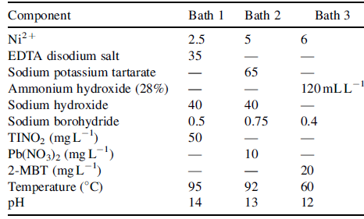
Ni-B Electroless Coating
Bath composition in g/L
pH value above 12 must be maintained to suppress precipitation of nickel boride
Only substrate that can withstand high alkalinity is used
Inclusion of Thallium in Bath 1 acts as a stabilizer and enables the deposition process to take place at lower temperature
Environmental consideration dictate the type and composition of plating baths

Slide 46
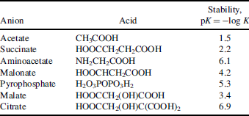
Bath Additives
Additives are added to improve bath stability, deposition rate, product film grain structure, surface smoothness and brightness.
Complex agents – Organic acids or their salts, ammonium ion (for pH control), pyrophosphate ion (for alkaline bath).
Role of additives:
Help to maintain stable pH level
Help to prevent precipitation of Ni salts such as phosphites
Reduce the concentration of free Ni ions
Rate of Ni deposition is proportional to the rate dissociation of Ni complex to form Ni ion. Thus, plating rate is inversely proportional to complex ion’s stability constant.
Stabilizers are also a form of additives. A bath can decompose suddenly without signs of warning. An increase in the volume of evolving H₂ is followed by precipitation of nickel phosphide or nickel boride. Role of stabilizer is to retard this precipitation. In addition, some stabilizer can also accelerate plating. Classes of stabilizers:
Compounds of group IV elements (Sc, Te etc.)
Unsaturated organic acids (maleic)
Heavy metal cations (Sn²⁺, Pb²⁺)
Oxygen-containing compounds (AsO²⁻, MoO₄²⁻)

Slide 47
Bath Additives – Contd.
Stabilizer’s concentration in a bath is crucial
Type 1 and 4 are effective at 0.1ppm; at 3ppm, plating is stopped if added in high amount
Thiourea in proper concentration range increases deposition rates significantly
Type 3 and 2 are used in molar concentration ranges of 10⁻³-10⁻⁶ and 10⁻¹-10⁻³, respectively.
Air agitation by purging oxygen through the bath improves bath stability by shifting mixed potential from ~620 to -550mV (vs. SCE).
Adding 100ppm of palladium chloride to warm plating solution also stabilizes bath if no visible black precipitate is evidence within first 60s.
Buffers are added to neautralize both acid and base without changing the pH of the solution drastically.
Titration method can be used to determine the quantity of buffer required to be added
Commonly used buffer: Acetic acid, Propionic acid, Glutaric acid, Succinic acid, Adipic acid
Boric acid and its salt, together with amine, serve as buffering agents, decreasing the evolution of hydrogen ions.
Dimethylaminoborane as reducing agent and boric acid and its salt with amine as buffer have very long operating life. This may be because the reaction by-product is soluble in the bath

Slide 48
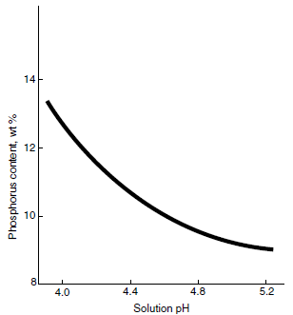
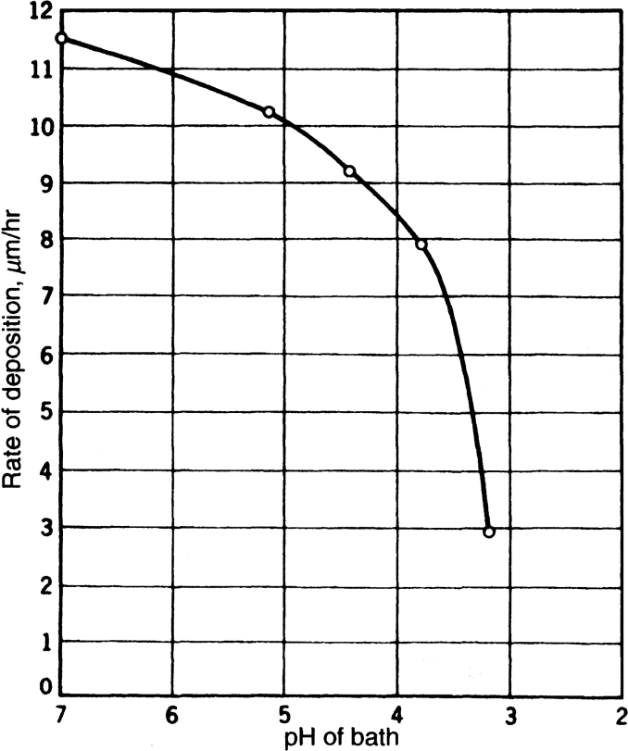
Effect of pH on Plating
Bath: NiCl2.6H2O (30g/L; NaH2PO2.H2O (10g/L; sodium glycolate (10g/L)
Deposition rate decreases with increasing pH
Amount of P in coating decreases with increasing pH
Effect of pH on properties depends on the application.
If corrosion resistance (low porosity) or a nonmagnetic state in as deposited state is a desired property than lowering pH is advisable.
If P content in the coating must remain stable, then change in pH must be avoided.

Slide 49
Film Properties
Electroless Ni have unique properties of wear and corrosion resistance.
Structure and chemical make up of the coating depends on bath composition, temperature, and agitation.
Uniform deposition rate on complex shaped objects
Two types: Ni-P and Ni-B
As-deposited electroless Ni is a metastable supersaturated alloy. Structure of electroless Ni grown in acidic bath using hypophosphate as reducing agent is said to be amorphous. Heat treatment at ~330oC results in semicrystalline FCC Ni interspersed with intermetallics such as Ni₃P or Ni₃B.
In as-deposited state, intermetallics do not form and P/B are trapped in between Ni atoms randomly.
Amount of P in Ni-P coating depends on bath pH. Higher the pH, lower is the P content and higher is the degree of crystallinity of Ni.
P acts as inhibitor to Ni crystal formation
During deposition and hydrogen evolution, pH value close to the growing film will become higher while subsequent stirring action lowers pH. This periodic change in pH results in varying P content as a function of film thickness.

Slide 50
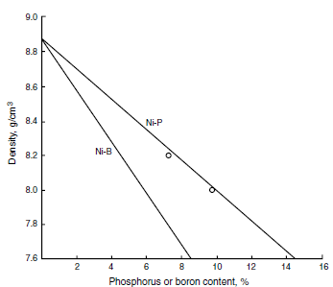
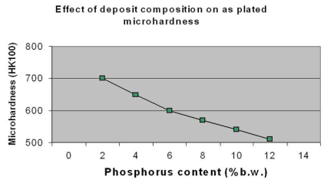
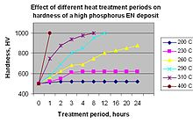
Film Properties
Electroless Ni coating is more uniform and have lower porosity than the equivalent electroplated Ni alloy
Density of film decreases with increasing P or B
Hardness
As-deposited of Ni-P films - 550kg/mm⁻², with increasing P content, hardness decreases gradually.
Hardness of Ni-P film can be increased to ~1000 kg/mm⁻² by
heat treating them at 300ºC for ~10 min. However, if
heat treated for longer time, hardness will drop to
the lower value due to precipitation and coarsening of precipitate.
As-deposited Ni-B films – 700kg/mm⁻². Hardness of Ni-B coating
is not dependent of B content.
Addition of Mo to Ni-B coating, increases hardness
Corrosion and Wear Resistance
Electroless Ni coating have less porosity. If the area of the substrate (anode) is exposed due to pores, then current density will be high and consequently corrosion rate will be high and the coating is said to corrode sacrificially. The inclusion of Zn in proper quantity may become effective corrosion protecting agent.
Factors affecting corrosion resistance of electroless Ni coating: Surface properties and finish, surface pretreatment, deposit thickness, deposit properties, plating post treatment, nature of corrosive medium

Slide 51
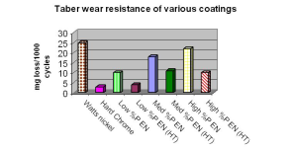
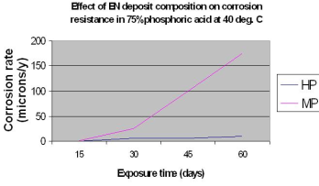
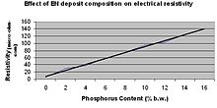
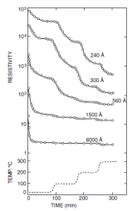
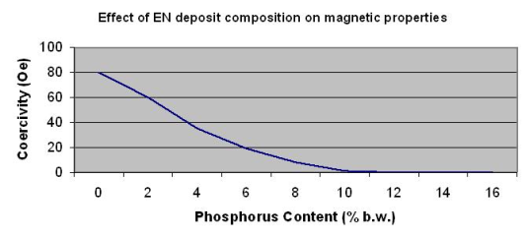
Film Properties – Contd.
Corrosion and Wear
Heat treatment at ~350ºC increases hardness but lowers corrosion resistance due to microcracking. Heat treatment at ~650ºC improves corrosion resistance, because of improved bonding with steel.
Electroless Ni coating with low P (<5wt%) – relatively high
hardness, good wear resistance, and poor corrosion resistance
Electroless Ni coating with high P (>10wt%) – Relatively low
hardness and less wear resistance, and good corrosion resistance
Electroless Ni coating with medium P (5-10wt%) – Relatively
medium hardness and moderate wear resistance, and
moderate corrosion resistance
Electric and Magnetic Properties
As-deposited electroless Ni films form acidic bath possess an amorphous structure. On heat treating as-deposited coating, structure changes to polycrsytalline Ni and Ni₃P precipitates resulting in decrease in electrical resistivity and nature of film changes from nonmagnetic to weakly ferromagnetic.
Magnetic coercivity of low P containing Ni-P coating increases on heat treating due to precipitation of paramagnetic intermetallic Ni₃P, which impedes the movement of domain wall.

Slide 52
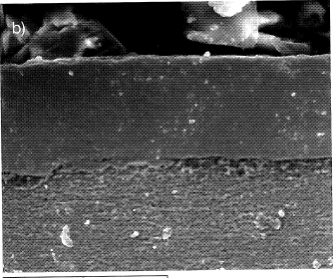
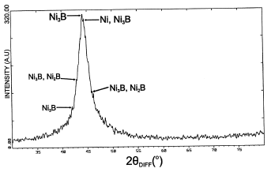
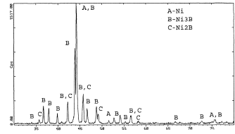
Electroless Ni-B Coating
Bath Composition |  | g/L
Metallic Ion | NiCl₂x6H₂O | 20
Alkalinity reserve | NaOH | 39
Complexing agent | NH₂-CH₂-CH₂-NH₂ | 59
Stabilizer | Pb(NO₃)₂ | 0.0145
Reducing agent | NaBH₄ | 0.48
Roughness Ra = 0.21μm
Heat treated at 850ºC in vacuum
As-deposited

Slide 53
Advancement in Electroless Ni-B Coating
Composite
Diaomond particle reinforced composite Ni-B coating
Activation stage
Diamond powder (~80μm size)
Rinse in distilled water
Immerse for 2 min in a stannous chloride (2g/L)-HCl (5mL/L) solution
Bath Constituents
Nickel chloride (30g/L)
Sodium hypophosphite (40g/L)
Sodium citrate (25g/L)
Ammonium chloride (50g/L)
Temp. of plating bath: 86+/-1ºC
pH of bath: 9-10; pH is maintained by adding appropriate amount of concentrated ammonia solution

Slide 54
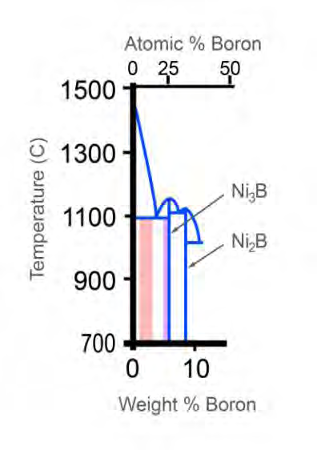
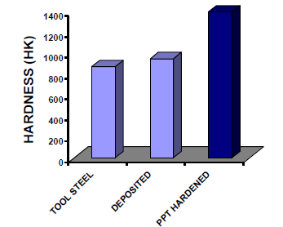
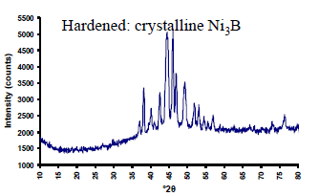
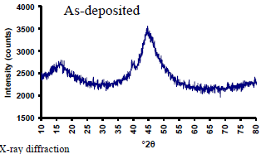
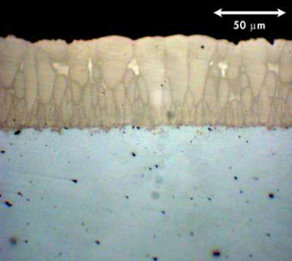
Advancement in Ni-B coating – UCT Proprietary Product
Intermetallic Ni₃B based coating
Deposited composition: Ni-6wt%B (85-100vol% Ni₃B in heat treated condition)
High hardness and high toughness
Uniform deposition: 10-100μm
Damage tolerant coating, Temp. tolerant up to 700ºC
Lubricity/Low coefficient of friction
Low temp. process 96ºC, Fast deposition rate (20μm/hr)
Ability to coat following substrate: steel, stainless steel, bronze/brass, Ni alloys
Columnar Structure

Slide 55
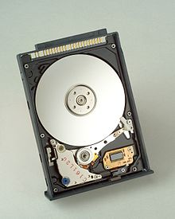
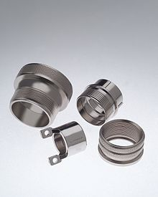
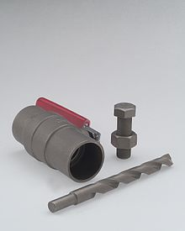
Ni-B Coating - Oil and Gas Applications
Product Area | Coating Application Part
Pumps: Centrifugal, Artificial lift Gas separator Sucker rod | Impellers, diffusers, housings Rotors, bearings, chambers, sleeves, vanes, augers Plunger heads, valves
Ball Valves & Ball Seats Severe Service Trunion valves | Balls, valve seats, bearing sleeves, thrust bearings Trunions, stems, seats, bearing sleeves
Choke Valves | Housings, choke disks, bearing disks
Gate Valves | Gate wedges, gate plates, lift nuts
Production completion equipment | Top drive swivels, wash-pipes
Fishing tool | BOP bolts, caps, swivel joints
Other Applications

Slide 56
Testing, Evaluation of Surface Properties
Corrosion Test
Tafel electrochemical measurements
Salt Spray test per ASTM B117
X-ray diffraction
Phase Identification
Internal Stress
Microhardness
Wear test (Pin-on-disc)

