Slide 1
Introduction to process metallurgy-Unit 3
Prof. Monil Salot

Slide 2
ELECTROMETALLURGY

Slide 3
Unit-3
Electrometallurgical Processes
Basics of Electrometallurgical processes: Electrowinning and Electrorefining,
Aqueous/Fused salt electrolysis.
Flow-sheets of Extraction of Important Metals
Simplified Flowsheets for the production of
Iron
Steel
Aluminum
Copper
Zinc
Lead.

Slide 4
Electrometallurgy
Metallurgical Processes utilise electricity supplied from external resources – Electrowinning , Electrorefining , lectrodeposition
Electro winning produces metal by electrolysis of an aqueous solution or a fused salt
Electro refining is a refining process based on electrolytic phenomena
Electro deposition ( Electrolysis) refers to technique of depositing one metal on another at cathode
Electrolytic decomposition is used in both extraction & refining

Slide 5
Electrometallurgy

Slide 6
Electrometallurgy

Slide 7
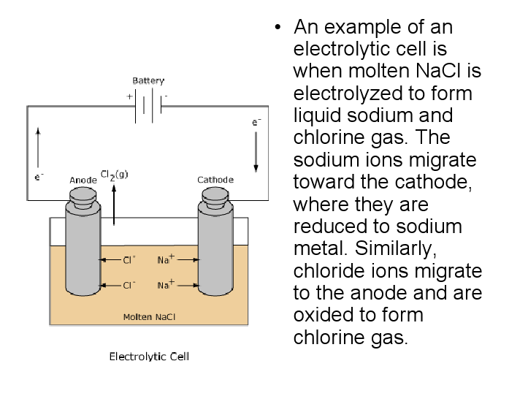
Electrometallurgy

Slide 8
Electrometallurgy

Slide 9
Electrometallurgy
In extraction process , anode is either an insoluble conductor ( Cu / Ni matte )
In refining process , anode is impure metal
The electrolyte is aq. solution / fused salt with high electrical conductivity & metal ion concentration
Cathode – pure metal / blank of another metal
Selection of electrolyte :
It should have high ionic conductivity ( conduction by ion only and not by electron as it will short circuit the electrodes

Slide 10
Electrometallurgy
It must be chemically inert towards electrodes
It must be stable at the temperature of operation
The metal compound should dissociate at a voltage much lower than required for dissociation of solvent
Metals Cu , Zn , Sn , Au & Mn produced by aqueous electrolysis
Reactive metals Ti , Zr , Th , Na, K , Mg , Al – produced by their fused salt electrolysis

Slide 11
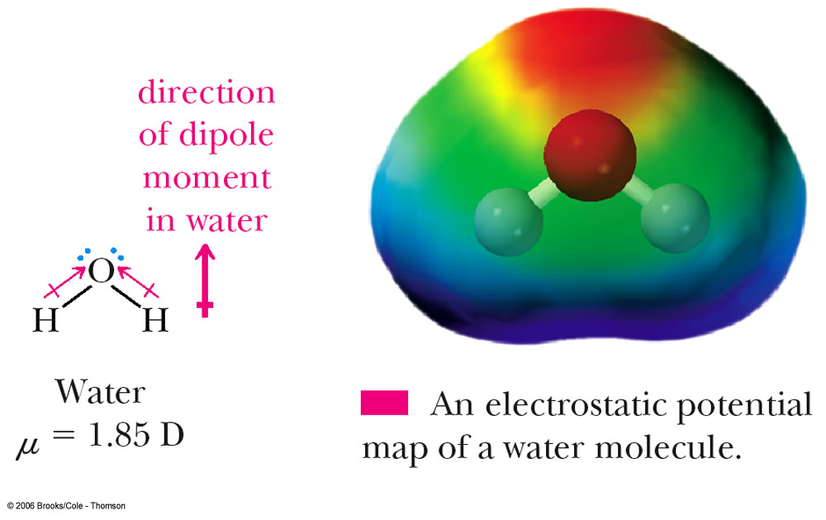
Electrometallurgy
Structure of Solvent Media affects electrolytic phenomena
Stucture of Aqueous solution
Water is made up of associated molecules. In ‘association’ the asymmetric molecules cling to each other by hydrogen bond

Slide 12
Electrometallurgy
The result of such association is a liquid having high dielectric constant ( capacity to hold high electric charge )
This helps cause the breakdown of ionic compounds as the attractive force between the molecule of compound is inversely proportional to dielctric constant of medium
Water also forms hydrated complexes of metal ions e.g. Cu [( H2O)4]++
Most aqueous solution of metal compounds contain complexed metal ions
e.g. in ammoniacal solution , Ni forms series of amines
as Ni (NH3)_{x}++

Slide 13
Electrometallurgy
Fused Salt Electrolytes
Ionic melts – non aqueous inorganic solvents
Consist of charged particles, anions & cations in intimate contact with higher attractive force
In case of NaCl , energy required to transfer cations surrounded by anions to a position surrounded by cations is 200 Kcal/mole ( heat of fusion 7 Kcal/mole)
Ionic nature of molten salt / mixture makes it good conductors of electricity
It depends on ionic size , ionic interaction , temp.

Slide 14
Electrometallurgy
A salt with ionic lattice ( NaCl) forms a melt with high conductivity which increases as the size of anion / cation decreases
Conductivity of salts such as HgI2, InCl3, InBr3 decreases as temperature increases –due to decrease in electrolyitic dissociation
ELECTROLYSIS OF AQUEOUS SOLUTIONS
Water can dissolve high concentration of salt renders it suitable for electrolysis.
Aqueous solution have high conductivity at ambient temperature

Slide 15
Electrometallurgy
Various stages for extraction of metal by electro winning
process :
Leaching of roasted ore MO + H ion > M ion + H2O
Purification & concentration of leach liquor
Anode & Cathode reaction during electrolysis
H2O > H ion + O2 + 2e ( in acid solution)
M ion + 2e > M deposit at cathode
4. Recirculation of acid liberated at anode for leaching purpose

Slide 16
Electrometallurgy
Overall reaction will be MO > M+ O2 which suggests that evolution of oxygen favours anode reaction
Decomposition potential is the difference between the reversible potentials for anode & cathode reaction
The operating cell voltage is greater than this difference as it includes activation potential at electrodes, resistance offered by electrolyte , contacts & circuit
Electro refining
Impure anode is corroded & purified metal is deposited
only a small voltage is required to over come electrolyte resistance – low power consumption

Slide 17
Electrometallurgy
Energy for electro refining is 1/5 of electro winning
Metals Cu , Zn, Ga, Cd, Sn , Au & Bi, when immersed in their salt solutions, rapidly establish reversible potential
Due to low activation over potential , these metals are deposited with high current density
Transition metals with high activation over potential are deposited with low current efficiency
Over Potential / Voltage
The difference between the electrical potential of an
electrode or cell under passage of current and without
current calculated theoretically

Slide 18
Electrometallurgy
Overvoltage is governed by concentration of electrolyzed substance, temperature, composition of elctrolyte, nature of the electrode surface, mode of mass transfer, and current density
A rapid reaction occurs with a small overvoltage (a few millivolts). A slow reaction requires a large overvoltage (a few volts)
Total overvoltage due to concentration overvoltage, activation overvoltage, reaction overvoltage, and crystallization overvoltage
Concentration – reactant /product near electrode or bulk

Slide 19
Electrometallurgy
Activation Over potential Activation overvoltage arises from slowness in the rate of the electron transfer reaction at the electrode surface.
To drive an electrode reaction at a current density, it is necessary to overcome an energy barrier, the energy of activation for the reaction.
The additional energy ( beyond thermodynamic value) to overcome this barrier is provided by the electrical energy to cell in form of increased ( over) potential.
The magnitude of this activation overvoltage often depends upon the nature of the electrode material.

Slide 20
Electrometallurgy
Higher hydrogen overvoltage helps in preventing the displacement of hydrogen from acid solution during electro winning of Zn
Anodic Dissolution of Metal Sulphide ( for extraction )
MS > M(++) + S + 2e at anode
M(++) + 2e > M at cathode

Slide 21
Electrometallurgy
ELECTROLYSIS OF FUSED SALTS
As per emf series , metals placed above hydrogen not amenable to electrolytic deposition ( electrowininng)
Due to polarisation , some metal become stable in solution during current flow which are above H2 but upto Mn
Metals above Mn are too reactive in aq. solution and are produced by electrolyzing water-free fused salt mixtures
Theoretically , any metal can be obtained by direct electrolysis of one of its salts

Slide 22
Electrometallurgy
In practice , it is advantageous to dissolve a compound such as halide mixture of more stable halides
Mixture of NaCl & KCl improves conductivity & lowers melting point
It also reduces possibility of dissolution of metal in salt
Molten salts ( high temp media) have distinctive advantage – reactive metal is obtained in absence of hydrogen ion
Overvoltage on molten metal low at high current density – greater through put

Slide 23
Electrometallurgy
Disadvantages
Due to high temperature , current efficiency is lowered due to side reactions between products & electrodes
Anode ( normally graphite) leads to formation of CO & CO2 , CO affecting the metal by diffusing into melt
Factors affecting Fused Salt Electrolysis
Evaporation of metal from cathode – liberation of sodium from fused sodium chloride
Chemical side reaction – proper electrolyte & lower temp

Slide 24
Electrometallurgy
Formation of lower valency compounds at cathode reduces current efficiency
e.g. Electrolysis of SnCl4 – Sn reacts with electrolyte to form SnCl2 , after saturation Sn starts depositing on cathode
Formation of higher valency compounds at anode reduces current efficiency
e.g. Electrolysis of SnCl2 – Cl2 liberated at anode reacts with Sn to form SnCl4 , after saturation of melt with SnCl4, further reaction ceases

Slide 25
Electrometallurgy
Dissolution of metal in the fused salt –eliminated by dissolving metal salt in a more stable salt to form dilute solution
Recombination of electrolysis products with original salt
e.g. electrolysis of MgCl2 – liberated metal Mg ( reactive) and Cl gas is not allowed to come in contact
Current losses due to moisture – fluoride pose no problem but chlorides are hygroscopic so in situ production by feeding metal oxide into the cell for chlorination

Slide 26
Electrometallurgy
Solubility of Metals in Fused Salts
For a solution of a metal in its own salt – high solubility of metal – Cd-CdCl2 , Bi-BiCl3 systems
Solubility of metal increases with temperature upto maximum limit beyond which it decreases
When a fused salt of metal is diluted with salt of a less noble metal , solubility of former metal reduces rapidly
Activity of solvent salt decreases due to complex formation between two different salts

Slide 27
Electrometallurgy
For example : ( refer NFE2)
Solubility of Al in cryolite ( Na3AlF6) is reduced by adding NaF , Pb reduced in Pbcl2 by adding KCl
Solubility of a metal can be minimised by using lowest possible temperature and a mixture of fused salts instead of pure salt
Mixture of salts also facilitates attainment of low temperature by forming low melting compositions.
Electrowinning is presently being used for extracting a large number of metals from their molten salts

Slide 28
Electrometallurgy
Important example – Electrolysis of Alumina which is dissolved in cryolite bath
However it is not possible to dissolve oxides in molten salts to produce ionic solutions suitable for electrolysis
Oxides dissolve in silicates but unsuitable due to its high melting point & viscosity
Typical data for Electro refining – Copper refining
Electrolyte composition – Cu 50 gpl , H2SO4 200 gpl
Current density – 200 A/m2 , Cell voltage – 0.3 V

Slide 29
Electrometallurgy
Typical data for Electro winning
Al extraction from Al2O3
Molten salt Electrolyte – Al2O3 in NaAlF6,CaF2 , NaF
Cell voltage – 4.5-5 , Temp -960 oC , C.D. - 5000 A/m2 ,
Mg from MgCl2
Molten salt electrolyte –MgCl2 in NaCl –KCl , Temp -750 C,
Cell voltage – 6.5-7.5 , Anode –carbon anode
ELECTROLYSIS OF LOW TEMP NONAQUEOUS
SYSTEM ( ORGANIC SOLUTIONS) – metal dissolved at
anode and deposited

Slide 30
Electrometallurgy
Advantages :
In some cases , organic media is better suited for plating e.g. Al & Zn have coherent coating better than from aq. Solution
Reactive metals can not be plate in aq. media
e.g. Zn plating on Uranium for corrosion resistance use organic media at low temperature
Disadvantages :
Poor conductivity – hence less commercial application
Poor quality of deposits

Slide 31
Electrometallurgy
Electrolytes for Non Aqueous Class of Metals
Lithium
-LiCl in acetone or aliphatic alcohols
-(AlCl3 +LiCl) in propylene carbonate
Magnesium
-MgBr2 and magnesium borohydride in diethyle ether
No large scale application
In general , metals having high melting points when
deposited from liquids at low temperature often yield non
adhesive deposits with poor physical properties.

Slide 32
Electrometallurgy
CELL DESIGN
Box , Electrodes , Electrolyte , provision for removal of gases & products , byproducts
Electrodes – solid metal , graphite or metallic sulphides , molten metal ( in fused salt process )
Electrode design modification ( rigid & large most suitable ) to avoid polarisation & maximum surface area
-Rigidity of electrode ensures uniform gap between them

Slide 33
Electrometallurgy
Material of the cell which can withstand chemical attack of electrolyte
For aq. solutions
Wood lined with Pb or Pb-Sb alloys , rubber lined steel ,
cast iron , mild steel , plastic or glass fibre resin-bounded
For molten salts
Refractory coated steels or stainless steel
Performance Criteria
Current efficiency , Cell voltage ( due to resistances)

Slide 34
Electrometallurgy
Internal Resistances ( electrolyte, gas bubble layer on electrode , diaphragms , electrode)
Contact resistance ( consume 20% of total energy) – reduced by minimising contact points , better material , permanent connections
ELETROPLATING
Object , usually metallic , is coated with one or more thin but adherent layers of other metal or alloy
Ed = Eo - (RT/ZF)ln a + P ( modified nernst Eq.)

Slide 35
Electrometallurgy
Eo – decomposition potential
a – activity of depositing cation on cathode
P – additional potential for uniform rate deposition
Metals used for electroplating – Ni , Ag , Cr , Cu , Zn , Au , Cd , Fe , Pb , Co , W , brass ( alloy)
Electroplating baths
Ag – cyanide solution containing NaAg(CN)2
Cr –CrO3 with small amount of sulphate in acid

Slide 36
Electrometallurgy

Slide 37
Electrometallurgy

Slide 38
Electrometallurgy

Slide 39
Electrometallurgy

Slide 40
Electrometallurgy

Slide 41
Electrometallurgy

Slide 42
Electrometallurgy

Slide 43
Electrometallurgy

Slide 44
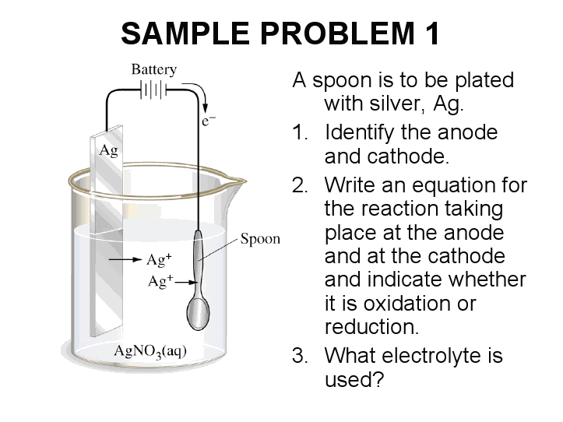
Electrometallurgy
Silver electroplating. The anode is a silver bar and the cathode is
an iron spoon

Slide 45
Electrometallurgy
Electrolyte – AgNO3

Slide 46
Electrometallurgy
Faraday Laws of Electrolysis
First Law The quantity of a substance produced by electrolysis is proprotional to the quantity of electricty used.
Second Law For a given quantity of electricity the quantity of substance produced is proportional to its weight.
The quantity of electricity or charge contained in a current running for a specified time can be calculated: Q = I x t

Slide 47
Electrometallurgy
The Faraday constant, F, is the quantity of electricity carried by one mole of electrons.
F = Avogadro's Number x charge on electron in coulombs
F = 6.022 x 10²³ mol⁻¹ x 1.602192 x 10⁻¹⁹ C F = 96,484 C mol⁻¹
The quantity of electricity required to deposit an amount of metal can be calculated: Q = n(e) x F
Q ,Quantity of electricity in coulombs (C) n(e) = moles of electrons F = Faraday constant = 96, 500 C mol⁻¹

Slide 48
Electrometallurgy
Electrical Energy, E, can be calculated:
E = Q x V
E = electrical energy in joules (J) Q = quantity of electricity in coulombs (C) V = voltage (or EMF) in volts (V)
1 kilowatt-hour, kWH, is a unit of electrical energy. 1 kWH = 3.6 x 10⁶ J
Example
Calculate the time required to deposit 56g of silver from a
silver nitrate solution using a current of 4.5A.

Slide 49
Electrometallurgy
Solution:
1) Calculate the moles of electrons required for the reaction:
Ag⁺ + e -----> Ag(s)
Moles of Ag(s) deposited, n(Ag) = moles of electrons required, n(e)
moles of Ag = n(Ag) = mass ÷ MM mass Ag deposited = 56g
MM = 107.9 g mol⁻¹ (from Periodic Table) n (Ag) 56 ÷ 107.9 = 0.519 mol = n(e)

Slide 50
Electrometallurgy
2) Quantity of electricity required:
Q = n(e) x F Q = ? C n(e) = 0.519 mol F = 96,500 C mol⁻¹ Q = 0.519 x 96,500 = 50,083.5 C
3) Time required: t = Q ÷ I Q = 50,083.5 C I = 4.5 A t = 50,083.5 ÷ 4.5 = 11,129.67 seconds t = 11,129.67 ÷ 60 = 185.5 minutes t = 185.5 ÷ 60 = 3.1 hours

Slide 51
Alumina Refining – Bayer’s Process
150-350 g/l of Na2O
Leaching of mix of mono
& trihydrate for 2.5 hrs

Slide 52
Alumina Refining – Bayer’s Process
Cooled to 100 C
Speed up settling
To eliminate redmud in liquor
TiO2 -27%,Fe2O3-30%,Al2O3-13%, SIO2-6-8%

Slide 53
Alumina Refining – Bayer’s Process
T < 80 deg C

Slide 54
Pyrometallurgical Route for Sulphide Cu ore

Slide 55
Lead Extraction from Galena

Slide 56
Lead Extraction from Galena

Slide 57
Flow Sheet for Zinc.

Slide 58
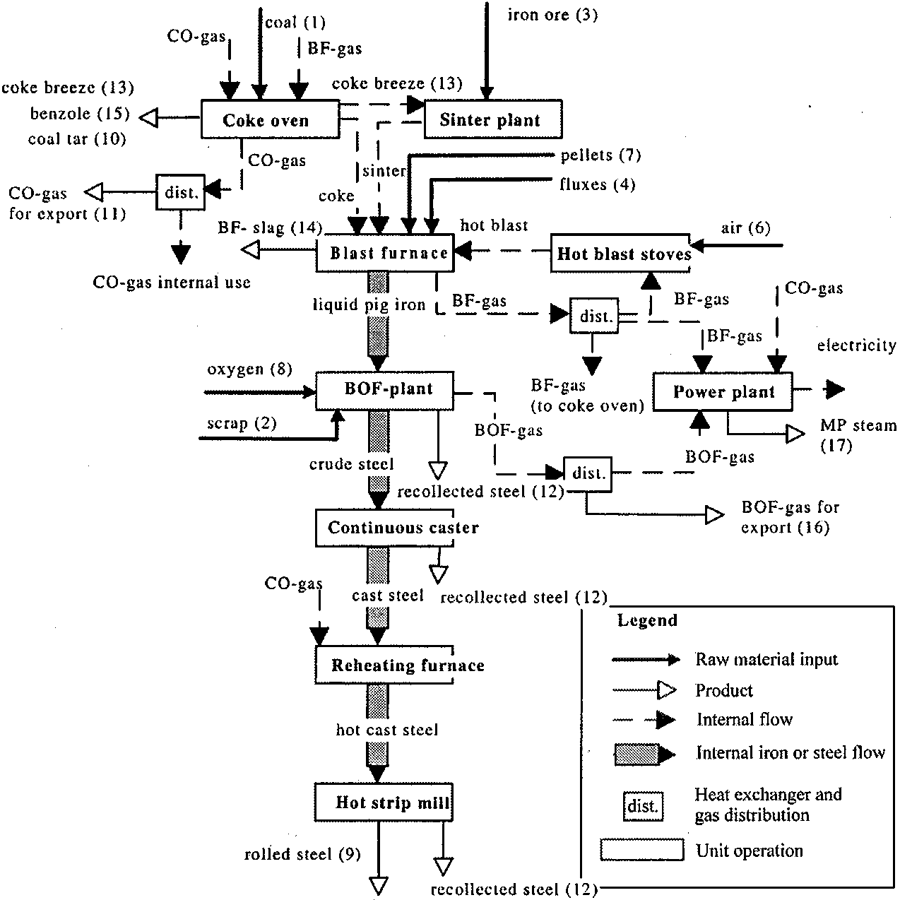
Iron & Steel making flowsheet

Slide 59
Iron making flowsheet

Slide 60
Steel making flowsheet

