Slide 1
Unit 2: Chemical Conversion Coating
Phosphating, Chromating, Anodizing, Thermochemical processes, industrial practice, economy and energy considerations

Slide 2
Phosphating
A type of chemical conversion coating
Insoluble phosphate is precipitated on the component
Adherent
Coating is formed as a result of topochemical reaction, which causes the surface of base metal to integrate itself as a part of corrosion resistant film

Slide 3
Historical Development
S/N | Year | Advancement Made
1 | 1906 | Phosphating of iron and steel using phosphoric acid and iron filings
2 | 1908 | Treatment of phosphate coatings with oxidizing agents to reduce process time
3 | 1909 | Regeneration of the bath and formulation of zinc phosphate baths requiring high temperature . process time of one hour
4 | 1911 | Formulation of manganese phosphate bath requiring high temperature - process time of 2-2.5 hours
5 | 1914 | Parkerising process with maintenance of total acid to free acid ratio
6 | 1928 | Recognition of phosphate coating as paint base
7 | 1929 | Bonderizing process with the addition of Copper accelerator-coating 20 time: 10 minutes to 1 hour
8 | 1933 | Use of oxidizing agents like nitrate for acceleration . coating time: 5 minutes
9 | 1934 | Use of phosphate coating for cold working operations for metals
10 | 1937 | Spray phosphating . phospating time: 60-90 seconds
11 | 1940 | Development of non-coating phosphate process based on sodium or ammonium phosphates
12 | 1941 | Development of cold phosphating methods

Slide 4
Historical Development
S/N | Year | Advancement Made
13 | 1941 | Phosphating of aluminium surfaces using zinc phosphate and fluorides
14 | 1943 | Use of disodium phosphate containing titanium as pre-dip before phosphating
15 | 1950’s | Large scale application of manganese phosphate coatings as an oil retaining medium . for use on bearing or sliding surfaces etc.
16 | 1960’s | Use of special additives to control coating weight
17 | 1960’s | Spray process at operating temperature of 25-30 °C
18 | 1970’s | Improvement in coating quality, use of spray cleaners based on surfactant technology
Initially, phosphating was used in cars, refrigerators and furniture to protect from corrosion
First reliable phosphate coating was applied in 1869 by dipping red hot iron in phosphoric acid to prevent them from rust
In the last 30 years, development work has focused on quality improvement by use of low temperature phosphating baths to overcome energy crisis, use of low zinc technology, use of special additives in phosphating bath, use of heavy metal ions
New types of coatings such as Sn, Ni, Pb phosphate have been introduced
All conventional phosphating solutions are dilute phosphoric acid based solution of one or more alkali metal/heavy metal ions.

Slide 5
Special Additives in Phosphate Coating
S/N | Additives used | Purpose | Impact
1 | α-hydroxy carboxylic acids To reduce the coating Improve bath life through like tartaric and citric acids, weight lesser consumption of tripolyphosphate, sodium, chemicals potassium tartrate | To reduce the coating weight | Improve bath life through lesser consumption of chemicals
2 | Chelants such as EDTA, NTA, DTPA gluconic acids and polycarboxy o-amino acids. | To increase coating weight | Reduction in process time
3 | Quaternary ammonium N and P compound containing amido or amino group. Calcium, Formic acid ester, chelate of an acidic organic phosphate | Grain refinement | Improved corrosion protection, shorter processing times. Better adhesion of subsequent finishes; better corrosion protection.
4 | Nickel (II) | To improve surface texture | Better adhesion of subsequent finishes, better corrosion protection
5 | Lead compounds, tungstate ions, gaseous nitrogen peroxide, hydroxylamine sulphate, hexamine | To accelerate phosphating proces | Reduction in process time
6 | Persulphate and permonosulphuric acid | To prevent concentration of ferro-nitroso complex in nitrite accelerated zinc phosphating bath | Better utilization of nitrite and reduction in the evolution of toxic vapours
7 | Cuclic trimetaphosphate | To reduce the operating temperature and increase tolerance to dissolved iron | Thinner, smoother, and improve corrosion resistance

Slide 6
Special Additives in Phosphate Coating
S/N | Additives used | Purpose | Impact
8 | Lauric, Palmitic, and Stearic acids with fatty amines and ethoxylated amines | To improve lubricant properties | Improved workability of the metal
9 | Carbohydrates, dialkyl-triaminepentakis methylene phosphonic acid and its slt, fluoborate or sluosilicate | To decrease scalling | Improve the servie life of heating coils and provide uniform heating of the bath
10 | Phosphonic acid ester, Mg or Zn nitrat | To prevent the build up of sudge on tank walls | Improved service life of the equipment
11 | Amines, Sn (IV), Arsenic compounds, Zn salt of an organic N-compound | As inhibtors | Improves corrosion resistance
12 | ZnCO₃ | To reduce acidity of the bath and to maintain the equilibrium | Consistent performance of the bath
13 | Thiourea | Stabilizer in non-aqueous phosphating solutions, as inhibitors | Improved stability of the bath
14 | Sodium lignosulphonate | To modify the physical form of sludge | Reduce the tendency to form a crust on heat transfer surfaces, improve process efficiency
15 | Methyaminoethoxysilane | To prevent rehydration of phosphate dihrydrate | Impart hydrophobic and anti-corrosion properties
16 | Hexametaphosphate | To decrease surface roughness, increase absorption of sodium sterate | Enables deep drawing of tubes with reduction in wall thickness

Slide 7
Chemistry of Phosphating
When a steel panel is introduced in the phosphating bath, topochemical reaction initiates in which the iron dissolution is initiated at the microanodes present on the substrate by the free phosphoric acid present in the bath.
Hydrogen evolution occurs at the microcathodic sites
Fe + 2H₃PO₄ →Fe(H₂PO₄)₂ + H₂ ↑
Formation of Ferrous phosphate leads to concurrent local depletion of free acid in the solution and hence pH at metal/solution interface increases.
This changes the equilibrium between soluble primary phosphates and insoluble tertiary phosphates of heavy metal ions, resulting in rapid conversion and deposition of insoluble metal tertiary phosphates.
In zinc phosphating bath, equilibrium state may be represented as:
  Zn(H₂PO₄)₂ ↔ ZnHPO₄ + H₃PO₄
  ZnHPO₄ ↔ Zn₃(PO₄)₂+ H₃PO₄
Certain amount of free phosphoric acid must be present to repress hydrolysis and keep bath stable for effective deposition of phosphate at microcathodic sites.
Temperature – High Temp. favors easy precipitation of tertiary phosphates in a shorter time
Depending upon bath temperature, free phosphoric acid content must be chosen to maintain equilibrium condition
Too much of phosphoric acid delays the formation of coating and excessive metal loss

Slide 8
Accelerating Phosphating Process
Phosphating reaction tends to be slow due to polarization caused by hydrogen evolved in the cathodic reaction. In order to achieve coating formation in a practicable time, some acceleration in chemical process is required. Different ways to accelerate ways:
  Mechanical acceleration
    When a phosphating solution is sprayed forcibly on to a metal surface, coatings are formed more readily than by immersion process. Spray process produces thin coating, fine crystals-line suitable for paint base. In addition, action of brushes and rollers on the surface during processing accelerates coating
  Electrochemical acceleration
    Cathodic treatment
    Anodic treatment promotes metal dissolution as well as passivity
    Pulse method – Higher coating weights of low porosity was achieved by applying small current. Applying cathodic current to form phosphate coating on stainless steel using calcium modified zinc phosphating bath
  Chemical acceleration

Slide 9
Chemical Acceleration
Type of accelerator | Example | Concentration | Advantages | Disadvantages
NO₃⁻ | NaNO₃, Zn(NO₃)₂ | 1-3% | Lower sludge | Reduction of FePO₄ increases Fe content of the coating
NO₂⁻ | NaNO₂ | 0.1-0.2 g/l | Rapid processing at low temp. | Corrosive fumes, unstable bath temp.
ClO₃⁻ | ZnClO₃)₂ | 0.5-1% | No white stain | Corrosive nature of chlorate, high concentrations poisons the bath, removal of gelatinnous precipitate is difficult
H₂O₂ | H₂O₂ | 0.05 g/l | Low coating weight, free from stain, no harmful product | Bath control is difficult, heavy sludge formation, limited stability, continuous addition is required
Perborate | Sodium Perborate | - | Good corrosion resistance, no separate neutraliser | Heavy sludge, continuous addition is required

Slide 10
Chemical Acceleration – Contd.
Type of accelerator | Example | Concentration | Advantages | Disadvantages
Oxime | Acetaldehyde oxime | 1-5 g/l | Stable in acidic environment | -
Amido sulphonic acid and their N-substituted derivates | Benzoicacid sulphamide, Benzenesulphoanilide, N-cyclohexyl, sulphamic acid | 0.1-6 g/l | Immediate operation, Fine grained coating bath | Effectiveness is impaired in presence of Ca ions in the bath
Alkali metal bromate + Aromatic | Sodium bromate + nitrocompound, m-nitrobenzene sulphonate | 0.8-1.1 0.25-0.5 g/l | Fine grained coating, improved adhesion, and corrosion resistance | -

Slide 11
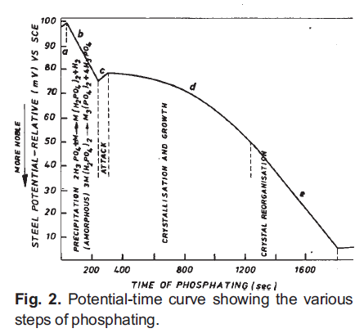
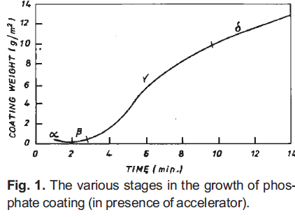
Kinetics of Phosphating Process
Coating formation proceeds through following stages:
  Electrochemical attack of steel
  Amorphous precipitation
  Dissolution of the base metal
  Crystallization and growth
  Crystal reorganization

Slide 12
Phosphating Process Details
Cleaning
  Most critical step. Surface must be free from contaminants such as oil, grease, wax, corrosion products, soils etc. Ideal clean removes all contaminants and prevent re-deposition or formation of other detrimental reaction products.
    Sand blasting, solvent degreasing, vapor degreasing, alkaline cleaning, acid pickling (HCl, H₂SO₄, and H₃PO₄), electrolytic pickling
Rinsing
  It prevents the drag out of chemical used in cleaning process
Phosphating
  Suitably cleaned process are subjected to phosphating process to form an insoluble, corrosion resistant phosphate layer on the substrate. Phosphating can be performed by Spray and Immersion process
    Choice of phosphating method depends on size and shape of substrate. Spray process is preferred for shorter process time but requires more factory floor space and special equipment. Immersion process is slower, produce uniform coating, and require less space. Immersion process are more susceptible to contamination and suitable to smaller parts
  Phosphating can be effectively performed on ferrous metals such as mild steel, maraging steels, galvanized steels, and non-ferrous metals such as Zn, Al, Mg, and Cd
  Physical properties such as hardness, tensile strength, workability of original metal is retained after phosphating
  Dimensional change caused by phosphating ~ 10⁻³ mm.
  Phosphating is carried out between 30-99ºC for few seconds to several minutes

Slide 13
Factors Affecting Phosphating Process
Phosphating process involves consistent depletion of bath constituents. To obtain good quality coating, following bath parameters must be strictly controlled within optimum limits:
  Free acid (FA) value (i.e. free H⁺ ions in phosphate solution)
  Total acid (TA) value (i.e. total phosphate content of the phosphate solution
  FA/TA ratio (acid coefficient)
  Accelerator content
  Iron content
  Other metallic and non-metallic constituents

Slide 14
Post Phosphating Processes
Rinsing
  Thoroughly rinsed with deionized water to remove any acid residue, soluble salts, non-adherent particles that can blister paint films. Generally, overflow rinsing or spray rinsing is followed.
Chromic acid sealing
  Phosphate coatings are usually porous in nature, that has adverse affect on corrosion resistance. A hot dilute chromic acid rinse is usually used to seal porosity by ~50% and improves corrosion resistance by deposition of insoluble chromates on the base areas of coating.
  It helps in dissolving protruding crystals of the phosphate coating
  Chromic acid treatments leaves slightly acidic residue which most paint can tolerate.
  Concentration range of 0.0125-0.050% is used.
  Though chromic acid sealing improves corrosion but Cr(VI) effluents is a serious concern due to its occupational and health hazards.
Drying
  After chromic acid rinsing, parts must be dried before finishing by simple evaporation, forced drying by blowing air or by heating.
Final finish
  Paints, oils, varnishes etc.

Slide 15
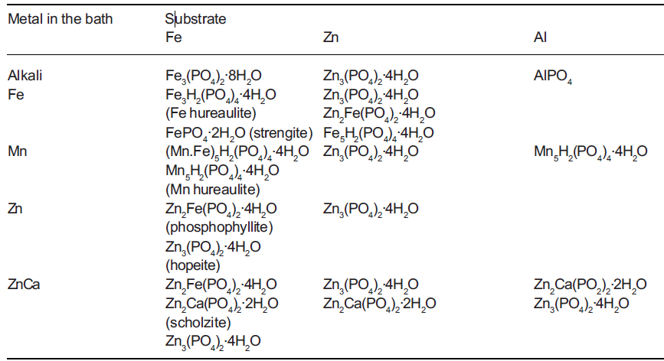
Composition of Phosphate Coating
Phosphate coating thickness varies from 1-50 μm, but for practical purpose, it is measured as weight per unit area
Ratio between coating weight per unit area and thickness varies between 1.5 – 3.5 for majority of industrial phosphate coatings.

Slide 16
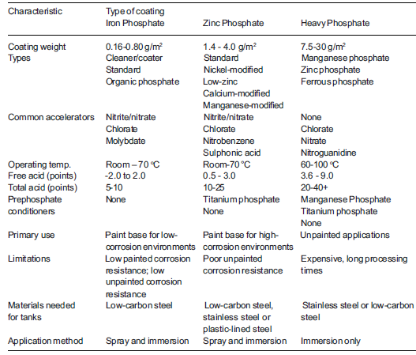
Phosphate Coating Characteristics

Slide 17
Mechanism of Zinc Phosphate Coating Formation
Formation and growth process occur in three stages:
  1st stage: Platelet crystals formed on the surface are randomly oriented. Some are parallel, some are vertical, and some are of needle type. Crystals grow laterally over the substrate
  2nd stage: It consists of nucleation and growth of several crystals on the upper surface of original crystals. The growth direction is usually vertical to the site and forms needle like crystals
  3rd stage: A thin layer of zinc phosphate spread from the base of the original crystals.

Slide 18
Factors Affecting Phosphate Coating Properties
Nature of substrate
  Composition of the metal: Steels with small amount of more noble metals such as Cr, Ni, Mo, and V can be phosphated more easily. However, higher concentration of these elements beyond certain critical limit may decrease the intensity of acid attack resulting in poor coating formation.
  Low C steels are easy to coat with phosphate. With increasing C content, rate of phosphating becomes slower and resultant crystals are larger. In general, ferrite phase in steel promotes metal attack and pearlite leads to coarsening of the phosphate crystal as nucleation is limited on island of pearlite. High surface carbon results in inferior coating quality.
  Phosphorous in steel refines grain size and increase surface coverage. Addition of P improves perforation corrosion resistance after painting. P may inhibit hydrogen recombination during initial staged of phosphating, which can form porosity and inferior corrosion resistance.
  Rate of phosphating is also controlled by S, which is primarily controlled by the balance of Si and Mn.
  Most unfavourable are carbide forming alloying element in steel and surface C content
Structure of the metal surface
  Rougher surface results in higher coating weight per unit area and faster phosphating
  Roughness (R_{a}) of ~0.76-1.77 μm is acceptable for most cases.
  In cold rolled steel, zinc phosphate growth is preferred on (111) α-Fe
  Phosphate coating growth is epitaxial. It is easy to deposit zinc phosphate on ferric oxide film than ferrous oxide.

Slide 19
Factors Affecting Phosphate Coating Properties – Contd.
Surface preparation
Surface activation
  Colloidal titanium phosphate serves as an activating agent because it has same stoichiometry and offer crystallographic plane for epitaxial growth.
  Activation agent results in the formation of fine grained thin and compact coating
  Colloids in aqueous media have composition Na₄TiO(PO₄)₂.0-7H₂O and are disc shaped. These particles are adsorbed on metal surface when colloidal solution is applied. During phosphating process, activated substance comes in contact to Zinc phosphating bath and ion exchange between the Na-ion on the surface of titanium phosphate particles and zinc ions of the phosphating solution takes place. The ion exchanged particles act as nucleating agents for the zinc phosphate crystals.
  Activation process greatly increases rate of phosphate coating.
  1-2% disodium phosphate solution containing 0.01% of titanium compounds have been used extensively used as activation agent in industries
  Other activating agents are: dilute solution of cupric or nickel sulphates, oxalic acid and polyphosphonates

Slide 20
Factors Affecting Phosphate Coating Properties – Contd.
Thermal or thermo-chemical treatments cause formation of heterogeneous phases on metal surface that can act as heterogeneous site for nucleation of phosphate.
Annealing treatment of 0.3Mn-0.2Ti modified steel at 280ºC results in the formation of manganese oxide and titanium oxide, which promotes the formation of phosphates.
Increased deformation during cold rolling and a high treatment temperature favors the phosphate coating formation with a good surface coverage whereas a rapid rise in temperature during heat treatment yields an unfavorable condition.
Machined surface results in high rate of deposition

Slide 21
Processing Problems and Remedial Measures
Maintenance of bath parameters and operating conditions at an optimum level is a major problem in continuous operation
  Over heating of bath
  Creation of excess acidity at metal/solution interface
  Change in acidity of bath due to carryover of alkaline solution
  Baths used for long time forms sludge of ferric phosphate
Remedies
  Periodic removal of sludge
  To enhance bath life, make-up solutions and solids are usually required

Slide 22
Defects in Phosphate Coating
Stained coating, low corrosion resistance, coating covered with loose white powdery deposit
  Possible cause: inadequate degreasing and cleaning, incorrect acid coefficient, incorrect solution composition, incorrect operating conditions, incorrect maintenance of chemicals, excessive sludge formation and faults in after treatment.

Slide 23
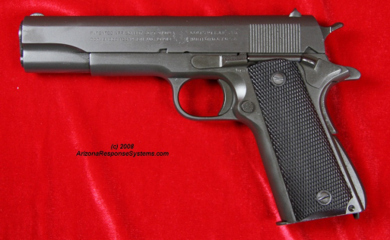
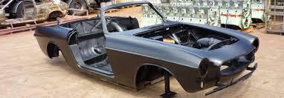
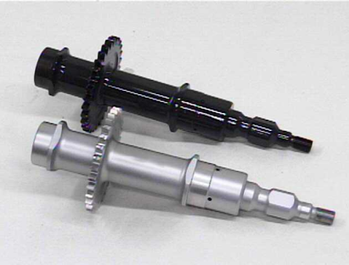
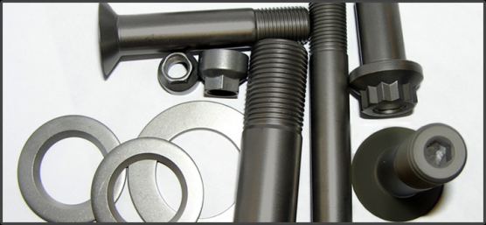
Applications of Phosphate Coating
Corrosion protection
  Due to their insulating nature, phosphate coating provides an effective physical barrier to protect both ferrous and non-ferrous metals against environment. For good corrosion resistance, parts are coated with paint or oil.
  Nd-Fe-B type magnets are highly susceptible to both climatic and corrosive environment, since Nd along with other rare earth elements belong to most electrochemically active metals. Application of Zinch phosphate coating greatly improves its corrosion resistance (See next slide)
Oxidation resistance
  Formation of phosphate layer induces significant improvement in oxidation resistance in temp. range of 300-700ºC.
As bases for paint
Provide wear resistance
  Phosphate coating absorb oil or retain lubricant due to their porosity helps to reduce wear loss. Manganese phosphate + lubricant have superior wear resistance, less friction, less noise. Phosphating increase sliding distance to scuff and scuffing load. However, under dry sliding condition, no benefits of phosphate coating was observed.
An aid in cold forming of steel
  Power used in drawing operation, sets up a great amount of friction between steel surface and die and consequently reduces speed of operation and die life. Application of light to medium weight zinc phosphate coating with lubricant makes improves cold forming efficiency. In addition, it prevents any damage during forming process
Mn, Zn, and Fe phosphate coatings are used as absobent in laser surface hardening of steel.

Slide 24
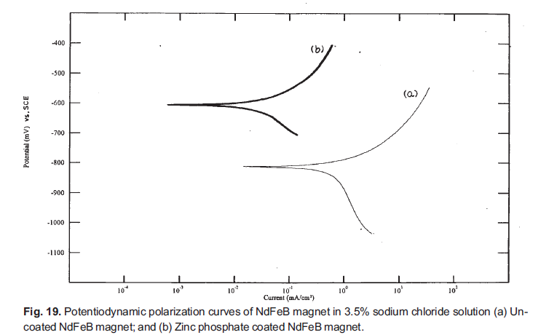
Effect of Phosphate Coating on Corrosion Resistance

Slide 25
Environmental Impact
Waste generated in phosphating operation is a matter of great concern.
Two types of wastes are produced:
  Liquid wastes generated from acid pickling, alkaline cleaning, rinsing stages, and chromic acid sealing stage
  Solid waste in the form of sludge are considered hazardous and are subjected to strict regulations for disposal. Sludge consists of ~20wt%Fe, 10wt%Zn, 1-3wt%Mn, <1wt%Ni, and 50-55 wt% phosphate. Recovery of metal, phosphate to prepare phosphate solution is possible by reduction sintering or wet chemical processing
Phosphating process discharges 400g/m² of CO²⁻ equivalent mass to the environment which has some green house effect.

Slide 26
Summary on Phosphate Coating
Cost effective solution to corrosion and wear resistance problems
Waste generated must be disposed per regulation or utilized effectively
Phosphate coating can be applied to both ferrous and non-ferrous metals
Thin phosphate coating provides good surface finish

Slide 27
Chromate Conversion Coating

Slide 28
Chromate Conversion Coating
Chromate conversion coatings are formed on metal surfaces as a result of the chemical attack that occurs when a metal is immersed in or sprayed with an aqueous solution of chromic acid, chromium salts such as sodium or potassium chromate or dichromate, hydrofluoric acid or hydrofluoric acid salts, phosphoric acid, or other mineral acids.
The chemical attack facilitates the dissolution of some surface metal and the formation of a protective film containing complex chromium compounds.
A variety of metals including zinc, cadmium, magnesium, and aluminum and electrodeposited metal coatings, can be coated with chromate layer.
Chromate conversion coatings are generally used to increase the corrosion resistance of the metal to which they are applied.

Slide 29
Chromate Conversion Coating
Most conversion coatings slowly dissolve in water and provide limited protection in this medium; however, they furnish excellent protection in marine atmospheres and in high-humidity environments.
The protection provided by chromate coatings increases directly with thickness up to a certain point, after which the protective nature is sacrificed due to the formation of a porous, non-adherent film.
Chromate conversion coatings are also used for a variety of decorative and functional applications.
They can be produced in a variety of colors, ranging from the very bright coatings obtained on zinc and cadmium, which simulate the appearance of bright nickel and chromium, to the olive drab frequently applied to military equipment.
Chromate coatings provide an excellent nonporous bonding surface for all paints that have good molecular adhesion.

Slide 30
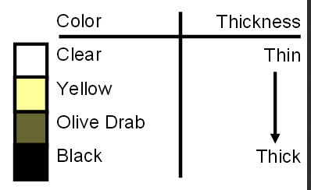
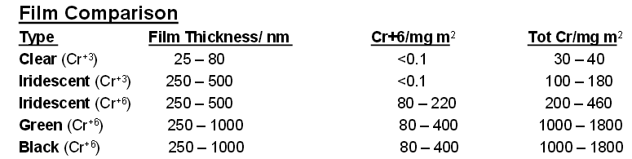
Hexavalent Chromium
Primary use in conversion coatings used for enhanced corrosion protection, for appearance, and as adhesion film for organic coating
Chromate coating can be applied to:
  Zn coated steel
  Zn plate and castings
  Zn coated Cu and Brass substrates
  Directly to Al
  Silver (electroplate for connectors)
  Mg
  Cd
Products
  Die cast products
  Shells (connectors)
  Fasteners
  Electrical chassis/cabinets
Coating characteristics
  Very thin

Slide 31
Alternative to Hexavalent Chromium
Cr: Classified as Group A human carcinogen
  Known to cause nasal ulcerations
  Negative reactions with reproductive and gastrointestinal tract
  Negative dermal effects.
No universal replacement for Cr⁺⁶
Trivalent chromium (Cr⁺³) is most commonly offered alternative to Cr⁺⁶
  Automotive industry approved the use of Cr⁺³
  Corrosion resistance of Cr⁺³ < Cr⁺⁶
  Organic top-coat is used to improve corrosion resistance
Permanganates offer promising potential to replace chromate coating
Newer formulations use Zirconium, non-chrome metal oxide
Silicate derived from Silane (Costly)
Organometallics: Silane based chemistry, (Improved color over chromates) Limited options due to instability in water & non conductive - good base for paints
Titanates
Partially Solubalized Silanes
Organo-zirconates (Excellent as paint primer)
Replacement coating should be Chromium and/ or Nickel free

Slide 32
Processing Steps – Chromating Al Alloys
Non-etch Alkaline Cleaning
Pre-Cleaning
After Alkaline Cleaning Rinse
Chromate Chemical Conversion Coating
Brush (Consistent)
Immersion (Consistent)
Spray (Not so good)
  Bath composition is very critical
  Excess chloride, fluoride or sulphate in solution are too reactive, while phosphate hinder film formation. Higher concentration of Ca, Ba, Mg, and Fe ions results in poor quality of coating; hence water dilution is critical
Rinse
Deoxidizer using chromate-sulphate or sodium sulphate + nitric acid or mechanical removal using abrasive nylon mesh pad
Higher alloying elements in Al reduces chromating rate
Air drying >140ºF deteriorates film
After Chromate Chemical Rinse
Final Acidulated Rinse

Slide 33
Chemical Processing – General Chromating of Zn
Reaction involves metal surface, aqueous solution containing chromates & select activator ions.
Activator types: Acidic sulfates, chlorides, fluorides, phosphates & complex cyanides.
Generally chemistry is tailored to work with a specific base metal, i.e., Aluminum or Zinc, Zn Alloys or Cadmium
Processing sequence:
1. Metal ions on part surface are dissolved by acid medium & enter
solution as ions.
2. Localized rise in pH in immediate vicinity of metal / solution interface.
3. Metal ions combine with chromate ions to form insoluble compound at localized high pH zone which precipitate on the metal part surface as an adherent coating.
4. Reaction by-products enter solution
5. Thickness builds from the base metal outward –process is self limiting as metal exposure is reduced due to increase in chromate coverage. (Chemistry must diffuse through active layer to react with Zn base)

Slide 34
Typical Process Cycle
Zn Electroplate
Rinse
Dip 0.25% -0.5% Nitric Acid
Dip in chromic acid
Cold water rinse
Leach using a dilute alkali bath
Cold water rinse
Dry
Seal/ Top Coat?

Slide 35
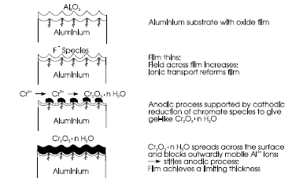
Mechanism of Chromate Conversion

Slide 36
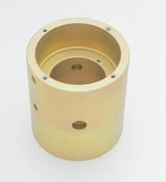
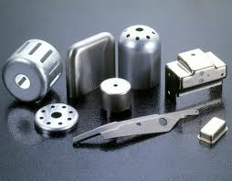
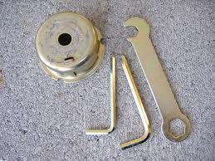
Applications
Chromate conversion coatings have been used to protect Zn based metals from corrosion.
Chromate coating works better than phosphate coating but hazardous effect of hexavaelnt chrome (Banned in Europe) has limited its applicability.
Electrode potential of chromate coating is more negative than zinc coated
Aircraft skin

Slide 37
Anodizing

Slide 38
Anodizing
Background
  Anodizing process first used in industry in 1923 to protect Duralumin seaplane parts from corrosion using chromic acid.
  Aluminum is most widely anodized metal
  Magnesium, Titanium, and Zinc are capable of being anodized but not used to a wide extent
  Other metals such as tin and copper can be anodized, but rarely practiced

Slide 39
What is Anodizing?
Anodizing is the successful development and control of natural oxidation process that occurs when Al is exposed to the atmosphere
  Try to corrode Al but in a control way
Anode Reaction
  Reaction at Metal/Oxide
    2Al + 3O₂⁻ → Al₂O₃ + 6e⁻
  Reaction at Oxide/Electrolyte
    2Al _{(metal)} + 3H₂O → Al₂O_{3(oxide coating)} + 6H⁺ + 6e⁻
  Total reaction at anode
    2Al → 2Al³⁺ + 6e⁻
  Cathode Reaction
    6H⁺ + 6e⁻ → 3H_{2(gas)}
  Total reaction in anodizing process
    2Al _{(metal)} + 3H₂O → Al₂O₃ + 3H₂

Slide 40
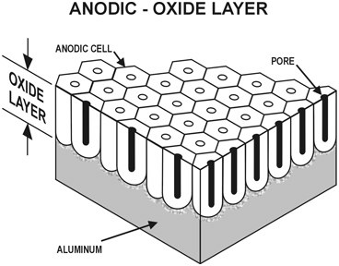
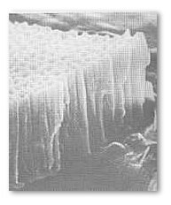
Anodizing Basics
Basic Concept
  Creates or thickens an oxide layer on surface of metal
  Allows electrical insulation of the given metal
  Creates opportunity of various decorative effects: dyeing, brightening, preservation of surface texture
  Increases surface hardness of the metal, improves corrosion and wear resistance

Slide 41
Characteristics of Anodized Coating
Hard, comparable to sapphire
  Bright anodizing hardness: 200-350 HV (Base metal hardness: 60-130HV); Hard anodizing hardness: 350-1400 HV
Transparent
Insulating
Wide color range
Good bonding, no flaking
Advantages
  Durable
  Stable color and aesthetic look
  Low cost
  Health and safety
  Good resistance against pitting, galvanic, and general corroosion
  Wear resistance
  Electrical resistance
  Minor increase in fire protection

Slide 42
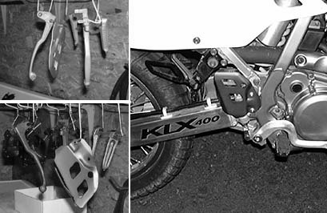

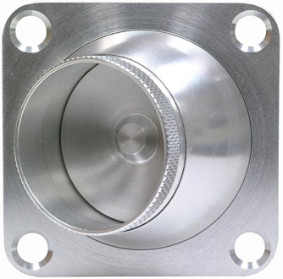
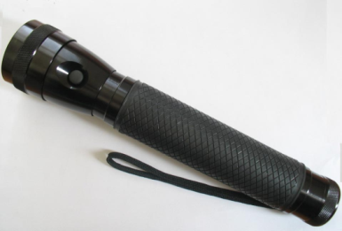
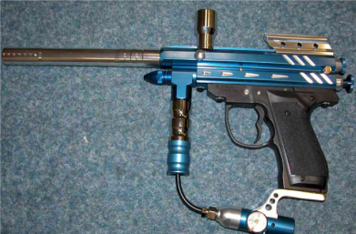

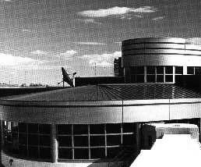
Applications of Anodizing Coating
Entertainment Industry
  Sporting goods and boats
Military/Aerospace
Commercial
Structural (Building)
Food preparation equipments and furniture

Slide 43
Anodizing Method
 | Continuous Coil Anodizing | Sheet Anodizing | Batch or Piece Anodizing
Uses | High volume, coiled sheet, foil, products with less severe forming | Wide widths, plate, large fabricated products | Extrusions, castings, parts with severe forming
Advantages | Wide range of metal and film thicknesses, less material handling. Precise color control and uniformity, low cost | Small runs, thicker films, anodized edges | Small runs, Thicker films, Anodized edges
Disadvantages | Bare edges on stamped parts, Crazing (looks like network of fine cracks) when severely formed, Limited to sheet and foil | Color variance, high cost, film thickness variance, crazing when severely formed | Color variance, excessive handling, high cost
Process | Coil anodizing involves continuous unwinding of coils through a series of anodizing tanks and then rewinding. | Sheet anodizing involves racking or framing of sheets and immersing them in large tanks. | Piece anodizing involves racking parts and immersing them in a series of treatment tanks

Slide 44
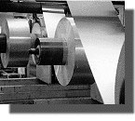
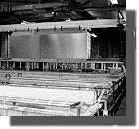
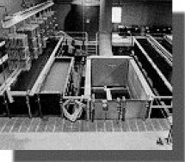
Anodizing Methods
Coil Anodizing
Sheet Anodizing
Batch or Piece Anodizing

Slide 45
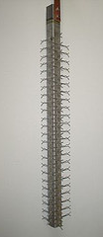
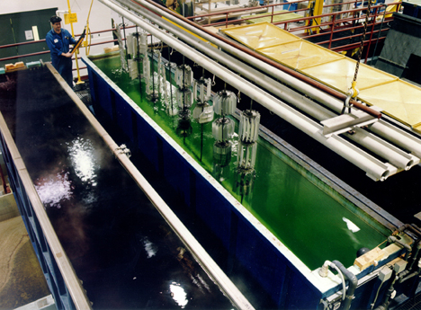
Anodizing Equipment
DC power source
Racks or jigs to support work pieces
Electrolytic solution:
  Sulfuric acid
  Chromic acid
  Oxalic acid
  Phosphoric acid
Solution, water, dye, and sealing tanks

Slide 46
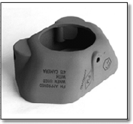
Type of Anodizing
Bright Anodizing
  Provides glossy and shiny look
  Oxide coating thickness ~10μm for good abrasion resistance and good reflection
  Uses: Finishing trim components, Automotive applications such as window trims, bumpers
Hard Anodizing
  Anodized coating hardness: 350-1400HV (by mixed electrolyte)
  Good abrasion resistance
  Good heat resistance. Hard anodic oxide coating of 75 μm thickness can withstand short exposure to temp. up to 2000ºC.
  Good electrical insulation
  Application: Provide wear resistance surface to parts such as: pistons, cylinders, hydraulic gears. Provides flame and chemical resistance surface.

Slide 47
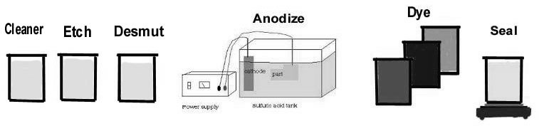
Typical Anodizing Process
Cleaning
  Removal of unwanted surface contamination and to prepare the surface for further processing
Rinsing (done multiple times)
  Effectively terminate the cleaning process and remove all by-products and contaminants
Etching
  Dissolve the surface of aluminum to: Diminish extrusion die lines and mild scratch, develop smooth, uniform finish, obtain a diffuse finish
  Heated NaOH for 0-20 minutes, remove 0-65μm of Al per side.
Deoxidizing & Desmutting
  Remove surface oxide, remove intermetallics, metal and metal oxides on the surface after cleaning etching, activate surface
  Ambient acid bath (1-5 min.)

Slide 48
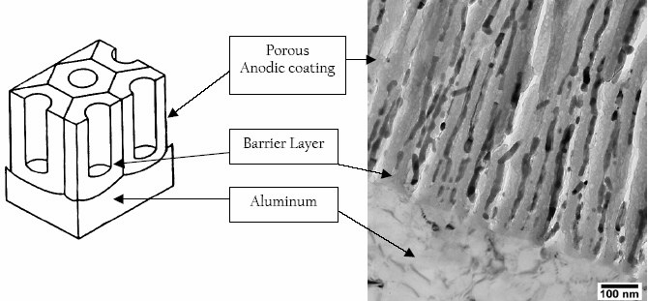
Anodizing Aluminum
Anodizing
  Electrochemical oxidation of Al surface to produce a stable film oxide (Eletrolyte: Sulfuric acid)
  A porous insulating layer of Al and O is produced by passing current through Al in conductive medium
  Process Variables:
    Cycle Time, Voltage, Current Density, Electrolyte Chemistry, Electrolyte Concentration, Electrolyte Temperature

Slide 49
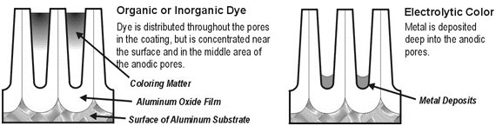
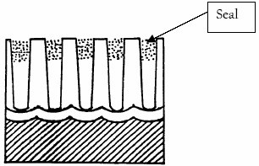
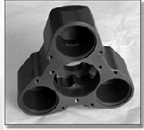
Coloring
  Deposit metal powder (Cu, Ni, Co etc.) at the bottom of the pore during electrolysis process
  Deposit organic or inorganic dye in the pore
Sealing Anodic Coatings
  Purpose is to close pores in the anodic film and render the film inert, non-staining, non-absorbing, non-reacting, and non-corroding

Slide 50
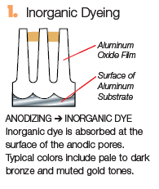
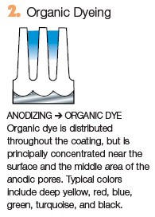
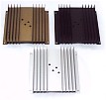
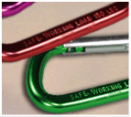
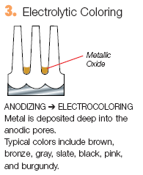
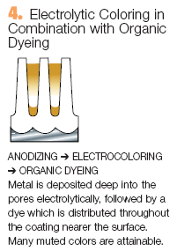
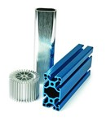

Color Anodizing
Courtesy of the Aluminum Extruders Council

Slide 51
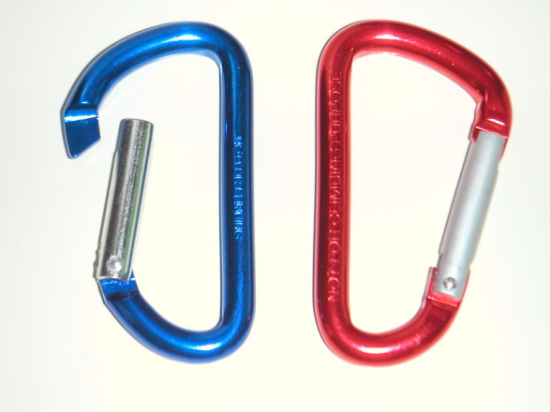
Advantages
Process is well suited for mass production
Minimal impact on dimensional tolerances
Durability and life of treatment
Color stability
Easy to maintain
Aesthetically pleasing
Cost
Health and safety
Maintenance
  Mild detergent with an abrasive cleaning technique can be used to remove dirt and stains

Slide 52
Disadvantages
Limited selection of metals can be anodized
Bulk anodizing of small items can be difficult or impossible given certain processes
Small gaps in coating are produced at points of contact with jigs or fixtures
Oxidation layers need to be removed from jigs and fixtures after every use

Slide 53
Laboratory Testing
Coating Thickness – ASTM B244 – Eddy Current
Coating weight – ASTM B137 – Acid Dissolution
Seal Quality
  ASTM B136 – Modified Dye Stain
  ASTM B680 – Acid Dissolution
Abrasion Resistance – FED-STD-141-Method 6192.1
Gloss – ASTM D523
Corrosion Resistance – ASTM B117 (Salt Spray)

Slide 54
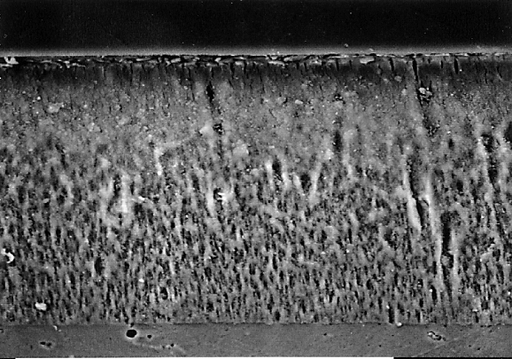
Cross-Sectional View of a Dyed And Sealed Anodic Film
Ni(OH)2 precipitate absorbed dye & hydrated coating
Hydrated anodic coating
Non-hydrated anodic coating
Aluminum substrate

Slide 55
Case Study: TiO₂ Nanotubes Arrays fabricated by anodizing process
TiO₂ films have attracted attention for a great variety of applications such as:
dye-sensitizing solar cells,
photo catalysis,
gas sensing …
TiO₂ nanoporous structures are desirible for these applications due to their high surface area
A number of techniques have been used to make TiO₂ films, including:
Sol-gel,
Chemical vapor deposition
Pulsed laser deposition

Slide 56

TiO₂ Nanotubes Arrays fabricated by anodizing process
DC Power supply
e ⁻
e ⁻
(+)
(-)
Anode
Ti
Cathode
Oxide
O ²⁻
H₂O
Ti
Electrolyte
Electrolyte (HF)
H₂O
Oxide
Ti ⁴⁺
Ti
Ti
Ti ⁴⁺
TiO₂
Ti
TiO₂
Tubular morphology
Ti
TiO₂ barrier oxide

Slide 57
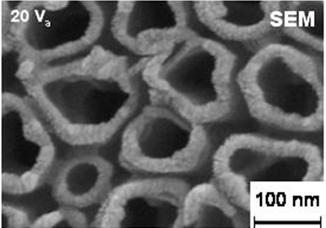
TiO₂ Nanotubes Arrays fabricated by anodizing process
Top view
Side view
Forming
Conditions
Anodizing Voltage: 20V
Anodizing Time: 20 min
10 nm
100 nm
HF Solution
Morphology
Description
~300 nm
Tube wall: ~10 nm
Tube hole diameter: ~100 nm
Tube height : ~ 300 nm
Void volume estimated ~ 77 %

Slide 58
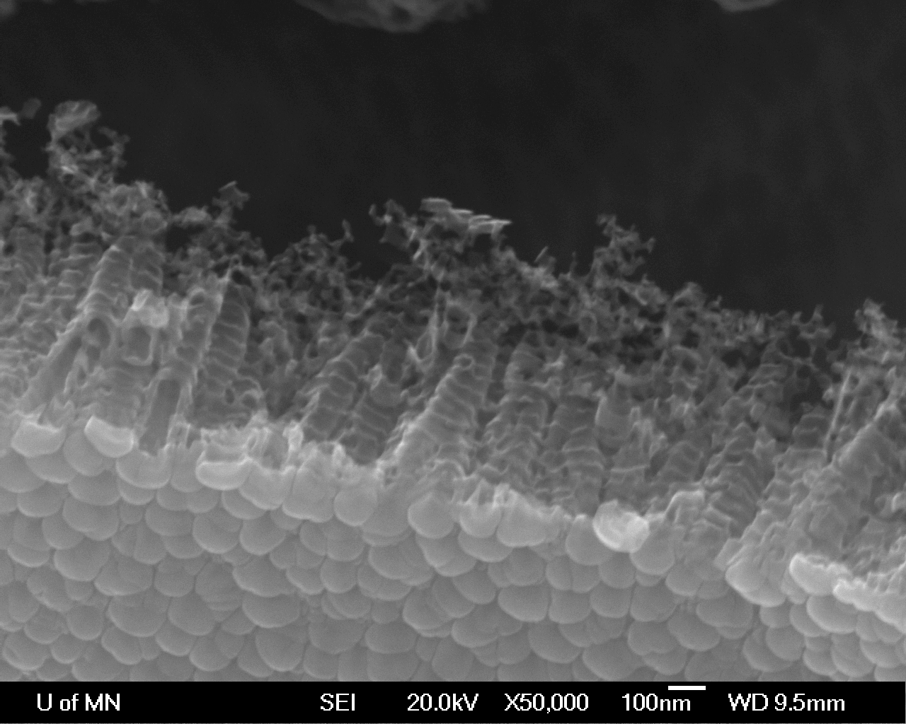
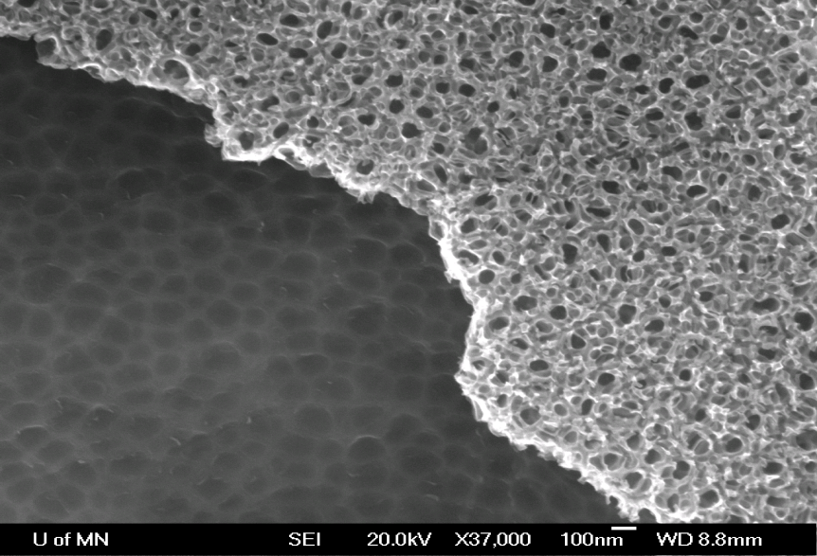
TiO₂ Nanotubes Arrays fabricated by anodizing process

Slide 59
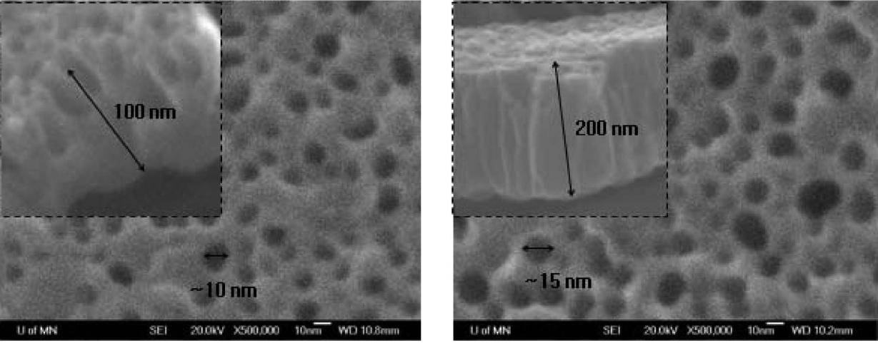
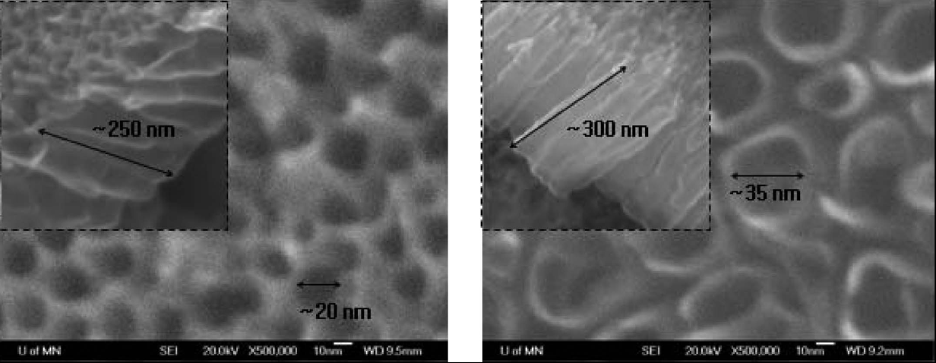
TiO₂ Nanotubes Arrays fabricated by anodizing process
Tube size with varied anodizing time (10V)
2 min
5 min
10 min
20 min

Slide 60
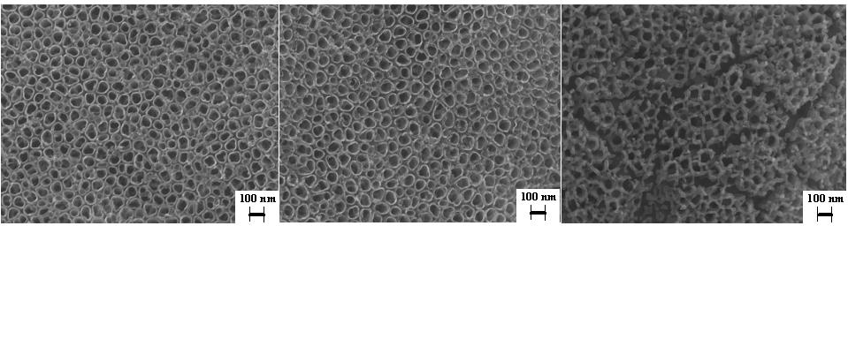
TiO₂ Nanotubes Arrays fabricated by anodizing process
TiO₂ nanotubes formed at 20 V for 20 min in HF solution.
no heat treatment 300 ºC, 3h heat treatment 700 ºC, 3h heat treatment

Slide 61
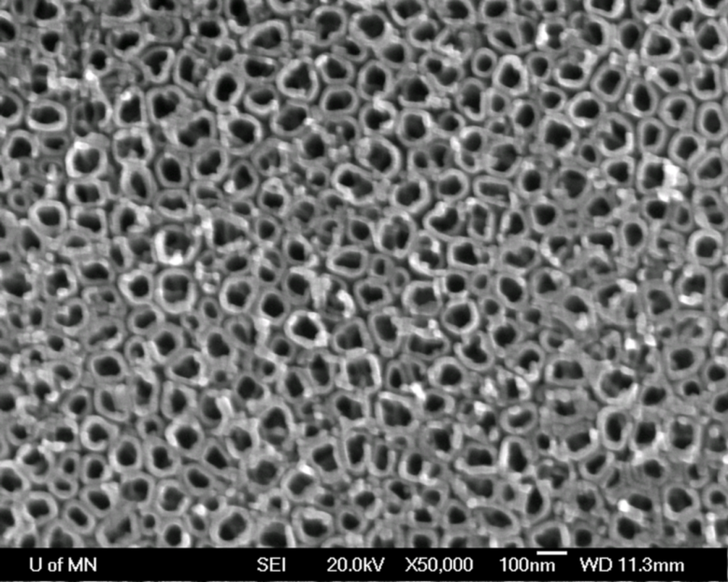
TiO₂ Nanotubes Arrays fabricated by anodizing process
100 nm
TiO₂ Nanotubes
TiO₂ Nanotubes coated with Pt or Pd

Slide 62
TiO₂ Nanotubes Arrays fabricated by anodizing process
TiO₂ Nanotubes Arrays fabricated by anodizing process
Summary
Arrays of Aligned TiO₂ Nanotubes were formed using
anodizing process
Significance :
- Very thin walls of nanotubes ~ 10 nm
- Small tube diameter ~ 80 nm
- High surface area to volume ratio
Potential Application:
- Gas sensor
- Catalysts Support
- Solar energy conversion
- Photocatalyst

Slide 63
Thermo-Chemical Processes
Thermo-Chemical Processes for Low Alloy Steel
Ferritic
Austenitic
Nitriding
Nitrocarburizing
Carburizing
Carbonitriding
(Other thermochemical processes such as Carburizing, Carbonitriding, Siliconizing, Chromizing, Aluminizing, Boronizing, Boronitriding will be covered in Unit 6)

Slide 64
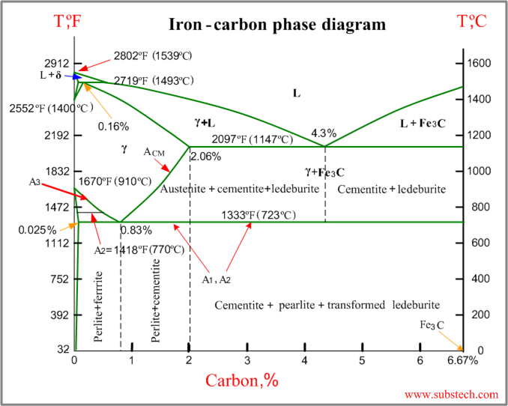
Temperature Range
Carburizing
Carburizing
Carbonitriding
Carbonitriding
Nitrocarburizing
Nitriding
Nitrocarburizing
Nitriding
Above Eutectoid Temp.: Carburizing: 800-1200ºC; Carbonitriding: 750-900ºC
Below Eutectoid Temp.: Nitriding: 350-590ºC; Nitrocarburizing: 400-590ºC

Slide 65

Theory of Nitriding Process: Fe-N Phase Diagram
The solubility limit of nitrogen in iron is temperature dependent, and at 450 °C (840 °F) the iron-base alloy will absorb up to 5.7 to 6.1% of N. Beyond this, the surface phase formation on alloy steels tends to be predominantly epsilon (ε) phase. This is strongly influenced by the carbon content of the steel; the greater the carbon content, the more potential for the ε phase to form. As the temperature is further increased to the gamma prime (γ′) phase temperature at 490 °C (914 °F), the “window” or limit of solubility begins to decrease at a temperature of ~ 680 °C
(1256 °F). The equilibrium diagram shows that control of the nitrogen diffusion is critical to process success. The δ-phase, not shown on this diagram, exists from 11.0 to 11.35% N at temperatures below approximately 500 °C (930 °F).

Slide 66
Fe-N Phases
α-Ferrite can dissolve 0.4 at% of N without substantial straining with N atom occupying octahedral interstices.
When N>2.4 at%, γ’ is formed resulting in tetragonal straining and N atoms occupying 1/3 of the possible octahedral interstices.
Solubility of N in γ’ is 10.3 at% and they occupy octahedral interstices of FCC-Fe lattice (Fe-N solid solution – two interpenetrating lattices i.e. sub-lattice of Fe and N)
ε nitride has 15-33 at% of nitrogen. In steel containing Si, amorphous Si₃N₄ precipitated because volume misfit between nitride and matrix slowed down the process
During nitriding, a compound layer composed of ε and/or γ’ is formed.
Beneath the compound layer, a diffusion zone extends in the ferrite matrix in which nitrogen is dissolved interstitially
Slow cooling after nitriding can lead to the formation of γ’ and consequently alter the sub-layer thickness within compound layer.

Slide 67

Solubility Limit of N in Fe
Nitrided layer consists of compound layer (γ’ (Fe₄N) and ε (Fe₂₋₃N)) and diffusion zone. Diffusion zone consists of α-phase and different kinds of carbides. Compound layer in steel determines its wear and corrosion resistance and diffusion layer determines its fatigue resistance. Nitrogen concentration decreases rapidly below the compound layer. Nitriding causes relatively less distortion vis-à-vis carburizing. However, due to low diffusion coefficient at low temp., the hardened case is relatively shallow.

Slide 68

Nitriding Agent
NH₃ → [N] + (3/2)H₂ Ammonia is decomposed or cracked by heat to liberate nascent Nitrogen
Where a _{N} = activity of nitrogen, P = Partial pressure
Dissociation of NH3 must be controlled to reduce the amount of nascent nitrogen in order to limit the formation of compound layer. This is done by diluting NH₃ with H₂
Machlet was the first metallurgist to pioneer gas nitriding process but Adolph Fry got the credit for publishing his work and is regarded as the father of nitriding
Relationship between local equilibrium and nitriding potential (k) as a function T
Lehrer Diagram of pure iron (using Thermo-Calc)

Slide 69


Effect of N Content on Phase Evolution in Steel
Crystal structure of γ’-Fe4N showing two unit cells
Phase distribution within a nitrided case on steel and accompanied nitrogen depth concentration
Porosity in ε-layer

Slide 70


Diffusion of N in Steel
No phase transformation and no rapid quenching; minimize distortion and dimensional change; Source of slight distortion is due to relaxation of residual stress
Alloying elements have significant effect on nidriding. High surface hardness is obtained on steels containing Cr, Mo, Al, V, and W (all forms stable nitrides)
Processing at higher temp. increases the risk of forming nitride network, which should be avoided
Nitralloy group of steel was developed for nitriding since steels with higher alloying element were not readily available for nitriding (Germal Process – no use of H)

Slide 71

Hardness vs. Case Depth
Role of Compound Layer:
High N concentration results in greater porosity and becomes brittle, resulting in flaking
For gear type applications, compound layer is undesirable, so parts are grounded to remove compound layer
Compound layer provides chemical stability and improves corrosion resistance
Beneficial Effects of Nitriding:
Improve high cycle fatigue due to compressive residual stress and strong nitride layer; LCF durability decreased due to the cracking of nitride layer.
Improve wear resistance, reduce friction

Slide 72
British Standard Nitriding Steels
Designation | C | Si | Mn | P | Cr | Mo | Ni | V | Al
En40A* | 0.20-0.35 | 0.10-0.3 | 0.40-0.55 | <0.05 | 2.90-4.00 | 0.60-0.80 | <0.40 | -- | --
En40B* | 0.20-0.30 | 0.10-0.35 | 0.40-0.65 | <0.05 | 2.90-3.50 | 0.40-0.70 | <0.40 | 0.10-0.30 | --
En40C* | 0.30-0.50 | 0.10-0.35 | 0.40-0.80 | <0.05 | 2.90-3.50 | 0.70-1.20 | <0.40 | 0.10-0.30 | --
En41A’ | 0.25-0.35 | 0.10-0.35 | <0.65 | <0.05 | 1.40-1.80 | 0.10-0.25 | <0.40 | -- | 0.90-1.30
En41B’ | 0.25-0.45 | 0.10-0.35 | <0.65 | <0.05 | 1.40-1.80 | 0.10-0.25 | <0.40 | -- | 0.90-1.30
* International designation: CrMoV9
‘ International designation: 34CrAlMo5

Slide 73

Nitriding Processes – Salient Characteristics
  Gas
    Case-Hardening Process
    Nitrogen Introduction Nitrogenous Gas, Ammonia
    Surface of a Solid Ferrous Alloy
    Suitable Temperature between 495 and 565°C (for Steels)
  Liquid
    Thermo-chemical Diffusion Treatment
    Hardening Components With Repeatability.
    Salt Bath, at Less Critical Temperatures.
    Preserves Dimensional Stability
    Corrosion Protection
    Exhibit Long-Term Resistance to Wear, Seizure, Scuffing, Adhesion and Fatigue.
  Plasma
    Vacuum Chamber, Pressure = 0.64 Pa
    Pre-Heat Cycle, Surface Cleaning
    Ion Bombardment
    Control Gas Flow, N, H, CH4
    Nitriding rate is enhanced by mixing H₂ with N₂
    Ionization by Voltage Blue-Violet Glow
    Wear Resistant Layer
  Bright
    Modified gas nitriding with ammonia and hydrogen. Atmosphere gas is continually withdrawn from the nitriding furnace and passed through a temperature controlled scrubber containing NaOH solution. Trace amount of HCN formed in the furnace is removed and improve rate of nitriding. Control over nitrogen activity is enhanced with little or no white layer on the surface. If present, more ductile γ’ is formed.
***Lots of more nitriding methods for specific applications***
http://www.nitriding.co.uk/np01.htm

Slide 74
Nitriding Processes – Salient Characteristics
Pack Nitriding
  Employs nitrogen-bearing organic compounds as a source of nitrogen. Upon heating, the compound that is relatively stable at 570ºC, slowly decomposes. Nitriding time 2-16hours.
  Parts are packed with in glass, ceramic or aluminum container with nitriding compound.
  Containers are covered with Al foil and heated b y convenient means
Pressure nitriding
  Sealed retort is used, capable to withstand high pressure
  Furnace is evacuated of air and then filled with ammonia to a predetermined pressure, depending on part surface area.
  ~50-100 g of ammonia are supplied per square meter of surface to be nitrided.
  Advantages: Complicated shaped parts can be nitrided. Thickness of white layer is controlled by varying the amount of ammonia added initially.
  Disadvantages: Retort sealing is not always convenient, After 45 min, 50% ammonia is used up, further development is slow, to restrict white layer, case depth must not exceed 0.50-0.63 mm, and in filling the welded retort with ammonia, dangerous pressure can develop if sufficient quantity of ammonia is allowed to condense. So, keep retort warmer than ammonia supply tank

Slide 75
Gas Nitriding Process
Patented in 1913 and 1921
Conducted at 550-580ºC in box furance or fludized bed in an atmosphere filled with partially dissociated ammonia. Advantage of fluidized bed furnace is rapid and uniform heating
Catalytic decomposition of ammonia to form nascent nitrogen
Limitation of conventional gas nitriding
  Superficial concentration of nitrogen can’t be precisely controlled
  Structure of nitrided layer and the entire process lacks repeatability
Controlled gas nitriding (Nitreg®)
  Mixed gas atmosphere (Ammonia + Additive gas)
  Process is controlled by nitriding potential instead of dissociation rate
  More uniform nitrided case for complex geometries
  Masking is difficult (require protective pastes or plating)
  Surface activation is necessary for stainless steel to remove passive film
Application factors: To obtain high surface hardness, increase wear and antigalling resistance, improve fatigue life, improve corrosion resistance (except stainless steels), surface hardness is retained at high temperature.

Slide 76
Base Material And Applications
Base Material: Alloying elements such as Al, Cr, V, W, and Mo are beneficial in nitriding because they form nitrides that are stable at nitriding temp. Mo, in addition, reduces the risk of embrittlement at nitriding temp. Other elements such as Ni, Cu, Si, and Mn have little effect of nitriding characteristics
Nitriding Steel: Nitralloy, 135M, Nitralloy N and equivalents
High speed steels: AISI M2, M36, M42
Tool steels: D2, H11, H13, A10, A2, S7
Carbon Steels: 1045, 1008, 1010, 1020, 1045, 1060
Alloy Steels: 4130, 4140, 4330V, 4340, 5130, 5140, 8620, 9310
Stainless Steels: 300 and 400 series
Cast Irons: Ductile, Grey
Applications
Stampings, forgings, castings, and machined parts used in machinery, defense, aerospace (Compound layer thickness <2μm), automotive, tool, and die, oil drilling, mining, and paper mill industries

Slide 77


Gas Nitriding
Prior heat treatment: before being nitrided, all hardenable steels must be hardened and tempered at 30ºC higher than nitriding temp.
After hardening and tempering, parts must be thorughly cleaned. Vapor degreasing is effective, followed by abrasive cleaning
Furnace purging: After loading and sealing the furnace, it is necessary to purge air at temp. ~150ºC. This avoids any potential explosion. Care must be taken to avoid oxidation of parts. A typical purging cycle consists of: 1) close furnace and start flow of anhydrous ammonia gas at a fast flow rate, 2) set furnace temp. at 150ºC. When the furnace had been purged to an extent that ~10% or less air is present, then heat the furnace to nitriding temp. Ammonia should not be introduced into the furnace containing air at 330ºC. Purging is also employed at the end of nitriding cycle when furnace is cooled from nitriding temp. Dilution of ammonia lessens the discomfort level to employees.
Emergency purging: If the supply of ammonia is cut off during the nitriding cycle or if a break occurs in the supply line, there is a great danger that air may be sucked into the furnace. To ensure positive pressure, an emergency purging system that will pump dry nitrogen or an oxygen-free gas into the furnace. Mixtures of ammonia and 15-20% air are explosive if ignited by a spark. Advantage of nitrogen purging over ammonia include its safety, ease of handling and ease of control.
Nascent nitrogen is produced by dissociation of ammonia when it contacts hot steel parts. It is important that the dissociation rate of ammonia at the beginning of nitriding be about 15-35% for 4-10h. This is achieved by constant flow rate of ammonia.
Porous outer layer – Conventional nitriding

Slide 78
Conventional gas nitriding process
  Partially dissociated NH₃
  @ 500-600ºC
  Superficial nitrogen concentration can’t be adequately controlled and N+C concentration may be > 11wt%, causing over saturation of the superficial compound layer (white layer), which can be porous and brittle and has spalling tendencies, detrimental to gear life
  In many cases epsilon zone is grounded to remove compound layer, thus adding machining cost
  White layer is beneficial (increased corrosion and better lubricity) if porosity is limited and quality is improved
  Inadequate process control means lack of repeatability
  Furnace heating and cooling
    Limit the heating rate to 55ºC/h or slower to minimize temp. gradient
  Distortion and Dimensional Changes
    Relief of residual stress from prior operation such as welding, hardening, machining
    Stress induced during nitriding due to inadequate fixturing, rapid heating or cooling
    Stresses induced by the increase in volume that occurs in the case
  Stabilizing treatment: There is a balance between compressive stresses in the case and tensile stresses in the core. If this balance is upset by grinding off a part of the case, slow dimensional change may occur. To prevent this, nitrided parts are grounded, heated to 565ºC for 1h

Slide 79
Economy and Energy Considerations – Gas Nitriding
To reduce nitriding costs, it is necessary to select a furnace from comparison of unit costs for electricity, gas, maintenance, etc., for furnaces of different types and sizes.
The most economical of all the furnaces used in industry are electric shaft furnaces.
Furnaces with a moveable chamber are the most expensive. With a large volume of production they can be replaced with multi-bed bell furnaces (if shaft furnaces cannot be used), which makes it possible to increase the output of the furnace by a factor of at least two and reduce the cost of nitriding by at least 13–20%.
With a substantial volume of production it is inefficient to use shaft furnaces with V<0.6 m³.
The use of the semicontinuous process in furnaces of various types reduces the specific expenditure of electrical energy by 15–30%, reduces the specific expenditure of gas, increases the output of the furnace, and reduces the cost of nitriding.
With increasing outputs and lower nitriding costs in large batch furnaces it is advisable to shorten the nitriding process as much as possible. This makes it necessary to equip large furnaces with a system of forced cooling.
With nitriding in furnaces with V>0.6 m³ the major expense (up to 49%) is for electrical energy, while in small furnaces the major expense is for equipment (up to 55%).

Slide 80
Case Studies
Reduction of Gear Finishing Costs with Nitriding by changing gear material from 4130 to AMS 6475.
  Gears made of 4130 steel were carburized in salt and marquenched in salt at 260ºC and lapped to eliminate distortion.
  Nitralloy gears were nitrided and lapping was not required. So, though cost of Nitralloy is greater than 4130 steel, but eliminating lapping cost significantly lowered the overall gear production cost.
Effect of previous heat treatments
  Shaft pinions made of mill-heat-treated 4150 bar stock were scrapped because of a pronounced increase in distortion. This problem was eliminated by stress relieving treatment at a temp. 30ºC above nitriding temp.

Slide 81



Slide 82

Examples where Nitriding is better than Carburizing

Slide 83


Double-Stage Nitriding (Floe ProcessTM)
First stage at 495-525ºC with ammonia dissociation rate 15-30%
Second stage at 565ºC with ammonia dissociation rate 65-80%, for which external ammonia dissociator is necessary.
Primary objective of double-stage nitriding is to reduce the depth of white layer
Lowers case hardness, increase case depth, may lower core hardness depending on prior tempering temp. and total nitriding time, may lower the apparent effective case depth because of the loss of core hardness.

Slide 84
Gas Nitriding Process – Contd.
Nitreg® Process
  Suitable for plain C steel and stainless steel
  Negligible dimensional change
  Relatively low T treatment (500-600ºC); Components can be nitrided in quenched and tempered conditions
  White layer is not brittle
  High repeatability due to tight temperature control
  Excellent circulation of gaseous atmosphere
  Nitriding potential is used as controlling parameter. Nitriding potential may be varied between 0.5-15 for a given process temperature depending up on the steel composition
  Time, temperature, and nitriding potential can be programmed
  Controlled cooling rate after treatment inhibits the formation of undesirable nitrides or carbonitrides at grain boundaries in diffusion zone; thus increase toughness

Slide 85

Types of Nitreg® Gas Nitriding Layer

Slide 86

Effect of Alloy Composition on Case Depth
Deep nitrided steel (32CrMoV13) is used for aerospace bearings of main shaft or jet engines, operating under high pressure, high speed, and with limited lubrication
  This application required case depth of more than 600 μm, nitriding process at 525-550ºC for 100h; surface hardness ranges from 730-830HV; Compound layer of ~30μm is removed by grinding; Diffusion layer has two zones: 1) First ~100mm below compound layer is depleted of carbides due to their dissolution and precipitation of more stable nitrides and carbonitrides, and 2) second zone is free of any precipitate. High rolling contact fatigue life is due to compressive residual stress and semi-coherent nano-sized nitrides.

Slide 87


Equipment
Batch type furnaces (Vertical retort, bell type or box furnace)
  A means of sealing the charge to exclude air and other contaminants while containing the controlled atmosphere
  An inlet line for introducing atmosphere and an outlet line for exhausting used atmosphere
  Heating elements and appropriate temp. controls
  Fan for forced air circulation to equalize temp.
Vertical Retort Furnace
Bell Type Furnace
Thermocouple
Gasket
Oil seal
Work basket
Heating element
Fan
Cooling assembly

Slide 88
Equipment
To minimize reaction, fixture, retorts, fans, work basket are made of steels with Cr and Ni. Enamel coated basket has also been successfully used.
Ammonia supply: Anhydrous ammonia (refrigeration grade, 99.98 wt%). Storage tanks are situated outside the building in which nitriding equipment is located.
Special precaution: To avoid leaks, exceptionally good piping should be followed. Materials used for valves, pipes are stainless steel, aluminum. Ammonia corrodes brass, Zn.
Pressure regulation
Exhaust gas: Contains air, air+ammonia, ammonia+hydrogen+nitrogen and are released in air as high as possible outside building. Nitrogen gas is purged during heating and cooling and burnt at the terminal during nitriding cycle. Building must be well ventilated.
Safety Precaution: Anhydrous ammonia is flammable with a narrow range. Concentrations of 15-25% ammonia in air produces explosive mixtures. Dry ammonia is non-corrosive; however, in contact with air, it is corrosive. Ammonia is highly soluble in water, so spraying equipment is required in case of severe leak.
Hydrogen hazard: Anhydrous ammonia produces considerable amount of hydrogen upon cracking, which is flammable. Racking or complete dissociation does not occur in nitriding furnace but there is enough hydrogen in exhaust that can be considered as fire hazard. Because of the presence of hydrogen in the nitriding furnace, it should never be opened when it is heated to nitriding temp. If it is necessary to remove the part before the furnace is cooled, the furnace must be purged with inert gas.

Slide 89
Common Nitriding Problems
Low case hardness or shallow case
  Composition unsuitable for nitriding
  Improper microstructure
  Failure to quench and temper prior to nitriding
  Low core hardness
  Surface passivation, from machining, inadequate cleaning or foreign matter
  Excessively low or high nitriding temp.
  Insufficient ammonia flow
  Nonuniform circulation or temp. in furnace
  Prolonged exposure of furnace parts or temp. in furnace
  Insufficient time at temp.
Discoloration of workpieces
  Inadequate surface cleaning/etching, phosphate coating
  Oil, air or moisture in the retort
    Oil in the retort can occur due to inadequate cleaning of parts, low pressure at seal, overheating of seal, leakage at the base
    Moisture in the retort can occur due to leakage from cooling chamber, water being sucked during rapid cooling with inadequate gas flow
    Air in the retort can occur due to inadequate seal, leakage around pipes/thermocuple, and introduction of air to purge ammonia while charge is above 175ºC.
Excessive dimensional changes
Cracking and spalling of nitrided surface
Variation in percentage of ammonia dissociation
Deeper white layer
Plugging of exhaust lines and pipette lines

Slide 90
Common Nitriding Problems – Contd.
Excessive Dimensional Changes
  Inadequate stress relieving prior to nitriding
  Inadequate support of parts during nitriding
  Inappropriate part design (Asymmetric design)
  Unequal case at various surfaces of part
Cracking and spalling
  Due to dissociation in excess of 85%
    Variation in % of dissociation may be due to: small charge, overactive surface furnace parts and fixtures, leakage or loss of sample from burette, change in gas flow caused by buildup of pressure in furnace, variations in furnace temp.
  Design (particularly sharp corners)
  Excessively thick white layer
  Decarburization of surface in prior heat treatment
  Improper heat treatment
White layer deeper than permitted due to:
  Nitriding temp. being too low
  Percentage of dissociation below the recommended minimum (15%) first stage
  First stage held too long
  Percentage of dissociation too low during the second stage
  Fast purging with raw ammonia instead of cracked ammonia or nitrogen above 480ºC during slow cooling.

Slide 91
Nitriding of Stainless Steel
Austenetic stainless steels of 3xx series are the most difficult to nitride. However, 301, 302, 303, 304, 308, 309, 316, and 347 have been successfully nitrided. These non-magnetic materials can be hardened, so the core remains soft. This is true for non-hardenable ferritic steel such as 430 and 446 SS.
Hardenable SS: Martensitic transformation, followed by tempering prior to nitriding.
Prior to nitriding, non-hardenable ferritic SS must be annealed and relieved of machining stresses.
Surface preparation: Chromium oxide must be removed by dry honing, wet blasting, pickling, chemical reduction in a reducing atmosphere or submersion in salt.
Depletion of Chromium oxide on the surface due to the precipitation of chromium carbides results in the loss of corrosion resistance
  Solution: Low temperature plasma nitriding – formation of S-phase (extended austenite).

Slide 92

Liquid Salt Nitriding Process
Developed in 1940s using fused salt bath containing either cyanides or cyanates.
Typical salt bath composition: mixture of 60-70% sodium salts {96.5% NaCN, 2.5% Na2CO3, 0.5% NaCNO} and 30-40% potassium salts {96%KCN, 0.6%K2CO3, 0.75% KCNO, 0.5% KCl}
Advantages: Short cycle time (1.5h for low alloy steel) due to intense heating and high reactivity. Bath reactivity can be increased by adding S or melt pressurizing.
Operating temp. = 565ºC produces a case of 0.3mm thickness with oxide layer at the top followed by diffusion layer
Limitations: Bath toxicity and poor quality of nitride surface (high surface roughness)

Slide 93


Plasma or Ion Nitriding
Invented by Wehnheldt and Berghause in 1932 but commercialized in 1970s.
Glow discharge phenomenon to introduce nascent nitrogen to the surface on an alloy and its subsequent diffusion into subsurface layers.
Plasma is formed in a vacuum using high-voltage electrical energy to accelerate nitrogen ions which bombard the alloy surface.
High Cathodic potential is applied to the screen surrounding parts, which become real cathode; Therefore, plasma forms on the active screen, heating it up.
Radiation from the screen heats up the part to nitriding temperature.
Plasma formed on screen is composed of ions, electrons, and active nitriding species which are forced to flow over the nitrided part by the designed gas circulation.
Complex geometries can be uniformly nitrided
Compound layer | N₂, % | H2, % | CH₄, %
Negligible | 8-15 | 85-92 | -
Thin | 20-35 | 65-80 | -
Thick | 40-60 | 40-60 | -
Extra thick | 75-79 | 40-60 | 1-2

Slide 94
Advantages of Plasma Nitriding
Repetitive metallurgical results and complete control of the nitrided layers.
Superior fatigue, wear resistance, and hard and tough layer.
High dimensional stability, eliminates secondary operation, low operating-temperature capability, and produces parts that retain surface finish.
Total absence of pollution
Efficient use of gas and electrical energy
Total process automation
Selective nitriding by simple masking techniques
Process span that encompasses all subcritical nitriding
Reduced nitriding time
Limitations:
High capital cost
Need for precision fixturing with electrical connections, lack of feasibility for liquid quenching for carbon steels
Applications: Structural elements subject to cyclic loading, workpieces requiring precision dimensions, components subject o sliding wear, part exposed to mild corrosion

Slide 95


Comparison of Salt Bath Vs. Gas Vs. Plasma Nitriding

Slide 96

Comparison Between Ion Nitriding and Ammonia Gas Nitriding
Ammonia gas nitriding produces a compound zone made of both ε and γ’. High internal stresses develop from the differences in volume growth associated with each phase. In addition, interfacial bond strength of these phases are weak. Thus allowing the white layer to fracture by small applied load. Under cyclic loading, cracks in the compound zone can serve as initiation points from the propagation of fatigue cracks.
The single-phase γ’ compound zone, which is thin and more ductile, exhibits superior fatigue properties in ion nitrided part.

Slide 97

Laser Nitriding
A relatively new concept, still in R&D state
Material is placed in the reactive gas environment and irradiated with the laser light.
Nitrogen is fed through a nozzle into the melt pool.
On a time scale of hundreds of nanoseconds, the high intensity pulse-laser irradiation of I ≈ 10⁸ W/cm² in ambient nitrogen atmosphere is capable of generating 1- 1.5 μm thick nitrided layer.

Slide 98
Beam Ion Implantation
At limited scale, beam ion implantation can be used to incorporate nitrogen into a material surface. The conventional ion beam implantation, applied at room temperature, is capable to modify chemistry of relatively thin layers of materials.
Using a beam of nitrogen ions with an energy of up to 1 MeV at room temperature, a continuous nitride layer of the order of 1 μm can be synthesized. There are, however, techniques exploring elevated temperatures of up to 600 ºC or hybrids such as plasma immersion implantation or low voltage plasma immersion implantation, allowing generating thicker layers.
After treatment, conducted at 400 ºC for 0.5 h and 1 h, both the beam ion implantation and the plasma ion implantation produced over 1 μm thick layer, enriched in nitrogen to 20-30 at%, while ion nitriding and gas nitriding produced layers with a thickness below 1 μm and the lower nitrogen concentration.

Slide 99
Case Study: Low Temperature Plasma Nitriding of Stainless Steel

Slide 100
Nitriding of Ti Alloys
Why nitride Ti Alloys
High strength to weight ratio
Heat and corrosion resistance
Low hardness and high wear rate
  Nitriding provides one of the ways to improve wear resistance
Nitriding of Ti Alloy
  Gas nitriding at high temperature 650-1000ºC, require longer time (100h); lower fatigue life
  Plasma nitriding at low temperature 400-950ºC, shorter duration (0.5-32h), generates compound layer thickness ~50μm, reduction in fatigue life can be eliminated by lowering nitriding temperature. Compound layer hardness ~ 800-1200 HV on Ti6Al4V
  Ion beam nitriding at 500-900ºC for 20h to produce 5-8mm thick compound layer.
  Laser nitriding has been tried, Surface has tendency to cracking.

Slide 101

Microstructural Development
Nitriding temperature is below polymorphic transformation
α-Ti→ α-Ti(N) (interstitial solution of N) → Ti₂N →TiN

Slide 102
Application of Other Nitrided Materials
Nitrided-niobium has a potential application in particle accelerator. Nb made cavity of superconducting radio-frequency accelerator operates at 9K. Nitriding results in the formation of δ-NbN with critical temperature raised to 17K. Laser nitriding is effective.
Refractory Materials
  Nitrided Nb-30Ti10W: proton exchange membrane fuel cell
  Nitrided Zr as cathodes in arc heater with greater erosion resistance. Microwave plasma generator is used to for zirconium nitride on its surface
  Nitriding Yttria stabilized zirconia using high temperature plasma nitriding process formed a complex layer comprising of tetragonalcubic zirconia, zirconium nitride and oxynitride
Al alloys can be nitrided by plasma nitriding process at 500ºC for 20h to form 1-2 μm thick layer of AlN, which improves wear resistance.

Slide 103
Future of Nitriding Process
Replacing Liquid Nitriding
  Environmental Effects
  Ease of Control
  More Complex Substrates
  Performed at Lower Temperatures
  Creates Higher Residual Stress
Develop process model
Effect of process variables such as Time, temperature, gas flow rate, surface activation etc. on properties
  Time Effects
    Increase Diffusion Depth
  Temperature Effects
    Surface Composition
    Deposition Efficiency
    Diffusion Rate
    Diffusion Depth
  Gas Velocity Effects
    Surface Composition
    Replenishes Nitrogen Gas
    Minimizes Stagnant Layer Thickness
  Surface Activation
    Increase nitriding rate

Slide 104
Nitrocarburizing
During nitrocarburizing, N and C are supplied to the surface of steel in ferritic phase at temp. between 500-580ºC.
For low and medium C-steel, nitrocarburizing is not as fast as nitriding process
Properties of nitrocarburized parts are not always superior than nitriding
As compared to nitriding, nitrocarburizing process is difficult to control.
Process technology
  Salt Bath Nitrocarburizing (Tufftride®) consisting of alkali cyanate and alkali carbonate @480-630ºC.
  Gas nitrocarburizing: Cleaner alternative to salt bath nitriding. Nitrocarburizing agents consist of ammonia (source of nascent N), C-bearing additives – CO₂, CO, and H₂
  Plasma Nitrocarburizing: Integrating low temperature plasma nitriding and additions of carburizing species to the plasma media. In low Temp. plasma nitrocarburizing process, it is difficult to produce a single ε-Fe₂₋₃(N,C) phase compound layer on steel. Instead, it generates a compound layer with mixed phases of ε-Fe₂₋₃(N,C) and γ’-Fe₄(N,C), which are known to be detrimental to tribological applications under impact load. Amount of gas consumption in plasma nitrocarburizing is substantially lower (~10 times lower) than gas nitrocarburizing

Slide 105
Nitrocarburizing – Contd.
Emissions | Unit | Plasma | Gas
Amount of gas used | M³/h | 0.6 | 6.0
Total C emission via CO/CO₂ | Mg/m³ | 504 | 137253
Total amount of NO_{x} gas | Mg/m³ | 1.2 | 664
Output of residual C bearing gas | Mg/h | 302 | 823518
Output of residual NO_{x} gas | Mg/h | 54 | 3984
Low pressure nitrocarburizing process consists of NH₃ and CO₂ – accelerated the formation of Fe₃(N,C) and contribute to the growth of adherent nitrocarburized layers.
Nitreg-ONC® technology generates modified complex compound layer consisting of increased concentration of C, O, and N. Consequently, it has superior wear resistance, anti-scuffing and anti-seizing properties. In addition, it results in excellent corrosion resistance (comparable to stainless steel). Superior corrosion resistance is attributed to superficial oxide layer

Slide 106
Diffusion and Transfer Rates
In gas nitrocarburization, transfer of N and C atoms can be divided into 3 steps: 1) dissociation onto the steel surface, 2) diffusion in the compound layer, and 3) diffusion in the solid solution zone.
Ammonia dissociates on the steel surface and surface adsorbs nitrogen atoms.
2NH₃ → 2N + 3H₂
Carbon dioxide dissociation:
CO₂ + H₂ → CO + 3H₂O
CO + H₂ → C + H₂O
Adsorption speed of N and C – Eq. 1; Diffusion rate of compound layer – Eq. 2
Diffusion rate of diffusion layer – Eq. 3; Temp. dependent diffusivity – Eq. 5
Eq. 1
Eq. 2
Eq. 3
Eq. 4
Eq. 5
Since nitrocarburizing process takes place at relatively low temp., process time required to obtain desired case depth is high as compared to carburizing

Slide 107


Factors Affecting the Formation of Compound Layer
Time, Temperature and Carbon potential (r_{N} and r_{C})
Composition of steel alloy – medium or high C steel,
  ε-phase forms in compound layer; Cr –steel (100Cr6)
  Small amount of chromium nitrides (Cr₂N and CrN) formed
  during salt bath nitriding.
Longer process time and high N potential increases the amount of porosity because interstitial nitrogen combine to form molecules by pressure of gaseous nitrogen at grain boundaries and other dicontinuities.
  Increasing alloying content lowers porosity by decreasing nitrogen activity.
Lehrer Diagram
Phase Diagram: a) Fe-N and b) Fe-N-0.5C

Slide 108

Factors Affecting the Formation of Diffusion Layer
Thickness of diffusion zone increases with increasing temperature and time.
Increasing the amount of nitride and carbide former reduces the nitrocarburizing depth
Case hardened layer is relatively thin and can not withstand heavy loads. So the load bearing capacity is improved by hardening and tempering prior to nitrocarburizing. Tempering temperature should be at least 20-30ºC higher than nitrocarburizing temperature. Otherwise base metal hardness will decrease on nitrocarburizing.
Isothermal section of the Fe-C-N phase diagram at 580 °C

Slide 109
Microstructural Evolution
Compound layer starts with C-rich cementite, followed by nitrogen richer and C-deficient phases of ε and γ’. Both steps are due to higher solubility of N in α-Fe than C and lower rate of nitrogen transfer from the gas into the solid phase.
Typical compound layer is composed of ε-Fe₃(N,C)_{1+x}, γ’-Fe₄(N,C)_{1-z}, and θ-Fe₃C cementite
Beneath compound layer, the diffusion layer forms, which consists of C and N dissolved in ferritic matrix.
Best properties are achieved when compound layer contains predominantly the single ε phase.
Compound layer of ~20μm thickness significantly improve hardness, wear, and corrosion resistance.
Phase | N (at%) | C (at%) | Crystallography | Atomic Arrangement @580-590ºC
α-Fe | 0-37 | 0-0.02 | Fe bcc | N,C in octahedral sites
θ-Fe₃C | 0 | 25 | Fe-Orthorhombic | C in trigonal prisms
γ’-Fe₄(N,C)_{1-z} | 19.4-20 | <0.7 | Fe fcc | N ordered in central octahedral sites
ε-Fe₃(N,C)_{1+x} | 15-33 | 0-8 | Fe hcp | N ordered in octahedral sites

Slide 110
Microstructural Evolution – Contd.
To produce thicker layer, nitrocarburizing process is conducted above Fe-N eutectoid point 590ºC.
Austenitic plasma nitrocarburizing at 700ºC for 3 h of 0.45%C steel the layer contains mainly the ε-Fe₂₋₃(N,C) phase but unlike after ferritic nitrocarburizing process, the austenite layer forms between the ε phase and diffusion zone
Corrosion resistance is significantly improved by oxidizing treatment after nitrocarburizing by plasma oxidizing at 500ºC for 1-2h. It produces oxide layer (Fe₃O₄) of thickness 1-2μm. On the top of compound layer.
Plasma nitrocarburizing in atmosphere of 87% N₂ + 8% H₂ + 5% CO₂: (a) Armco iron, 570ºC for 3h; (b) 0.45% C steel, 700ºC for 3h

Slide 111

Applications
To increase surface hardness and wear resistance of carbon and nitriding steels, stainless steels, and special steels.
After low temp. plasma nitrocarburizing of 304 Stainless steel at 450ºC, nitrocarburized layer consists of nitrogen-enriched layer on the top of a carbon enriched layer without nitride and carbide precipitates. Hardness – 1500HV, improved wear and corrosion resistance. Superior corrosion resistance is attributed to supersaturation of an upper part of the nitrogen-enriched layer.
Salt bath nitrocarburizing of AstaloyCrM®+0.3%C at 580ºC for 2h resulted in increased corrosion resistance owing to the formation of ε-iron carbonitride Fe₂₋₃(CN).

Slide 112
Applications - Nitrocarburizing
Rocker-arm spacers, textile machinery gears, pump cylinder blocks, and jet nozzles have been nitrocarburized for improved wear resistance
Crankshafts and drive shafts have been nitrocarburized for improved fatigue properties
Nitrocarburizing treatments have been successfully applied to most ferrous materials including wrought and sintered plain carbon and alloy steels and cast irons.

Slide 113
Ferritic Nitrocarburizing Process
Preliminary treatments
  Surface to be free of contaminants such as oxides, scales, oil, decarburization. This is achieved by vapor degreasing. For high Cr materials and cast iron, grit blasting with fine abrasive and a light phosphate coating is applied.
  Highly finished surface is associated with superficial metal flow at the surface and sometime they are difficult to nitrocarburize.
  Preliminary heat treatment involves simple stress relieving to control distortion to hardening and tempering. Stress relieving temp. should be at least 25ºC above nitrocarburizing temp.
Furnace Condition and Safety Precautions
  Hot chamber temp. should be well controlled within +/-5ºC at 570ºC throughout the entire volume.
  Gas leaks must be minimized
  Safety precuation must be rigorously enforced because the process involves a combustible explosive atmosphere. Gas burn-off ports must be properly sized, free of clogging, well vented from the building, and equipped with dependable pilots.
  Adequate extinguisher equipment
  Oil must be free from water (for oil quenching)
  Maintenance of temperature controller and over temp. devices

Slide 114
Nitrocarburizing Process - Physical Metallurgy
N, C, and O activities of nitrocarburizing atmosphere necessary to achieve the desired oxygen-bearing ε carbonitride layer is given below:
Added gas mixture | Quasi-equilibrium Composition, vol% |  |  |  |  |  |  | Activities
 | N₂ | H₂ | CO | H₂ | CO₂ | NH₃ | HCN | a_{N} | a_{C} | a_{O}
50%endogas+50%NH₃ | 24.1 | 25.9 | 9.0 | 0.76 | 0.68 | 38.4 | 1.16 | 1620 | 22.4 | 0.072
40%endogas+ 10%air+50%NH₃ | 29.2 | 24.3 | 6.7 | 2.46 | 1.77 | 35.4 | 0.244 | 1650 | 4.81 | 0.25
5%CO₂+60%N₂+35%NH₃ | 58.8 | 15.5 | 2.9 | 2.98 | 1.45 | 18.4 | 0.045 | 1680 | 1.09 | 0.48
5%CO₂+5%CO+55%NH₃ | 54.4 | 15.9 | 6.4 | 2.22 | 2.31 | 18.6 | 0.135 | 1640 | 3.32 | 0.34
5%CO₂+20%H₂+45%N₂+30%NH₃ | 45.4 | 26.6 | 3.4 | 3.5 | 1.16 | 19.9 | 0.049 | 8.06 | 1.88 | 0.33

Slide 115
Ammonia dissociates at 570ºC: NH₃→N+(3/2)H₂
Nitrogen activity (a_{N}):
Small amount of hydrogen cyanide is present due to the interaction between ammonia and carbon monoxide
HCN→C+N+(1/2)H₂
Nitriding activity
Where, a_{c} = carbon activity
Contents of C and O-bearing constituents of the nitrocarburizing atmosphere depends on:
H₂+CO₂ → H₂O + CO
If the atmosphere is composed of ammonia and endogas mixture with an inherent high content of CO, then the carbon activity will be high and the dominant carburizing reaction at 570ºC: CO+H₂→ C+H₂O
Presence of C during nitrocarburizing stabilizes ε-phase and will form at much lower N activities than in the absence of carbon.
Carbon activity for an endogas-ammonia mixture is very high compared to N-based atmosphere; However C-activity can be reduced by addition of air
Oxygen lowers the activity of Carbon in nitrocarburizing atmosphere. Hence, presence of O2 is important to produce good nitrocarburizing quality.
In Hydrogen cyanide/carbon mass transfer, one C atom is transferred for every nitrogen atom. This lead to C buildup in the compound layer till cementite is produced unless C is removed by decarburization reaction, which is highly undesirable.

Slide 116



Compound Layer Formation
Structure of ε-phase (compound layer) can’t be accurately predicted by ternary phase diagram (Fig. 1). Presence of O₂ within ε-phase influences the phase limits.
Around 570oC, the pearlitic cementite in low alloy steels transform to ε-phase (Fig. 2) indication existence of three phase field (α-ε-cementite).
Fig. 1
Fig. 2
Pure iron (99.9%) after nitrocarburizing in low methanol-ammonia mixture consists of ε-iron-carbonitride phase at the top, followed by γ‘ iron nitride phase with limited C solubility.
With the increase in methanol/ammonia ratio, γ‘ phase is displaced away from the layer/matrix interface and at ~45-60% methanol-remaining ammonia, γ’ was absent in compound layer (ε-carbonitride phase).
With methanol>60%, compound layer was thin and it consists of cementite.

Slide 117


Sequence of Events During Nitrocarburizing of High C Steel
Ferrite and cementite dissolve nitrogen
Cementite transforms into ε-phase via
ferrite + cementite→ Ferrite + ε
Epsilon phase grows at the expense of ferrite until a covering compound layer is formed
Continued growth of the monophase compound layer is controlled by nitrogen diffusion
N₂+35%NH₃+5%CO₂ atmosphere at 580ºC for 2h

Slide 118


Diffusion Zone Characteristics and Fatigue Properties
Diffusion zone characteristics is independent of type of nitrocarburizing media
In plain C-steel with large amount of ferrite, only N diffuses from the nitrocarbruized layer, since ferrite is in equilibrium with respect to C
However, some outward C diffusion from high C concentration regions of the matrix into the compound layer can be experienced with most grades of steel and cast iron. This loss of C has no effect on fatigue life.
Wohler fatigue curves for unnotched specimens of untreated and gaseous nitrocarburized mild steel
Fatigue strength of low-carbon steel nitrocarburized at 570 °C or carburized at 900 °C

Slide 119

Industrial Gaseous Ferritic Nitrocarburizing
Nitemper Process:
  50%Ammonia+50%Endogas at 570ºC for 1-3h; followed by oil quench or cooled under protective atmosphere
Alnat-N Process
  Carburizing gas is added to ammonia/nitrous oxide/nitrogen mixture
Limitations: Optimum condition for all classes of material could not be assured, lack of reproducibility. These difficulties were monitored by infrared monitoring and control systems. However, gas analysis is problematic with high ammonia and high dew point. Solid electrolyte sensor offers good alternative solution

Slide 120


Black Nitrocarburizing
Post nitrocarburizing oxidation treatments have been used for aesthetic properties and improve fatigue strength.
Low temperature quenching results in lowering yield strength owing to the precipitation of nitride.
Corrosion resistance increases with oxidation of nitrocarburized parts

Slide 121
Alternative Black Nitrocarburizing
After nitrocarburizing, the fluidized bed is purged with nitrogen for 2 minutes, followed by oxidation step during which steam and air are injected to impart a thin Fe₂O₃ layer on treated component.
Fluidized bed quenching is used followed by polymeric emulsion sealant.

Slide 122


Glow-Discharge Plasma Nitrocarburizing
90%N₂/H₂ atmosphere with controlled addition of CO₂ (~2.5%) at 570ºC for 2h
  With pure iron, increases CO₂ up to 1%, stabilized ε-phase. Further increase of CO₂ to 2%, formed surface oxides
  With plain C-steel, increasing CO₂ resulted in stabilizing ε-phase but a mixture of ε and γ’ observed
  With low alloy Cr-bearing steel, γ’ phase was suppressed even with 0.5% CO₂.
Equipment
  Vacuum furnace
  Vacuum system
  Gas supply with gas mixing and pressure control system
  Electric power supply unit
  Microprocessor control unit
Advantages
  No toxic fumes or waste produced
  No risks of explosion
  No significant dirt, noise or heat pollution
  Reduced processing times
  Reduced energy consumption
  Reduced treatment gas consumption
Challenges
  Controlling the quality of compound structure to achieve monophase ε-carbonitride; accordingly it usually consists of mixture of ε and γ’ phase.

Slide 123
Nitrocarburizing – Case Study

Slide 124
https://www.youtube.com/watch?v=O0GQPHh3Szk

