Slide 1
“Principle of Mineral Processing”

Slide 2
Principle of Mineral Processing - Syllabus
Chapter 2
Liberation and its significance, Comminution and sizing, Laws of
comminution, Crushing and Grinding- types, equipment, washing, sorting
and hand-picking ; Laboratory and industrial screening- equipment, screen
efficiency ; Classifier- mechanical and hydraulic, sizing and sorting
classifiers, Mill calculation.

Slide 3
Liberation
Concentration of mineral species - other mineral detached by controlled communition
Purpose of sizing - optimum unlocking of desired mineral & grading of product.
Sizing - value , gangue & middlings present
Different hardness / unlocking behaviour of gangue & values - single stage crushing not economical.
Economic liberation mesh size determination by lab test

Slide 4
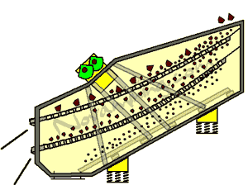
Screen size representation
Mesh No – No of openings per inch of screen
Sieve Analysis of Ore Sample : Example
Mesh size %wt retained Cummulative % pass
+10 7 93
-10 +5 80 13
-5 +1 10 3
-1 3
Mesh no relation with size of aperture
-Tyler (USA) , ASTM , BS standards
60 mesh – 250 micron / 0.25 mm
100 mesh – 150 micron / 0.15 mm

Slide 5
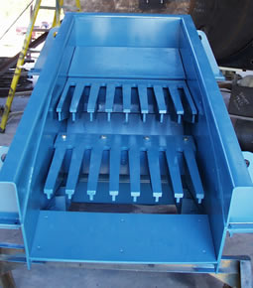
Screen size representation
Industrial screens – Fixed & Moving Types
Fixed Type
-Bar screen / Grizzlies ( Large size ,with slop ,ore /rock )
Cap 10-50 T/m2/mm/day
-Roll Screens - Bank of rolls ,
10-110 mm , hard material
-Punch Screens - MS/SS
Abrasive material ,40 mm
.

Slide 6
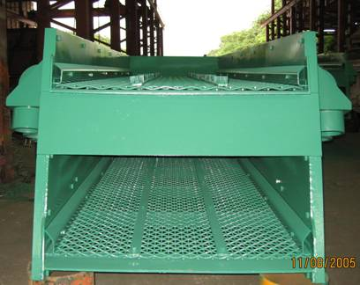
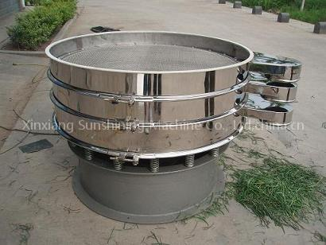
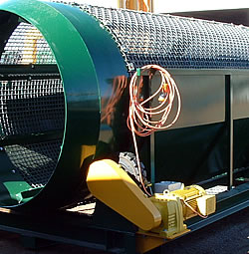
Types of Screen
Moving Type –
Vibrating Screens
Cap 50-200 t/m2/mm/day
Shaking Screen Cap 20-80
Trommels Cap 3-20

Slide 7
Screen Efficiency
Recovery- Undersize after screen / Undersize during lab test
Factors
Particle shape
Size of screen ( mesh size)
Relative size of particle & screen size
Angle of incidence - min cross section of particle on drop
Bunching of small particle due to friction
Moisture content
Feed spread over screen
Rate of feed & thickness of layer
Shaking motion of screen
.

Slide 8
Comminution
Objective – size reduction
-Liberation of value from gangue
-Handling & Transportation
-Preparation for ore processing
Stages of size
-Explosive shattering Big size to 1000 mm
-Primary crushing 1000 to 100 mm
-Secondary crushing 100 to 10 mm
-Coarse Grinding 10 to 1 mm
-Fine grinding 1 to 0.01 mm
-Very fine grinding 100 to 1 micron

Slide 10
Comminution Laws
Ore / Mineral irregular compared to crystal behaviour
Factors – Blasting , chemical oxidation in mining , two minerals intercrystallised
Variety of disruptive forces – compression, tension,shear
Energy utilisation for degree of size reduction
Rittinger’s Law
Energy for size reduction α Energy of new surface – Net free energy change of state
Kick’s law
Energy α log (reduction ratio).e.g 1 cm/mm to 0.5 cm/mm – Activation energy – volume of fragments

Slide 11
Comminution Laws
Bond theory
Theoretical net energy for size reduction = Net energy for unit length of crack * total crack length
Validation of laws
Example : Red ratio
Crushing 100 cm to 6 cm 2⁴
Sec Crushing 60 mm to 4 mm 2⁴
Grinding 4000 to 8 micron 2⁸
As per Kick’s law – energy requirement in 1:1:2 ratio but in actual practice -10-30 times more - small particles with fewer cracks , high probability of escaping being crushed

Slide 12
Comminution Laws
Bond theory
Theoretical net energy for size reduction = Net energy for unit length of crack * total crack length
Validation of laws
Example : Red ratio
Crushing 100 cm to 6 cm 2⁴
Sec Crushing 60 mm to 4 mm 2⁴
Grinding 4000 to 8 micron 2⁸
As per Kick’s law – energy requirement in 1:1:2 ratio but in actual practice -10-30 times more - small particles with fewer cracks , high probability of escaping being crushed

Slide 13
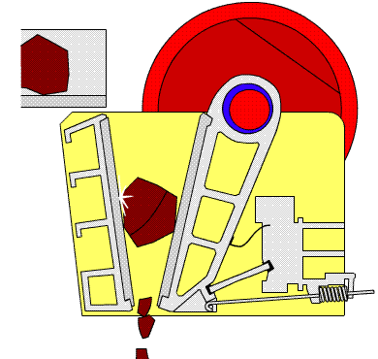
Crushing Equipment
Blake Jaw Crusher
Features :
Large opening per unit cost
2. Shape of opening for large block shaped feed better than a gyratory.
3. Handling of dirty or sticky feed better, without buildup.
4. Maintenance is easier.
5. Easy dismantling

Slide 14
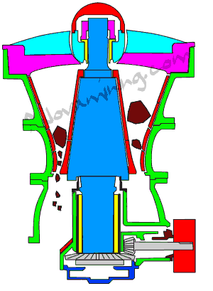
Crushing Equipment
Gyratory Crusher
Features :
High capacity per investment dollar. ( 900 t/h , 1.2 m – 200 mm gape )
2. Handles thin, slab-like material better than a jaw crusher.
3. Choked crushing
4. Foundation costs lower than for jaw crusher
6. Easier installation than JC since more compact design and crushing stresses more even.

Slide 15
Secondary Crushing Machines
Cone Crusher

Slide 16
Crushing Capacity
Jaw Crusher Volumetric Capacity :
Q =B.S.s.Cot(a.k_{jaw}.60n) m3/h
Gyratory Crusher Volumetric Capacity ;
Q = (D-S)¶. S.s.cot (a.k.60 n) m3/h
B - inner width of crusher ( m)
S - open side setting (m)
s - throw ( m)
a - angle of nip
n - speed of crusher (rpm)
k_{jaw} - material constant 1.5-2 ( type of material , liner type, feed type)
D - diameter of outer head mantle at discharge point
K_{Gyra} – material constant 2-3
16

Slide 17
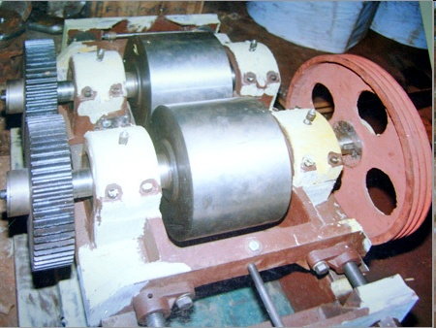
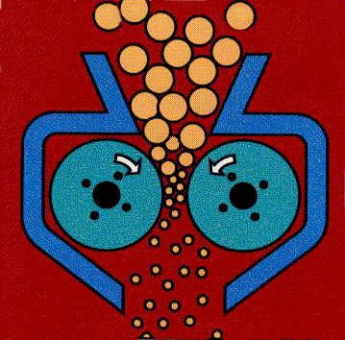
Crushing Equipment
Low reduction ratio ( 3:1 to 4:1 )
Size of roll proportional to material size
Uniform & small size produced
Nip angle relation with Roll & Particle size & rolls gap
Method of feeding important uniformity
Free & choke feed
Roller Capacity
C feed (kg/h) = 188.5*N*D*W*s*d
N = rpm , D =dia of roll (m) , W =roll width ( m) , s = feed density ( kg/m3),
D=distance between roll (m)
Roll Crusher

Slide 18
Nip angle , Roll size , feed size in Crushing

Slide 19
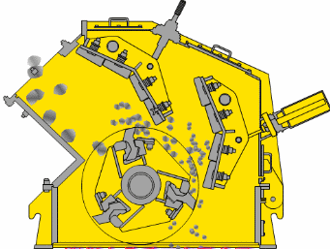
Fine Crushing Machines
Impact Crushing Mill
Hammer Mill

Slide 21
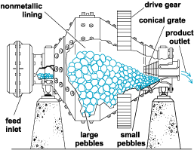
Grinding
Grinding- finer size – Abrasion & impact Batch / Continuous Dry ( <1% moisture) / Wet Grinding Open circuit grinding for coarse size Closed Circuit grinding for fine size Types of Grinding mill : Shape,Grinding media ,Grinding force Tumbling mill – Cylindro-conical shape Media – Rods, Balls, Pebbles
Tumbling mill

Slide 22
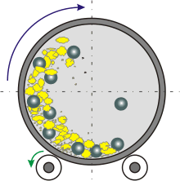
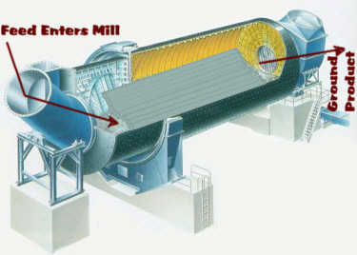
Types of Tumbling mill
Media – Rods, Balls, Pebbles Ball mill – Balls of Fe, steel , WC filled in Cylinderical / cylindro-conical vessel -Load < 40% filling of vessel in Dry Rod mill – rods 75-100 mm dia -Length /diameter ratio >1.4 -more wear than ball mill -Coarser particles crushed -Selective grinding – low fines Autogenous mill
Ball Mill
Rod mill

Slide 23
Theory – Ball Mill

Slide 24
Theory – Ball Mill
mv2/R
mg Cos a = mV2/R
Centripetal force = Centrifugal force
m=mass of ball ( kg) , N – rev/min of mill
V – linear vel of ball m/sec
G –gravitational acceleration
a
V = 2 pi R N /60
Cos a = 4 (pi)2 N2 R / 60*60*g
= 0.0011N² R
Consider d as dia of ball & D as Ball mill dia , effective radius of outer most path will be (D-d)/2
Cos a = 0.0011 N² (D-d)/2
Critical speed occurs at angle a =0 , N_{c} ₌ 42.3/ (D-d)^{0.5} rev/min
mg

Slide 25
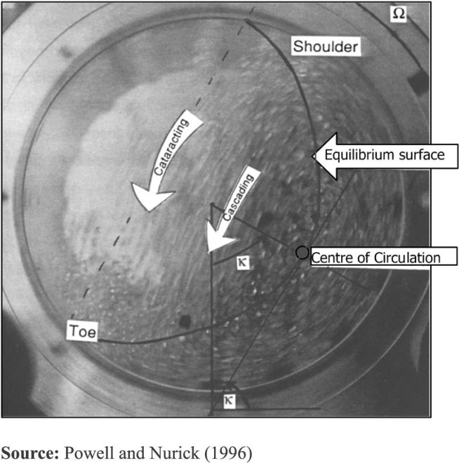
Theory – Ball Mill
% loading = 113-126*H/D , H Unfilled gap , D inner dia
Speed of mill always 75% of critical rotation Nc ( rpm)
No grinding – Load centrifuges
Heavier lumps close to shell
Lighter grains – move forward

Slide 26
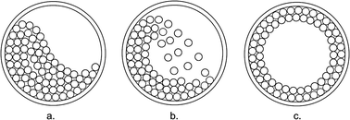
Ball Mill Operation
Factors : Selection of Grinding media size -Increase in size – larger particle break due to pressure -Decrease in size – more surface area – higher grinding capacity Speed of mill – high without centrifuging the charge – fall of material favourable
Solid-Liquid Ratio – Coating of material on grinding media – 70:30 to 80:20 for Ball mill Recirculating load – 5:1 ( feed / return ) , presence of fine slime,clay

Slide 27
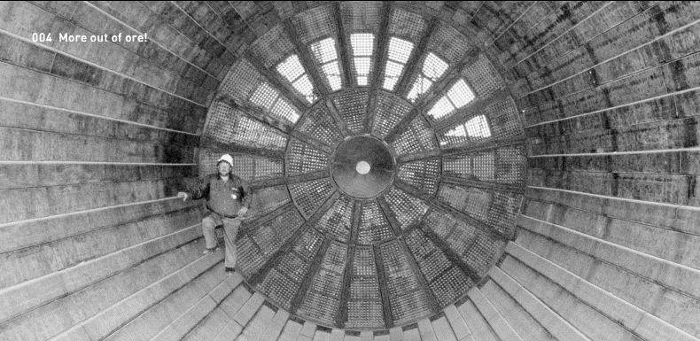
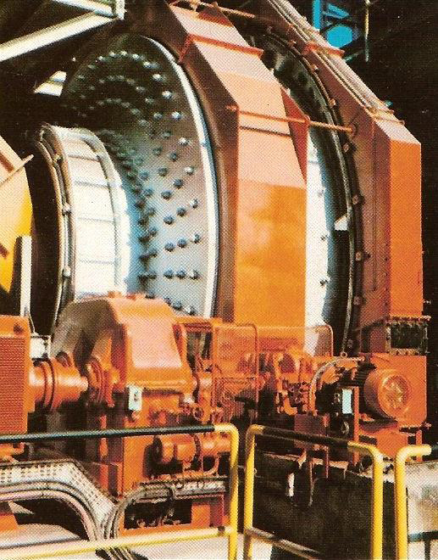
BALL MILL WITH – GRATE-DISCHARGE
AEROFALL MILL

Slide 28
Classification
Particles of various sizes , shapes & sp. gravities separated by different rate of travel through fluid –water/air Heavy , coarser, rounder grains settle faster than lighter , angular & finer Particles fall – under vertically acting hydraulic force of rising fluid ( water /air) – frictional drag & collision Fall of particle – Packing density ( particle no / pulp vol) around its movement Due to frictional retardation , Coarse material clasiification difficult – application range 1mm to 50 microns

Slide 29
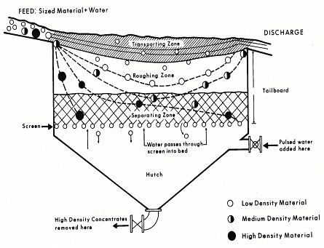
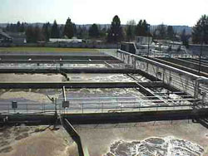
Classification
Movement of solids in fluid under two conditions Free Settling – falling of particle freely in still water / upward current without interference of other particle ( settling tanks , thickener , classifiers) Hindered Settling – falling in crowded mass – low falling velocity ( Jigs , Heavy media separators )
Settling Tanks

Slide 30
Classification
Classification under - Hindered Settling Conditions ( fluid with 40-70% solids ) - Free Settling Conditions ( Fluid with 3-35% solids ) Condition for classification based on SORTING or SIZING Hindered settling condition ( 40-70% solid) for sorting – product subjected to tabling due to large difference in sp gravities of minerals Classifier as sizing device – Free settling condition – dilute suspension ( 3-4 % solid) used – minimum effect of density difference

Slide 31
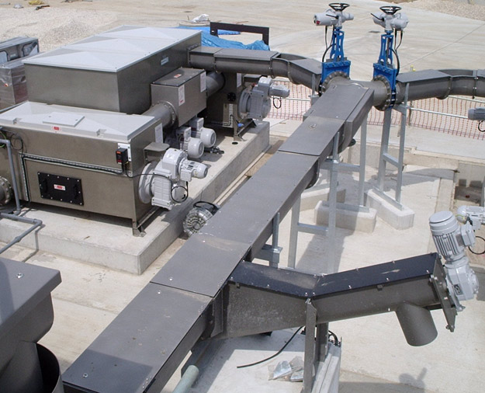
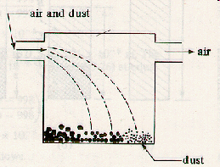
Sorting Classifiers
Hindred settling , Coarse particles , Sp Gravity & Shape of the particles Launder type, Cylinderical , Trapezoidal tank classifiers , Hydrotator classifiers ( coal cleaning by water ) Very little use Gravity classification
Launder type classifiers

Slide 32
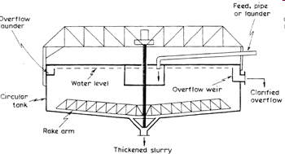
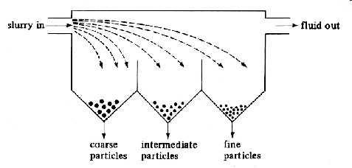
Sizing Classifiers – Non Mechancial
Surface classifier- fine material at the water surface – Thickeners , Pyramidal box type classifier ( Spitzkasten)
Thickener
Spitzkasten

Slide 33
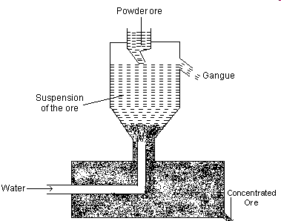
Sizing Classifiers – Non Mechancial
Hydraulic Classifier ( upward current ) for Coarse material ( >180 microns) -Shape : cylinderical / tapering - Water rise at controlled rate in upward direction & feed from the top - Lighter grains overflow to second compartment with lower water velocity

Slide 34
Sizing Classifiers – Mechancial
Shape – Rectangular or bowl shaped inclined settling tank Pulp ( density 30% ) fed in such condition : - Coarse particle flow downward freely - Lighter ones discharge through weir / overflow Stirring by – Drag belts / Set of rakes / Spiral screw
Rake classifier
Bowl classifier

Slide 35
Spiral Classifier

Slide 36
Sizing Classifiers – Mechancial
Spiral Classifiers – sloping trough ( 25-35 cm/m) as in rake classifier , stirring by helix / spiral ribbons ( 3-20 rpm) , material moved from bottom of the tank Multizone classifier - two settling zones ( one for hindered settling near rake and other for free settling ) Overdrain classifiers – Long sloping trough , drag belt with scrapper - heavier particles in the bottom driven up slope

Slide 37
Sizing Classifiers – Mechancial
Settling velocity 100 times more in air than water Pneumatic classifier –Two annular conical shells , air as medium , vanes in outer shell – coarse / heavier particles descend via inner shell – Hardinge & Gayco models Cyclones ( Centrifugal Classifiers) -Very fine particles require more time to settle - surface drag force neutralization by gravitational force -Increase in gravitational pull due to Centrifugal force

Slide 38
Sizing Classifiers
Hydro/ Pneumatic cyclone : spinning motion imparted to suspension by water / air . Air Cyclones - Frictional drag of air / particle touching the wall - pronounced

Slide 39
Cyclone Classifiers
Vortex finder – zone of low pressure & centrifugal force Fine particles tend to move towards vortex finder VF adjusted to minimise short circuiting of new pulp by reducing cross section of cyclone – VF on conical portion Particle subjected to centrifugal force mv²/R ( V –tangential velocity) and drag force by inward flow of fluid Each particle with particular radial path balancing the forces If radial path of particle < vortex – particles carried to vortex stream as overflow

Slide 40
Cyclone Classifiers
If Radial path > vortex , particles large & dense at the wall of cone – fall to apex of cyclone Cyclone suited to dilute pulp ( 80% solid in underflow ) Factors affecting operation Particle dia ( 5 -150 microns) , Rate of feed , Cone angle Solid –liquid ratio , Position of vortex finder , Apex & vortex finder diameters , Sp gravity of particle , Feed pressure diameter of overflow pipe , length of cone

Slide 41
Cyclone Classifiers
Advantages over other classifiers : -Less floor area , cheaper equipment , less power consumption , low maintenance , operational ease -Most suitable for fines -Smooth out surges ,robust in structure , low wear , easy control -Capital cost less, High settling rate due to CF force , Higher circulating load Demerits : Wear & tear on feed pipe , not suitable for particle < 5 micron

Slide 42
Classifiers Capacity : It is proportional to a) cross sectional area b) rising velocity of fluid ( water /air) c) solid content in the fluid C ( t/h)= aAvΩd a = constant = 1.875 A = cross sectional area ( ft2) v = velocity of fluid (ft/ min ) Ω = % of solids by volume d = Sp. Gr. of solids ( t/m3) C = tons of solids /hr
42

Slide 43
Classifiers Efficiency : -Difficult to quantify , Distribution of product in overflow & underflow with respect to feed -It is the ratio , on % basis , classified material in the overflow / classifiable material in the feed -Normal range 50 -80% -Hinderance for high efficiency – flocculation of pulp Cost of classification – 300 mesh require 4 times settling space for classification of 150 mesh & 12 times compared to 65 mesh
43

