Slide 1
Introduction to process metallurgy-Unit 1
Prof. Monil Salot

Slide 2
PYROMETALLURGY

Slide 3
Unit-I
Pyrometallurgical Processes
Basics of Pyrometallurgical Processes
Drying
Calcination
Agglomeration
Sintering
Roasting
Smelting
Converting
Refining processes with examples for metals like Aluminum, Copper, Zinc, and Lead.

Slide 4
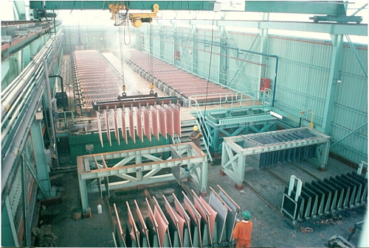
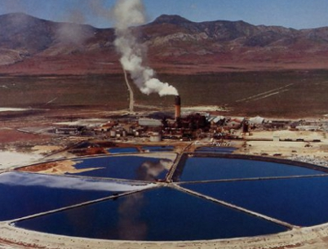
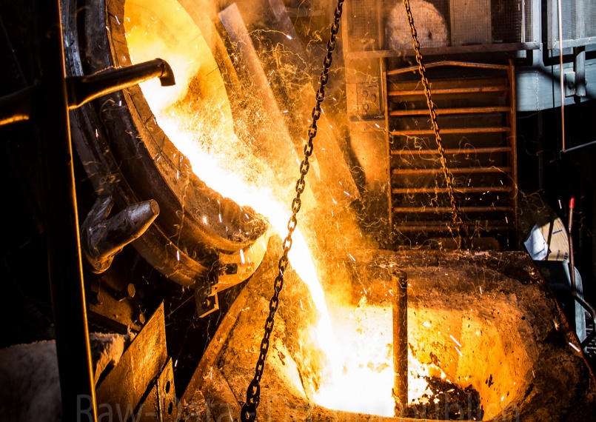
What is Process Metallurgy?
The branch of metallurgy concerned with the extraction of metals from ore, and with the refining of metals; usually synonymous with extractive metallurgy.

Slide 5
What is Extraction of metals?
It is a process of reduction.
What is reduction?
Metal present in compound or in solution are convert in to elemental form.
Process
bulk of metal is separated from impurities
But still it is impure
need to be refined
After Refining
Better properties
Better quality
Recovery of valuable by products

Slide 6
Extractive Metallurgy- An Introduction
Extractive Metallurgy deals with extraction and refining of metals. More than sixty elements are metals which are generally extracted from various forms of natural occurrence in the Earth’s crust.
A mineral is a naturally occurring compound. These are mostly inorganic compounds consisting of one or more metals in association with nonmetals e.g. oxygen, sulphur etc. A mineral is solid and crystalline and has a composition varying within certain limits. It also has well defined physical properties.
An ore is a naturally occurring aggregate of minerals from which one or more metals or minerals may be extracted economically. An ore may exhibit wide variation in composition and is physical and chemical characteristics.
When ore deposits are exploited in extractive metallurgy there is generally some waste product. This waste is composed of some minerals in the ore which are not useful form the point of view of metal extraction. These are known as gangue or gangue minerals. The useful minerals are sometimes called ore minerals.

Slide 7
Extractive Metallurgy
Pyrometallurgy
Hydrometallurgy
Electrometallurgy
Carried out in aqueous media at/ or around room temperature
Carried out at high temperature
Employs electrolysis for separation at room as well as high temperature

Slide 8
Pyrometallurgy- Definition
Pyrometallurgy is a branch of extractive metallurgy. It consists of the thermal treatment of minerals and metallurgical ores and concentrates to bring about physical and chemical transformations in the materials to enable recovery of valuable metals
Extraction and purification of metals by processes involving the application of heat. The most important operations are roasting, smelting, and refining. Roasting, or heating in air without fusion, transforms sulfide ores into oxides, the sulfur escaping as sulfur dioxide, a gas. Smelting is the process used in blast furnaces to reduce iron ores. Tin, copper, and lead ores are also smelted.

Slide 9
Pyrometallurgy- Importance & Need
Metal production are relatively cheaper and suited for large scale production.
Higher reaction rate at high temperature - small unit – high production rate.
Some reactions which are not thermodynamically possible at low temperature become so at higher temperatures.
Greater ease of physical separation of the product metal from gangue material.
Example- metal slag separation

Slide 10
Pyrometallurgy-Introduction
The word pyro derived from a Greek word which means fire.
A pyrometallurgical processes may be defined as one involving the application of heat.
Pyrometallurgy can be further classified as follows:
Solid-state processing
Liquid – State processing

Slide 11
Solid-state Processing
This does not involve any melting. It is typically carried out in the temperature range of 500-1200 ºC, as exemplified by roasting of sulphides, calcinations , solid state reduction of metal oxides by H, and CO.
Solids are mostly immiscible and hence the product of solid sate processing is either pure or is a mechanical mixture.
In the latter case, it requires further separation.

Slide 12
Liquid – State Processing:
This involves melting of fat least the metal- containing phase and is on the whole carried out at a higher temperature.
Examples are blast furnace smelting, steelmaking, distillation refining of zinc from impure lead etc.
Liquid state processing separates out of the metal either in pure or in impure form.
Appreciable compositional changes in the liquid are possible due to miscibility, rapid diffusion and mixing.

Slide 13
Important Pyrometallurgical Processes
Drying
Calcination
Roasting
Agglomeration
Sintering
Pelletizing
Smelting
Distillation
Fire Refining

Slide 14
Drying
Drying is thermal removal of liquid moisture (not chemically bound) from a material.
Drying is usually accomplished by contacting the moist solids with hot combustion gases generated by burning fossil fuels.
In some cases, heat for drying can be provided by hot air or inert gas that has been indirectly heated.
The amount of heat required for a given drying operation corresponds to the heat required to vaporize the liquid moisture, the heat required to raise the temperature of the products (dry solids and water vapor) to the final drying temperature, and heat required to offset radiant heat losses.

Slide 15
Drying
Usually the drying temperature is set at a nominal value above the boiling point of water, often about 120°C.
In special cases, such as in the drying of certain water-soluble salts, higher drying temperatures are required. In salt drying, the feed moisture is saturated with dissolved salts, which alters the boiling point and requires higher drying temperatures.
Drying of moist solids is carried out in several types of industrial dryers, including rotary dryers, fluidized bed dryers, and flash dryers.

Slide 16
Drying
Another type of drying, called spray drying, is carried out when the material to be dried is completely dissolved in aqueous solution. The solution is sprayed (usually through a specially designed nozzle) into a heated chamber and as the water is evaporated, solids crystallize. The water vapor is exhausted from the dryer, and dry solids are collected, usually in a conical section of the dryer.
Solid material produced from a spray dryer often has special particle size and shape characteristics, which may be controlled by the concentration of dissolved material in the solution, and the design of the atomizing spray nozzle.

Slide 20
Calcination
Calcination is the thermal treatment of ore that brings about its decomposition and eliminates the volatile product-usually carbon dioxide or water.
The temperature required for calcinations can be calculated from the free energy-temperature relationship for the reaction under consideration. For example, the reaction for the decomposition of calcium carbonate in a kiln is
CaCO_{3(c)} = CaO_{(c)} + CO_{2(g)} , ΔG˚_{T}(cal) = 42300 – 37.7T
When the CO₂ pressure is 1 atm, ΔG˚_{T} becomes equal to 0(zero) and T becomes equal to 1123 K or 850˚C, so that a kiln temperature of 1000˚C would be sufficient to provide a rapid temperature rise in the mineral particles and to reach the decomposition temperature.
Since the reaction is endothermic, the rate of decomposition is probably controlled by the rate of heat transfer into the particle.

Slide 21
Calcination- Application
To produce cement from CaCo₃
To cause decomposition of hydrated minerals
To cause decomposition of volatile matter contained in petroleum Coke.
The decomposition of calcium carbonate (limestone) to calcium oxide (lime) and carbon dioxide, in order to create cement.

Slide 23
Roasting
The roasting of an ore or a concentrate is a process which leads smelting in Pyrometallurgy and leaching in hydrometallurgy.
An oxide is more easily reduced to the metal than a sulphide, and leaching becomes easier if the metal were present as a sulphate, chloride etc.
Therefore, the mineral constituents of an ore must be converted into another chemical form. Such a conversion can be brought about by roasting.
Roasting usually involves heating of ores below the fusion point in excess of air.
The main purpose of calcinations is to decompose an ore, where roasting, by employing oxygen or some other element, aims at the chemical conversion of an ore.

Slide 24
Roasting
It brings about chemical conversion and makes the raw materials more suitable for subsequent reduction.
Earlier, the major application of roasting included removal of sulphur or other elements such as arsenic and tellurium as volatile oxides.
At present, however, roasting implies a wide variety of more complicated operations.
It can be defined as the process of heating of the ore below the fusion point to change it chemically to a form more suitable to subsequent treatment for ultimate extraction of the metal.

Slide 25
Roasting: Classification
Roasting
Oxidizing Roasting
Volatilizing Roasting
Chloridizing Roasting

Slide 26
Oxidizing Roasting
This is carried out to burn sulphur from sulphides with conversion of sulphides in whole or in part into oxides.
The general reaction is
MS_{(s)} + $\frac{3}{2}$O_{2(g)} = MO_{(S)} + SO_{2(g)}
For example,
PbS_{(s)} + $\frac{3}{2}$O_{2(g)} = PbO_{(S)} + SO_{2(g)}
ZnS_{(s)} + $\frac{3}{2}$O_{2(g)} = ZnO_{(s)} + SO_{2(g)}

Slide 27
Oxidizing Roasting
Under certain conditions, oxidizing roasting may involve other reactions, leading to formation of sulphates or even the release of the metal itself in elemental form.
When a sulphide ore is roasted to a point where almost the entire sulphur content is eliminated, the residue is called dead roast.
A catalytic agent often speeds up the roasting process. Quartz and other gangue materials often act as catalyst during roasting.

Slide 28
Volatilizing Roasting
Volatilizing roasting eliminates volatile oxides such as As₂O₃, Sb₃O₃ and ZnO from an ore.
In volatilizing roasting, the inflow of oxygen should be carefully controlled, as excessive oxidation may lead to the formation of non-volatile higher oxides.

Slide 29
Chloridizing Roasting
This is carried out to convert certain metal compounds to Chloridizing from which the metal may be subsequently obtained by reduction.
Many metals, for example, uranium, beryllium, niobium, zirconium, and titanium, are extracted from their chlorides.
Some chloridizing reactions are
2NaCl + MS +2O₂ = Na₂SO₄ + MCl₂
4NaCl + 2MO + S₂ + 3O₂ = 2Na₂SO₄ + 2MCl₂

Slide 30
Other Types of Roasting
Reduction Roasting:
It is the process of heating material in contact with reducing agent to get reduction of certain compound.
Fe₂O₃ + C → Fe₃O₄ + CO
FeO + H₂→ Fe + H₂O
FeO + C → Fe + CO
SulphatingRoasting:
It converts certain sulphide ores to sulphates.
ZnS + $\frac{3}{2}$O₂→ZnO + SO₂
ZnO + SO₃→ ZnSO₄
2SO₂ + O₂→ 2SO₃
Reduction of hematite to magnetite is an example of magnetic roasting.
Blast roasting or sinter roasting is not only modifies the physical condition of an ore but also helps in its partial oxidation.

Slide 31
Methods of roasting: Based on types of furnace design used for roasting
Hearth roasting
Flash roasting
Fluidized bed roasting
Blast roasting or sinter roasting

Slide 36
Kinetics of roasting
Rate of roasting can be increase by increase rate of diffusion of O2 through M-oxide layer by following way.
Grinding of metal sulphide (increasing surface area):
By increasing the ratio of sulphide area to unit weight of M-sulphide particles.
Increasing temperature (keeping within limit to avoid fusion):
It increases rate of diffusion of gases (i.e. O₂,SO₂) through pores in M-oxide layer.

Slide 37
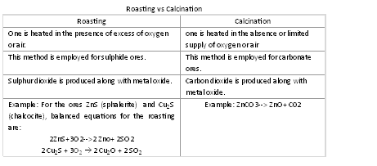

Slide 38
Agglomeration
The process by which a relatively fine size material is converted to larger size is called agglomeration.
There are three methods of agglomeration
Sintering
Pelletizing
Briquetting

Slide 39
AGGLOMERATION
Agglomeration is used to combine the resulting fine particles into durable clusters.
The iron concentrate is balled in drums and heated to create a hardened agglomerate.
Agglomerates may be in the form of pellets, sinter, briquettes, or nodules.
The purpose of agglomerating iron ore is to improve the permeability of blast furnace feed leading to faster gas-solid contact in the furnace .
Agglomerating the ore prior to being sent to blast furnaces reduces the amount of coke consumed in the furnace by increasing the reduction rate.

Slide 40
Pelletizing
Pelletizing is the process of compressed or molding of product into the shape of a pellet. A large range of different products are pelletized including chemicals, iron ore, animal compound feed, and more.
Pelletizing is carried out in two types of machines:
Disc pelletizer
Drum pelletizer
Mixture of fine ore, moisture (10-15%), and binder (2%) (e.g. Bentonite ) is fed as charge to pelletizer.
Binding takes place due to binder and moisture.
Pelletizing is followed by firing.

Slide 41
Pelletizing
Formation of green balls by rolling a fine iron bearing material with a Water + binder or aditives
Size: 5-20 mm
Dried, preheated and fired.
Pelletizing is carried out in two types of machines:
Disc pelletizer
Drum pelletizer
Mixture of fine ore, moisture (10-15%), and binder (2%) (e.g. Bentonite ) is fed as charge to pelletizer.
Steps
Feed preparation
Green ball production and sizing
Green ball induration
Drying
Preheating
Firing
Colling of hardened pellets

Slide 42
Pelletizer

Slide 43
Sintering
Sintering is a method for making objects from powder, by heating the material in a sintering furnace below its melting point (solid state sintering) until its particles adhere to each other.
Sintering is mostly done in Dwight-Lloyd sintering machine.
Mixture of fine ore-mostly up to 3 mm excluding 100 mesh, moisture (5%) and solid fuel coke is fed as charge.
Binding takes place due to partial fusion.
In this, sintering & firing of material takes place simultaneously.

Slide 44
Sintering
Agglomeration technique of fine materials to produce cluster by incipient fusion at high temperature.
Binding takes place due to partial fusion.

Slide 45
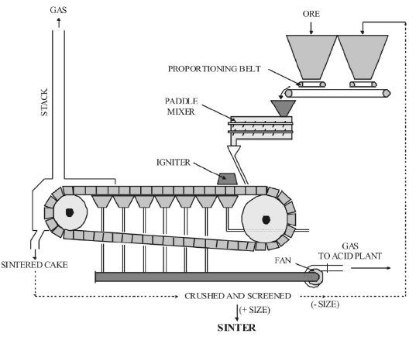

Slide 46
Dwight-Llyod sintering Machine

Slide 47
No. | Sintering | Pelletizing
1. | As charge = fine ore + moisture(5%) + solid fuel coke breeze for heat generation fine ore mostly up to 3 mm excluding 100 mesh. Generally no binder is used. Flux may/ may not be used. | As charge = fine ore + moisture (10 - 15%) + binder (2%). Fine ore are very fine of -100 mesh. Moisture – critical amount Binder – organic or inorganic e.g. bentonite.
2. | Charged is mixed and sintered by heating. | Charge is mixed and pelletized by mechanical process.
3. | Binding takes place by partial fusion. | Binding takes place because of binder and moisture.
4. | In sintering, sintering and firing of material takes place simultaneously. | First pelletizing is done followed by firing. Firing is called hardening.
5. | Mostly done in Dwight-Lloyed sintering machine. | It is done on disc or drying pelletizing machine.
6. | Final product is porous sinter cake. | Final product is pellets of various sizes.

Slide 48
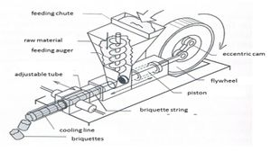
Briquetting
It is the mechanically processing the fine flux size material using a press, punch and die assembly to get briquettes.

Slide 49
Need of agglomeration
Lots of fine material produced from various sources.
During mining (called blue dust)
During concentration (process like flotation)
Collection of flue dust (from flue gases)
Such material is not suitable for some of the extraction process because it doesn’t give good permeability of the bed. (permeability is ability of gases to pass through)
For fine size, gas will not pass easily than large particles.

Slide 50
Smelting
Smelting is a process for the production of a metal or metal rich phase called matte.
It is the process of reduction of metal oxides with carbon / sulphide / sulphur in a suitable furnace.
During smelting it should be remembered that since the gangue in the ore is generally less fusible than metal, a flux must be added to form a slag that is easily fusible. The smelting process for metal extraction can be written as
Mineral + gangue +reducing agent + flux = metal/matte + slag + gas.

Slide 51
SMELTING
Heating process for production of metal or matte. (Reduction of oxide of metal with C/S/sulphide in suitable furnace i.e. B/F, Reverberatory F/C or ele. F/C).
Smelting Process
Mineral + Gangue + Reducing agent + Flux = Metal/matte +slag +Gas
Gangue in the ore
Less fusible than metal
Form a slag
Easily fusible
Addition of flux

Slide 52
Characteristic of smelting operation
The material to be smelted are usually charged in to solid state.
Products – liquid state ; solid material (dust) is carried away by the furnace gases.
The heat required for smelting is usually supplied by external sources.

Slide 53
Reduction smelting
Matte smelting
Carried out in B/F.
Ore is reduced by C in the presence of Flux
Molten metal and slag
Either Reverberatory or flash smelter
Reducing agent is not used.
Molten matte and molten slag.

Slide 54
Role of fluxes and slags
Flux
Used to lower both liquidus temperature and viscosity of slag.
Classified according to the chemical type and selected on the basis of chemical nature of gangue and the properties desired in the slag( density and viscosity)
For siliceous gangue: basic oxide such as lime is used as a flux
For basic gangue: an acidic oxide such as silica used.
Potassium carbonate /sodium carbonate: flux has to act as cover.
Oxidizing flux (Na₂O₂,NaNO₃ and KNO₃) and Reducing agent ( NaCN) : Metallurgy of Precious metals.
Neutral flux (CaF2 or Na2SO4): special application for ex. Fused electrolytic bath

Slide 55
Slag
Two main function
Collect the unreduced gangue materials
To provide a medium.
To effectively fulfill these functions, a slag must possess the following properties.
Specific gravity difference between metal and slag should be high.
Slag must be fluid enough
Slag must have a chemical composition

Slide 56
Smelting
Some of the general characteristics of a smelting operation are:
The materials to be smelted are usually charged in the solid state.
The products of the smelting furnace are in the liquid state; the solid material that escapes is the dust that is carried away by the furnace gases.
The heat required for smelting is usually supplied by external sources.

Slide 57
Types of smelting
Types of smelting
Reduction smelting
Matte smelting
Reduction smelting:
That is carried out in a blast or electric furnace, the ore is reducer by carbon, in the presence of flux, to produce the molten metal and the slag.
Sometimes, reduction is brought about by another metal whose oxides are much more suitable than those of the metal being extracted.

Slide 58
Types of smelting
Matte smelting:
It is usually carried out in either a reverberatory flash smelter. It can be carried out in electric furnace.
In matte smelting, a reducing agent is not used.
The sulphide itself acts as a reducing agent.
In this operation, metal is not produced; the products being molten matte and molten slag.

Slide 59
Distillation
It is carried out for the metals like Zn, Cd, Mg. Here the metal compound is reduced to elemental state of a temperature above boiling point of metal and sometimes reducing agent may be used with metal compound.
Evaporation result in metal vapour, must then condense to liquid or solid state.
$metal compound \underset{→}{T>B.P.} metal vapour above B.P.of metal$
e.g. production of Zn

Slide 60
Fire Refining
This process is done to remove impurities and recover precious metal like gold, silver etc.
e.g. iron making is smelting process & steel making is fire refining process.

Slide 61
REFINING PROCESSES
Figure shows a liquid-vapour equilibrium diagram.
Species A has a boiling point lower than that of species B.
Therefore, on heating, A vaporizes more easily. When the liquid of composition X is heated, the first vapour has composition Y which has a higher content of A.
The composition of the vapour and the liquid depends on the temperature at which they are at equilibrium.
However, at any temperature, the vapour has higher fraction of species A compared to that in the liquid.
Therefore A can be preferentially removed from b by distillation.

Slide 62
Selective dissolution
One can sometime remove an impurity element by selective dissolution in a solvent metal.
For example, during refining of lead bullion obtained from the lead blast furnace, molten zinc is added to recover minor amounts of silver contained in lead.
Zinc dissolves silver preferentially and forms a separate phase which is collected and processed for silver recovery.
This process is called Parke’s process.

Slide 63
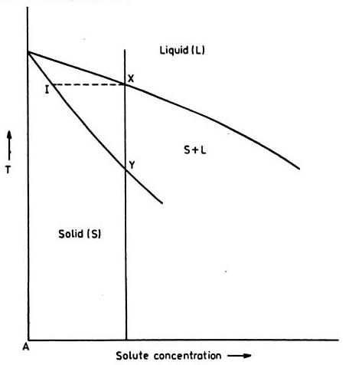
Zone Refining

Slide 65
The advancement of semiconductor industry with its requirement for ultra high purity materials led to the development of zone refining.
In zone refining, a small molten zone moves through a long charge of alloy or impure metal.
The differences in impurity concentration between liquid ans crystallizing solid lead to segregation of impurities into the moving liquid zone and corresponding purification of the solidifying material.
Zone refining is generally used to produce ultra-pure metals.

Slide 66
When a liquid is cooled slowly, then solidifcation begins at a particular temperature.
The initial solid is purer, as the temperature is lowered down, more and more solid separates, the final solid formed having less purity.
The impurity concentration is lower in the solid than in liquid at equilibrium.
The differences in the impurity concentration between liquid and crystallizing solid led to segregation of impurities into the moving liquid zone and corresponding purification of the solidifying material.
Impurities of solid moves along with solidus line and impurities of liquid moves along the liquidus line

Slide 67
With the help of a heating device, a molten metal zone is obtained at one end of the metal bar; then the molten zone is slowly moved from one to another end of the bar by moving heating device.
Thus every time impurities are thrown in liquid zone and hence pure solid is separated from impure liquid.
This process is repeated few times to get ultra pure metal. The impurities are finally segregated at one end of the bar and is chopped out.

Slide 68
Liquation
In liquation, the impurity separates out from the parent metal due to immiscibility, the efficiency of separation being dependent upon the nature of the metal- impurity phase diagram.
An example is provided by the purification of lead through zinc removal.
On cooling impure, lead and solid zinc separate out leaving a liquid poorer in zinc and therefore, richer in lead.
This method, which basically depends on differences in melting points and in densities of immiscible phases is, however, uneconomical and, therefore, rarely employed commercially.

Slide 69
Converting
Converting is a term used to describe a number of metallurgical smelting processes. The most commercially important use of the term is in the treatment of molten metal sulfides to produce crude metal and slag, as in the case of copper and nickel converting. Another, now uncommon, use of the term referred to batch treatment of pig iron to produce steel by the Bessemer process. The vessel used was called the Bessemer converter.

Slide 70
Converting in copper metallurgy
A mixture of copper and iron sulfides referred to as matte is treated in converters to oxidize iron in the first stage, and oxidize copper in the second stage. In the first stage oxygen enriched air is blown through the tuyeres to partially convert metal sulfides to oxides:
FeS + O₂ → FeO + SO₂
CuS + O₂ → CuO + SO₂
Since iron has greater affinity to oxygen, the produced copper oxide reacts with the remaining iron sulfide:
CuO + FeS → CuS + FeO
The bulk of the copper oxide is turned back into the form of sulfide. In order to separate the obtained iron oxide, flux (mainly silica) is added into the converter. Silica reacts with iron sulfide to produce a light slag phase, which is poured off through the hood when the converter is tilted around the rotation axis:
2 FeO + SiO₂ → Fe₂SiO₄ (sometimes denoted as 2FeO•SiO₂, fayalite)

Slide 71
After the first portion of slag is poured off the converter, a new portion of matte is added, and the converting operation is repeated many times until the converter is filled with the purified copper sulfide. The converter slag is usually recycled to the smelting stage due to the high content of copper in this by-product. Converter gas contains more than 10% of sulfur dioxide, which is usually captured and subjected to the production sulfuric acid.
The second stage of converting is aimed at oxidizing the copper sulfide phase (purified in the first stage), and produce blister copper. The following reaction takes place in the converter:
CuS + O₂ → Cu + SO₂
Copper content in the obtained blister copper is typically more than 95%. Blister copper is the final product of converting.

Slide 72
Equipment
The converting process occurs in a converter. Two kinds of converters are widely used: horizontal and vertical.
Horizontal converters of the Pierce-Smith type prevail in the metallurgy of non ferrous metals. Such a converter is a horizontal barrel lined with refractory material inside. A hood for the purpose of the loading/unloading operations is located on the upper side of the converter. Two belts of tuyeres come along the axis on either sides of the converter.
Molten sulfide material, referred to as matte, is poured through the hood into the converter during the operation of loading. Air is distributed to tuyeres from the two tuyere collectors which are located on opposite sides of the converter. Collector pipes vary in diameter with distance from the connection to air supplying trunk; this is to provide equal pressure of air in each tuyere.

Slide 73
Converter

Slide 74
Smelting In Blast Furnace

Slide 75
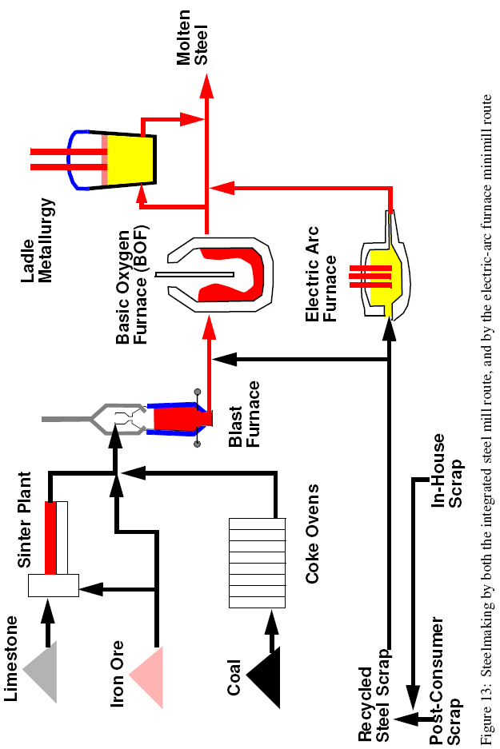

Slide 76
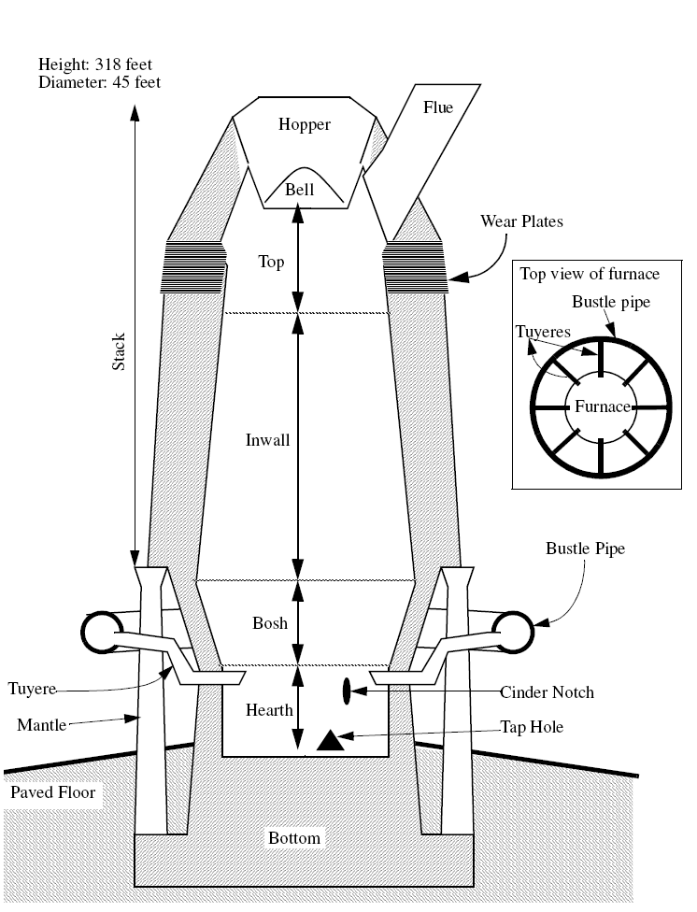
Stack. In the blast-furnace stack, there is a flow of gas and solids. In the stack, hematite or magnetite is reduced to sponge iron by the action of carbon monoxide.
Bosh. This is the part of the furnace where the contents melt. As shown in Figure, several chemical reactions take place in the bosh. This is where the slag is formed.
Hearth. In the hearth, molten pig iron and molten slag segregate from each other and are tapped off separately. Slag is lower density than iron, and so it floats on the molten metal.

Slide 77
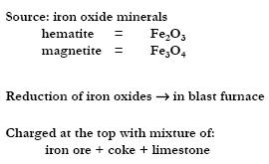
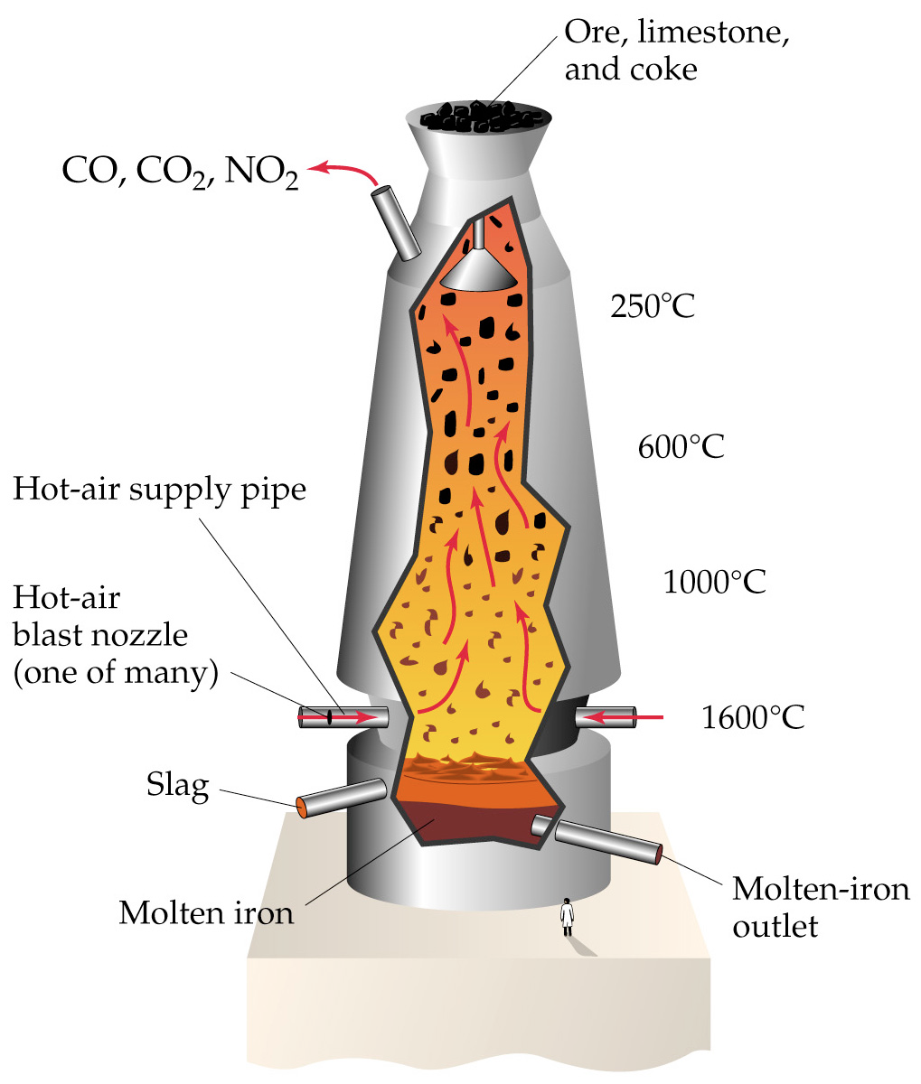
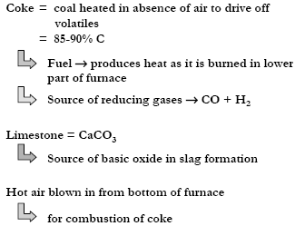

Slide 78
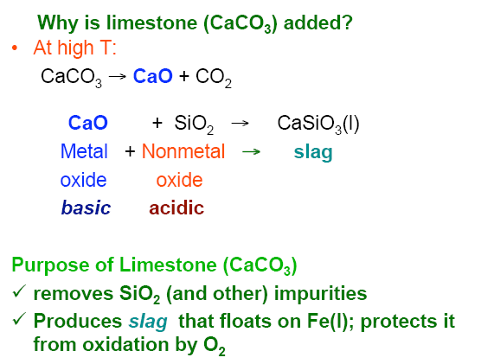

Slide 79
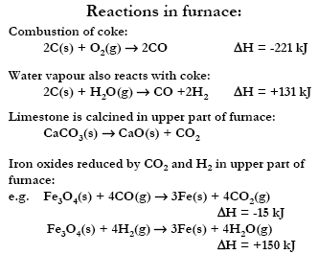

Slide 80
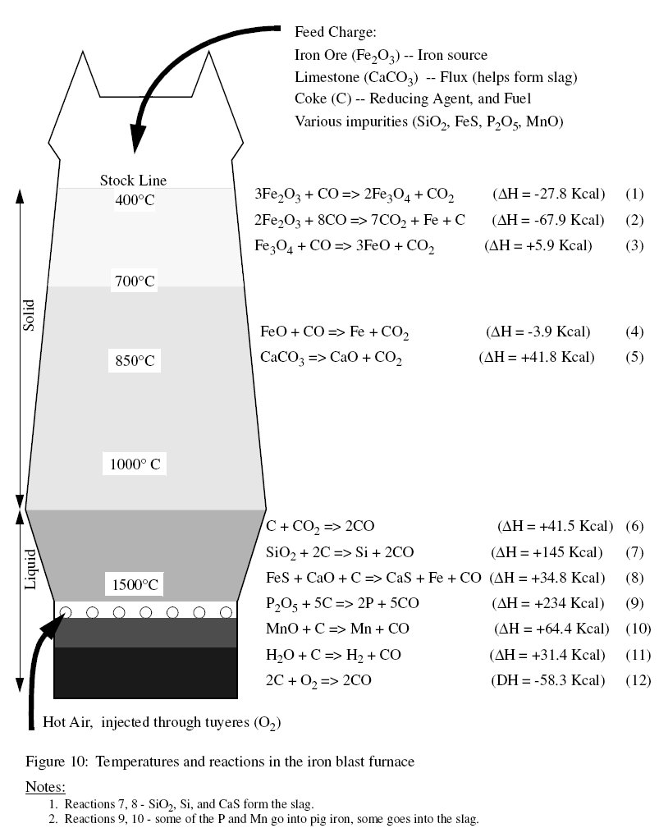

Slide 81
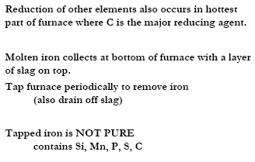

Slide 82
If iron is going to be made into steel it is poured directly into a basic oxygen furnace.
The molten iron is converted to steel, an alloy of iron.
To remove impurities, O₂ is blown through the molten mixture.
The oxygen oxidizes the impurities.
Air cannot be present in the converter because the nitrogen will form iron nitride (causes the steel to be brittle).

Slide 83
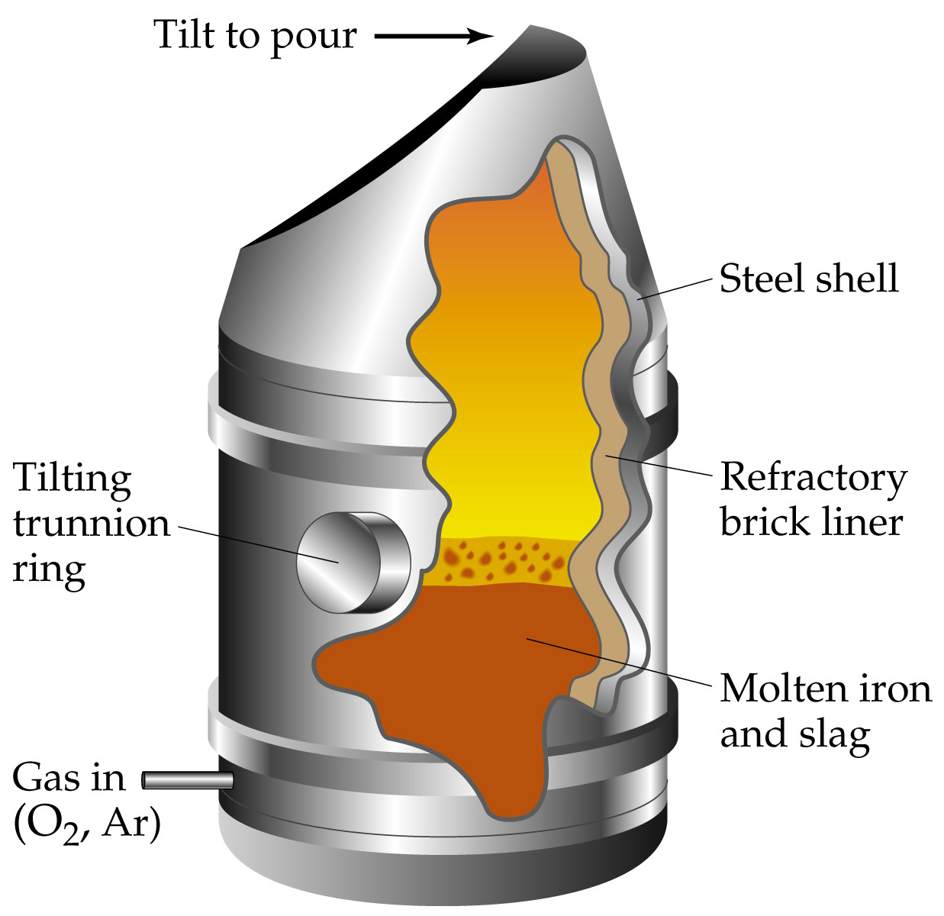
Formation of Steel
Oxygen diluted with Ar is used as the oxidizing agent.
When oxygen emerges from the converter, then all the impurities have been oxidized and the iron is poured into a ladle.

Slide 84
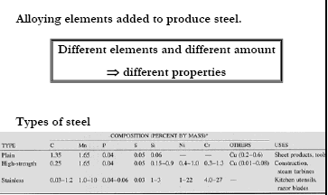

Slide 85
Metallothermic Reduction
Carbon reduction of metal compounds is sometime known as carbothermic reduction.
A compound may also be reduced by a metallothermic process using a metal such as aluminium or silicon as the reducing agent.
These metals combine with oxygen to produce more stable oxides.
The reduction of fe2o3 by aluminium is the basis of highly exothermic reduction is used in a joining process called thermit welding.
The reaction is
Fe₂O_{3(s)} + 2Al_{(s)} = Al₂O₃ + 2Fe_{(l)}

Slide 86
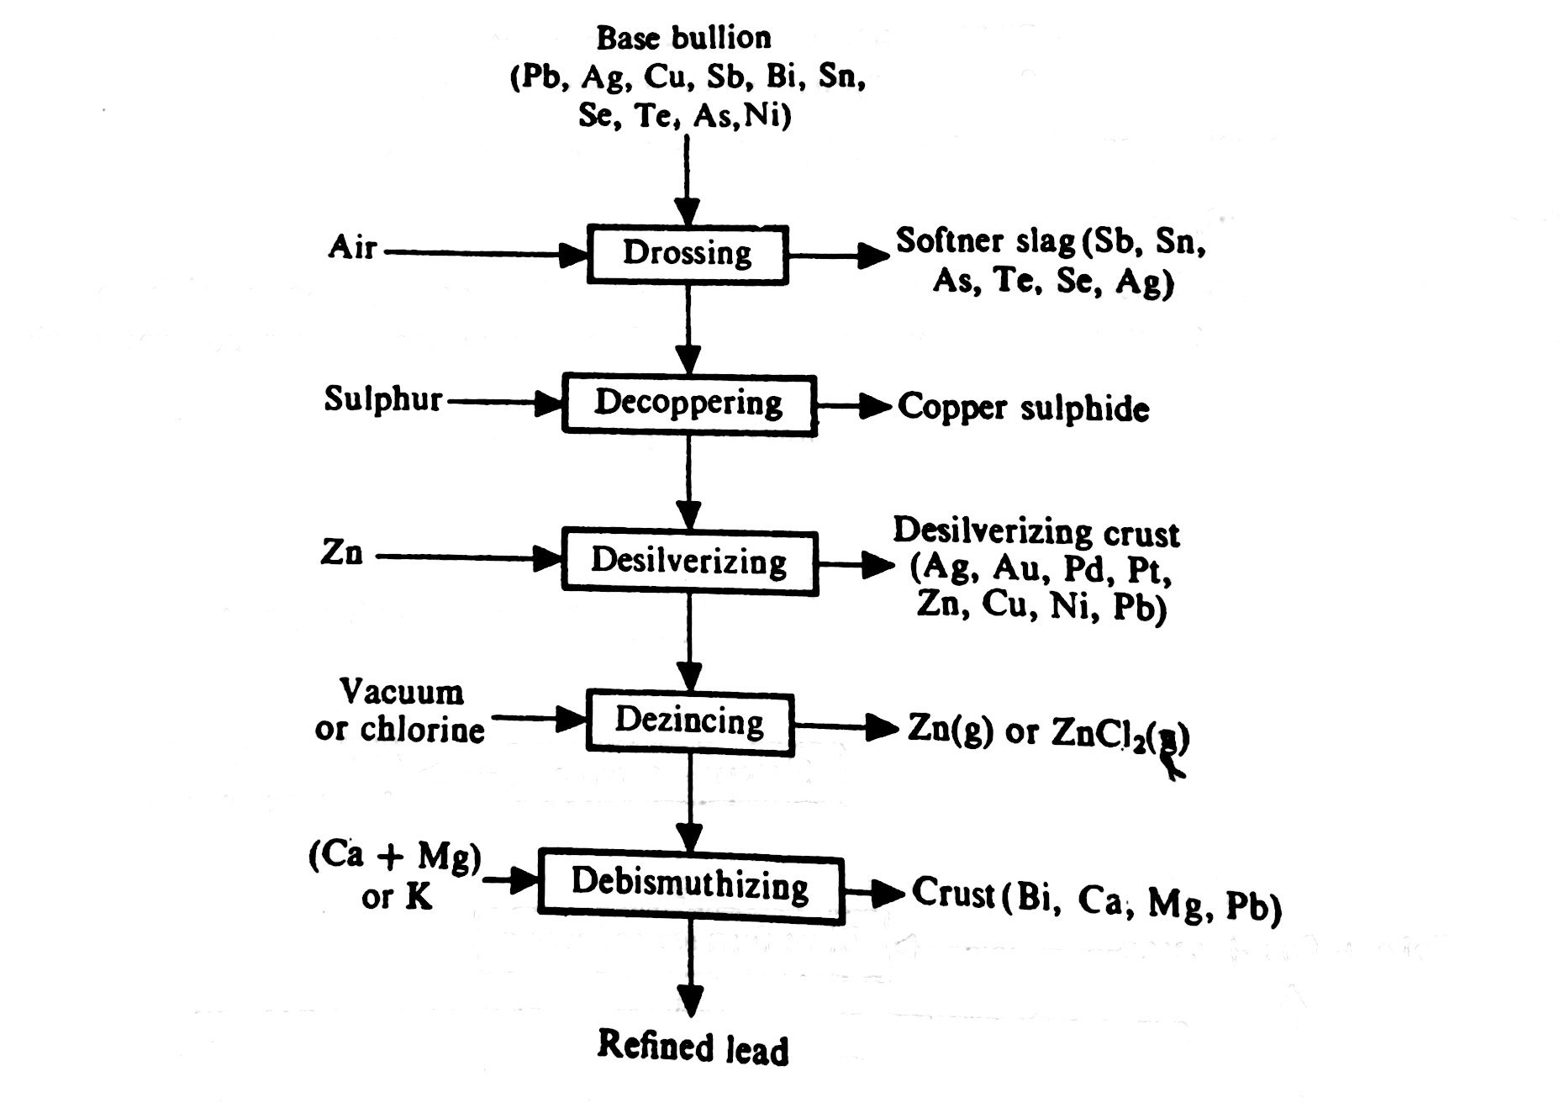
Pyrometallurgical Route for Lead

Slide 87
Pyrometallurgical Route for Zinc.

