Slide 1
Syllabus
Unit 1: Introduction to surface engineering,
Scope of surface engineering in metals, ceramics, polymers and composites, Surface Preparation methods such as Chemical, Electrochemical, Mechanical- Sand Blasting, Shot peening, Shot blasting, Hydroblasting, Vapor Phase Degreasing etc., Properties of Various Coating, Coating Methods.
Unit 2: Chemical Conversion Coating:
Chromating, Phosphating, Anodizing, Thermochemical processes, industrial practice, economy and energy considerations.
Unit 3: Metallic coating
Surface pretreatments, Hot Dipping, galvanizing, Electrolytic and Electroless plating of important metals and alloys, testing/evaluation of surface properties.
Unit 4: Coating from Vapour Phase:
PVD, CVD, Various Methods used, mechanisms, important reactions involved and applications.
Unit 5: Plasma Coating:
Sputtering, Plasma Spray & Ion Implantation Methods, mechanisms & applications. Surface modification by directed energy beams like ion, electron and laser beams, novelty of composition and microstructures.
Unit 6: Diffusion Coating:
Various Techniques For Single And Multiple Element Coating, High Temperature Coating- Carburising, Carbonitriding, Silicanizing,Chromizing, Aluminizing, Boronizing, Boronitriding.

Slide 2
Text Books:
J. R. Davis-Surface Engineering for Corrosion and Wear Resistance.
George J. Rudzki -Surface Finishing Systems. metal annd non-metal finishing handbook-guide,Metals Park : ASM, 1983
James A. Murphy- Surface Preparation and Finishes for Metal, McGraw-Hill, New York 1971
References Books:
P. G. Sheasby and R. Pinner - Surface treatment and finishing of Aluminium and its alloy,Volume-2, 5th ed., ASM, Metals Park, 1987
K. E. Thelning -Steel and its Heat Treatment Bofors Handbook, London : Butterworths, 1975
Surface Engineering Hand Book, edited by Keith Austin, London : Kogan Page, 1998

Slide 3
Grading
Mid Semester Exam – 30 Marks
CIE– 10 Marks
End Semester Exam – 60 Marks

Slide 4
Scope of Surface Engineering
Surface Engineering – Definition: Treatment of the surface and near-surface regions of a material to allow the surface to perform functions that are distinct from those functions demanded from the bulk of the material” – ASM Handbook
Relevance (why we need to engineer surface?)
Various types of surface engineering processes
Methods
Properties
Advantages
Limitations
Surface engineering products and their applications
Properties of various surface engineered products

Slide 5
why we need to engineer surface
Surfaces have different properties than bulk material / need to optimize both
Surfaces can be completely re-engineered
Surfaces can be ‘functionalized’ to achieve a specific molecular configuration
Surface engineering techniques are both varied and complex – providing a change to the outermost material interface

Slide 6
Properties
Improved corrosion resistance through barrier or sacrificial protection
Improved oxidation and/or sulfidation resistance
Improved wear resistance
Reduced frictional energy losses
Improved mechanical properties, for example, enhanced fatigue or toughness
Improved electronic or electrical properties
Improved thermal insulation
Improved aesthetic appearance
Improved fatigue resistance

Slide 7
According to the current U.S. corrosion study, the direct cost of metallic corrosion is $276 billion on an annual basis. This represents 3.1% of the U.S. Gross Domestic Product (GDP)

Slide 8
Cost of Metallic Corrosion in the US
Industry | Billions of US Dollars
 | 1975 | 1995
Motor Vehicles - Total | 31.4 | 94.0
Motor Vehicles - Avoidable | 23.1 | 65.0
Aircraft – Total | 3.0 | 13.0
Aircraft – Avoidable | 0.6 | 3.0
Other Industries – Total | 47.6 | 189.0
Other Industries – Avoidable | 9.3 | 36.0
All Industries – Total | 82.0 | 296.0
All Industries – Avoidable | 33.0 | 104.0
Source: ASM Handbook

Slide 9
Methods & Services
Protective Coatings | B$ | 108.6
Corrosion Resistant Alloys | B$ | 7.7
Corrosion Inhibitors | B$ | 1.1
Engineering Plastics/Polymers | B$ | 1.8
Cathodic & Anodic Protection | B$ | 1.0
Corrosion Control Services | B$ | 1.2
Research & Development | B$ | -
Education & Training | B$ | -
TOTAL: | B$ | 121.41

Slide 10
Industrial Operations with Significant Annual Wear Economic Consequences
Industry | Operation | Loss mass*, 10¹² Btu
Utilities (28% of total US consumption) | Seals Accessories Bearings Reliability | 185 120 55 145
Transportation (26% of total US consumption | Brakes Valve trains Piston ting assemblies Transmission Bearings Gears | Not estimated
Mining | Ore Processing Surface mining Drilling | 22.80 13.26 10.70
Agriculture | Tilage Planting | 16.85 2.47
Primary metals | Hot rolling Cold rolling | 14.30 0.14
*Assumes 19.2x10⁶ Btu per ton of energy represented in lost weight of steel.
Combined effect of Corrosion + Wear is a serious concern and result in accelerated loss of material
Corrosion can occur without wear but the opposite is rarely true

Slide 11
Synergistic Relationships between Wear and Corrosion Mechanism
Abrasion
Remove protective oxidized metal and polarized coatings to expose unoxidized metal
Forms microscopic grooves and dents for concentration cell corrosion
Increase microscopic surface area exposed to corrosion
Removed strain-hardened surface layers
Cracks brittle metal constituents forming sites for impact hydraulic splitting
Plastic deformation by high-stress metal-mineral contact causes strain hardening and susceptibility to chemical attack
Corrosion
Produces pits that induce microcracking
Microcracking at pits invite hydraulic splitting during impact
Roughens surface, reducing energy needed to abrade away metal
May produce hydrogen with subsequent absorption and cracking in metal
Selectively attacks grain boundary weakening adjacent metal

Slide 12
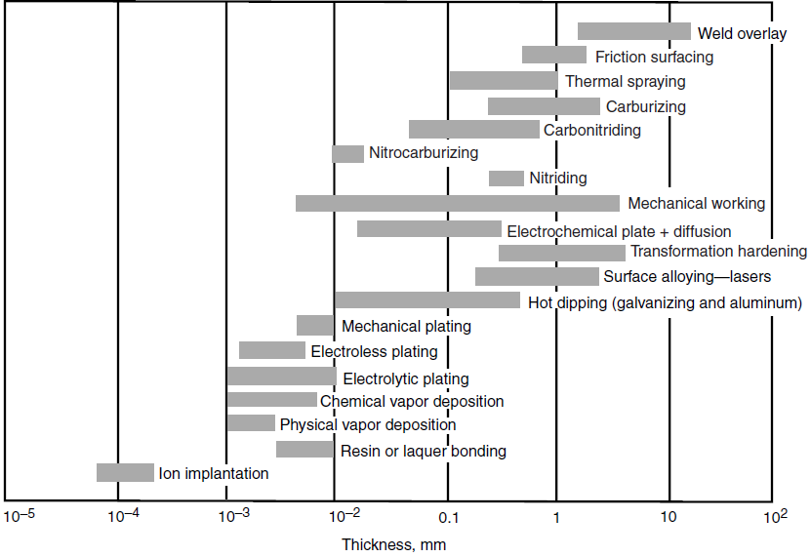
Approximate Thickness of Various Coatings

Slide 13
Surface Engineering - Industries Served

Slide 14
Surface-area-to-volume ratio
The surface-area-to-volume ratio also called the surface-to-volume ratio.
The surface-area-to-volume ratio is an important factor for the reactivity, that is, the rate at which the chemical reaction will proceed.
Materials with large surface-area-to-volume ratios (e.g., very small diameter, or very porous or otherwise not compact) react at much faster rates than monolithic materials, because more surface is available to react.

Slide 15
SURFACE PROCESSING OPERATIONS
Industrial Cleaning Processes
Heat Treatment
Coating Processes
Diffusion
Ion Implantation
Plating and Related Processes
Conversion Coating
Vapor Deposition Processes (CVD and PVD)
Organic Coatings
Ceramic Coatings
Thermal and Mechanical Coating Processes

Slide 16
Overview of Industrial Cleaning
Almost all workparts must be cleaned one or more times during their manufacturing sequence
Processes used to clean the work surfaces
Chemical cleaning methods - use chemicals to remove unwanted contaminants from the work surface
Mechanical cleaning - involves removal of contaminants by various mechanical operations

Slide 17
Why Parts Must be Cleaned Prior to Surface Treatments
Prepare surface for subsequent processing, such as a coating application or adhesive bonding
Improve hygiene conditions for workers and customers
Remove contaminants that might chemically react with the surface
Enhance appearance and performance of the product

Slide 18
Factors in Selecting a Cleaning Method
Contaminant to be removed
Degree of cleanliness required
Substrate material to be cleaned
Purpose of cleaning
Environmental and safety factors
Size and geometry of the part
Production and cost requirements

Slide 19
Contaminant to be Removed
Various contaminants build up on part surfaces, either due to previous processing or factory environment
Principal surface contaminants found in factory
Oil and grease, e.g., lubricants in metalworking
Solid particles such as metal chips, abrasive grits, shop dirt, dust, etc.
Buffing and polishing compounds
Oxide films, rust, and scale

Slide 20
Degree of Cleanliness
Refers to the amount of contaminant remaining after a given cleaning operation
A simple test is a wiping method, in which the surface is wiped with a clean white cloth
Amount of soil absorbed by the cloth is observed
Non‑quantitative but easy to use

Slide 21
Other Factors in Selection
The substrate material must be considered
So that damaging reactions are not caused by the cleaning chemicals
Aluminum is dissolved by most acids and alkalis
Steels are resistant to alkalis but react with virtually all acids
Cleaning methods and associated chemicals should be selected to avoid pollution and health hazards

Slide 22
Schematic representation of a metal surface, adapted from Bhushan and Gupta (1991)

Slide 23
Chemical Cleaning Processes
Alkaline cleaning
Emulsion cleaning
Solvent cleaning
Acid cleaning
Ultrasonic cleaning

Slide 24
Alkaline Cleaning
Uses an alkali to remove oils, grease, wax, and various types of particles (metal chips, silica, light scale) from a metallic surface
Most widely used industrial cleaning method
Alkaline solutions include sodium and potassium hydroxide (NaOH, KOH), sodium carbonate (Na₂CO₃), borax (Na₂B₄O₇)
Cleaning methods: immersion or spraying followed by water rinse to remove residue

Slide 25
Emulsion Cleaning
EMULSION CLEANING is an industrial cleaning process that uses an organic solvent as the main active agent. The solvent is usually a hydrocarbon of distilled petroleum dispersed in water
Used on either metal or nonmetallic parts
Must be followed by alkaline cleaning to eliminate all residues of the organic solvent prior to plating

Slide 26
Solvent Cleaning
Organic materials such as oil and grease are removed from a metallic surface by chemicals that dissolve the soils
Common application techniques: hand‑wiping, immersion, spraying, and vapor degreasing
Vapor degreasing (a solvent cleaning method) uses hot vapors of chlorinated or fluorinated solvents

Slide 27
Acid Cleaning
Removes oils and light oxides from metal surfaces using acid solutions combined with water‑miscible solvents, wetting and emulsifying agents
Common application techniques: soaking, spraying, or manual brushing or wiping carried out at ambient or elevated temperatures
Cleaning acids include hydrochloric (HCl), nitric (HNO₃), phosphoric (H₃PO₄), and sulfuric (H₂SO₄)

Slide 28
Acid Pickling
More severe acid treatment to remove thicker oxides, rusts, and scales
Distinction between acid cleaning and acid pickling is a matter of degree of reaction
Generally results in some etching of the metallic surface which serves to improve organic paint adhesion

Slide 29
Ultrasonic Cleaning
Mechanical agitation of cleaning fluid by high‑frequency vibrations (between 20 and 45 kHz) to cause cavitation (formation of low pressure vapor bubbles that scrub the surface)
Combines chemical cleaning and mechanical agitation of the cleaning fluid
Cleaning fluid is generally an aqueous solution containing alkaline detergents
Highly effective for removing surface contaminants

Slide 30
Mechanical Cleaning
Physical removal of soils, scales, or films from the work surface by abrasives or similar mechanical action
Often serves other functions also, such as deburring, improving surface finish, and surface hardening
Processes:
Blast finishing
Shot peening
Mass finishing processes

Slide 31
Sand Blasting
High velocity impact of particulate media to clean and finish a surface
Media is propelled at the target surface by pressurized air or centrifugal force
Most well‑known method is sand blasting, which uses grits of sand as blasting media
Other blasting media:
Hard abrasives such as Al₂O₃ and SiC
Soft media such as nylon beads

Slide 32
Hydroblasting
This technique relies entirely on the energy of water striking a surface for cleaning the surface.
Abrasives are not used in hydroblasting; thus eliminating dust pollution caused by the disposal of used abrasives.
High pressure hydroblasting – above 10,000 psi
Ultrahigh pressure hydroblasting – above 25,000 psi
Temperature rise – compression of water to achieve desired pressure will create a temperature rise and high velocity water jet striking steel will impart energy as heat
Chemical corrosion inhibition – Water soluble chemical corrosion inhibitors are used. This may leave a crystalline layer on the surface, which may result in blistering during coating operation
Removal of flash rusting
Removal of oil and grease – It can emulsify and remove oil and grease

Slide 33
Shot Peening
High velocity stream of small cast steel pellets (called shot) is directed at a metallic surface to cold work and induce compressive stresses into surface layers
Used primarily to improve fatigue strength of metal parts
Purpose is therefore different from blast finishing, although surface cleaning is accomplished as a byproduct of the operation

Slide 34
Shot blasting
Wheel blasting
Converts electric motor energy into kinetic abrasive energy by rotating a turbine wheel. Capacity varies from 60 kg/min. – 1200 kg/min. It is used to de-rust, de-scale, de-burr, de-sand or clean large areas of parts
Air blasting
Blast media is pneumatically accelerated by compressed air and projected by nozzles onto the component. For special aplications, water mix can be used (wet blasting)

Slide 35
Mass Finishing
Finishing parts in bulk by a mixing action in a container, usually in the presence of an abrasive media
Mixing causes parts to rub against media and each other to achieve desired finishing action
Parts are usually small and therefore uneconomical to finish individually
Processes include:
Tumbling
Vibratory finishing

Slide 36
Tumbling
Use of a horizontally oriented barrel of hexagonal or octagonal cross section in which parts are mixed by rotating the barrel at speeds of 10 to 50 rev/min
Finishing by "landslide" action - media and parts rise in the barrel as it rotates, then top layer tumbles down due to gravity
Drawbacks: slow, noisy, and large floor-space required

Slide 37
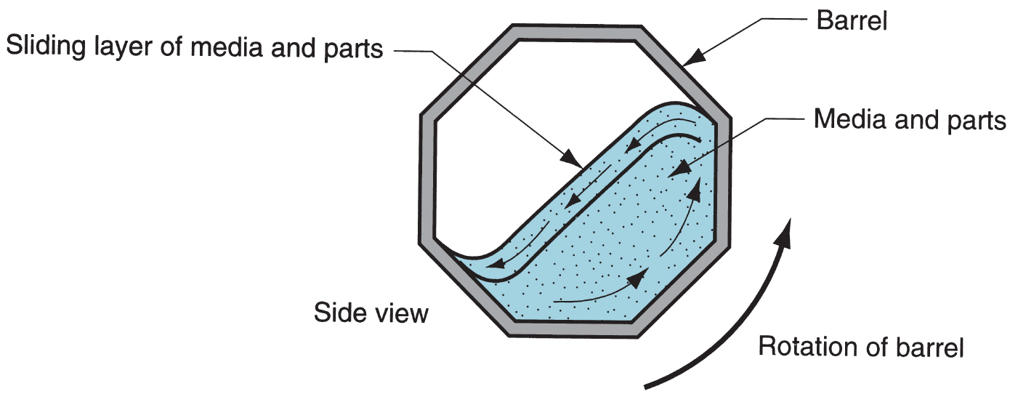
Tumbling (Barrel Finishing)
Diagram of tumbling (barrel finishing) operation showing "landslide" action of parts and abrasive media

Slide 38
Vibratory Finishing
Alternative to tumbling
Vibrating vessel subjects all parts to agitation with the abrasive media, as opposed to only the top layer as in barrel finishing
Processing times for vibratory finishing are significantly reduced
Open tubs permit inspection of parts during processing, and noise is reduced

Slide 39
Mass Finishing Media
Most are abrasive
Some media perform nonabrasive operations such as burnishing and surface hardening
Natural media (corundum, granite, limestone) - generally softer and nonuniform in size
Synthetic media (Al₂O₃ and SiC) - greater consistency in size, shape, and hardness
Steel - used for surface‑hardening, burnishing, and light deburring operations

Slide 40
Media Shapes in Mass Finishing
Typical preformed media shapes: (a) abrasive media for finishing, and (b) steel media for burnishing

Slide 41
Some basic factors to review in media selection may be outlined as follows:
1 . Determine correct size and/or shape which will contact all critical edges and/or surfaces, yet permit satisfactory separation of parts from media.
2. Select media which will remove burrs, achieve required radius and surface finish, produce desired action on edges, corners and surfaces relative to one another.

Slide 42
3.Determine media type, media density, particle size so that an optimum media-to-part ratio can be implemented for the parts being processed.
4.Select media which will make possible minimum process cycle or machine time.
5. Select size, type and shape to avoid lodging in holes and recesses, and type which will not fracture and create lodging problems. Media should be small enough to flow through holes and slots, or large enough to remain outside such areas.

Slide 43
6. Select media with minimum wear rate for lowest operating cost, minimum amount of
reclassification during use.
7. Consider availability of media in consistent quality.
8. Media must be able to process the range of products scheduled for a given machine.
9. Media must be of proper density to avoid parts migrations, achieve minimum part-on part impingement.

Slide 44
10.Media which can carry out an abrasive operation, and, with a change of compound,
perform a surface refinement cycle may be desirable.
11.Media should be able to achieve surface refinement both when new and when somewhat worn; should require no break-in to facilitate addition to existing load.

Slide 45
Types of Coating
Diffusion and ion implantation
Plating and related processes
Conversion coating
Vapor deposition processes
Organic Coatings

Slide 46
Processes to Alter Surface Chemistry
Two processes that impregnate the surface of a substrate with foreign atoms
Diffusion
Ion implantation

Slide 47
Diffusion
Alteration of surface layers of material by diffusing atoms of a different material (usually an element) into surface, usually at high temperatures
Surface still contains a high proportion of substrate material
Diffused element has maximum percentage at the surface and rapidly declines with distance below surface
Applications: metallurgy and semiconductor manufacture

Slide 48
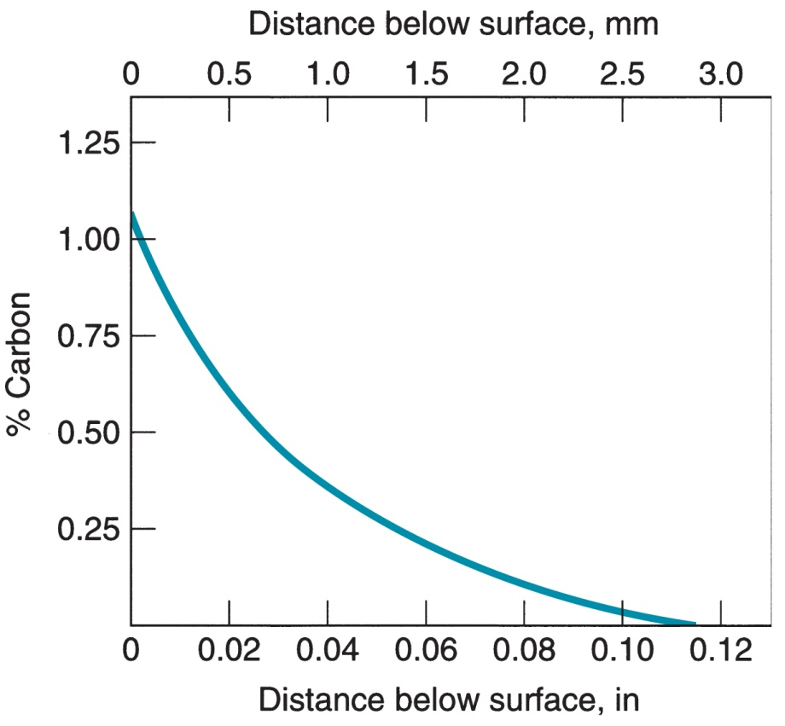
Profile of Diffused Element
Characteristic profile of diffused element as a function of distance below surface in diffusion
Plot given here is for carbon diffused into iron

Slide 49
Metallurgical Applications of Diffusion
Surface treatments to increase hardness and wear resistance
Carburizing, nitriding, carbonitriding, chromizing, and boronizing
Surface treatments to increase corrosion resistance and/or high‑temperature oxidation resistance
Aluminizing - diffusion of aluminum into carbon steel, alloy steels, and superalloys
Siliconizing – diffusion of silicon into steel surface

Slide 50
Semiconductor Applications
Diffusion of an impurity element into the surface of a silicon chip to change the electrical properties at the surface to create devices such as transistors and diodes
Called doping in semiconductor processing

Slide 51
Ion Implantation
Embedding atoms of one (or more) foreign element(s) into a substrate surface using a high‑energy beam of ionized particles
Results in alteration of the chemistry and physical properties of layers near the substrate surface
Produces a much thinner altered layer and different concentration profile than diffusion
Alternative to diffusion when the latter is not feasible due to high temperatures required

Slide 52
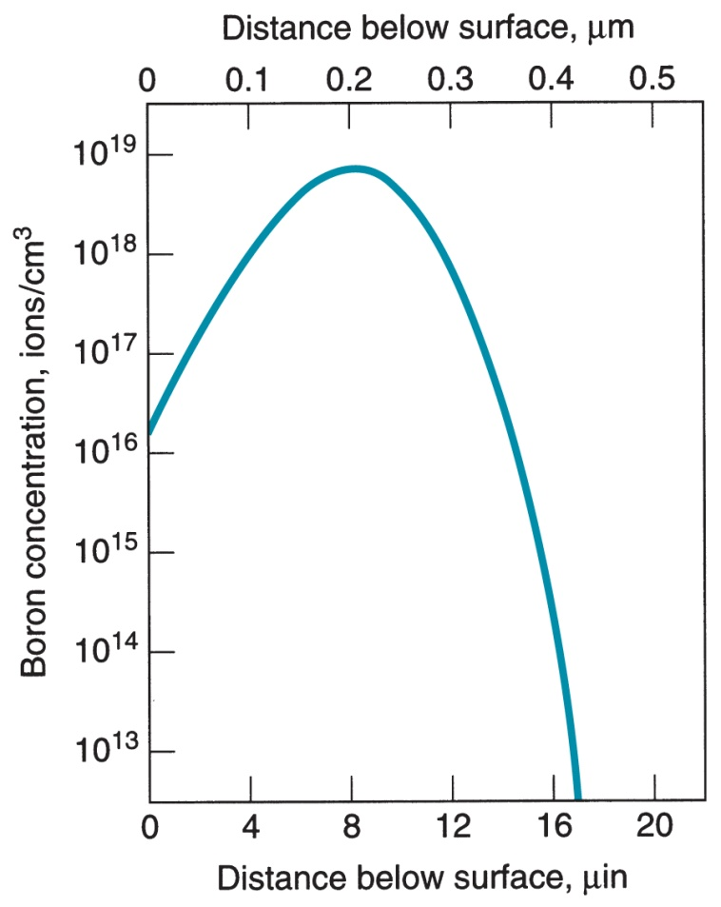
Profile of Surface Chemistry
Profile of surface chemistry using ion implantation
Shown here is a typical plot for boron implanted in silicon
Note the difference in profile shape and depth of altered layer compared to diffusion coating

Slide 53
Advantages and Applications of Ion Implantation
Advantages
Low temperature processing
Good control and reproducibility of impurity penetration depth
Solubility limits can be exceeded without precipitation of excess atoms
Applications
Modifying metal surfaces to improve properties
Fabrication of semiconductor devices

Slide 54
Some General Comments on Coating of Engineering Materials
Metal products are almost always coated ‑ by painting, plating, or other process
Exceptions: stainless steel, brass
Nonmetallic materials are sometimes coated
Plastic parts to give metallic appearance
Antireflection coatings on glass lenses
Coating and deposition processes used in the fabrication of semiconductor chips and printed circuit boards

Slide 55
Reasons for Coating Metal Parts and Products
Corrosion protection
Enhance product appearance
Add color and/or texture
Wear resistance and/or friction reduction
Increase electrical conductivity or resistance
Prepare metallic surface for subsequent processing
Rebuild surfaces worn or eroded during service

Slide 56
Plating and Related Processes
Coating thin metallic layer onto the surface of a substrate material
Substrate is usually metallic, although methods are available to plate plastic and ceramic parts
Processes:
Electroplating (most common plating process)
Electroforming
Electroless plating
Hot dipping

Slide 57
Electroplating
Electrolytic process in which metal ions in an electrolyte solution are deposited onto a cathode workpart
Also called electrochemical plating
Anode is generally made of the plating metal and serves as source of the plate metal
Direct current from an external power supply is passed between anode and cathode
Electrolyte is an aqueous solution of acids, bases, or salts

Slide 58
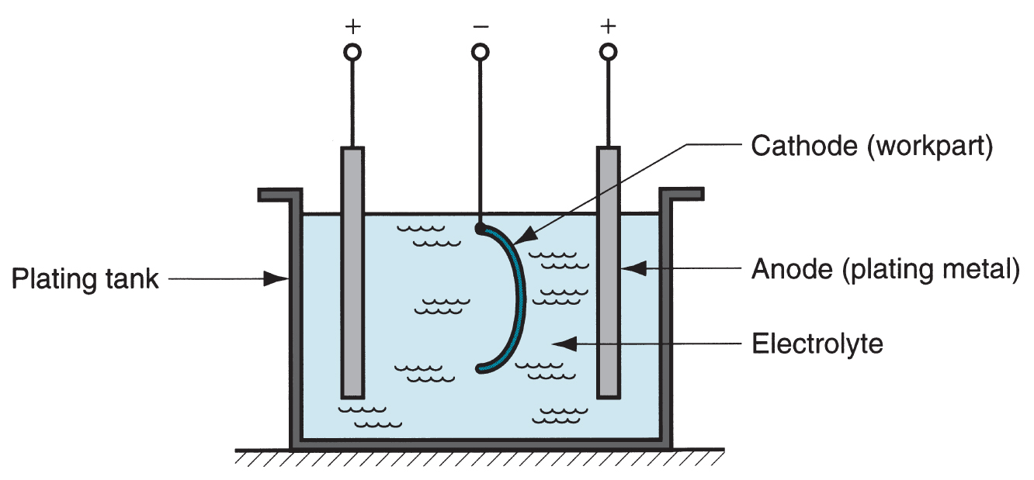
Electroplating
Setup for electroplating

Slide 59
Theoretical Electroplating Equation
Faraday’s laws can be summarized:
V = C I t
where V = volume of metal plated, mm³ (in³); C = plating constant which depends on electrochemical equivalent and density, mm³/amp‑s; I t (current x time) = electrical charge, amps-s
C indicates the amount of plating material deposited onto the cathodic workpart per electrical charge

Slide 60
Principal Electroplating Methods
Barrel plating - performed in rotating barrels - suited to plating many small parts in a batch
Rack plating – racks of copper wire formed into shapes to hold parts and conduct current to them - used for parts that are large, heavy, or complex
Strip plating – continuous strip is pulled through the plating solution by means of a take‑up reel – suited to high production

Slide 61
Common Coating Metals
Zinc - plated on steel products such as fasteners, wire goods, electric switch boxes, and sheetmetal parts as a sacrificial barrier to corrosion
Nickel - for corrosion resistance and decorative purposes on steel, brass, zinc die castings, etc.
Also used as base coat for chrome plate
Tin - widely used for corrosion protection in "tin cans" and other food containers

Slide 62
More Coating Metals
Copper - decorative coating on steel and zinc, either alone or alloyed as brass
Also important in printed circuit boards
Chromium - decorative coating widely used in automotive, office furniture, and kitchen appliances
Also one of the hardest electroplated coatings for wear resistance
Precious metals (gold, silver) - plated on jewelry
Gold is also used for electrical contacts

Slide 63
Electroforming
Electrolytic deposition of metal onto a pattern until the required thickness is achieved, after which the pattern is removed to leave the formed part
Process is virtually the same as electroplating but its purpose is different
Whereas typical plating thickness is only about 0.05 mm (0.002 in) or less, electroformed parts are often substantially thicker, so the production cycle is proportionally longer

Slide 64
Electroformed Products
Metals used for electroforming: copper, nickel, and nickel cobalt alloys most common
Typical applications: fine molds and dies (e.g., for lenses) and plates for embossing and printing
Notable application: molds for CDs and DVDs
Surface details imprinted onto CDs and DVDs are measured in μm

Slide 65
Electroless Plating
Metallic plating process driven entirely by chemical reactions ‑ no electric current is supplied
Deposition onto a part surface occurs in an aqueous solution containing ions of the desired plating metal
Workpart surface acts as a catalyst for the reaction in the presence of reducing agent
Metals that can be plated: nickel, copper, and gold
Notable application: copper for plating through‑holes of printed circuit boards

Slide 66
Hot Dipping
Metal substrate (part) is immersed in a molten bath of a second metal; when removed, the second metal is coated onto the first
Common substrate metals: steel and iron
Coating metals: zinc, aluminum, tin, and lead
Primary purpose is corrosion protection

Slide 67
Hot Dipping Processes
Galvanizing - zinc coated onto steel or iron
Most important hot dipping process
Aluminizing - coating of aluminum onto a substrate
Excellent corrosion protection, in some cases five times more effective than galvanizing
Tinning - coating of tin onto steel for food containers, dairy equipment, and soldering applications

Slide 68
Conversion Coatings
Family of coating processes in which a thin film of oxide, phosphate, or chromate is formed on a metallic surface by chemical or electrochemical reaction
Immersion and spraying are the two common methods of exposing metal surface to the reacting chemicals
Common metals treated: steel (including galvanized steel), zinc, and aluminum

Slide 69
Reasons for Using Conversion Coatings
Corrosion protection
Preparation for painting
Wear resistance
Permits surface to better hold lubricants for metal forming processes
Increase electrical resistance of surface
Decorative finish

Slide 70
Conversion Coating Processes
Chemical conversion coatings - chemical reaction only
Phosphate and chromate conversion coatings are the common treatments
Anodizing - oxide coating produced by electrochemical reaction
Anodize is a contraction of anodic oxidize
Most common on aluminum and its alloys

Slide 71
Chemical Conversion Coatings
Phosphate coating - transforms base metal surface (e.g., steel, zinc) into phosphate film by exposure to phosphate salts and dilute phosphoric acid
Useful preparation for painting of automobiles
Chromate coating - transforms base metal (e.g., aluminum, copper, magnesium, zinc) into various forms of chromate films (sometimes colorful) using solutions of chromic acid, chromate salts, etc.

Slide 72
Anodizing
Electrolytic treatment that produces a stable oxide layer on a metallic surface
Applications: aluminum and magnesium common
Also zinc, titanium, and other metals
Dyes can be incorporated into anodizing process to create a wide variety of colors
Especially common in aluminum anodizing
Functions: primarily decorative; also corrosion protection

Slide 73
Physical Vapor Deposition (PVD)
Family of processes in which a material is converted to its vapor phase in a vacuum chamber and condensed onto substrate surface as a very thin film
Coating materials: metals, alloys, ceramics and other inorganic compounds, even some polymers
Substrates: metals, glass, and plastics
Very versatile coating technology
Applicable to an almost unlimited combination of coatings and substrate materials

Slide 74
Applications of PVD
Decorative coatings on plastic and metal parts such as trophies, toys, pens and pencils, watchcases, and interior trim in automobiles
Antireflection coatings of magnesium fluoride (MgF₂) onto optical lenses
Depositing metal to form electrical connections in integrated circuits
Coating titanium nitride (TiN) onto cutting tools and plastic injection molds for wear resistance

Slide 75
Processing Steps in PVD
All physical vapor deposition processes consist of the following steps:
Synthesis of coating vapor
Vapor transport to substrate
Condensation of vapors onto substrate surface
These steps are generally carried out in a vacuum chamber, so evacuation of the chamber must precede PVD process

Slide 76
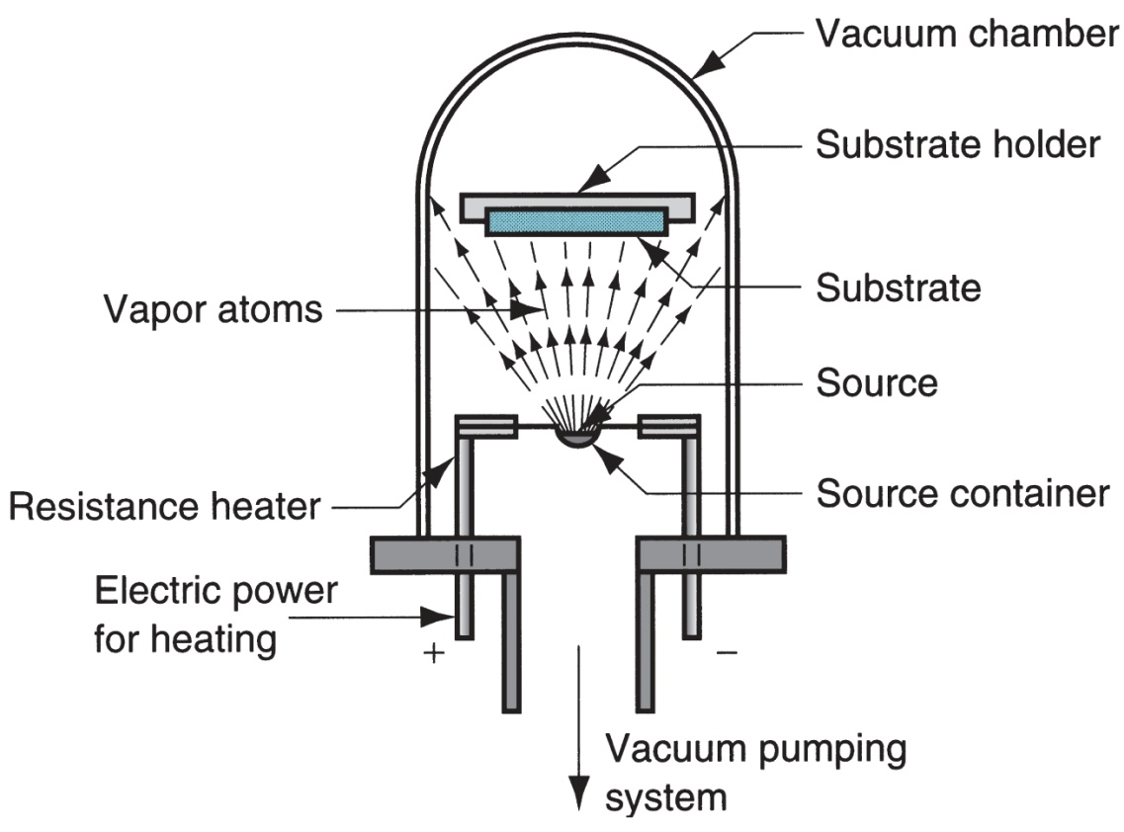
Physical Vapor Deposition
Setup for vacuum evaporation, one form of PVD, showing vacuum chamber and other process components

Slide 77
Chemical Vapor Deposition (CVD)
Involves interaction between a mixture of gases and the surface of a heated substrate, causing chemical decomposition of some of the gas constituents and formation of a solid film on the substrate
Reactions occur in enclosed reaction chamber
Reaction product nucleates and grows on substrate surface to form the coating
Most CVD reactions require heat
Variety of coating and substrate materials

Slide 78
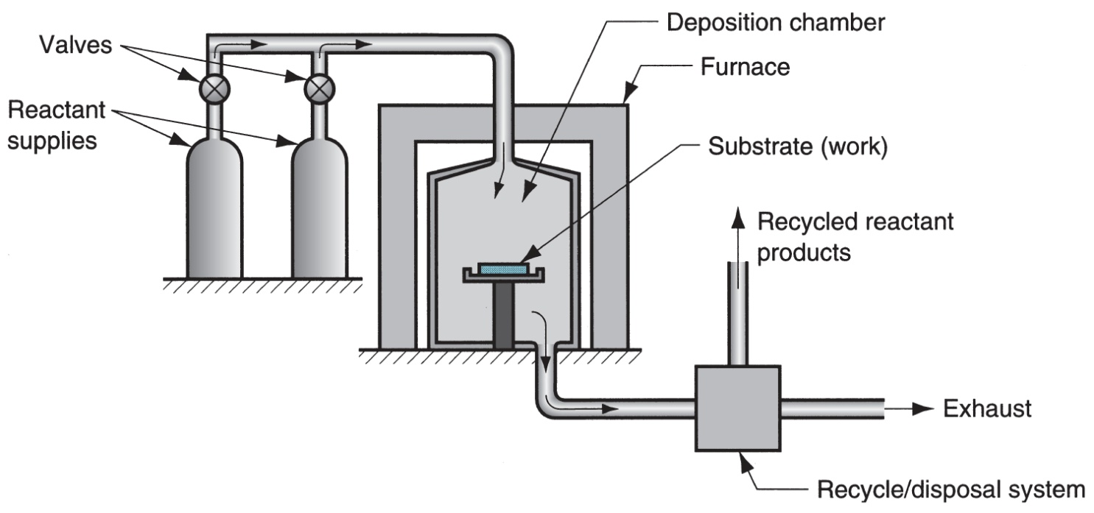
Chemical Vapor Deposition
Typical reactor used in CVD

Slide 79
Applications of CVD
Industrial metallurgical processes
Mond process to reduce nickel from its ore
Coated carbide tools
Solar cells
Refractory metals on jet engine turbine blades
Integrated circuit fabrication
Other applications for resistance to wear, corrosion, erosion, and thermal shock

Slide 80
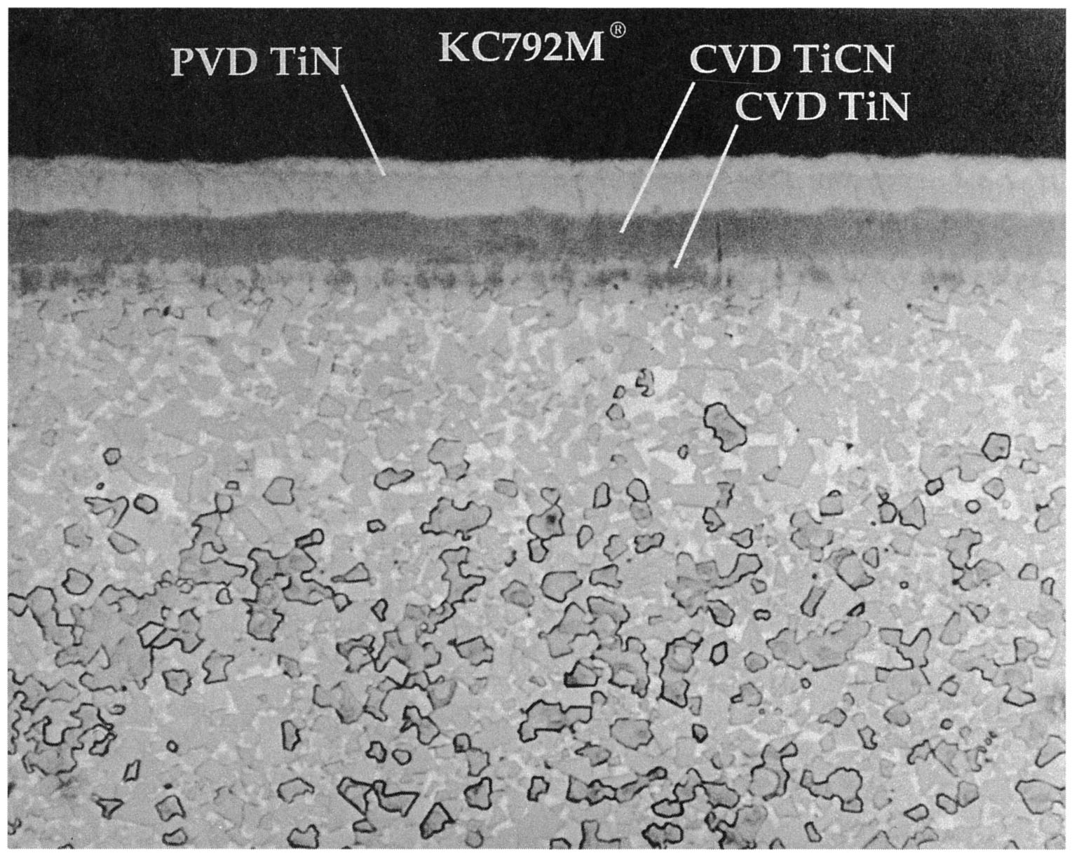
PVD and CVD
Photomicrograph of cross section of a coated carbide cutting tool using CVD and PVD

Slide 81
Organic Coatings
Polymers and resins (natural or synthetic) usually formulated to be applied as liquids that dry or harden as thin surface films on substrate materials
Advantages:
Wide variety of colors and textures available
Capacity to protect the substrate surface
Low cost
Ease with which they can be applied

Slide 82
Ingredients in Organic Coatings
Binders - give the coating its properties
Dyes or pigments - provide color to the coating
Solvents - dissolve the polymers and resins and add proper fluidity to the liquid
Additives

Slide 83
Binders
Polymers and resins that determine the solid state properties of the coating, such as strength, physical properties, and adhesion to the substrate surface
Binder holds the ingredients in the coating during and after application to the surface
Common binders in organic coatings:
Natural oils (to produce oil‑based paints)
Resins of polyesters, polyurethanes, epoxies, acrylics, and cellulosics

Slide 84
Dyes and Pigments
Provide color to the coating
Dyes - soluble chemicals that color the coating liquid but do not conceal surface beneath
Coatings generally transparent or translucent
Pigments - solid particles of microscopic size dispersed in coating liquid but insoluble in it
Not only color the coating, but also hide the surface below
Since pigments are particulate, they also tend to strengthen the coating

Slide 85
Solvents
Liquid substances used to dissolve the binder and certain other ingredients in the liquid coating composition
Common solvents used in organic coatings:
Aliphatic and aromatic hydrocarbons
Alcohols
Esters
Ketones
Chlorinated solvents

Slide 86
Additives
Surfactants (to facilitate spreading on the surface)
Biocides and fungicides
Thickeners
Heat and light stabilizers
Coalescing agents
Plasticizers
Defoamers
Catalysts to promote cross‑linking

Slide 87
Application Methods
Brushing
Rolling
Spraying
Dip coating (immersion)
Flow coating (showering)

Slide 88
Drying and Curing
Drying - process in which organic coating converts from liquid to solid
Many organic coatings dry by evaporation of their solvents
Curing - forms a durable film on the substrate surface
Involves a chemical change in the organic resin in which polymerization or cross‑linking occurs to harden the coating

Slide 89
Application Example: Automobile Car Body
Typical sequence applied to sheet metal car body in mass production of automobiles:
Phosphate coat applied by dipping car body
Primer coat applied by dipping car body
Color paint coat applied by spray coating
Clear coat (for high gloss and added protection) applied by spraying

Slide 90
Porcelain Enameling
Porcelain coatings are valued for:
Beauty and color
Smoothness and ease of cleaning
Chemical inertness and general durability
Porcelain enameling is the name given to the technology of these ceramic coating materials and the processes by which they are applied

Slide 91
Materials and Products
Porcelain = a ceramic made from kaolin, feldspar, and quartz
Substrates: steel, cast iron, and aluminum as a vitreous porcelain enamel
Products: sinks, bathtubs, lavatories, ranges, water heaters, washing machines, dishwashers, jet engine components, automotive mufflers, and electronic circuit boards

Slide 92
Thermal Spraying
Spraying molten coating materials onto substrate, where they solidify and adhere to surface
Coating materials: Pure metals and alloys; ceramics (oxides, carbides, certain glasses); other metallic compounds (sulfides, silicides); cermet composites; and certain plastics (e.g., epoxy, nylon, teflon).
Substrates: Metals, ceramics, glass, some plastics, wood, and paper

Slide 93
Applications of Thermal Spraying
First applications were to rebuild worn areas on used machinery components and to salvage workparts that had been machined undersize
Also used in manufacturing as a coating process for corrosion resistance, high temperature protection, wear resistance, electrical conductivity, electrical resistance, electromagnetic interference shielding

Slide 94
Hard Facing
Surfacing technique in which alloys are applied as welded deposits to substrate metals
Distinguishing feature is that fusion occurs between coating and substrate
Thermal spraying involves mechanical interlocking which does not stand up as well to abrasive wear
Well suited to applications requiring wear resistance
Applications: coating of new parts and repair of heavily worn, eroded, or corroded part surfaces

