Slide 1
Operations Research
Class Test II
12/3/2020

Slide 2
The stock brokerage firm of Blank, Leibowitz, and Weinberger has analyzed and recommended two stocks to an investors’ club of college professors. The professors were interested in factors such as short-term growth, intermediate growth, and dividend rates. These data on each stock are given in the table.
Each member of the club has an investment goal of (1) an appreciation of no less than $720 in the short term, (2) an appreciation of at least $5,000 in the next three years, and (3) a dividend income of at least $200 per year. What is the smallest investment that a professor can make to meet these three goals?
8 marks
 | LOUISIANA GAS AND POWER | TRIMEX INSULATION COMPANY
Short Term Growth | 0.36 | .24
Intermediate growth | 1.67 | 1.50
Dividend rates | 4% | 8%

Slide 3
The seasonal yield of olives in a Piraeus, Greece, vineyard is greatly influenced by a process of branch pruning. If olive trees are pruned every two weeks, output is increased. The pruning process, however, requires considerably more labor than permitting the olives to grow on their own and results in a smaller size olive. It also, though, permits olive trees to be spaced closer together. The yield of 1 barrel of olives by pruning requires 5 hours of labor and 1 acre of land. The production of a barrel of olives by the normal process requires only 2 labor hours but takes 2 acres of land. An olive grower has 250 hours of labor available and a total of 150 acres for growing. Because of the olive size difference, a barrel of olives produced on pruned trees sells for $20, whereas a barrel of regular olives has a market price of $30. The grower has determined that because of uncertain demand, no more than 40 barrels of pruned olives should be produced. Use graphical LP to find (a) the maximum possible profit. (b) the best combination of barrels of pruned and regular olives. (c) the number of acres that the olive grower should devote to each growing process.
8 Marks

Slide 4
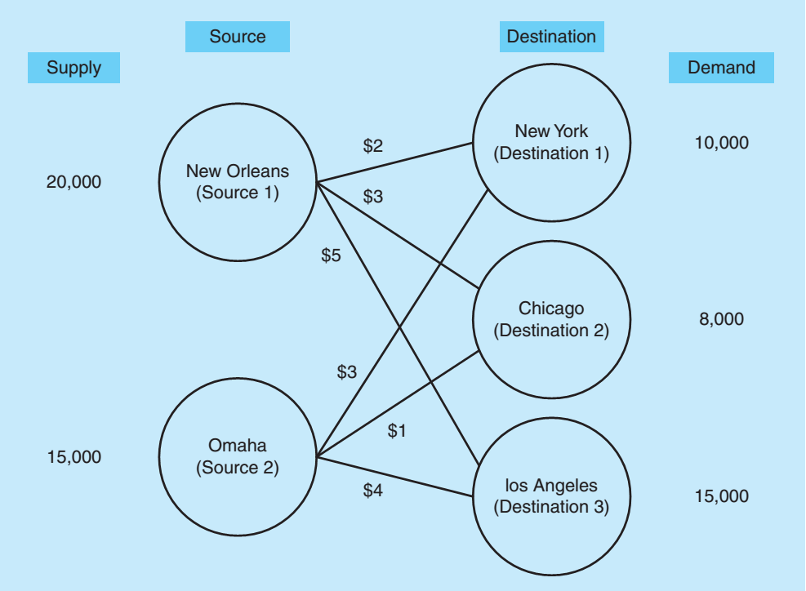
LP Formulation 7 Marks

Slide 5
Solve following transportation problem with least cost and VM method 7 Marks

