Slide 1
Non-Destructive Testing
Monil Salot

Slide 2
Unit 3
Pulse Echo and Through Transmission techniques of UT, Calibration methods, use of standard blocks, Thickness determination by ultrasonic method. Study of A, B and C scan presentations.
Radiographic testing of metallic components. X-ray and Gamma-Ray radiography. Their principles, methods of generation. Industrial radiography techniques. Types of films, screens and penetrameters. Interpretation of radiographs. Film Processing. Radiography Contrast.

Slide 4
Principle of Operation

Slide 5
Instruments used in Ultrasonic Testing
Pulser/Receiver
Ultrasonic Transducer
Couplant
Display Screen
Receiver/Amplifier

Slide 6
•
A typical UT inspection system consists of several functional units, such as the pulser /receiver, transducer, and display devices.
A pulser /receiver is an electronic device that can produce high voltage electrical pulses.
Driven by the pulser, the transducer generates high frequency ultrasonic energy. The sound energy is introduced and propagates through the materials in the form of waves.
When there is a discontinuity (such as a crack) in the wave path, part of the energy will be reflected back from the flaw surface. The reflected wave signal is transformed into an electrical signal by the transducer and is displayed on a screen. In the applet below, the reflected signal strength is displayed versus the time from signal generation to when a echo was received.
Signal travel time can be directly related to the distance that the signal travelled. From the signal, information about the reflector location, size, orientation and other features can sometimes be gained.
•
•
•
•

Slide 7
Types of Waves
•
In solids, sound waves can propagate in four principle modes that are
based on the way the particles oscillate. Sound can propagate as longitudinal waves, shear waves, surface waves, and in thin materials as plate waves. Longitudinal and shear waves are the two modes of
propagation most widely used in ultrasonic testing.
The particle movement responsible for the propagation of longitudinal and shear waves is illustrated below.
•

Slide 8
Longitudinal Wave
In longitudinal waves, the oscillations occur in the longitudinal direction or the direction of wave propagation. Since compressional and dilational forces are active in these waves, they are also called pressure or compressional waves. They are also sometimes called density waves because their particle density fluctuates as they move. Compression waves can be generated in liquids, as well as solids because the energy travels through the atomic structure by a series of compressions and expansion (rarefaction) movements.

Slide 9
Transverse Wave
In the transverse or shear wave, the particles oscillate at a right angle or transverse to the direction of propagation. Shear waves require an acoustically solid material for effective propagation, and therefore, are not effectively propagated in materials such as liquids or gasses. Shear waves are relatively weak when compared to longitudinal waves. In fact, shear waves are usually generated in materials using some of the energy from longitudinal waves.

Slide 10
Surface Wave
Surface Wave: Surface wave is also called as Rayleigh Waves represent an oscillating motion that travels along the surface of a teat specimen to a depth of one wavelength. Surface wave can be used to detect breaking cracks in a test specimen.

Slide 11
Lamp Wave
Lamp Wave: Lamp wave are surface waves propagate parallel to the test surface and have a particle motion that is elliptical. They occur when the thickness of the test material is only a few wavelength at the test frequency and where the test specimen is of uniform thickness

Slide 12
Particle Vibrations
Wave Types in Solids
Longitudinal
Transverse (Shear)
Surface - Rayleigh Plate Wave - Lamb
Parallel to wave direction
Perpendicular to wave direction
Elliptical orbit - symmetrical mode
Component perpendicular to surface (extensional wave)

Slide 13
Terminologies Used in Ultrasonic Testing
Wavelength: The distance travelled by a wave during a particle of the medium completes one vibration is called wavelength. It is also defined as the distance between any two nearest on the wave having same phase
Time Period: The time period of a wave is the time taken by the wave to travel a distance equal to its wavelength
Frequency: This is defined as the number of waves produced in one second.
Sensitivity and Resolution: Sensitivity and resolution are two terms that are often used in ultrasonic inspection to describe a technique's ability to locate flaws. Sensitivity is the ability to locate small discontinuities. Sensitivity generally increases with higher frequency (shorter wavelengths). Resolution is the ability of the system to locate discontinuities that are close together within the material or located near the part surface. Resolution also generally increases as the frequency increases.

Slide 14
Scattering and Attenuation: Scattering is the reflection of the sound in directions other than its original direction of propagation. Absorption is the conversion of the sound energy to other forms of energy. The combined effect of scattering and absorption is called attenuation. Ultrasonic attenuation is the decay rate of the wave as it propagates through material.
Acoustic impedance: Sound travels through materials under the influence of sound pressure. Because molecules or atoms of a solid are bound elastically to one another, the excess pressure results in a wave propagating through the solid.
The acoustic impedance (Z) of a material is defined as the product of its density (p) and acoustic velocity (V).
Z = pV

Slide 15
Mode Conversion in UST
When sound travels in a solid material, one form of wave energy can be transformed into another form.
For example, when a longitudinal waves hits an interface at an angle, some of the energy can cause particle movement in the transverse direction to start a shear (transverse) wave. Mode conversion occurs when a wave encounters an interface between materials of different acoustic impedances and the incident angle is not normal to the interface.
it was pointed out that when sound waves pass through an interface between materials having different acoustic velocities, refraction takes place at the interface. The larger the difference in acoustic velocities between the two materials, the more the sound is refracted. Notice that the shear wave is not refracted as much as the longitudinal wave. This occurs because shear waves travel slower than longitudinal waves. Therefore, the velocity difference between the incident longitudinal wave and the shear wave is not as great as it is between the incident and refracted longitudinal waves.

Slide 16
Also note that when a longitudinal wave is reflected inside the material, the reflected shear wave is reflected at a smaller angle than the reflected longitudinal wave. This is also due to the fact that the shear velocity is less than the longitudinal velocity within a given material.
Snell's Law holds true for shear waves as well as longitudinal waves and can be written as follows.
Where:
VL1 is the longitudinal wave velocity in material 1. VL2 is the longitudinal wave velocity in material 2.
VS1 is the shear wave velocity in material 1. VS2 is the shear wave velocity in material 2.

Slide 17
Ultrasonic Testing Methods
Ultrasonic testing is a very versatile inspection method, and inspections can be accomplished in a number of different ways.
Ultrasonic inspection techniques are commonly divided into three primary classifications.
–Pulse-echo and Through Transmission (Relates to whether reflected or transmitted energy is used)
–Normal Beam and Angle Beam (Relates to the angle that the sound energy enters the test article)
–Contact and Immersion (Relates to the method of coupling the transducer to the test article)

Slide 18
Transmission Through Method
In this method, the defect can be identified on quantifying the received sound waves.
Test Procedure:
Two transducers located on opposing sides of the test specimen are used. One transducer acts as a transmitter, the other as a receiver.
Discontinuities in the sound path will result in a partial or total loss of sound being transmitted and be indicated by a decrease in the received signal amplitude.
Through transmission is useful in detecting discontinuities that are not good reflectors, and when signal strength is weak. It does not provide depth information.

Slide 19
The result can be seen through CRT screen display
Digital received
display showing sound through
material thickness.
Digital display showing loss of received signal due to presence of a discontinuity in the sound field.

Slide 20
Pulse-Echo Testing Methods
Test Procedure:
In pulse-echo testing, a transducer sends out a pulse of energy and the same or a second transducer listens for reflected energy (an echo).
Reflections occur due to the presence of discontinuities and the surfaces of the test article.
The amount of reflected sound energy is displayed versus time, which provides the inspector information about the size and the location of features that reflect the sound.

Slide 21
The pulse-echo technique allows testing when access to only one side of the material is possible, and it allows the location of reflectors to be precisely determined.
Digital display showing signal generated from sound reflecting off back surface.
Digital display showing the presence of a reflector midway through material, with lower amplitude back surface reflector.

Slide 22
Straight Beam testing Methods
In normal beam testing, the sound beam is introduced into the test article at 90 degree to the surface.
It is also called straight beam technique. In this technique, mostly transducer is in direct contact with specimen.
In this technique, determination of the location of a discontinuity in a part or structure is done accurately measuring the time required for SHORT Ultrasonic pulse generated from the or the surface of a discontinuity and be returned to the transducer.

Slide 23
Angle Beam Testing
In angle beam testing, the sound beam is introduced into the test article at some angle other than 90.
In this technique, the refracted beam is used to inspect angle beam transducers and wedges are used to introduce a refracted shear wave in to the test material.
An angles sound path allows the sound beam to come in from the side thereby improving detectability of deflects and flaws in and around test specimen.
The choice between normal and angle beam inspection usually depends on two considerations:
-The orientation of the feature of interest – the sound should be directed to produce the largest reflection from the feature.
-Obstructions on the surface of the part that must be worked around.

Slide 25
Contact Testing Technique
Contact testing are used for direct contact inspections, and are manipulated manually. As the name suggests , this transducer has direct contact with this specimen.
These transducers are designed in such a manner so that it is easy to grip and move along a surface.
To get useful levels of sound energy into a material, the air between the transducer and the test article must be removed. This is referred to as coupling.
In contact testing, a couplant such as water, oil or a gel is applied between the transducer and the part.

Slide 26
Immersion Testing Technique
In immersion testing, the part and the transducer are place in a water bath. This arrangement allows better movement of the transducer while maintaining consistent coupling.
With immersion testing, an echo from the front surface of the part is seen in the signal but otherwise signal interpretation is the same for the two techniques.
Immersion technique is typically used inside a water tank

Slide 27
Resonance Testing Technique

Slide 28
Resonance is a fast inspection technique and this inspection is different from other US techniques. It is basically used to determine the thickness of test specimen.
This technique involves in varying the frequency of Ultrasonic waves to exit a maximum amplitude in body is called resonance testing.
This technique is used by industries undergoing mass production.
Principle: This technique is based on the fact that a good bell will ring with good note, while a cracked bell will ring with a cracked note. So by hitting a material and measuring its response, we can find the discontinuity and also the thickness of the material.
Construction and working: For resonance inspection, we normally locate the components to be tested on three or four piezo transducers. It is not necessary to scan the component with the transducers, nor to rotate the component as one test will evaluate the whole body.
One transducer acts as a transmitter while others act as receivers, measuring the amplitude of vibration at the specific frequency of the transmitter at one of its harmonics. These transducers have ceramic tips to prevent wear and to provide a good transfer of energy.

Slide 29
Ultrasonic Transducer
Ultrasonic transducers are used to transfer electrical energy to mechanical energy and vice-versa. It is also called as probe. There are wide classifications of transducers. Some of the transducers are.
1.Piezo electric transducers 2.Polyvinylidene Fluoride transducers 3.Electromagnetic Acoustic Transducers 4.Laser generator ultrasound

Slide 30
1. Piezo electric transducers
In this transducer, it consist of materials which generate electric charges when mechanically stressed. We know that a piezo electric crystal generates electricity when it is vibrated mechanically, thus the piezo electric material is mounted at the front end of transducer.
When electric pulse is applied to piezo electric crystal, it produces high frequency ultrasonic waves due to its vibration.
Advantages:
Compact, Simple, Offers high Output, high frequency
Disadvantages:
Difficult to get required shape of piezo electric element Additional circuits are needed to reduce acoustic impedance.

Slide 32
2. Polyvinylidene Fluoride Transducer
Polymer based piezo electric transducer are available in Non destructive testing using ultrasonics. Polymer materials like PVDF exhibits piezo electric activity. Relatively high activity is found to exists in polarized PVDF.
Advantages:
High frequency range,
Easily shaped to focus the beam, Transfer energy easily Disadvantages:
Not applicable in contact application, Requires additional circuits for high power.

Slide 33
3. Electro Magnetic Acoustic Transducer
This is made up of coils, which are placed close to test pieces. So it is basically non contact type. It actually produces a magnetic field that interacts with metal, producing a deformation in the surface of the material which in turn produces ultrasonic energy.
Advantages:
No Need of Couplant,
Used to inspect high temperature, Beam can be well focused
Disadvantages: Low efficiency, Large in Size.

Slide 35
4.Laser Generated Ultrasound
There are two separate laser, one is to heat the surface and produce the wave and a second is to detect the defects from reflected wave. Due to his surface heating, acoustic propagation is accomplished. This heating causes thermal expansion on the surface, which results in the formation of a wave that travels through the material.
Advantages:
No need couplant,
Acoustic impedance is achieved easily
Disadvantages:
Relatively low cost

Slide 36
Reference Block With Artificially Created Defects
For quantitative characterization of material properties and defects, it is important to calibrate the characteristics of an ultrasonic instrument.
A widely adopted technique is the use of ultrasonic reference blocks specified by ASTM,AWS etc.
Blocks are made of such material as Al, steel, Titanium, plastic, etc.
Artificial defects such as flat bottom holes, side derived holes, notches and step wedges are usually provided in blocks.

Slide 37
Time of Flight Diffraction (TOFD)

Slide 38
Time-of-flight diffraction (TOFD) method of ultrasonic testing is a sensitive and accurate method for the non-destructive testing of welds for defects.
In a TOFD system, a pair of ultrasonic probes sits on opposite sides of a weld. One of the probes, the transmitter, emits an ultrasonic pulse that is picked up by the probe on the other side, the receiver. In undamaged pipes, the signals picked up by the receiver probe are from two waves: one that travels along the surface and one that reflects off the far wall. When a crack is present, there is a diffraction of the ultrasonic wave from the tip(s) of the crack. Using the measured time of flight of the pulse, the depth of a crack tips can be calculated automatically by simple trigonometry.

Slide 39
Modes of Display
Ultrasonic data can be collected and displayed in a number of different formats. The three most common formats are know in the NDT world as A-scan, B-scan and C-scan presentations. Each presentation mode provides a different way of looking at and evaluating the region of material being inspected. Modern computerized ultrasonic scanning systems can display data in all three presentation forms simultaneously.

Slide 40
A Scan
A Scan is one of the simplest method of displaying the results of ultrasonic testing. Here the time of flight of the pulse is represented in X axis and the amplitude of the echoes are represented in Y axis.
In this, certain amount of ultrasonic energy is reflected at the top and bottom faces of the material. The echoes from the top and bottom faces give the initial and back wall peaks on the CRT.
Suppose a defect is present under the probe in the material it is indicated as small echoes in CRT. This corresponds to a defect peak on the surface of CRT screens.
The size of the defect is proportional to the height of the defect peak and depth of the defect from the top of the material is proportional to the position of the defect peak on the horizontal sweep of the CRT

Slide 42
B Scan
B Scan represents a two dimensional image of a stationary specimen. Here, the dimension of the specimen is displayed in the X axis, while the travel of the ultrasonic pulse in the specimen is displayed in the Y axis.
In this scan, the ultrasonic probe is move along a line on the top face of the material. This scan shows the reflection of ultrasonic pulse energy from the top and bottom faces of the testing material, also from the defects as the ultrasonic probes moves along a line of the surface of the material.
The B Scan presents the cross sectional view of the material alone a line and provides a depth of flaw from the surface of the material and also length of the flaw along the line of movement of the probe.

Slide 44
C Scan
C Scan display is the best method to display the flaw depth. In order to determine the accurate depth of the flaw, the probe is moved on the test specimen. The echo of the scan output a shaded line with varying intensity which indicates the absence of the flaw. The echoes of the scan output without any shading indicates the flaw shape.
In this scan, the ultrasonic probe is swept continuously line by line on the complete top face. This scan produces a plan of the material and this is similar to radiograph.
C Scan has been particularly used in corrosion detection in pipes and pressure vessels and in the detection of delamination's in composite materials

Slide 46
Advantages
It is sensitive to both surface and subsurface discontinuities.
The depth of penetration for flaw detection or measurement is superior to other NDT methods.
Only single-sided access is needed when the pulse-echo technique is used.
It is highly accurate in determining reflector position and estimating size and shape.
Minimal part preparation is required.
Electronic equipment provides instantaneous results.
Detailed images can be produced with automated systems.
It has other uses, such as thickness measurement, in addition to flaw detection.

Slide 47
Limitations
Surface must be accessible to transmit ultrasound.
Skill and training is more extensive than with some other methods.
It normally requires a coupling medium to promote the transfer of sound energy into the test specimen.
Materials that are rough, irregular in shape, very small, exceptionally thin or not homogeneous are difficult to inspect.
Cast iron and other coarse grained materials are difficult to inspect due to low sound transmission and high signal noise.
Linear defects oriented parallel to the sound beam may go undetected.
Reference standards are required for both equipment calibration and the characterization of flaws.

Slide 48
Applications
Testing of ferrous and non ferrous pipes
Testing weld in pressure vessels
Fatigue detection in welds and boilers
Inspection of large castings
Structural integrity of aircraft parts

Slide 49
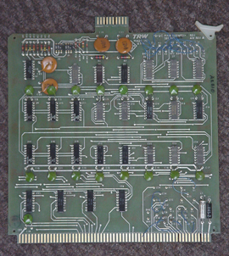
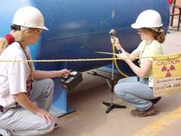
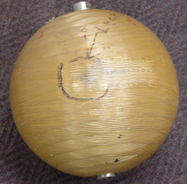
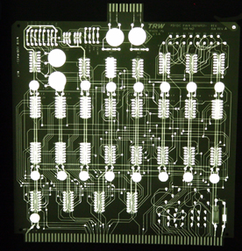
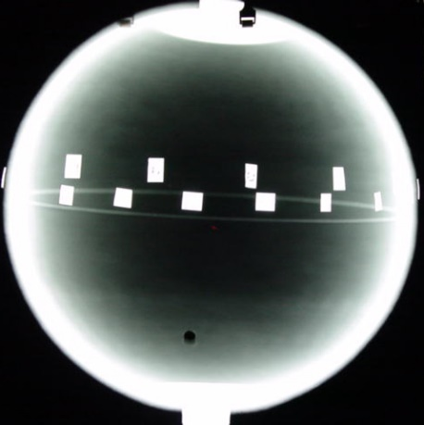
RADIOGRAPHIC TESTING

Slide 50
Introduction
This module presents information on the NDT method of radiographic inspection or radiography.
Radiography uses penetrating radiation that is directed towards a component.
The component stops some of the radiation. The amount that is stopped or absorbed is affected by material density and thickness differences.
These differences in “absorption” can be recorded on film, or electronically.

Slide 51
Outline
Electromagnetic Radiation
General Principles of Radiography
Sources of Radiation
Gamma Radiography
X-ray Radiography
Imaging Modalities
Film Radiography
Computed Radiography
Real-Time Radiography
Direct Digital Radiography
Computed Radiography
Radiation Safety
Advantages and Limitations
Glossary of Terms

Slide 52
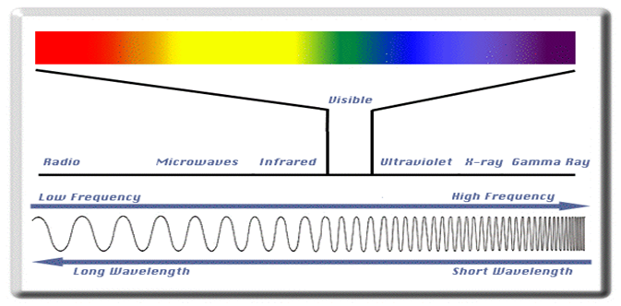
Electromagnetic Radiation
The radiation used in Radiography testing is a higher energy (shorter wavelength) version of the electromagnetic waves that we see every day. Visible light is in the same family as x-rays and gamma rays.

Slide 53
General Principles of Radiography
The part is placed between the radiation source and a piece of film. The part will stop some of the radiation. Thicker and more dense area will stop more of the radiation.
The film darkness (density) will vary with the amount of radiation reaching the film through the test object.
X-ray film
= less exposure
= more exposure
Top view of developed film

Slide 54
General Principles of Radiography
The energy of the radiation affects its penetrating power. Higher energy radiation can penetrate thicker and more dense materials.
The radiation energy and/or exposure time must be controlled to properly image the region of interest.
Thin Walled Area
Low Energy Radiation
High energy Radiation

Slide 55
Flaw Orientation
IDL 2001
Optimum Angle
Radiography has sensitivity limitations when detecting cracks.
= easy to detect
= not easy to detect
X-rays “see” a crack as a thickness variation and the larger the variation, the easier the crack is to detect.
When the path of the x-rays is not parallel to a crack, the thickness variation is less and the crack may not be visible.

Slide 56
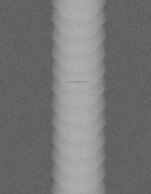
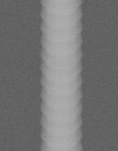
Flaw Orientation (cont.)
IDL 2001
Since the angle between the radiation beam and a crack or other linear defect is so critical, the orientation of defect must be well known if radiography is going to be used to perform the inspection.
0º
10º
20º

Slide 57
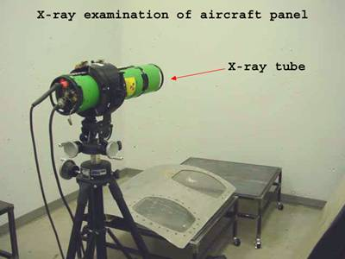
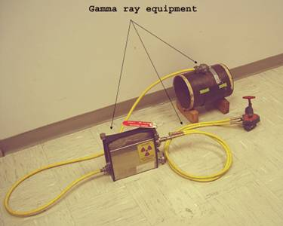
Radiation Sources
Two of the most commonly used sources of radiation in industrial radiography are x-ray generators and gamma ray sources. Industrial radiography is often subdivided into “X-ray Radiography” or “Gamma Radiography”, depending on the source of radiation used.

Slide 58
Gamma Radiography
Gamma rays are produced by a radioisotope.
A radioisotope has an unstable nuclei that does not have enough binding energy to hold the nucleus together.
The spontaneous breakdown of an atomic nucleus resulting in the release of energy and matter is known as radioactive decay.

Slide 59
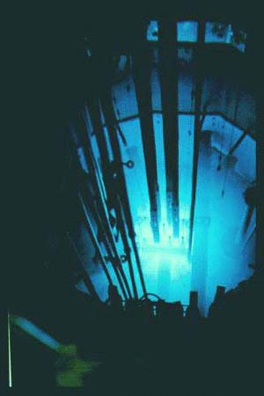
Gamma Radiography (cont.)
Most of the radioactive material used in industrial radiography is artificially produced.
This is done by subjecting stable material to a source of neutrons in a special nuclear reactor.
This process is called activation.

Slide 60
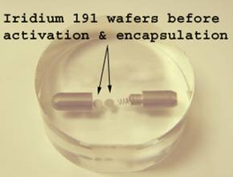
Gamma Radiography (cont.)
Unlike X-rays, which are produced by a machine, gamma rays cannot be turned off. Radioisotopes used for gamma radiography are encapsulated to prevent leakage of the material.
The radioactive “capsule” is attached to a cable to form what is often called a “pigtail.” The pigtail has a special connector at the other end that attaches to a drive cable.

Slide 61
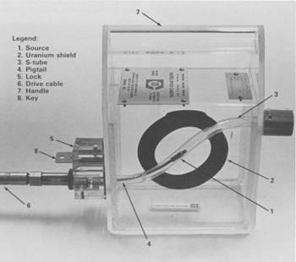
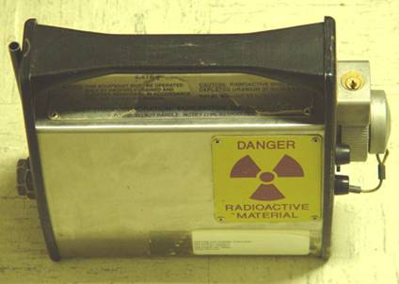
Gamma Radiography (cont.)
A device called a “camera” is used to store, transport and expose the pigtail containing the radioactive material. The camera contains shielding material which reduces the radiographer’s exposure to radiation during use.

Slide 62
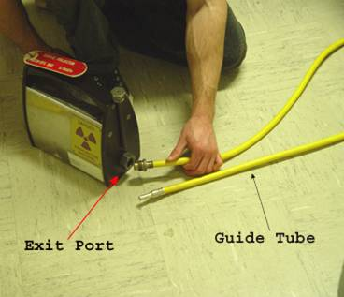
Gamma Radiography (cont.)
A hose-like device called a guide tube is connected to a threaded hole called an “exit port” in the camera.
The radioactive material will leave and return to the camera through this opening when performing an exposure!

Slide 63
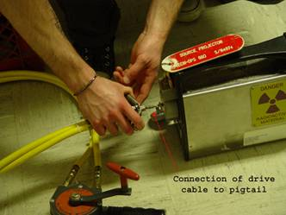
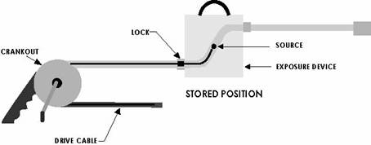
Gamma Radiography (cont.)
A “drive cable” is connected to the other end of the camera. This cable, controlled by the radiographer, is used to force the radioactive material out into the guide tube where the gamma rays will pass through the specimen and expose the recording device.

Slide 64
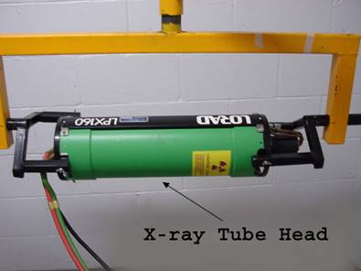
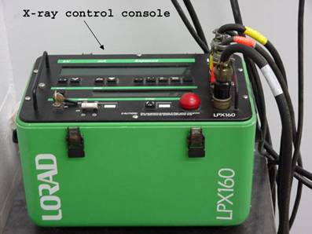
X-ray Radiography
Unlike gamma rays, x-rays are produced by an X-ray generator system. These systems typically include an X-ray tube head, a high voltage generator, and a control console.

Slide 65
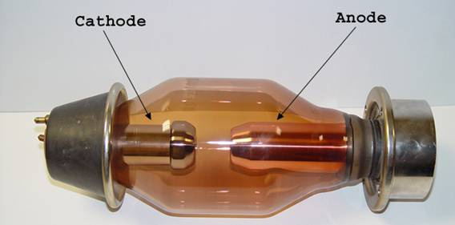
X-ray Radiography (cont.)
X-rays are produced by establishing a very high voltage between two electrodes, called the anode and cathode.
To prevent arcing, the anode and cathode are located inside a vacuum tube, which is protected by a metal housing.

Slide 66
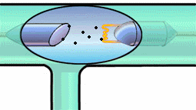
X-ray Radiography (cont.)
The cathode contains a small filament much the same as in a light bulb.
Current is passed through the filament which heats it. The heat causes electrons to be stripped off.
The high voltage causes these “free” electrons to be pulled toward a target material (usually made of tungsten) located in the anode.
The electrons impact against the target. This impact causes an energy exchange which causes x-rays to be created.
High Electrical Potential
Electrons
+
-
X-ray Generator or Radioactive Source Creates Radiation
Radiation
Penetrate
the Sample
Exposure Recording Device

Slide 67
Imaging Modalities
Several different imaging methods are available to display the final image in industrial radiography:
Film Radiography
Real Time Radiography
Computed Tomography (CT)
Digital Radiography (DR)
Computed Radiography (CR)

Slide 68
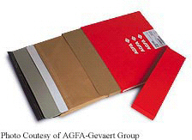
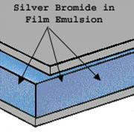
Film Radiography
One of the most widely used and oldest imaging mediums in industrial radiography is radiographic film.
Film contains microscopic material called silver bromide.
Once exposed to radiation and developed in a darkroom, silver bromide turns to black metallic silver which forms the image.

Slide 69
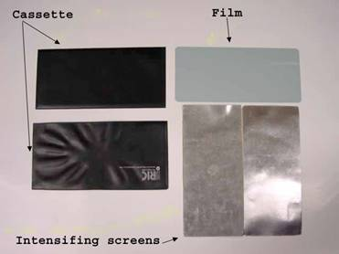
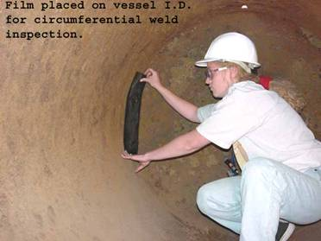
Film Radiography (cont.)
Film must be protected from visible light. Light, just like x-rays and gamma rays, can expose film. Film is loaded in a “light proof” cassette in a darkroom.
This cassette is then placed on the specimen opposite the source of radiation. Film is often placed between screens to intensify radiation.

Slide 70
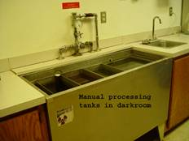
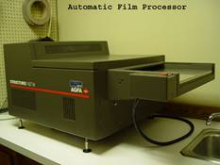
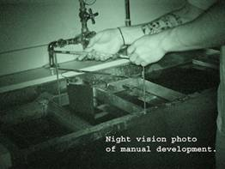
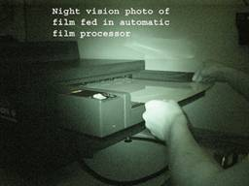
Film Radiography (cont.)
In order for the image to be viewed, the film must be “developed” in a darkroom. The process is very similar to photographic film development.
Film processing can either be performed manually in open tanks or in an automatic processor.

Slide 71
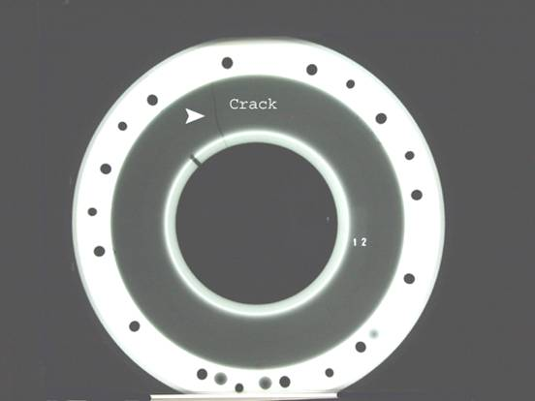
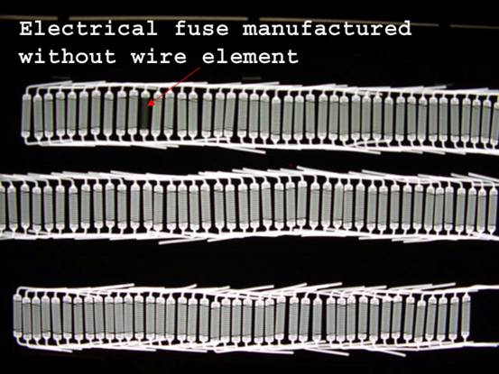
Film Radiography (cont.)
Once developed, the film is typically referred to as a “radiograph.”

Slide 72
Digital Radiography
One of the newest forms of radiographic imaging is “Digital Radiography”.
Requiring no film, digital radiographic images are captured using either special phosphor screens or flat panels containing micro-electronic sensors.
No darkrooms are needed to process film, and captured images can be digitally enhanced for increased detail.
Images are also easily archived (stored) when in digital form.

Slide 73
Digital Radiography (cont.)
There are a number of forms of digital radiographic imaging including:
Computed Radiography (CR)
Real-time Radiography (RTR)
Direct Radiographic Imaging (DR)
Computed Tomography

Slide 74
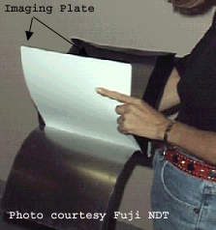
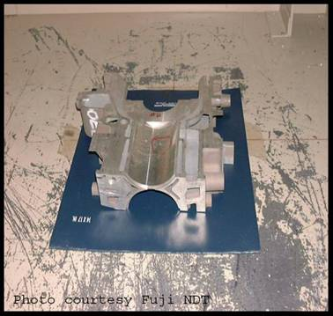
Computed Radiography
Computed Radiography (CR) is a digital imaging process that uses a special imaging plate which employs storage phosphors.

Slide 75
Computed Radiography (cont.)
X-rays penetrating the specimen stimulate the phosphors. The stimulated phosphors remain in an excited state.
CR Phosphor Screen Structure
X-Rays
Protective Layer
Phosphor Layer
Phosphor Grains
Substrate

Slide 76
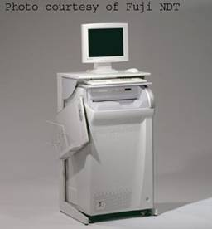
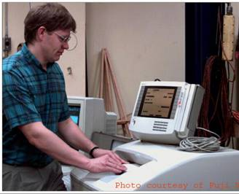
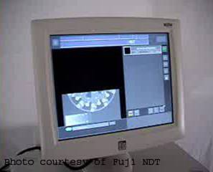
Computed Radiography (cont.)
After exposure:
The imaging plate is read electronically and erased for re-use in a special scanner system.

Slide 77
Computed Radiography (cont.)
As a laser scans the imaging plate, light is emitted where X-rays stimulated the phosphor during exposure. The light is then converted to a digital value.
Optical
Scanner
Photo-multiplier Tube
Laser Beam
A/D
Converter
Imaging
Plate
110010010010110
Motor
Notes:
Within a CR reader, the IP is scanned with a laser beam in order to initiate the emission of light from the storage phosphors (photostimulated luminescence). The intensity of light emitted from the IP is proportional to the amount of radiation absorbed by the storage phosphor.
The laser scans across the surface of the IP in a raster pattern. During the reading process, the light that is emitted from the IP is collected by a light guide & sent to a photomultiplier tube (PMT). The signal coming from the PMT is amplified, spatially sampled, & then sent to be converted to a digital signal (in an analog to digital converter). The resultant digital information can now be electronically transmitted, manipulated, & more efficiently stored.

Slide 78
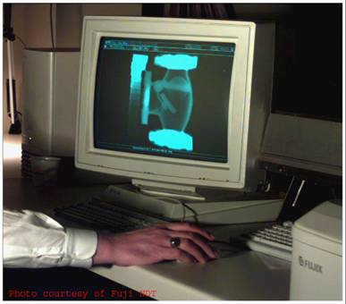
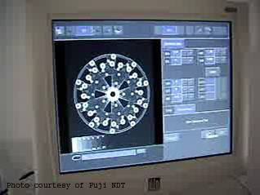
Computed Radiography (cont.)
Digital images are typically sent to a computer workstation where specialized software allows manipulation and enhancement.

Slide 79
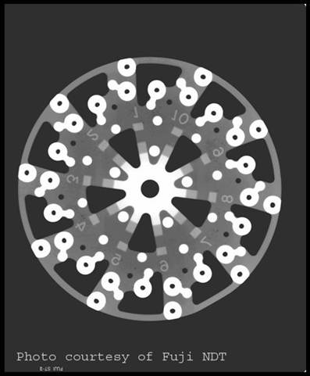
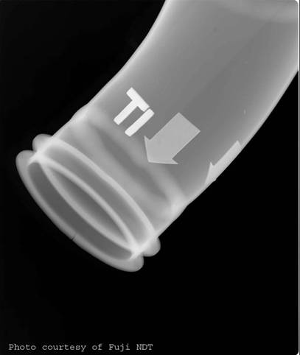
Computed Radiography (cont.)
Examples of computed radiographs:

Slide 80
Real-Time Radiography
Real-Time Radiography (RTR) is a term used to describe a form of radiography that allows electronic images to be captured and viewed in real time.
Because image acquisition is almost instantaneous, X-ray images can be viewed as the part is moved and rotated.
Manipulating the part can be advantageous for several reasons:
It may be possible to image the entire component with one exposure.
Viewing the internal structure of the part from different angular prospectives can provide additional data for analysis.
Time of inspection can often be reduced.

Slide 81
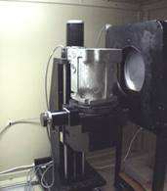
Real-Time Radiography (cont.)
The equipment needed for an RTR includes:
X-ray tube
Image intensifier or other real-time detector
Camera
Computer with frame grabber board and software
Monitor
Sample positioning system (optional)

Slide 82
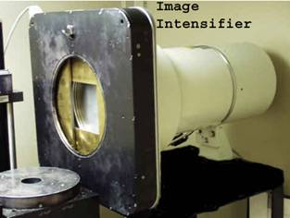
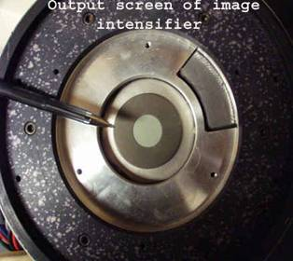
Real-Time Radiography (cont.)
The image intensifier is a device that converts the radiation that passes through the specimen into light.
It uses materials that fluoresce when struck by radiation.
The more radiation that reaches the input screen, the more light that is given off.
The image is very faint on the input screen so it is intensified onto a small screen inside the intensifier where the image is viewed with a camera.

Slide 83
Real-Time Radiography (cont.)
A special camera which captures the light output of the screen is located near the image intensifying screen.
The camera is very sensitive to a variety of different light intensities.
A monitor is then connected to the camera to provide a viewable image.
If a sample positioning system is employed, the part can be moved around and rotated to image different internal features of the part.

Slide 84
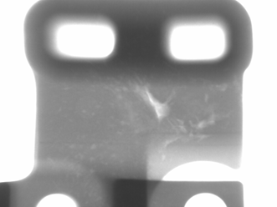
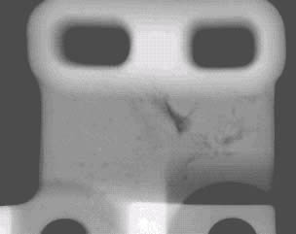
Real-Time Radiography (cont.)
Comparing Film and Real-Time Radiography
Real-time images are lighter in areas where more X-ray photons reach and excite the fluorescent screen.
Film images are darker in areas where more X-ray photons reach and ionize the silver molecules in the film.

Slide 85
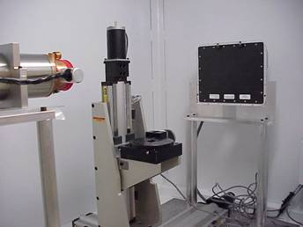
Direct Radiography
Direct radiography (DR) is a form of real-time radiography that uses a special flat panel detector.
The panel works by converting penetrating radiation passing through the test specimen into minute electrical charges.
The panel contains many micro-electronic capacitors. The capacitors form an electrical charge pattern image of the specimen.
Each capacitor’s charge is converted into a pixel which forms the digital image.

Slide 86
Computed Tomography
Computed Tomography (CT) uses a real-time inspection system employing a sample positioning system and special software.

Slide 87
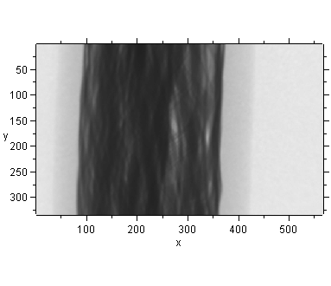
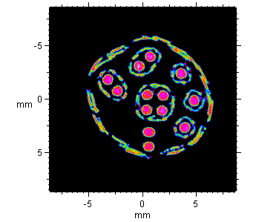
Computed Tomography (cont.)
Many separate images are saved (grabbed) and complied into 2-dimensional sections as the sample is rotated.
2-D images are them combined into 3-dimensional images.
Real-Time Captures
Compiled 2-D Images
Compiled 3-D Structure

Slide 88
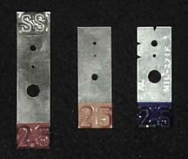
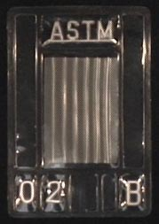
Image Quality
Image quality is critical for accurate assessment of a test specimen’s integrity.
Various tools called Image Quality Indicators (IQIs) are used for this purpose.
There are many different designs of IQIs. Some contain artificial holes of varying size drilled in metal plaques while others are manufactured from wires of differing diameters mounted next to one another.

Slide 89
Image Quality (cont.)
IQIs are typically placed on or next to a test specimen.
Quality typically being determined based on the smallest hole or wire diameter that is reproduced on the image.

Slide 90
Radiation Safety
Use of radiation sources in industrial radiography is heavily regulated by state and federal organizations due to potential public and personal risks.

Slide 91
Radiation Safety (cont.)
There are many sources of radiation. In general, a person receives roughly 100 mrem/year from natural sources and roughly 100 mrem/year from manmade sources.

Slide 92
Radiation Safety (cont.)
X-rays and gamma rays are forms of ionizing radiation, which means that they have the ability to form ions in the material that is penetrated. All living organisms are sensitive to the effects of ionizing radiation (radiation burns, x-ray food pasteurization, etc.)
X-rays and gamma rays have enough energy to liberate electrons from atoms and damage the molecular structure of cells.
This can cause radiation burns or cancer.

Slide 93
Radiation Safety (cont.)
Technicians who work with radiation must wear monitoring devices that keep track of their total absorption, and alert them when they are in a high radiation area.
Survey Meter
Pocket Dosimeter
Radiation Alarm
Radiation Badge

Slide 94
Radiation Safety (cont.)
There are three means of protection to help reduce exposure to radiation:

Slide 95
Radiographic Images

Slide 96
Radiographic Images
Can you determine what object was radiographed in this and the next three slides?

Slide 97
Radiographic Images

Slide 98
Radiographic Images

Slide 99
Radiographic Images

Slide 100
Advantages of Radiography
Technique is not limited by material type or density.
Can inspect assembled components.
Minimum surface preparation required.
Sensitive to changes in thickness, corrosion, voids, cracks, and material density changes.
Detects both surface and subsurface defects.
Provides a permanent record of the inspection.

Slide 101
Disadvantages of Radiography
Many safety precautions for the use of high intensity radiation.
Many hours of technician training prior to use.
Access to both sides of sample required.
Orientation of equipment and flaw can be critical.
Determining flaw depth is impossible without additional angled exposures.
Expensive initial equipment cost.

Slide 102
Glossary of Terms
Activation: the process of creating radioactive material from stable material usually by bombarding a stable material with a large number of free neutrons. This process typically takes place in a special nuclear reactor.
Anode: a positively charged electrode.
Automatic Film Processor: a machine designed to develop film with very little human intervention. Automatic processors are very fast compared to manual development.

Slide 103
Glossary of Terms
Capacitor: an electrical device that stores an electrical charge which can be released on demand.
Cathode: a negatively charged electrode.
Darkroom: a darkened room for the purpose of film development. Film is very sensitive to exposure by visible light and may be ruined.
Exposure: the process of radiation penetrating and object.
Gamma Rays: electromagnetic radiation emitted from the nucleus of a some radioactive materials.

Slide 104
Glossary of Terms
Phosphor: a chemical substance that emits light when excited by radiation.
Pixel: Short for Picture Element, a pixel is a single point in a graphic image. Graphics monitors display pictures by dividing the display screen into thousands (or millions) of pixels, arranged in rows and columns. The pixels are so close together that they appear connected.
Photo-multiplier tube: an amplifier used to convert light into electrical signals.

Slide 105
Glossary of Terms
Radioactive: to give off radiation spontaneously.
Radiograph: an image of the internal structure of and object produced using a source of radiation and a recording device.
Silver Bromide: silver and bromine compound used in film emulsion to form the image seen on a radiograph.

