Slide 1
Non-Destructive Testing
Monil Salot

Slide 2
Unit 2
Dye penetrant Methods, Basic Principles, Capillary Action, Wetting and Non-Wetting Characteristics, Different Types of Penetrants, Detailed Procedure and Recent Developments in DPT.
Magnetic Particle Testing methods, Basic Principles of MPT, magnetization methods demagnetization methods, MPT equipment & instruments, sensitivity calibration of MPT equipment.
Ultrasonic methods of NDT-Basic principles of wave propagation, types of waves, transducers and transducer materials, advantages and limitations of UT.

Slide 3
PENETRANT TESTING

Slide 4
Introduction
LIQUID PENETRANT INSPECTION is a nondestructive method of revealing discontinuities that are open to the surfaces of solid and essentially nonporous materials.
The advantage that a liquid penetrant inspection (LPI) offers over an unaided visual inspection is that it makes defects easier to see for the inspector.
Liquid penetrant seep into various types of minute surface openings by capillary action. Because of this, the process is well suited to the detection of all types of surface cracks, laps, porosity, shrinkage areas, laminations, and similar discontinuities.

Slide 5
Introduction
It is extensively used for the inspection of wrought and cast products of both ferrous and nonferrous metals, powder metallurgy parts, ceramics, plastics, and glass objects.
Also known as:
  Dye Penetrant Inspection(DPI)
  Penetrant Flaw Detection (PFD)
  Penetrant Testing (PT)

Slide 6
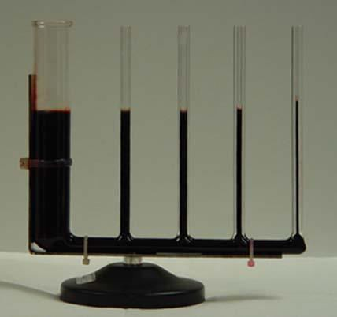
What Makes PT Work?
Every step of the penetrant process is done to promote capillary action.
This is the phenomenon of a liquid rising or climbing when confined to small openings due to surface wetting properties of the liquid.
Some examples:
  Plants and trees draw water up from the ground to their branches and leaves to supply their nourishment.
  The human body has miles of capillaries that carry life sustaining blood to our entire body.

Slide 7
Basic Processing Steps of a Liquid Penetrant Inspection
Surface Preparation
Penetration Application
Penetrant Dwell
Excess Penetrant Removal
Developer Application
Indication Development
Inspection
Clean Surface

Slide 8
1. Surface Preparation Or Pre-cleaning
Parts must be free of dirt, rust, scale, oil, grease, etc. to perform a reliable inspection.
The cleaning process must remove contaminants from the surfaces of the part and defects, and must not plug any of the defects.
Mechanical operations can smear metal over the flaw opening and prevent the penetrant from entering.
Physical Methods
Scale
Slag
Corrosion products
Chemical Methods Oils and Greases Paints

Slide 9
Chemical Methods
Vapour Degreasing
Hot Solvent Degreasing
Cold solvent Degreasing
Solvent materials with Emulsifiers
Acid / Alkaline Cleaning
Steam cleaning
Paint Removal

Slide 10
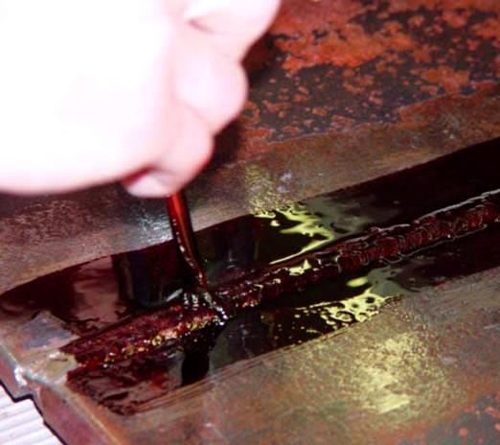
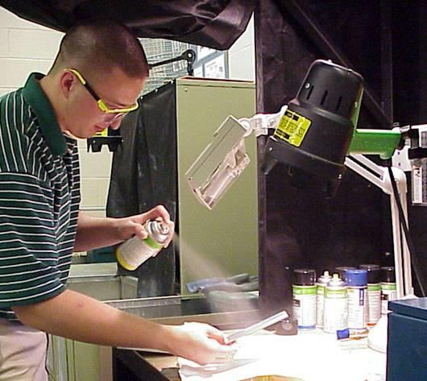
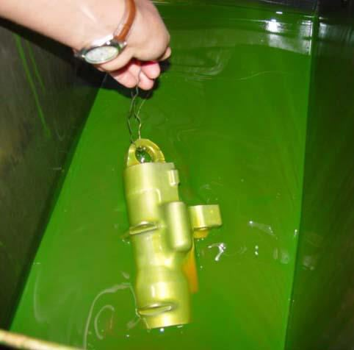
Step 2–Penetrant Application
Once the surface has been thoroughly cleaned and dried, the penetrant material is applied.
Many application such as:
methods of
are possible
Brushing
Spraying
Dipping/ Immersing
And more

Slide 11
Cont…
Liquid penetrant inspection depends mainly on a penetrant's effectively wetting the surface of a solid work-piece or specimen, flowing over that surface to form a continuous and reasonably uniform coating, and then migrating into cavities that are open to the surface.
The cavities of interest are usually exceedingly small, often invisible to the unaided eye.
The ability of a given liquid to flow over a surface and enter surface cavities depends principally on the following:

Slide 12
Cont…
Cleanliness of the surface
Configuration of the cavity
Cleanliness of the cavity
Size of surface opening of the cavity
Surface tension of the liquid
Ability of the liquid to wet the surface
Contact angle of the liquid

Slide 13
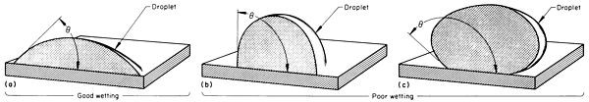
Wetting characteristics as evaluated by the angle, θ, between a
droplet of liquid and a solid surface.
Good wetting is obtained when θ< 90° (a);
poor wetting, when θ ≥ 90° (b) and (c).

Slide 14
Critical factors for Penetrant Application
Penetration / Dwell time
Component Temperature

Slide 15
Characteristics of Penetrant Materials
Penetrants are formulated to possess a number characteristics. To perform well, a penetrant must:
of important
Spread easily over the surface being inspected.
Be drawn into surface breaking defects by capillary action or other mechanisms.
Remain in the defect but remove easily from the surface of the part.
Remain fluid through the drying and developing steps so it can be drawn back to the surface.
Be highly visible or fluoresce brightly to produce easy to see indications.

Slide 16

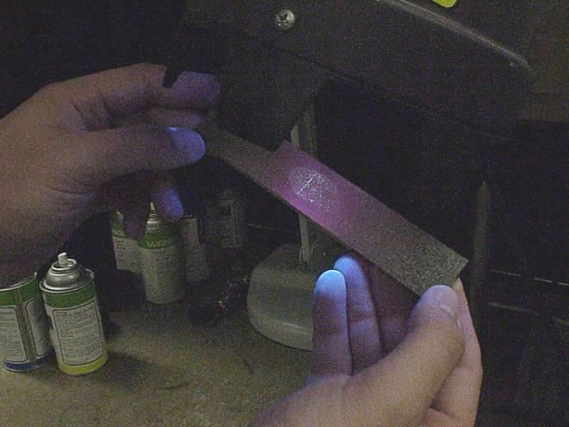
Visible And Fluorescent PT
Inspection can be performed using visible (or red dye) or fluorescent penetrant materials.
Visible Pt is performed under white light while fluorescent PT must be performed using an ultraviolet light in a darkened area. All are all in the level 1 sensitivity range.
Fluorescent PT is more sensitive than visible PT because the eye is more sensitive to a bright indication on a dark background. Sensitivity ranges from 1 to 4.
Photo Courtesy of Contesco

Slide 17
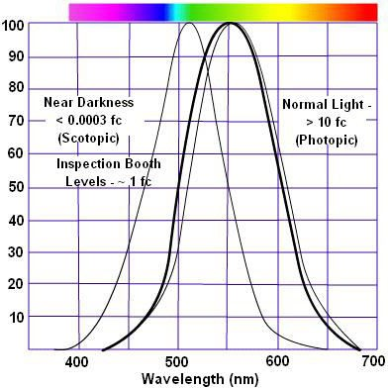
Why is Visible Penetrant Red and Fluorescent Penetrant Green?
Visible penetrant is usually red because red stands out and provides a high level of contrast against a light background
Fluorescent penetrant is green because the eye is most sensitive to the color green due to the number and arrangement of the cones (the color receptors) in the eye.

Slide 18
Sensitivity Levels
Penetrants are also formulated to produce a variety of sensitivity levels. The higher the sensitivity level, the smaller the defect that the penetrant system is capable of detecting.
The four sensitivity levels are:
  Level 4 - Ultra-High Sensitivity
  Level 3 - High Sensitivity
  Level 2 - Medium Sensitivity
  Level 1 - Low Sensitivity
As the sensitivity level increases, so does the number of non-relevent indications. Therefore, a penetrant needs to be selected that will find the defects of interest but not produce too many non-relevent indications.

Slide 19
3. Penetrant Dwell
The penetrant is left on the surface for a sufficient time to allow as much penetrant as possible to be drawn from or to seep into a defect.
Penetrant dwell time is the total time that the penetrant is in contact with the part surface.
Dwell times are usually recommended by the penetrant producers or required by the specification being followed.
The times vary depending on the application, penetrant materials used, the material, the form of the material being inspected, and the type of defect being inspected for.

Slide 20
Minimum dwell time typically range from five to 60 minutes.
Generally, there is no harm in using a longer penetrant dwell time as long as the penetrant is not allowed to dry.
The ideal dwell time is often determined by experimentation and may be very specific to a particular application.
The dwell time vary according to penetrant type, temperature, material type and surface finish.

Slide 21
4. Excess Penetrant Removal
Four basic methods are formed to accommodate the wide variations in the following principal factors:
  Surface condition of the work-piece being inspected
  Characteristics of the flaws to be detected
  Time and place of inspection
  Size of the work-piece
  Sensitivity required

Slide 22
Cont..
This is the most delicate part of the inspection procedure because the excess penetrant must be removed from the surface of the sample while removing as little penetrant as possible from defects.
Depending on the penetrant system used, this step may involve:
  cleaning with a solvent (Solvent Removable)
  direct rinsing with water (Water washable)
  or first treating the part with an emulsifier and then rinsing with water (Post Emulsifiable)

Slide 23
Cont..
Four Basic methods Used are:
Water washable, method A
Post-emulsifiable lipophilic, method B
Solvent removable, method C
Post-emulsifiable hydrophilic, method D

Slide 24
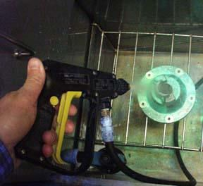
1. Water-washable penetrant (method A)
Minimise mechanical action
Spray wash
Pressure as low as possible
Temperature less than 50ºC

Slide 25
Water-washable penetrant (method A)
This method is designed so that the penetrant is directly water washable from the surface of the work-piece;
It does not require a separate emulsification step, as does the post-
emulsifiable penetrant methods.
It can be used to process work-pieces quickly and efficiently.
It is important, however, that the washing operation be carefully controlled because water-washable penetrants are susceptible to over-washing.
The essential operations involved in this method are illustrated schematically in Fig. 1

Slide 26
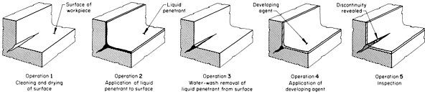
Five essential operations for liquid penetrant inspection using the water-washable system

Slide 27
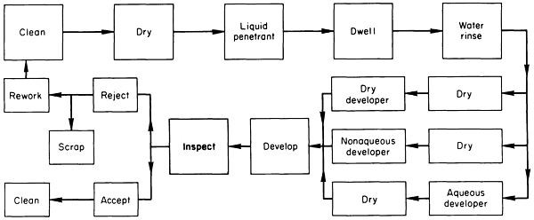
Processing flow diagram for the water-washable liquid penetrant system

Slide 28
Disadvantages
Advantages
Susceptible to washing
Usable on rough surfaces
Suitable for batch testing
Cheaper than other methods
over
Least sensitive method
Requirement for a water
source

Slide 29
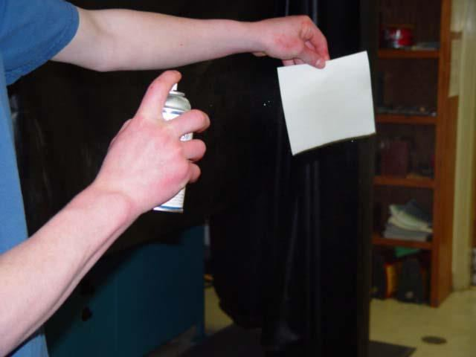
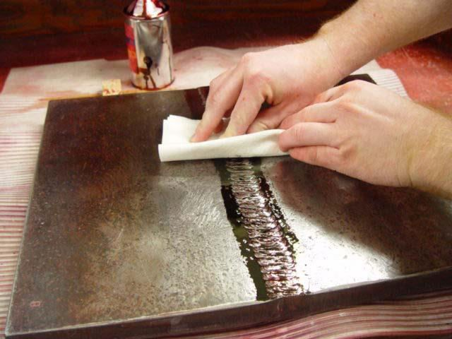
2. Solvent-removable penetrant (method C)
Clean off the excess with a lint
free cloth.
Wipe with a solvent dampened rag.
Though shall not spray the cleaner directly onto the item under test.

Slide 30
Solvent-removable penetrant (method C)
This method is available for use when it is necessary to inspect only a localized area of a work-piece or to inspect a work-piece at the site rather than on a production inspection basis.
Normally, the same type of solvent is used for pre-cleaning and for removing excess penetrant.
This penetrant process is convenient and broadens the range of applications of penetrant inspections.
However, because the solvent-removable method is labor intensive, it is not practical for many production applications.

Slide 31
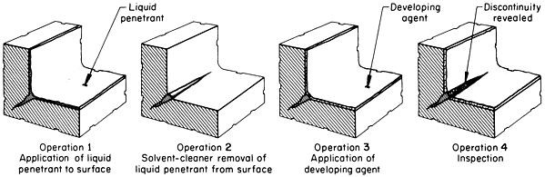
When properly conducted and when used in the appropriate applications, the solvent-removable method can be one of the most sensitive penetrant methods available.
The operations for this process are illustrated schematically in Fig.
Operations (in addition to pre-cleaning) for the solvent-removable
liquid penetrant system

Slide 32
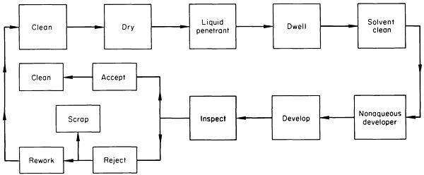
Processing flow diagram for the solvent-removable liquid penetrant system

Slide 33
Disadvantages
Advantages
Portability
No water supply needed
Not suited to batch testing
Requires hand wiping so time consuming
More expensive than water
washable
Potentially hazardous chemicals

Slide 34
3. Post-emulsifiable penetrant (methods B and D)
Emulsifiers
Emulsifiers are liquids used to render excess penetrant on the surface of a work-piece water washable.
There are two methods used in the post-emulsifiable method: method B, lipophilic, and method D, hydrophilic.
Both can act over a range of durations from a few seconds to several
minutes, depending on:
  the viscosity, concentration, method of application, and chemical composition of the emulsifier, as well as on the roughness of the workpiece surface

Slide 35
Method B, lipophilic emulsifiers
Method B, lipophilic emulsifiers are oil based, are used as supplied, and function by diffusion .
The emulsifier diffuses into the penetrant film and renders it spontaneously emulsifiable in water.
The rate at which it diffuses into the penetrant establishes the emulsification time.
The emulsifier is fast acting, thus making the emulsification operation very critical.
The emulsifier continues to act as long as it is in contact with the work-piece; therefore, the rinse operation should take place quickly to avoid over-emulsification.

Slide 36
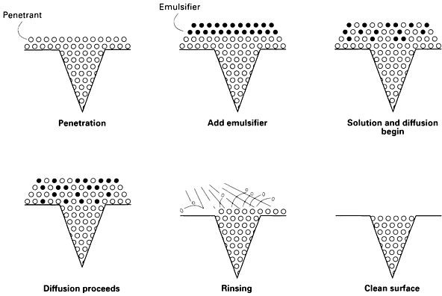
Elements in the functioning of lipophilic emulsifiers

Slide 37
Method D, hydrophilic emulsifiers
Method D, hydrophilic emulsifiers are water based and are usually supplied as concentrates that are diluted in water to concentrations of 5 to 30% for dip applications and 0.05 to 5% for spray applications.
Hydrophilic emulsifiers function by displacing excess penetrant
from the surface of the part by detergent action.
The force of the water spray or the air agitation of dip tanks provides a scrubbing action.
Hydrophilic emulsifier is slower acting than the lipophilic emulsifier; therefore, it is easier to control the cleaning action.
In addition to the emulsifier application, method D also requires a pre-rinse.

Slide 38
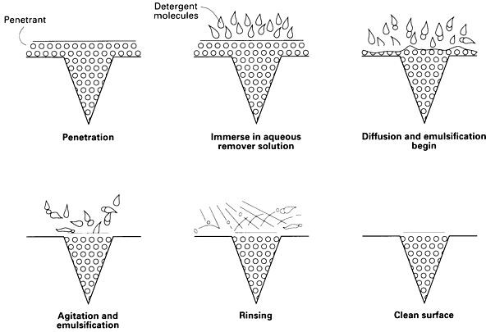
Elements in the functioning of hydrophilic emulsifiers

Slide 39
Utilizing a coarse water spray, the pre-rinse helps remove the excess penetrant to minimize contamination of the emulsifier.
Of greater significance, only a very thin and uniform layer of penetrant
will remain on the surface, thus allowing easy removal of the surface
layer with minimum opportunity of removing penetrant from the flaws.
This step is required because the penetrant is not miscible with the hydrophilic emulsifier.
The penetrant manufacturer should recommend nominal emulsification
times for the specific type of emulsifier in use.
The emulsification time must be carefully controlled so that the surface penetrant becomes water soluble but the penetrant in the flaws does not.

Slide 40
Post-emulsifiable penetrant (methods B and D)
Actual emulsification times should be determined experimentally for the particular application.
The manufacturer should also recommend the concentrations for hydrophilic emulsifiers.
The operations involved in the post-emulsifiable method are illustrated schematically in Fig. 2a for the lipophilic system and in Fig. 2b for the hydrophilic system.
Despite the additional processing steps involved with the post- emulsifiable methods B and D, these methods are the most reliable for detecting minute flaws.

Slide 41
Stages
Immerse component in penetrant
Immerse component in emulsifier
Emulsifier diffuses into the penetrant making it water washable
Water wash removes excess penetrant / emulsifier
Penetrant in defects left unaffected
Contact time critical
Determined by experimentation

Slide 42
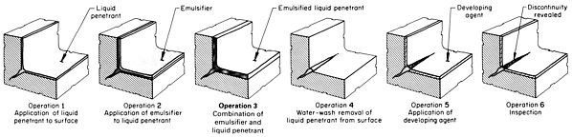
Fig. 2a Operations (in addition to precleaning) for the post- emulsifiable, method B, lipophilic liquid penetrant system

Slide 43
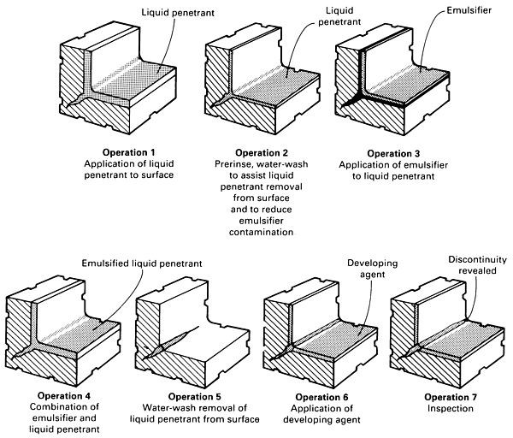
Fig. 2b Operations (in addition to pre-cleaning) for the postemulsifiable, method D, hydrophilic liquid penetrant system

Slide 44
Advantages
Disadvantages
Not suited surfaces
Maximum
ability
penetrating
to rough
Greater control over
penetrant removal
More expensive
More time consuming

Slide 45
5. Developer Application
A thin layer of developer is then applied to the sample to draw penetrant trapped in flaws back to the surface where it will be visible.
Developers come in a variety of forms that may be applied by
dusting (dry powdered), dipping, or spraying (wet developers).
Developing depends on the form of developer to be used.

Slide 46
Developer Properties
Absorptive
Fine texture
Able to mask out background colour
Evenly and easily applicable
Light and even coat
Non-fluorescing
Easily wetted
Contrasting colour
Easily removed
Non-toxic and Non-irritant

Slide 47
With Developer
No Developer

Slide 48

With Developer
No Developer

Slide 49
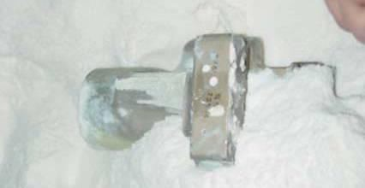
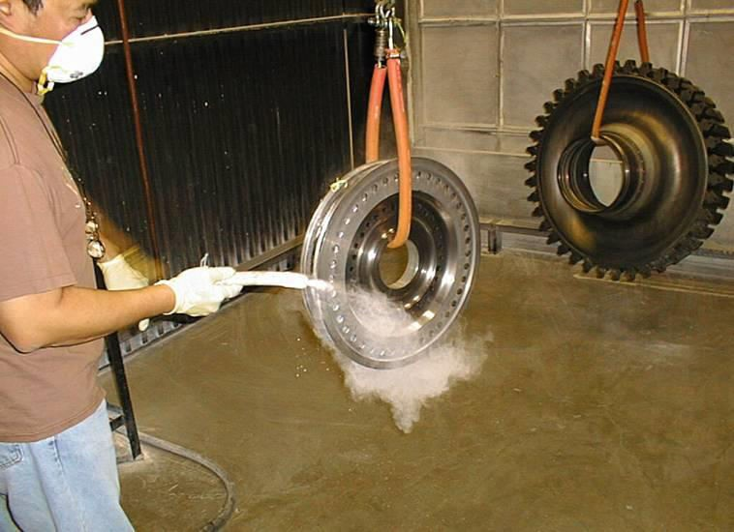
Developer Types
Dry Powder Developer
Prior to applying a dry powder developer, the component must be thoroughly dried. Drying is usually accomplished in a hot air circulating oven.
The developer is then applied by immersing the part in the powder or by dusting of the part with the powder.
The part can also be placed in a developer dust cloud chamber.

Slide 50
Dry-developer powder (form A) is applied after the work-piece has been dried and can be applied in a variety of ways.
For simple applications, especially when only a portion of the surface of a large part is being inspected, applying with a soft brush is often
adequate.
Excess developer can be removed from the work-piece by a gentle air blast (140 kPa, or 20 psi, maximum) or by shaking or gentle tapping.
Whichever means of application is chosen, it is important that the work-piece be completely and evenly covered by a fine film of developer.

Slide 51
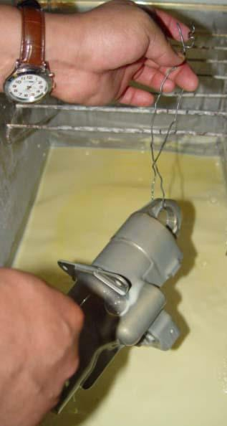
Cont…
Wet Developer (water- suspended and water- soluble)
Wet developers are applied by immersing or spraying the part while it is still wet from the penetrant removal process.
The part is completely coated and the excess liquid allowed to drain to prevent pooling
The part is then dried in a hot air circulating oven.

Slide 52
Aqueous Developer
Water-soluble developer (form B) is applied just after the final wash and immediately prior to drying by dip, flowon, or spray techniques.
No agitation of the developer bath is required.
Removal of the developer coating from the surface of the workpiece is required and easily accomplished because the dried developer coating is water soluble and therefore completely removable by a water rinse.

Slide 53
Aqueous Developer
Water-suspendible developer (form C) is applied just after the final wash and immediately before drying.
Dip, flow-on, and spray are common methods of application.
Care must be taken to agitate the developer thoroughly so that all particles are in suspension; otherwise, control of the concentration of the applied coating is impossible.
Removal of the water-suspendible developer can best be achieved by water spray rinsing.
If allowed to remain indefinitely on the workpiece, the developer can become difficult to remove.

Slide 54
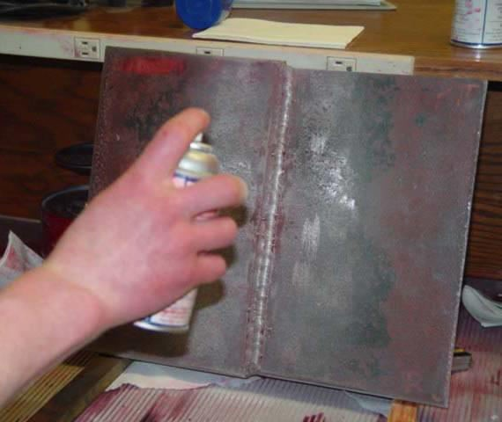
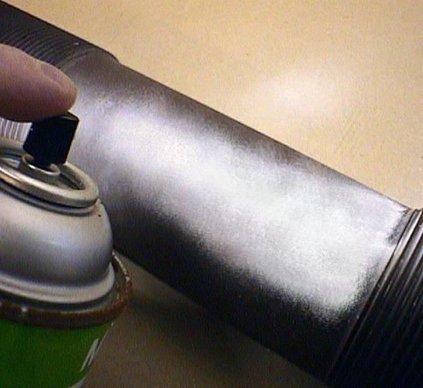
Cont..
Non-aqueous Suspended)
Non-aqueous
Developer
(Solvent-
aerosol spray to a thoroughly dried and cooled part.
A thin even coating should be applied. The coating should be white but still slightly transparent when performing a visible dye penetrant inspection, and even thinner when performing a fluorescent penetrant inspection.
developer is applied by a

Slide 55
Solvent-suspendible nonaqueous developer (form D) is always applied after drying by spraying, either with aerosol containers or by conventional or electrostatic methods.
Proper spraying produces a thin, uniform layer that is very sensitive in producing either fluorescent or red visible indications.
The volatility of the solvent makes it impractical to use in open
tanks.
Not only would there be solvent loss, reducing the effectiveness of the developer, but there would also be a hazardous vapor condition.
Dipping, pouring, and brushing are not suitable for applying
solvent-suspendible developer.

Slide 56
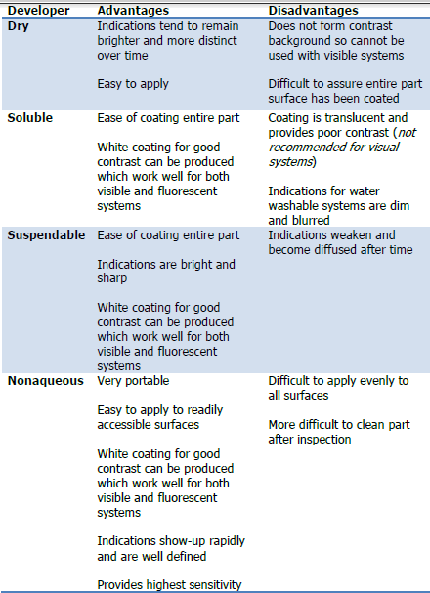

Slide 57
6. Indication Development
The developing time begins immediately after application of the
developer.
The developer is allowed to stand on the part surface for a period of time sufficient to permit the extraction of the trapped penetrant out of any surface flaws.
This development time is usually a minimum of 10 minutes.
Significantly longer times may be necessary for tight cracks.
Excessive developing time is seldom necessary and usually results in excessive bleeding of indications, which can obscure flaw delineation.

Slide 58
7. Inspection
Inspection is then performed under appropriate lighting to detect indications from
any flaws which may be present.
The inspection area should be
inspection.
properly darkened for fluorescent penetrant
Recommended black light intensity is 1000 to 1600 W/cm². The intensity of the
black light should be allowed to warm up prior to use--generally for about 10 min.
White light intensity should not exceed 20 lx (2 ftc) to ensure the best inspection
environment.
Visible-penetrant systems provide vivid red indications that can be seen in visible light. Lighting intensity should be adequate to ensure proper inspection; 320 to 540 lx (30 to 50 ftc) is recommended.

Slide 59
8. Post Clean Surface
The final step in the process is to thoroughly clean the part surface to remove the developer from the parts that were found to be acceptable.
After Test/ Inspection residues are required to be removed
because
  They may be harmful to the component
or
  They may impair subsequent processing

Slide 60
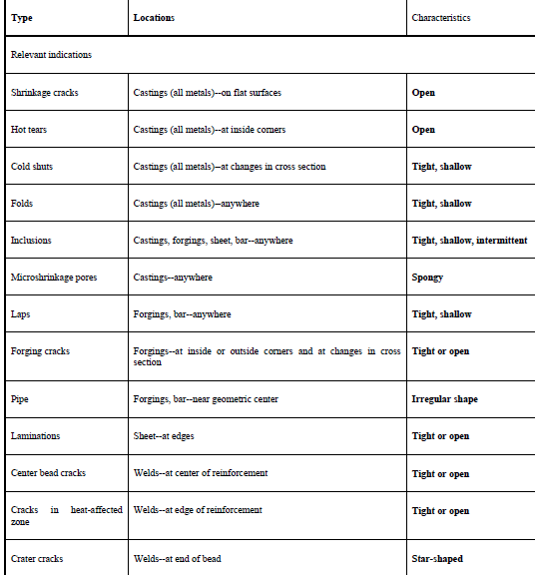
Common types, locations, and characteristics of flaws or discontinuities revealed by
liquid penetrant inspection

Slide 61
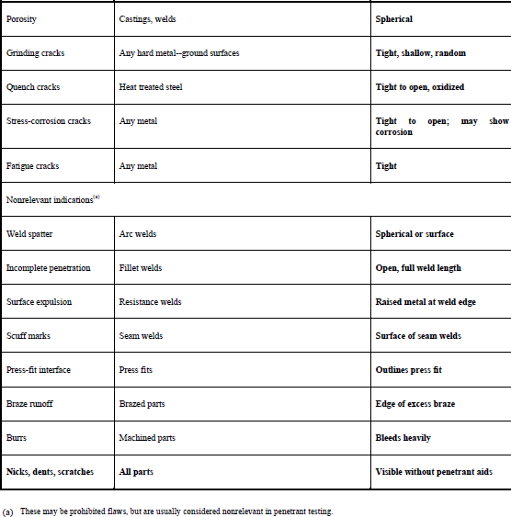

Slide 62
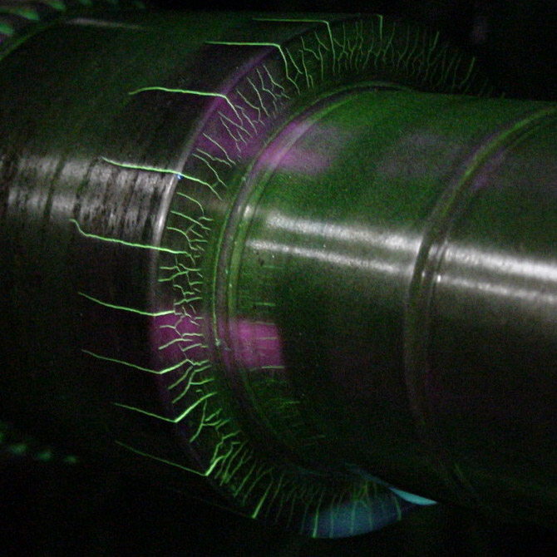
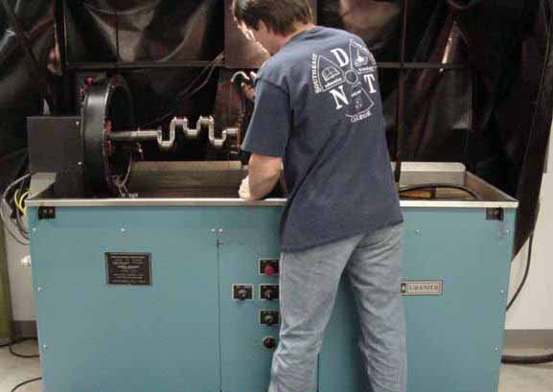
MAGNETIC PARTICLE TESTING

Slide 63
Introduction
This module is intended to present information on the widely used method of magnetic particle inspection.
Magnetic particle inspection can detect both production discontinuities (seams, laps, grinding cracks and quenching cracks) and in-service damage (fatigue and overload cracks).

Slide 64
Outline
Magnetism and Ferromagnetic Materials
Introduction of Magnetic Particle Inspection
Basic Procedure and Important Considerations
  Component pre-cleaning
  Introduction of magnetic field
  Application of magnetic media
  Interpretation of magnetic particle indications
Examples of MPI Indications

Slide 65
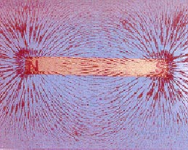
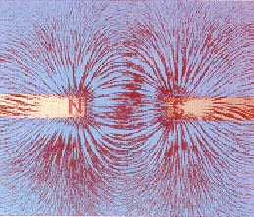
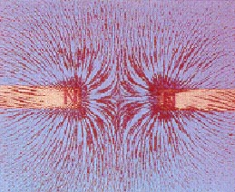
Introduction to Magnetism
Magnetism is the ability of matter to attract other matter to itself. Objects that possess the property of magnetism are said to be magnetic or magnetized and magnetic lines of force can be found in and around the objects. A magnetic pole is a point where the a magnetic line of force exits or enters a material.
Magnetic field lines:
Form complete loops.
Do not cross.
Follow the path of least resistance.
All have the same strength.
Have a direction such that they cause poles to attract or repel.
Magnetic lines of force around a bar magnet
Opposite poles attracting
Similar poles repelling

Slide 66
Ferromagnetic Materials
A material is considered ferromagnetic if it can be magnetized. Materials with a significant Iron, nickel or cobalt content are generally ferromagnetic.
Ferromagnetic materials are made up of many regions in which the magnetic fields of atoms are aligned. These regions are call magnetic domains.
Magnetic domains point randomly in demagnetized material, but can be aligned using electrical current or an external magnetic field to magnetize the material.
S
N
Demagnetized
Magnetized

Slide 67
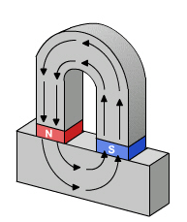
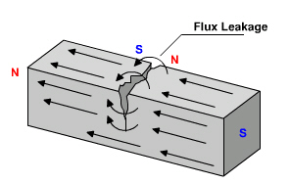
How Does Magnetic Particle
Inspection Work?
A ferromagnetic test specimen is magnetized with a strong magnetic field created by a magnet or special equipment. If the specimen has a discontinuity, the discontinuity will interrupt the magnetic field flowing through the specimen and a leakage field will occur.

Slide 68
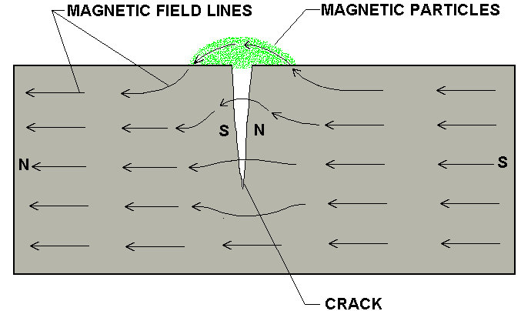
How Does Magnetic Particle
Inspection Work? (Cont.)
Finely milled iron particles coated with a dye pigment are applied to the test specimen. These particles are attracted to leakage fields and will cluster to form an indication directly over the discontinuity. This indication can be visually detected under proper lighting conditions.

Slide 69
Basic Procedure
Basic steps involved:
  Component pre-cleaning
  Introduction of magnetic field
  Application of magnetic media
  Interpretation of magnetic particle indications

Slide 70
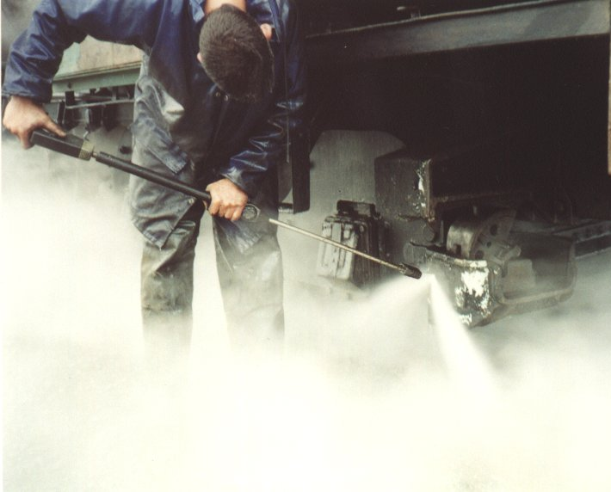
Pre-cleaning
When inspecting a test part with the magnetic particle method it is essential for the particles to have an unimpeded path for migration to both strong and weak leakage fields alike. The part’s surface should be clean and dry before inspection.
Contaminants such as oil,
grease, or scale may not
only prevent particles from
being attracted to leakage
fields, they may also
interfere with interpretation
of indications.

Slide 71
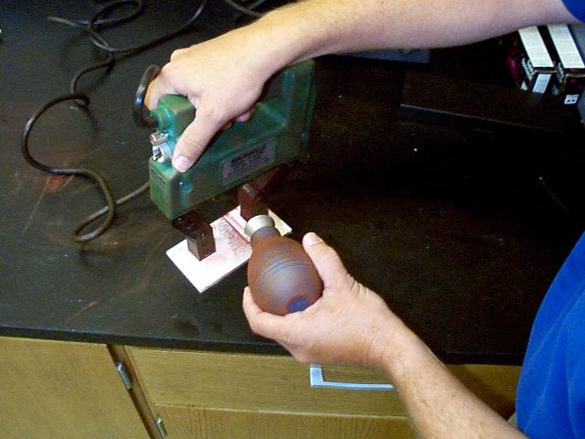
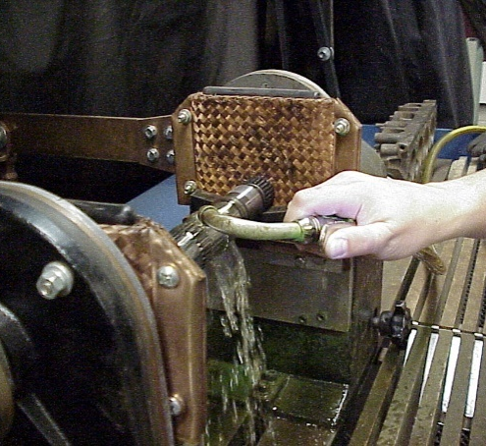
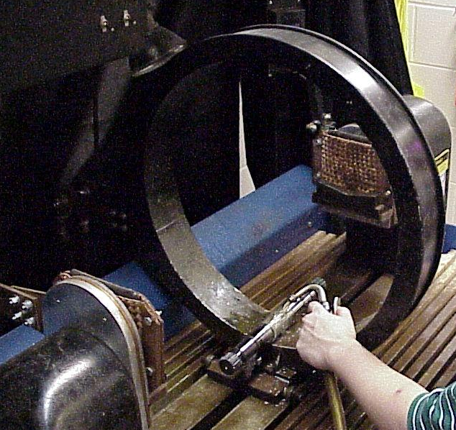
Introduction of the Magnetic Field
The required magnetic field can be introduced into a component in a number of different ways.
  Using a permanent magnet or an electromagnet that contacts the test piece
  Flowing an electrical current through the specimen
  Flowing an electrical current through a coil of wire around the part or through a central conductor running near the part.

Slide 72
Direction of the Magnetic Field
Two general types of magnetic fields (longitudinal and circular) may be established within the specimen. The type of magnetic field established is determined by the method used to magnetize the specimen.
A longitudinal magnetic field has magnetic lines of force that run parallel to the long axis of the part.
A circular magnetic field has magnetic lines of force that run circumferentially around the perimeter of a part.

Slide 73
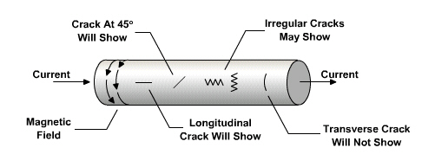
Importance of Magnetic Field Direction
Being able to magnetize the part in two directions is important because the best detection of defects occurs when the lines of magnetic force are established at right angles to the longest dimension of the defect. This orientation creates the largest disruption of the magnetic field within the part and the greatest flux leakage at the surface of the part. An orientation of 45 to 90 degrees between the magnetic field and the defect is necessary to form an indication.
Flux Leakage
No Flux Leakage
Since defects may occur in various and unknown directions, each part is normally magnetized in two directions at right angles to each other.

Slide 74
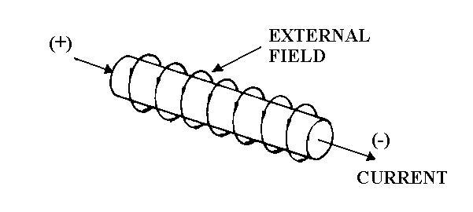
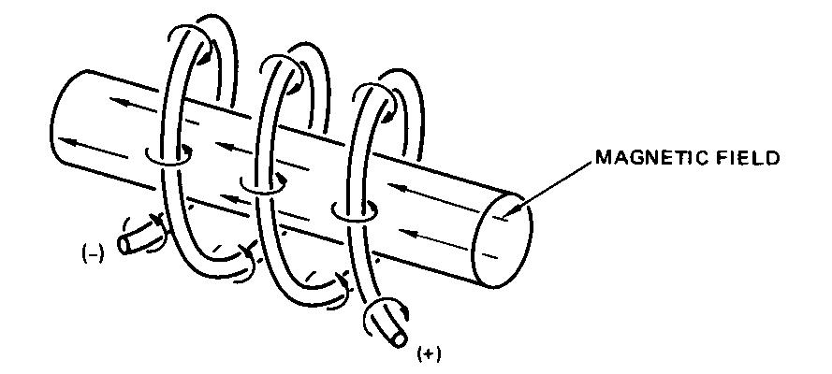
Question
? From the previous slide regarding the optimum test sensitivity, which kinds of defect are easily found in the images below?
Longitudinal (along the axis)
Transverse (perpendicular the axis)

Slide 75
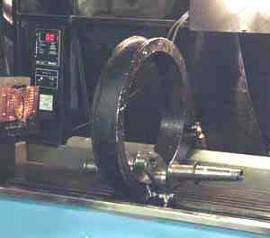
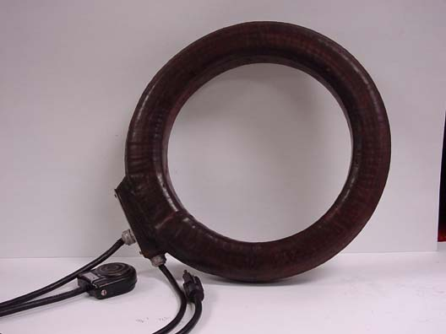
Producing a Longitudinal Magnetic Field Using a Coil
A longitudinal magnetic field is usually established by placing the part near the inside or a coil’s annulus. This produces magnetic lines of force that are parallel to the long axis of the test part.
Coil on Wet Horizontal Inspection Unit
Portable Coil

Slide 76
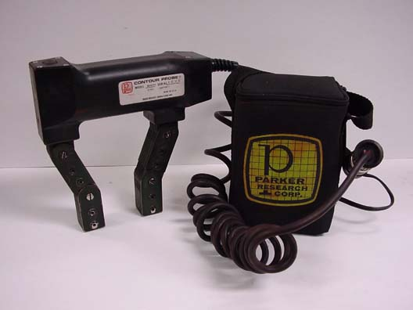
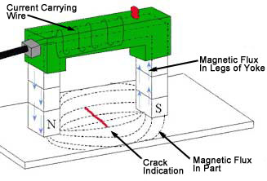
Producing a Longitudinal Field Using Permanent or Electromagnetic Magnets
Permanent magnets and electromagnetic yokes are also often used to produce a longitudinal magnetic field. The magnetic lines of force run from one pole to the other, and the poles are positioned such that any flaws present run normal to these lines of force.

Slide 77
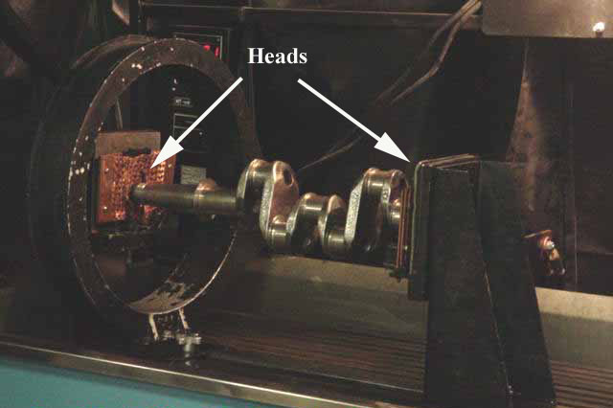
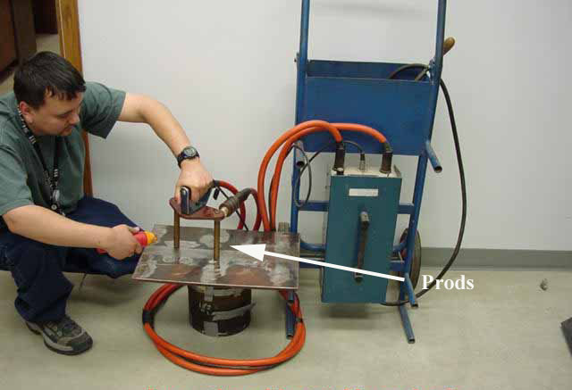
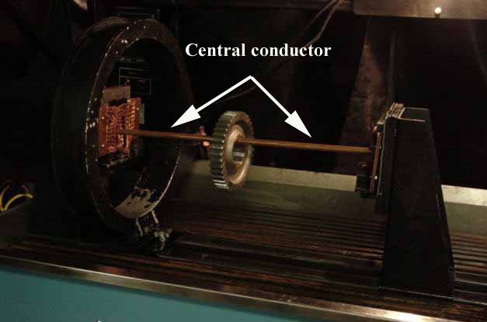
Circular Magnetic Fields
Magnetic Field
Electric
Current
Circular magnetic fields are produced by passing current through the part or by placing the part in a strong circular magnet field.
A headshot on a wet horizontal test unit and the use of prods are several common methods of injecting current in a part to produce a circular magnetic field. Placing parts on a central conductors carrying high current is another way to produce the field.

Slide 78
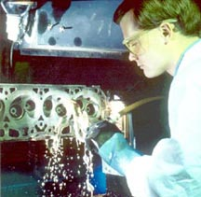
Application of Magnetic Media (Wet Versus Dry)
MPI can be performed using either dry particles, or particles suspended in a liquid. With the dry method, the particles are lightly dusted on to the surface. With the wet method, the part is flooded with a solution carrying the particles.
The dry method is more portable. The wet method is generally more sensitive since the liquid carrier gives the magnetic particles additional mobility.

Slide 79
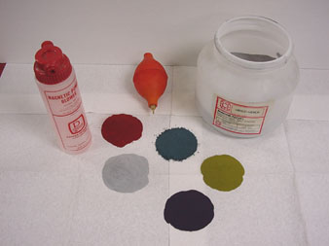
Dry Magnetic Particles
Magnetic particles come in a variety of colors. A color that produces a high level of contrast against the background should be used.

Slide 80




Wet Magnetic Particles
  Wet particles are typically supplied as visible or fluorescent. Visible particles are viewed under normal white light and fluorescent particles are viewed under black light.

Slide 81

Interpretation of Indications
After applying the magnetic field, indications that form must interpreted. This process requires that the inspector distinguish between relevant and non-relevant indications.
The following series of images depict relevant indications produced from a variety of components inspected with the magnetic particle method.

Slide 82


Crane Hook with
Service Induced Crack
Fluorescent, Wet Particle Method

Slide 83


Gear with
Service Induced Crack
Fluorescent, Wet Particle Method

Slide 84


Drive Shaft with
Heat Treatment Induced Cracks
Fluorescent, Wet Particle Method

Slide 85


Splined Shaft with
Service Induced Cracks
Fluorescent, Wet Particle Method

Slide 86


Threaded Shaft with
Service Induced Crack
Fluorescent, Wet Particle Method

Slide 87


Large Bolt with
Service Induced Crack
Fluorescent, Wet Particle Method

Slide 88


Crank Shaft with
Service Induced Crack Near Lube Hole
Fluorescent, Wet Particle Method

Slide 89

Lack of Fusion in SMAW Weld
Indication
Visible, Dry Powder Method

Slide 90

Toe Crack in SMAW Weld
Visible, Dry Powder Method

Slide 91

Throat and Toe Cracks in
Partially Ground Weld
Visible, Dry Powder Method

Slide 92
Demagnetization
Parts inspected by the magnetic particle method may sometimes have an objectionable residual magnetic field that may interfere with subsequent manufacturing operations or service of the component.
Possible reasons for demagnetization include:
  May interfere with welding and/or machining operations
  Can effect gauges that are sensitive to magnetic fields if placed in close proximity.
  Abrasive particles may adhere to components surface and cause and increase in wear to engines components, gears, bearings etc.

Slide 93
Demagnetization (Cont.)
Demagnetization requires that the residual magnetic field is reversed and reduced by the inspector.
This process will scramble the magnetic domains and reduce the strength of the residual field to an acceptable level.
Magnetized
Demagnetized

Slide 94
Advantages of
Magnetic Particle Inspection
Can detect both surface and near sub-surface defects.
Can inspect parts with irregular shapes easily.
Precleaning of components is not as critical as it is for some other inspection methods. Most contaminants within a flaw will not hinder flaw detectability.
Fast method of inspection and indications are visible directly on the specimen surface.
Considered low cost compared to many other NDT methods.
Is a very portable inspection method especially when used with battery powered equipment.

Slide 95
Limitations of
Magnetic Particle Inspection
Cannot inspect non-ferrous materials such as aluminum, magnesium or most stainless steels.
Inspection of large parts may require use of equipment with special power requirements.
Some parts may require removal of coating or plating to achieve desired inspection sensitivity.
Limited subsurface discontinuity detection capabilities. Maximum depth sensitivity is approximately 0.6” (under ideal conditions).
Post cleaning, and post demagnetization is often necessary.
Alignment between magnetic flux and defect is important

Slide 96
Glossary of Terms
Black Light: ultraviolet light which is filtered to produce a wavelength of approximately 365 nanometers. Black light will cause certain materials to fluoresce.
Central conductor: an electrically conductive bar usually made of copper used to introduce a circular magnetic field in to a test specimen.
Coil: an electrical conductor such a copper wire or cable that is wrapped in several or many loops that are brought close to one another to form a strong longitudinal magnetic field.

Slide 97
Glossary of Terms
Discontinuity: an interruption in the structure of the material such as a crack.
Ferromagnetic: a material such as iron, nickel and cobalt or one of it’s alloys that is strongly attracted to a magnetic field.
Heads: electrical contact pads on a wet horizontal magnetic particle inspection machine. The part to be inspected is clamped and held in place between the heads and shot of current is sent through the part from the heads to create a circular magnetic field in the part.
Leakage field: a disruption in the magnetic field. This disruption must extend to the surface of the part for particles to be attracted.

Slide 98
Glossary of Terms
Non-relevant indications: indications produced due to some intended design feature of a specimen such a keyways, splines or press fits.
Prods: two electrodes usually made of copper or aluminum that are used to introduce current in to a test part. This current in turn creates a circular magnetic field where each prod touches the part. (Similar in principal to a welding electrode and ground clamp).
Relevant indications: indications produced from something other than a design feature of a test specimen. Cracks, stringers, or laps are examples of relevant indications.

Slide 99
Glossary of Terms
Suspension: a bath created by mixing particles with either oil or water.
Yoke: a horseshoe magnet used to create a longitudinal magnetic field. Yokes may be made from permanent magnets or electromagnets.

Slide 100



Ultrasonic Testing

Slide 101
Introduction
This module presents an introduction to the NDT method of ultrasonic testing.
Ultrasonic testing uses high frequency sound energy to conduct examinations and make measurements.
Ultrasonic examinations can be conducted on a wide variety of material forms including castings, forgings, welds, and composites.
A considerable amount of information about the part being examined can be collected, such as the presence of discontinuities, part or coating thickness; and acoustical properties can often be correlated to certain properties of the material.

Slide 102
Outline
Applications
Basic Principles of sound generation
Pulse echo and through transmission testing
Inspection applications
Equipment
  Transducers
  Instrumentation
  Reference Standards
Data presentation
Advantages and Limitations
Glossary of terms

Slide 103

Basic Principles of Sound
Sound is produced by a vibrating body and travels in the form of a wave.
Sound waves travel through materials by vibrating the particles that make up the material.
The pitch of the sound
is determined by the
frequency of the wave
(vibrations or cycles
completed in a certain
period of time).
Ultrasound is sound
with a pitch too high
to be detected by the
human ear.

Slide 104

Basic Principles of Sound (cont.)
The measurement of sound waves from crest to crest determines its wavelength (λ).
The time is takes a sound wave to travel a distance of one complete wavelength is the same amount of time it takes the source to execute one complete vibration.
The sound wavelength
is inversely proportional
to its frequency. (λ = 1/f)
Several wave modes of
vibration are used in
ultrasonic inspection.
The most common are
longitudinal, shear, and
Rayleigh (surface) waves.

Slide 105


Basic Principles of Sound (cont.)
Ultrasonic waves are very similar to light waves in that they can be reflected, refracted, and focused.
Reflection and refraction occurs when sound waves interact with interfaces of differing acoustic properties.
In solid materials, the vibrational energy can be split into different wave modes when the wave encounters an interface at an angle other than 90 degrees.
Ultrasonic reflections from the presence of discontinuities or geometric features enables detection and location.
The velocity of sound in a given material is constant and can only be altered by a change in the mode of energy.

Slide 106


Ultrasound Generation
Ultrasound is generated with a transducer.
A piezoelectric element in the transducer converts electrical energy into mechanical vibrations (sound), and vice versa.
The transducer is capable of both transmitting and receiving sound energy.

Slide 107
Principles of Ultrasonic Inspection
Ultrasonic waves are introduced into a material where they travel in a straight line and at a constant speed until they encounter a surface.
At surface interfaces some of the wave energy is reflected and some is transmitted.
The amount of reflected or transmitted energy can be detected and provides information about the size of the reflector.
The travel time of the sound can be measured and this provides information on the distance that the sound has traveled.

Slide 108
Test Techniques
Ultrasonic testing is a very versatile inspection method, and inspections can be accomplished in a number of different ways.
Ultrasonic inspection techniques are commonly divided into three primary classifications.
  Pulse-echo and Through Transmission
  (Relates to whether reflected or transmitted energy is used)
  Normal Beam and Angle Beam
  (Relates to the angle that the sound energy enters the test article)
  Contact and Immersion
  (Relates to the method of coupling the transducer to the test article)
Each of these techniques will be discussed briefly in the following slides.

Slide 109

Test Techniques - Pulse-Echo
In pulse-echo testing, a transducer sends out a pulse of energy and the same or a second transducer listens for reflected energy (an echo).
Reflections occur due to the presence of discontinuities and the surfaces of the test article.
The amount of reflected sound energy is displayed versus time, which provides the inspector information about the size and the location of features that reflect the sound.
f
initial
pulse
back surface
echo
crack
echo
crack
plate
0
2
4
6
8
10
UT Instrument Screen

Slide 110




Test Techniques – Pulse-Echo (cont.)
Digital display showing signal generated from sound reflecting off back surface.
Digital display showing the presence of a reflector midway through material, with lower amplitude back surface reflector.
The pulse-echo technique allows testing when access to only one side of the material is possible, and it allows the location of reflectors to be precisely determined.

Slide 111
Test Techniques – Through-Transmission
Two transducers located on opposing sides of the test specimen are used. One transducer acts as a transmitter, the other as a receiver.
Discontinuities in the sound path will result in a partial or total loss of sound being transmitted and be indicated by a decrease in the received signal amplitude.
Through transmission is useful in detecting discontinuities that are not good reflectors, and when signal strength is weak. It does not provide depth information.
1
1
T
R
T
R
2
1
1
2
0
2
4
6
8
10

Slide 112




Test Techniques – Through-Transmission
Digital display showing received sound through material thickness.
Digital display showing loss of received signal due to presence of a discontinuity in the sound field.

Slide 113


Test Techniques – Normal and Angle Beam
In normal beam testing, the sound beam is introduced into the test article at 90 degree to the surface.
In angle beam testing, the sound beam is introduced into the test article at some angle other than 90.
The choice between normal and angle beam inspection usually depends on two considerations:
  The orientation of the feature of interest – the sound should be directed to produce the largest reflection from the feature.
  Obstructions on the surface of the part that must be worked around.

Slide 114
Test Techniques – Contact Vs Immersion
To get useful levels of sound energy into a material, the air between the transducer and the test article must be removed. This is referred to as coupling.
In contact testing (shown on the previous slides) a couplant such as water, oil or a gel is applied between the transducer and the part.
In immersion testing, the part and the transducer are place in a water bath. This arrangement allows better movement of the transducer while maintaining consistent coupling.
With immersion testing, an echo from the front surface of the part is seen in the signal but otherwise signal interpretation is the same for the two techniques.
1
2
IP
1
2
IP = Initial Pulse
FWE = Front Wall Echo
DE = Defect Echo
BWE = Back Wall Echo
FWE
IP
FWE
BWE
BWE
DE
Defect
0
2
4
6
8
10
0
2
4
6
8
10

Slide 115
Inspection Applications
Some of the applications for which ultrasonic testing may be employed include:
Flaw detection (cracks, inclusions, porosity, etc.)
Erosion & corrosion thickness gauging
Assessment of bond integrity in adhesively joined and brazed components
Estimation of void content in composites and plastics
Measurement of case hardening depth in steels
Estimation of grain size in metals
On the following slides are examples of some common applications of ultrasonic inspection.

Slide 116


Thickness Gauging
Ultrasonic thickness gauging is routinely utilized in the petrochemical and utility industries to determine various degrees of corrosion/erosion.
Applications include piping systems, storage and containment facilities, and pressure vessels.

Slide 117



Flaw Detection - Delaminations
Contact, pulse-echo inspection for delaminations on 36” rolled beam.
Signal showing multiple back surface echoes in an unflawed area.
Additional echoes indicate delaminations in the member.

Slide 118



Flaw Detection in Welds
One of the most widely used methods of inspecting weldments is ultrasonic inspection.
Full penetration groove welds lend themselves readily to angle beam shear wave examination.

Slide 119
Equipment
Equipment for ultrasonic testing is very diversified. Proper selection is important to insure accurate inspection data as desired for specific applications.
In general, there are three basic components that comprise an ultrasonic test system:
- Instrumentation
- Transducers
- Calibration Standards

Slide 120

Transducers
Transducers are manufactured in a variety of forms, shapes and sizes for varying applications.
Transducers are categorized in a number of ways which include:
  - Contact or immersion
  - Single or dual element
  - Normal or angle beam
In selecting a transducer
for a given application, it
is important to choose the
desired frequency,
bandwidth, size, and in some cases focusing
which optimizes the inspection capabilities.

Slide 121

Contact Transducers
Contact transducers are designed to withstand rigorous use, and usually have a wear plate on the bottom surface to protect the piezoelectric element from contact with the surface of the test article.
Many incorporate ergonomic designs for ease of grip while scanning along the surface.

Slide 122


Contact Transducers (cont.)
Contact transducers are available with two piezoelectric crystals in one housing. These transducers are called dual element transducers.
One crystal acts as a transmitter, the other as a receiver.
This arrangement improves near surface resolution because the second transducer does not need to complete a transmit function before listening for echoes.
Dual elements are commonly employed in thickness gauging of thin materials.

Slide 123


Contact Transducers (cont.)
A way to improve near surface resolution with a single element transducer is through the use of a delay line.
Delay line transducers have a plastic piece that is a sound path that provides a time delay between the sound generation and reception of reflected energy.
Interchangeable pieces make it possible to configure the transducer with insulating wear caps or flexible membranes that conform to rough surfaces.
Common applications include thickness gauging and high temperature measurements.

Slide 124

Transducers (cont.)
Angle beam transducers incorporate wedges to introduce a refracted shear wave into a material.
The incident wedge angle is used with the material velocity to determine the desired refracted shear wave according to Snell’s Law)
Transducers can use fixed or variable wedge angles.
Common application is in weld examination.

Slide 125


Transducers (cont.)
Immersion transducers are designed to transmit sound whereby the transducer and test specimen are immersed in a liquid coupling medium (usually water).
Immersion transducers
are manufactured with
planar, cylindrical or spherical acoustic
lenses (focusing lens).

Slide 126
Instrumentation
Ultrasonic equipment is usually purchased to satisfy specific inspection needs, some users may purchase general purpose equipment to fulfill a number of inspection applications.
Test equipment can be classified in a number of different ways, this may include portable or stationary, contact or immersion, manual or automated.
Further classification of instruments commonly divides them into four general categories: D-meters, Flaw detectors, Industrial and special application.

Slide 127


Instrumentation (cont.)
D-meters or digital thickness gauge instruments provide the user with a digital (numeric) readout.
They are designed primarily for corrosion/erosion inspection applications.
Some instruments provide the user with both a digital readout and a display of the signal. A distinct advantage of these units is that they allow the user to evaluate the signal to ensure that the digital measurements are of the desired features.

Slide 128


Instrumentation (cont.)
Flaw detectors are instruments designed primarily for the inspection of components for defects.
However, the signal can be evaluated to obtain other information such as material thickness values.
Both analog and digital display.
Offer the user options of gating horizontal sweep and amplitude threshold.

Slide 129


Instrumentation (cont.)
Industrial flaw detection instruments, provide users with more options than standard flaw detectors.
May be modulated units allowing users to tailor the instrument for their specific needs.
Generally not as portable as standard flaw detectors.

Slide 130


Instrumentation (cont.)
Immersion ultrasonic scanning systems are used for automated data acquisition and imaging.
They integrate an immersion tank, ultrasonic instrumentation, a scanning bridge, and computer controls.
The signal strength and/or the time-of-flight of the signal is measured for every point in the scan plan.
The value of the data is plotted using colors or shades of gray to produce detailed images of the surface or internal features of a component.

Slide 131


Images of a Quarter Produced With an Ultrasonic Immersion Scanning System
Gray scale image produced using the sound reflected from the front surface of the coin
Gray scale image produced using the sound reflected from the back surface of the coin (inspected from “heads” side)

Slide 132
Calibration Standards
Calibration is a operation of configuring the ultrasonic test equipment to known values. This provides the inspector with a means of comparing test signals to known measurements.
Calibration standards come in a wide variety of material types, and configurations due to the diversity of inspection applications.
Calibration standards are typically manufactured from materials of the same acoustic properties as those of the test articles.
The following slides provide examples of specific types of standards.

Slide 133



Calibration Standards (cont.)
Thickness calibration standards may be flat or curved for pipe and tubing applications, consisting of simple variations in material thickness.
ASTM Distance/Area Amplitude
Distance/Area Amplitude standards utilize flat bottom holes or side drilled holes to establish known reflector size with changes in sound path form the entry surface.
NAVSHIPS

Slide 134



Calibration Standards (cont.)
There are also calibration standards for use in angle beam inspections when flaws are not parallel to entry surface.
These standards utilized side drilled holes, notches, and geometric configuration to establish time distance and amplitude relationships.
IIW
DSC DC Rhompas
SC
ASME Pipe Sec. XI

Slide 135


Qualification Standards
Qualification standards differ from calibration standards in that their use is for purposes of varying proper equipment operation and qualification of equipment use for specific codes and standards.
DC-dB Accuracy
AWS Resolution
IOW Beam Profile

Slide 136
Data Presentation
Information from ultrasonic testing can be presented in a number of differing formats.
Three of the more common formats include:
  A-scan
  B-scan
  C-scan
These three formats will be discussed in the next few slides.

Slide 137


Data Presentation - A-scan
A-scan presentation displays the amount of received ultrasonic energy as a function of time.
Relative discontinuity size can be estimated by comparing the signal amplitude to that from a known reflector.
Reflector depth can be determined by the position of the signal on the horizontal sweep.
Signal Amplitude
Time
Signal Amplitude
Time

Slide 138


Data Presentation - B-scan
B-scan presentations display a profile view (cross-sectional) of a test specimen.
Only the reflector depth in the cross-section and the linear dimensions can be determined.
A limitation to this display technique is that reflectors may be masked by larger reflectors near the surface.

Slide 139



Data Presentation - C-scan
The C-scan presentation displays a plan type view of the test specimen and discontinuities.
C-scan presentations are produced with an automated data acquisition system, such as in immersion scanning.
Use of A-scan in conjunction with C-scan is necessary when depth determination is desired.
Photo of a Composite Component
C-Scan Image of Internal Features

Slide 140
Advantage of Ultrasonic Testing
Sensitive to small discontinuities both surface and subsurface.
Depth of penetration for flaw detection or measurement is superior to other methods.
Only single-sided access is needed when pulse-echo technique is used.
High accuracy in determining reflector position and estimating size and shape.
Minimal part preparation required.
Electronic equipment provides instantaneous results.
Detailed images can be produced with automated systems.
Has other uses such as thickness measurements, in addition to flaw detection.

Slide 141
Limitations of Ultrasonic Testing
Surface must be accessible to transmit ultrasound.
Skill and training is more extensive than with some other methods.
Normally requires a coupling medium to promote transfer of sound energy into test specimen.
Materials that are rough, irregular in shape, very small, exceptionally thin or not homogeneous are difficult to inspect.
Cast iron and other coarse grained materials are difficult to inspect due to low sound transmission and high signal noise.
Linear defects oriented parallel to the sound beam may go undetected.
Reference standards are required for both equipment calibration, and characterization of flaws.

Slide 142
Glossary of Terms
Acoustical properties: ultrasonic material characteristics such as velocity, impedance, and attenuation.
ASTM: acronym for American Society for Testing and Materials. This society is extensively involved in establishing standards for materials and the testing of materials.
Back reflection: a display signal that corresponds to the far surface of a test specimen, side opposite to transducer when testing with longitudinal waves.
Band width: a range of frequencies either transmitted or received, may be narrow or broad range.
B-scan: presentation technique displaying data in a cross-sectional view.

Slide 143
Glossary of Terms
Calibration: a sequence of instrument control adjustments/instrument responses using known values to verify instrument operating characteristics. Allows determination of unknown quantities from test materials.
CRT: acronym for Cathode Ray Tube. Vacuum tube that utilizes one or more electron guns for generating an image.
C-scan: presentation technique that displays specimen data in a plan type view.
DAC (Distance Amplitude Correction-curves): a graphical method of allowing for material attenuation. Percentage of DAC is often used as a means of acceptance criteria.
Discontinuity: an interruption in the physical structure of a material, examples include fissures, cracks, and porosity.

Slide 144
Glossary of Terms
IIW: calibration standard meeting the specification of the International Institute of Welding.
Longitudinal (Compression) waves: ultrasonic mode of propagation in which the particle vibration is parallel to the direction of propagation.
Near Surface Resolution: the ability of an ultrasonic system to display reflectors located close to the entry surface.
Pulse-echo: ultrasonic test method that utilizes reflected sound as a means of collecting test data.
Rayleigh (Surface) waves: ultrasonic mode of propagation where the sound travels along the surface, particle vibration is elliptical.

Slide 145
Glossary of Terms
Reflection: the changing in direction of sound waves as they strike a surface.
Snell’s Law: an equation of ratios used to determine incident or refracted angle of sound, denotes angle/velocity relationship.
Sweep display: horizontal line on the lower portion of the display, often called the time base line.
Through transmission: test technique in which ultrasound is transmitted from one transducer and received by a separate transducer on the opposite side of the test specimen.
Wavelength: the distance that a sound wave travels as it completes one cycle, normally measured in inches or millimeters.

