Slide 1
Non-Destructive Testing
Monil Salot

Slide 2
Unit 1
Fundamentals and introduction to non-destructive testing. Scope and limitations of NDT
Visual examination methods. Different visual examination aids.
Leak and pressure testing of industrial components. Various methods of pressure and leak testing underlying principles of these testing systems.

Slide 3
Material Testing
Prior to manufacturing, many materials, design, and production decisions are made to ensure product reliability and proper performance.
Quality is related to the presence of those defects and imperfections in the finished product which impair the performance level.
A variety of testing methods
  Mechanical Testing
  Non-Destructive Testing (NDT)

Slide 4
Inspection Planning consists of Five Essentials
What to inspect: To determine important characteristics to achieve desired quality.
How to inspect: Right equipment, clear definition and trained inspectors.
When to inspect: Inspection stages shall be such as to make least use for best results.
Where to inspect: The areas to be covered by inspection such as incoming material, manufacture and final product.
How much to inspect: Minimum inspection should be done consistent with the requirement.

Slide 5
Advantages of NDT over MT/DT
Tests are made directly on the object.
Various NDT methods can be applied on the same part and hence many or all properties of interest can be measured.
In-service testing is possible.
Repeated checks over a period of time is possible.
Very little specimen preparation is sufficient.
Time requirements are generally less.

Slide 6
Limitations of NDT
Measurements are indirect and hence reliability is to be verified.
Skilled judgment and experience are required to interpret indications.
Equipments are sometimes’ more costly and complicated.

Slide 7
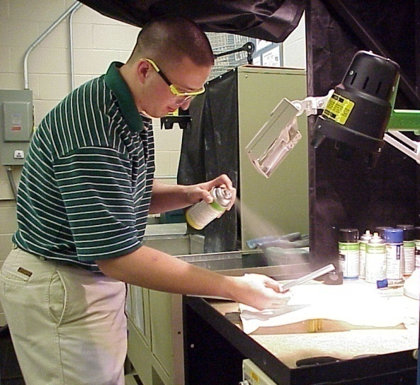
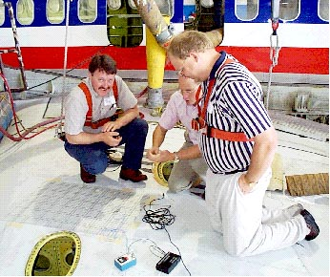
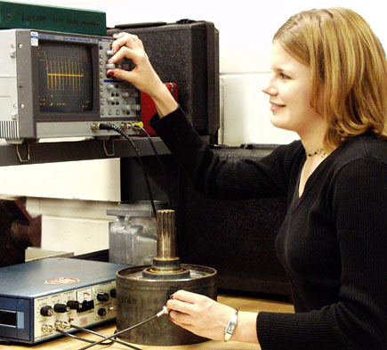
Non-Destructive Testing
Notes:
This presentation was developed by the Collaboration for NDT Education to provide students and other audiences with a general introduction to nondestructive testing. The material by itself is not intended to train individuals to perform NDT functions, but rather to acquaint individuals with some of the common NDT methods and their uses. All rights are reserved by the authors but the material may be freely used by individuals and organizations for educational purposes. The materials may not be sold commercially, or used in commercial products or services.
Comments are welcome at NDT-ed@cnde.iastate.edu.

Slide 8
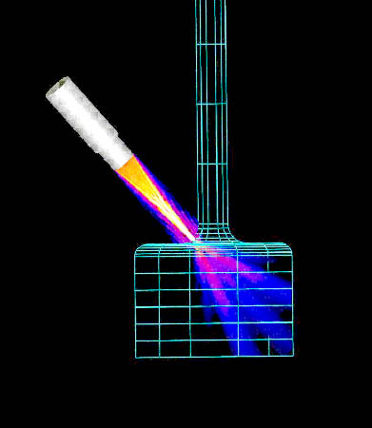
Definition of NDT
The use of noninvasive
techniques to determine
the integrity of a material,
component or structure
or
quantitatively measure
some characteristic of
an object.
i.e. Inspect or measure without doing harm.

Slide 9
Methods of NDT
Visual
Thermography
Microwave
Magnetic Particle
Flux Leakage
X-ray
Acoustic Microscopy
Acoustic Emission
Magnetic Measurements
Liquid Penetrant
Ultrasonic
Replication
Eddy Current

Slide 10
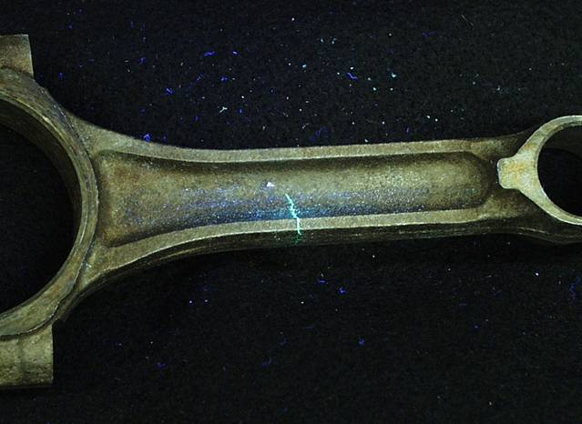
What are Some Uses of NDE Methods?
Flaw Detection and Evaluation
Leak Detection
Location Determination
Dimensional Measurements
Structure and Microstructure Characterization
Estimation of Mechanical and Physical Properties
Stress (Strain) and Dynamic Response Measurements
Material Sorting and Chemical Composition Determination
Fluorescent penetrant indication

Slide 11
When are NDE Methods Used?
There are NDE application at almost any stage
in the production or life cycle of a component.
  To assist in product development
  To screen or sort incoming materials
  To monitor, improve or control manufacturing processes
  To verify proper processing such as heat treating
  To verify proper assembly
  To inspect for in-service damage

Slide 12
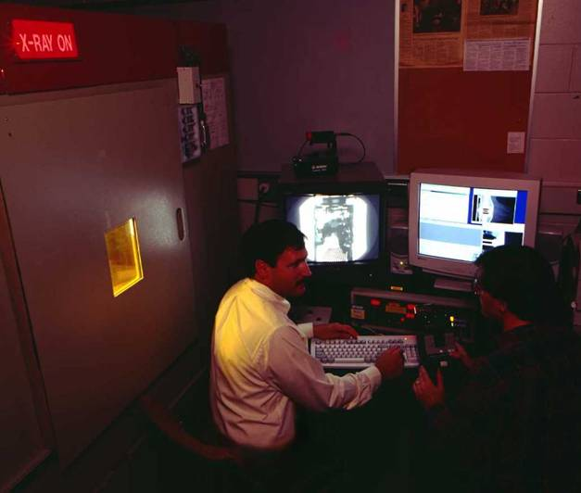
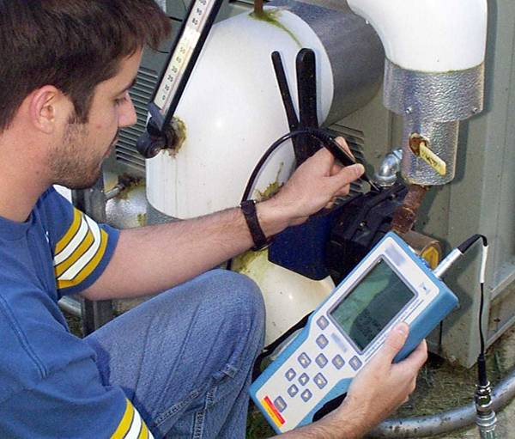
Six Most Common NDT Methods
Visual
Liquid Penetrant
Magnetic
Ultrasonic
Eddy Current
X-ray/ Radiography

Slide 13
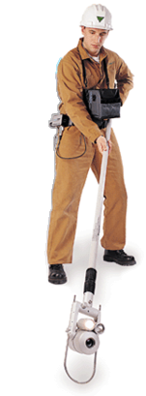
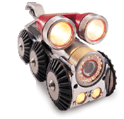
Visual Inspection
Most basic and common inspection method.
Tools include fiberscopes, borescopes, magnifying glasses and mirrors.
Portable video inspection unit with zoom allows inspection of large tanks and vessels, railroad tank cars, sewer lines.
Robotic crawlers permit observation in hazardous or tight areas, such as air ducts, reactors, pipelines.

Slide 14
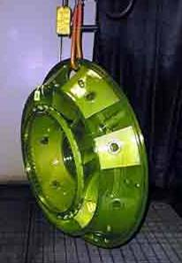
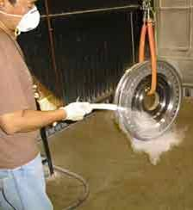
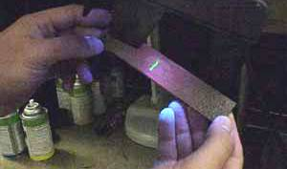
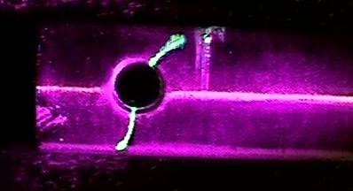
Liquid Penetrant Inspection
A liquid with high surface wetting characteristics is applied to the surface of the part and allowed time to seep into surface breaking defects.
The excess liquid is removed from the surface of the part.
A developer (powder) is applied to pull the trapped penetrant out the defect and spread it on the surface where it can be seen.
Visual inspection is the final step in the process. The penetrant used is often loaded with a fluorescent dye and the inspection is done under UV light to increase test sensitivity.

Slide 15
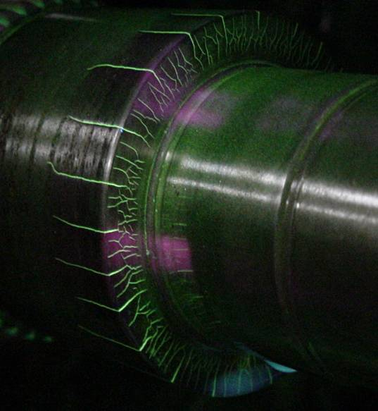
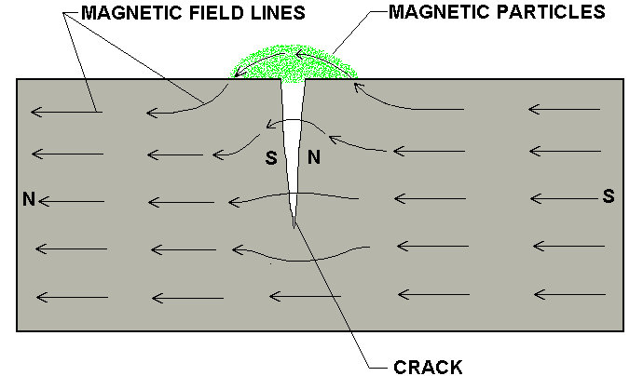
Magnetic Particle Inspection
The part is magnetized. Finely milled iron particles coated with a dye pigment are then applied to the specimen. These particles are attracted to magnetic flux leakage fields and will cluster to form an indication directly over the discontinuity. This indication can be visually detected under proper lighting conditions.

Slide 16
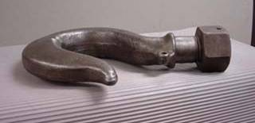
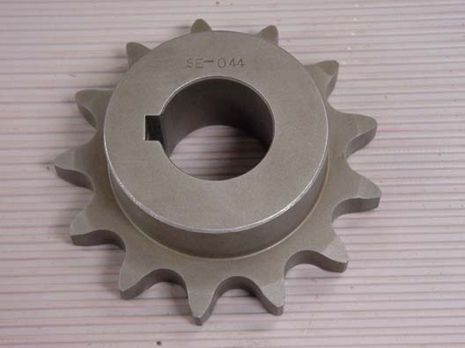
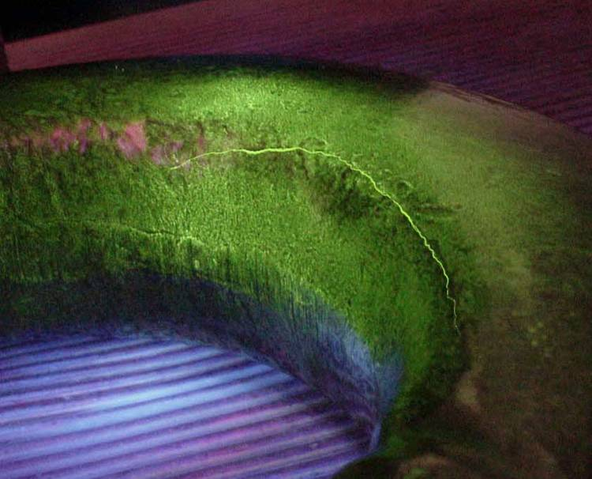
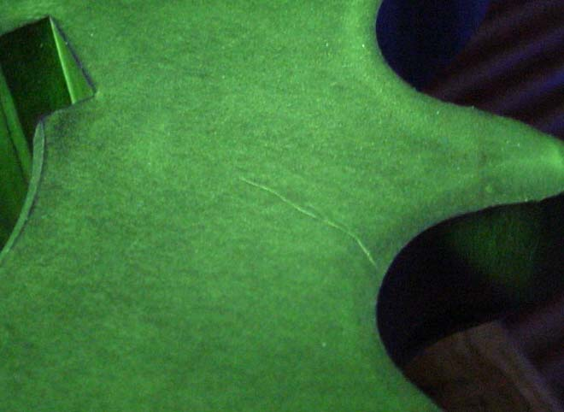
Magnetic Particle Crack Indications

Slide 17
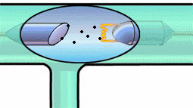
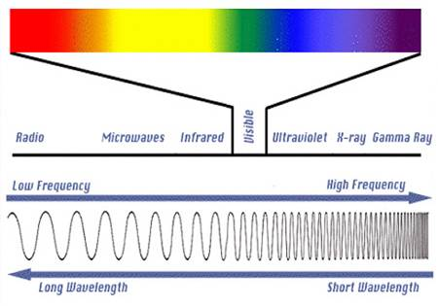
Radiography
The radiation used in radiography testing is a higher energy (shorter wavelength) version of the electromagnetic waves that we see as visible light. The radiation can come from an X-ray generator or a radioactive source.
High Electrical Potential
Electrons
+
-
X-ray Generator or Radioactive Source Creates Radiation
Radiation
Penetrate
the Sample
Exposure Recording Device

Slide 18
Film Radiography
The part is placed between the radiation source and a piece of film. The part will stop some of the radiation. Thicker and more dense area will stop more of the radiation.
The film darkness (density) will vary with the amount of radiation reaching the film through the test object.
X-ray film
= less exposure
= more exposure
Top view of developed film

Slide 19
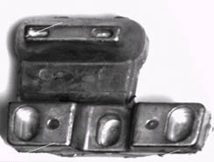
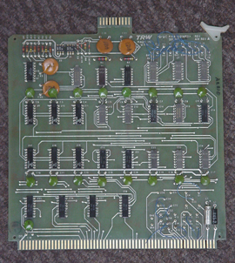
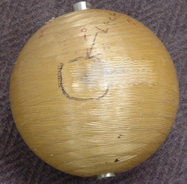
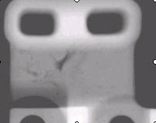
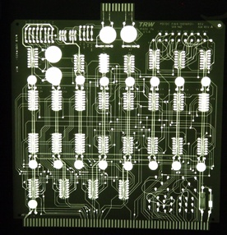
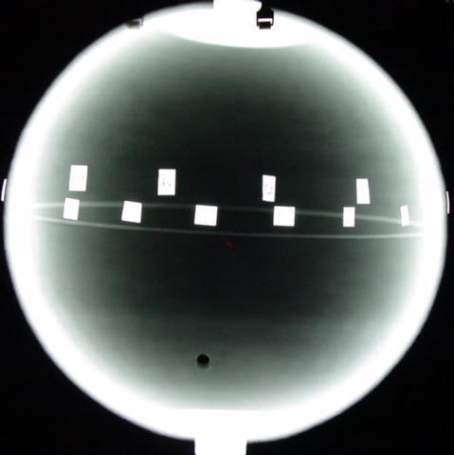
Radiographic Images

Slide 20
Eddy Current Testing
Coil's
Coil
magnetic field
Eddy current's
magnetic field
Eddy
currents
Conductive
material

Slide 21
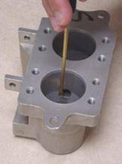
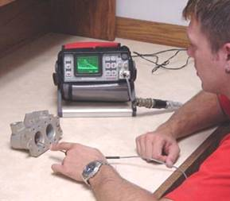
Eddy Current Testing
Eddy current testing is particularly well suited for detecting surface cracks but can also be used to make electrical conductivity and coating thickness measurements. Here a small surface probe is scanned over the part surface in an attempt to detect a crack.

Slide 22
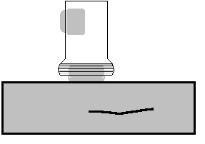
Ultrasonic Inspection (Pulse-Echo)
High frequency sound waves are introduced into a material and they are reflected back from surfaces or flaws.
Reflected sound energy is displayed versus time, and inspector can visualize a cross section of the specimen showing the depth of features that reflect sound.
f
initial
pulse
back surface
echo
crack
echo
crack
0
2
4
6
8
10
plate
Oscilloscope, or flaw detector screen

Slide 23
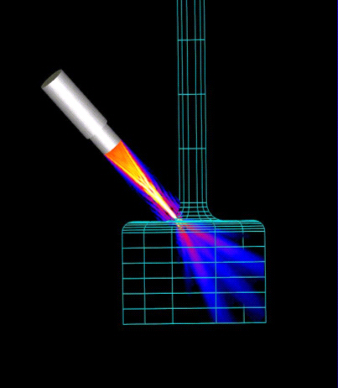
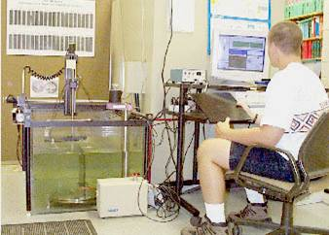
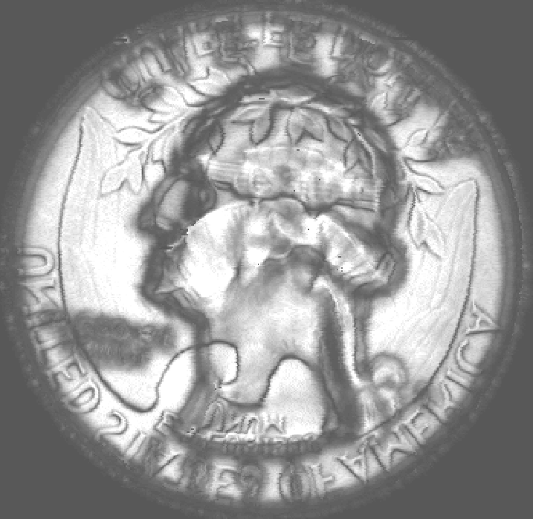

Ultrasonic Imaging
High resolution images can be produced by plotting signal strength or time-of-flight using a computer-controlled scanning system.
Gray scale image produced using the sound reflected from the back surface of the coin (inspected from “heads” side)
Gray scale image produced using the sound reflected from the front surface of the coin

Slide 24
Common Application of NDT
Inspection of Raw Products
Inspection Following Secondary Processing
In-Services Damage Inspection

Slide 25
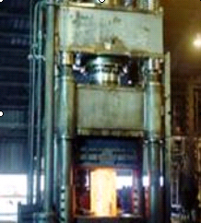
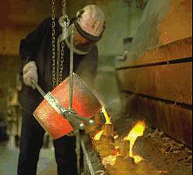
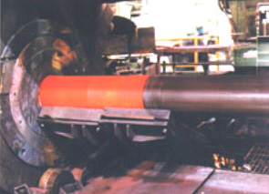
Inspection of Raw Products
Forgings,
Castings,
Extrusions,
etc.

Slide 26
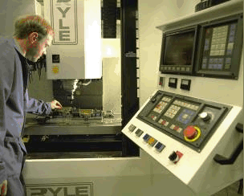

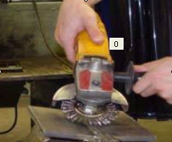
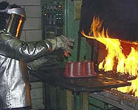
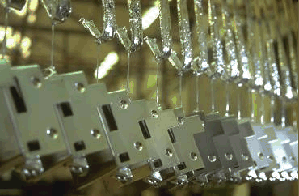
Inspection Following
Secondary Processing
Machining
Welding
Grinding
Heat treating
Plating
etc.

Slide 27
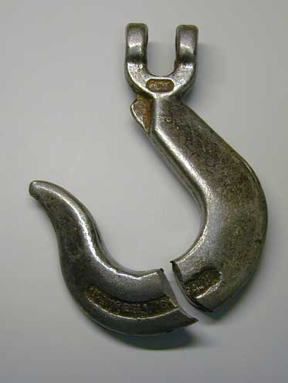
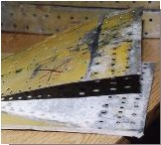
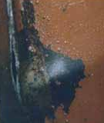
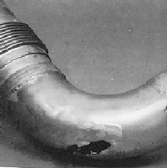
Inspection For
In-Service Damage
Cracking
Corrosion
Erosion/Wear
Heat Damage
etc.

Slide 28
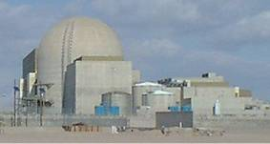
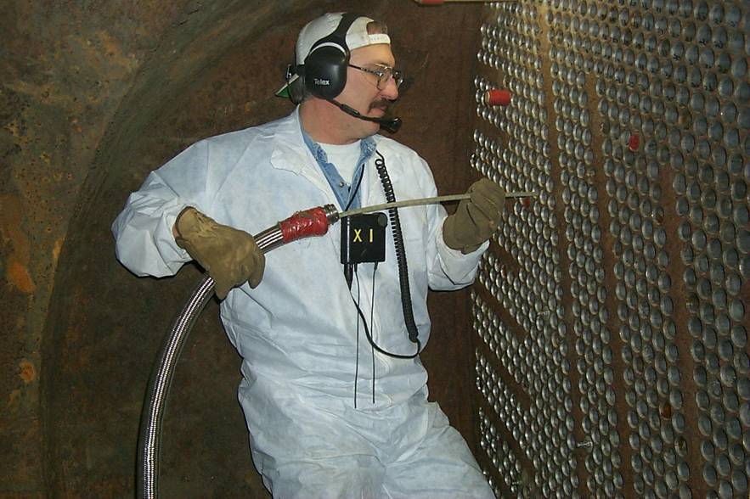
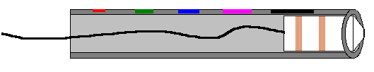
Power Plant Inspection
Periodically, power plants are shutdown for inspection.
Inspectors feed eddy current probes into heat exchanger tubes to check for corrosion damage.
Pipe with damage
Probe
Signals produced by various amounts of corrosion thinning.

Slide 29
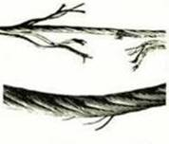
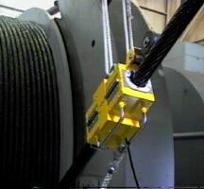

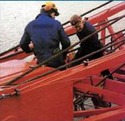

Wire Rope Inspection
Electromagnetic devices and visual inspections are used to find broken wires and other damage to the wire rope that is used in chairlifts, cranes and other lifting devices.

Slide 30




Storage Tank Inspection
Robotic crawlers use ultrasound to inspect the walls of large above ground tanks for signs of thinning due to corrosion.
Cameras on long articulating arms are used to inspect underground storage tanks for damage.

Slide 31



Aircraft Inspection
Nondestructive testing is used extensively during the manufacturing of aircraft.
NDT is also used to find cracks and corrosion damage during operation of the aircraft.
A fatigue crack that started at the site of a lightning strike is shown below.

Slide 32



Jet Engine Inspection
Aircraft engines are overhauled after being in service for a period of time.
They are completely disassembled, cleaned, inspected and then reassembled.
Fluorescent penetrant inspection is used to check many of the parts for cracking.

Slide 33

Crash of United Flight 232
Sioux City, Iowa, July 19, 1989
A defect that went undetected in an engine disk was responsible for the crash of United Flight 232.

Slide 34


Pressure Vessel Inspection
The failure of a pressure vessel can result in the rapid release of a large amount of energy. To protect against this dangerous event, the tanks are inspected using radiography and ultrasonic testing.

Slide 35




Rail Inspection
Special cars are used to inspect thousands of miles of rail to find cracks that could lead to a derailment.
Notes:
The heavy loads that trains place on the railroad tracks can result in the formation of cracks in the rail. If these cracks are not detected, they can lead to a derailment. Special rail cars equipped with NDT equipment are used to detect rail defects before they are big enough to cause serious problems.

Slide 36



Bridge Inspection
The US has 578,000 highway bridges.
Corrosion, cracking and other damage can all affect a bridge’s performance.
The collapse of the Silver Bridge in 1967 resulted in loss of 47 lives.
Bridges get a visual inspection about every 2 years.
Some bridges are fitted with acoustic emission sensors that “listen” for sounds of cracks growing.
Notes:
The US has 578,000 highway bridges, which are the lifelines of US commerce. Corrosion, cracking and other damage can all affect the bridges load carrying capacity. Therefore, all of the elements that directly affect performance of the bridge including the footing, substructure, deck, and superstructure must be periodically inspected or monitored. Visual inspection is the primary NDE method used to evaluate the condition of the majority of the nation's highway bridges. Inspectors periodically (about every two years) pay each bridge a visit to assess its condition. However, it is not uncommon for a fisherman, canoeist and other passerby to alert officials to major damage that may have occurred between inspections.
The potential penalties for ineffective inspection of bridges can be very severe. Instances of major bridge collapse are very rare, but the results are truly catastrophic. The collapse of the famous Silver Bridge at Point Pleasant, Ohio in 1967 resulted in loss of 47 lives. The cost of this disaster was 175 million dollars but some experts estimate the same occurrence today would cost between 2.1 and 5.6 billion dollars. Furthermore, these cost figures do not take into account factors such as loss of business resulting from loss of access or detours, the cost resulting from blockage of a major river shipping channel, and potential environmental damage due to hazardous materials being transported over the bridge at the time of collapse.
Fatigue cracking and corrosion will become increasingly important considerations as we go beyond the 75 year life expectancy and current visual inspection techniques will not suffice. The life extension approach will require increased use of NDE in a coordinated effort to obtain reliability assurance for these structures. NDE techniques such as magnetic particle inspection and ultrasonic inspection are being used with greater frequency. One of the newer NDE technologies being used is acoustic emission (AE) monitoring. Some bridges are being fitted with AE instruments that listen to the sounds that a bridge makes. These sophisticated systems can detect the sound energy produced when a crack grows and alert the inspector to the cracks presence. Sensors can be permanently fixed to the bridge and the data transmitted back to the lab so that continuous bridge condition monitoring is possible. The image provided here shows field engineers installing an AE monitoring system on the lift cables of the Ben Franklin Bridge in Philadelphia, PA

Slide 37


Pipeline Inspection
NDT is used to inspect pipelines to prevent leaks that could damage the environment. Visual inspection, radiography and electromagnetic testing are some of the NDT methods used.
Magnetic flux leakage inspection. This device, known as a pig, is placed in the pipeline and collects data on the condition of the pipe as it is pushed along by whatever is being transported.
Remote visual inspection using a robotic crawler.

Slide 38


Special Measurements
Boeing employees in Philadelphia were given the privilege of evaluating the Liberty Bell for damage using NDT techniques. Eddy current methods were used to measure the electrical conductivity of the Bell's bronze casing at various points to evaluate its uniformity.

Slide 39
Six Most Common NDT Methods
Visual
Liquid Penetrant
Magnetic
Ultrasonic
Eddy Current
X-ray/ Radiography

Slide 40
Visual Inspection

Slide 41
What is Visual Inspection?
NDT process – non destructive testing is the original term used to identify a method of inspection that does not destroy a product usefulness.
Visual Testing (VT) is the monitoring of specific parameters by visual and optical assessments of test objects and surfaces using the visible portion of the electromagnetic spectrum.
Examination with the eye – therefore you are only able to DETECT SURFACE DISCONTINUITIES.
Most important and most extensively used NDE/NDI/NDT method (before any NDT or DT be applied.)

Slide 42
Advantages
Usually inexpensive - the majority of expense will be in the inspector’s wage.
Equipment is small and inexpensive – there’s a lot of equipment to aid in visual inspection, but all small and inexpensive.
VT is the most portable NDT process.
Testing is simple
Testing speed is high
Testing is possible while test object is being used
Permanent records are available when latest equipment are used

Slide 43
Limitations
Can detect only surface flaws
Eye resolution is weak
Eye fatigue
Subject to human error – must spend adequate time to prevent errors.

Slide 44
Applications
Checking of the surface condition of the component.
Checking of alignment of mating surfaces.
Checking of shape of the component.
Checking for evidence of leaking.
Checking for internal side defects.

Slide 45

VISION
Eye: Various components of the human eye are illustrated in Fig. The eye operates in a similar way to a camera.

Slide 46
Formation of an image in the eye
Light passes through the transparent cornea and enters the inner part of the eye through the pupil.
The size of the pupil and thus the amount of light entering the eye is controlled by the iris.
The lens focuses light rays from an object onto the retina, at the rear of the eyeball.
The retina is a complex part of the eye, and only the very back of it (an area of approximately 380 mm²) is light sensitive.
It is packed with photosensitive cells called rods and cones and, by converting light to electrical signals, these allow us to see images in color and detail, and to see at night.

Slide 47
Rods are not color sensitive but detect the intensity of the light and can respond at very low levels, whereas cones are sensitive to different colors, responding according to the color's specific wavelength, but need a much higher intensity of light to respond.
These signals are passed along the optic nerve to the brain which then processes the information and forms the picture we see.
The brain requires process data to enable the picture to be formed and identified, which is gained by training and experience.

Slide 48

Equipment And Accessories
Instruments for illumination
  An important factor affecting visual tests is lighting, an improper lighting condition existing during a visual examination is that can’t be rectified by improving upon the magnification.
  The amount of light required for visual test is dependent on several factors such as
    type of test,
    the importance of speed or accuracy,
    reflections from backgrounds and inspection variables.
General lighting devices

Slide 49
Flash lamp: This is a tungsten filament bulb, with a battery supply up to 12 V. It is portable robust and easy to use
Incandescent: These devices are most commonly sold as microscopic lights. Their useful life is not long as they burn out and overheat easily. They do not have sufficient intensity and tend to produce an image of light bulb filament on the subject being illuminated.
Discharge: These are gas discharge lamps. They emit only certain (selective) wavelengths, so are usually only used where there is no other source available. Examples include: sodium and mercury vapour lamps.

Slide 50
Fluorescent: This is a gas discharge tube, which can be battery operated or use mains voltages. Their usefulness is limited, but they give a soft uniform light over a large area.
Non-continuous - Electronic flash (stroboscopic): This method is using a synchronised pulse of light to inspect rapid moving machinery. This makes rotary/moving components appear still, so that they can be inspected more accurately.

Slide 51
Machine vision technology
Machine vision acquires processes and analyzes an image to reach a conclusion automatically.
A machine vision system consists of a light source, a video camera, a video digitizer a computer and an image display.
The light source illuminates the test object for the camera to form image.
The video digitizer converts the image into digital form and the digital image is then stored in a two dimensional memory.
The computer first enhances the contrast of the image with a procedure known as image enhancement.

Slide 52

The image is then simplified by the process image segmentation.
The next step is feature extraction and finally the computer identifies and groups objects in the image.
Illuminated magnifiers

Slide 53
Image transmitting instruments
1. Rigid borescopes
  A rigid borescope is used as visual inspection aid and equipment to inspect internal surfaces such as bores of rifles, cannons, in- service defects in a variety of equipment such as turbines, automotive components and process piping etc.
  Similarly the borescopes are of immense use in aircraft and aerospace industry.
  Rigid borescopes are generally limited to applications with a straight - line path between the observer and area to be observed.
  Rigid borescopes in length in sizes ranging from 0.15 m to 30 m and in diameters from 0.9 mm to 70 mm are available. The magnification is usually 3X to 4X, but powers up to 50X are available.

Slide 54

Rigid borescopes

Slide 55
2. Flexible fibrescopes
  Flexible fibrescopes are generally used in situations that do not have a direct line of sight to the observer such as around bends and corners.
  The flexible fibrescopes are available in diameters ranging from 1.4 mm to 13 mm and lengths up to12 m.
  Special quartz fibrescopes are available in lengths up to 30 m.
  The fibres used in the light guide bundle are generally 30 μm in diameter. The fibre diameter in the image guide range from 6.5 μm to 17 μm for better image resolution.
  For enhancing image resolution further, an objective lens with a wider field of view and also to magnify the image at the eyepiece is used.

Slide 56

Flexible fibrescope.

Slide 57
Chemical aids
In visual testing, chemical techniques are used to clean and enhance the surface of the component to be tested.
Cleaning process removes dirt, grease, rust and mill scale.
Contrast is enhanced by chemical etching.
Macro etching is the use of chemicals to attack material surfaces to improve the visibility of discontinuities for visual inspection at normal and low power magnifications.

Slide 58
WORK PARAMETERS AND CONDITIONS
Surface preparation
Observation techniques
  Visual angle and distance:
    It is general recommendation for operator to be placed at a distance for his eye to be within 600 mm of the test surface at an angle not less than 30 degrees.
    The criterion set above is based on the fact that the angle of vision and the distance of the eye from the test surface determine the minimum angular separation of the two points resolvable by the eye as shown in Fig.
    This is known as eye’s resolving power.
  Illumination
Illumination conditions dependent on type of surface to be examined & expected defects
Evaluation of visual acuity, calibration of the examination using reference samples
Presentation of results to be used in analysis, documentation and filing

Slide 59

Minimum angle for typical visual testing

Slide 60


Equipment –
Precision Measurements
Sliding calipers are a precision refinement of the common rule, which results in greater accuracy of measurements.
They may incorporate either a dial indicator or digital readout.
Sliding-type calipers are commonly used to check dimensional tolerances of machined components, wear on components, and fit between components.

Slide 61



Equipment –
Precision Measurements
Micrometers are precise measurement instruments used to make accurate direct readings in contact measurements.
Micrometers are designed for inside, outside, and depth measurements, and are available in a wide variety of shapes and sizes.
Micrometers may be either thousandth inch (.001”) or ten thousandth inch (.0001”) measurement capable.

Slide 62


Equipment –
Precision Measurements
Micrometers operate on the principle that a precision made screw with a pitch of forty threads per inch will advance one fortieth of an inch (.025”) with each complete turn.
On a one inch micrometer, the sleeve is marked longitudinally with forty lines to the inch which corresponds to the number of threads on the spindle.

Slide 63

Equipment –
Precision Measurements
The reading line on the sleeve is divided into forty equal parts by vertical lines, each designates 1/40th” or .025” and every fourth line denotes hundreds of thousandths and is numbered 1 – 0.
The beveled edge of the thimble is divided into twenty five equal parts with each representing .001”, with every line numbered from 0 -24.

Slide 64

Equipment –
Precision Measurements
Example:
  One major division on the sleeve is visible, representing one tenth of an inch.
  Two minor divisions are visible, which each represent an additional 25 thousandths.
  Line 15 on the thimble coincides with the reading line on the sleeve indicating that fifteen one thousandths of an inch should be added to the measurement.
  By adding all three values, the micrometer reading is obtained.
  0.100”
  (2 X 0.025) 0.050”
  (15 X .001) 0.015”
  0.165”

Slide 65


Equipment – Transferring Gauges
Transfer instruments are used to take measurements which are transferred to direct measurement devices.
They consist of calipers, dividers, telescoping gages and small hole gages.

Slide 66


Equipment – Transferring Gauges
Spring type calipers are available for contact measurements of inside and outside dimensions.
They are useful for measuring distances between and over surfaces.
They are commonly used to transfer dimensions or sizes between the work piece and standard measuring devices, such as graduated rules.
The size of a linear or rounded indication of a discontinuity may be measured with dividers.

Slide 67


Equipment – Transferring Gauges
Small hole gages are a type of transfer instrument used to measure small holes or slots.
They are generally supplied in sets with a range of 1/8” - 1/2”.
The actual measurement is determined by transferring a properly adjusted gage to a micrometer.

Slide 68



Equipment – Transferring Gauges
Telescoping gages make inside measurements such as hole diameter and slot width.
They are designed to be measured by a micrometer after being set to the hole or slot size.
To make accurate measurements it is important to make sure the telescoping gage is aligned properly in the measuring faces of the micrometer.

Slide 69


Equipment – Screw Pitch Gage
The screw pitch gage is a basic visual aid for checking the number of threads per inch and rough inaccuracies of threads.
The gage consists of a steel case with a number of folding leaves at each end.
Each leaf is number and contains teeth corresponding to a specific thread pitch.

Slide 70
Dimensional Conformance
Visual inspection is commonly employed for general dimensional conformance, assembly fit, and alignment between components.
Common applications include determining:
  Weld size and tolerance.
  Component dimensions.
  Material alignment and allowable distortion.

Slide 71

Cont…
Welds are commonly inspected for dimensional tolerance.
There are several types of gages used to inspect welding fit up and finished weldments.
These gages are intended for general inspection where close tolerances are not required.
The gage used is determined by the application.
Palmgren gage
Fillet gage set
VWAC gage
Cambridge gage

Slide 72



Cont…
Visual inspection is commonly used to determine weld size and tolerances according to standards and engineering specifications.
Convexity measurement with VWAC gage. Certified-Used primarily to measure Undercut but can also be used to measure porosity. Suitable as a depth gage too
Throat measurement using a Palmgren gage.
Leg size determination with fillet gage.

Slide 73


Dimensional Conformance
Undercut in a weld is readily seen visually. In many cases its depth must be measured to determine if it exceeds code requirements.
Measurement of undercut depth with VWAC gage.
Visual Weld Acceptance Criteria

Slide 74


Checks Amount Of Porosity Per Linear Inch
Checks Crown Height

Slide 75

Dimensional Conformance
Component finish dimensions are checked with the use of measurement devices, such as transferring gages and precision measurement gages.
Small hole gage used in determining hole diameter.
The finished depth of a machined mold is determined with a depth micrometer.

Slide 76
Inspection Applications
Applications for visual inspection and many and range from looking a product over for obvious defect to performing detailed inspections. Some of the common applications include:
Detection of surface anomalies such as scratches, excess surface roughness, and areas void of paint or plating.
Crack, porosity, corrosion or other flaw detection.
Dimensional conformance.
Precision measurements.
Foreign object detection.
Component location.

Slide 77



Inspection Applications –
Flaw Detection
Visual inspection of manufactured materials and components is a cost effective means of identifying flaws.
Visual inspection of a casting reveals a crack between a threaded opening and a pressed fit.
The aluminum sand casting has hot tears and shrinkage at the transition zones.

Slide 78


Inspection Applications –
Flaw Detection
In-service inspections of existing components and structures is commonly accomplished visually.
In this example, visual inspection of a fire escape reveals a failure in a handrail tube.
The failure is in the tube seam and is likely the result of ice expansion.

Slide 79


Inspection Applications –
Flaw Detection
Normal inspection practices for highway bridges rely almost entirely on visual inspection to evaluate the condition of the bridges.

Slide 80


Inspection Applications –
Flaw Detection
Over 80 percent of all aircraft inspections are performed visually.

Slide 81


Inspection Applications –
Flaw Detection
Weld quality requirements are commonly determined through visual inspection.
Many standards have established acceptance criteria for welds.
Transverse weld crack
Slag rolled into toe of weld

Slide 83
Leak Testing
LEAK TESTING is the branch of nondestructive testing that concerns the escape or entry of liquids or gases from pressurized or into evacuated components or systems intended to hold these liquids.
Leaking fluids (liquid or gas) can penetrate from inside a component or assembly to the outside, or vice versa, as a result of a pressure differential between the two regions or as a result of permeation through a somewhat extended barrier.
Leak testing encompasses procedures for one or a combination of the following: ·
  Locating (detecting and pinpointing) leaks ·
  Determining the rate of leakage from one leak or from a system ·
  Monitoring for leakage
Leak testing is increasing in importance because of the rising value of, and warranties on, manufactured products and because of the constantly increasing sensitivity of components and systems to external contaminants. Environmental concerns are causing additional emphasis on leak testing and its conduct.

Slide 84
Leak Testing Objectives
To prevent the loss of costly materials or energy
To prevent contamination of the environment ·
To ensure component or system reliability

Slide 85
Terminology
Leak: An actual through-wall discontinuity or passage through which a fluid flows or permeates; a leak is simply a special type of flaw
Leakage: The fluid that has flowed through a leak
Leak rate: The amount of fluid passing through the leak per unit of time under a given set of conditions; properly expressed in units of quantity or mass per unit of time
Minimum detectable leak: The smallest hole or discrete passage that can be detected
Minimum detectable leak rate: The smallest detectable fluid-flow rate

Slide 86
Measurement of Leakage:
A leak is measured by how much leakage it will pass under a given set of conditions. Because leakage will vary with conditions, it is necessary to state both the leak rate and the prevailing conditions to define a leak properly.
At a given temperature, the product of the pressure and the volume of a given quantity of gas is proportional to its mass.
Therefore, leak rate is often expressed as the product of some measure of pressure and volume per unit of time--for example, standard cubic centimeters per second (std cm3 /s) torr liters per second (torr · L/s), micron liters per second (L/s), and atmosphere cubic centimeters per second (atm cm3 /s)

Slide 87
Types of Leak
A real leak is an essentially localized leak, that is, a discrete passage through which fluid may flow (crudely, a hole). Such a leak may take the form of a tube, a crack, an orifice, or the like. As with flaws, all leaks are not the same. Leaks tend to grow over time, and they tend to operate differently under different conditions of pressure and temperature. A system may also leak because of permeation of a somewhat extended barrier; this type of real leak is called a distributed leak. A gas may flow through a solid having no holes large enough to permit more than a small fraction of the gas to flow through any one hole. This process involves diffusion through the solid and may also involve various surface phenomena, such as absorption, dissociation, migration, and desorption of gas molecules.
Virtual leaks involve the gradual desorption of gases from surfaces or escape of gases from nearly sealed components within a vacuum system. It is not uncommon for a vacuum system to have both real leaks and virtual leaks at the same time.

Slide 88
Types of Flow in Leaks
Permeation.
Molecular Flow
Transitional flow
Viscous flow
Laminar and Turbulent Flow
Choked flow

Slide 89
If the leak rate is:
Less than 10-6 atm cm3 /s, the flow is usually molecular
10-4 to 10-6 atm cm3 /s, the flow is usually transitional
10-2 to 10-6 atm cm3 /s, the flow is usually laminar
Greater than 10-2 atm cm3 /s, the flow is usually turbulent

Slide 90
Leak Testing-Acoustic Method
The turbulent flow of a pressurized gas through a leak produces sound of both sonic and ultrasonic frequencies If the leak is large, it can probably be detected with the ear. This is an economical and fast method of finding gross leaks. Sonic emissions are also detected with such instruments as stethoscopes or microphones, which have limited ability to locate as well as estimate the approximate size of a leak. Electronic transducers enhance detection sensitivity. Smaller leaks can be found with ultrasonic probes operating in the range of 35 to 40 kHz, although actual emissions from leaks range to over 100 kHz.

Slide 91


Slide 92
Ultrasonic detectors are considerably more sensitive than sonic detectors for detecting gas Leaks and from distances of 15 m (50 ft) are capable of detecting air leaking through a 0.25 mm (0.010 in.) diam hole at 35 kPa (5 psi) of pressure.
The performance of an ultrasonic leak detector is a function of detection distance, orifice diameter, and internal air pressure.
The sound level produced is an inverse function of the molecular weight of the leaking gas.
Therefore, a given flow rate of a gas such as helium will produce more sound energy than the same flow rate of a heavier gas such as nitrogen, air, or carbon dioxide. If background noise is low, ultrasonic detectors can detect turbulent gas leakage of the order of 10-2 atm cm3 /s.
Ultrasonic leak detectors have also been successfully used with ultrasonic sound generators when the system to be tested could not be pressurized.

Slide 93
Bubble Testing
A simple method for leak testing small vessels pressurized with any gas is to submerge them in a liquid and observe bubbles.
If the test vessel is sealed at atmospheric pressure, a pressure differential can be obtained by pumping a partial vacuum over the liquid or by heating the liquid.
The sensitivity of this test is increased by reducing the pressure above the liquid, the liquid, density, the depth of immersion in the liquid, and the surface tension of the liquid.

Slide 94
Immersion Testing:
Oils are a more sensitivity medium than ordinary water. Therefore, it is common practice to test electric components in a bath of hot per-fluorocarbon.
When testing by reducing the pressure above the liquid, several precautions must be observed, particularly if the reduced pressure brings the liquid close to its boiling point. If the liquid begins to boil, a false leak indication will be given.
The test vessel must be thoroughly cleaned to increase surface wetting, to prevent bubbles from clinging to its surface, and to prevent contamination of the fluid..

Slide 95
If water is used, it must be distilled or deionized and should be handled with minimal sloshing to reduce the absorbed-gas content. A small amount of wetting agent is normally added to water to reduce surface tension.
With the addition of the proper wetting agent, water can be even more sensitive than oils. Water-base surfactant solutions can be used successfully to detect leaks as small as 10-6 atm cm3 /s. Immersion testing can be used on any internally pressurized item that would not be damaged by the test liquid.
Although this test can be relatively sensitive, as previously stated, it is more commonly used as a preliminary test to detect gross leaks. This method is inexpensive, requires little operator skill for low-sensitivity testing, and enables an operator to locate a leak accurately

Slide 96
Helium Leak Detector
Why use helium for leak detection?
Helium is the best choice to find leaks because it is non-toxic, inert, non-condensable, non-flammable, present in the atmosphere in trace amounts (5 ppm).
Due to its small atomic size, helium passes easily through leaks. The only molecule smaller than helium is hydrogen which is not inert. Helium is lighter than the next inert gas neon, which is more expensive. It is also relatively inexpensive and is available in various size cylinders and also in pure form easily.
There are other leak detection methods but none of them is as accurate in terms of localization and quantification, as helium leak detection method.

Slide 97
Principle of helium leak detector (HLD)
The HLD leak detector is based on the principle of field mass spectrometer. The leaked helium gas is ionized by the electron beam from the filament within the ion chamber of the analyzing tube.
The ions are accelerated using added voltage and move out through a slit and then pass through the magnetic field generated by the analyzer. Since the circular trajectories of the ions depend on their mass, the collector can catch only the helium ions and detect helium.

Slide 98
Using a special detector the ion current is converted into an electric current. This current is accelerated and displayed on the screen using leak detection units. The measured current is in direct proportion to helium concentration and therefore equal to the measured leak.

Slide 99


Slide 100
The HLD is a system containing the following modules:
Helium mass spectrometer leak detector,
Control system and valves which control individual steps of the measuring cycle, from evacuation to testing to venting,
Rotary & TMP vacuum pumps to maintain sufficiently low pressure in the spectrometer,
Vacuum Gauge for measuring the vacuum and
Fixtures, which connect the unit to be tested with the detector.

