Slide 1
Module 2
Types of Development

Slide 2
Forecasting Air Transport Demand
Projecting air travel for an airport, city, or region is a critical and fundamental step in the airport planning process.
Forecasting is an attempt replicate a future situation based on historical data, developing patterns and scenarios of future demand for air travel.
Industry and market forces of today and yesterday to build a case for the future.
History of the market, society, and air transport industry would provide the basic ingredients.
(ICAO) has been compiling statistics on air travel since the start of commercial air travel.
Passengers
Aircraft movements
Passenger-distance traveled, or more precisely “revenue” passengers traveled, in terms of revenue passenger-kilometers

Slide 3
To design facilities, forecasts of hourly passenger flows are required.
To operate different facilities of the airport, weekly and daily patterns are also needed.
The forecasts of aircraft on the airside and passengers on the landside are the basis for their respective facilities design.
Estimate of ground vehicles on the airport access is important to design the airport access and parking infrastructure.
All these separate facilities ultimately would rely on the basic air transport demand forecasts.
The quality and accuracy of a forecast are reflective of the tools, data, and methodology adopted in the forecasting process.
The logic of assumptions, analytical models used, and accuracy and validity of data all contribute to the quality and accuracy of the forecasts.

Slide 4
In conducting forecasts of airport demand, the following factors are considered
1. Availability of capacity; airports and airspace 2. General economic situation; locally, nationally, and internationally 3. Socioeconomic and demographic variables of the airport region 4. Economic factors directly related to airlines operating at the airport 5. Competition between airlines serving the airport as well as competition between the air and other modes of transport 6. Environmental and political constraints on the air transport system and airline industry 7. Technological advancement in aeronautics, telecommunication, air navigation, and other related fields 8. Overall safety, security, and convenience of air travel

Slide 5
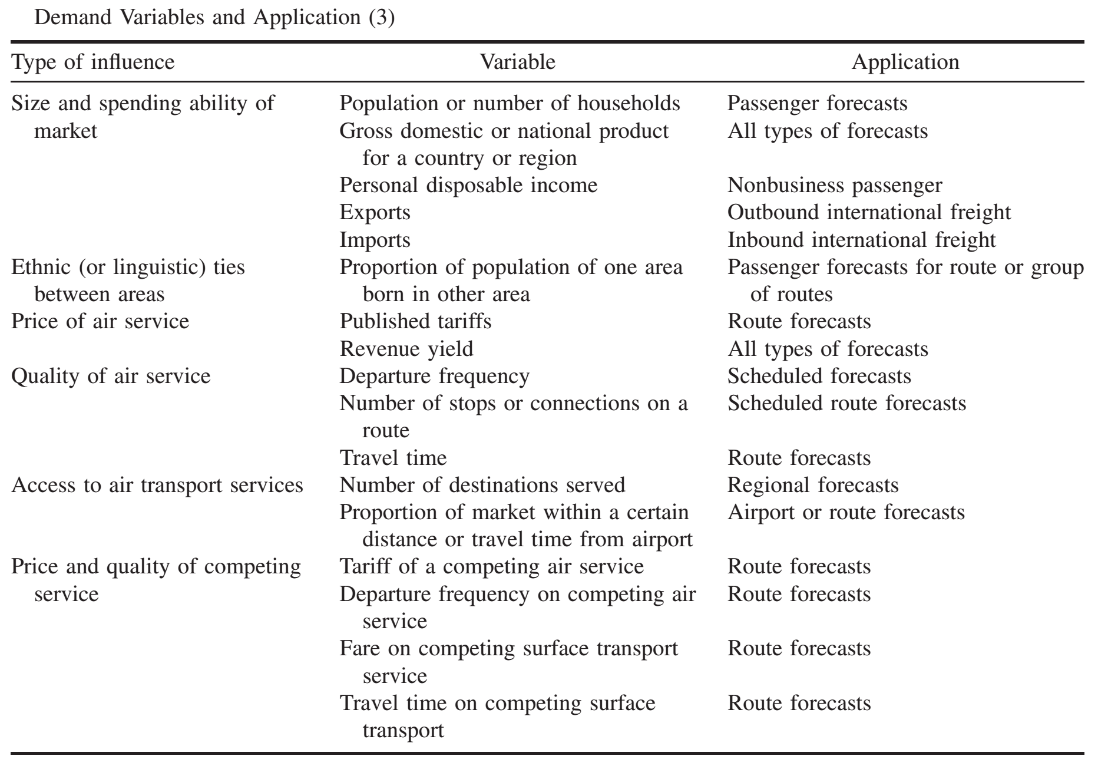

Slide 6
COMPONENTS OF AIR TRANSPORT DEMAND
On the local and regional levels, the socioeconomic/demographic variables and the shifts and directions the economy takes would play the major role in defining the number of passengers within the region or airport.
On the national level, the state of the national economy and the state of the airline industry are the major factors that would dictate aviation demand.
Other factors include geographic and demographic distribution of demand, technological advancement in the industry, and perhaps politically sensitive environmental issues.
Internationally, bilateral agreements, state of global and regional economies, political considerations vis-a-vis hostilities, regional turmoil and internal security, airline` globalization, cultural and social ties between nations, and advances in aeronautics, telecommunication, navigation, and surveillance technologies all may contribute to the size and kind of international air travel.
In terms of components of air travel, the airports and airlines distinguish between the originating (origin–destination, or OD) passengers and the connecting passengers.
The split of passenger demand between these two basic components of demand may impact how the airlines operate, but most importantly how the individual airport facilities are used.

Slide 7
FACTORS AFFECTING AIRPORT CAPACITY
Runway Capacity
small aircraft usually require short runways only, a parallel runway can be utilized
Terminal Capacity
1. Apron requirements
2. Location of airbridges
3. Access to upper decks of wide-bodied aircraft
4. Baggage handling
5. Handling large batches inside the terminal
6. Security

Slide 8
ELEMENTS OF AIRPORT MASTER PLAN (As per ICAO Guidelines)
Preplanning. The preplanning process includes:
Initial needs determination based on observed or potential deficiencies in the existing plan or airport
The manner of calling for requests for proposals and subsequent consultant selection
Development of study design, showing a scope of work that includes goals and objectives, data availability, forecast horizons, environmental considerations, schedules, and deliverables; organization of a formal structure of review committees for coordination and public involvement program; adjustment of the scope of work to budgetary requirements.
Negotiation of consultant contract
Application for study funding

Slide 9
Public Involvement
Timing of public involvement that ensures that all major decisions are set before the public at an early stage of the planning process before irreversible decisions are made
Appropriate public involvement techniques where appropriate: technical advisory and citizens’ advisory committees, public information meetings, smallgroup meetings and briefings, public awareness campaign, and Stakeholder identification, including potentially users and tenants, groups and individuals within the sponsor’s (airport’s) organization, Nodal agency personnel, resource agencies and governmental units with regulatory or review authority, and other interested groups
Identification and Documentation of the key issues and the operation of the public involvement progam itself

Slide 10
Environmental Considerations
Aviation Forecasts. There is a need to develop short-, medium-, and long-term forecasts of aeronautical demand to permit well-conceived planning leading to the ultimate development of the airport site.

Slide 11
Facility Requirements
At this stage, having determined the levels of future demand, it is possible to assess the ability of the existing airport, both airside and landside, to support the forecast demand.
The requirements for new facilities can be driven by a number of factors: • Lack of capacity due to increased demand • Changes in security requirements required by the Transportation Security Administration • Changes in Nodal agecy’ standards or noncompliance with existing standards • Changes in the nature of the airport’s vision of service provision • Outdated and unsuitable existing facilities

Slide 12
Demand–Capacity Analysis
(a) Forecast aircraft operations vis-a-vis airspace capacity
(b) Forecast aircraft operations vis-a-vis air traffic control facilities
(c) Forecast aircraft operations vis-a-vis airfield capacity
(d) Forecast passenger movements vis-a-vis passenger terminal capacity
(e) Forecast cargo volumes vis-a-vis air cargo terminal capacity
(f) Forecast access traffic vis-a-vis surface access route capacity

Slide 13
Facility also include:
(a) Runways. Orientation, length, width, clearances, clear zones, approach slopes, orientation, crosswind runway provision, capacity, staged construction, cost implications of delay to aircraft, pavement design strength and cost effectiveness.
(b) Taxiways. Width, location, clearances, design and location of exits, grades, effect on runway capacity, staged construction, pavement design strength and cost effectiveness.
(c) Electronic, Visual, and Satellite Aids to Navigation. This provision depends on fleet mix, percent of time bad weather is present, and cost to users.
(d) Airspace Requirements
(e) Passenger Terminal Complex
Gates and apron frontage: Clearances, grades, aircraft mix, number of aircraft gate positions by aircraft class, aircraft parking clearances, ground servicing equipment space requirements.
Passenger terminal building: Public areas required for major functions such as baggage claim, check-in, government controls etc;airline and administration offices, maintenance and mechanical services; commercial space for shops and services.
Curbfronts: These are a function of the modal splits used by arriving and departing passengers and the needs of service vehicles

Slide 14
(g) Air Cargo
Belly freight carriers: passenger aircraft, using some of the belly space for containerized freight
Combination carriers: passenger aircraft with a reconfigured cabin, using some of the main deck for containerized freight
All cargo carriers: sell space to freight forwarders or companies and carry freight between airports
Integrated carriers: door-to-door services using their own aircraft and trucks, often requiring their own freight terminal
Freight forwarders: arrangers of transport which includes ground transport at either end of the flight and customs clearance where necessary.

Slide 15
(h) Support Facilities - aircraft rescue and firefighting, airport maintenance, fuel storage, aircraft maintenance and deicing
(i) Ground Access - Regional transportation network
On-airport circulation roadways: The added demand from passengers and their meters and senders, employees, delivery vehicles, and others will be diverse in destinations and timing of peaks.
Parking must be supplied for passengers, meeters and senders, employees, visitors, and delivery vehicles.
(j) Utilities. The master plan will address the future requirements for water, sanitary sewage, stormwater drainage, deicing run-off, industrial waste, communications, natural gas, and electric power supply

Slide 16
Airport Layout Plan Drawing Set. The full set of recommended drawings comprises:
Cover sheet
Airport layout plan
Data sheet
Facilities layout plan
Terminal area plan
Airport airspace drawing
Inner portion of approach space drawing
On-airport land use drawing
Off-airport land use drawing
Airport property map
Runway departure surface drawing
Utility drawing
Airport access plan
Other necessary plans that are specific to the airport

Slide 17
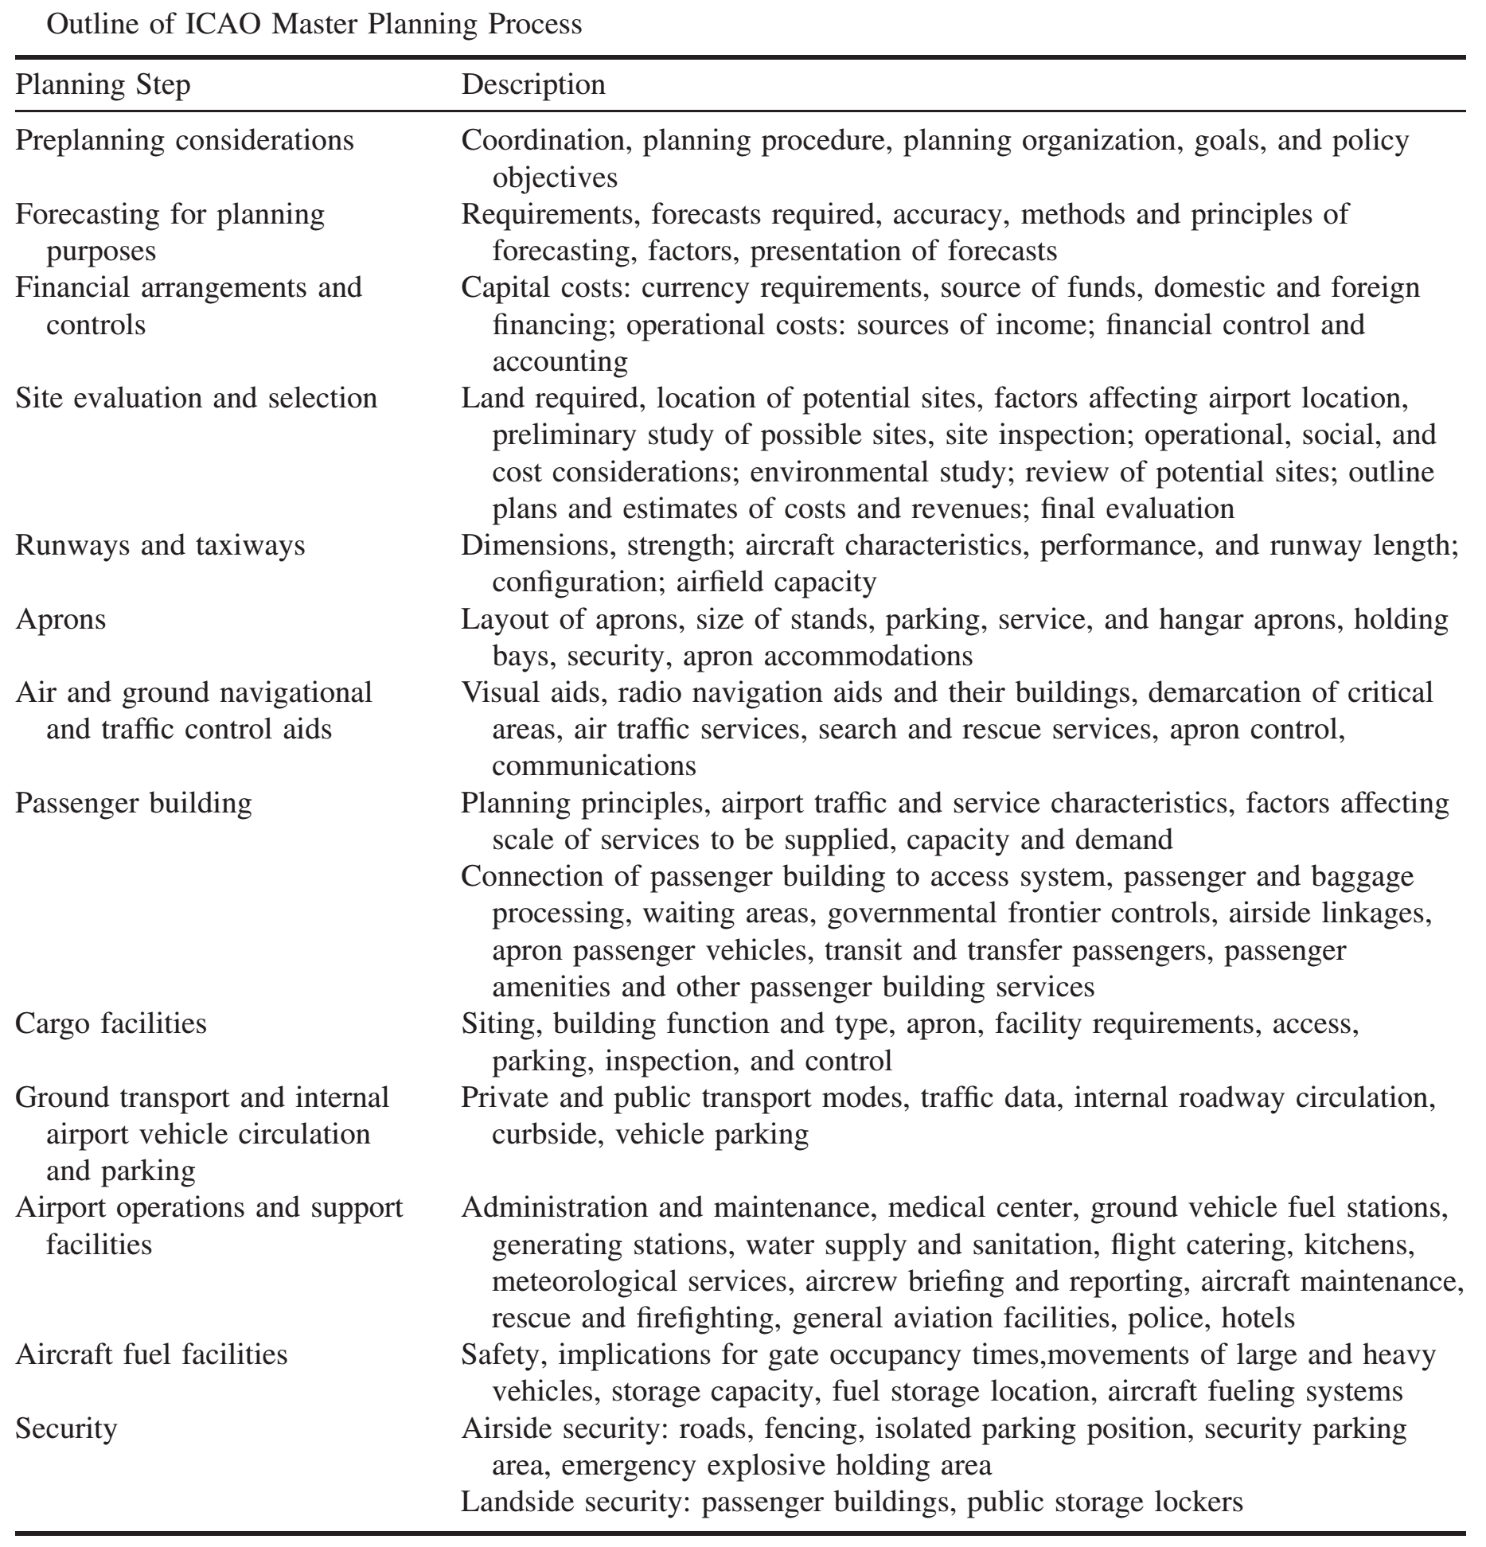

Slide 18
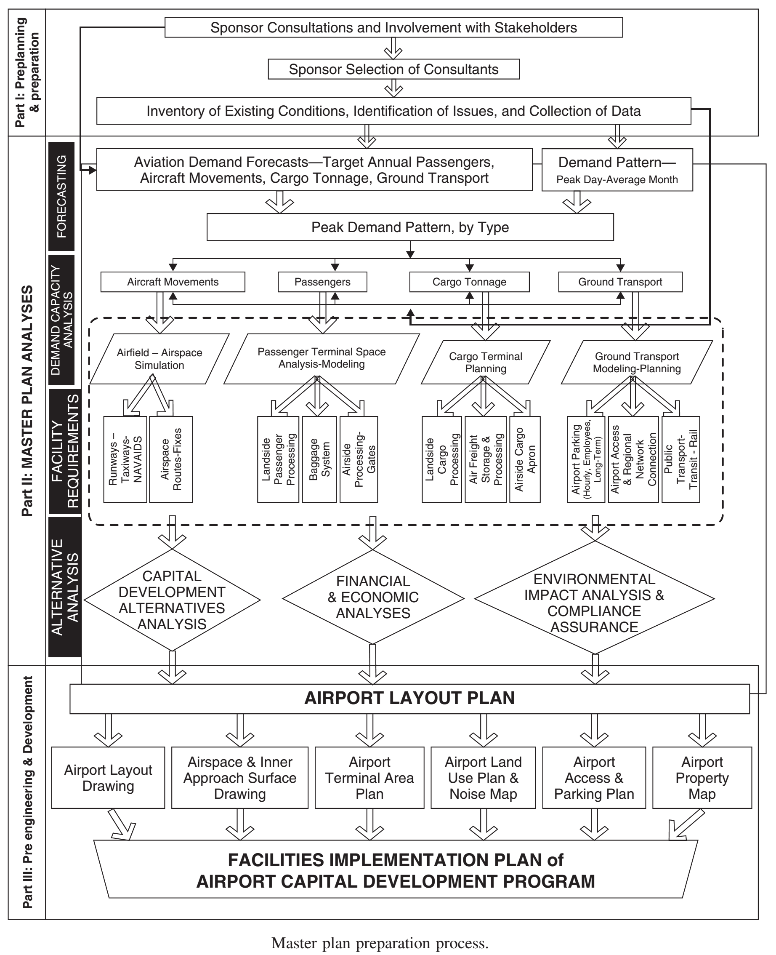

Slide 19
Airport Layout Design
The layout of an airport is dependent upon a number of factors, of which the most important are:
Number and orientation of runways
Number of taxiways
Size and shape of aprons
Area and shape of available land
Topography and site soil conditions
Obstacles to air navigation
Required proximity of land uses within the airport boundary
Surrounding land uses
Timing and scale of phased development of the airport
Meteorology
Size and scale of airport facilities being planned

Slide 20
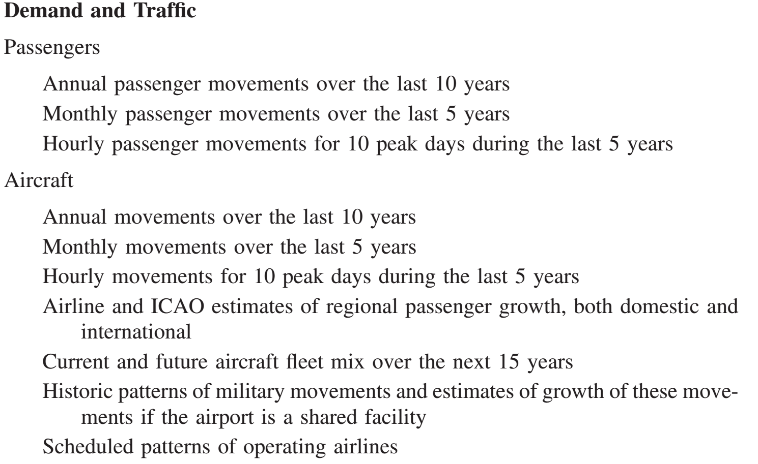
In a master planning exercise, the following Data Requirements could be expected

Slide 21
Data Requirements

Slide 22
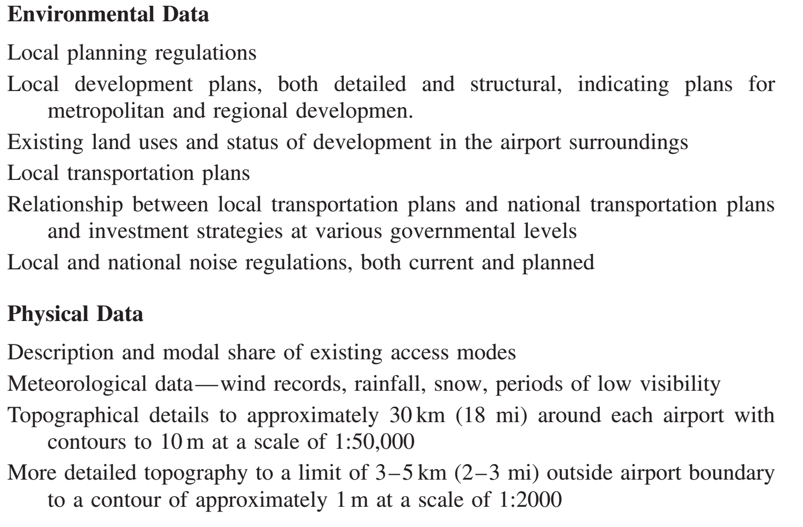

Slide 23
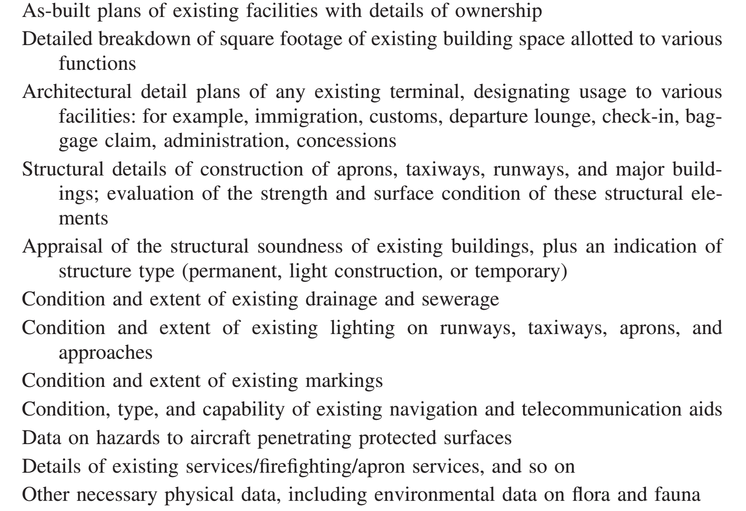

Slide 24
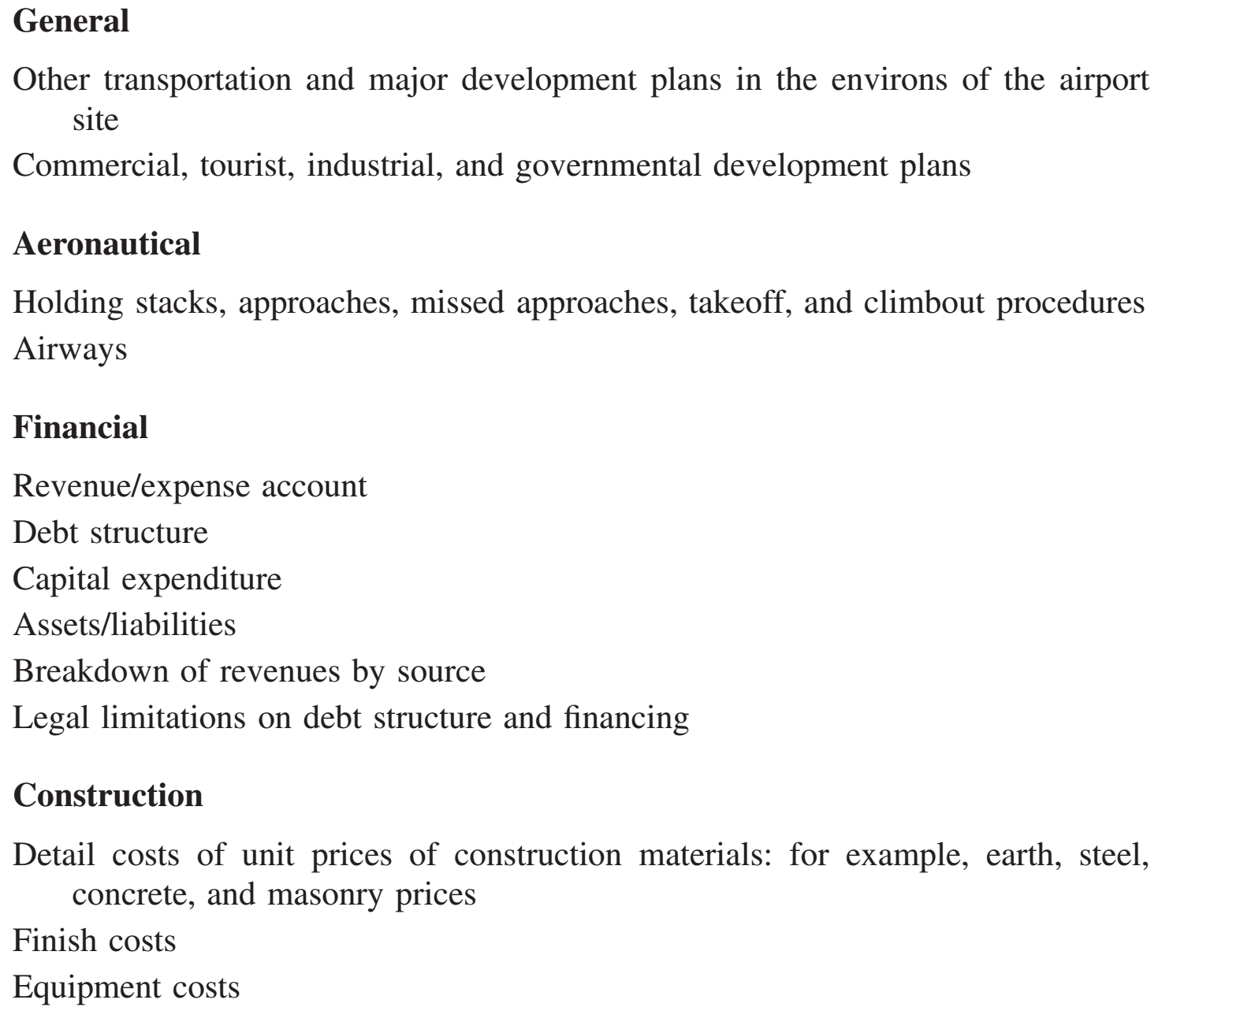

Slide 25
STRUCTURE OF MASTER PLAN REPORT
Introduction and purpose of the master plan
Inventory of the existing conditions and facilities
Demand analysis: forecasts of passenger traffic , cargo traffic, air transport movements, general aviation and military movements, ground access traffic movements by public and private modes
Demand/capacity analysis: comparison of the existing capacity vis-a-vis the forecast demand—approaches, runways, taxiways, aprons, terminals, support facilities, access, and parking

Slide 26
Sequenced facility provision: sequenced and staged provision of capacity in accordance with the development of demand. Where necessary, capacity enhancement will be computed for:
Airside: Runways, taxiways, apron, holding areas, support facilities
Terminals: Passenger and cargo
Landside: Access modes and parking, support facilities
Passenger terminal layout with preliminary sketches
Cargo terminal
Schedule of improvements: usually in the form of a Gantt chart showing major improvement items and timing
Cost estimates: runways, taxiways, aprons, and holding areas; cargo and passenger terminals; control tower
Utilities and support facilities (meteorological, fire, fuel, catering, security, etc.); roads, parking, and other access facilities; military areas; general aviation facilities; aircraft maintenance areas, airport maintenance areas
Capital improvement program: usually supplied in spreadsheet format

