Slide 1
Unit IV
Excess functions, Concept of 1 wt% standard state and Interaction coefficient, Regular solutions, Sievert’s law-residual gases in steel Phase relations and phase rule-its applications, Free energy-composition and temperature-composition diagrams for binary alloy systems and their correlation, determination of liquidus, solidus and solvus lines, Effect of pressure on phase transformation and phase equilibrium

Slide 2
Excess Partial Molar Quantities
Activity coefficient for actual or real solution is a measure of the departure from ideal condition
Excess Partial Molar Quantity is a measure of the difference between the partial molar quantity of a component in actual or real solution and to partial molar quantity of a component in ideal solution

Slide 3
Excess Partial Molar Free Energy
Excess partial molar free energy of component 1 in a solution ( ):
Where, is the partial molar free energy for component 1 and is ideal partial molar free energy for component 1
Since:
and
Therefore:
Similarly, we have equation for partial molar enthalpy and partial molar entropy
For Enthalpy:
; For ideal solution,
For Entropy:
; For ideal solution,
Gibbs Free Energy:
For ideal solution

Slide 4
1wt% Standard State
Why we need 1wt% for activity calculation?
Most commercial alloys are dilute solution and is expressed in wt%
Industry prefers wt% for material calculation
Activity in new scale is defined as:
Or,
Where h_{i} is the Henrian Activity of solute i of 1wt% standard state
Henry’s law is valid when wt%i → 0 (i.e. the case of dilute solution)
Therefore, h_{i} = wt%i , when Henry’s law is valid
Thus, if Henry’s law extends to 1wt%i then h_{i} = 1 at 1wt%

Slide 5
1wt% Standard State – Contd.
If deviation from Henry’s law occurs below 1wt% standard state then Henry’s law is extended up to 1wt% by extrapolation method
To take care of such deviations, a term called Henrian Activity coefficient (f_{i}) is introduced, which is defined as:
Since,
For Henry region:
Ideal Solution
a_{i}
A
Non-Ideal Solution
B
Or,
Henry’s law
C’
Wt %i
C

Slide 6
Example
Si (liquid, pure) + O₂ (g, 1tm) → SiO₂ (s); Where Si = Si dissolved in liquid iron
In ideal condition: Si (Liquid, pure) + O₂(g,1tm) = SiO₂(s, pure) ----Eqn. 1
Change in Free Energy:
Since SiO₂ is in pure form, a_{SiO2} = 1
In Henry’s regime, the standard reaction:
Si (1wt% solution) + O₂ (g, 1tm) → SiO₂ (s) -----Eqn. 2
Subtracting Eqn. 2 from Eqn. 1, we get: Si (liquid, pure) = Si (1 wt% solution)

Slide 7
Example – Contd.
Si (liquid, pure) = Si (1 wt% solution)
Free energy change for the above reaction:
Or,
Where, is partial molar free energy of mixing of Si in molten iron at 1wt%Si.

Slide 8
Solute-Solute Interaction in Dilute Multi-Component Solution
C, Si, Mn, S, and P in Fe forms dilute solution of Fe in liquid steel
Activity coefficient of C in liquid iron depend on Si content – Observed by Prof. Chipman
This happens because in addition to interaction between solute and solvent, there is also an interaction between one solute and those of other solute
Consequently, activity of both solutes increases
Suppose, A is the solvent and B,C,D….are solutes, then by using Taylor’s series, we get:
In case of dilute solution, since X_{B}, X_{C},… are small, 2nd and higher order derivatives can be ignored
Or,
Where,
1st order interaction coefficient. In Henry’s regime,

Slide 9
Solute-Solute Interaction in Dilute Multi-Component Solution – Contd.
Or,
Where,
Or,
Since,
Then,

Slide 10
Definition
A phase: is a physically distinct part of a system that is mechanically separable from other parts is the system; e.g. a melt or a mineral
A phase diagram:
P, T Shows the stability ranges of phases (minerals, melts, solutions)
as functions of composition,, pH and Eh.
Components: Minimum number of chemical constituents that
are required to describe the compositions of all phases in the system
(there are never be more components than phases in a system)
Degrees of freedom: The number of variables to define the position of a mineral assemblage in a phase diagram
Intensive properties: P, T, pH, Eh (Environmental variables)
Extensive properties: V, m, partial pressure

Slide 11
The Gibbs Phase Rule
F = C - P + v
F = number of degrees of freedom
The number of variables to define
the position of a mineral assemblage in a phase diagram
P = number of phases (i.e. mechanical separable constituents
C = minimum number of components (chemical
constituents that must be specified in order to define all phases)
v = intensive properties or environmental variables,
in P/T and pH/Eh diagrams = 2

Slide 12
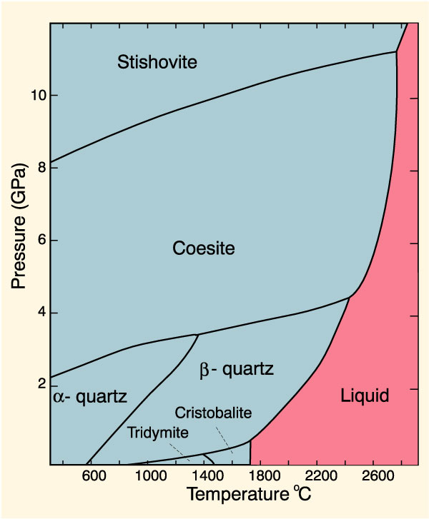
1 - Component Systems
1. The system SiO₂
Two environmental
variables: P and T
One component = SiO₂
7 different phases
Point A:
F = C – P + 2
F = 1 – 1 + 2
F = 2
Divariant area
= two variables to
define a position in
the coesite stability field
A
C
B

Slide 13
1 - C Systems
1. The system SiO₂
Two environmental
variables: P and T
One component = SiO₂
7 different phases
Point B:
F = C – P + 2
F = 1 – 2 + 2
F = 1
Univariant area =
one variable to
define a position on the
the coesite - α-quartz
phase boundary
A
C
B

Slide 14
1 - Component Systems
1. The system SiO₂
Two environmental
variables: P and T
One component = SiO₂
7 different phases
Point C:
F = C – P + 2
F = 1 – 3 + 2
F = 0
invariant = Triple point
do not need any variable
to define equilibrium
between coesite,
a- and b-quartz
A
C
B

Slide 15
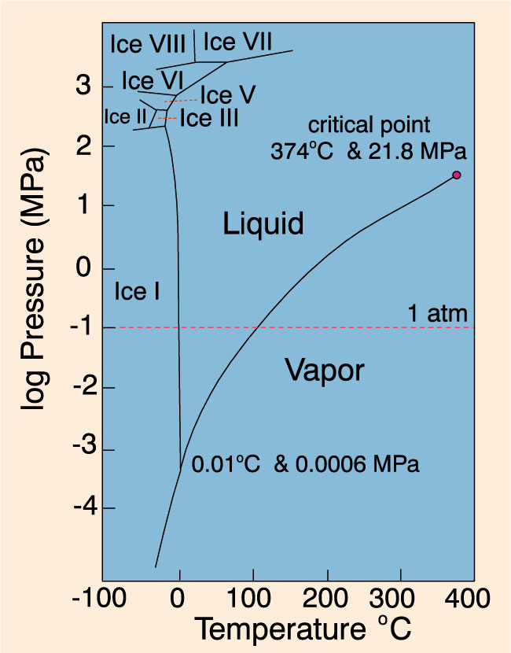
1 - Component Systems
2. The system H₂O
Point C:
F = C – P + 2
F = 1 – 3 + 2
F = 0
Triple point
C

Slide 16
F = C - P + 2
As the number of components increases, so do the required degrees of freedom needed to define the system. Consequently, as the system becomes more complex, it becomes necessary to fix more variables to define the system.
As the number of phases in equilibrium increases, the number of the required degrees of freedom becomes less.
Liquid water+vapor F=1-2+2=1
ethyl alcohol+vapor F=1-2+2=1
liquid water+liquid ethanol+vapor F=2-2+2=2
liquid water+liquid benzyl alcohol+vapor mixture →
F=2-3+2=1 → benzyl alcohol and water form two separate liquid phases and one vapor phase.

Slide 18
Two component systems containing liquid phases
Miscible systems such as water and ethanol.
Immiscible systems such as water and mercury.
Partial miscibility (or immiscibility) such as phenol and water.
Critical solution temperature: The maximum temperature at which the two – phase region exists.

Slide 19
Two component systems containing liquid phases
Figure – Temperature-composition diagram for the system consisting of water and phenol

Slide 20
Two component systems containing liquid phases
Upper consolute temperature: All combinations above this temperature are completely miscible (one phase).
Lower consolute temperature: below which the components are miscible in all proportions.

Slide 21
Phase equilibrium in three component systems
As one proceeds from binary systems to systems with three or more components, the phase diagrams become more complex.
Each component adds another dimension to the representation of the phase equilibrium.
Thus, for three components, two dimensions are required to represent the phase diagrams for a single temperature and pressure; these are conveniently depicted by a triangular diagram in which each vertex represents a pure component.

Slide 22
Phase equilibrium in three component systems

Slide 23
Phase equilibrium in three component systems
In a system containing three components, but only one phase there are 4 degrees of freedom. These are temperature, pressure, and the concentrations of 2 of the 3 components.
This system is considered non-condensed. If we hold the temperature constant and the system is condensed where pressure is held at 1atm then the degrees of freedom of the system are only 2.

Slide 24
Ternary Systems with one pair of partially miscible liquids
In a system in which there are 2 liquids which are partially miscible and then you add a liquid that is miscible with both original liquids there will be a phase in which all liquids are completely miscible or are one phase.
An example of this is benzene and water which are partially miscible. Alcohol is completely miscible with both benzene and water. The addition of sufficient alcohol to a two-phase system of benzene and water would produce a single liquid phase in which all three components are miscible. Alcohol in this case is acting in a manner comparable to that of temperature in the binary phenol-water system. See figure on the next slide.
The curve afdeic, frequently termed the binodal curve, marks the extent of the two-phase region.

Slide 26
Ternary Systems with one pair of partially miscible liquids
In the previous figure (a system of three liquids, one pair of which is partially miscible), F=2 in a single-phase region, so two concentrations must be defined to fix the particular region. Within the binodal curve, afdeic, F=1 so we need to know one concentration term, since this will allow the composition of one phase to be fixed on the binodal curve. From the tie line, we can then obtain the composition of the conjugate phase.
The tie lines in this case are not parallel to the base of the triangle. It depends on the relative solubility of the third component (alcohol) in the other two components (water,benzene).

Slide 27
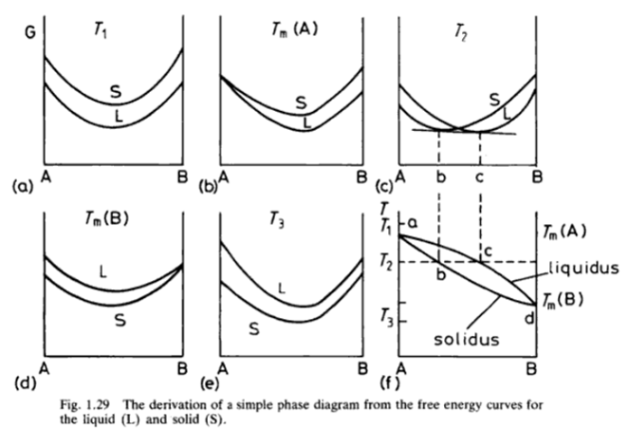
Solid to liquid phase diagram in a two component system : A and B are completely miscible and ideal solutions
At equilibrium, when both T and P are constant, sum total of chemical potential = 0
i.e. dμ^{α} = dμ^{β} where, μ^{α} = δG/δn_{a}

Slide 28
Binary (two component) systems : Activity, a of a component
Activity is simply related to chemical potential by:
G_{B}
μ_{A} = G_{A} + RT ln a_{A}
G_{A}
ΔG_{MIX}
-RTln a_{B}
μ_{B} = G_{B} + RT ln a_{B}
-RTln a_{A}
It is another means of describing the state of the system. Low activity means that the atoms are reluctant to leave the solution (which implies, for example, a low vapour pressure).
μ_{B}
μ_{A}
0
X_{B}
1
i.e. For homogeneous mixing, Γ<0 ⇒ a_{A}<X_{A} and a_{B}<X_{B}
So the activity is the tendency of a component to leave solution

Slide 29
Binary phase diagrams : The Miscibility gap
ΔH_{MIX} > 0
G
G
T₂
T₁
solid
L
a b c d
S
Common tangent
liquid
A
B
A
B
G
liquid
Single phase, mixed solid
T₃
T₁
L
T₂
S
2 phase: (A+δB) and (B+δA)
Compositions e and f ;
“The miscibility gap”
e
f
T₃
e
f
A
B
A
X_{B}
B

Slide 30
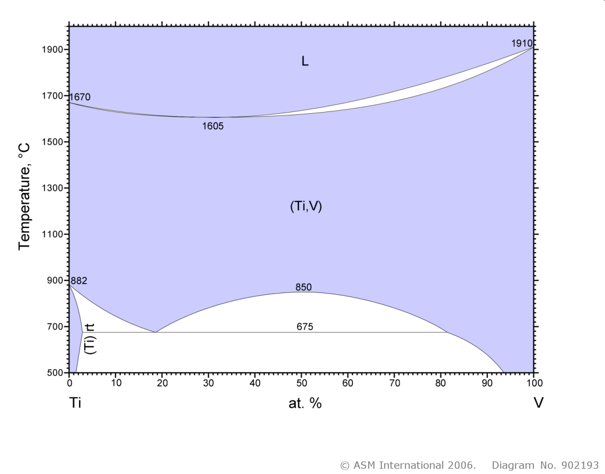
Titanium-Vanadium
Blue : single phase
(bcc)
White : two phase
(hcp)
(bcc)
What can we deduce?
Ti and V atoms bond weakly
There are no ordered phases
(Ti,V) phase : mixture of Ti and V in a fcc structure
Ti (hcp) phase does not dissolve V well

Slide 31
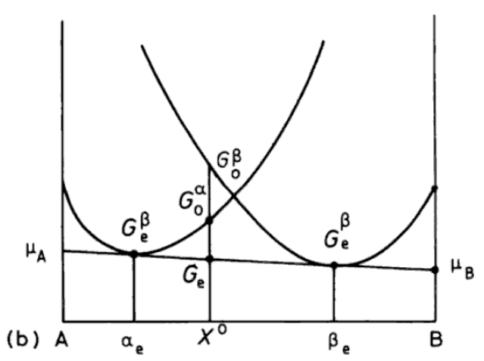
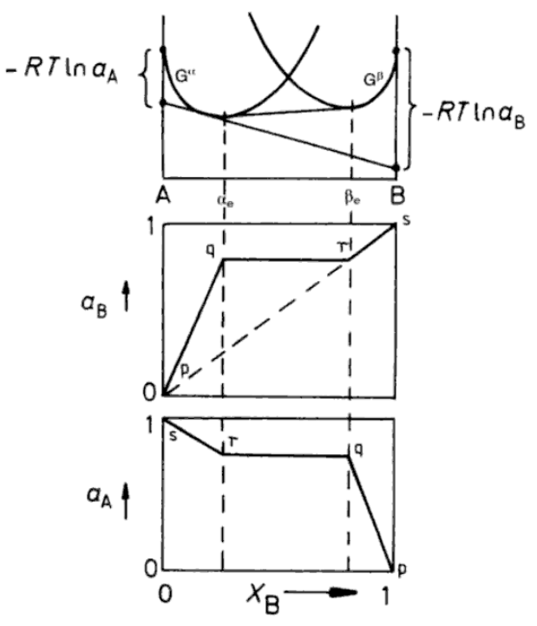
Equilibrium in heterogenous systems
For systems with phase separation (α and β) of two stable structures (e.g. fcc and bcc), we must draw free energy curves.
G^{α} is the curve for A and B in fcc structure (α phase)
G^{β} is the curve for A and B in bcc structure (β phase)
For: X⁰<α_{e} → α phase only
X⁰>β_{e} → β phase only
Common tangent
If β_{e}<X⁰>α_{e} then minimum free energy is G_{e}
And two phases are present (ratio given by the Lever rule – see later)
When two phases exist in equilibrium, the activities of the components must be equal in the two phases:

Slide 32
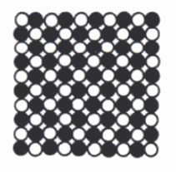
Binary (two component) systems : Ordered phases
Previous model gross oversimplification : need to consider size difference between A and B (strain effects) and type/strength of chemical bonding between A and B.
Systems with strong A-B bonds can form Ordered and/or intermediate phases
Ordered phases occur for (close to) integer ratios.
i.e. 1:1 or 3:1 mixtures. But entropy of mixing is very small so increasing temperature can disorder the phase. At some critical temperature, long range order will disappear.
Ordered structures can also tolerate deviations from stoichiometry. This gives the broad regions on the phase diagram
Ordered substitutional

Slide 33
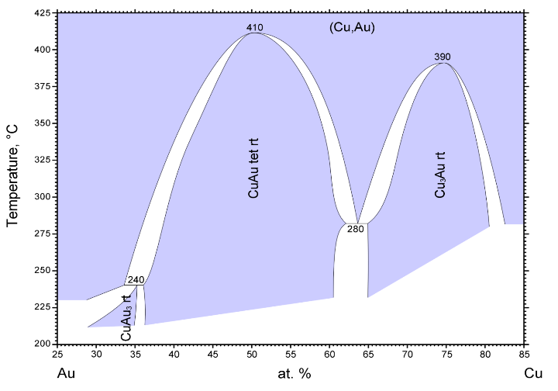
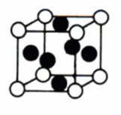
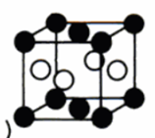
Random mixture
The Copper-Gold system
(fcc)
(fcc)
Single phases
Mixed phases
N.B. Always read the legend!!! (blue is not always ‘singe phase’)

Slide 34
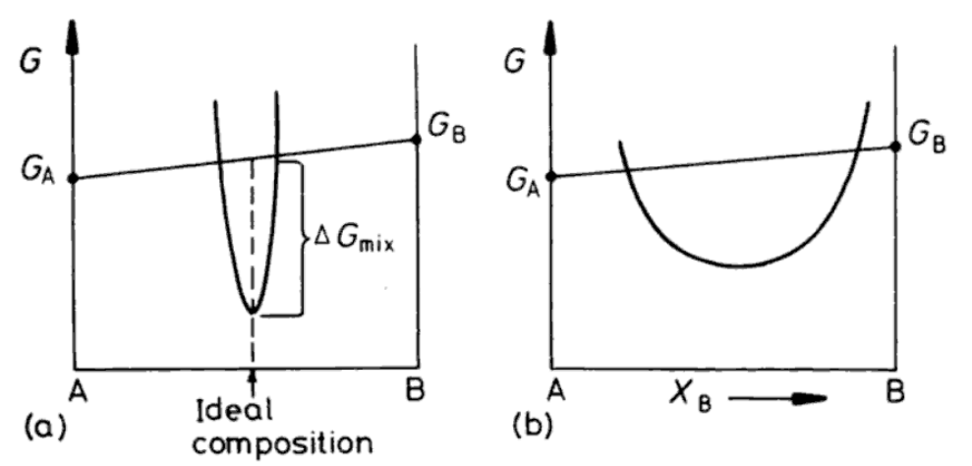
An intermediate phase is a mixture that has different structure to that of either component
Range of stability depends on structure and type of bonding (Ionic, metallic, covalent…)
Intermetallic phases are intermediate phase of integer stoichiometry e.g. Ni₃Al
Narrow stability range
broad stability range

Slide 35
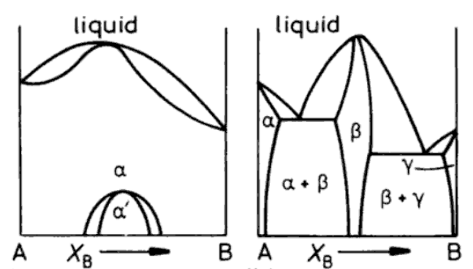
Binary phase diagrams : Ordered phases
ΔH_{MIX} < 0
Peak in liquidus line : attraction between atoms
i.e. A and B attract
1 phase, solid
Weak attraction
Strong attraction
Ordered phase α
Ordered β phase extends to liquid phase

Slide 36
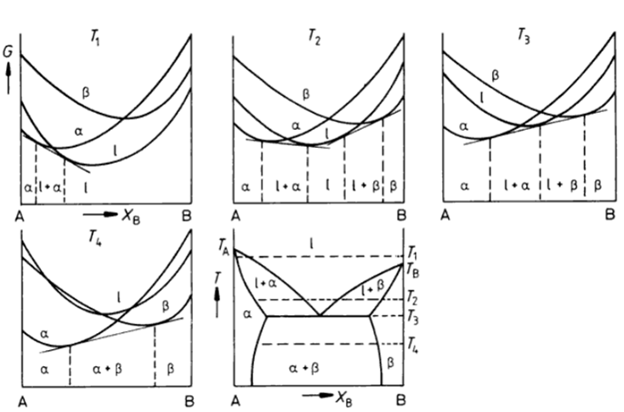
Binary phase diagrams : Simple Eutectic systems
ΔH_{MIX}  0 ; A and B have different crystal structures;
Two phase
Single phase
Eutectic point
α Phase is A with δB dissolved (crystal structure A)
β Phase is B with δA dissolved (crystal structure B)

Slide 37
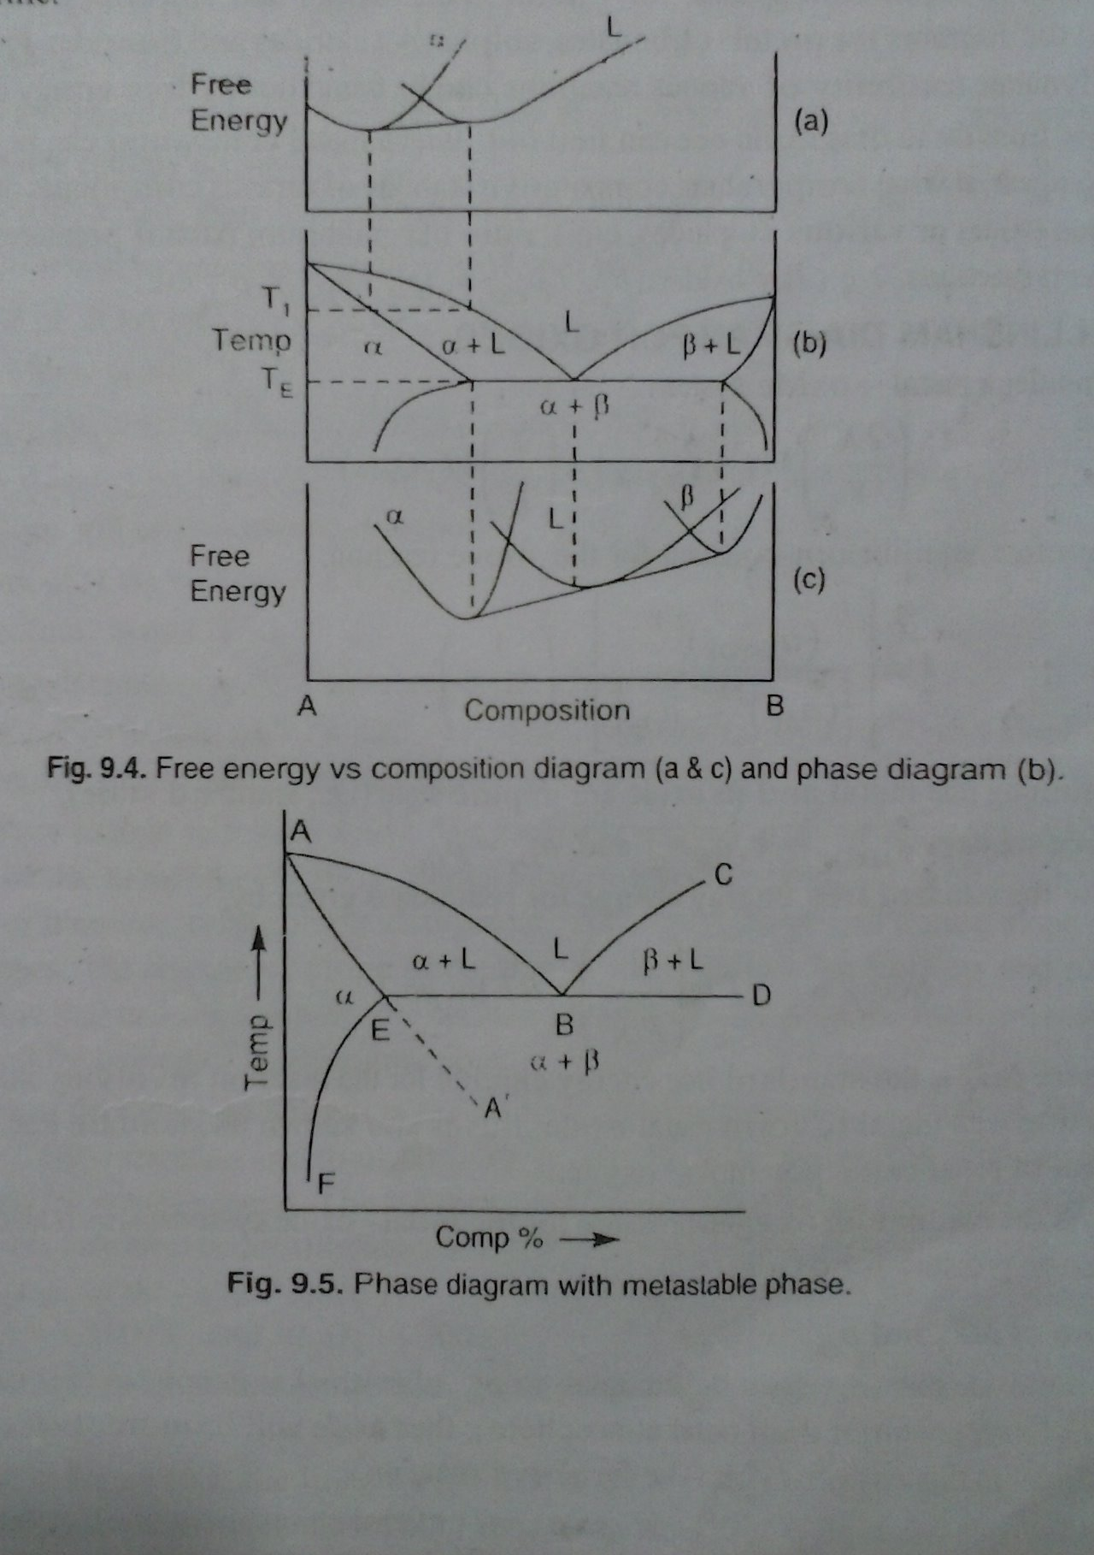
Construction of Phase Diagram from Free Energy vs. Composition Plot

Slide 38
Metastable Phase

Slide 39
Characterization of Slag
Slag – Combined molten oxides which are the by-product of smelting and refining process (Example – In steel making – Oxides and sulphides in molten state)
Slag is lighter than molten metal and is immiscible in metal
Role of Slag in steel making
Acts as a sink for impurities during refining of steel
Control oxidizing and reducing potential during refining through FeO content. Higher FeO makes the slag oxidizing and lower FeO will make it reducing
Prevents passage of nitrogen and hydrogen from atmosphere to the molten steel
Absorbs oxide/sulphide inclusions
Acts as a thermal barrier to prevent heat transfer from molten steel to the surrounding
Protects steel against re-oxidation
Emulsifies hot metal and promotes carbon oxidation
In arc melting process, slag prevents the radiation of heat of arc to the walls of the furnace and roof.

Slide 40
Factors Affecting the Characteristics of Slag
Important properties of slag
Viscosity (If slag acts as receiver for oxides and it does not take in reaction and is very viscous or dry, so it can’t easily separated from steel melt. On the other hand. If the slag acts as receiver and participates in refining reaction, it should be less vsicous or wet.
Thermal conductivity
Surface tension
Basicity
Factors affecting properties of slag
Temperature
Composition (Adding Fluorspar (CaF₂) or bauxite (Al₂O₃) decreases slag
Slag affects the intensity of erosion of the refractory or furnace and dissolution of the furnace lining material in the slag phase.

Slide 41
Types of Slag
Acid oxides: SiO₂, P₂O₅, TiO₂, V₂O₅, B₂O₃ etc. (deficient of oxygen ions)
Basic oxides: CaO, MgO, FeO, MnO, Na₂O, K₂O etc. (more oxygen ions)
Amphoteric oxides: Al₂O₃, Fe₂O₃, Cr₂O₃, V₂O₃
The ability of slag to retain oxides is expressed by:
V-ratio= %CaO / %SiO₂
Modified V-ratio = %CaO / (%SiO₂ + %Al₂O₃ + %P₂O₅)
Basicity (B) = (%(All basic oxides) / (%(All acid oxides)
For Acid slag: V or B < 1
For Basic Basicity: V or B > 1

Slide 42
Thermodynamic of Slag-Metal Reaction
Sulphur removal from metal is an example of slag-metal reaction
FeS + CaO → CaS + FeO
Equilibrium constant:
Coefficient of sulphur distribution between slag and metal will be:

Slide 43
How to Increase Kinetics of Desulphurization?
For efficient removal of S, high basicity and low FeO are required
Low oxygen potential is essential for sulphur removal. Content of S in metal relates to that of oxygen as: [%S] = 4[%O]
Desulphurization accelerates with the increase in temperature. At high Temp., solubility of Calcium sulphide in the slag increases, which increases desulphurization
Desulphurization increases by adding Fluorspar, which lowers viscosity and increases basicity
Desulphurization is more kinetically controlled than thermodynamically.

