Slide 1
Unit III
Ellingham diagram in detail for metal oxides, Activity, Gas phase Reactions (H2O- H2 and CO2 –CO mixtures), Reactions involving solid and gases, Activities in concentrated solution, Activity in industrial liquid metallic solution, Thermodynamics of solutions, Gibb’s-Duhem equation, Partial molar properties of mixing, Ideal solution, Raoult’s law, Henry’s law, Non-ideal solution

Slide 2
Ellingham Diagram
What is Ellingham Diagram?
C.J.T. Ellingham in 1944 constructed free energy vs. temperature diagrams for various metal oxides and sulphides.
Subsequently, similar diagrams were constructed for Metal-Carbonates, Sulphates, Chlorides, Fluorides.
It helps to predict the thermodynamics feasibility of various reactions
Helps to determine the critical temperature, ratio of equilibrium partial pressure of gases involved for a given reaction

Slide 3
Ellingham Diagram (Contd.)
We know: ⇒ y = mx + C
Ellingham Diagram
Ellingham Diagram for Oxides
ΔGº_{f}
X
Slope = -ΔSº_{f}
Intercept = ΔHº_{f}
T
Therefore, equilibrium constant for above reaction:
Ellingham Diagram
Since, activity of metal (a_{M}) and its oxide in pure state = 1
X
Slope = -ΔSº_{f}
ΔHº_{f}
T
ΔGº _{f}= standard free energy change for 1 mole of oxygen reacting with metal to form metal oxide

Slide 4
Ellingham Diagram (Contd.)
Variation of ΔGº_{f} and P_{O2}
If the oxide has very low P_{O2} compare to P_{O2} of external atmosphere (i.e. oxygen in the oxide is at lower potential than outer atmosphere) ; then oxide will be more stable or more difficult to reduce. In this case, ΔGº_{f} < 0 for above reaction
If the oxide has high P_{O2} compare to P_{O2} of external atmosphere (i.e. oxygen in the oxide is at higher potential than outer atmosphere) ; then oxide will be more unstable or more easy to reduce. In this case, ΔGº_{f} > 0 for above reaction
Hence to find out whether a given oxide will dissociate under a given condition, we need to know p_{O2} for metal-oxide system.
Important features of Ellingham Diagram for oxides
Standard enthalpy (or heat) and standard entropy of formation of oxide can be determined from Ellingham diagram
Negative entropy of formation: 2M(s) + O₂(g) → 2MO(s)
Positive entropy of formation: 2C(s) + O₂(g) → 2CO(g)
Zero entropy of formation: C(S) + O₂(g) → CO₂(g)
The point where linearity in ΔGº_{f} vs. T plot changes is called kink. It signifies phase transformation
It tells us the condition under which an element will act as reducing agent or oxidizing agent

Slide 5
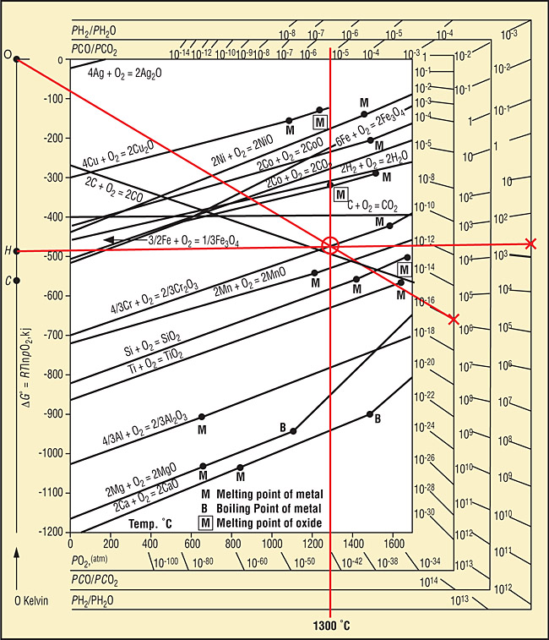
Ellingham Diagram for Oxides

Slide 6
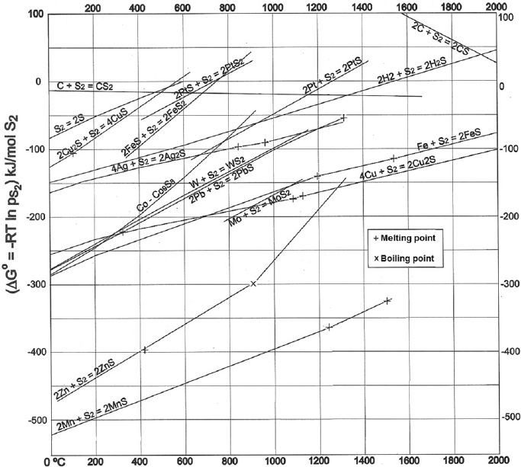
Ellingham Diagram for Sulphides

Slide 7
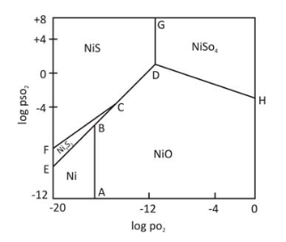
Predominance Area Diagram
Roasting of Sulphide (MS)
At constant T, k(i), k(ii), and k(iii) are constants.
Plot of log (P_{SO2}) vs. log (P_{O2}) for all reaction is called predominance area diagram for sulphide roasting
Case i: MS(s) +3/2O₂(g) → MO(s) + SO₂(g)
Or.
Ni-S-O system at 1000K
Case ii: MO(s) +SO₂(g) +1/2O₂(g)→ MSO₄(s)
Or.
Case iii: MS(s) +2O₂(g) → MSO₄(s)
B,C, D are called invariant point (degree of freedom = 0)
Along AB, BC, EB, CD, DG, DH, FC, degree of freedom = 1
Or.

Slide 8
Uses of Predominance Area Diagram
It shows stable phase under different conditions (gas pressures)
It predicts possible processing routes
It predicts the condition for the formation of a particular phase
Thermodynamically, it is possible to produce metal sulphide by controlling p_{O2}

Slide 9
Gas Phase Reactions (H₂O-H₂ and CO₂-CO mixtures)
These mixtures are used in experimental chemical metallurgy, where partial pressure is fixed to control reaction
Assumption: Chemical equilibrium is reached rapidly among reacting species (which is not true all the time)
H₂(g) + 1/2O₂(g) → H₂O(g)
Thus, it is possible to calculate k_{e} for a given T and calculate the required p_{H2O}/p_{H2}
CO(g) + 1/2O₂(g) → CO₂(g)
Thus, for a given T, k_{e} can be calculated and subsequently the required value of p_{CO2}/p_{CO} can be calculated

Slide 10
Solutions and Partial Molar Quantities
Solution is defined as a homogeneous phase composed of different chemical substances.
Aqueous solutions (example: NaCl solution
Nonaqueous solution: (Metallurgical solution)
Metallic solution (Ag-Cu, Fe-Ni)
Non-metallic solution (molten slag (SiO₂, CaO, FeO, and Al₂O₃)
Atomic fraction = Total number of gram atoms / Total number of gram atoms of all components present in solution = n_{i}/Σn_{i}
Conversion of weight% to atom% and vice-versa for binary system (A-B)

Slide 11
Basic Definition – Contd.
Mole Fraction:
Molality: Number of mole of solute per 1000g of solvent
Molarity: Number of mole of solute per liter of solution
Normality: Gram equivalents of solute per liter of solution

Slide 12
Ideal and Non-Ideal Solutions
Rault’s Law
The partial pressure of the vapor of any component of an ideal solution is equal to the product of its mole fraction and the vapor pressure of the pure component at the same temperature as that of ideal solution
P_{A}=X_{A}*Pº_{A}
Where: P_{A} is the partial pressure of vapor of component A in ideal solution, X_{A} is its mole fraction, and Pº_{A} is the vapor pressure of the pure component
Since, for ideal solution: P_{A} = f_{A} and Pº_{A} = fº_{A}; where f is fugacity of vapor
Therefore, f_{A}=X_{a} fº_{A};
Since by definition, f_{A}/fº_{A} = a_{A}, Therefore, a_{A} = X_{A}
The activity of a component equal to the mole fraction of that component
a_{A} = X_{A}
Ideal Solution
Ideal solution obeys Rault’s law over all temperatures and pressure
a_{A}
Non- Ideal Solution
Non- Ideal solution does not obey Rault’s law. i.e. a_{A} ≠ X_{A}
X_{A}

Slide 13
Non-Ideal Solution
Henry’s Law states that the activity of a component (i.e. solute) is proportional to its mole fraction.
a_{A} = γX_{A} ; where γ is activity coefficient or activity quotient
i) For ideal solution, γ = 1
ii) For non-ideal solution,
γ > 1 (+ve deviation from Rault’s law)
γ <1 ((-ve deviation from Rault’s law)
Rault’s Law
a_{A}
Henry’s Law
X_{A}
Non-ideal solution does not obey Raoult’s law
Non-ideal solution do not have any general relation between activity and mole fraction

Slide 14
Solubility of Gas
Sivert’s Law states that the solubility of a diatomic gas in a molten metal at a given temperature is proportional to the square root of its partial pressure
If hydrogen gas at pressure in equilibrium with a molten metal will form a system represented by: H₂(g) = 2H
Where, H is atomic hydrogen in molten metal
Equilibrium constant,
Considering that H in molten metal obeys gas law,
Hence, for diatomic gas like hydrogen,
Where k’ is solubility constant and is partial pressure of hydrogen gas

Slide 15
Solubility of Gas – Contd.
For monoatomic gas like He, solubility is proportional to its partial pressure
For multiatomic gas:
Where n is the number of atom in each gas molecule

Slide 16
Gibbs-Duhem Equation
Why we need it?
Thermodynamic properties of a substance (i.e. P,V,H,S,G etc.) in pure state are different from those in a state of solution (Example: Vapor pressure of pure metal (Pº_{A}) is lowered when it goes into a state of solution (P_{A})
Activity of component in solution:
Where, P_{A} is partial pressure of vapor of A over solution and Pº_{A} is vapor pressure of A over pure A.
Change in Gibbs free energy:

Slide 17
Gibbs-Duhem Equation – Contd.
If G is the thermodynamic quantity per mole of the solution and G’ is the thermodynamic quantity of n mole of the solution →
Where, G’=f(P,T,n₁,n₂,n₃…….)
Where is called partial molar quantity of component 1 and is considered as constant
On partially differentiating,
Where is called partial molar quantity of component 2 and is considered as constant
Similarly,

Slide 18
Gibbs-Duhem Equation – Contd.
Dividing by n:
Or,
(Equation 1)
On integrating:
X_{i} = Mole fraction of i^{th} component
Or,
On Differentiating:
Equation 2 – Equation 1 = 0
(Equation 2)
Gibbs – Duhem Equation

Slide 19
Gibbs-Duhem Equation – Contd.
Since,
Or,
Similarly:
For Binary System:
Where; H₁ and H₂ are partial molar enthalpy
Similarly:
For Binary System:
Where; S₁ and H₂ are partial molar enthalpy

Slide 20
Methods for Obtaining Partial Molar Quantities
For Binary system at constant P and T:
By Differentiating:
From Gibbs-Duhem Equation:
Now for Binary system:
Therefore,
Or,
By Differentiating:
Multiplying by X₁/dX₂:
Or,
Similarly,
Therefore, for multicomponent system:

Slide 21
General Inter-Relations of Partial Molar Quantities
Differentiating w.r.t . n₁ :
Or,
Similary:
Since,
Differentiating :
Every relation developed for a substance of fixed composition in terms of molar quantities is also valid for each component of a solution in terms of partial molar quantities

Slide 22
Integration of the Gibbs-Duhem Equation
From Gibbs-Duhem Equation:
Since,
Therefore,
Or,
On Integrating from X₁ = 1 → X₁
Or,

Slide 23
Integration of the Gibbs-Duhem Equation – Contd.
For Binary System:
By Differentiating:
Since,
Or,
---(2)
Or,
---(1)
Subtracting Eq. (1) from Eq. (2), we get,
Therefore,
Since,
Or,

Slide 24
Integration of the Gibbs-Duhem Equation – Contd.
From previous slide:
----(3)
On integrating from X₁ = 1 → X₁ :
Therefore,
However, difficulty in integrating this equation is solved by considering Darken’s function (α)
In Binary system,
and
Or,
and
On differentiating:
Therefore, combining Eq. (3) and eq. (4) and integrating, we get:
----(4)

Slide 25
Thermodynamics of Mixing of Solutions
When two or more liquid metals are mixed together, the change in free energy (ΔG) must be negative for complete mixing
If ΔG > 0 when two liquid metals are mixed together, then we get immiscible metals.
ΔH^{M} can be positive (Example: Al-Sn (endothermic)) or negative (Example: Al-Cu-Sn, Al-Cu (Exothermic)) depending on evolution or absorption of heat on mixing
ΔS^{M} can be positive or negative depending on arrangement and order of each components of the solution
For ideal solution, ΔH^{M,id} = 0 and ΔS^{M,id} = -R(X₁lnX₁ + X₂lnX₂ +……)
Since,
For ideal solution,
Or,
Or,

Slide 26
Regular Solution
Regular solutions are not ideal but vary from ideal behavior marginally; wherein their entropy of mixing (ΔS^{M}) is the same as those of an ideal solution (ΔS^{M,id})
i.e. ΔS^{M}= ΔS^{M,id}
Therefore, for regular solution,
By definition, for real solution:
Therefore,

Slide 27
Regular Solution – Contd.
Since, a=γX
Therefore,
For regular solution, which behave very closely to ideal solution, if the component in solution exhibits negative deviation from ideal behavior , γ < 1 and ΔH^{M} < 0, resulting in evolution of heat on mixing
Similarly, for regular solution, which behave very closely to ideal solution, if the component in solution exhibits positive deviation from ideal behavior , γ > 1 and ΔH^{M} > 0, resulting in absorption of heat on mixing
This provides a way of measuring activity coefficient and activity of components on mixing for regular solution
Example of regular solution: Ag-Cu, Al-Zn, Cd-Zn, Fe-Mn, Fe-Ni etc.

Slide 28
Activities in Concentrated Liquid Metallic Solution
Concentrated liquid metallic solution obeys Raoult’s law, i.e.,
a_{i}=X_{i}
Very few solutions obey Raoult’s law in the entire composition range.
To indicate departure of a solution from Raoult’s law, activty coefficient is used (γ_{i}) :
If γ_{i} > 1, the deviation from ideal behavior is called positive deviation
If γ_{i} < 1, the deviation from ideal behavior is called negative deviation
Deviation occurs when solute concentration increases and solute atoms become sufficiently close to each other in solution to mutually interact
Examples: 1) Liquid Fe-Mn and Fe-Ni solutions are ideal and obey Raoult’s law
2) Liquid Fe-Cu shows positive deviation from Raoult’s law
3) Liquid Fe-Si shows negative deviation from Raoult’s law

Slide 29
Activities in Industrial Liquid Metallic Solutions
Industrial liquid metallic solutions are generally dilute solutions
Example: Hot metal produced from blast furnace contains ~93-95% Fe as solvent and ~5-7% solute elements such as C, Si, Mn, P, and S
In dilute binary solutions, solute obeys Henry’s law and solvent obeys Roult’s law. In case of hot metal such as steel, the solute elements such as C, Si, Mn, P, and S obeys Henry’s law and Fe obeys Raoult’s law.
In other words, in infinitely dilute solutions, activities of solutes are proportional to their respective concentrations (Henry’s law).

Slide 30
Values of Activity Coefficients for Metallic Solutions
Solvent | Solute | Activity coefficient (Deviation from Raoult’s Law) | Temperature, K
Cu | Zn | 0.14 (negative deviation) 0.24 (negative deviation) | 877 1075
Fe | Co Cr Ni | 1.0 (ideal solution) 1.0 (ideal solution) 0.66 (negative solution) | 1873 1873 1873
Pb | Ag Au Zn | 2.3 (positive deviation) 1.5 (positive deviation) 0.25 (negative deviation) 11.0 (positive deviation) | 1273 1358 873 926
Ni | Fe | 0.26 (negative deviation) 0.40 (negative deviation) | 1783 1873

Slide 31
Activity Coefficients for Metallic Solutions – Contd.
Some solute obeys Raoult’s law, e.g. Co and Cr in Fe
Values of γº < 1 indicates negative deviation from Raoult’s law
Values of γº > 1 indicates positive deviation from Raoult’s law
For solutions that do not obey Raoult’s law, deviation from ideal behavior is more at lower temperature. Thus, separation of Zn from Pb-Zn liquid solution is more favored at lower temperature.
For Pb-Zn system, where γº = 11 at 926K; Since a = f/fº and for non-ideal gas, f = P at low temperature;
Then,
Hence,
Where, p_{Zn} is the equilibrium partial pressure of Zn vapor over Pb-Zn allow at low concentration of Zn at 926K and p_{Zn}º is the equilibrium partial pressure of Zn vapor over pure liquid Zn at 926K.
Therefore, increasing p_{Zn} helps in preferential removal of Zn vapor during vacuum distillation

