Slide 1


Transport Phenomena in Metallurgical Processes
Syllabus
Chapter 1
Heat Transfer (Conductive and Convective)
Modes of heat transfer. Conduction of heat through solid. Steady and unsteady state. Fourier law of heat conduction. General equation of heat conduction in cartesian co-ordinate, spherical and cylindrical systems. Convective heat transfer. Free and forced convection. Application dimensional analysis of effective boundary
layer.

Slide 2
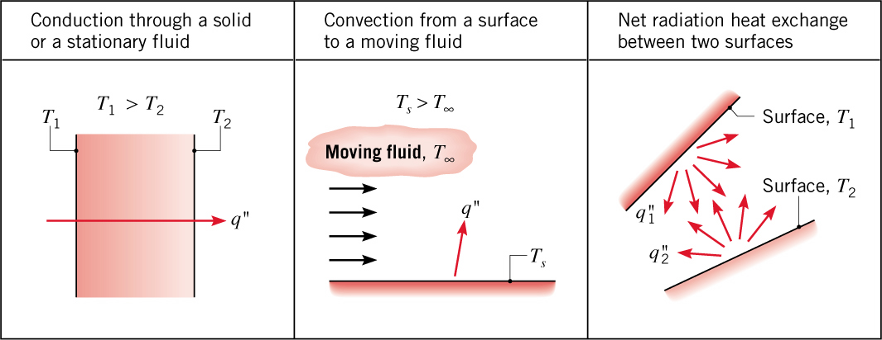
Modes of Heat Transfer
Conduction: Heat transfer in a solid or a stationary fluid (gas or liquid) due to the random motion of its constituent atoms, molecules and /or electrons.
Convection: Heat transfer due to the combined influence of bulk and random motion for fluid flow over a surface.
Radiation: Energy that is emitted by matter due to changes in the electron configurations of its atoms or molecules and is transported as electromagnetic waves (or photons).
Conduction and convection require the presence of temperature variations
in a material medium.
Although radiation originates from matter, its transport does not require a material medium
and occurs most efficiently in a vacuum

Slide 3
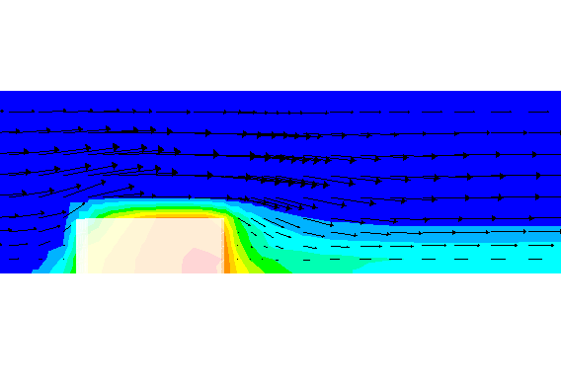
Convection Heat Transfer
Convection is movement of heat with a fluid
E.g., when cold air sweeps past a warm body, it draws away warm air near the body and replaces it with cold air
often, we want to know the heat transfer coefficient, h (next page)
flow over a heated block

Slide 4
Physical Mechanism of Convection
Conduction and convection are similar in that both mechanisms require the presence of a material medium.
But they are different in that convection requires the presence of fluid motion.
Heat transfer through a liquid or gas can be by conduction or convection, depending on the presence of any bulk fluid motion.
The fluid motion enhances heat transfer, since it brings warmer and cooler chunks of fluid into contact, initiating higher rates of conduction at a greater number of sites in a fluid.

Slide 5
Convective Heat Transfer
Understand the physical mechanism of convection
Visualize the development of velocity and thermal boundary layers during flow over surfaces
Gain a working knowledge of the dimensionless Reynolds, Prandtl, and Nusselt numbers
Nondimensionalize the convection equations and obtain the functional forms of friction and heat transfer coefficients
Free / Natural & Forced convection

Slide 6
Newton’s Law of Cooling
q
T_{body}
The rate of convection heat transfer is observed to be proportional to the temperature difference and is expressed by Newton’s law of cooling as
(6-1)

Slide 7
Experience shows that convection heat transfer strongly depends on the fluid properties:
  dynamic viscosity μ,
  thermal conductivity k,
  density ρ, and
  specific heat c_{p}, as well as the
  fluid velocity V.
It also depends on the geometry and the roughness of the solid surface.
The convection heat transfer coefficient h depends on the several of the mentioned variables, and thus is difficult to determine.

Slide 8
All experimental observations indicate that a fluid in motion comes to a complete stop at the surface and assumes a zero velocity relative to the surface (no-slip).
The no-slip condition is responsible for the development of the velocity profile.
The flow region adjacent
to the wall in which the
viscous effects (and thus
the velocity gradients) are
significant is called the boundary layer.

Slide 9
An implication of the no-slip condition is that heat transfer from the solid surface to the fluid layer adjacent to the surface is by pure conduction, and can be expressed as
Equating Eqs. 6–1 and 6–3 for the heat flux to obtain
The convection heat transfer coefficient, in general, varies along the flow direction.
(6-3)
(6-4)

Slide 10
Velocity Boundary Layer
Consider the parallel flow of a fluid over a flat plate.
x-coordinate: along the plate surface
y-coordinate: from the surface in the normal direction.
The fluid approaches the plate in the x-direction with a uniform velocity V.
Because of the no-slip condition V(y=0)=0.
The presence of the plate is felt up to δ.
Beyond δ the free-stream velocity remains essentially unchanged.
The fluid velocity, u, varies from 0 at y=0 to nearly V at y=δ.

Slide 11
Velocity Boundary Layer
The region of the flow above the plate bounded by δ is called the velocity boundary layer.
δ is typically defined as
the distance y from the
surface at which
u=0.99V.
The hypothetical line of
u=0.99V divides the flow over a plate into two regions:
  the boundary layer region, and
  the irrotational flow region.

Slide 12
Thermal Boundary Layer
Like the velocity a thermal boundary layer develops when a fluid at a specified temperature flows over a surface that is at a different temperature.
Consider the flow of a fluid
at a uniform temperature of
T∞ over an isothermal flat
plate at temperature T_{s}.
The fluid particles in the
layer adjacent assume the surface temperature T_{s}.
A temperature profile develops that ranges from T_{s} at the surface to T∞ sufficiently far from the surface.
The thermal boundary layer ─ the flow region over the surface in which the temperature variation in the direction normal to the surface is significant.

Slide 13
The thickness of the thermal boundary layer δ_{t} at any location along the surface is defined as the distance from the surface at which the temperature difference T(y=δ_{t})-T_{s}= 0.99(T∞-T_{s}).
The thickness of the thermal boundary layer increases in the flow direction.
The convection heat transfer rate anywhere along the surface is directly related to the temperature gradient at that location.

Slide 14
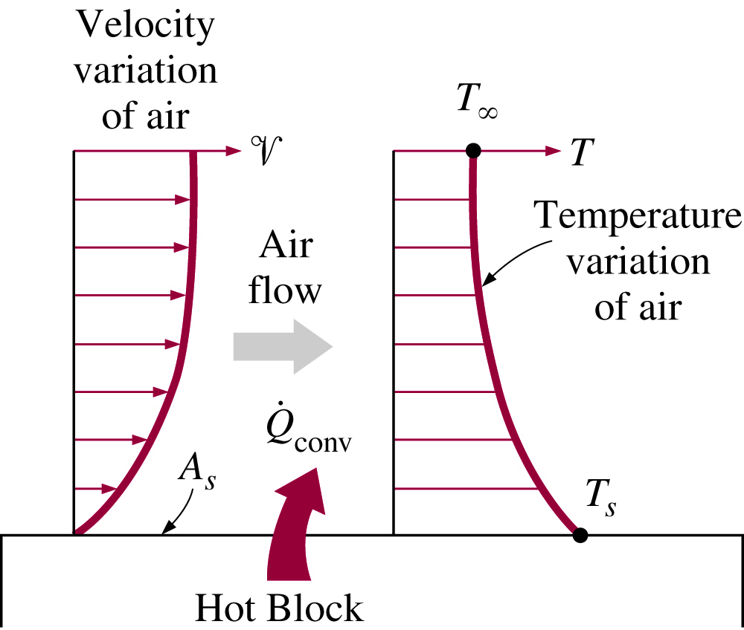
Momentum & Heat Transfer over plate

Slide 15
Classification of Fluid Flows
Viscous versus inviscid ( no viscosity) regions of flow
Internal versus external flow
Compressible versus incompressible flow
Laminar versus turbulent flow
Natural (or unforced) versus forced flow
Steady versus unsteady flow
One-, two-, and three-dimensional flows

Slide 16
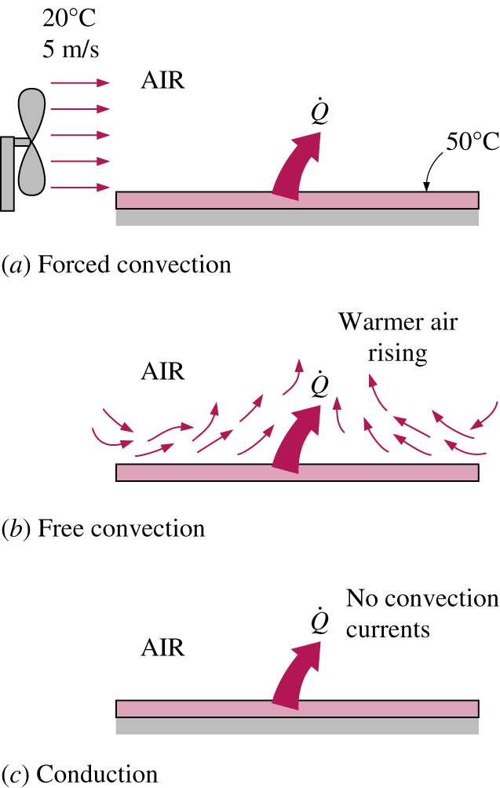
Heat Transfer from a hot surface to the surrounding fluid by convection and conduction.

Slide 17
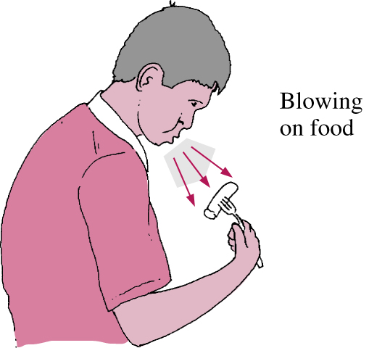
We resort to forced convection whenever we need to increase the rate of heat transfer.

Slide 18
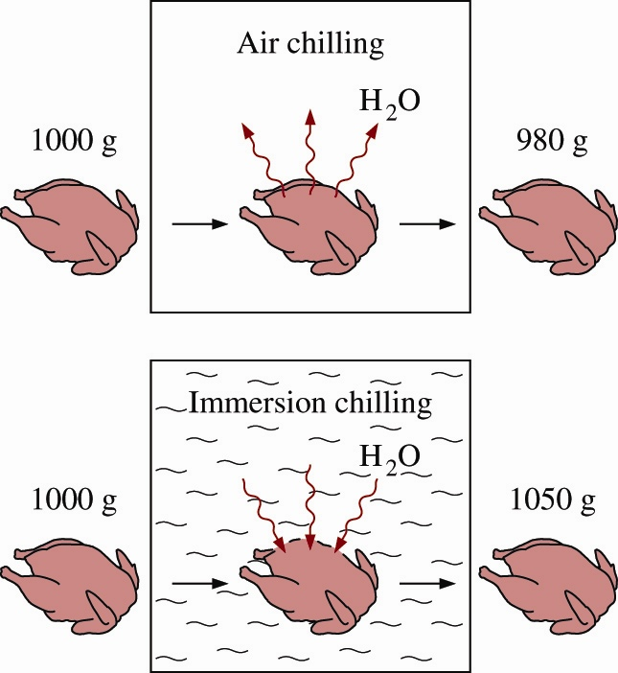
NC

Slide 19
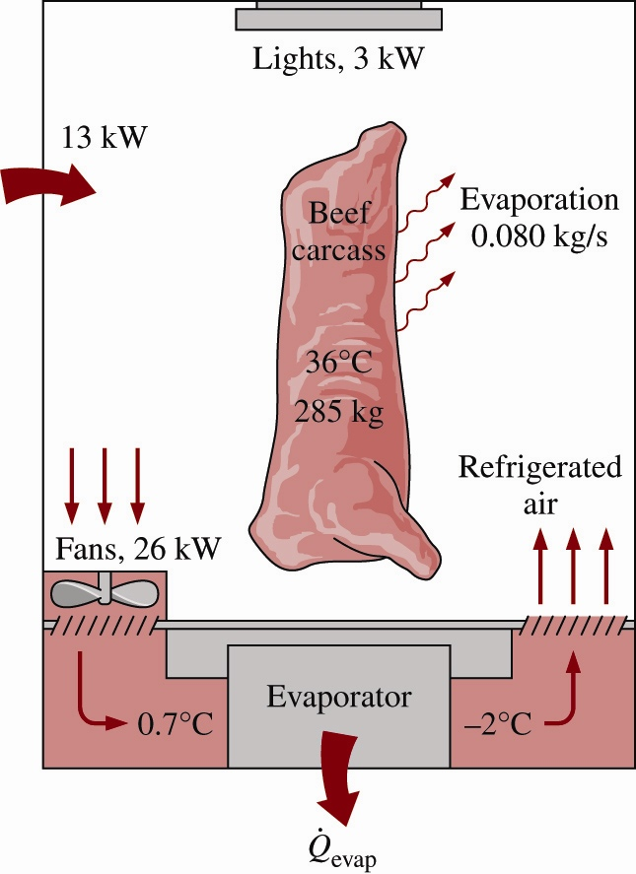
FC

Slide 20
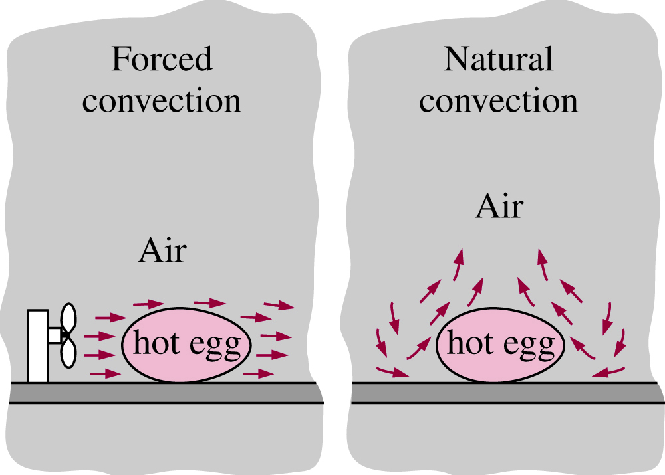

Slide 21
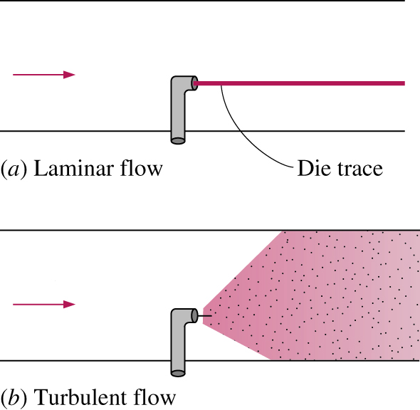
The behavior of colored fluid injected into the flow in laminar and turbulent flows in a tube.

Slide 22
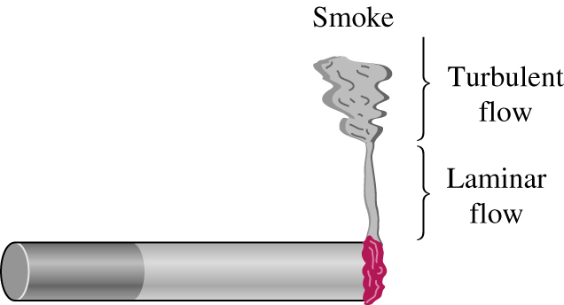
Laminar and turbulent flow regimes of cigarette smoke.

Slide 23
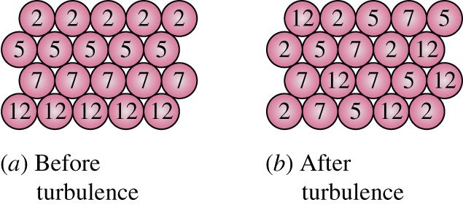

Slide 24
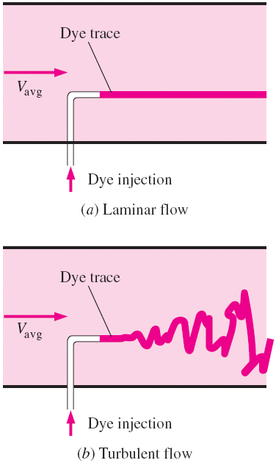
Laminar and Turbulent Flows
Laminar flow ─ the flow is characterized by smooth streamlines and highly-ordered motion.
Turbulent flow ─ the flow is
characterized by velocity
fluctuations and
highly-disordered motion.
The transition from laminar
to turbulent flow does not
occur suddenly.

Slide 25
The velocity profile in turbulent flow is much fuller than that in laminar flow, with a sharp drop near the surface.
The turbulent boundary layer can be considered to consist of four regions:
  Viscous sublayer
  Buffer layer
  Overlap layer
  Turbulent layer
The intense mixing in turbulent flow enhances heat and momentum transfer, which increases the friction force on the surface and the convection heat transfer rate.

Slide 26
DIMENSIONLESS NUMBERS
Dimensionless quantity is a quantity without an associated physical dimension.
It is thus a "pure" number, and as such always has a dimension of 1.
Dimensionless quantities are widely used in mathematics, physics, engineering, economics, and in everyday life (such as in counting).
Numerous well-known quantities, such as π, e, and φ, are dimensionless.

Slide 27
Dimensionless Numbers
Dimensionless quantities are often defined as products or ratios of quantities that are not dimensionless, but whose dimensions cancel out when their powers are multiplied.
This is the case, for instance, with the engineering strain, a measure of deformation. It is defined as change in length over initial length but, since these quantities both have dimensions L (length), the result is a dimensionless quantity.
A dimensionless quantity is not always a ratio; for instance, the number of people N in a room is a dimensionless quantity.

Slide 28
Dimensionless Numbers
Example
An angle is measured as the ratio of the length of a circle's arc subtended by an angle whose vertex is the centre of the circle to some other length.
The ratio, length divided by length, is dimensionless. When using radians as the unit, the length that is compared is the length of the radius of the circle.
When using degree as the units, the arc's length is compared to 1/360 of the circumference of the circle.

Slide 29
Dimensionless Numbers
It is almost impossible to read an article or listen to a
lecture on heat transfer without hearing names like
Reynolds. Nusselt, Rayleigh, etc.
These names refer to very specific dimensionless numbers that are used to characterize and classify the heat transfer problems.
This article attempts to explain the meaning and significance of these numbers and help you to get used to them.
But first, why do we need dimensionless numbers anyway?

Slide 30
Dimensionless Numbers
We have invented dimensionless numbers to be able to take our knowledge from experimenting with one system to learning about another system with different dimensions.
If I have come up with some neat formula for calculating the pressure drop in a 2 inch pipe, can I use that formula for a 4 inch pipe?
In a way, we are trying to get rid of dimensions in order to extend our knowledge beyond its source of acquisition

Slide 31
A major advantage of nondimensionalizing is the significant reduction in the number of parameters.
The original problem involves 6 parameters (L, V, T, T_{s}, ν, α), but the nondimensionalized problem involves just 2 parameters (Re_{L} and Pr).
Refer AI 6 ( forced)
6 parameters
2 parameters
Nondimensionalizing
L, V, T, T_{s},ν, α
Re_{L}, Pr

Slide 32
Dimensionless Numbers
Mr. Osborne Reynolds experimented with pipes of different diameters
He discovered that, regardless of the pipe diameter, if the ratio of UD/ μ exceeds 2500 or so, the flow no longer stays nice and laminar.
This ratio is what we call Reynolds number and is probably the most commonly used dimensionless group in fluid dynamics.
Dimensionless numbers allow us to experiment with model cars, airplanes and ships and predict the behavior of the big thing under actual conditions

Slide 33
Dimensionless Numbers
All we have to establish is to make sure that there is similarity between the model and the actual thing.
Given below are the most common Dimensionless correlations used to solve complex problems in convective heat transfer :
Reynolds Number
Nusselt Number
Prandtl Number
Grashof Number
Rayleigh Number

Slide 34
Dimensionless Numbers
Before getting into the definitions of these numbers, we should define the physical properties of fluids since they show up all over the place in the dimensionless numbers.
Density
Mass of fluid contained in a unit volume. Its units are Kg/m^3 .
Typical values: Water = 1000 kg/m^3, Mercury = 13546 kg/m^3, Air = 1.23 kg/m^3, Paraffin Oil = 800 kg/m^3. (at pressure =1.013e+5 Pascals and Temperature = 288.15 K.)

Slide 35
Dimensionless Numbers
Viscosity
It is the property of a fluid, due to cohesion and interaction between molecules, which offers resistance to sheer deformation of the fluid.
The viscosity of a fluid is a measure of its resistance to deformation
Different fluids deform at different rates under the same shear forces.
Fluid with a high viscosity such as syrup, deforms more slowly than fluid with a low viscosity such as water

Slide 36
Dimensionless Numbers
Shear Stress
Consider the flow of a fluid over the surface of a plate.
The fluid layer in contact with the surface tries to drag the plate along via friction, exerting a friction force on it.
Friction force per unit area is called shear stress, and is denoted by τ.
Experimental studies indicate that the shear stress for most fluids is proportional to the velocity gradient.
The fluids that that obey the linear relationship are called Newtonian fluids.

Slide 37
The viscosities of liquids decrease with temperature, whereas the viscosities of gases increase with temperature.
A more practical approach in external flow
is to relate τ_{s} to the upstream velocity V as
C_{f} is the dimensionless friction coefficient (most cases is determined experimentally.
The friction force over the entire surface is determined from

Slide 38

Dimensionless Numbers
All fluids are viscous and ( water close to Newtonian Fluids ) obey the linear relationship given by Newton's law of viscosity. , where is the shear stress.
is the "coefficient of dynamic viscosity“
The Coefficient of Dynamic Viscosity is defined as the shear force, per unit area, (or shear stress ), required to drag one layer of fluid with unit velocity past another layer a unit distance away

Slide 39
Dimensionless Numbers
Reynolds Number
The transition from laminar to turbulent flow depends on the surface geometry, surface roughness, flow velocity, surface temperature, and type of fluid.
The flow regime depends mainly on the ratio of the inertia forces to viscous forces in the fluid.
This ratio is called the Reynolds number, which is expressed for external flow as
This dimensional correlation plays an important role in Forced Convection
(6-13)
V-velocity,ν –kinematic viscosity , m2/s , μ –dynamic viscosity kg/ms

Slide 40
Reynolds Number
At large Reynolds numbers (turbulent flow) the inertia forces are large relative to the viscous forces.
At small or moderate Reynolds numbers (laminar flow), the viscous forces are large enough to suppress these fluctuations and to keep the fluid “inline.”
Critical Reynolds number ─ the Reynolds number at which the flow becomes turbulent.
When the Reynolds number is large, the inertia forces are in command. Viscous forces dominate the boundary layer when the Reynolds number is small

Slide 41
Dimension less numbers
Now, how does this relate to transition from laminar to turbulent flow?
Any real flow of fluid contains small disturbances that will grow given enough opportunities as long as the viscous forces dominate these disturbances are under control.
As the inertia forces get bigger, the viscosity can no longer maintain order .
These tiny disturbances grow into trouble makers and there is transition to turbulent flow.

Slide 42
Dimension less numbers
Another important quantity of the boundary layer that is influenced by the Reynolds number is its thickness.
As the Reynolds number increases, the viscous layer gets squeezed into a smaller distance from the surface.
The value of Reynolds number beyond which the flow is no longer considered laminar is called the critical Reynolds number.

Slide 43
Dimension less numbers
For flow over a flat plate, the critical Reynolds number is observed to vary between 1e+5 to 3e+6 depending on the turbulence level in the free stream and the roughness of the surface. We normally use 5e+5 as the critical Reynolds number for flow over flat plates.
Calculation of the Reynolds number is easy as long as you:
Identify the characteristic length
Pick the right velocity
Use a consistent set of units

Slide 44
Dimensionless numbers
For flow over a flat plate, the characteristic length is the length of the plate and the characteristic velocity is the free stream velocity.
For pipes the characteristic length is the pipe diameter and the characteristic velocity is the average velocity through the pipe obtained by dividing the volumetric flow rate by the cross-sectional area (we are assuming that the pipe is full, of course).

Slide 45
Dimension less numbers
For pipes with a non-circular cross-section, the characteristic length is the Hydraulic Diameter defined as 4A/P, where A is the cross-sectional area of the duct and P is the wetted perimeter.
You can easily verify that for a circular pipe the hydraulic diameter equals the pipe diameter. For non-circular pipes the average velocity is used as the characteristic velocity.
You must decide, based on your design objectives, which length and velocity length scales make sense for calculation of the Reynolds number.

Slide 46
Dimension less numbers
Nusselt Number
Nusselt number is the dimensionless heat transfer coefficient dealing with convection heat transfer.
It, therefore, provides a measure of the convection heat transfer at the surface.
It is defined as hL/k where, h is the heat transfer coefficient, L is a characteristic length and k is the thermal conductivity.
But, what does this grouping mean from a physical standpoint? Let's find out.

Slide 47
Dimension less numbers
We have to look at the boundary layer in order to explain the concept of Nusselt number.
When a fluid flows over a solid surface, the first layer of the fluid stick to the boundary (we even have a name for this thing called, no slip condition).
This causes the flow to retard in the vicinity of the wall.
As we move away from the wall the effect of this no slip thing gets smaller and smaller up to a point where it is no longer felt by the fluid.

Slide 48
Dimension less numbers
As we move further and further away from the wall, the effect of the hot wall is felt less and less (it, of course, depends on the thermal conductivity of the fluid).
Eventually, there comes a point where the fluid does not have a clue about the hot wall.
The layer of fluid between the wall and this point is called the thermal boundary layer.
It is where all of the action is taking place (as far as heat transfer between the solid and fluid is concerned).

Slide 49
Dimension less numbers
It is common practice to nondimensionalize the heat transfer coefficient h with the Nusselt number
Heat flux through the fluid layer by convection and by conduction can be expressed as, respectively:
Taking their ratio gives
(6-5)
(6-6)
(6-7)
(6-8)

Slide 50
Nu >> 1
Nu > 1
Nu = 1

Slide 51
Dimension less numbers
The Nusselt number represents the enhancement of heat transfer through a fluid layer as a result of convection relative to conduction across the same fluid layer
So, the Nusselt number may be viewed as the ratio of convection to conduction for a layer of fluid.
If Nu=1, we have pure conduction. Higher values of Nusselt mean that the heat transfer is enhanced by convection.
Grashof Number ( Refer Y -1)
This number is for natural or free convection. The Grashof number is the ratio of buoyancy forces to the viscous forces.

Slide 52
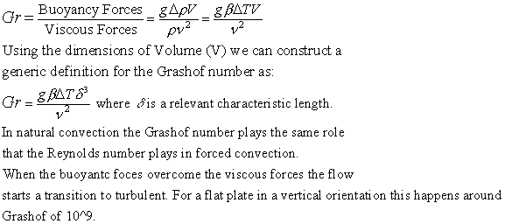
Dimension less numbers

Slide 53

Dimension less numbers
Rayleigh Number
The Rayleigh number is the product of Grashof and Prandtl numbers.
It turns out that in natural convection the Nusselt number scales with Rayleigh rather than just Grashof . ( refer Y-4 NC)
Most correlations in natural convection are of the form:

Slide 54
Dimension less numbers
Prandtl Number
Heat transfer scientists have invented another dimensionless number called the Prandtl number which is a grouping of the properties of the fluid but it has a significance to our discussion.
The relative thickness of the velocity and the thermal boundary layers is best described by the dimensionless parameter Prandtl number, defined as

Slide 55
Prandtl Number
Heat diffuses very quickly in liquid metals (Pr«1) and very slowly in oils (Pr»1) relative to momentum.
Consequently the thermal boundary layer is much thicker for liquid metals and much thinner for oils relative to the velocity boundary layer.
μ –dynamic viscosity kg/ms, Cp -sp heat , k –thermal conductivity

Slide 56
Prandtl Number
It is the ratio of momentum diffusivity (kinematic viscosity) to thermal diffusivity. It can be related to the thickness of the thermal and velocity boundary layers.
It is actually the ratio of velocity boundary layer to thermal boundary layer. When Pr=1, the boundary layers coincide. Typical values of the Prandtl number are:
Material | Pr
Liquid metals | 0.004-0.03
Gases | 0.7-1.0
Water | 1.7-13.7
Oils | 50-100,00

Slide 57
Convective Heat Transfer
When Pr is small, it means that heat diffuses very quickly compared to the velocity (momentum).
This means the thickness of the thermal boundary layer is much bigger than the velocity boundary layer for liquid metals.

Slide 58
Convective Heat Transfer
Experimental Approach:
Consider fluid flowing in a heated pipe. We are interested in convective heat transfer from the inside heated surface of the pipe to the fluid.
Carry out the experiment with fluid entering at velocity of u¹ at a temperature T^{i}.
Measure the electric current passing through to determine the rate of heat transfer, q.
Thus, we determine q, A, T^{i}, and T^{s}. Then using Newton’s law of cooling we calculate h.

Slide 59
Convective Heat Transfer
Now repeat the experiment for different diameter of pipe, or different temperature of the pipe surface, and determine new h value.
Perform a series of experiments to determine h values as a function of operating variables, q, A, T^{i} and T^{s}.
This can result in a large amount of data, but we organize data using the three dimensionless numbers.
For each experimental set, we calculate the dimensionless numbers , we plot Nusselt Number vs Reynolds number for different values of Prandtl number.

Slide 60
Convective Heat Transfer
It has been shown that for a given fluid, with a fixed Prandtl number, we get a straight line plot between log N^{Nu} and log N^{Re}.
Thus a convenient expression is of the form
By substituting experimentally obtained coefficients in above equation, we obtain empirical correlations.
Different correlations have been obtained for laminar and turbulent conditions

Slide 61
Convective Heat Transfer
Methodology to solve problems involving convection heat transfer:
Identify flow geometry
Is it a pipe, sphere, rectangular duct, plate? Is the fluid flowing inside or outside the pipe
2. Identify the fluid, and determine its properties
Is it water, air or a liquid feed? Determine the average fluid temperature far away from the solid surface, T∞

Slide 62
Convective Heat Transfer
In some cases, the average inlet and outlet temperatures may be different, in that case calculate the average fluid temperature.
Use the average fluid temperature to determine the physical and thermal properties of the fluid, such as viscosity, density, and thermal conductivity (from Appendix tables).

Slide 63
Convective Heat Transfer
Use the average fluid temperature to determine the physical and thermal properties of the fluid, such as viscosity, density, and thermal conductivity (from Appendix tables).
3. Calculate the Reynolds number
Using the velocity of the fluid, fluid properties, characteristic dimension, determine the Reynolds number. Determine if the flow is laminar, transitional, or turbulent.
4. Select an appropriate empirical correlation and determine h.
Select an empirical correlation from the following. Calculate Nusselt number and then h value.

Slide 64
Convective Heat Transfer
4. Select an appropriate empirical correlation and determine h.
Select an empirical correlation from the following. Calculate Nusselt number and then h value.
Important correlations
-For Natural Convection
Nu = constant ( Gr.Pr) ^m = constant ( Ra) ^m - different for range of Ra or Gr.Pr values ( refer lab manual)
-For forced convection
Nu = constant ( Re.Pr) ^n - different for range of Re

Slide 65
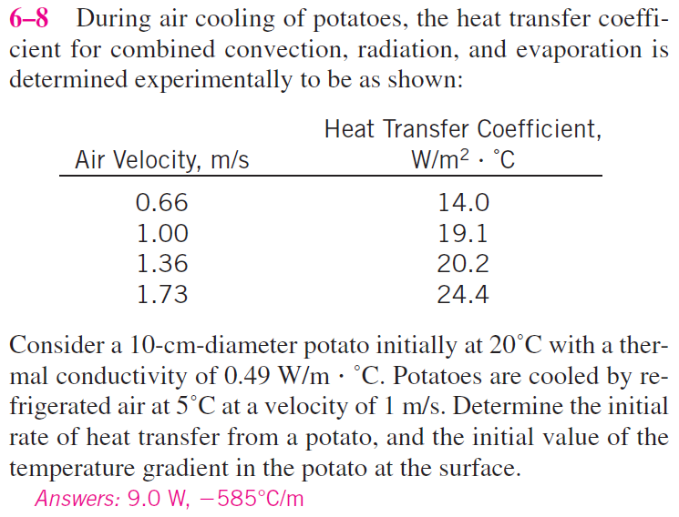

Slide 66
Heat transfer coefficients at different air velocities are given during air cooling of potatoes. The initial rate of heat transfer from a potato and the temperature gradient at the potato surface are to be determined.
Assumptions
1. Steady operating conditions exist.
2. Potato is spherical in shape.
3. Convection heat transfer coefficient is constant over the entire surface.
Properties
The thermal conductivity of the potato is given to be k = 0.49 W/m.°C.

Slide 67
Analysis
The initial rate of heat transfer from a potato is
where the heat transfer coefficient is obtained from the table at 1 m/s velocity.

Slide 68
The initial value of the temperature gradient at the potato surface is

Slide 69
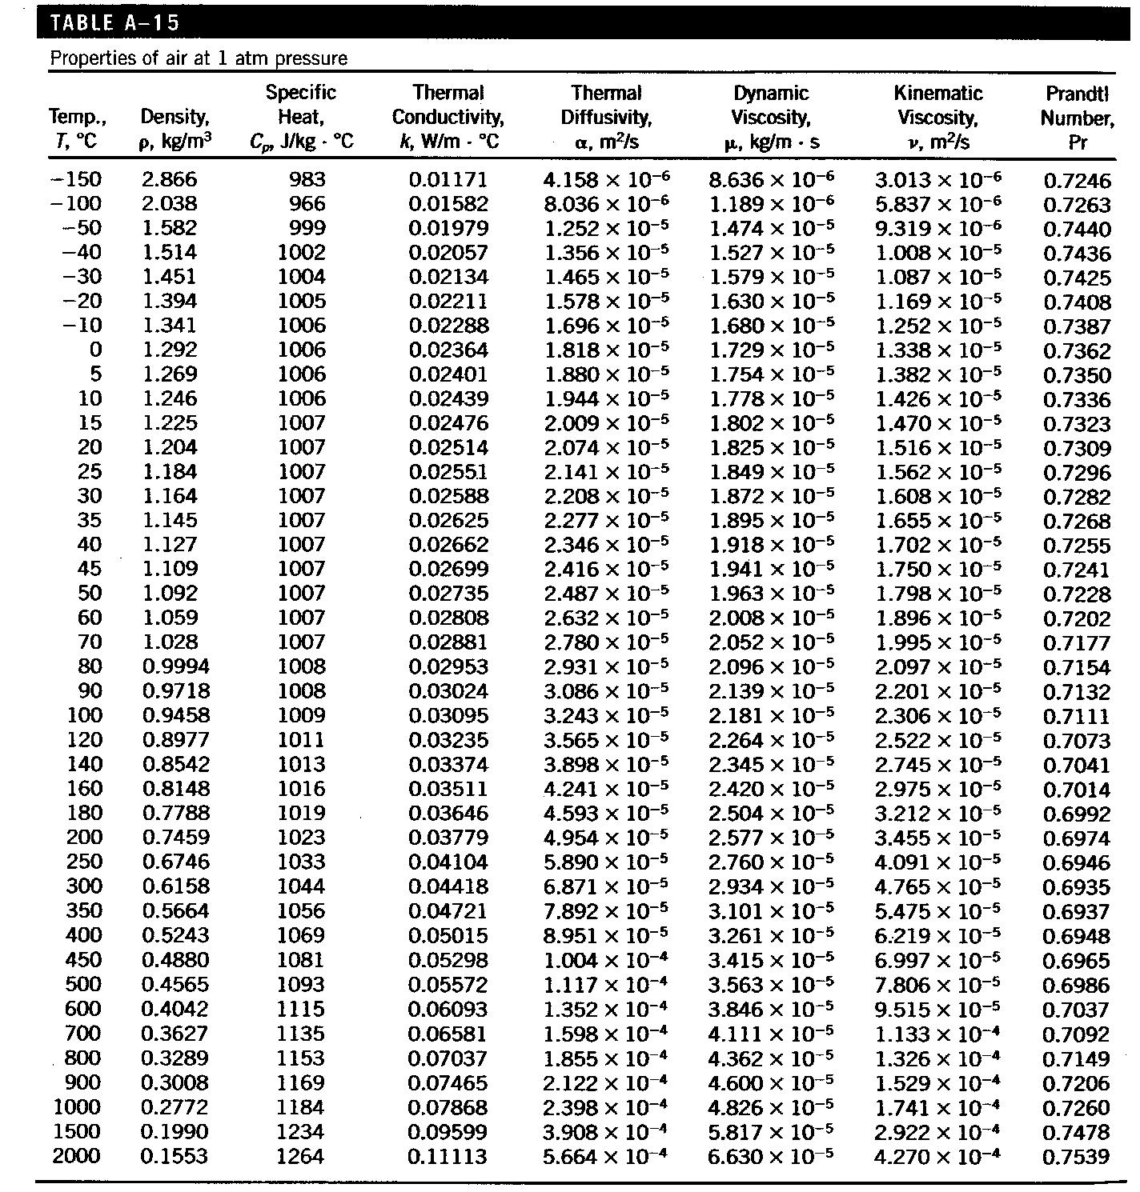

Slide 70
Transport Phenomena in Metallurgical Processes
Syllabus
Chapter 1
Heat Transfer (Conductive and Convective)
Modes of heat transfer. Conduction of heat through solid. Steady and unsteady state. Fourier law of heat conduction. General equation of heat conduction in cartesian co-ordinate, spherical and cylindrical systems. Convective heat transfer. Free and forced convection. Application dimensional analysis of effective boundary
layer.

Slide 71
Transport Phenomena in Metallurgical Processes
Syllabus
Heat Transfer (Radiative)
Aspects of Radiative Heat Transfer. Reflection, absorption and transmission of radiation. Black body radiation. Planck's Law. Wein's distribution Law. Heat transfer between two bodies by radiation. Lambert's Law

Slide 72
Heat Transfer
Heat always moves from a warmer place to a cooler place.
Hot objects in a cooler room will cool to room temperature.
Cold objects in a warmer room will heat up to room temperature.

Slide 73
Question
If a cup of coffee and a ice cube were left on the table in this room what would happen to them? Why?
The cup of coffee will cool until it reaches room temperature. The ice cube will melt and then the liquid will warm to room temperature.

Slide 74
Heat Transfer Methods
Heat transfers in three ways:
  Conduction
  Convection
  Radiation

Slide 75

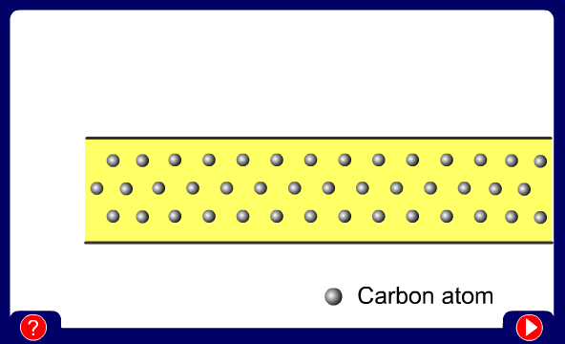
Conduction
When you heat a metal strip at one end, the heat travels to the other end.
As you heat the metal, the particles vibrate, these vibrations make the adjacent particles vibrate, and so on and so on, the vibrations are passed along the metal and so is the heat. We call this?
Conduction

Slide 76
Metals are different
The outer e______ of metal atoms drift, and are free to move.
lectrons
When the metal is heated, this ‘sea of electrons’ gain k_____ energy and transfer it throughout the metal.
inetic
Insulators, such as w___ and p____, do not have this ‘sea of electrons’ which is why they do not conduct heat as well as metals.
ood
lastic

Slide 77

Why does metal feel colder than wood, if they are both at the same temperature?
Metal is a conductor, wood is an insulator. Metal conducts the heat away from your hands. Wood does not conduct the heat away from your hands as well as the metal, so the wood feels warmer than the metal.

Slide 78
Convection
What happens to the particles in a liquid or a gas when you heat them?
The particles spread out and become less dense.
A liquid or gas.
What is a fluid?
This effects fluid movement.

Slide 79
Fluid movement
Cooler, more d____, fluids sink through w_____, less dense fluids.
ense
armer
In effect, warmer liquids and gases r___ up.
ise
Cooler liquids and gases s___.
ink

Slide 80
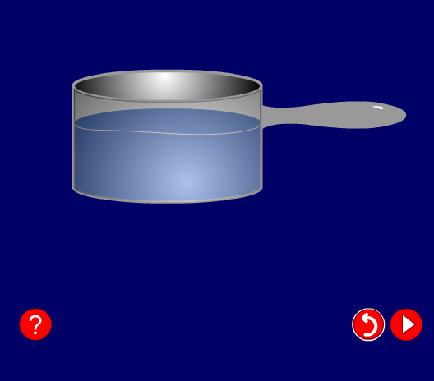
Water movement
Cools at the surface
Convection current
Cooler water sinks
Hot water rises

Slide 81
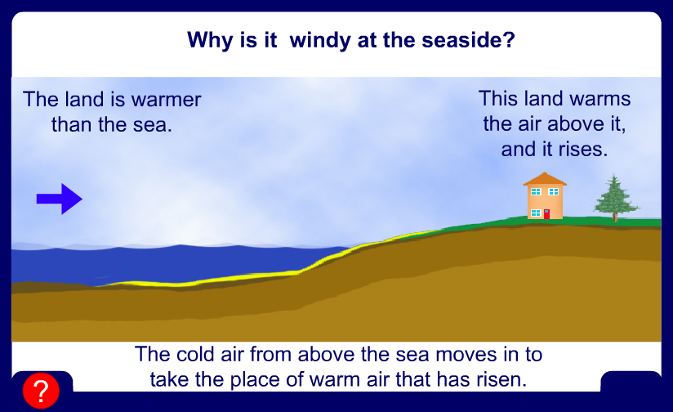
Why is it windy at the seaside?

Slide 82
Cold air sinks
Where is the freezer compartment put in a fridge?
Freezer compartment
It is warmer at the bottom, so this warmer air rises and a convection current is set up.
It is put at the top, because cool air sinks, so it cools the food on the way down.

Slide 83
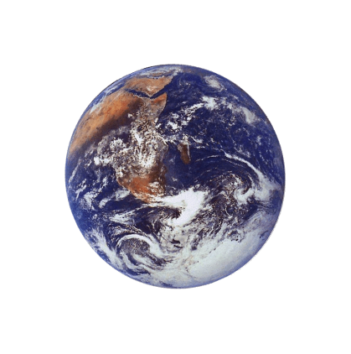

The third method of heat transfer
How does heat energy get from the Sun to the Earth?
There are no particles between the Sun and the Earth so it CANNOT travel by conduction or by convection.
RADIATION
?

Slide 84
Radiation
Radiation travels in straight lines
True/False
Radiation can travel through a vacuum
True/False
Radiation requires particles to travel
True/False
Radiation travels at the speed of light
True/False

Slide 85
Emission experiment
Four containers were filled with warm water. Which container would have the warmest water after ten minutes?
Dull metal
Shiny black
Shiny metal
Dull black
shiny metal
The __________ container would be the warmest after ten minutes because its shiny surface reflects heat _______ back into the container so less is lost. The ________ container would be the coolest because it is the best at _______ heat radiation.
radiation
dull black
emitting

Slide 86
Absorption experiment
Four containers were placed equidistant from a heater. Which container would have the warmest water after ten minutes?
Dull metal
Shiny black
Shiny metal
Dull black
dull black
The __________ container would be the warmest after ten minutes because its surface absorbs heat _______ the best. The _________ container would be the coolest because it is the poorest at __________ heat radiation.
radiation
shiny metal
absorbing

Slide 87
Convection questions
Why does hot air rise and cold air sink?
Cool air is more dense than warm air, so the cool air ‘falls through’ the warm air.
Why are boilers placed beneath hot water tanks in people’s homes?
Hot water rises.
So when the boiler heats the water, and the hot water rises, the water tank is filled with hot water.

Slide 88
Radiation questions
Why are houses painted white in hot countries?
White reflects heat radiation and keeps the house cooler.
Why are shiny foil blankets wrapped around marathon runners at the end of a race?
The shiny metal reflects the heat radiation from the runner back in, this stops the runner getting cold.

Slide 89
1. Which of the following is not a method of heat transfer?
A. Radiation
B. Insulation
C. Conduction
D. Convection

Slide 90
2. In which of the following are the particles closest together?
A. Solid
B. Liquid
C. Gas
D. Fluid

Slide 91
3. How does heat energy reach the Earth from the Sun?
A. Radiation
B. Conduction
C. Convection
D. Insulation

Slide 92
4. Which is the best surface for reflecting heat radiation?
A. Shiny white
B. Dull white
C. Shiny black
D. Dull black

Slide 93
5. Which is the best surface for absorbing heat radiation?
A. Shiny white
B. Dull white
C. Shiny black
D. Dull black

Slide 94
Transport Phenomena in Metallurgical Processes
Heat Transfer due to temperature gradient – non
isothermal system
Conduction :
Heat transfer from one part of system to other part
By exchange of internal energy of melocules or atoms
with their neighbours
Without causing a net macroscopic flow of mass
Which means > Transfer of heat requires solid or fluid medium consisting of continuous array of atoms / molecules

Slide 95
Transport Phenomena in Metallurgical Processes
Convection :
Transfer of heat takes place through macroscopic movement of material
From one part to other part of the system
These two parts will be at different temperatures
It is predominant in case of fluids
Radiation :
Heat energy gets transferred from one part to other by
means of electromagnetic waves

Slide 96
Transport Phenomena in Metallurgical Processes
A body depending on its temperature emits energy in form of electromagnetic waves or radiations
When these radiations strike another object , a part of these may be absorbed resulting in transfer of heat from one body to another
This heat mode of heat transfer does not need any supporting material or medium for transfer of energy
It is predominant at high temperature
e.g. Luminous flame , Hot metal bath

Slide 97
Transport Phenomena in Metallurgical Processes
Study of heat transfer in metallurgical processes : Aim ?
Temperature profile inside reactor or reaction zone
Calculation of avg temperature in the furnace
Estimating heat losses from the bounding surfaces
We require knowledge of :
- Temperature ( T) as a function of
- Location ( x,y,z)
- Time ( t)

Slide 98
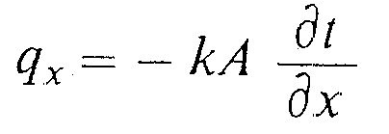
Transport Phenomena in Metallurgical Processes
As per 2nd law of thermodynamics , heat will flow from
higher temperature to lower temp
Heat flux α Temperature gradient
Mathematical form
where (qx) rate of heat transfer per unit time is related to the area A ( normal to direction of heat flow)
k – proportionality constant - thermal conductivity of material
x – direction of heat flow

Slide 99
Transport Phenomena
(-) sign – flow from higher to lower temp
t – temperature
It is one dimensional form of equation called –
FOURIER ‘S LAW of Heat Conduction
This law is used in conjunction with law of conservation of
energy for calculation of temperature profiles in the system

Slide 100
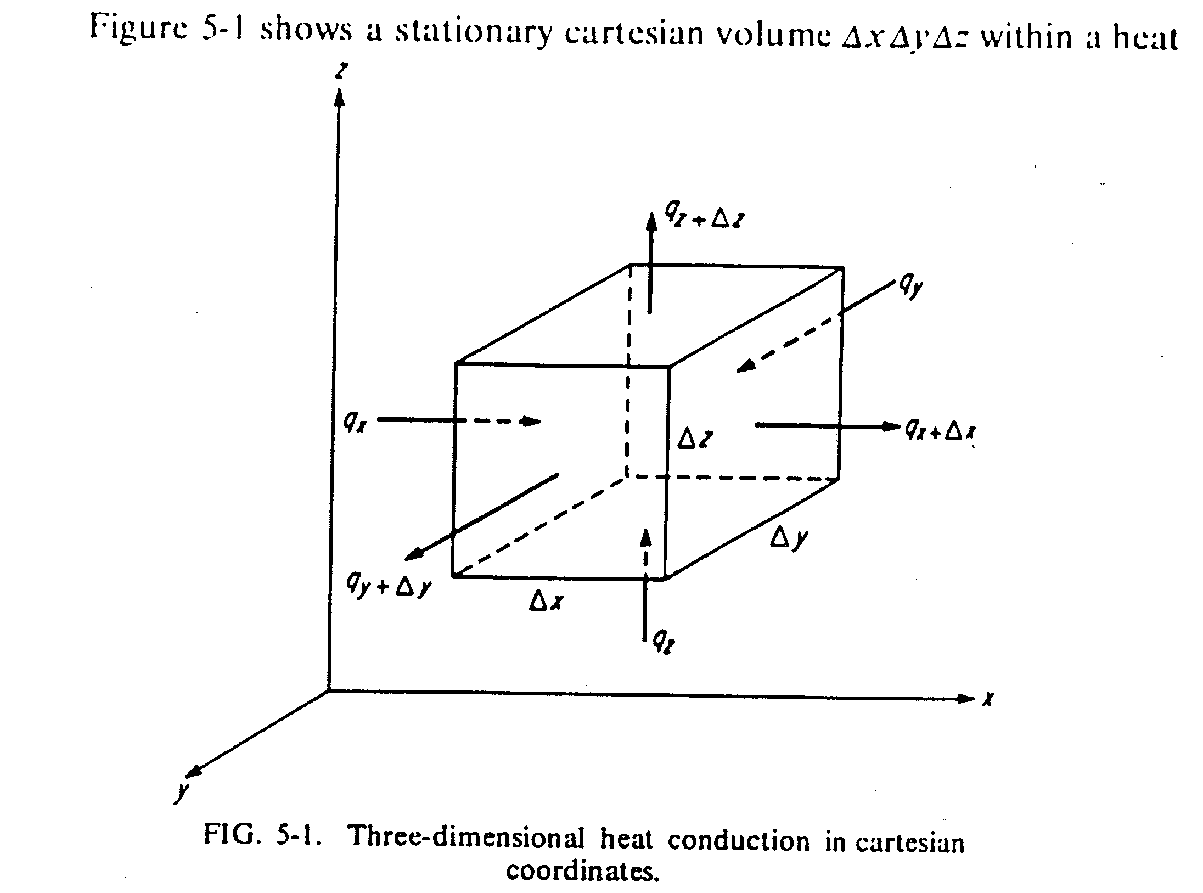
Transport Phenomena

Slide 101
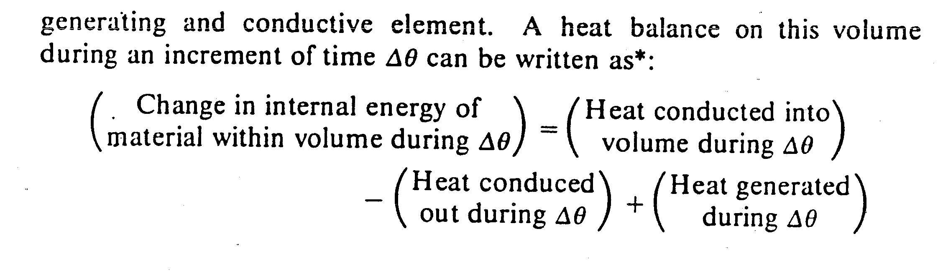
Transport Phenomena

Slide 102
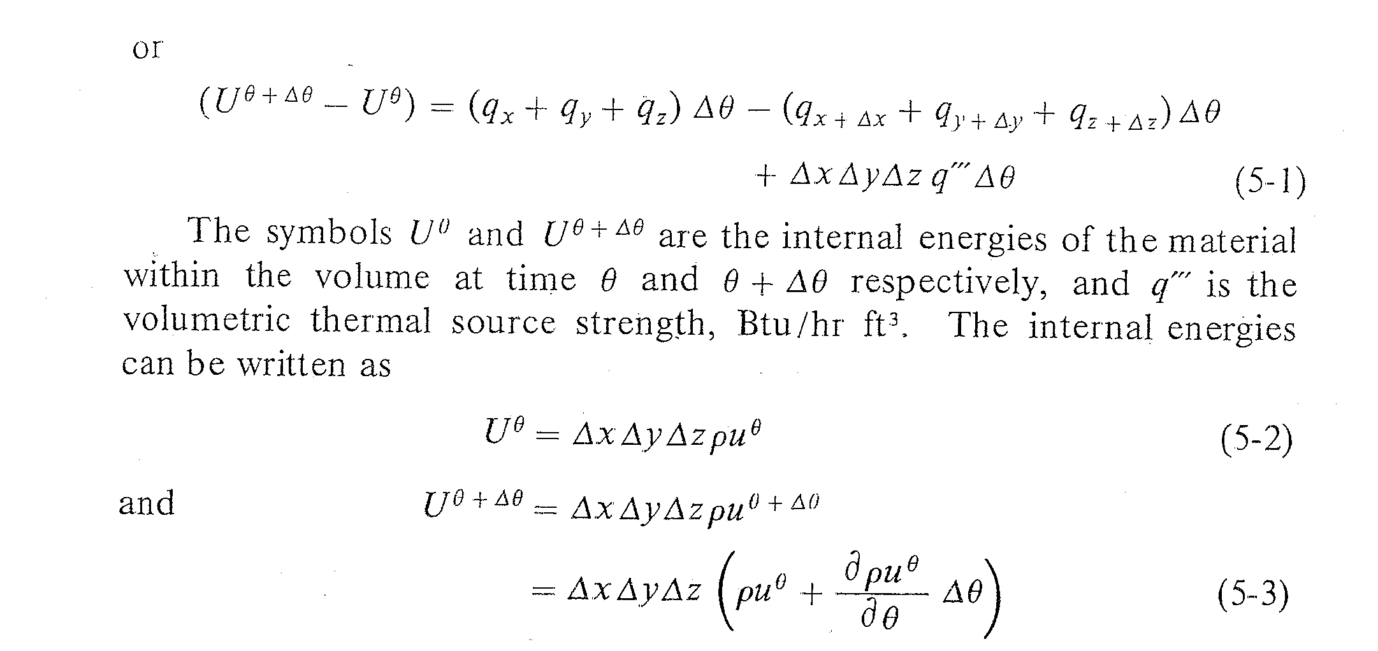
Transport Phenomena

Slide 103
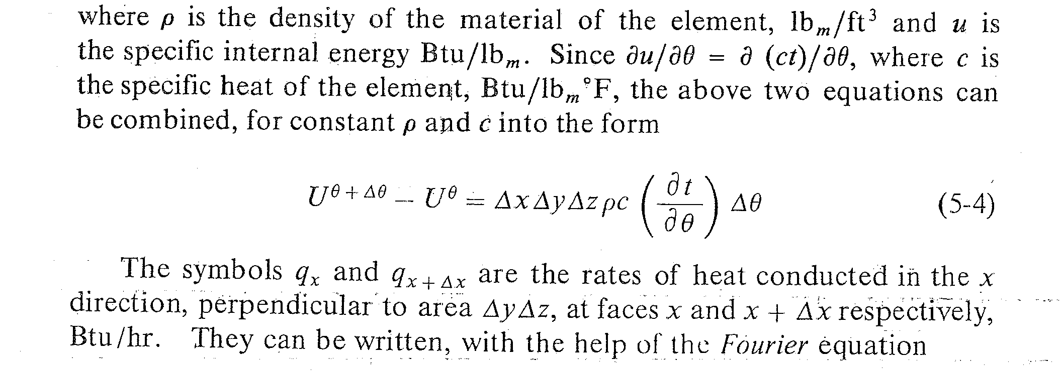
Transport Phenomena

Slide 104
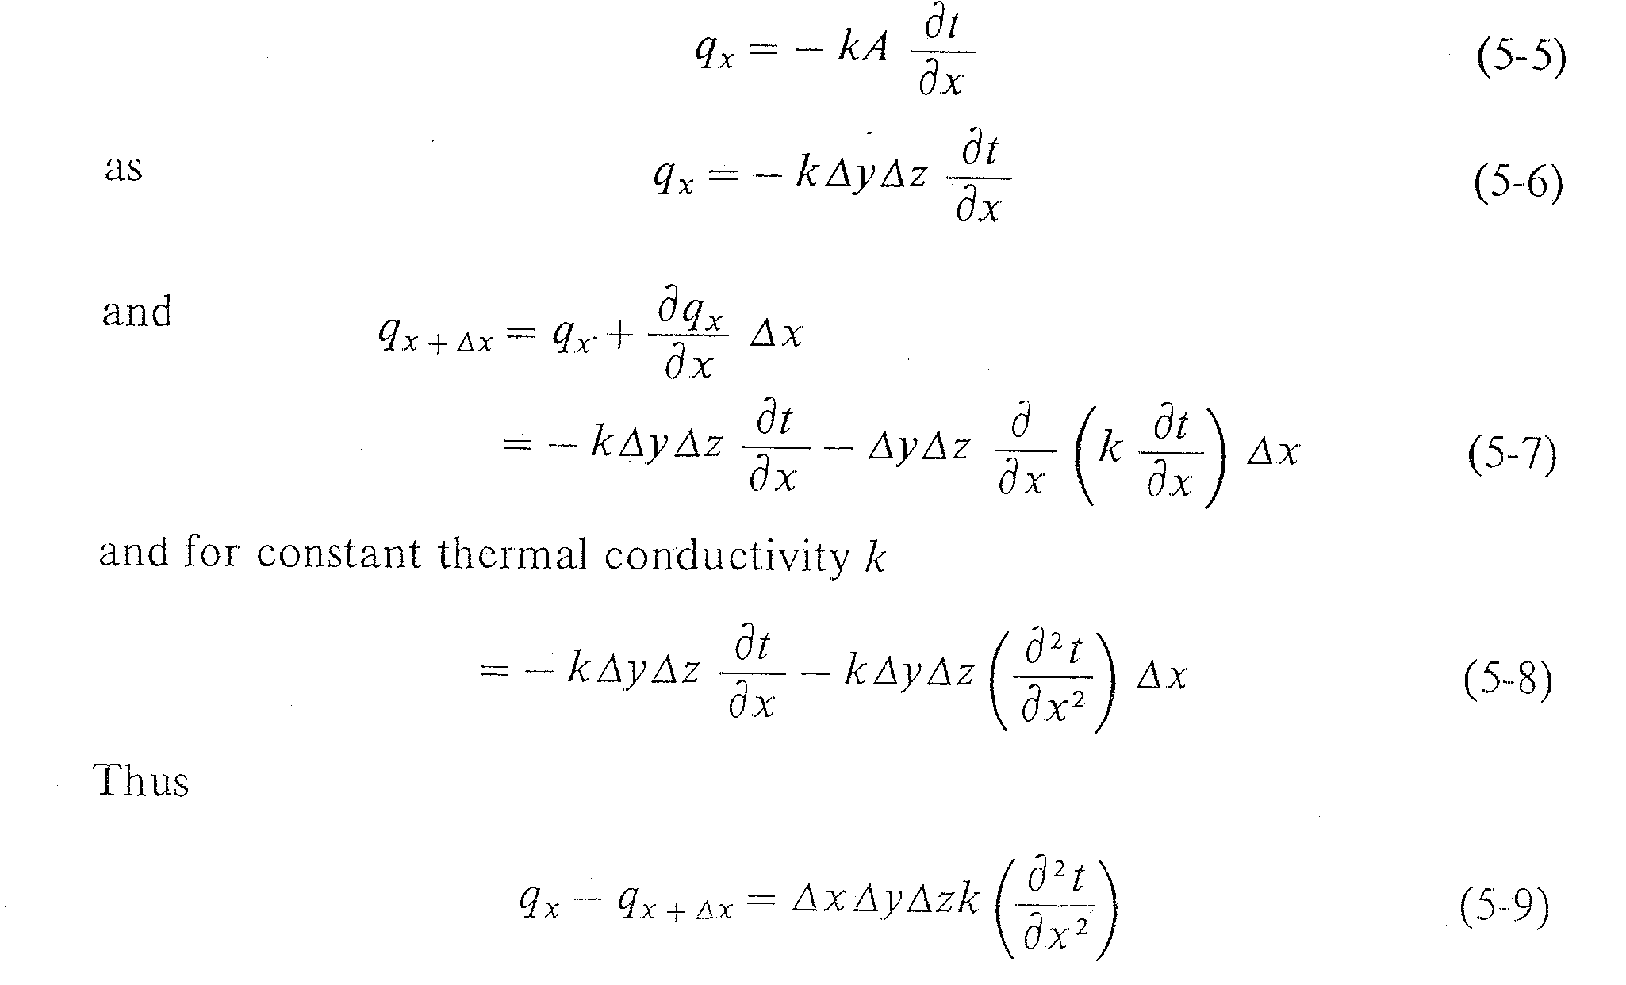
Transport Phenomena

Slide 105
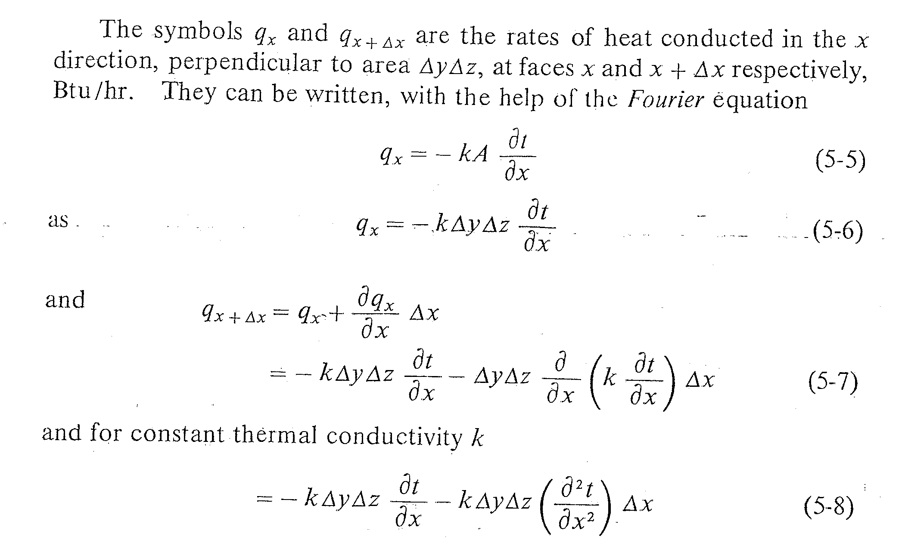
Transport Phenomena

Slide 106
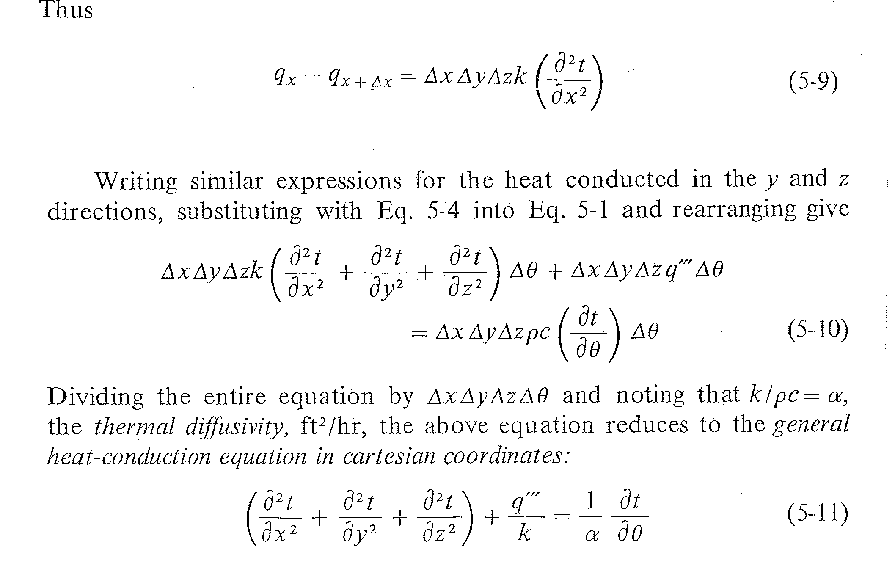
Transport Phenomena

Slide 107
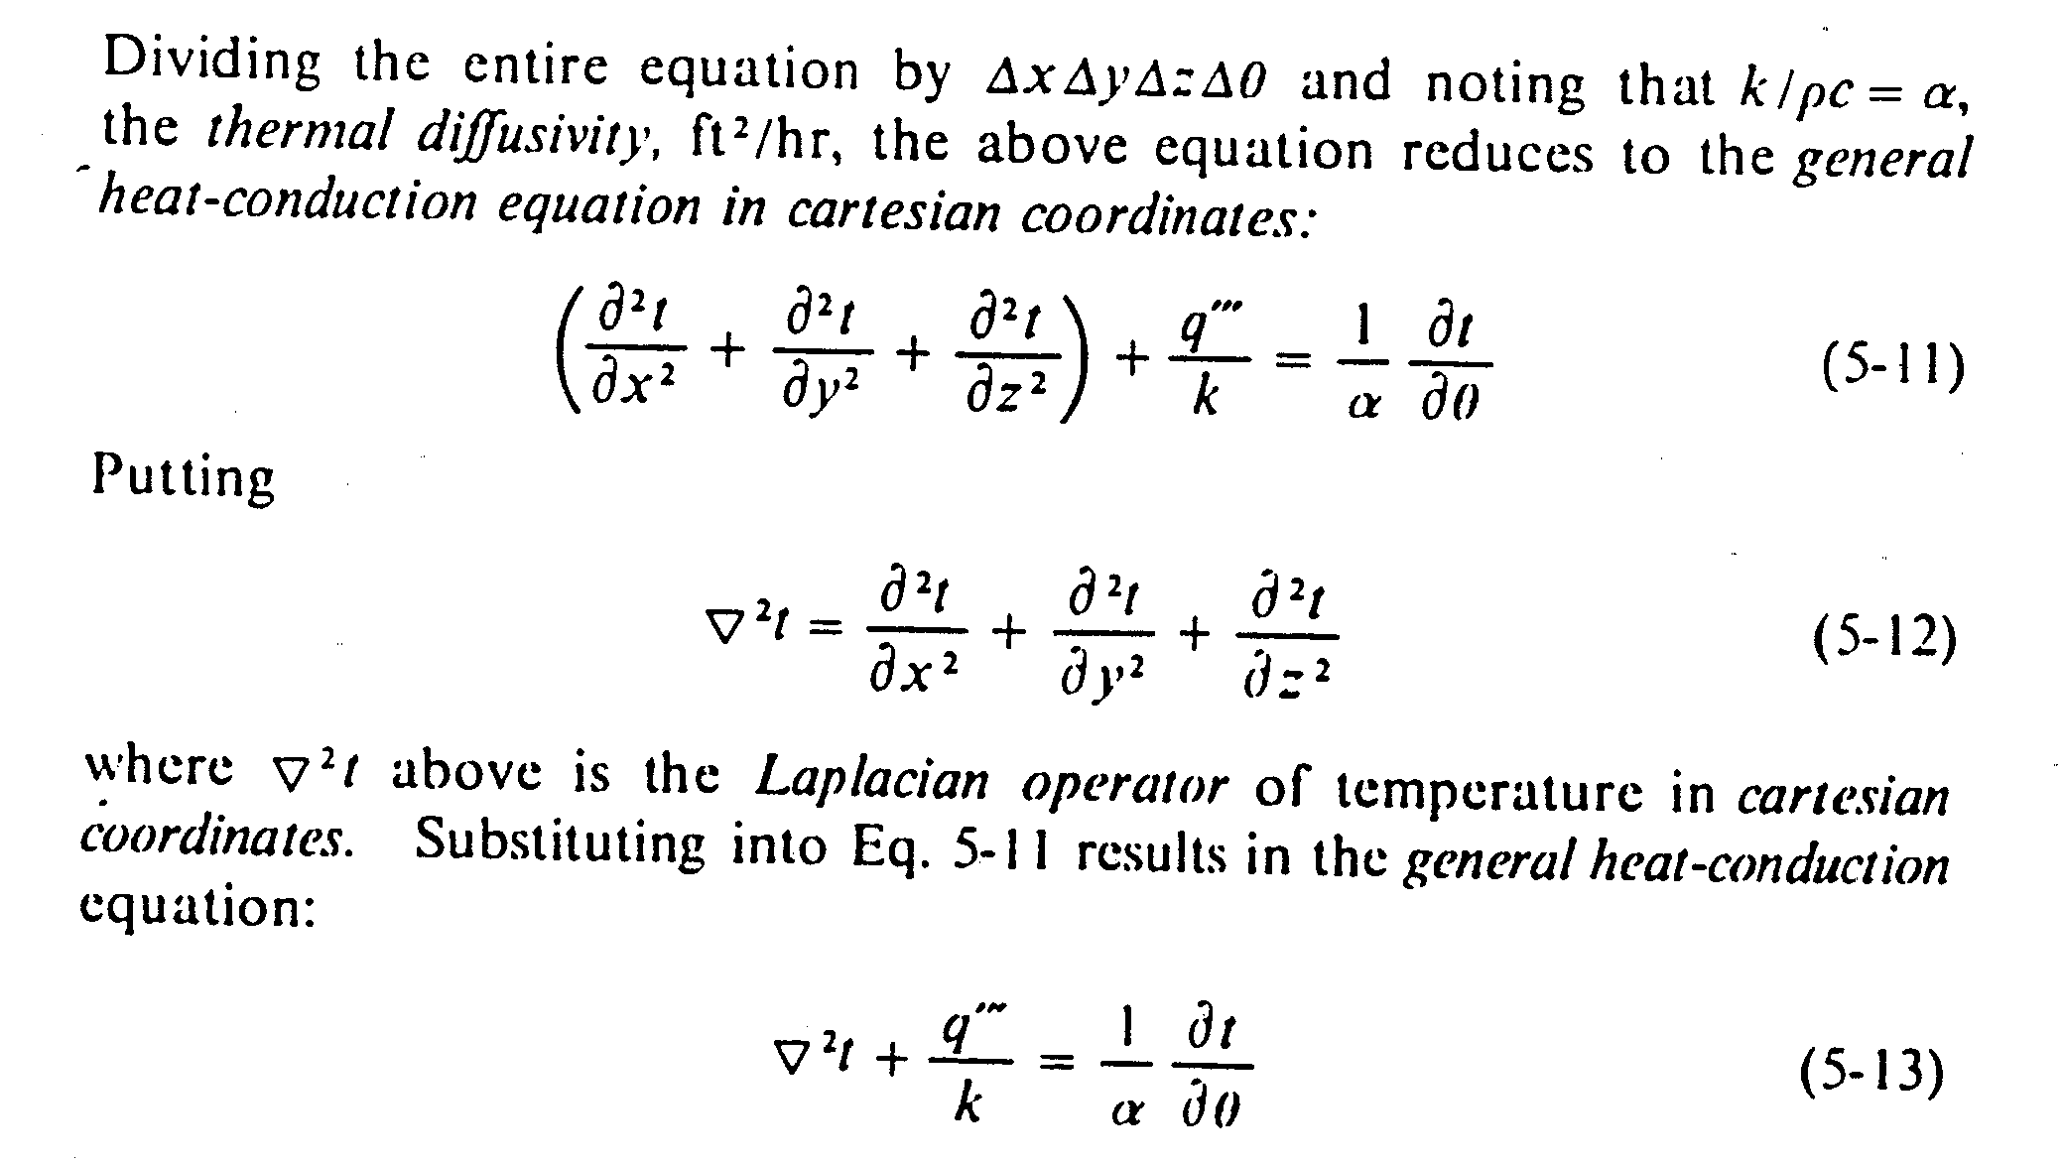
Transport Phenomena

Slide 108
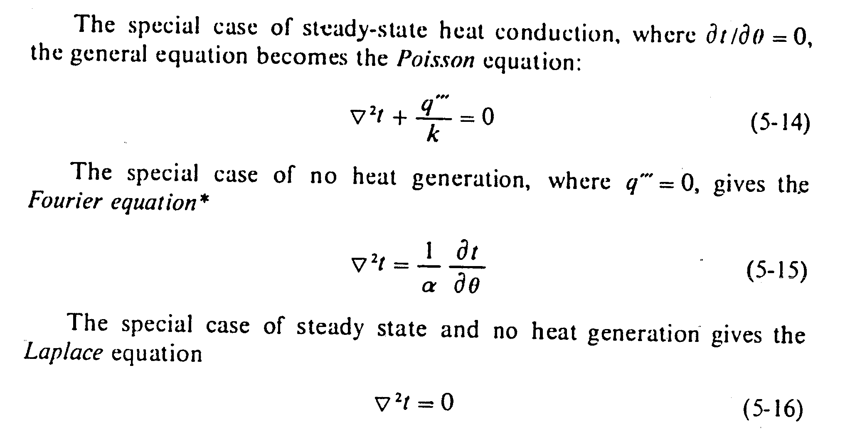
Transport Phenomena

Slide 109
Converting between rectangular and Cylindrical Coordinates
No real surprises here!
Cylindrical to rectangular
(r,θ,z)
r
θ
Rectangular to Cylindrical
r
θ

Slide 110
Finally, a Point in Spherical Coordinates!
(ρ ,θ ,φ)
Our designated point on the sphere is indicated by the three spherical coordinates (ρ , θ , φ) ---(radial distance, azimuthal angle, polar angle).
Please note that this notation is not at all standard and varies from author to author and discipline to discipline. (In particular, physicists often use φ to refer to the azimuthal angle and θ refer to the polar angle.)
ρ

Slide 111
Converting Between Rectangular and Spherical Coordinates
(x,y,z)
r
Spherical to rectangular
φ
z
ρ

Slide 112
Converting from Spherical to Rectangular Coordinates
Rectangular to Spherical
(x,y,z)
r
φ
z
ρ

Slide 113
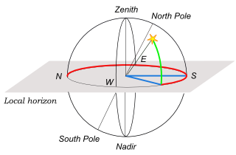
Heat Transfer
HORIZONTAL COORDINATES. Azimuth, from the North point (red) -also from the South point toward the West (blue). Altitude, green.

Slide 114
Representing 3D points in Spherical Coordinates
We measure the latitude or azimuthal angle on the latitude circle, starting at the positive x-axis and rotating toward the positive y-axis.
The range of the angle is
Angle is called θ.
Note that this is the same angle as the θ in cylindrical coordinates!

Slide 115
Heat Transfer
Unsteady State ( Transient) Heat Conduction
Most metallurgical processes involve heating or
cooling of substances where temperature distribution
is not only a function of space but also function of time
Three types of process where transient heat conduction takes place :
1) primarily transient heat conduction
e.g. heat treatment , solidification

Slide 116
Heat Transfer
2) where transient heat conduction plays significant role
e.g. Welding , Zone refining
3) where transient heat conduction plays minor role
e.g. Gas-solid and slag-metal reactions
Heating or Cooling of plates , Cylinders & Spheres – this
phenomena encountered in metallurgical processes such
as heat treatment processes , heating & cooling during hot
working of metals

Slide 117
Heat Transfer
In these cases , temperature distribution is determined
by solving heat conduction equation
When there is no temp gradient inside the plate ( high
thermal conductivity) – temperature distribution will be
independent of space but dependent on time –
Newtonian heating or Cooling
However with lower thermal conductivity , there will be
temperature gradient and will depend on space & time

