Slide 1
Facility Layout
Chapter Eight
Chase, R., Shankar, R., & Jacobs, F. R. (2010). Operations and Supply Chain Management, 14e. McGraw-Hill Education.
McGraw-Hill/Irwin
Copyright © 2014 by The McGraw-Hill Companies, Inc. All rights reserved.

Slide 2
Layout Decisions
Facility layout: the process of determining placement of departments, workgroups within departments, workstations, machines, and stock-holding points within a facility
This process requires the following inputs:
The amount of space required and the distance that must be traveled between elements in the layout
Estimates of product or service demand
Processing requirements
Space requirements for the elements
Space availability within the facility

Slide 3
The basic objective of the layout decision is to ensure a smooth flow of work, material, people, and information through the system. Effective layouts also:
Minimize movement and material handling costs;
Utilize space efficiently; Utilize labor efficiently;
Eliminate bottlenecks;
Facilitate communication and interaction between workers, between workers and their supervisors, and between workers and customers;
Reduce manufacturing cycle time and customer service time;
Eliminate wasted or redundant movement;
Facilitate the entry, exit, and placement of material, products, and people; Incorporate safety and security measures;
Promote product and service quality;
Encourage proper maintenance activities;
Provide a visual control of activities;
Provide flexibility to adapt to changing conditions;
Increase capacity

Slide 4
Basic Production Layout Formats
Workcenter or process layout (job-shop or functional layout)
Similar equipment are grouped together.
Assembly line or product layout (flow-shop layout)
Work processes are arranged according to the steps by which the product is made.
Manufacturing cell
Dissimilar machines are grouped to work on similar products.
Project layout
Product remains at one location.
Workstation - Area where work of a particular nature is carried out, such as a specific location on an assembly line
Notes:
4

Slide 5
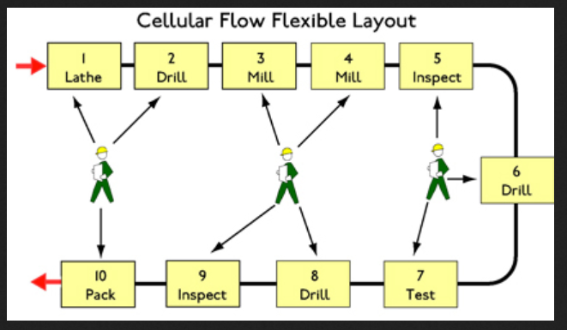

Slide 6
Workcenters
Given
The flow (number of moves) to and from all departments
The cost of moving from one department to another
The existing or planned physical layout of the plant
Determine
The “best” locations for each department, where best means maximizing flow, which minimizes costs
Notes:
6

Slide 7
Example 8.1: Toy Factory
Goal is to arrange eight workcenters to minimize interdepartmental handling cost.
Assume all workcenters have same space and fit in building.
All material is transported in standard crates by forklift.
Transportation costs are $1 to move between adjacent workcenters.
Extra $1 for each workcenter in between

Slide 8
Steps
Illustrate the interworkcenter flow by a model.
Determine the cost of this layout.
Search for workcenter location changes that will reduce costs.

Slide 9
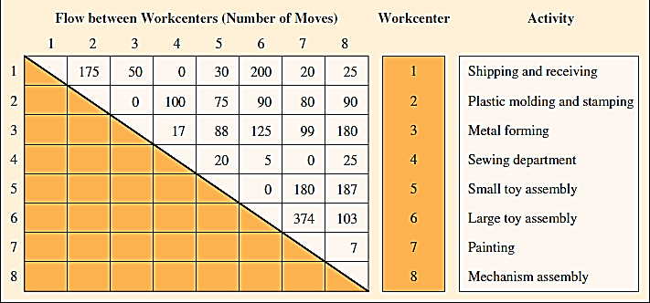
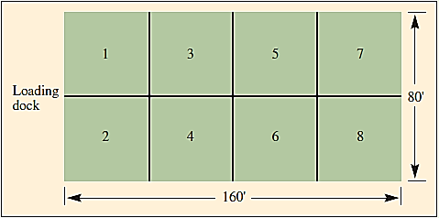
Example 8.1: Interworkcenter Flow, and Building Dimensions and Workcenters

Slide 10
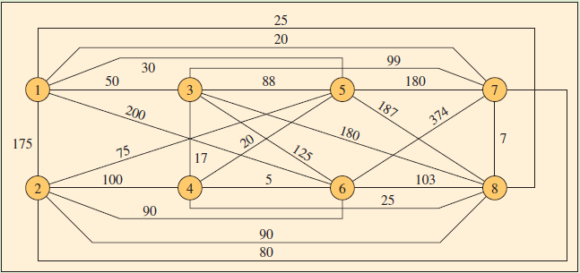
Example 8.1: Interworkcenter Flow Graph with Number of Annual Movements

Slide 11
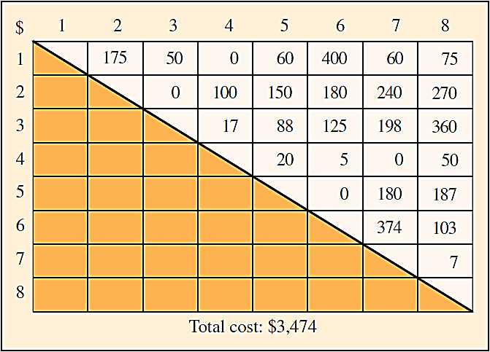
Example 8.1: Cost Matrix – First Solution

Slide 12
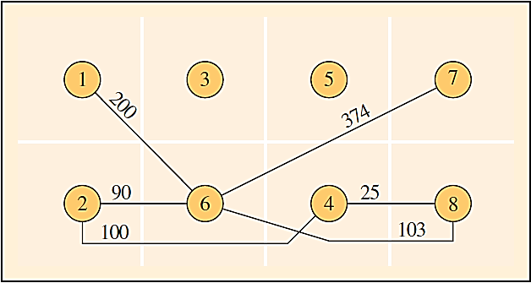
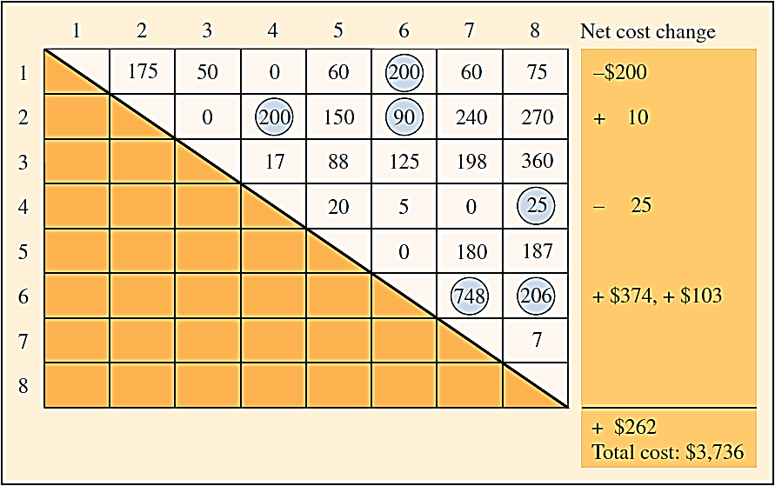
Example 8.1: Revised Interworkcenter Flowchart and Cost Matrix – Second Solution

Slide 13
Systematic Layout Planning
Numerical flow of items between workcenters
Can be impractical to obtain
Does not account for the qualitative factors that may be crucial to the placement decision
Systematic layout planning
Accounts for the importance of having each department located next to every other department
Is also guided by trial and error
Switching workcenters then checking the results of the “closeness” score
Notes:
9

Slide 14
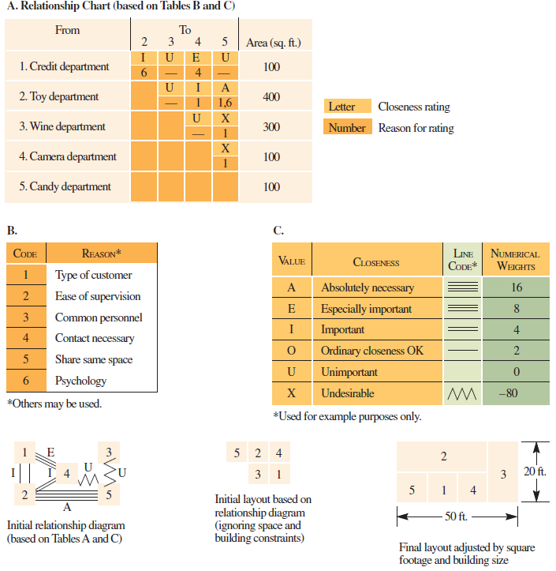
Systematic Layout Planning for a Floor of a Department Store
Notes:
9

Slide 15
Assembly Line
Assembly line: progressive assembly linked by some material handling device
Some form of pacing is present and the allowable processing time is equivalent for all workstations
Important differences:
Material handling devices
Line configuration
Pacing
Product mix
Workstation characteristics
Length

Slide 16
Assembly-Line Design
Workstation cycle time: a uniform time interval in which a moving conveyor passes a series of workstations
Also the time between successive units coming off the line
Assembly-line balancing: assigning all tasks to a series of workstations so that each workstation has no more than can be done in the workstation cycle time
Precedence relationship: the order in which tasks must be performed in the assembly process

Slide 17
Assembly-Line Balancing
Specify the sequential relationships among tasks.
Determine the required workstation cycle time.
Determine the theoretical minimum number of workstations.
Select a primary and secondary assignment rule.
Assign tasks.
Evaluate the efficiency of the balance.
Rebalance if needed.

Slide 18
Assembly-Line Balancing

Slide 19
Assembly-Line Balancing
The Model J Wagon is to be assembled on a conveyor belt. Five hundred wagons are required per day. Production time per day is 420 minutes, and the assembly steps and times for the wagon are given in Exhibit 8.9A. Assignment: Find the balance that minimizes the number of workstations, subject to cycle time and precedence constraints.

Slide 20
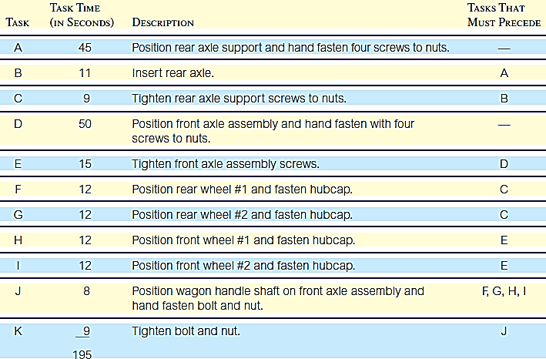
Example 8.2: Assembly Steps and Times

Slide 21
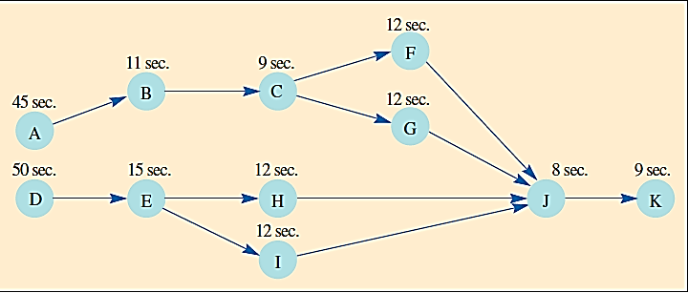
Example: Precedence Graph

Slide 22
Example: C and N_{t}

Slide 23
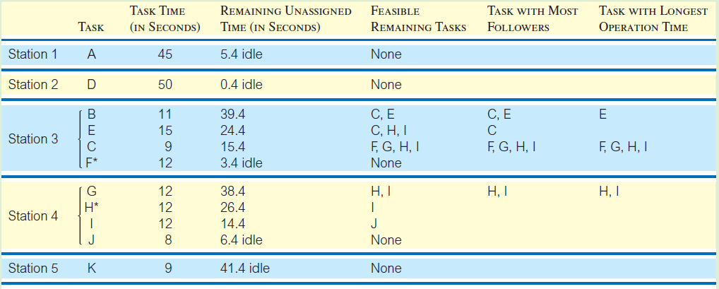
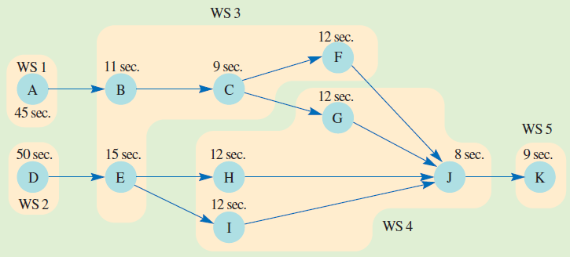
Example: Assignment

Slide 24
Example: Efficiency

Slide 25
Task Splitting
Split the task
Share the task
Use parallel workstations
Use a more skilled worker
Work overtime
Redesign

Slide 26
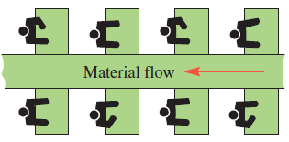
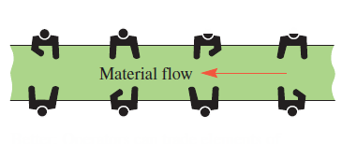
Flexible Line Layouts
Problem – operators trapped in “cages” prevents sharing work among them
Solution – remove barriers so operators can trade work and operators can be added or removed as needed

Slide 27
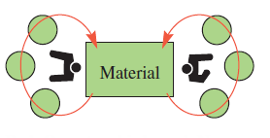
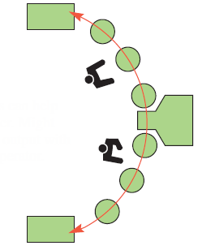
Flexible Line Layouts
Problem – operators “birdcaged” with no opportunity to share work or add third operator
Solution – operators can help each other and third operator can be added if needed

Slide 28
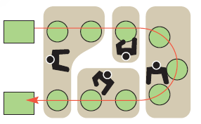
Flexible Line Layouts
Problem – straight line is difficult to balance
Solution – U-shaped line gives better operator access and may reduce need for operators

Slide 29
Mixed-Model Line Balancing
Most factories produce a number of different products.
Inventory can be reduced by building some of each product during every period (e.g., day, week, etc.).
Mixed-model line balancing is one means of scheduling this varied production.

Slide 30
Example 8.3: Mixed-Model Line Balancing
Processing must be completed for both Model J and Model K wagons.
Equal number of each model are required.
Cycle time – 6 minutes for Model J and 4 minutes for Model K.
In an 8-hour day, how should the models be processed?
Total Processing Time
Because K = J, we can produce 48 of each per day (6 of each per hour.

Slide 31
Example 8.3: Mixed-Model Line Balancing
This line is balanced at 6 frames of each type per hour with a minicycle time of 12 minutes.
Another balance is J K K J K J, with times of 6, 4, 4, 6, 4, 6. This balance produces 3J and 3K every 30 minutes with a minicycle time of 10 minutes (JK, KJ, KJ).

Slide 32
Developing a Manufacturing Cell
Grouping parts into families that follow a common sequence of steps
Identifying dominant flow patterns of parts families as a bases for location of processes
Physically grouping machines and processes into cells

Slide 33
Example: Original Workcenter Layout

Slide 34
Example: Routing Matrix Based upon Flow of Parts

Slide 35
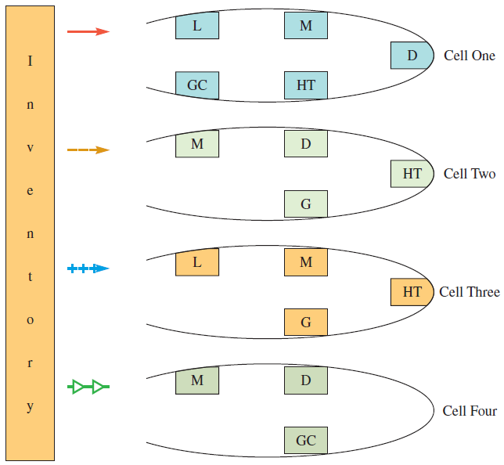
Example: Reallocating Machines to Form Cells

Slide 36
Manufacturing Cell Benefits
Better human relations
Improved operator expertise
Less in-process inventory and material handling
Faster production setup
Notes:
34

Slide 37
Project Layout
Is characterized by a relatively low number of production units.
Visualize the product as the hub of a wheel with materials and equipment arranged concentrically around the production point.
A high degree of task ordering is common.
To the extent that this precedence determines production stages, a project layout might be developed by arranging materials according to their technological priority.

Slide 38
Retail Service Layout
Goal — maximize net profit per square foot of floor space
Servicescapes
Ambient conditions
Background characteristics, such as noise
Spatial layout and functionality
Planning the circulation path of customers and grouping merchandise
Signs, symbols, and artifacts
Parts of the service that have social significance
Notes:
37

Slide 39
Alternative Store Layouts
Notes:
37

Slide 40
Marketing Research and Retail Layout
People in supermarkets tend to follow a perimeter pattern in their shopping behavior. Placing high-profit items along the walls of a store will enhance their probability of purchase.
Sale merchandise placed at the end of an aisle in supermarkets almost always sells better than the same sale items placed in the interior portion of an aisle.
Notes:
37

Slide 41
Marketing Research and Retail Layout
Credit and other non-selling departments that require customers to wait for the completion of their services should be placed either on upper floors or in “dead” areas.
In department stores, locations nearest the store entrances and adjacent to front window displays are most valuable in terms of sales potential.
Notes:
37

Slide 42
Office Layout
More open offices
Low divider walls
Size and orientation of desks indicates importance of people behind them
ServiceMaster (A major janitorial firm) places its know-how room (tools , manuals) at the center

