Slide 1
Manufacturing Processes
Chapter Seven
Chase, R., Shankar, R., & Jacobs, F. R. (2010). Operations and Supply Chain Management, 14e. McGraw-Hill Education.
McGraw-Hill/Irwin
Copyright © 2014 by The McGraw-Hill Companies, Inc. All rights reserved.

Slide 2
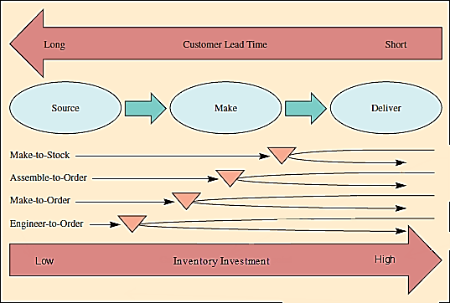
Production Processes
Production processes are used to make any manufactured item.
Step 1 – Source the parts needed
Step 2 – Make the product
Step 3 – Deliver the product

Slide 3
Production Process Terms
Lead time – the time needed to respond to a customer order
Customer order decoupling point – where inventory is positioned to allow entities in the supply chain to operate independently
Lean manufacturing – a means of achieving high levels of customer service with minimal inventory investment

Slide 4
Types of Firms
Make-to-Stock
Assemble-to-Order
Make-to-Order
Engineer-to-Order
Serve customers from finished goods inventory
Combine a number of preassembled modules to meet a customer’s specifications
Make the customer’s product from raw materials, parts, and components
Work with the customer to design and then make the product

Slide 5
Make-to-Stock
Examples of products include the following:
Televisions
Clothing
Packaged food products
Essential issue in satisfying customers is to balance the level of inventory against the level of customer service.
Easy with unlimited inventory, but inventory costs money
Trade-off between the costs of inventory and level of customer service must be made.
Use lean manufacturing to achieve higher service levels for a given inventory investment.

Slide 6
Assemble-to-Order
A primary task is to define a customer’s order in terms of alternative components because these are carried in inventory.
An example is the way Dell Computer makes their desktop computers.
One capability required is a design that enables as much flexibility as possible in combining components.
There are significant advantages from moving the customer order decoupling point from finished goods to components.

Slide 7
Make-to-Order/Engineer-to-Order
Boeing’s process for making commercial aircraft is an example.
Customer order decoupling point could be in either raw materials at the manufacturing site or the supplier inventory.
Depending on how similar the products are, it might not even be possible to preorder parts.

Slide 8
How Production Processes are Organized
Project: the product remains in a fixed location
Manufacturing equipment is moved to the product.
Workcenter (job shop): similar equipment or functions are grouped together
Manufacturing cell: a dedicated area where products that are similar in processing requirements are produced
Assembly line: work processes are arranged according to the progressive steps by which the product is made
Continuous process: assembly line only the flow is continuous such as with liquids
Notes:
11

Slide 9
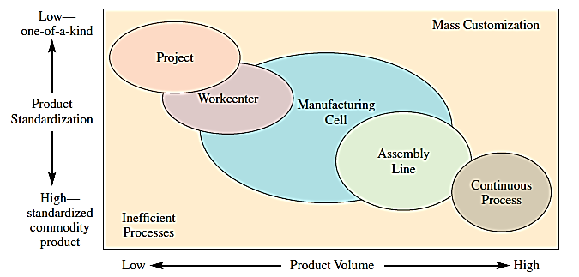
Product–Process Matrix: Framework Describing Layout Strategies
Notes:
11

Slide 10
Production System Design
Project Layout
The product remains in a fixed location.
Workcenter
A high degree of task ordering is common.
A project layout may be developed by arranging materials according to their assembly priority.
Most common approach to developing this type of layout is to arrange workcenters in a way that optimizes the movement of material.
Sometimes is referred to as a department and is focused on a particular type of operation.
Optimal placement often means placing workcenters with large interdepartmental traffic adjacent to each other.

Slide 11
Production System Design
Manufacturing Cell
Formed by allocating dissimilar machines to cells that are designed to work on similar products (shape, processing, etc.)
Assembly Line and Continuous Layout
Designed for the special purpose of building a product by going through a series of progressive steps

