Slide 1
DESIGN OF PRODUCTS AND SERVICES
Chapter Three
McGraw-Hill/Irwin
Copyright © 2014 by The McGraw-Hill Companies, Inc. All rights reserved.

Slide 2
The Product Design Process
Companies continuously bring new products to market
Product design is integral to success
Product design differs significantly depending on the industry
Companies often outsource major functions
Contract manufacturer: an organization capable of manufacturing and/or purchasing all the components needed to produce a finished product
Examples? Advantageous of contract manufacturing?

Slide 3
Core Competency
Given the importance of contract manufacturing, firms has to decide on its core competency.
Core competency: the one thing a company can do better than its competitors
A core competency has three characteristics:
It provides potential access to a wide variety of markets
It increases perceived customer benefits
It is hard for competitors to imitate
Examples?

Slide 4
Examples of Successes in Design
Dell
Ikea
Asian paints

Slide 5
Six Phases of the Generic Development Process (Formal Process)
Phase 0: Planning
Phase 1: Concept development
Phase 2: System-level design
Phase 3: Design detail
Phase 4: Testing and refinement
Phase 5: Production ramp-up

Slide 6
Phase 0: Planning
The planning activity is often referred to as “phase zero” because it precedes the project approval and launch of the actual product development process.
This phase begins with corporate strategy and includes assessment of technology developments and market objectives.
The output of the planning phase is the project mission statement, which specifies the target market for the product, business goals, key assumptions, and constraints.

Slide 7
Phase 1: Concept Development
Needs of the target market are identified
Alternative product concepts are generated and evaluated
One or more concepts are selected for further development and testing
Concept: a description of the form, function, and features of a product

Slide 8
Phase 2: System-Level Design
The system-level design phase includes the definition of the product architecture.
The decomposition of the product into subsystems and components.
Final assembly scheme for the production system is usually defined
Output:
Geometric layout of the product
Functional specifications for each subsystem
Preliminary process flow diagram

Slide 9
Phase 3: Design Detail
This phase includes the complete specification of the geometry, materials, and tolerances of all the unique parts in the product.
The identification of all the standard parts to be purchased from suppliers.
A process plan is established, and tooling is designed for each part to be fabricated within the production system.
The output of this phase is:
the drawings or computer files describing the geometry of each part and its production tooling,
the specifications of purchased parts, and
the process plans for the fabrication and assembly of the product.

Slide 10
Phase 4: Testing and Refinement
Construction and evaluation of multiple preproduction versions of product
Same geometry and material as production version
Not necessarily fabricated with the actual production processes
Prototypes tested to determine if the product will work as designed and whether the product satisfies customer needs.

Slide 11
Phase 5: Production Ramp-Up
The product is made using the intended production system.
To train the workforce and to work out any remaining problems in the production processes.
Products produced during production ramp-up are sometimes supplied to preferred customers and are carefully evaluated to identify any remaining flaws.
The transition from production ramp-up to ongoing production is usually gradual.
At some point in the transition, the product is launched and becomes available for widespread distribution.

Slide 12
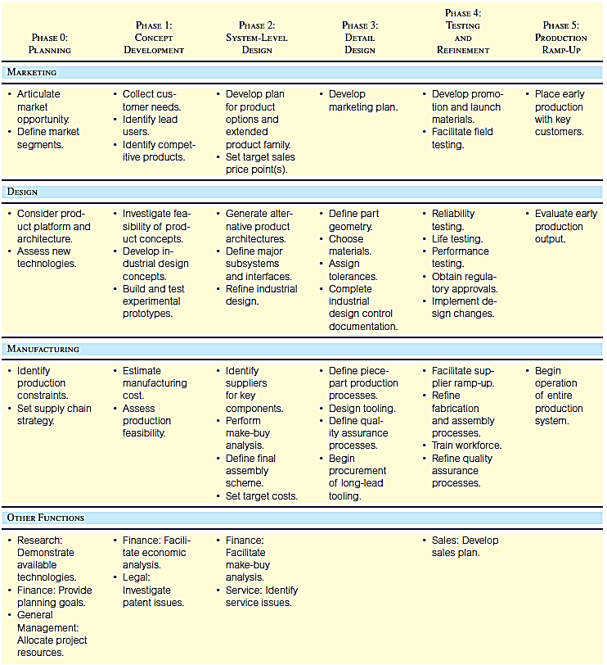
The Generic Product Development Process

Slide 13
Generic Product Development Process
Technology-push products: In developing technology-push products, a firm begins with a new proprietary technology and looks for an appropriate market in which to apply this technology (that is, the technology “pushes” development).
Platform products: A platform product is built around a preexisting technological subsystem (a technology platform).
Huge investments are made in developing these platforms, and therefore every attempt is made to incorporate them into several different products.
Process-intensive products: production process has an impact on the properties of the product
Product design cannot be separated from process design

Slide 14
Generic Product Development Process Continued
Customized products are slight variations of standard configurations and are typically developed in response to a specific order by a customer. Examples include switches, motors, batteries, and containers.
High-risk products: technical or market uncertainties create high risks of failure
Quick-build products: For the development of some products, such as software and many electronic products, building and testing prototype models has become such a rapid process that the design-build-test cycle can be repeated many times.

Slide 15
Generic Product Development Process Continued
Complex systems: Larger-scale products such as automobiles and airplanes are complex systems composed of many interacting subsystems and components. When developing complex systems, modifications to the generic product development process address a number of system-level issues.
Generic: begins with a market opportunity and team selects appropriate technologies to meet customer needs

Slide 16
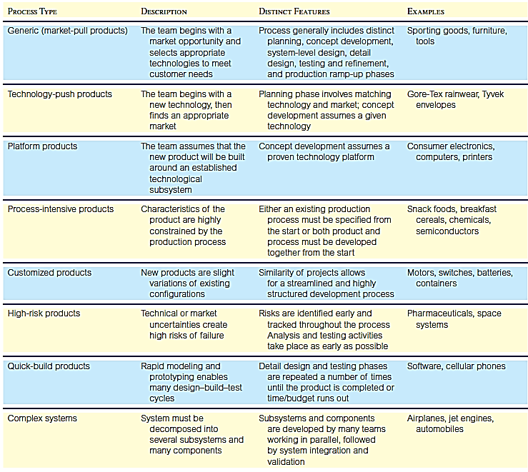
Summary of Variants of Generic Product Development Process

Slide 17
Summary of Variants of Generic Product Development Process

Slide 18
Designing for the Customer
House of Quality
Ideal Customer Product
Quality Function
Deployment
Value Analysis/
Value Engineering

Slide 19
Quality Function Deployment
Interfunctional teams from marketing, design engineering, and manufacturing
Begins with listening to the customer
Uses market research
Customer preferences are defined and broken down into customer requirements
House of quality
Notes:
6

Slide 20
QFD: Village Volvo
QFD involves converting the expectations and demands of the customers into clear objectives.
Village Volvo is an independent auto service garage that specializes in Volvo auto maintenance and competes with Volvo dealers for customers. Village Volvo has decided to assess its service delivery system in comparison with that of the Volvo dealer to determine areas for improving its competitive position. The steps in conducting the QFD project and constructing a “house of quality” follow:
Establish the aim of the project. In this case, the objective of the project is to assess Village Volvo’s competitive position.
Determine customer expectations.
Describe the elements of the service. The columns of the house of quality matrix contain the service elements that management can manipulate to satisfy customer expectations.

Slide 21
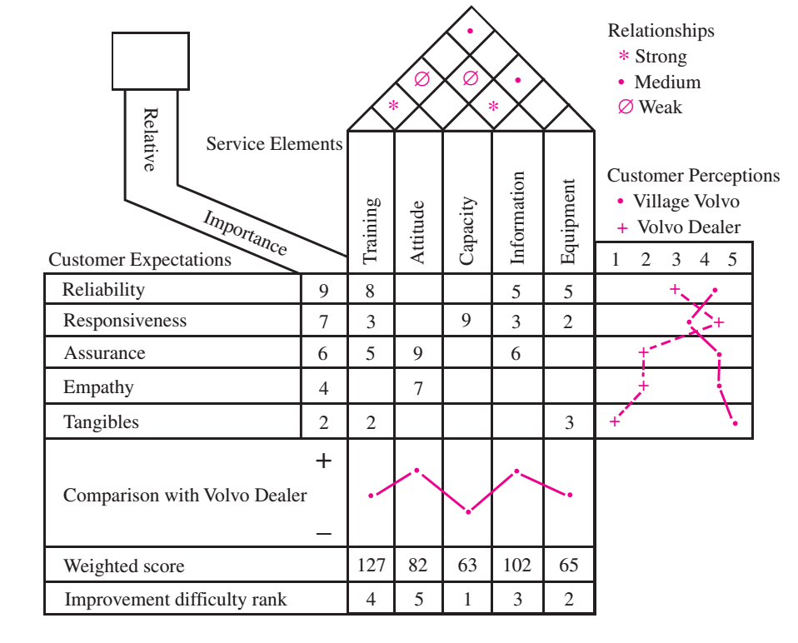
Completed House of Quality Matrix for a Car Door
Customer requirements information forms the basis for this matrix, used to translate them into operating or engineering goals

Slide 22
Value Analysis/Value Engineering (VA/VE)
Purpose is to simplify products and processes
Objective is to achieve better performance at a lower cost while maintaining all functional requirements defined by the customer
Does the item have any design features that are not necessary?
Can two or more parts be combined into one?
How can we cut down the weight?
Are there nonstandard parts that can be eliminated?
Notes:
8

Slide 23
Ecodesign
Ecodesign: the incorporation of environmental considerations in the design and development of products or services
The whole life cycle is considered
The product is considered as a system
A multi-criteria approach is used
Application of ecodesign can benefit business

Slide 24
BioBag
BioBag biodegradable and compostable plastic bags are used for carrying produce and are supplied on a roll. Text on the bag says “This bag is certified compostable. Use, reuse, then compost.”

Slide 25
Designing Service Products
Service products are very different
Direct customer involvement introduces significant variability in the process
Questions to address:
How will this variability be addressed?
What are the implications for operational cost and the customer service experience?

Slide 26
Three General Factors for Determining Fit
Similarity to current services - Service experience fit
The new service should fit into the current service experience for the customer
Similarity to current process - Operational fit
Existing processes should be able to support the operation of the new service
Financial justification - Financial impact
Introducing a new service should be financially justified

Slide 27
Complexity and divergence
A useful way of analyzing the process similarity for new service development is by specifying the complexity and divergence of the proposed service process relative to the basic service process.
Complexity is the number of steps involved in a service and the possible actions that can be taken at each step.
Divergence is the number of ways a customer/service provider interaction can vary at each step according to the needs and abilities of each.

Slide 28
Complexity and divergence
The result may be a combination of higher complexity/divergence on some steps and lower complexity/divergence on others.
This can be used to determine different resource requirements such as worker skills, layout, and process controls.
For example, the hypothetical family restaurant considered is considering whether to change the service to create a new process format. Relative to the current process, a minimum service format would have lower complexity/divergence, while an upscale format would have higher complexity/divergence.

Slide 29
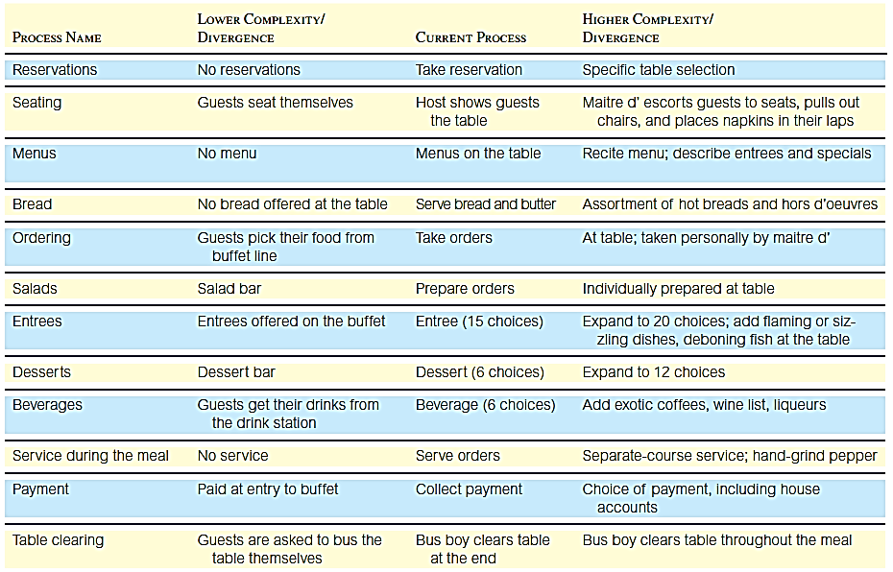
Structural Alternatives for a Family Restaurant

Slide 30
Designing Products for Manufacture and Assembly
Design means aesthetics value? or Specifications? or detailing of materials components?
Traditional approach
“We design it, you build it” or “over the wall”
Concurrent engineering
“Let’s work together simultaneously”
Notes:
9

Slide 31
Measuring Product Development Performance
A steady stream of new products is important to competitiveness
Firms must respond to changing customer needs and competitor moves
Ability to identify opportunities and bring new products to market is critical
Must also be efficient

Slide 32
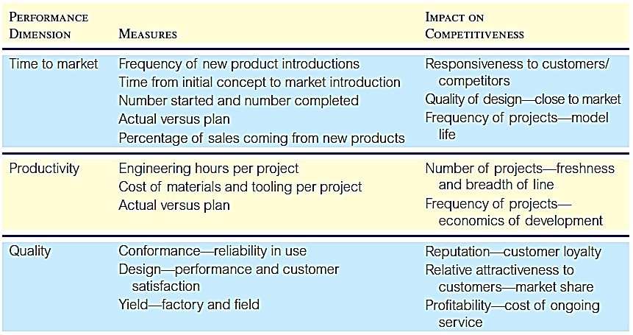
Performance Measures for Development Projects

