Slide 1
Six Sigma Quality
Chapter Twelve
Chase, R., Shankar, R., & Jacobs, F. R. (2010). Operations and Supply Chain Management, 14e. McGraw-Hill Education.
McGraw-Hill/Irwin
Copyright © 2014 by The McGraw-Hill Companies, Inc. All rights reserved.

Slide 2
Total Quality Management (TQM)
Total quality management: managing the entire organization so that it excels on all dimensions of products and services that are important to the customer
Two fundamental operational goals
Careful design of the product or service
Ensuring that the organization’s systems can consistently produce the design

Slide 3
Malcolm Baldrige National Quality Award
An award established by the U.S. Department of Commerce given annually to companies that excel in quality.
The Baldrige Quality Award is given to organizations that have demonstrated outstanding quality in their products and processes.

Slide 4
Malcolm Baldrige National Quality Award
The award program is administered by the National Institute of Standards and Technology, an agency of the U.S. Department of Commerce.
A total of up to 18 awards may be given annually in these categories: manufacturing, service, small business, education and health care, and not-for-profit.

Slide 5
What It Takes to Apply for Baldrige
Candidates for the award must submit an application of up to 50 pages that details the approach, deployment, and results of their quality activities under seven major categories:
Leadership
Strategic Planning
Customer and Market Focus
Information and Analysis
Human Resource Focus
Process Management
Business Results

Slide 6
Baldrige – Scoring
Applications are scored on total points out of 1,000.
Those >650 get selected for site visits, which decide the final winner.
Other benefits:
Feedback from the Baldrige examiners
“An audit report of the firm’s practices.”
Many states use Baldrige Criteria as the basis for their own awards.

Slide 7
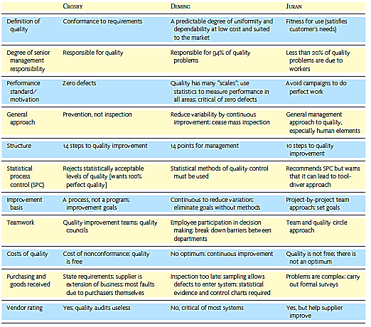
The Quality Gurus

Slide 8
Quality Specifications and Quality Costs
Design quality: inherent value of the product in the marketplace
Conformance quality: degree to which the product or service design specifications are met
Performance
Features
Reliability/ Durability
Serviceability
Aesthetics
Perceived Quality

Slide 9
Costs of Quality
Quality Costs
Appraisal costs – costs of the inspection and testing to ensure that the product or process is acceptable
Prevention costs – sum of all the costs to prevent defects
Internal failure costs – costs for defects incurred within the system
External failure costs – costs for defects that pass through the system

Slide 10
Six Sigma
A philosophy and set of methods companies use to eliminate defects in their products and processes
Seeks to reduce variation in the processes that lead to product defects
The name, “Six Sigma,” refers to the goal of no more than four defects per million units

Slide 11
Six Sigma Methodology
Define, measure, analyze, improve, and control (DMAIC)
Developed by General Electric as a means of focusing effort on quality using a methodological approach
Overall focus of the methodology is to understand and achieve what the customer wants
Seeks to reduce the variation in the processes that lead to these defects

Slide 12
DMAIC Cycle
Define - identify customers and their priorities
Measure - determine how to measure the process and how it is performing
Analyze - determine the most likely causes of defects
Improve - identify means to remove the causes of defects
Control - determine how to maintain the improvements

Slide 13
Six Sigma Analytical Tools
Flowchart - a diagram of the sequence of operations
Run chart - depict trends in data over time
Pareto chart - help to break down a problem into components
Checksheet - basic form to standardize data collection
Cause-and-effect diagram - show relationships between causes and problems
Opportunity flow diagram - used to separate value-added from non-value-added
Process control chart - used to assure that processes are in statistical control

Slide 14
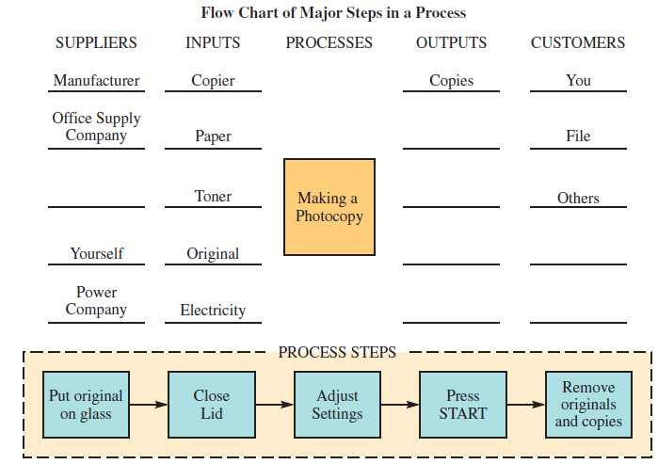
Flowchart

Slide 15
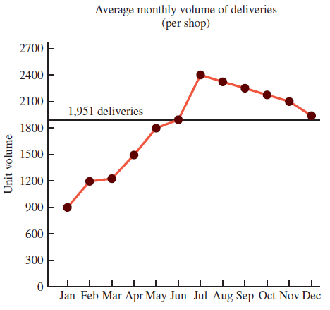
Run Chart

Slide 16
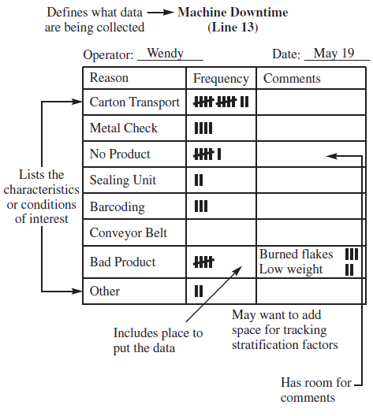
Checksheet

Slide 17
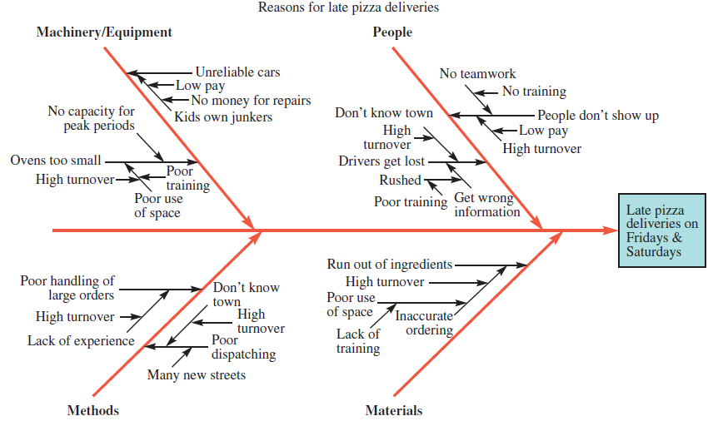
Cause-and-Effect Diagram (Fishbone Diagram)

Slide 18
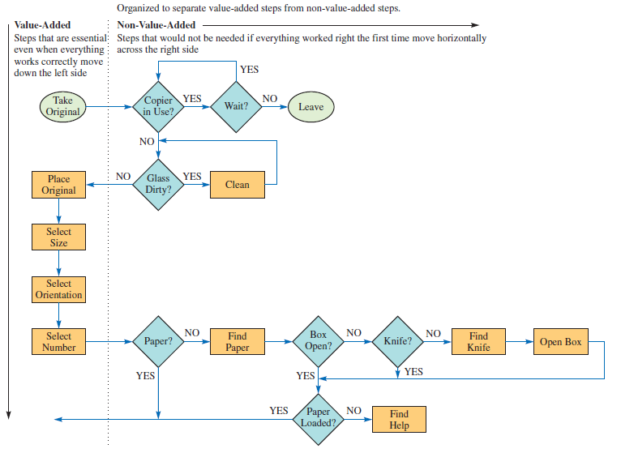
Opportunity Flow Diagram

Slide 19
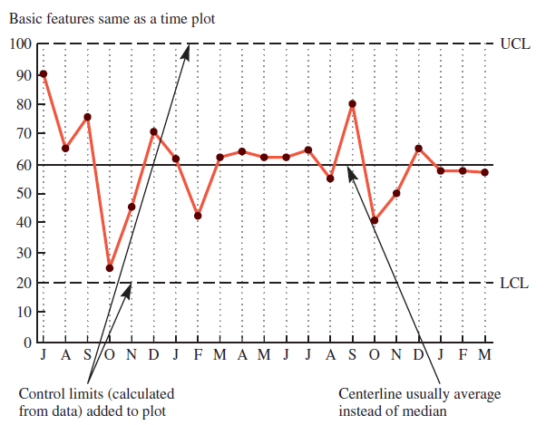
Process Control Chart

Slide 20
Additional Six Sigma Tools
Failure mode and effect analysis (FMEA): is a structured approach to identify, estimate, prioritize, and evaluate risk of possible failures at each stage in the process
Design of experiments (DOE): a statistical methodology to determine cause-and-effect relationships between process variables and output
Permits experimentation with many variables simultaneously

Slide 21
Six Sigma Roles and Responsibilities
Executive leaders must champion the process of improvement
Corporation-wide training in Six Sigma concepts and tools
Set stretch objectives for improvement
Continuous reinforcement and rewards

Slide 22
The Shingo System: Fail-Safe Design
Shingo’s argument:
SQC methods do not prevent defects
Defects arise when people make errors
Defects can be prevented by providing workers with feedback on errors.
Successive check
Self-check
Source inspection
Poka-yoke includes:
Checklists
Special tooling that prevents workers from making errors

Slide 23
ISO 9000 and ISO 14000
Series of standards agreed upon by the International Organization for Standardization (ISO)
Adopted in 1987
Used in more than 160 countries
A prerequisite for global competition?
ISO 9000 an international reference for quality; ISO 14000 primarily concerned with environmental management

Slide 24
Three Forms of ISO Certification
First party: a firm audits itself against ISO 9000 standards
Second party: a customer audits its supplier
Third party: a "qualified" national or international standards or certifying agency serves as auditor

Slide 25
External Benchmarking Steps
Identify those processes needing improvement.
Identify a firm that is the world leader in performing the process.
Contact the managers of that company and make a personal visit to interview managers and workers.
Analyze data.

