Slide 1
Module 17A/PROPELLER
CONTANTS----------------------------- PAGE NUMBERS
01.Fundamentals -------------------- 01 TO 22.
02 Propeller Construction ------ 23 to 28.
03 Propeller Pitch Control ------ 29 TO 50.
04 Propeller Synchronizing ----- 59 TO 61.
05. Propeller Ice Protection ----- 51 TO 56.
06. Propeller Maintenance------ 62 TO 75.
07.Propeller Storage and
Preservation ------------------------- 76 TO 79.

Slide 2
General
The propeller, the unit that must absorb the power output of the engine, has passed through many stages of development.
Although most propellers are two-bladed, great increases in power output have resulted in the development of four and six-bladed propellers of large diameters.
However, all propeller-driven aircraft are limited by the revolutions per minute (rpm) at which propellers can be turned.
Propeller-driven aircraft have several advantages and are widely used for applications in turboprops and reciprocating engine installations. Takeoff and landing can be shorter and less expensive.

Slide 3
General Information
Thrust is the force that move the aircraft through the air. Thrust is generated by the propulsion system of the aircraft. There are different types of propulsion systems develop thrust in different ways, although it usually generated through some application of Newton's Third Law. Propeller is one of the propulsion system. The purpose of the propeller is to move the aircraft through the air. The propeller consist of two or more blades connected together by a hub. The hub serves to attach the blades to the engine shaft. .

Slide 4
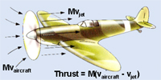

Slide 5
The blades are made in the shape of an airfoil like wing of an aircraft. When the engine rotates the propeller blades, the blades produce lift. This lift is called thrust and moves the aircraft forward. most aircraft have propellers that pull the aircraft through the air. These are called tractor propellers. Some aircraft have propellers that push the aircraft. These are called pusher propellers

Slide 6
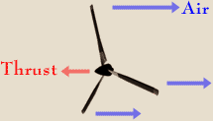

Slide 7
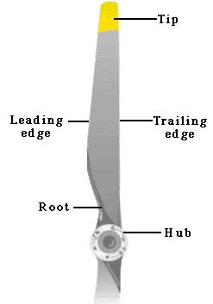
Description
Leading Edge of the airfoil is the cutting edge that slices into the air. As the leading edge cuts the air, air flows over the blade face and the camber side.

Slide 8
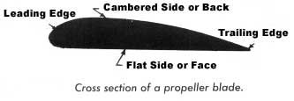
Blade Face is the surface of the propeller blade that corresponds to the lower surface of an airfoil or flat side, we called Blade Face.

Slide 9
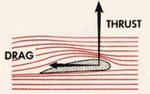
Blade Back / Thrust Face is the curved surface of the airfoil.

Slide 10
Blade Shank (Root) is the section of the blade nearest the hub.
Blade Tip is the outer end of the blade fartest from the hub.
Plane of Rotation is an imaginary plane perpendicular to the shaft. It is the plane that contains the circle in which the blades rotate.

Slide 11
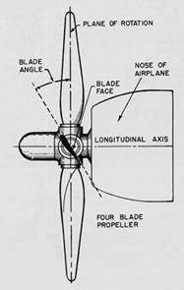

Slide 12
Blade Angle is formed between the face of an element and the plane of rotation. The blade angle throughout the length of the blade is not the same. The reason for placing the blade element sections at different angles is because the various sections of the blade travel at different speed. Each element must be designed as part of the blade to operate at its own best angle of attack to create thrust when revolving at its best design speed

Slide 13
Blade Element are the airfoil sections joined side by side to form the blade airfoil. These elements are placed at different angles in rotation of the plane of rotation.
The reason for placing the blade element sections at different angles is because the various sections of the blade travel at different speeds. The inner part of the blade section travels slower than the outer part near the tip of the blade. If all the elements along a blade is at the same blade angle,

Slide 14
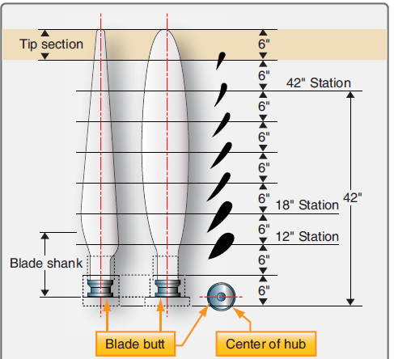

Slide 15
the relative wind will not strike the elements at the same angle of attack. This is because of the different in velocity of the blade element due to distance from the center of rotation.
The blade has a small twist (due to different angle in each section) in it for a very important reason. When the propeller is spinning round, each section of the blade travel at different speed, The twist in the peopeller blade means that each section advance forward at the same rate so stopping the propeller from bending.

Slide 16
Thrust is produced by the propeller attached to the engine driveshaft. While the propeller is rotating in flight, each section of the blade has a motion that combines the forward motion of the aircraft with circular movement of the propeller. The slower the speed, the steeper the angle of attack must be to generate lift. Therefore, the shape of the propeller's airfoil (cross section) must chang from the center to the tips. The changing shape of the airfoil (cross section) across the blade results in the twisting shape of the propeller.

Slide 17
Relative Wind is the air that strikes and pass over the airfoil as the airfoil is driven through the air.
Angle of Attack is the angle between the chord of the element and the relative wind. The best efficiency of the propeller is obtained at an angle of attack around 2 to 4 degrees.
Blade Path is the path of the direction of the blade element moves.

Slide 18
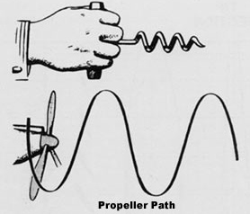

Slide 19
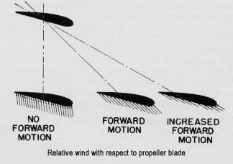

Slide 20
Pitch refers to the distance a spiral threaded object moves forward in one revolution. As a wood screw moves forward when turned in wood, same with the propeller move forward when turn in the air.
Geometric Pitch is the theoritical distance a propeller would advance in one revolution.

Slide 21
Effective Pitch is the actual distance a propeller advances in one revolution in the air. The effective pitch is always shorter than geometric pitch due to the air is a fluid and always slip.

Slide 22
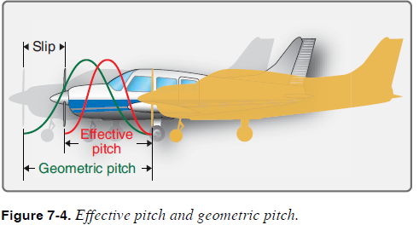

Slide 23
INTRODUCTION
Propeller blades are made of:
Wood.
Steel Alloys.
Forged solid aluminium alloys.
Composites.
The Hub assemblies are made of cast steel or aluminium alloys.
WOODEN BLADES
The first propeller blades were made of wood – Figure 63 & Figure 64. They are made from a solid block wood or laminated. Common types of wood used were:
  Mahogany.
  Cherry.
  Black Walnut.
  Oak.
  Birch (Most Common).

Slide 25
Three stages of wood propeller production:
• Glued planks.
• White.
• Finished propeller.
Each layer of a propeller is usually of the same thickness and type of wood.
A minimum of five layers of wood are used the planks of wood are glued together to form a blank.
During fabrication the blank is roughed to a shape and is allowed to set for a week to allow equal distribution of moisture through all of the layers.
The rough-shaped blank is called a white. The white is finished to the exact aerofoil example - Figure 65.

Slide 27
WOODEN BLADE PROTECTION
Wood blades can be protected by the use of steel, fabric or plastic strips along their leading edges and tips – Figure 67.
Wooden blades are usually varnished or painted for protection.
Tip fabric is usually applied to the propeller.
The cotton tip fabric is glued to the last 12 to 15 inches of the propeller blade and serves to reinforce the strength of the thin sections of the tip.
The fabric is doped to prevent deterioration by weather and the sun’s rays.
The propeller is varnished with a coat of water-repellent clear varnish to protect the wood surface.
Some propellers do not use tip fabric, but are coated with plastic before the metal tipping is applied.
This plastic coating provides protection and added strength to the propeller.

Slide 29
Propeller Location
Tractor Propeller
Tractor propellers are those mounted on the upstream end of a drive shaft in front of the supporting structure. Most aircraft are equipped with this type of propeller. The tractor type of propeller comes in all types of propellers. A major advantage of the tractor propeller is that lower stresses are induced in the propeller as it rotates in relatively undisturbed air.

Slide 30
Pusher Propellers
Pusher propellers are those mounted on the downstream
end of a drive shaft behind the supporting structure. Pusher propellers are constructed as fixed- or variable-pitch propellers. Seaplanes and amphibious aircraft have used a greater percentage of pusher propellers than other kinds of aircraft. On land planes, where propeller-to-ground clearance usually is less than propeller-to-water clearance of watercraft, pusher propellers are subject to more damage than tractor propellers.

Slide 31
Types of Propellers
Fixed-Pitch Propeller
As the name implies, a fixed-pitch propeller has the blade pitch, or blade angle, built into the propeller. [Figure 7-11]
The blade angle cannot be changed after the propeller is built. Generally, this type of propeller is one piece and is constructed of wood or aluminum alloy.

Slide 32
Test Club Propeller
A test club is used to test and break in reciprocating engines. [Figure 7-12] They are made to provide the correct amount of load on the engine during the test break-in period. The multi-blade design also provides extra cooling air flow during testing.

Slide 33
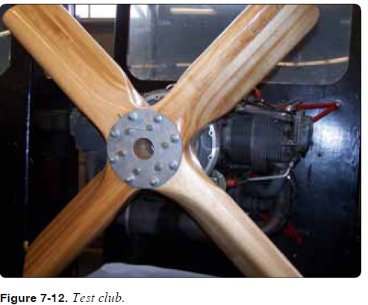

Slide 34
Ground-Adjustable Propeller
The ground-adjustable propeller operates as a fixed-pitch propeller. The pitch, or blade angle, can be changed only when the propeller is not turning. This is done by loosening the clamping mechanism that holds the blades in place. After
the clamping mechanism has been tightened, the pitch of the blades cannot be changed in flight to meet variable flight requirements. The ground-adjustable propeller is not often used on present-day airplanes.

Slide 35
Controllable-Pitch Propeller
This type of propeller is not to be confused with a constant speed propeller.
The controllable-pitch propeller permits a change of blade pitch, or angle, while the propeller is rotating. This allows the propeller to assume a blade angle that gives the best performance for particular flight conditions. The number of pitch positions may be limited, as with a two-position
controllable propeller, or the pitch may be adjusted to any angle between the minimum and maximum pitch settings of a given propeller.

Slide 36
Constant-Speed Propellers
To provide an efficient propeller, the speed is kept as constant as possible. By using propeller governors to increase or decrease propeller pitch
The governor-controlled, constant-speed propeller changes the blade angle automatically, keeping engine rpm constant.

Slide 37
Feathering Propellers
Feathering propellers must be used on multi-engine aircraft to reduce propeller drag to a minimum under one or more engine failure conditions. A feathering propeller is a constant-speed propeller used on multi-engine aircraft that has a mechanism to change the pitch to an angle of approximately 90°.By rotating the propeller blade angle parallel to the line offlight, the drag on the aircraft is greatly reduced. With the blades parallel to the airstream, the propeller stops turning and minimum wind milling

Slide 38
Reverse-Pitch Propellers
Almost all reverse-pitch propellers are of the feathering type. A reverse pitch propeller is a controllable propeller in which the blade angles can be changed to a negative value during operation. This aerodynamically
brakes the aircraft and reduces ground roll after landing. Reversing the propellers also reduces aircraft speed quickly on the runway just after touchdown and minimizes aircraft brake wear.

Slide 39
Governor Mechanism
The engine-driven single-acting propeller governor (constant-speed control) receives oil from the lubricating system and boosts its pressure to that required to operate the pitch-changing mechanism. It consists of a gear pump to increase the pressure of the engine oil, a pilot valve controlled by flyweights in the governor to control the flow of oil through the governor to and away from the propeller, and a relief valve system that regulates the operating oil pressures in the governor.

Slide 40
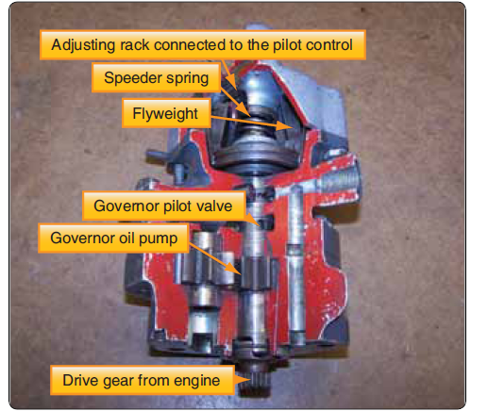

Slide 41
A spring called the speeder spring opposes the governor flyweight’s ability to fly outward when turning. The tension on this spring can be adjusted by the propeller control on the control quadrant. The tension of the speeder spring sets the maximum rpm of the engine in the governor mode. As the engine and propeller rpm is increased at the maximum set point (maximum speed) of the governor, the governor flyweights overcome the tension of the speeder spring and move outward. This action moves the pilot valve in the governor to release oil from the propeller piston and allows the blade flyweights to increase blade pitch, which increases the load on the engine, slowing it down or maintaining the set speed.

Slide 42
Underspeed Condition
When the engine is operating below the rpm set by the pilot using the cockpit control, the governor is operating in an under speed condition. [Figure 7-17] In this condition, the
flyweights tilt inward because there is not enough centrifugal force on the flyweights to overcome the force of the speeder spring. The pilot valve, forced down by the speeder spring,
meters oil flow to decrease propeller pitch and raise engine
rpm.

Slide 43
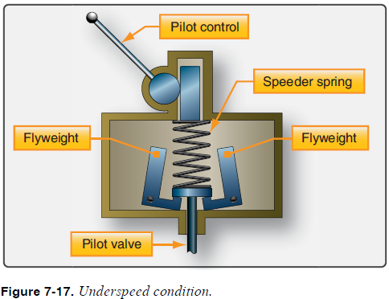

Slide 44
Over speed Condition
In an over speed condition, the centrifugal force acting on the flyweights is greater than the speeder spring force. The flyweights tilt outward and raise the pilot valve. The pilot valve then meters oil flow to increase propeller pitch and lower engine rpm.

Slide 45
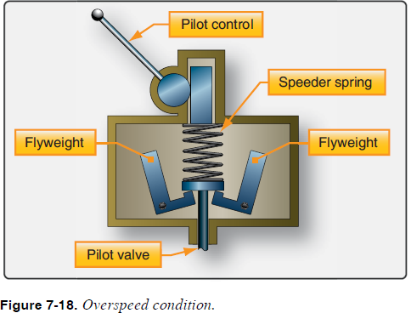

Slide 46
On-Speed Condition
In an on-speed condition, the centrifugal force
acting on the flyweights is balanced by the speeder spring, and the pilot valve is neither directing oil to nor from the propeller hydraulic cylinder. In the on-speed condition, the forces of the governor flyweights and the tension on the speeder spring are equal; the propeller blades are not moving or changing pitch.

Slide 47
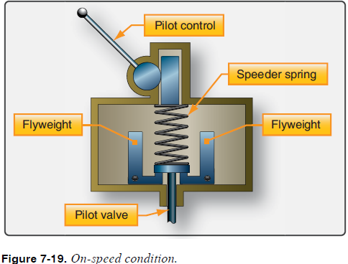

Slide 48
Constant-Speed Propellers
Hartzell Constant-Speed, Nonfeathering
One model of nonfeathering aluminum hub constant-speed propeller utilizes oil pressure from a governor to move the blades into high pitch (reduced rpm). The centrifugal twisting moment of the blades tends to move them into low pitch (high rpm) in the absence of governor oil pressure. This is an exception to most of the aluminum hub models and feathering models.

Slide 49
Constant-Speed Feathering Propeller
The feathering propeller utilizes a single oil supply from a governing device to hydraulically actuate a change in blade angle.
Feathering is accomplished by releasing the governor oil pressure, allowing the counterweights and feathering spring
to feather the blades. This is done by pulling the condition lever (pitch control) back to the limit of its travel, which opens up a port in the governor allowing the oil from the propeller to drain back into the engine.

Slide 50
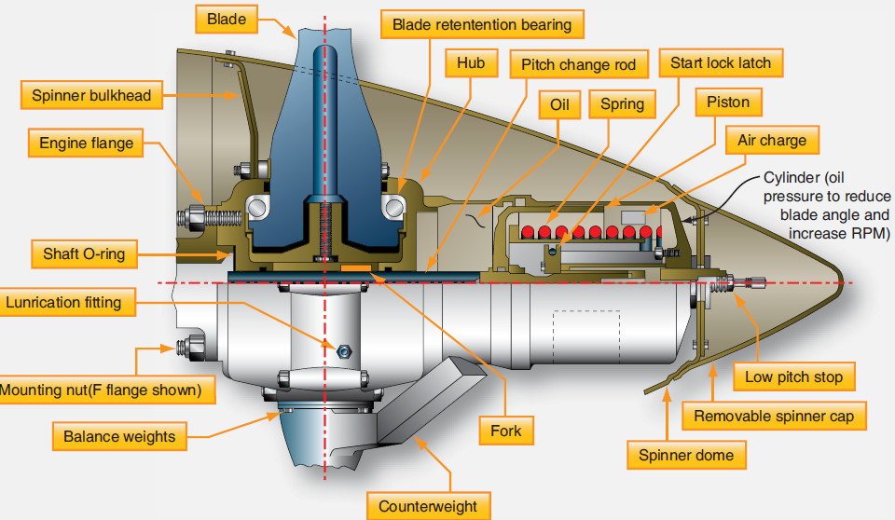

Slide 51
Feathering occurs because the
summation of internal propeller forces causes the oil to drain out of the propeller until the feather stop position is reached.
An elapsed time for feathering of between 3 and 10 seconds is usual with this system. Engine shutdown is normally accomplished during
the feathering process.

Slide 52
Unfeathering
Unfeathering can be accomplished by any of several methods, as follows:
1. Start the engine, so the governor can pump oil back into the propeller to reduce pitch. In most light twins, this procedure is considered adequate since the feathering of the propeller would happen infrequently.Vibration can occur when the engine starts and the propeller starts to come out of feather.

Slide 53
2. Provide an accumulator connected to the governor with a valve to trap an air-oil charge when the propeller is feathered, but released to the propeller when the rpm
control is returned to normal position. This system is used with training aircraft because it unfeathers the propeller in a very short time and starts the engine
wind milling.

Slide 54
3. Provide an unfeathering pump that provides pressure to force the propeller back to low pitch quickly using engine oil.
Normal in-flight unfeathering is accomplished when the pilot positions the propeller condition lever into the normal flight (governing) range.

Slide 55
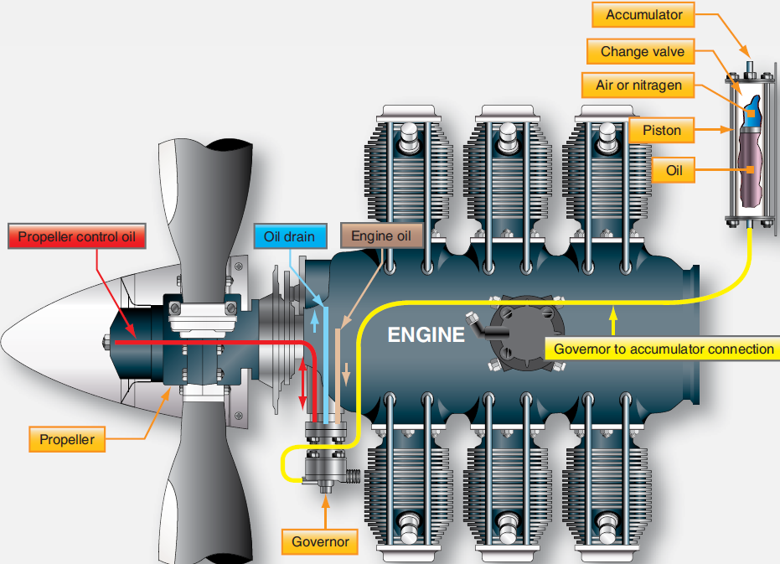

Slide 56
Auto feathering System
An auto feather system is used normally only during take off, approach, and landing. It is used to feather the propeller automatically if power is lost from either engine. The system uses a solenoid valve to dump oil pressure from the propeller cylinder (this allows the prop to feather) if two torque switches sense low torque from the engine. This system has a test-off-arm switch that is used to arm the system.

Slide 57
Ice Control Systems
Ice formation on a propeller blade, in effect, produces a distorted blade airfoil section that causes a loss in propeller
efficiency. Generally, ice collects asymmetrically on a propeller blade and produces propeller unbalance and
destructive vibration and increases the weight of the blades.

Slide 58
Anti-Icing Systems
A typical fluid system includes a tank to hold a supply of anti-icing fluid. [Figure 7-27] This fluid is forced to each propeller by a pump. The control system permits variation in the pumping rate so that the quantity of fluid delivered to a propeller can be varied, depending on the severity of icing. Fluid is transferred from a stationary nozzle on the engine nose case into a circular U-shaped channel (slinger ring) mounted on the rear of the propeller assembly. The fluid under pressure of centrifugal force is transferred through nozzles to each blade shank.

Slide 59
Because airflow around a blade shank tends to disperse anti-icing fluids to areas where ice does not collect in large quantities, feed shoes, or boots, are installed on the blade leading edge. These feed shoes are a narrow strip of rubber extending from the blade shank to a blade station that is approx 75%of the propeller radius. The feed
shoes are molded with several parallel open channels in which fluid flows from the blade shank toward the blade

Slide 60
tip by centrifugal force. The fluid flows laterally from the channels over the leading edge of the blade. Isopropyl alcohol is used in some anti-icing systems because of its availability and low cost.

Slide 61
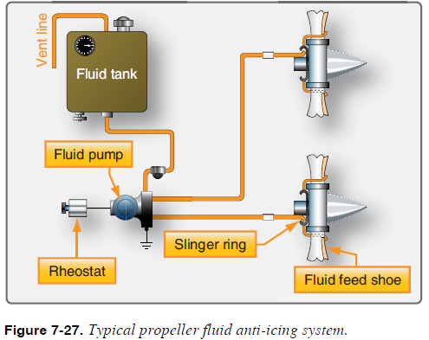

Slide 62
Deicing Systems
An electric propeller-icing control system consists of an electrical energy source, a resistance heating element, system controls, and necessary wiring. [Figure 7-28] The heating elements are mounted internally or externally on the propeller spinner and blades. Electrical power from the aircraft system is transferred to the propeller hub through electrical leads, which terminate in slip rings and brushes. Flexible connectors are used to transfer power from the hub to the blade elements.

Slide 63
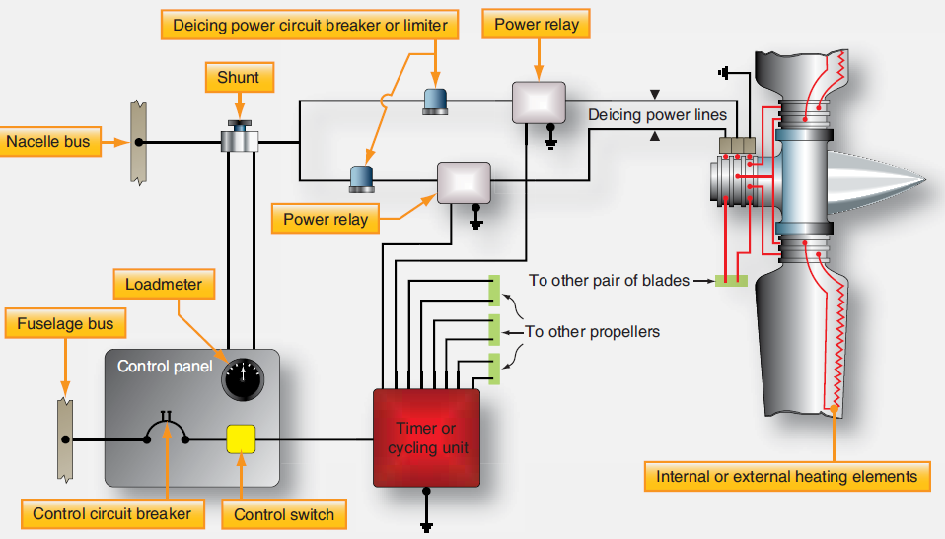

Slide 64
A deice system consists of one or more on-off switches. The pilot controls the operation of the deice system by turning on one or more switches.
The timer or cycling unit determines the sequence of which blades (or portion thereof) are currently being deiced, and for what length of time. The cycling unit applies power to each
deice boot, or boot segment, in a sequence or all on order.

Slide 65
Propeller Synchronization and Synchrophasing
Most multi-engine aircraft are equipped with propeller-synchronization-systems. Synchronization systems provide a means of controlling and synchronizing engine rpm. Synchronization reduces vibration and
eliminates the unpleasant beat produced by unsynchronized propeller operation. A typical synchrophasing system is an electronic system.
It functions to match the rpm of both enginesand establish a blade phase relationship between the left and right propellers to reduce cabin noise.

Slide 66
The system is controlled by a two-position switch located forward of the throttle quadrant. Turning the control switch on suppliesdirect current (DC) power to the electronic control box. Input signals representing propeller rpm are received from magnetic pickup on each propeller. The computed input signals are corrected to a command signal and sent to an
rpm trimming coil located on the propeller governor of the slow engine. Its rpm is adjusted to that of the other propeller.

Slide 67
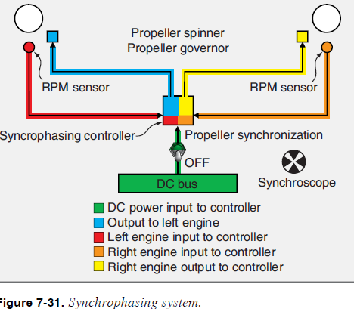

Slide 68
Propeller Inspection and Maintenance
Propellers must be inspected regularly. The exact time interval for particular propeller inspections is usually specified by the propeller manufacturer. The regular daily inspection of propellers varies little from one type to another.
Typically, it is a visual inspection of propeller blades, hubs, controls, and accessories for security, safety, and general condition. Visual inspection of the blades does not mean a careless or casual observation. The inspection should be meticulous enough to detect any flaw or defect that may exist.

Slide 69
Inspections performed at greater intervals of time (e.g., 25,50, or 100 hours) usually include a visual check of:
1. Blades, spinners, and other external surfaces for excessive oil or grease deposits.
2. Weld and braze sections of blades and hubs for evidence of failure.
3. Blade, spinner, and hubs for nicks, scratches, or other flaws. Use a magnifying glass if necessary.
4. Spinner or dome shell attaching screws for tightness.

Slide 70
5. The lubricating requirements and oil levels, when applicable.
If a propeller is involved in an accident, and a possibility exists that internal damage may have occurred, or if a propeller has had a ground strike or sudden stoppage, the recommendations of the engine and propeller need to be adhered to. The propeller should be disassembled and inspected. Whenever a propeller is removed from a shaft, the hub cone seats, cones, and other contact parts should be examined to detect undue wear, galling, or corrosion.

Slide 71
Wood Propeller Inspection
Wood propellers should be inspected frequently to ensure airworthiness. Inspect for defects, such as cracks, dents, warpage, glue failure, de lamination defects in the finish, and charring of the wood between the propeller and the flange
due to loose propeller mounting bolts. Examine the wood close to the metal sleeve of wood blades for cracks extending outward on the blade. These cracks sometimes occur at the
threaded ends of the lag screws and may be an indication of internal cracking of the wood. Check the tightness of the lag screws,

Slide 72
which attach the metal sleeve to the wood blade, in accordance with the manufacturer’s instructions. In-flight tip failures may be avoided by frequent inspections of the metal cap, leading edge strip, and surrounding areas. Inspect for
such defects as looseness or slipping, separation of soldered joints, loose screws, loose rivets, breaks, cracks, eroded sections, and corrosion. Inspect for separation between the metal leading edge and the cap, which would indicate the cap
is moving outward in the direction of centrifugal force.

Slide 73
This condition is often accompanied by discoloration and loose rivets. Inspect the tip for cracks by grasping it with the hand and slightly twisting about the longitudinal blade centerline
and by slightly bending the tip backward and forward. If the leading edge and the cap have separated, carefully inspect for cracks at this point. Cracks usually start at the leading
edge of the blade. Inspect moisture holes are open. A fine line appearing in the fabric or plastic may indicate a crack in the wood. Check the trailing edge of the propeller blades for bonding, separation, or damage.

Slide 74
Metal Propeller Inspection
Metal propellers and blades are generally susceptible to fatigue failure resulting from the concentration of stresses at the bottoms of sharp nicks, cuts, and scratches. It is necessary,
therefore, to frequently and carefully inspect them for such defects. The inspection of steel blades may be accomplished by either visual, fluorescent penetrant

Slide 75
Or magnetic particle inspection. The visual inspection is easier if the steel blades are covered with engine oil or rust-preventive
compound. The full length of the leading edge (especially near the tip), the full length of the trailing edge, the grooves and shoulders on the shank, and all dents and scars should be
examined with a magnifying glass to decide whether defects are scratches or cracks.

Slide 76
Aluminum Propeller Inspection
Carefully inspect aluminum propellers and blades for cracks and other flaws. A transverse crack or flaw of any size is cause for rejection. Multiple deep nicks and gouges on the leading edge and face of the blade is cause for rejection.
Use dye penetrant or fluorescent dye penetrant to confirm suspected cracks found in the propeller.

Slide 77
Composite Propeller Inspection
Composite blades need to be visually inspected for nicks, gouges, loose material, erosion, cracks and debonds, and lightning strike. [Figure 7-32] Composite blades are inspected for delaminations and debonds by tapping the blade or cuff (if applicable) with a metal coin. If an audible change is apparent, sounding hollow or dead, a debond or delamination is likely. [Figure 7-33] Blades that incorporate a “cuff” have a different tone when coin tapped in the cuff

Slide 78
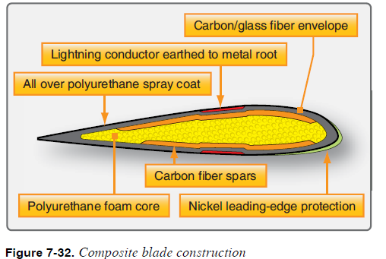

Slide 79
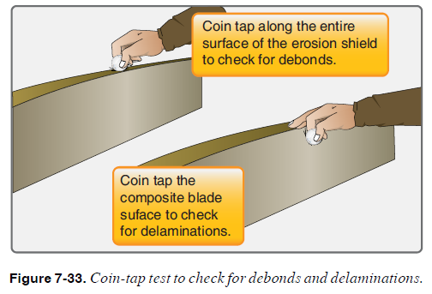

Slide 80
area. To avoid confusing the sounds, coin tap the cuff area and the transition area between the cuff and the blade separately from the blade area.
Repairs to propellers are often limited to minor type repairs. Certificated mechanics are not allowed to perform major repairs on propellers. Major repairs need to be accomplished by a certificated propeller repair station.

Slide 81
Propeller Vibration
Although vibration can be caused by the propeller, there are numerous other possible sources of vibration that can make troubleshooting difficult. If a propeller vibrates, whether due to balance, angle, or track problems, it typically vibrates throughout the entire rpm range, although the intensity of the vibration may vary with the rpm. If a vibration occurs only at one particular rpm or within a limited rpm range (e.g., 2200– 2350 rpm), the vibration is not normally a propeller problem but a problem of a poor engine-propeller match

Slide 82
Blade Tracking
Blade tracking is the process of determining the positions of the tips of the propeller blades relative to each other (blades rotating in the same plane of rotation). Tracking shows only the relative position of the blades, not their actual path.
The following method for checking tracking is normally used:
1. Chock the aircraft so it cannot be moved.
2. Remove one spark plug from each cylinder. This makes the propeller easier and safer to turn.

Slide 83
3. Rotate one of the blades so it is pointing down.
4. Place a solid object (e.g., a heavy wooden block that is at least a couple of inches higher off the ground than the distance between the propeller tip and the ground) next
to the propeller tip so that it just touches or attaches a pointer/indicator to the cowling itself. [Figure 7-34]

Slide 84
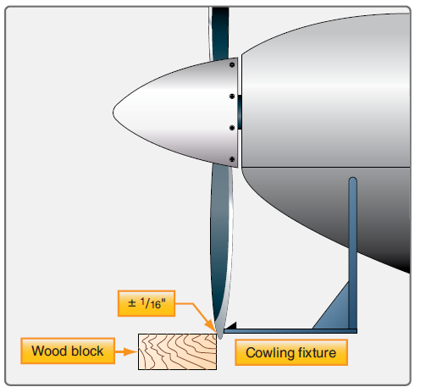

Slide 85
5. Rotate the propeller slowly to determine if the next blade tracks through the same point (touches the block/ pointer). Each blade track should be within 1⁄16 inch (plus or minus) from the opposite blade’s track.
6. An out-of-track propeller, may be due to one or more propeller blades being bent, a bent propeller flange, or propeller mounting bolts that are either over- or under torqued. An out-of-track propeller causes vibration and stress to the airframe and engine and may cause premature propeller failure.

