Slide 1
CATHODE RAY TUBE

Slide 2
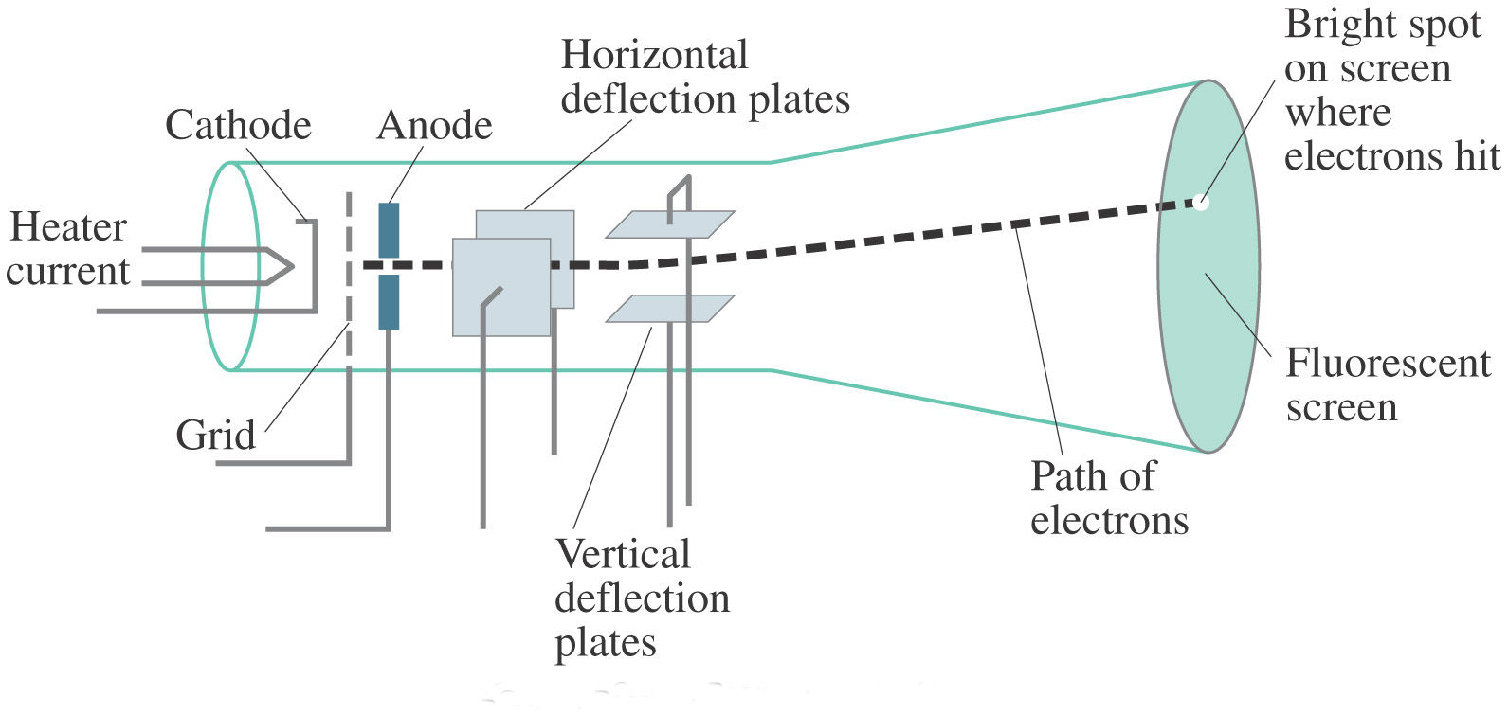
CIRCUIT DIAGRAM

Slide 3
INTRODUCTION
CRT is called the heart of oscilloscope.
It modulates, accelerates, and deflects electron beam(s) onto the screen to create the images.
The images may represent electrical waveforms, pictures (television, computer monitor), radar targets, or others.
The CRT uses an evacuated glass envelope which is large, deep (i.e. long from front screen face to rear end), fairly heavy, and relatively fragile.

Slide 4
OSCILLOSCOPE CRT
In oscilloscope CRTs, electrostatic deflection is used, rather than the magnetic deflection commonly used with television and other large CRTs.
The beam is deflected horizontally by applying an electric field between a pair of plates to its left and right, and vertically by applying an electric field to plates above and below.
Televisions use magnetic rather than electrostatic deflection because the deflection plates obstruct the beam when the deflection angle is as large as is required for tubes that are relatively short for their size.

Slide 5
ELECTRON GUN ASSEMBLY
The electron gun assembly consists of an indirectly heated cathode, a control grid surrounding the cathode, a focusing anode and an accel­erating anode.
The sole function of the electron gun assembly is to provide a focused electron beam which is accelerated towards the phosphor screen.
The cathode is a nickel cylinder coated with an oxide coating and emits plenty of electrons, when heated.
The emitting surface of the cathode should be as small as possible, theoretically a point.

Slide 6
ELECTRON GUN ASSEMBLY
Rate of emission of electrons or say the intensity of electron beam depends on the cathode current, which can be controlled by the control grid in a manner similar to a conventional vacuum tube.
The control grid is a metal cylinder covered at one end but with a small hole in the cover.
The grid is kept at negative potential (variable) with respect to cathode and its function is to vary the electron emission and so the brilliancy of the spot on the phosphor screen.

Slide 7
ELECTRON GUN ASSEMBLY
The hole in the grid is provided to allow passage for electrons through it and concentrate the beam of electrons along the axis of tube.
Electron beam comes out from the control grid through a small hole in it and enters a pre-accelerating anode, which is a hollow cylinder in shape and is at a potential of few hundred volts more positive than the cathode so as to accelerate the electron beam in the electric field.
This accelerated beam would be scattered now because of variations in energy and would produce a broad ill-defined spot on the screen.

Slide 8
ELECTRON GUN ASSEMBLY
This electron beam is focused on the screen by an electrostatic lens consisting of two more cylindrical anodes called the focusing anode and accelerating anode apart from the pre-accelerating anode.
The focusing and accelerating anodes may be open or close at both ends and if covered, holes must be provided in the anode cover for the passage of electrons.
The function of these anodes is to concentrate and focus the beam on the screen and also to accelerate the speed of electrons.

Slide 9
DEFLECTION PLATE ASSEMBLY
Electron beam, after leaving the electron gun, passes through the two pairs of deflection pates.
One pair of deflection plates is mounted vertically and deflects the beam in horizontal or X-direction and so called the horizontal or X-plates and the other pair is mounted horizontally and deflects the beam in vertical or Y-direction and called the vertical or Y-plates.
These plates are to deflect the beam according to the voltage applied across them. For example if a constant pd is applied to the set of Y-plates, the electron beam will be deflected upward if the upper plate is positive.

Slide 10
DEFLECTION PLATE ASSEMBLY
In case the lower plate is positive then the beam will be deflected downward. Similarly if a constant pd is applied to the set of X-plates, the electron beam will be deflected to the left or right of the tube axis according to the condition whether the left or right plate is positive.
When a sinusoidal voltage is applied to Y-plates, the beam will be moved up and down according to the variation of plate potential.

Slide 11
PHOSPHOR PERSISTENCE
Various phosphors are available depending upon the needs of the measurement or display application.
The brightness, color, and persistence of the illumination depends upon the type of phosphor used on the CRT screen.
Phosphors are available with persistence ranging from less than one microsecond to several seconds.
For visual observation of brief transient events, a long persistence phosphor may be desirable. For events which are fast and repetitive, or high frequency, a short-persistence phosphor is generally preferable.

Slide 12
GLASS BODY AND BASE
The whole assembly is protected in a conical highly evacuated glass housing through suitable supports.
The inner walls of CRT between neck and screen are usually coated with a conducting material known as aquadag and this coating is electrically connected to the cathode.
The coating is provided in order to accelerate the electron beam after passing between the deflecting plates and to collect the electrons produced by secondary emission when electron beam strikes the screen.

Slide 13
GLASS BODY AND BASE
Thus the coating prevents the formation of negative charge on the screen and state of equilibrium of screen is maintained.

Slide 14
GRATICULES
Most oscilloscopes have a graticule as part of the visual display, to facilitate measurements.
The graticule may be permanently marked inside the face of the CRT, or it may be a transparent external plate made of glass or acrylic plastic.
An internal graticule eliminates parallax error, but cannot be changed to accommodate different types of measurements.
Oscilloscopes commonly provide a means for the graticule to be illuminated from the side, which improves its visibility.
Horizontal and vertical marks are marked on the screen of the CRT to provide user a correct measurement.
These marks, usually in rectangular form, are called graticule.

Slide 15
COLORED CRT
There are two popular techniques for producing color displays with a CRT are:
1. Beam-penetration method
2. Shadow-mask method
Beam penetration method: It is a cheaper method and is used in Vector scan displays.

Slide 16
BEAM PENETRATION METHOD
In this method the inside section of CRT is coated with red (outer layer) and green (inner layer) phosphors.
If the electrons are slow they penetrate only the outer layer thus emitting red light, and if the electrons are moving fast they penetrate the outer layer and the inner layer.
The electrons speed is also adjusted in such a way that by combination of red and green, orange and yellow color are also produced.
The limitation of this method is that only four colors can be displayed in the screen. Since we have only four colors the quality of image is diminished.

Slide 17
SHADOW MASK METHOD
It is used basically in Raster scan displays (color TV). In this method, the screen has 3 phosphor colored dots which emits colors red, green and blue in a single pixel position.
We use 3 electron guns for emitting colors red, green and blue. Now, three electrons are fired from these guns simultaneously and when they pass through shadow mask they form a phosphor dot triangle of colors red, green and blue in screen.
This triangle is actually a pixel in the screen. The color of this pixel can be controlled by controlling the intensity of the electron beams.
Also, by controlling the intensity of electron beams we can produce other colors which are combinations of colors red, green and blue.

Slide 18
