Slide 1
Flight controls
Primary flight controls
Since the dawn of heavier-than-air flight and the discovery of the three axis flight control network, airplanes continue to employ the three primary controls: elevator, aileron, and rudder.
It should be noted that the same control inputs used by the pilot to fly small airplanes are used to control large aircraft.
The primary flight controls provide the aerodynamic force necessary to make the aircraft follow a desired flight path.

Slide 2
The flight control surfaces are normally hinged or movable airfoils designed to change the attitude of the aircraft by changing the airflow over the aircraft's surfaces during flight.
These surfaces are used for controlling the aircraft about its three axes
Typically, the ailerons and elevators are operated from the flight deck by means of a control stick, a control wheel, or yoke assembly and on some of the newer design aircraft, a joystick,(control column).
Longitudinal control is the climb and dive movement or pitch of an aircraft that is controlled by the elevator.
To cause the airplane to ascend from a straight and level attitude, the pilot pulls back on the control yoke or stick. Pushing the control forward lowers the nose of the aircraft for making descents.

Slide 3
Lateral control is the banking movement or roll of an aircraft that is controlled by the ailerons.
To roll the airplane around the longitudinal axis, the pilot rotates the control wheel or moves the stick to the left or right, as desired.
When the control is moved to the left, the left aileron rises above the wing and the right aileron descends below the wing. This causes the left wing to drop and the right wing to ascend resulting in a left bank.
Some aircraft may use multiple ailerons so that each wing includes an inboard and outboard aileron. In such instances, the control network may lock out the outboard ailerons during high-speed flight.
In addition to ailerons, spoilers may also be incorporated into aileron system. Each aircraft may have specific features contained in the flight control system to enhance the operation of the airplane.

Slide 4
Directional control around the vertical axis is the left and right movement or yaw of an aircraft that is controlled by the rudder.
Foot pedals normally control the position of the rudder.
Stepping on the right rudder pedal deflects the rudder to make a right turn. Stepping on the left pedal causes the aircraft to turn left.
Most often when making turns during flight, the application of the rudder is made in combination with the aileron control. When the proper proportion of rudder and ailerons are inputted into the control system for the purpose of banking through a turn, the airplane is in a coordinated turn.

Slide 8
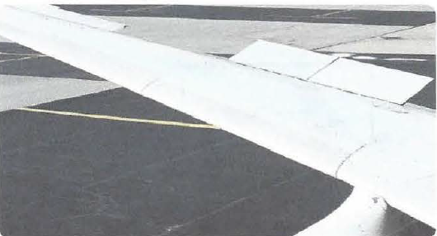
SECONDARY FLIGHT CONTROLS
Large airplanes will often employ a series of secondary flight controls to augment the performance of the aircraft during takeoff and landing and to supplement the controllability of the airplane throughout the various flight parameters.
Secondary flight controls include: spoilers, leading edge flaps, leading edge slats, trailing edge flaps, and speed brakes.
The secondary flight controls may further be used for aerodynamic braking once the airplane has landed.
A common secondary flight control involves the use of spoilers to assist in controlling the bank of the airplane. The flight spoilers rise on the side of the airplane where the aileron is deflected up. They remained down on the wing where the aileron is deflected below the surface of the wing.

Slide 9
TRIM CONTROLS (tabs)
Trim systems are added to flight control members to assist the crew in controlling the aircraft.
Trim systems may also be used to control the aircraft, to a
degree, during emergencies when the primary flight control system(s) fail or develop a fault.
Included in the trim controls are the trim tabs, servo tabs, balance tabs, and spring tabs.
TRIM TAB-
Trim tabs are small airfoils recessed into the trailing edges of the primary control surfaces.
Trim tabs can be used to correct any tendency of the aircraft to move toward an undesirable flight attitude. Their purpose is to enable the pilot to trim out any unbalanced condition that may exist during flight, without exerting any pressure on the primary flight controls.

Slide 10
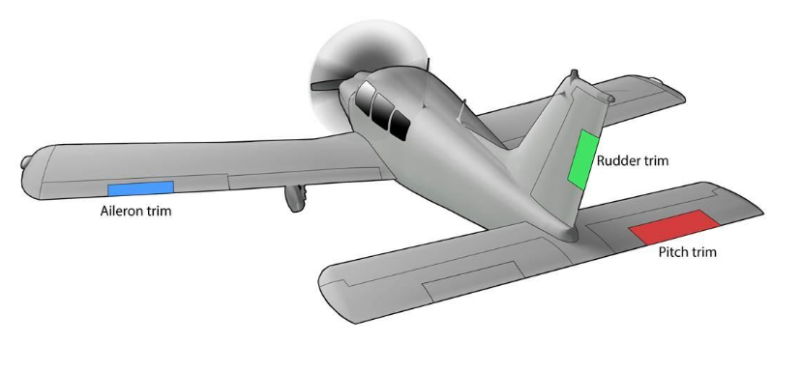
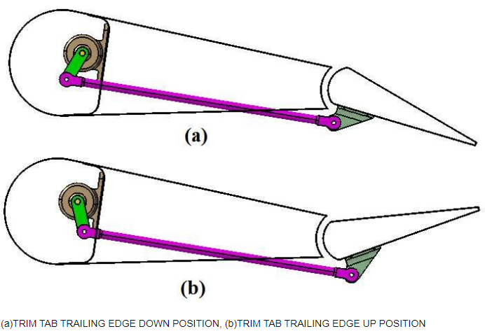
It moves opposite to the control surface means air strike on the tab and it produce force that hold the control surface in that position.

Slide 11
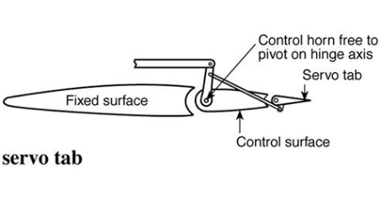
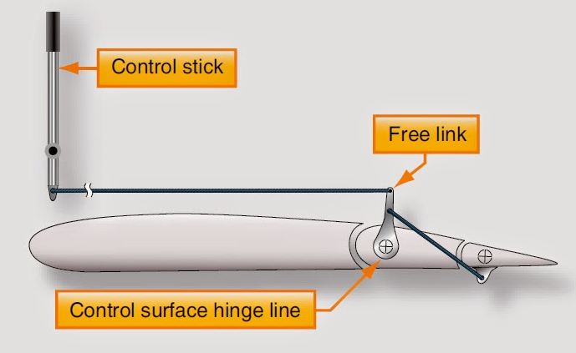
SERVO TAB
Servo tabs, sometimes referred to as flight tabs, are used primarily on the large main control surfaces. They aid in moving the main control surface and holding it in the desired position.
Only the servo tab moves in response to control movements inputted by the pilots.

Slide 12
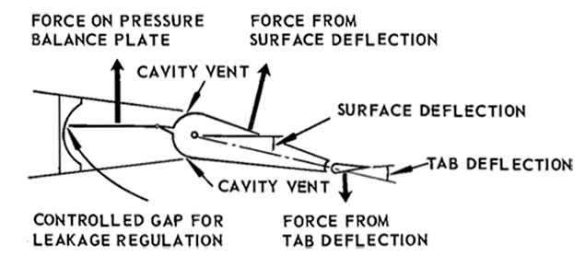
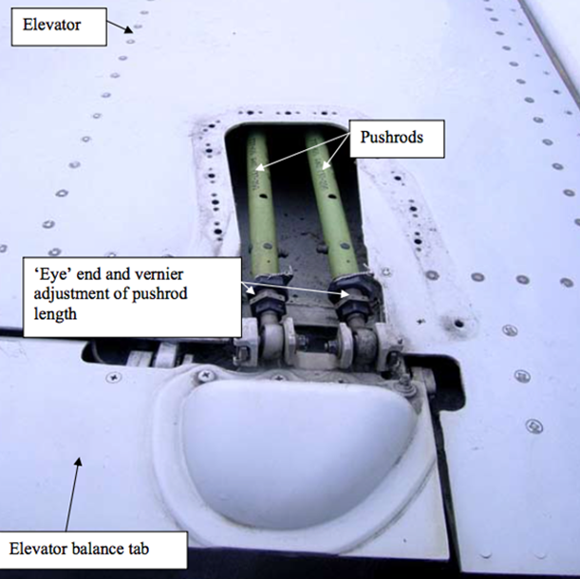
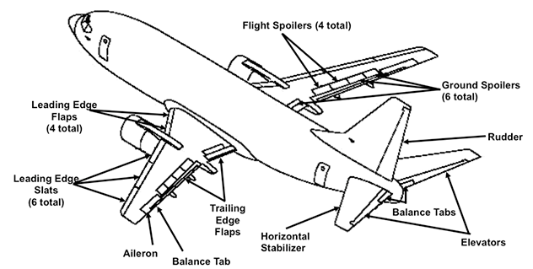
BALANCE TAB
Balance tabs are designed to move in the opposite direction of the primary flight control. Thus, aerodynamic forces acting on the tab assist in moving the primary control surface.

Slide 13
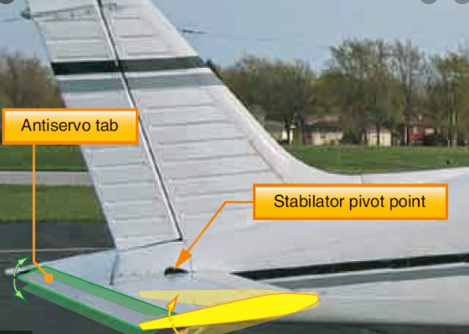
ANTI SERVO TAB
It is just like servo tab but moves same direction to control surface.
On those aircraft whose horizontal stabilizer are movable, in the stabilizers input to the control surface is too sensitive.
To reduce the sensitivity of pilot input.
This tab is tied through control linkage creat aerodymanic force the increase effort need to move the control surface
It makes flying an aircraft move stable.

Slide 14
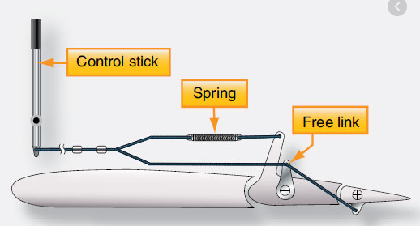
Spring tabs are similar in appearance to trim tabs, but serve an entirely different function.
Spring tabs are used for the same purpose as hydraulic actuators-to aid the pilot in moving the primary control surface.
control surface, but is operated by an independent control.
Control surface require excessive force to move only in final stage of travel, at that stage spring tab helps to move the control surface. ‘
Under normal flight loads, a spring tab has no role to play and remains streamlined to the control surface.

Slide 15
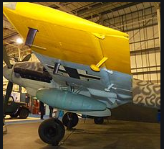

Slide 16
HIGH LIFT DEVICES
Included in the high lift devices group of flight control surfaces are the wing trailing edge flap s, slats, leading edge flaps, and slots. They may be used independently or in combination to improve the performance of the aircraft.
The trailing edge airfoils (flaps) increase the wing surface area when extended, thereby increasing lift on takeoff, and decreasing the speed of the airplane during landing.
These airfoils are retractable and fair into the wing contour. Other flaps are simply portions of the lower skin that extend into the airstream, thereby slowing the aircraft.
Leading edge flaps are airfoils extended from and retracted into the leading edge of the wing. Some installations create a slot (an opening between the extended airfoil and the wing leading edge).

Slide 17
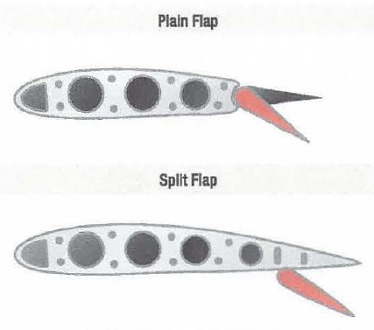
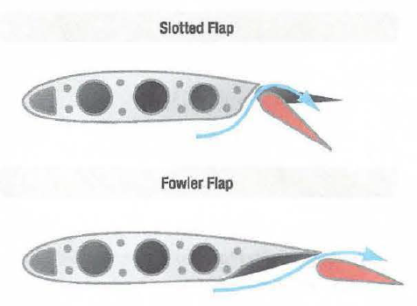
The flap (termed slat by some manufacturers) and slot create additional lift at the lower speeds used during takeoff and landing Other installations have permanent slots built in the leading edge of the wing.

Slide 18
Plain flaps
It form the trailing edge of the wing when the flap is in the retracted position.
The airflow over the wing continues over the upper and lower surfaces of the flap, making the trailing edge of the flap essentially the trailing edge of the wing.
The plain flap is hinged so that the trailing edge can be lowered. This increases wing camber and provides greater lift.
split flap
It is normally housed under the trailing edge of the wing.
The upper surface of the wing extends to the trailing edge of the flap. When deployed, the split flap trailing edge lowers away from the trailing edge of the wing.
Airflow over the top of the wing remains the same. Airflow under the wing now follows the camber created by the lowered split flap, increasing lift.

Slide 19
Fowler flaps
Fowler flaps not only lower the trailing edge of the wing when deployed but also slide aft, effectively increasing the area of the wing.
This creates more lift via the increased surface area, as well as the wing camber. When stowed, the fowler flap typically retracts up under the wing trailing edge similar to a split flap.
The sliding motion of a fowler flap can be accomplished with a worm drive and flap tracks.
Triple slotted flap
In this configuration, the flap consists of a fore flap, a mid flap, and an aft flap. When deployed, each flap section slides aft on tracks as it lowers.
The flap sections also separate leaving an open slot between the wing and the fore flap, as well as between each of the flap sections.
Air from the underside of the wing flows through these slots. The result is that the laminar flow on the upper surfaces is enhanced. The greater camber and effective wing area increase overall lift.

Slide 20
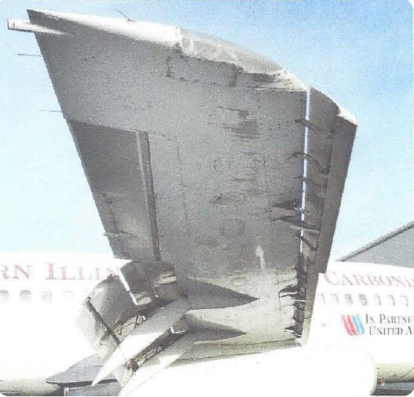
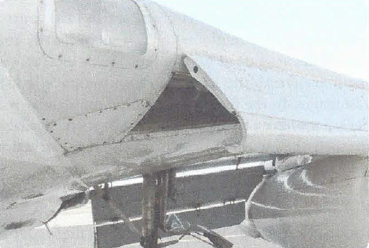
At cruising speeds, the trailing edge and leading edge flaps (slats) are retracted into the wing proper.
Slats are movable control surfaces attached to the leading edges of the wings. When the slat is closed, it forms the leading edge of the wing.
When in the open position (extended forward), a slot is created between the slat and the wing leading edge. At low airspeeds, this increases lift and improves handling characteristics, allowing the aircraft to be controlled at airspeeds below the normal landing speed.

Slide 21
LIFT DUMP AND SPEED BRAKES
Lift and speed decreasing devices are the speed brakes and spoilers.
In some installations, there are two types of spoilers. Ground spoilers are extended only after the aircraft is in the ground, thereby assisting in the braking action.
Flight spoilers assists in lateral control by being extended whenever the aileron on the same wing is deflected upward from neutral.
When actuated as speed brakes, the spoiler panels on both wings raise up.
Fiight spoilers may also be located along the sides, underneath the fuselage, or back at the tail.
In some aircraft designs, the wing panel on the up aileron side rises more than the wing panel on the down aileron side. This provides speed brake operation and lateral control simultaneously.

Slide 22
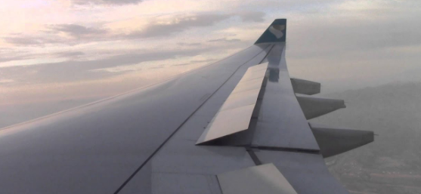
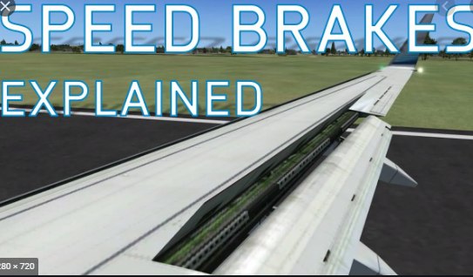

Slide 23
CONTROL SYSTEM OPERATION
MECHANICAL CONTROL
This is the basic type of system that was used to control early aircraft and is currently used in smaller aircraft where aerodynamic forces acting on the controls are not excessive.
The controls are mechanical and manually operated by the pilot.
The mechanical system of controlling an aircraft can include cables, push-pull tubes, bell cranks, levers, jackscrews, cable drums, and torque tubes.
The cable system is the most widely used because deflections of the structure to which it is attached do not affect its operation.
Some aircraft incorporate control systems that are a combination of mechanical control mechanisms.
These systems incorporate cable assemblies, cable guides, linkages, bell cranks, pushpull tubes, torque tubes, adjustable stops, and control surface snubbers or mechanical locking devices.

Slide 24
CONTROL CABLES
Control cables used in aviation are typically 7 x 7 and7 x 19 flexible steel wires.
Cables are very strong when placed under a tensile or pulling load.
Flexible cables do not have strength when pushed.
Consequently, when cables are used for flight controls, they often employ multiple cables so that one cable is under tension when the control input is made in one direction and the other cable is under tension when the control input is made in the opposite direction.
Control cables may run the entire length from the control mechanism manipulated by the crew to the control quadrant, cable drum, torque tube, bell crank, or lever that connects to the control surface.
Other cables may run from the pilot's control mechanism to hydraulic valves or other devices that ultimately deflect the control surfaces.
Most manufacturers of large aircraft will include some means whereby cables may be identified through labeling.

Slide 25
Throughout the length of the cable, pulleys may be used for changing the direction of the cable action or for cable support.
Fairleads are also used to guide control cables along their length. Fairleads are generally made from plastic of other material that contacts the cable as it moves back and forth.
These blocks of material are subject to wear over time.
Cable guides are also used to protect cables from damage.
Cables that extend from pressurized portions of the aircraft to unpressurized areas use seals to prevent loss cabin pressure.
Significant air leaks at such locations may affect the operation of the pressurization system.
Turnbuckles are normally included in the cable system for setting cable tension and serving as disconnect points.
Turnbuckles are threaded devices that have an end with right-handed threads and the opposite end with left-handed threads.

Slide 27
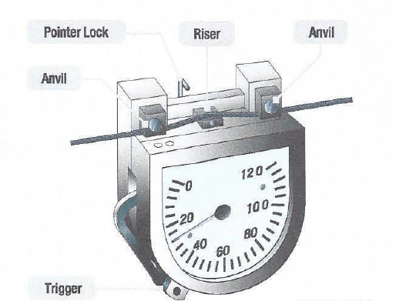
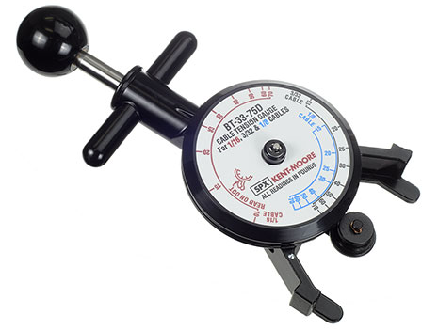
The cable terminals are threaded into the barrel of the turnbuckle.
Turnbuckles are safetied using lockwire. Some turnbuckle and terminal ends have the option of being safetied with special clips.
Setting the proper tension on the cables is critical to the rigging process. Improper cable tension may cause loss of control travel or damage to components.
Tensiometers are tools used to measure the tension placed on control cables.

Slide 28
Because airplanes stretch and contract with changes in temperatures, some airplanes use cable tension regulators to maintain proper cable tension throughout the range of conditions.
PUSH-PULL TUBES
Where cables only have strength when they are place under tension, or pulled, push-pull rods are able to transmit force in either direction.
Push-pull rods may be solid or hollow. The ends attached to the push-pull rods may be fixed or adjustable.
Technicians must ensure that adjustable ends have adequate thread engagement with the push-pull rod.
Inadequate thread engagement may lead to part failure and loss of control.
Witness holes are used to verify sufficient thread engagement

Slide 30
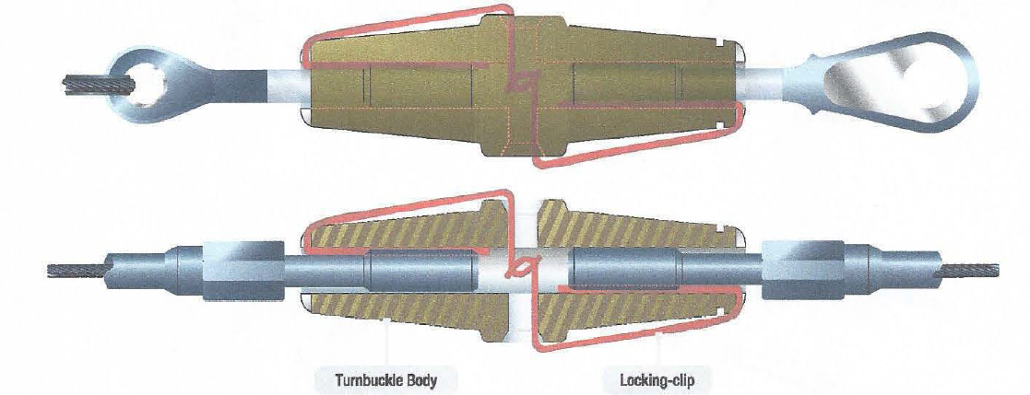

Slide 31
BELLCRANKS AND LEVERS
Bellcranks are constructed so that a series of levers are able to receive an input signal and deliver an output. [linear motion at an angle]
The output from a lever or bellcrank may amplify the input or vice-versa.
Frequently, bellcranks change the direction of movement.
1he input signal may come from a lateral direction and the output motion made in a longitudinal direction and vice-versa
JACKSCREWS
Jackscrews are commonly employed for moving surfaces that experience extreme aerodynamic loads, such as horizontal stabilizers and flaps.
Jackscrews are threaded units that convert rotary motion into linear travel.
The threads of jackscrews are quite coarse.
Jackscrews are ideal for trim applications of large control surfaces.

Slide 32
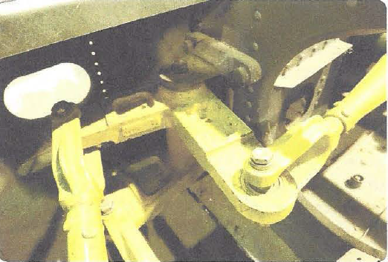
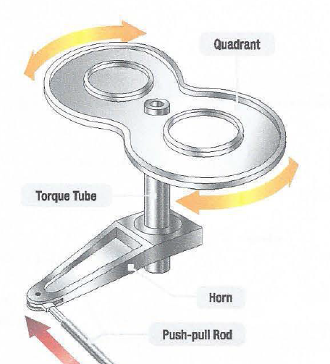
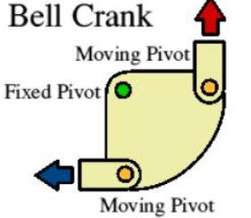

Slide 33
HVDROMECHANICAL CONTROL
As the size, complexity, and speed of aircraft increased, actuation of controls in flight be came more difficult to perform strictly using physical strength.
It soon became apparent that the pilot needed assistance to overcome the aerodynamic forces encountered by the control surfaces in order to control the aircraft.
Spring tabs, which were operated by the conventional control system, were moved so that the airflow over them actually moved the primary control surface.
This was sufficient for the aircraft operating in the lowest of the high-speed ranges (250-300 mph).
For higher speeds, a power-assisted (hydraulic) control system was designed and implemented Conventional cable or push-pull tube systems link the flight deck controls with the hydraulic system.

Slide 34
With the system activated, the pilot's movement of a control causes the mechanical link to open and close servo valves, thereby directing hydraulic fluid to and from actuators, which convert hydraulic pressure into control surface movements.
Because of the mechanical advantage of the hydromechanical flight control system, the pilot cannot feel the aerodynamic forces acting on the control surfaces, and there is a risk of overstressing the structure of the aircraft.
To overcome this problem,aircraft designers incorporated artificial feel systems into the design that provides increased resistance to the controls at higher speeds.
In essence, the artificial feel simulates what the pilot would sense in terms of control system input if the aircraft did not have a hydraulic control network.
Additionally, some aircraft with hydraulically powered control systems are fitted with a device called a stick shaker, which provides an artificial stall warning to the pilot.

Slide 35
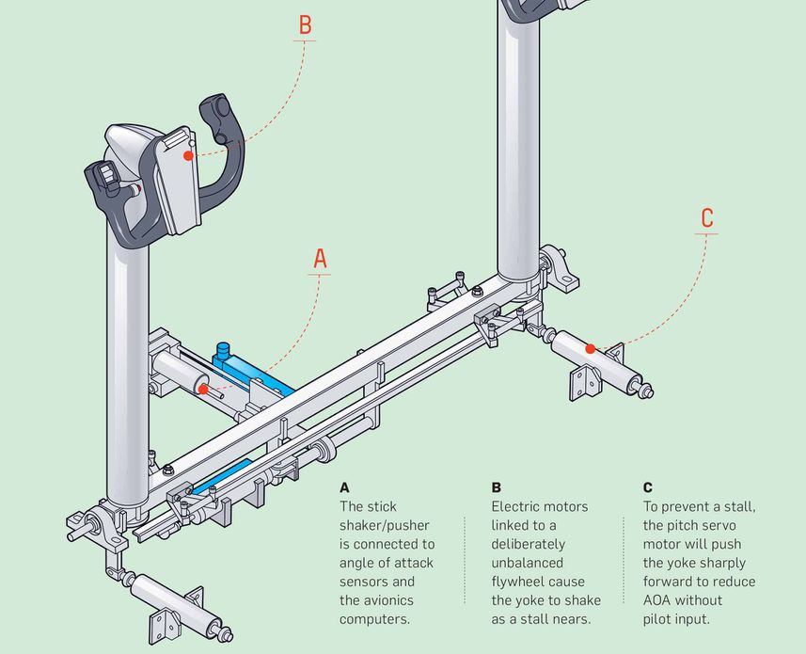
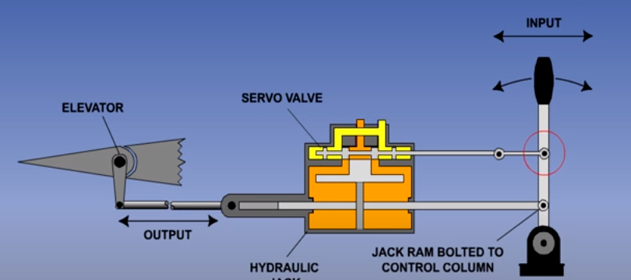
Large aircraft often have the mechanical control network connected to the flight control as a back-up means of controlling the aircraft in the event of a hydraulic system failure or failure of the hydraulic control system.
Often, aircraft are designed with multiple hydraulic actuation systems with the mechanical backup to ensure that the crew is able to control the aircraft.

Slide 36
ELECTRICAL AND ELECTRONIC CONTROLS
Modern aircraft have widely adopted electronics in their flight control systems.
Normally multiple computers are incorporated in the control network with computers interfacing with autopilots, auto-landing, auto-speed braking, flaps, stall warning, ground proximity system, and etc.
Regardless of the intricacy of computers involved in the control of the aircraft, their main function is to translate the control inputs made by the crew into actual control surface deflections.
Electric trim is often found to control the position of the horizontal stabilizer. To make the trimming operation convenient, the switches to operate the trim is located in the control yoke.
Pilots must activate both switches simultaneously to engage the trim motor(s).
A mechanical means of elevator trim is also provided on most aircraft.

Slide 37
This mechanism is commonly found on the pedestal and drives the trim transmission using flexible cables.
On many airplanes, the mechanical trim system moves when the horizontal stabilizer is trimmed via the pilot controlled electrical switches or when the autopilot trims the stabilizer.
Because the horizontal trim system is able to pitch the airplane nose up or down in a commanding fashion, some aircraft are equipped with a horizontal stabilizer trim brake system.
This mechanism arrests the motion of the stabilizer during trimming operations when the movement of the elevator control inputted by the pilot opposes the direction of trim.
Electrical controls may further serve as a back-up system.
The hydraulic motor normally drives the flap transmission.

Slide 38
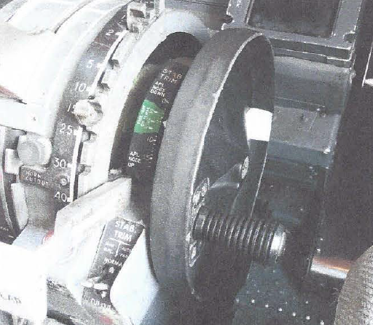
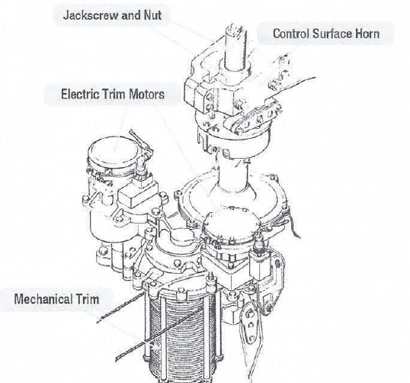
In the event of a complete hydraulic failure or fluid depletion, the crew may operate the flaps using an electric motor to power the flap transmission.
The ability to extend flaps for landing enhances the safety of the operation.

Slide 39
PNEUMATIC
This is another technique for assisting in the movement of a control surface of a large aircraft.
It is called balance panel.
Not visible when approaching the aircraft, it is positioned in the linkage that hinges the control surface to the aircraft.
Balance panels have been constructed typically of aluminum skin-covered frame assemblies or aluminum honeycomb structures.
The trailing edge of the location where the flight control is mounted is sealed to allow controlled airflow in and out of the hinge area where the balance panel is located.
In essence, two chambers are established.
The pressure differential generated by the deflection of the control surface allows the balance panel to assist in the movement of the flight control.

Slide 40
When the control surface is moved from the neutral position, differential pressure builds up across the balance panel.
This differential pressure acts on the balance panel in a direction that assists in the control surface movement.
For slight control surface movements, deflecting the control tab at the trailing edge of the surface is undemanding enough to not require significant assistance from the balance panel.
But, as greater deflection is commanded, the force resisting control tab and control surface movement becomes greater and assistance from the balance panel is needed. \
The seals and mounting geometry allow the differential pressure of airflow on the balance panel to increase as deflection of the control surface is increased.

Slide 41
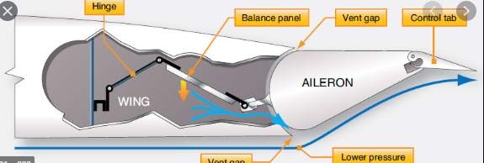

Slide 42
FLY-BY-WIRE CONTROL
The fly-by-wire (FBW) control system employs electrical signals that transmit the pilot's actions from the flight deck through a computer to the various flight control actuators.
The FBW system evolved as a way to reduce the system weight of the hydromechanical system, reduce maintenance costs, and improve reliability.
Electronic FBW control systems can respond to changing aerodynamic conditions by adjusting flight control movements so that the aircraft response is consistent for all flight conditions.
Additionally, the computers can be programmed to prevent undesirable and dangerous characteristics, such as stalling and spinning
Many of the later generation military high-performance aircraft are not aerodynamically stable.
This characteristicis designed into the aircraft for increased maneuverability and responsive performance.

Slide 43
Without the flight control computers reacting to the instability, the pilot would experience great difficulties controlling the aircraft.
These systems rely of the translation of control inputs into electrical signals and the conversion of the electrical signal into control surface movements.
Without the inclusion of control cables and other mechanical components, transducers, rotary variable differential transformers (RVDTs), electronic display screens, sensors, artificial feel systems power control units, power drive units, and other apparatuses are used for control operation.
With enhancements in flight control software, designers are able to use computers to send a host of signals to the various flight control members to reduce or eliminate flutter during flight.
Traditional mechanical flight control mechanisms were unable to perform such feats.

Slide 44
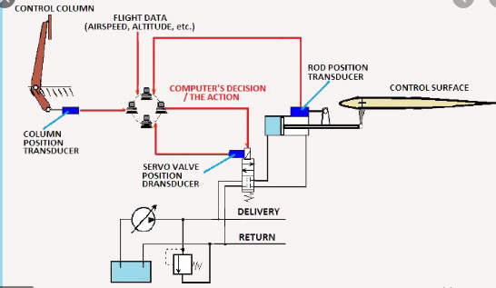
The Airbus A-320 was the first commercial airliner to use FBW controls.
Boeing used them in their 777 and newer design commercial aircraft.
The Dassault Falcon 7X was the first business jet to use a FBW control system.

Slide 45
FLY-BY-OPTICS
Aircraft designers continue to enhance flight control systems.
Where fly-by-wire systems are able to use computers to control the position of multiple flight
control surfaces, fly-by-optics further improve then ability of the system to transfer data.
Fly-by-optics networks are able to transfer data at higher speeds than wired systems. Fly-by-optics systems, also known as fly-by-light, are more immune to electrical interference that may affect fly-by-wire systems.

Slide 46
FLY-BY-WIRELESS
The next generation of flight controls include flyby- wireless and fly-by-less wires systems.
Similar to fly-by-wire systems, fly-by-wireless networks offer are reduction in weight of the aircraft by removing the extensive bundle of wires used in fly-by-wire aircraft.
The weight savings further translate into a measure of efficiency.
Another benefit of the fly-by-wireless system involves reduced maintenance.
Through years of service, the fly-by-wire harnesses will develop maintenance issues with connectors, corrosion, broken wires, etc.
Every connection becomes a potential point of failure.
Removing the wires from the flight control network, or reducing the number of associated wires, saves maintenance costs over the life of the aircraft.

Slide 47
ARTIFICIAL FEEL
Aircraft that use purely mechanical flight control systems do not require artificial feel on the controls.
The resistance transmitted through the control system provides the pilot with a natural feel regarding the magnitude of control input and associated stresses placed on the aircraft.
Aircraft that move control surfaces solely by hydromechanical and/or electromechanical means deprive the pilot of the feel of a mechanical control system.
Consequently, as the load or resistance generated by the flight control surface as it is deflected into the airstream is not directly transmitted to the pilot.
As a substitute, aircraft manufacturers have developed artificial feel systems to provide feedback regarding control input.

Slide 48
Without artificial feel, pilots could generate high levels of loads on the aircraft structure without realizing it.
Mechanisms used to produce artificial feel may be mechanical.
A common approach is to use a spring-loaded roller that fits into the valley of a flattened v-shaped cam.
As the control input is increased, the roller rides higher up the side of the cam, increasing the spring resistance felt by the pilot.
YAW DAMPER
One common control system is the yaw damper used on many large aircraft.
Typically associated with aircraft using swept wings that generate a motion referred to as a Dutch roll, the purpose of the yaw damper system is to counter the rolling tendency of the aircraft during flight.

Slide 49
Yaw dampers work when the aircraft is controlled manually by the flight crew or during operations. involving the autopilot.
The yaw damper system provides inputs to the rudder in proportion to the yaw rate of the aircraft and in a direction that negates the oscillations that would otherwise take place during flight.
Aside from increasing the stability of the aircraft, the yaw damper provides a smoother ride for the passengers.
MACH TRIM
Airfoils traveling at low subsonic speeds have a center of pressure acting on the wing that is approximatelyn one quarter the distance of the chord, aft of the leading edge.
The center of pressure does not move much until the aircraft begins traveling at high speeds.
When the aircraft passes through the air at speeds around Mach 0.7 and above, the center of pressure begins to move aft on the wing.

Slide 50
As aircraft approach the speed of sound, their form may further accelerate the air flowing over the wings and other portions of the aircraft.
When the aircraft reaches its critical Mach number, shock waves may develop over the wing. The area in front of the shock waves develops high lift.
This action continues to travel aft as the aircraft gains more speed.
The rearward movement of the lift production causes the aircraft to experience Mach tuck resulting in a nose down flight attitude.
To counter Mach tuck and keep the aircraft flying in a level attitude, Mach trim is incorporated in the control network.
Mach, or the speed of sound, is not a constant value.
The speed of sound varies largely with changes in temperature.
Another factor that enters the controllability of the airplane involves coffin corner.

Slide 51
The operation of the airplane enters coffin corner when the stall speed of the aircraft flying at high altitudes for a given weight and load factor approaches the critical Mach number.
Aircraft entering the coffin corner configuration may be very difficult to keep in stable flight. Any reduction of airspeed will cause the plane to stall and any increase of airspeed will generate a loss of lift due to entering critical Mach.
Pilots strive to keep the airplane out of the portion of the flight envelope known as coffin corner.
Mach trim basically trims the nose of the aircraft up as Mach tuck begins to act on the aircraft.
Most systems of Mach trim are automatic in that the flight crew does not have to manually change trim settings.
The crew may notice changes in trim as the control network implements Mach trim input.
To ensure the crew does not lose Mach trim during flight, airplanes will typically have redundant Mach trim systems.

Slide 52
RUDDER LIMITER
Airplanes that have a relatively low speed range (e.g., 200 knots) generally do not need flight control networks that limit control surface travel at higher speeds.
The structure of such airplanes is capable of absorbing the loads generated by large control surface deflections. But airplanes that are capable of traveling at high speeds (e.g., in excess of 350 knots) would require an extensive amount of structural reinforcement to handle the loads generated by large control deflections.
Such addition to the structure results in extra weight.
To combat the need for excess structure, many high speed aircraft resort to limiting control surface deflection during high speed operation. This is similar to operating an automobile.
When traveling along a highway at high speeds, the driver does not apply large inputs to the steering wheel, but rather small inputs.
The same automobile may need full steering deflection while traveling at low speeds as in the example of parking.

Slide 53
The same automobile may need full steering deflection while traveling at low speeds as in the example of parking.
Some aircraft reduce the travel available to the rudder based on the speed of the aircraft. At low speeds the need for substantial rudder travel is required.
At high speeds (e.g., above 250 knots) the effectiveness of the rudder is increased, thereby reducing the need for large deflections.
For the same number of degrees of rudder deflection, the load placed on the structure increases with the speed of the aircraft. Consequently, aggressive rudder deflections at high speeds may exceed the structural limitation of the aircraft.
To minimize the risk of exceeding structural limitations, aircraft may include rudder limiters that reduce rudder deflection at high speeds. In other words, full rudder deflection is only available at lower airspeeds.
For example, an airplane may have 30" of rudder deflection in the left and right directions at low speeds, such as takeoff, landing, climb, etc., with full pedal travel.

Slide 54
At cruise speeds the rudder limiter restricts the rudder deflection to T left and right with full pedal travel.
GUST LOCK SYSTEMS
Aircraft that use mechanical flight control systems will typically include a method for locking the controls when the aircraft is parked.
Normally referred to as gust locks, these mechanism may either be separate from the control system or an integral part of the control.
Separate gust locks may consist of a device that extends from a stationary part of the aircraft, such as the wing, and passes over and locks in place the flight control surface (e.g., the ailerons).
Another technique is to lock the movement of the flight controls with pins and other devices. Rather than being on the exterior of the aircraft, such locking devices are installed in the flight compartment to keep the controls from moving.
By physically locking the flight controls in place, damage to the structure or control network is eliminated during times when the aircraft is parked and the wind acts to deflect the flight control surfaces.

Slide 55
Gust locks will typically include a warning streamer with the following or similarly worded phrase: "REMOVE BEFORE FLIGHT.“
Large aircraft that have hydraulic assist systems to move flight control surfaces often include gust dampers in their power control units.
By using hydraulic fluid contained within the power control units that drive the flight control surfaces during flight, movement of the control surfaces by wind feeds a force into the hydraulic units.
These mechanisms provide gust snubbing by forcing hydraulic fluid through special bypass valves and other devices.
The end result is that the flight control surfaces are protected from wind gust damage.

Slide 56
BALANCING AND RIGGING
This section is presented for familiarization purposes only. Explicit instructions for the balancing of control surfaces are given in the manufacturer's maintenance and other technical publications for the specific aircraft and must be followed closely.
Any time repairs on a control surface add weight fore or aft of the hinge centerline; the control surface must be rebalanced or checked for proper balance.
When an aircraft is repainted, the balance of the control surfaces must be checked. Any control surface that is out of balance is unstable and does not remain in a streamlined position during normal flight.
For example, an aileron that is trailing edge heavy moves down when the wing deflects upward, and up when the wing deflects downward.
Such a condition can cause unexpected and violent maneuvers of the aircraft.

Slide 57
In extreme cases, fluttering and buffeting may develop to a degree that could cause the complete loss of the aircraft.
Rebalancing a control surface could include both static and dynamic balancing.
STATIC BALANCE
Static balance is the tendency of an object to remain stationary when supported from its own CG.
There are two ways in which a control surface may be out of static balance. They are called underbalance and overbalance.
When a control surface is mounted on a balance stand, a downward travel of the trailing edge below the horizontal position indicates underbalance.
Some manufacturers indicate this condition with a plus ( +) sign.
An upward movement of the trailing edge, above the horizontal position indicates overbalance.
This is designated by a minus (-) sign. These signs show the need for more or less weight in the correct area to achieve a balanced control surface

Slide 58
A tail-heavy condition (static underbalance) causes undesirable flight performance and is not usually allowed.
Better flight operations are gained by nose heavy static overbalance.
Most manufacturers advocate the existence of nose-heavy control surfaces. The structural repair manual of large aircraft provides an extensive amount of data regarding repairs and balancing of control surfaces and tabs.
There will be a section on repairs that do not require rebalancing.
Another section will provide data on how to calculate control balance following a repair or repainting without removing the control surface from the aircraft.
And there will be instructions for determining and correcting control surface balance with the surface removed and mounted on special tools.
Many manufacturers produce balancing weights that are added or removed from the control surface.
Often drawings providing details on producing corrective weights in the field are given in then structural repair manual.

Slide 59
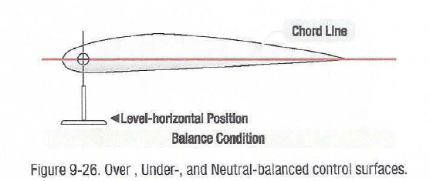

Slide 60
DYNAMIC BALANCE
Dynamic balance is that condition in a rotating body where in all rotating forces are balanced within themselves so that safe level of vibration is produced while the body is in motion.
Dynamic balance as related to control surfaces is an effort to maintain balance when the control surface is submitted to movement on the aircraft in flight.
It involves the placing of weights in the correct location along the span of the surfaces.
The location of the weights is, in most cases, forward of the hinge centerline.
REBALANCING PROCEDURES
Repairs to a control surface or its tabs generally increase the weight aft of the hinge centerline, requiring static rebalancing of the control surface system, as well as the tabs.
Control surfaces to be rebalanced should be removed from the aircraft and supported, from their own points, on a suitable stand, jig, or fixture .

Slide 61
Trim tabs on the surface should be secured in the neutral position when the control surface is mounted on the stand.
The stand must be level and be located in an area free of air currents.
The control surface must be permitted to rotate freely about the hinge points without binding.
Balance condition is determined by the behavior of the trailing edge when the surface is suspended from its hinge points.
Any excessive friction would result in a false reaction as to the overbalance or underbalance of the surface.
When installing the control surface in the stand or jig, a neutral position should be established with the chord line of the surface in a horizontal position.
Use a bubble protractor, or suitable device, to determine the neutral position before continuing balancing procedures

Slide 62
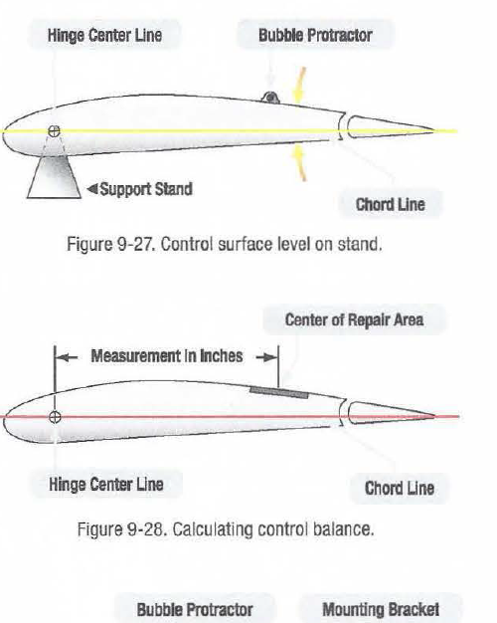
Sometimes a visual check is all that is needed to determine whether the surface is balanced or unbalanced.
Any trim tabs or other assemblies that are to remain on the surface during balancing procedures should be in place.
If any assemblies or parts must be removed before balancing, they should be removed.

Slide 63
REBALANCING METHODS
Several methods of balancing (rebalancing) control surfaces are in use by the various manufacturers of aircraft.
The most common are the calculation method, scale method, and the balance beam method.
The calculation method of balancing a control surface has one advantage over the other methods in that it can be performed without removing the surface from the aircraft.
In using the calculation method, the weight of the material removed from the repair area and the weight of the materials used to accomplish the repair must be known.
Subtract the weight removed from the weight added to get the resulting net gain in the amount of weight added to the surface.
The distance from the hinge centerline to the center of the repair area is then measured.

Slide 64
This distance must be determined to the nearest one hundredth of an inch or mm.
Follow the instructions provided by the manufacturer as they will provide a series of formulas and other information regarding this process
The next step is to multiply the distance times the net weight of the repair.
This results in an inch-pounds (inlb), or similar unit, answer. If the result of the calculation is within specified tolerances, the control surface is considered balanced.
If it is not within specified limits, consult the manufacturer's service manuals for the needed weights, material to use for weights, design for manufacturing corrective weights, and installation locations for the addition of weights.
The scale method of balancing a control surface requires the use of a scale that is graduated in hundredths of a pound or similar metric unit.
A support stand and balancing jigs for the surface are also required..

Slide 65
Use of the scale method requires the removal of the control surface from the aircraft Some manufacturers use the balance beam method.
This method often requires that a specialized tool be acquired or fabricated in the field.
The manufacturer's maintenance typically provides specific instructions and dimensions to fabricate the tool.
Once the control surface is placed on level supports, the weight required to balance the surface is established by moving the sliding weight on the beam.
The maintenance manual indicates where the balance point should be.
If the surface is found to be out of tolerance, the manual explains where to place weight to bring it into tolerance.
Aircraft manufacturers use different materials to balance control surfaces, the most common being lead or steel.

Slide 67
Larger aircraft manufacturers may use depleted uranium because it has a heavier mass than lead.
This allows the counterweights to be made smaller and still retain the same weight.
Specific safety precautions must be observed when handling counterweights of depleted uranium because it is radioactive.
The manufacturer's maintenance manual and service instructions must be followed and all precautions observed when handling the weights
AIRCRAFT RIGGING
Aircraft rigging involves the adjustment and travel of movable flight control surfaces that are attached to major aircraft structures, such as wings and vertical and horizontal stabilizers.
Ailerons, flaps, spoilers, and slats are attached to the wings, elevators are attached to the horizontal stabilizer, and the rudder is attached to the vertical stabilizer.

Slide 68
Rigging involves setting cable tension, adjusting travel limits of flight controls and tabs, and setting travel stops.
Newer generation aircraft incorporate various electronic controllers in the rigging process.
Often the rigging process involves a number of special tools and pins needed to hold control wheels, bellcranks, and other control system devices in a certain position.
Manufacturers typically will produce tools that are used to neutralize the position of the controls and measure travel with a scale.
In some instances, technicians may construct similar tools or use substitutes to measure control surface and trim tab travel.
Rigging is not limited to the mechanical elements of the flight controls.
Rigging of electronic equipment, if used, is also part of the process.

Slide 69
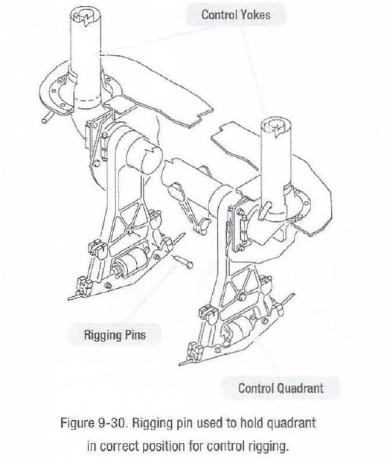

Slide 70
STALL PROTECTION/WARNING SYSTEMS
Stall warning systems incorporated on modern day jetliners are far more advanced than those used on smaller general aviation airplanes.
Stall warning systems typically involve multiple computers that monitor the
configuration of the aircraft and d flight data.
Annlyzing those bytes of information, the stall warning computers calculate when a airplane is nearing a stall condition.
In such instances, a stick shaker that provides a violent shaking motion to the control yoke will give the crew a warning well in advance of a stall, usually.
Some airplanes include a stick nudger or pusher that applies a nose down input to the elevator in an attempt to avoid the impending stall.
The flight crew has the option of overcoming the input made by the stick nudger or pusher.

Slide 71
The need for stick nudgers or pushers is due to the stall recovery characteristics of many larger airplanes.
Where the stick nudger or pusher is designed to avoid a stall, the stick shaker is a stall warning mechanism
The stall speed of the aircraft is affect by a number of variables.
In calculating the potential stall, the computers look at the position of the flaps, slats, speed brakes, airspeed, angle of attack, and other parameters.
Failure to take the proper corrective action during a stall may lead to serious consequences.
Airplane stalls have claimed many lives over the history of flight.
Angle of attack sensors commonly use a vane on the side of the fuselage that provides data regarding the angle that the aircraft is passing through the atmosphere.
As the airplane changes its angle of attack, the vane reacts by rotating to a new position that is parallel to the airflow passing across it and sending a signal to the appropriate computer(s).

Slide 72
As the data provided by the angle of attack sensor are critical to the safety of the aircraft during flight, the device is normally equipped with a heater to prevent the build-up of ice.
Unsafe for takeoff configuration warning is typically provided on large aircraft.
This warning, often an aural warning sound in conjunction with a visual warning light(s), is given when there is an unsafe condition prior to takeoff.
Such conditions include the improper position of the flaps or slats, the horizontal stabilizer position, the extension of speed brakes, the parking brake set, and so on.
The warning is normally triggered when the crew advances the throttle and a problem is present.
The value of this system is difficult to assess as attempting a takeoff when the airplane is improperly configured is likely to result in a tragic incident.

Slide 74
Landing configuration warning is provided when the airplane is improperly set up for landing.
One common warning occurs when the all members of the landing gear are not locked in the down position and a throttle lever is reduced to a low power setting.
A warning is frequently given when the flaps are extended for landing and the landing gear is not down and locked.
The extension of spoilers at low altitudes is likely to provide an unsafe landing configuration warning.
As with the unsafe for takeoff warning network, the crew receives an aural and visual warning when the landing configuration is improper.

