Slide 1
ELECTROSTATIC SENSITIVE DEVICES (ESDS)

Slide 2
CONTENTS
Introduction
Generation of electrostatic charge
Material characteristics affect static charge
ESD damage
Effect on electronic devices
Protection for electrostatic discharge sensitive (ESDS) devices

Slide 3
INTRODUCTION
Electrostatic charge is defined as “electric charge at rest”.
Static electricity is an imbalance of electrical charges within or on the surface of a material.
This imbalance of electrons produces an electric field that can be measured and that can influence other objects.
Electrostatic discharge (ESD) is defined as “the
rapid, spontaneous transfer of electrostatic charge induced by a high electrostatic field.”
Usually, the charge flows through a spark between two bodies at different electrostatic potentials
as they approach one another”.

Slide 4
INTRODUCTION
Electrostatic discharge can change the electrical characteristics of a semiconductor device, degrading or destroying it.
Electrostatic discharge also may upset the normal operation of an electronic system, causing equipment malfunction or failure.
Charged surfaces can attract and hold contaminants, making removal of the particles difficult.
When attracted to the surface of a silicon wafer or a device's electrical circuitry, air-borne particulates can cause random wafer defects and reduce product yields.

Slide 5
GENERATION OF ELECTROSTATIC CHARGE
Creating electrostatic charge by contact and separation of materials is known as "triboelectric charging.“
It involves the transfer of electrons between materials. The atoms of a material with no static charge have an equal number of positive (+) protons in their nucleus and negative (-) electrons orbiting the nucleus.
In Figure , Material "A" consists of atoms with equal numbers of protons and electrons. Material B also consists of atoms with equal (though perhaps different) numbers of protons and electrons. Both materials are electrically neutral.

Slide 6
GENERATION OF ELECTROSTATIC CHARGE
When the two materials are placed in contact and then separated, negatively charged electrons are transferred from the surface of one material to the surface of the other material.
Which material loses electrons and which gains electrons will depend on the nature of the two materials.
The material that loses electrons becomes positively charged, while the material that gains electrons is negatively charged. This is shown in Figure.
Static electricity is measured in coulombs. The charge “q” on an object is determined by the product of the capacitance of the object “C” and the voltage potential on the object (V):
q = CV
Commonly, however, we speak of the electrostatic potential on an object, which is expressed as
voltage.

Slide 7
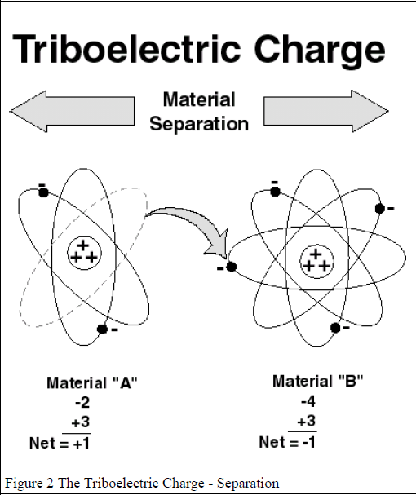

Slide 8
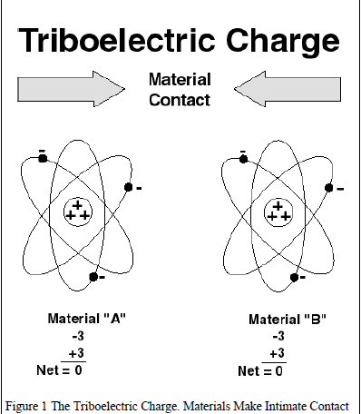

Slide 9
GENERATION OF ELECTROSTATIC CHARGE
This process of material contact, electron transfer and separation is a much more complex mechanism than described here.
The amount of charge created by triboelectric generation is affected by the area of contact, the speed of separation, relative humidity, and chemistry of the materials, surface work function and other factors. Once the charge is created on a material, it becomes an electrostatic charge (if it remains on the material). This charge may be transferred from the material, creating an electrostatic discharge or ESD event.

Slide 10
GENERATION OF ELECTROSTATIC CHARGE
Additional factors, such as the resistance of the actual discharge circuit and the contact resistance at the interface between contacting surfaces also affect the actual charge that is released.
In addition, the contribution of humidity to reducing charge accumulation. It should be noted that static charge generation still occurs even at high relative humidity.
An electrostatic charge also may be created on a material in other ways such as by induction, ion bombardment, or contact with another charged object. However, triboelectric charging is the most common.

Slide 11
Material Characteristics Affect Static Charge
Triboelectric Series :-When two materials contact and separate, the polarity and magnitude of the charge are indicated by the materials’ positions in a triboelectric series.
Insulative Materials :-Material that prevents or limits the flow of electrons across its surface or through its volume is called an insulator.
Insulators have an extremely high electrical resistance, insulative materials are defined as “materials with a surface resistance or a volume resistance equal to or greater than 1 × 1011 ohms.” A considerable amount of charge can be generated on the surface of an insulator.

Slide 12
MATERIAL CHARACTERISTICS AFFECT STATIC CHARGE
Because an insulative material does not readily allow the flow of electrons, both positive and negative charges can reside on insulative surface at the same time, although at different locations.
The excess electrons at the negatively charged spot might be sufficient to satisfy the absence of electrons at the positively charged spot.
However, electrons cannot easily flow across the insulative material's surface, and both charges may remain in place for a very long time.
Conductive Materials:-A conductive material, because it has low electrical resistance, allows electrons to flow easily across its surface or through its volume.
Conductive materials have low electrical resistance, less than 1 × 104 ohms (surface resistance) and 1 × 104 ohm (volume resistance) per ESD ADV1.0.

Slide 13
Material Characteristics Affect Static Charge
When a conductive material becomes charged, the charge (i.e., the deficiency or excess of electrons) will be uniformly distributed across the surface of the material.
If the charged conductive material makes contact with another conductive material, the electrons will be shared between the materials quite easily.
If the second conductor is attached to A/C equipment, ground or any other grounding point, the electrons will flow to ground and the excess charge on the conductor will be neutralized.
Static Dissipative Materials:- Static dissipativ materials have an electrical resistance between insulative and conductive materials (1 × 104 to 1 × 1011 ohms surface or volume resistance).

Slide 14
Material Characteristics Affect Static Charge
There can be electron flow across or through the dissipative material, but it is controlled by the surface
resistance or volume resistance of the material.
As with the other two types of materials, charge can be generated triboelectrically on a static dissipative material.
However, like the conductive material, the static dissipative material will allow the transfer of charge to ground or other conductive objects.
The transfer of charge from a static dissipative material will generally take longer than from a conductive material of
equivalent size.
Charge transfers from static dissipative materials are significantly faster than from insulators, and slower than from conductive material.

Slide 15
Material Characteristics Affect Static Charge
Electrostatic Fields :-
Charged materials also have an electrostatic field and lines of force associated with them.
Conductive objects brought into the vicinity of this electric field will be polarized by a process known as induction .
A negative electric field will repel electrons on the surface of the conducting item that is exposed to the field. A positive electric field will attract electrons to near the surface thus leaving other areas positively charged.
No change in the actual charge on the object will occur in polarization.

Slide 16
Material Characteristics Affect Static Charge
If, however, the item is conductive or dissipative and is connected to ground while polarized, the charge will flow from or to ground due to the charge
imbalance.
If the electrostatic field is removed and the ground contact disconnected, the charge will remain on the item.
If a nonconductive object is brought into the electric field, the electrical dipoles will tend to align with the field creating apparent surface charges.
A nonconductor (insulative material) cannot be charged by induction.

Slide 17
ESD Damage
Electrostatic damage is defined as “change to an item caused by an electrostatic discharge that makes it fail to meet one or more specified parameters.” and can occur at any point from manufacture to field service.
Typically, damage results from handling the devices in uncontrolled surroundings or when poor ESD control practices are used.
Generally damage is classified as either a catastrophic failure or a latent defect

Slide 18
ESD Damage
Catastrophic Failure
When an electronic device is exposed to an ESD event, it may no longer function.
The ESD event may have caused a metal melt, junction breakdown, or oxide failure.
The device's circuitry is permanently damaged causing the device to stop functioning totally or at least
partially.
Such failures usually can be detected when the device is tested before shipment.
If a damaging level ESD event occurs after test, the part may go into production and the damage will
go undetected until the device fails in final test.

Slide 19
ESD Damage
Latent Defect
As per ESD ADV1.0 latent failure is “a malfunction that occurs following a period of normal operation.
The failure may be attributable to an earlier electrostatic discharge event.
The concept of latent failure is controversial and not totally accepted by all in the technical community.”
A latent defect is difficult to identify. A device that is exposed to an ESD event may be partially degraded, yet continue to perform its intended function.
However, the operating life of the device may be reduced.

Slide 20
ESD Damage
A product or system incorporating devices with latent defects may experience premature failure after the user places them in service.
Such failures are usually costly to repair and in some applications may create personnel hazards.
It is relatively easy with the proper equipment to confirm that a device has experienced a catastrophic failure.
Basic performance tests will substantiate device damage. However, latent defects are extremely difficult to prove or detect using current technology, especially after the device is assembled into a finished product.

Slide 21
EFFECT ON ELECTRONIC DEVICES
ESD damage is usually caused by one of three events: direct electrostatic discharge to the device, electrostatic discharge from the device or field-induced discharges.
The level at which a device fails is known as the device’s ESD sensitivity or ESD susceptibility.
Discharge to the Device:-
An ESD event can occur when any charged conductor (including the human body) discharges to an item.
A cause of electrostatic damage could be the direct transfer of electrostatic charge from the human body or a charged material to the ESDS.

Slide 22
EFFECT ON ELECTRONIC DEVICES
The model used to simulate this event is the Human Body Model (HBM).
A similar discharge can occur from a charged conductive object, such as a metallic tool or fixture.
From the nature of the discharge, the model
used to describe this event is known as the Machine Model (MM).
Discharge from the Device:-
The transfer of charge from an ESDS to a conductor is also an ESD event.
Static charge may accumulate on the ESDS itself through handling or contact and separation with packaging materials, work surfaces, or machine surfaces.

Slide 23
EFFECT ON ELECTRONIC DEVICES
This frequently occurs when a device moves
across a surface or vibrates in a package.
The model used to simulate the transfer of charge from an ESDS is referred to as the Charged Device Model (CDM).
Field Induced Discharges:-
Another electrostatic charging process that can directly or indirectly damage devices is termed Field Induction.
Whenever any object becomes electrostatic ally charged, there is an electrostatic field associated with that charge.
If an ESDS is placed in that electrostatic field, a charge may be induced on the item.

Slide 24
EFFECT ON ELECTRONIC DEVICES
If the item is then grounded while within
the electrostatic field, a transfer of charge from the device occurs as a CDM event.
If the item is removed from the region of the electrostatic field and grounded again, a second CDM event will occur as the charge (of opposite polarity from the first event) is transferred from the device.

Slide 25
PROTECTION FOR ELECTROSTATIC DISCHARGE SENSITIVE (ESDS) DEVICES.
Work area:-
It is essential to handle ESDS devices at static-safe workstations. This will prevent yield loss (through catastrophic damage) or, worse, potential reliability failures in the field (through latent damage).
Where it is impractical or impossible to use antistatic wrist-straps or remove items that are composed of insulative materials at a static-safe workstation, use an air ionizer designed to neutralize electrostatic charges or apply topical antistats to control generation and accumulation of static charges.

Slide 26
PROTECTION FOR ELECTROSTATIC DISCHARGE SENSITIVE (ESDS) DEVICES.
When an air ionizer is utilized, it is vital that maintenance procedures and schedules are adhered to in order to ensure that ions generated by the ionizer are sufficiently balanced.
Avoid bringing sources of static electricity within 1 meter of a static-safe work bench.
Where it is necessary to use air-guns, use special models that do not generate static charges in the air stream.

Slide 27
PROTECTION FOR ELECTROSTATIC DISCHARGE SENSITIVE (ESDS) DEVICES
Personnel: -
Any accumulated charge on the body of the human operator should be discharged first before opening the protective container with ESDS devices inside.
The discharge can be accomplished by putting a hand on a grounded surface or, ideally, by wearing a grounded antistatic wrist-strap.
The use of an antistatic smock for each worker is highly recommended.
Education and training on ESD preventive measures is invaluable.
A regular audit is also helpful in supporting an ESD program.

Slide 28
PROTECTION FOR ELECTROSTATIC DISCHARGE SENSITIVE (ESDS) DEVICES
Packaging and Transportation:-
ESDS devices should be contained in a static protective bag or container at all times during storage or transportation.
Static-safe work bench:-
The diagram below shows a typical static-safe work bench.
The table top is covered by a static dissipative mat which is grounded through a 1 Meg-ohm resistor.
This resistor is required in order to protect the users of the static-safe work bench – in the event that the ground becomes electrically live, the resistor will prevent electrical shock at the work bench.
The same safety requirement holds true for the antistatic wrist-strap as well.

Slide 29
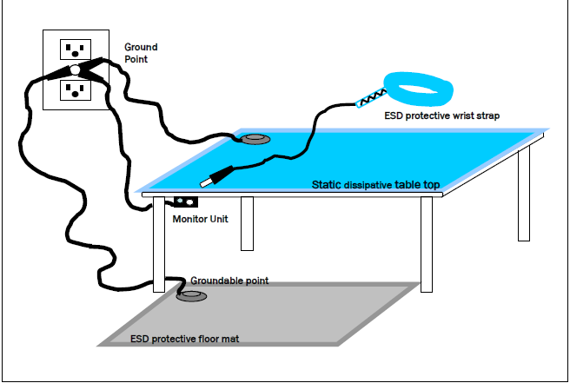

Slide 30
MATERIALS ARE SUITABLE FOR DISSIPATING STATIC ELECTRICITY
It is recommended that static dissipative materials are used as the medium (e.g. mats, containers) for discharging static charge to ground. These materials have the following properties:
Surface resistivity: 1 x 10⁵ to 1 x 10¹² ohms/m²
Volume resistivity: 1 x 10⁴ to 1 x 10¹¹ ohm-cm

Slide 31
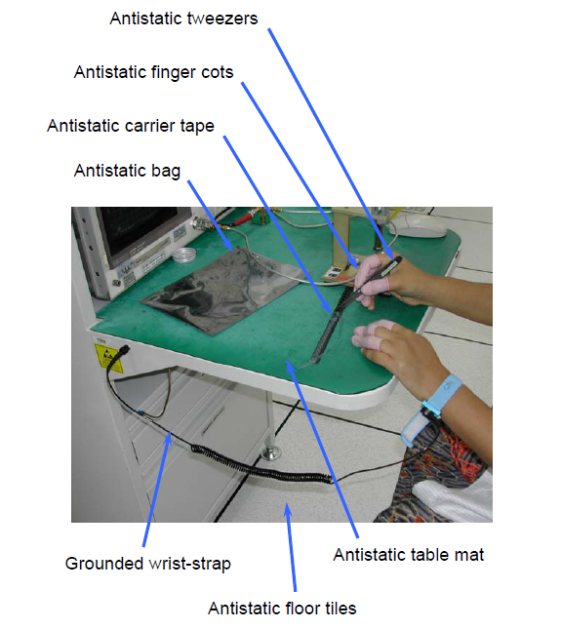
An example of a static-safe work bench (at Electrical Test).

Slide 32
ANTISTATIC FOOTWEAR
Where a wrist-strap is impractical, e.g. the job requires the worker to walk from one location to another, it is recommended that antistatic footwear such as antistatic shoes or heel- straps are worn.
The following fig. shows an example of an antistatic heel-strap with the grounding cord running into the socks to make contact with the skin.
It is also necessary to use an antistatic floor (e.g. conductive floor tiles) to work together with the antistatic footwear.

Slide 33
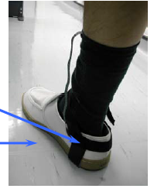

Slide 34
LABELS TO IDENTIFY ELECTROSTATIC DISCHARGE SENSITIVE (ESDS) DEVICES.
The following labels are commonly used on containers and packaging to alert anyone who handles the ESDS devices on the need to use static-safe procedures before handling the devices. The one on the left is preferred.

