Slide 1
DIODES

Slide 2
DIODE SYMBOLS

Slide 3
DIODE CHARACTERISTICS AND PROPERTIES
A pn junction is known as a semi-conductor or crystal diode.
The outstanding property of a crystal diode to conduct current in one direction only permits it to be used as a rectifier.
A crystal diode is usually represented by the schematic symbol
The arrow in the symbol indicates the direction of easier conventional current flow.

Slide 4
(i) If arrowhead of diode symbol is positive w.r.t. bar of the symbol, the diode is forward biased.
(ii) If the arrowhead of diode symbol is negative w.r.t. bar, the diode is reverse biased.

Slide 5
The PN junction diodes are generally rated for the following:
1. Maximum Average Forward Current - this refers to the maximum amount of average current that can be permitted to flow in the forward direction. If this exceeded, structure breakdown can occur. Maximum average forward current is usually given
at a specific temperature, (typically 25° C).
2. Peak Recurrent Forward Current - the maximum peak current that can be permitted to flow in the forward direction in the form of recurring pulses.
3. Maximum Surge Current - the maximum current permitted to flow in the forward direction in the form of nonrecurring pulses. Current should not equal this value for more than a few milliseconds.
4. Peak Reverse Voltage (PRV) - indicates the maximum reverse-bias voltage that may be applied to a diode without causing junction breakdown.

Slide 6
DIODE IDENTIFICATION

Slide 7
The first number in the system indicates the number of junctions in the semiconductor device and is a number, one less than the number of active elements.
Thus 1 designates a diode; 2 designates a transistor (which may be considered as made up of two diodes); and 3 designates a tetrode (a four-element transistor).
The letter "N" following the first number indicates semiconductor.
The 2- or 3-digit number following the letter "N" is a serialized identification number.
If needed, this number may contain a suffix letter after the
last digit.

Slide 8
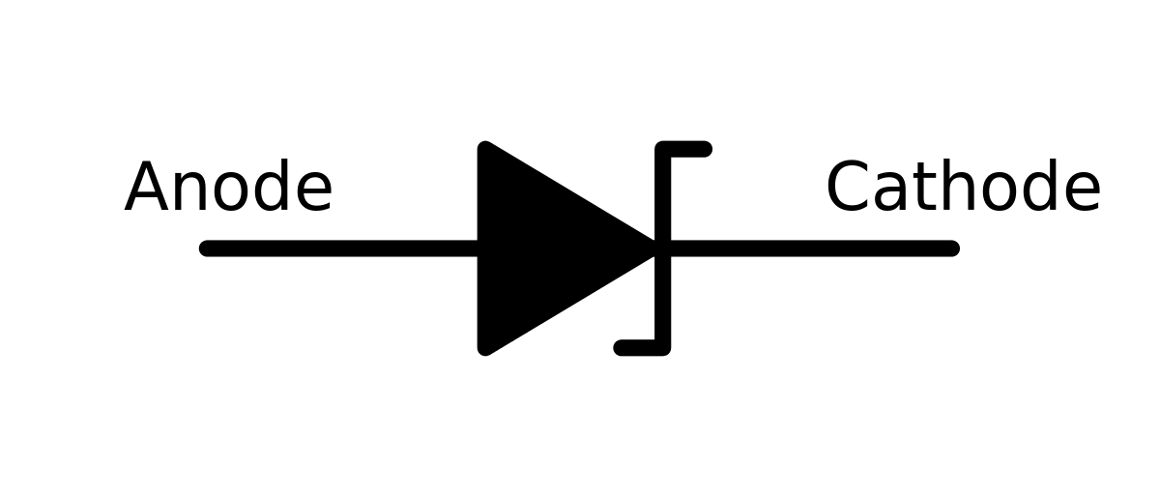
TYPES OF DIODES
ZENER DIODE (REVERSED BIASED)
IT IS HEAVILY DOPED WHICH ONLY OPERATES IN BREAKDOWN REGION
IT IS INDEPENDENT OF APPLIED VOLTAGE
IT IS USUALLY USED AS VOLTAGE REGULATORS
SYMBOL OF ZENER DIODE

Slide 9
SIGNAL DIODES (FORWARD BIASED)
Signal diodes are common semiconductor diodes that
are typically used in radio signal processing.
They pass small current usually up to 100 milliamps
PHOTODIODES (REVERSED BIASED)
IT IS A 2 TERMINAL JUNCTION DEVICE WHICH IS OPERATED BY FIRST REVERSE BIASING THE JUNCTION AND THEN ILLUMINATING IT.
THE NO. OF MINORITY CARRIERS DEPENDS ON THE INTENSITY OF LIGHT INCIDENT ON THE JUNCTION
USED AS PHOTO DETECTOR CIRCUIT

Slide 10
LIGHT EMITTING DIODES (FORWARD BIASED)
IT EMITS VISIBLE LIGHT WHEN ENERGISED.
THE COLOUR OF EMITTED LIGHT DEPENDS ON TYPE OF MATERIAL USED
A) GaAS – INFRARED RADIATION (INVISIBLE)
B) GaP – RED OR GREEN LIGHT
C) GaASP – RED OR YELLOW (AMBER)
OPERATING IT REVERSED BIASED WILL DESTROY IT.
LEDs ARE USED IN BURGLAR ALARM SYSTEM.
POWER RECTIFIER DIODES (FORWARD BIASED)
The rectifier diode is usually used in applications that
require high current, such as power supplies.
The range in which the diode can handle current can vary anywhere from one ampere to hundreds of amperes.

Slide 11
SCHOTTKY DIODES (FORWARD BIASED)
A Schottky diode is designed to have a metal, such as
gold, silver, or platinum, on one side of the junction and
doped silicon, usually an N-type, on the other side of the
junction.
In this respect, it is not a pure semiconductor diode. It is a metal semiconductor diode.
A Schottky diode is considered a unipolar device because free electrons are the majority carrier on both sides of the
junction.
The Schottky diode has no depletion zone or charge storage, which means that the switching time can be as high as 300 MHz.

Slide 12
VARACTOR DIODES (REVERSED BIASED)
The varactor, or varicap, is a diode that behaves like a variable capacitor.
Its capacitance is dependent on the applied voltage.
The PN junction functions like the dielectric and the N and P materials like the plates of a common capacitor

Slide 13
DIODE MAINTENANCE AND TESTING
The following is a list of some of the special safety precautions that should be observed when working with diodes:
• Never remove or insert a diode into a circuit with voltage applied.
• Never pry diodes to loosen them from their circuits.
• Always be careful when soldering to ensure that excessive heat is not applied to the diode.
• When testing a diode, ensure that the test voltage does not exceed the diode's maximum allowable voltage.
• Never put your fingers across a signal diode because the static charge from your body could short it out.
• Always replace a diode with a direct replacement, or with one of the same type.
• Ensure a replacement diode is put into a circuit in the correct direction.

Slide 14
TRANSISTORS

Slide 15
A Transistor consists of two PN junctions formed by sandwiching either p-type or n-type semiconductor between a pair of opposite types.
Transistors are use to amplify weak signal and it can also be used as switching circuit.
Transistors overcomes the disadvantages which were there while using an vacuum tube.

Slide 16
TYPES OF TRANSISTORS
UNIJUNCTION TRANSISTORS (UJT)
a) JUNCTION FIELD EFFECT TRANSISTOR (JFET)
b) METAL OXIDE SEMICONDUCTOR FIELD EFFECT TRANSISTOR (MOS-FET)
DEPLETION TYPE MOS-FET(D-MOSFET)
ENHANCEMENT TYPE MOSFET
(E-MOSFET)
2. BIPOLAR JUNCTION TRANSISTORS(BJT)
a) P-TYPE
b) N-TYPE

Slide 17
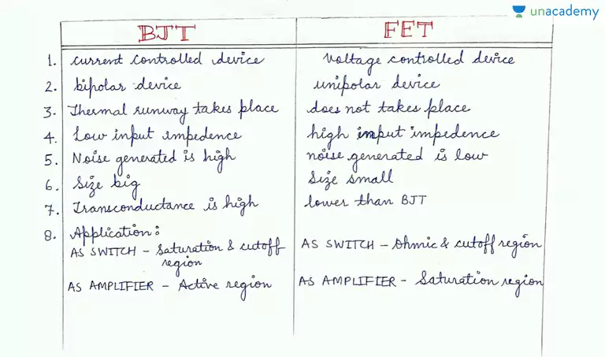
DIFFERENCE BETWEEN BJT AND FET

Slide 19
In each type of transistor, the following points may be noted :
(i) These are two pn junctions. Therefore, a transistor may be regarded as a combination of two
diodes connected back to back.
(ii) There are three terminals, one taken from each type of semiconductor.
(iii) The middle section is a very thin layer. This is the most important factor in the function of a
transistor.

Slide 20
A transistor (pnp or npn) has three sections of doped semiconductors.
The section on one side is the emitter and the section on the opposite side is the collector.
The middle section is called the base and forms two junctions between the emitter and collector.

Slide 21
Emitter.
The section on one side that supplies charge carriers (electrons or holes) is called the emitter.
The emitter is always forward biased w.r.t. base so that it can supply a large number of majority carriers.
(i), the emitter (p-type) of pnp transistor is forward biased and supplies hole charges to its junction with the base.
(ii), the emitter (n-type) of npn transistor has a forward bias and supplies free electrons to its junction with the base.
Size of emitter is moderate.
Doping in emitter is high.

Slide 22
Collector.
The section on the other side that collects the charges is called the collector.
The collector is always reverse biased.
Its function is to remove charges from its junction with the base.
the collector (p-type) of pnp transistor has a reverse bias and receives hole charges that flow in the output circuit.
(ii), the collector (n-type) of npn transistor has reverse bias and receives electrons.
Size of collecter is largest.
Doping in collector is moderate.

Slide 23
Base.
The middle section which forms two pn-junctions between the emitter and collector
is called the base.
The base-emitter junction is forward biased, allowing low resistance for the emitter
circuit.
The base-collector junction is reverse biased and provides high resistance in the collector
circuit.
Its is the thinnest section in transistor.
Doping in base is lowest.

Slide 24
Working of npn transistor.
the npn transistor with forward bias to emitter base junction and reverse bias to collector-base junction.
The forward bias causes the electrons in the n-type emitter to flow towards the base.
This constitutes the emitter current IE.
As these electrons flow through the p-type base, they tend to combine with holes.
As the base is lightly doped and very thin, therefore, only a few electrons (less than 5%) combine with holes to constitute base current IB.
The remainder (more than 95%) cross over into the collector region to constitute collector current IC.
In this way, almost the entire emitter current flows in the collector circuit.
It is clear that emitter current is the sum of collector and base currents i.e.
IE = IB + IC

Slide 26
(ii) Working of pnp transistor.
the basic connection of a pnp transistor.
The forward bias causes the holes in the p-type emitter to flow towards the base.
This constitutes the emitter current IE.
As these holes cross into n-type base, they tend to combine with the electrons.
As the base is lightly doped and very thin, therefore, only a few holes (less than 5%) combine with the electrons.
The remainder (more than 95%) cross into the collector region to constitute collector current IC.
In this way, almost the entire emitter current flows in the collector circuit.
It may be noted that current conduction within pnp transistor is by holes.
However, in the external connecting wires, the current is still by electrons.

Slide 28
Common Base Connection
In this circuit arrangement, input is applied between emitter and base and output is taken from collector and base.
Here, base of the transistor is common to both input and output circuits and hence the name common base connection

Slide 29
1. Current amplification factor (α). It is the ratio of output current to input current. In a
common base connection, the input current is the emitter current IE and output current is the collector current IC.
The ratio of change in collector current to the change in emitter current at constant collector base
voltage VCB is known as current amplification factor i.e. IB= IC/IE

Slide 30
It is clear that current amplification factor is less than unity.
This value can be increased (but not more than unity) by decreasing the base current.
This is achieved by making the base thin and doping it lightly.
Practical values of α in commercial transistors range from 0.9 to 0.99.

Slide 31
Common Emitter Connection

Slide 32
1. Base current amplification factor . In common emitter connection, input current is IB and output current is IC.
The ratio of change in collector current (IC) to the change in base current (IB) is known as base current amplification factor

Slide 33
Common Collector Connection

Slide 34
(i) Current amplification factor γ. In common collector circuit, input current is the base
current IB and output current is the emitter current IE. Therefore, current amplification in this circuit
arrangement can be defined as under
The ratio of change in emitter current (IE) to the change in base current (IB) is known as
current amplification factor in common collector (CC) arrangement

Slide 36
INTEGRATED CIRCUITS(IC)

Slide 37
An integrated circuit is one in which circuit components
such as transistors, diodes, resistors, capacitors etc. are
automatically part of a small semiconductor chip.
An integrated circuit consists of a number of circuit
components (e.g. transistors, diodes, resistors etc.) and
their inter connections in a single small package to perform
a complete electronic function. These components
are formed and connected within a small chip of semiconductor material.

Slide 38
The following points are worth noting about integrated circuits :
(i) In an IC, the various components are automatically part of a small semi-conductor chip and the individual components cannot be removed or replaced.
This is in contrast to discrete assembly in which individual components can be removed or replaced if necessary.
(ii) The size of an *IC is extremely small. In fact, ICs are so small that you normally need a microscope to see the connections between the components. Fig. 23.1 shows a typical semi-conductor chip having dimensions 0.2 mm × 0.2 mm × 0.001 mm. It is possible to produce circuits containing many transistors, diodes, resistors etc. on the surface of this small chip.
(iii) No components of an IC are seen to project above the surface of the chip.
This is because all the components are formed within the chip.

Slide 39
Advantages and Disadvantages of Integrated Circuits
Advantages : Integrated circuits possess the following advantages over discrete circuits :
(i) Increased reliability due to lesser number of connections.
(ii) Extremely small size due to the fabrication of various circuit elements in a single chip of semi-conductor material.
(iii) Lesser weight and **space requirement due to miniaturized circuit.
(iv) Low power requirements.
(v) Greater ability to operate at extreme values of temperature.
(vi) Low cost because of simultaneous production of hundreds of a like circuits on a small semiconductor wafer.
(vii) The circuit lay out is greatly simplified because integrated circuits are constrained to use minimum number of external connections.

Slide 40
Disadvantages : The disadvantages of integrated circuits are :
(i) If any component in an IC goes out of order, the whole IC has to be replaced by the new one.
(ii) In an IC, it is neither convenient nor economical to fabricate capacitances exceeding 30 pF.
Therefore, for high values of capacitance, discrete components exterior to IC chip are connected.
(iii) It is not possible to fabricate inductors and transformers on the surface of semi-conductor chip. Therefore, these components are connected exterior to the semi-conductor chip.
(iv) It is not possible to produce high power ICs (greater than 10 W).
(v) There is a lack of flexibility in an IC i.e., it is generally not possible to modify the parameters within which an integrated circuit will operate.

Slide 41
Four basic types of constructions are employed in the manufacture of integrated circuits, namely ;
(i) mono-lithic (ii) thin-film (iii) thick-film (iv) hybrid.
Monolithic ICs are by far the most common type used in practice.
Therefore, in this chapter we shall confine our attention to the construction of this type of ICs only. It may be worthwhile to mention here that regardless of the type of method used to fabricate active and passive components, the basic characteristics and circuit operation of an IC are the same as for any of their counterparts in a similar circuit using separate circuit components

Slide 43
Operational Amplifier
(i) The input stage of an OP-Amp is a differential amplifier (DA) and the output stage is typically a class B push-pull emitter follower.
(ii) The internal stages of an OP-Amp are direct-coupled i.e., no coupling capacitors are used.
The direct coupling allows the OP-Amp to amplify d.c. as well as a.c. signals.
(iii) An OP-Amp has very high input impedance (ideally infinite) and very low output impedance (ideally zero). The effect of high input impedance is that the amplifier will draw a very small current (ideally zero) from the signal source. The effect of very low output impedance is that the amplifier will provide a constant output voltage independent of current drawn from the source.
(iv) An OP-Amp has very high *open-loop voltage gain (ideally infinite); typically more than
200,000.
(v) The OP-Amps are almost always operated with negative feedback. It is because the openloop
voltage gain of these amplifiers is very high and we can sacrifice the gain to achieve
the advantages of negative feedback including large bandwidth (BW) and gain stability

Slide 44
PRINTED CIRCUIT BOARDS

Slide 45
An electric circuit is typically comprised of various
components connected by wire.
In many cases, the circuit performs a function that doesn't require the circuit or components to be large.
The development of solid state devices and the use of transistors has enabled many required electric functions on an aircraft to be carried out with small electronic circuits saving both space and weight.
These circuits are often created on printed circuit boards (PCB's).
PCB's are building blocks of nearly all electronic devices from the simple mouse used with a personal computer to the computer itself.
Very complex avionics radio and navigation equipment are also constructed with printed circuit board technology.

Slide 46
A printed circuit board is constructed from a thin sheet of non-conductive material often just 1/16-inch (1.5 mm) thick.
Modern PCB's surface mount the components on the same side as the copper traces.
Surface mounted components then allow more components and circuits on the same PCB since they are attached on both sides of the board.
The circuit(s) to be placed on the board are typically designed with computer software and transferred to the bonded copper surface by various techniques.

Slide 47
Removable PCB's, called cards, allow replacement
of defective units or repair in an equipped shop by
knowledgeable technicians.
There are three types of PCBs
Single layer
Double layer
Multi layer

Slide 50
SERVOMECHANISM

Slide 51
OPEN AND CLOSED SYSTEMS
An open loop system is one in which the controls are set to the desired setting.
The signal produced in the controller is amplified to operate a motor which moves the controlled unit, in this case the flight controls, to
the selected setting.
If there is something that prevents the unit from actually reaching the desired setting, the control system does not know this.
The system is said to be open because of this lack of feedback as to the results of the setting.
Bearing friction, wind resistance and other factors may cause a flight control setting on the controller to not actually be achieved. Open systems are not used on advanced aircraft autopilot or automatic
flight control systems.

Slide 52
A closed servomechanism system is one in which there is feedback, or follow-up, from the controlled unit.
This is done in the form of an electric or electronic signal.
The actual position of the unit is fed back as an input to the controller so that adjustments can be made to achieve or maintain the original selected settings.
The follow up information on the position of a controlled device is
often accomplished with an analog transducer.
A transducer is an electric device which converts the differing position of the physical flight control surface in to a variable electric output signal that can be processed by the controller.
It is basically a transformer with two secondary induction coils and a moving core that is attached to the controlled unit.
As the unit moves, the core moves, which changes the value of the voltage induced in the two secondary coils.
The differential of the output voltages of the coils is the feedback signal
sent to the controller.

Slide 53
Both linear (LVDT) and rotary differential transducers
(RVDT's) are used.
Since there is only an inductive connection between the primary and secondary coils, the transducers are very stable linear devices that operate accurately and reliably for long periods of time.
The core, which is mechanically linked to the flight control, or other unit whose movement is being
controlled, is the only moving part.
Another type of position monitoring system that incorporates feedback is known as a synchro system.

Slide 54
SYNCHRO SYSTEMS
Common types of synchro systems include the
1. autosyn,
2. selsyn, and
3. magnesyn synchro systems

Slide 55
DC SELSYN SYSTEMS
The DC selsyn system consists of a transmitter, an indicator, and
connecting wires.
The transmitter consists of a circular resistance winding and a rotatable contact arm.
The rotatable contact arm turns on a shaft in the center of the
resistance winding.
The two ends of the arm are brushes and always touch the winding on opposite sides.

Slide 56
On position indicating systems, the shaft to which the contact arm is fastened protrudes through the end of transmitter housing and is attached to the unit whose position is to be transmitted (e.g., flaps, landing gear).
The transmitter is often connected to the moving unit through a mechanical linkage.
As the unit moves, it causes the transmitter shaft to turn.
The arm is turned so that voltage is applied through the brushes to any two points around the circumference of the resistance
winding.
The rotor shaft of DC selsyn systems, measuring other kinds of data, operates the same way, but may not protrude outside of the housing.
The sensing device, which imparts rotary motion to the shaft, could
be located inside the transmitter housing.

Slide 59
AC SYNCHRO SYSTEMS
AC synchro systems are wired differently than DC
systems.
The varying current f lows through the
transmitter and indicator stator coils are induced as the AC cycles through zero and the rotor magnetic field flux is allowed to flow.
The important characteristic of all synchro systems is maintained by both the autosyn and magnasyn systems.
These systems are used in many of the sameapplications as the DC systems and more.
Since they are usually part of instrumentation for high performance aircraft, adaptations of autosyn and magnasyn synchro systems are frequently used in directional indicators and in autopilot system

Slide 60
TYPES OF AC SYNCHRO
TORQUE SYNCHRO
CONTROL SYNCHRO
DIFFERENTIAL SYNCHRO
RESOLVER SYNCHRO

Slide 61
INDUCTANCE TRANSMITTERS
There are other methods of transmitting condition
information on aircraft.
An inductance transmitter is used in older instruments, acceleration sensors and airdata computers.
It uses inductance windings similar to a synchro but the shape and spatial location of the laminated core is that of a capital letter “E”.
The center limb of the E is fed primary voltage and the upper and lower limbs contain secondary windings. An I-shaped bar of conductive material pivots in synch with the
position of the element being sensed.
It is located at the open end of the E.
As the bar pivot, the space between the upper and lower limbs of the E changes.
The voltage induced in the secondary coils on these limbs also changes due to the bar's influence on the electromagnetic field.
The varied output of the secondary windings is interpreted as the sensor position.

Slide 63
CAPACITANCE TRANSMITTERS
A capacitance transmitter is another type of device used on aircraft to transmit condition.
It is found most often in transport category aircraft fuel quantity systems.
Since a capacitor is a device that stores electricity, the amount it can store depends on three factors:
the area of its plates,
the distance between the plates, and
the dielectric constant of the material separating the plates.
A fuel tank unit contains two concentric plates that are a fixed distance apart.
Therefore, the capacitance of a unit can change if the dielectric constant of the material
separating the plates varies.
The units are open at the top and bottom so they can assume the same level of fuel
as is in the tanks.
Therefore, the material between the plates is either fuel (if the tank is full), air (if the tank empty), or some ratio of fuel and air depending on how much fuel remains in the tank

Slide 64
The capacitance of tank probes varies in a capacitance type fuel tank indicator system as the space between the inner and outer plates is filled with varying quantities of fuel and air depending on the amount of fuel in the tank.

Slide 65
A simplified capacitance bridge for a fuel quantity system.

