Slide 1
CONTAINTS PAGE NUMBER HOURS ALLOTED
Sub-Module 11.1.1 -Aero plane Aerodynamics and Flight Controls-- 02-87 16
Sub-Module 11.1.2- High Speed Flight ----------------------------- 88-116 05
Sub-Module 11.2 - Airframe Structures- General Concepts -------- 117- 199 14
Sub-Module 11.3.1 -Fuselage (ATA 52/ 53/ 56)---------------------- 200- 228 06
Sub-Module 11.3.2- Wings (ATA 57) --------------------------------- 229- 268 07
Sub-Module 11.3.3- Stabilizers (ATA 55)----------------------------- 269-270 03
Sub-Module 11.3.4- Flight Control Surfaces (AT A 55/57) -------- 271-289 05
Sub-Module 11.3.5- Nacelles/Pylons (ATA 54) ------------------------- 290-299 04

Slide 2
AEROPLANE AERODYNAMICS AND FLIGHT CONTROLS The directional control of a fixed wing aircraft takes place around the lateral, longitudinal, and vertical axes by means of flight control surfaces designed to create movement about these axes. These control devices are hinged or movable surfaces through which the attitude of an aircraft is controlled during takeoff, flight, and landing. They are usually divided into two major groups: 1) primary or main flight control surfaces and 2) secondary or auxiliary control surfaces.
PRIMARY FLIGHT CONTROL SURFACES The primary flight control surfaces on a fixed wing aircraft include: ailerons, elevators, and the rudder. The ailerons are attached to the trailing edge of both wings and when moved, rotate the aircraft around the longitudinal axis. The elevator is attached to the trailing edge of the horizontal stabilizer. When it is moved, it alters aircraft pitch,

Slide 3
which is the attitude about the horizontal or lateral axis. The rudder is hinged to the trailing edge of the vertical stabilizer. When the rudder changes position, the aircraft rotates about the vertical axis (yaw). Figure 1-1 shows the primary flight controls of a light aircraft and the movement they create relative to the three axes of flight.
Primary control surfaces are usually similar in construction to one another and vary only in size, shape, and methods of attachment. On aluminum light aircraft, their structure is often similar to an all metal wing. This is appropriate because the primary control surfaces are simply smaller aerodynamic devices. They are typically made from an aluminum alloy structure built around a single spar member or torque tube to which ribs are fitted and a skin is attached. The lightweight ribs are, in many cases, stamped out from flat aluminum sheet stock. Holes in the ribs lighten the assembly. An aluminum skin is attached with rivets.

Slide 4
Figure 1-2 illustrates this type of structure, which can be found on the primary control surfaces of light aircraft as well as on medium and heavy aircraft. Primary control surfaces constructed from composite materials are also commonly used. These are found on many heavy and high performance aircraft, as well as gliders, homebuilt, and light sport aircraft. The weight and strength advantages over traditional construction can be significant. A wide variety of materials and

Slide 5
construction techniques are employed. Figure 1-3 shows examples of aircraft that use composite technology on primary flight control surfaces. Note that the control surfaces of fabric covered aircraft often have fabric covered surfaces just as aluminum skinned (light) aircraft typically have all aluminum control surfaces. There is a critical need for primary control surfaces to be balanced so they do not vibrate or flutter in the wind. Performed to manufacturer's instructions, balancing usually consists of assuring that the center of gravity of a particular device is at or forward of the hinge point. Failure to properly balance a control surface could lead to catastrophic failure. Figure 1-4 illustrates several aileron configurations with their hinge points well aft of the leading edge. This is a common design feature used to prevent flutter.

Slide 6
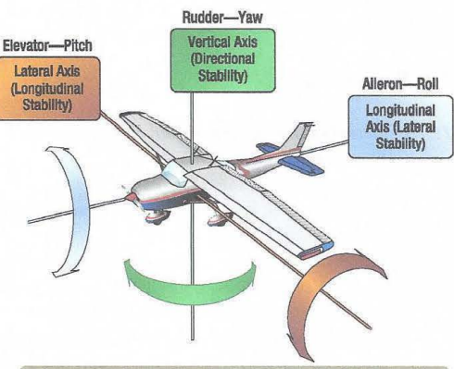

Slide 7
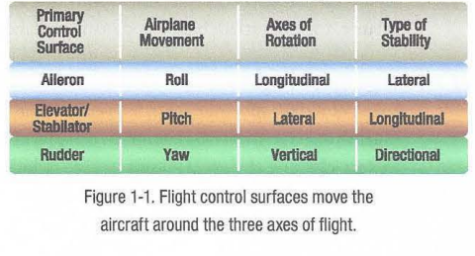

Slide 8
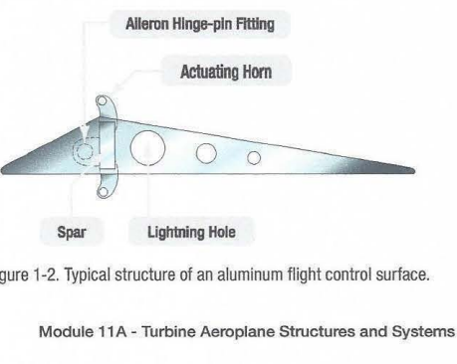

Slide 9
a particular device is at or forward of the hinge point. Failure to properly balance a control surface could lead to catastrophic failure. Figure 1-4 illustrates several aileron configurations with their hinge points well aft of the leading edge. This is a common design feature used to prevent flutter. OPERATION AND EFFECT OF ROLL CONTROL DEVICES AILERONS Ailerons are the primary flight control surfaces that move the aircraft about the longitudinal axis. In other words, movement of the ailerons in flight causes the aircraft to roll. Ailerons are usually located on the outboard trailing edge of each of the wings. They are built into the wing and are calculated as part of the wing's surface area. Figure 1-5 shows aileron locations on various wing tip designs.

Slide 10
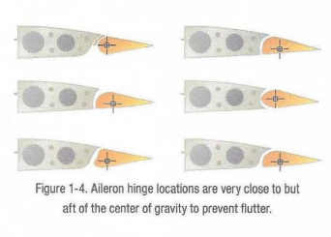

Slide 11
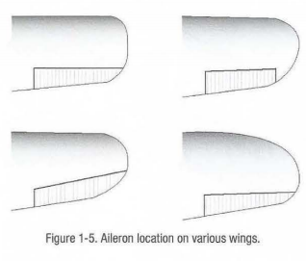

Slide 12
Ailerons are controlled by a side to side motion of the control stick in the cockpit or a rotation of the control yoke. When the aileron on one wing deflects down, the aileron on the opposite wing deflects upward. This amplifies the movement of the aircraft around the longitudinal axis. On the wing on which the aileron trailing edge moves downward, camber is increased and lift is increased. Conversely, on the other wing, the raised aileron decreases lift. (Figure 1-6) The result is a sensitive response to the control input to roll the aircraft. The pilot's request for aileron movement and roll are transmitted from the cockpit to the actual control surface in a variety of ways depending on the aircraft. A system of control cables and pulleys, push pull tubes, hydraulics, electric, or a combination of these can be employed. (Figure 1-7)

Slide 13
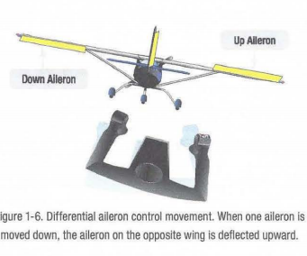

Slide 14
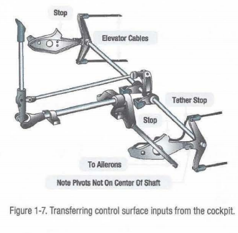

Slide 15
Simple, light aircraft usually Jo not have hydraulic or electric fiy by wire aileron control. These arc found un heavy and high performance aircraft. Large aircraft and some high performance aircraft may also have a second set of ailerons located inboard on the trailing edge of the wings. 1hese are part of a complex system of primary and secondary control surfaces used to provide lateral control and stability in flight. At low speeds, the ailerons may be augmented by the use of flaps and spoilers. At high speeds, only inboard aileron deflection is required to roll the aircraft while the other control surfaces are locked out or remain stationary. Figure 1-8 illustrates the location of the typical flight control surfaces found on a transport category aircraft.

Slide 16
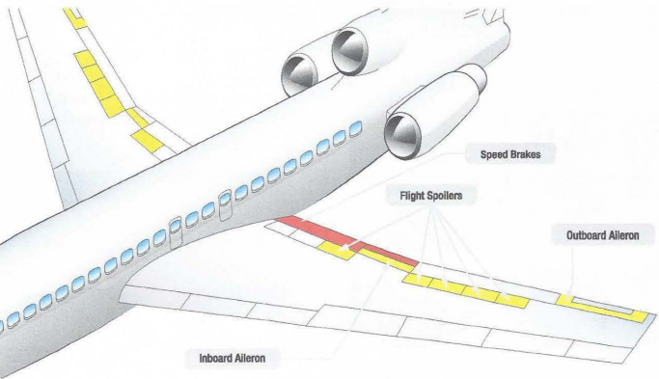

Slide 17
SPOILERS A spoiler is a device found on me upper surface of many heavy and high performance aircraft. It is stowed Rm~h to the wing's upper surface. When deployed, it raises up into the airstream and disrupts the laminar airflow of the wing, thus reducing lift. Spoilers are made with similar construction materials and techniques as the other flight control surfaces on the aircraft. Often, they are honeycomb core fiat panels. At low speeds, spoilers are rigged to operate when the ailerons operate to assist with the lateral movement and stability of the aircraft. On the wing where the aileron is moved up, the spoilers also raise thus amplifYing the reduction of lift on that wing. (Figure 1-9) On the wing with downward aileron deflection, the spoilers remain stowed. As the speed of the aircraft increases, the ailerons become more effective and the spoiler interconnect disengages. Note that spoilers are also used in as drag inducing devices.

Slide 18
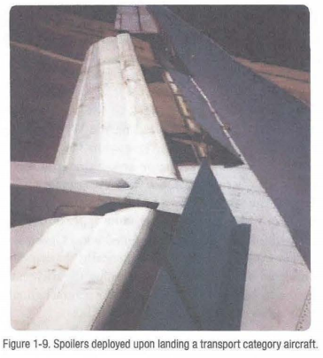

Slide 19
OPERATION AND EFFECT OF PITCH CONTROL DEVICES ELEVATORS The elevator is the primary flight control surface that moves the aircraft around the horizontal or lateral axis. This causes the nose of the aircraft to pitch up or down. The elevator is hinged to the trailing edge of the horizontal stabilizer and typically spans most or all of its width. It is controlled in the cockpit by pushing or pulling the control yoke forward or aft. Light aircraft use a system of control cables and pulleys or push pull tubes to transfer cockpit inputs to the movement of the elevator. High performance and large aircraft typically employ more complex systems. Hydraulic power is commonly used to move the elevator on these aircraft. On aircraft equipped with fly by wire controls, a combination of electrical and hydraulic power is used.

Slide 20
STABILATORS A movable horizontal tail section, called a stabilator, is a control surface that combines the action of both the horizontal stabilizer and the elevator. (Figure 1-10) Basically, a stabilator is a horizontal stabilizer that can also be rotated about the horizontal axis to affect the pitch of the aircraft. VARIABLE INCIDENCE STABILIZERS A variable incidence stabilizer refers to any horizontal stabilizer in which the angle of incidence of the horizontal stabilizer is adjustable. Thus, a stabilator is a variable incidence horizontal stabilizer. Various mechanisms and operating rigging are available. Most large aircraft use a motorized jackscrew to alter the position of the stabilizer often energized by the trim tab switch on the control yoke. The reason for a stabilator or any horizontal stabilizer variable incidence device is to minimize drag when trimming the aircraft in flight. Deflection of the elevator via the use of a trim tab causes drag and requires a relatively

Slide 21
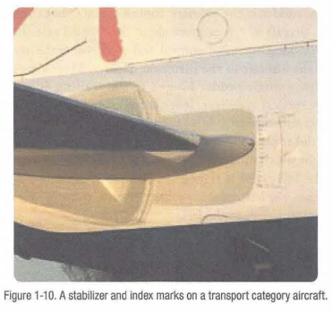

Slide 22
VARIABLE INCIDENCE STABILIZERS A variable incidence stabilizer refers to any horizontal stabilizer in which the angle of incidence of the horizontal stabilizer is adjustable. Thus, a stabilator is a variable incidence horizontal stabilizer. Various mechanisms and operating rigging are available. Most large aircraft use a motorized jackscrew to alter the position of the stabilizer often energized by the trim tab switch on the control yoke. The reason for a stabilator or any horizontal stabilizer variable incidence device is to minimize drag when trimming the aircraft in flight. Deflection of the elevator via the use of a trim tab causes drag and requires a relatively large elevator on large aircraft to achieve all desired trim settings. By varying the angle of the horizontal stabilizer to adjust pitch, less drag is created and elevator size and deflection may be reduced. (Figure 1-11) CANARDS A canard utilizes the concept of two lifting surfaces. It functions as a horizontal stabilizer located in front of the main wings. In effect, the canard is an airfoil similar to the horizontal surface on a conventional aft tail design.

Slide 23
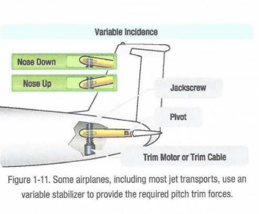

Slide 24
The difference is that the canard actually creates lift and holds the nose up, as opposed to the aft tail design which exerts downward force on the tail to prevent the nose from rotating downward. (Figure 1-12) The canard design dates back to the pioneer days of aviation, most notably used on the Wright Flyer. Recently, the canard configuration has regained popularity and is appearing on newer aircraft. Canard designs include two types, one with a horizontal surface of about the same size as a normal aft tail design, and the other with a surface of the same approximate size and airfoil shape of the aft mounted wing known as a tandem wing configuration. Theoretically, the canard is considered more efficient because using the horizontal surface to help lift the weight of the aircraft should result in less drag for a given amount of lift.

Slide 25
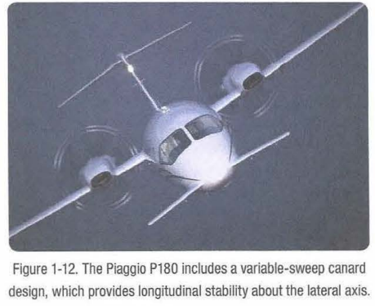

Slide 26
OPERATION AND EFFECT OF YAW CONTROL DEVICES RUDDERS The rudder is the primary control surface that causes an aircraft to yaw or move about the vertical axis. This provides directional control and thus points the nose of the aircraft in the direction desired. Most aircraft have a single rudder hinged to the trailing edge of the vertical stabilizer. It is controlled by a pair of foot operated rudder pedals in the cockpit. When the right pedal is pushed forward, it deflects the rudder to the right which moves the nose of the aircraft to the right. The left pedal is rigged to simultaneously move aft. when the left pedal is pushed forward, the nose of the aircraft moves to the left.

Slide 27
As with the other primary flight controls, the transfer of the movement of the cockpit controls to the rudder varies with the complexity of the aircraft. Many aircraft incorporate the directional movement of the nose or tail wheel into the rudder control system for ground operation. This allows the operator to steer the aircraft with the rudder pedals during taxi when the airspeed is not high enough for the control surfaces to be effective. Some large aircraft have a split rudder arrangement. This is actually two rudders, one above the other. At low speeds, both rudders deflect in the same direction when the pedals are pushed. At higher speeds, one of the rudders becomes inoperative as the deflection of a single rudder is aerodynamically sufficient to maneuver the aircraft.

Slide 28
RUDDER LIMITERS In flight, most large aircraft oscillate slightly from side to side. Yaw dampener units automatically detect this movement and send signals to the hydraulic power control unit (PCU) that moves the rudder so that it can correct for these yaw oscillations. Similarly, rudders are known to deflect without being commanded to do so by the flight crew. Again, the yaw dampener is designed to correct the fluctuations by signaling the PCU. However, too large of an involuntary deflection to a rudder can cause a loss of control of the aircraft. A ruder limiter is fitted to many aircraft to prevent any more than a few degrees of involuntary motion of the rudder. Essentially, it limits the movement unless it is commanded from the flight deck.

Slide 29
SECONDARY OR AUXILIARY CONTROL SURFACES There are several secondary or auxiliary flight control surfaces. Their names, locations, and functions of those for most large aircraft are listed in Figure 1-13. OPERATION AND EFFECT OF TABS TRIM TABS The force of the air against a control surface during the high speed of flight can make it difficult to move and hold that control surface in the deflected position. A control surface might also be too sensitive for similar reasons. Several different tabs are used to aid with these types of problems. The table in Figure 1-14 summarizes the various tabs and their uses. While in flight, it is desirable for the pilot to be able to take his or her hands and feet off of the controls and have the aircraft maintain its flight condition. Trims tabs are designed to allow this. Most trim tabs are small movable surfaces located on the trailing edge of a primary flight control surface.

Slide 30
A small movement of the tab in the direction opposite of the direction the flight control surface is deflected, causing air to strike the tab, in turn producing a force that aids in maintaining the flight control surface in the desired position. Through linkage set from the cockpit, the tab can be positioned so that it is actunlly holding the control surface in position rather than the pilot. 1herefore, elevator tabs are used to maintain the speed of the aircraft since they assist in maintaining the selected pitch. Rudder tabs can be set to hold yaw in check and maintain heading. Aileron tabs can help keep the wings level. Occasionally, a simple light aircraft may have a stationary metal plate attached to the trailing edge of a primary flight control, usually the rudder. This is also a trim tab as shown in Figure 1-15.

Slide 31
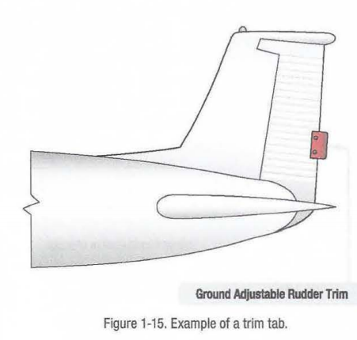

Slide 32
It can be bent slightly on the ground to trim the aircraft in flight to a hands off condition when flying straight and level. The correct amount of bend can be determined only by flying the aircraft after an adjustment. Note that a small amount of bending is usually sufficient. BALANC E TABS The aerodynamic phenomenon of moving a trim tab in one direction to cause the control surface to experience a force moving in the opposite direction is exactly what occurs with the use of balance tabs. (Figure 1-16) Often, it is difficult to move a primary control surface due to its surface area and the speed of the air rushing over it. Deflecting a balance tab hinged at the trailing edge of the control surface in the opposite direction of the desired control surface movement causes a force to position the surface in the proper direction with reduced force to do so. Balance tabs are usually linked directly to the control surface linkage so that they move automatically when there is an input for control surface movement. They also can double as trim tabs, if adjustable on the flight deck.

Slide 33
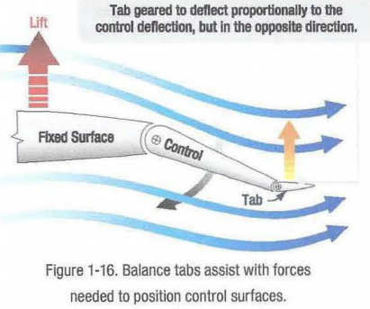

Slide 34
SERVO TABS A servo tab is similar to a balance tab in location and effect, but it is designed to operate the primary flight control surface, not just reduce the force needed to do so. It is usually used as a means to back up the primary control of the flight control surfaces. (Figure 1-17)
On heavy aircraft, large control surfaces require too much force to be moved manually and are usually deflected out of the neutral position by hydraulic actuators. These power control units are signaled via a system of hydraulic valves connected to the yoke and rudder pedals. The aircraft in flight Allows "hands off" maintenance or flight condition. Aids pilot in overcoming the force needed to move me control surface. Aerodynamically positions control surfaces that require too much force to move manually. Increases force needed by pilot to change 111ght control position. De-sensitizes night controls. Enables moving control surface when forces are high. Inactive during slow flight. Ground Adjustable Rudder Trim Figure 1-15. Example of a trim tab. Tab geared to deflect proportionally in the control deflection, but In the opposite direction. On fly by wire aircraft, the hydraulic actuators that move the flight control surfaces are signaled by electric input. In the case of hydraulic system failure(s), manual linkage to a servo tab can be used to deflect it. This, in turn, provides an aerodynamic force that moves the primary control surface.

Slide 35
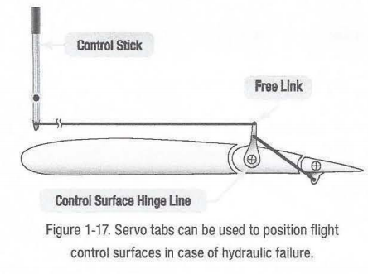

Slide 36
ANTI-SERVO/ANTI-BALANCE TABS Anti-servo tabs, as the name suggests, are like servo tabs but move in the same direction as the primary control surface. On some aircraft, especially those with a movable horizontal stabilizer, the input to the control surface can be too sensitive. An Anti-servo tab tied through the control linkage creates an aerodynamic force that increases the effort needed to move the control surface. This makes flying the aircraft more stable for the pilot. Figure 1-18 shows an Anti-servo tab in the near neutral position. Deflected in the same direction as the desired stabilator movement, it increases the required control surface input. Anti servo tabs are also known as anti-balance tabs.

Slide 37
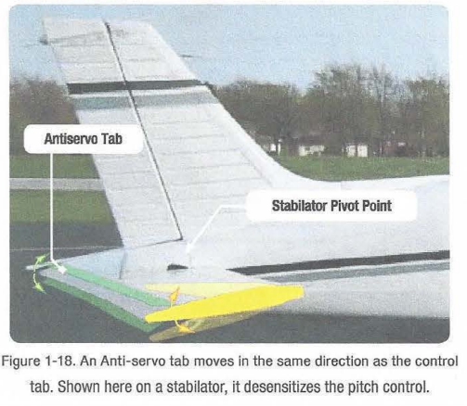

Slide 38
SPRING TABS A control surface may require excessive force to move only in the final stages of travel. When this is the case, a spring tab can be used. This is essentially a servo tab that does not activate until an effort is made to move the control surface beyond a certain point. When reached, a spring in line of the control linkage aids in moving the control surface through the remainder of its travel. (Figure 1-19)

Slide 39
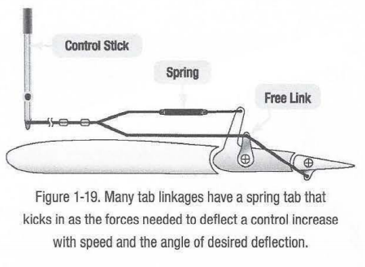

Slide 40
AERODYNAMIC BALANCE PANELS Figure 1-20 shows another way of assisting the movement of an aileron on a large aircraft. It is called an aileron balance panel. Not visible when approaching the aircraft, it is positioned in the linkage that hinges the aileron to the wing. Balance panels have been constructed typically of aluminum skin covered frame assemblies or aluminum honeycomb structures. The trailing edge of the wing just forward of the leading edge of the aileron is sealed to allow controlled airflow in and out of the hinge area where the balance panel is located.

Slide 41
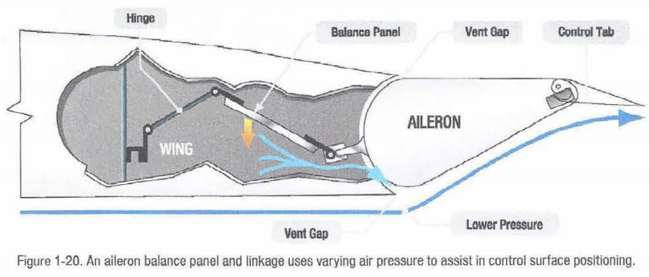

Slide 42
MASS BALANCE Flutter is an undesirable oscillation of an aircraft control surface which can have catastrophic effect on controllability of the aircraft. The center of lift on a control surface should be aft of the control surface center of gravity to prevent control surface flutter. Often, the addition of weight to the forward surface of an aileron, for example, is sufficient to move the CG of the airfoil forward and prevent flutter. Some aircraft designs, however, place the weight on a lever arm that extends forward of the control surface. This is known as a mass balance. Mass balances help prevent flutter and also reduce the required control stick pressure used to move a control surface. (Figure 1-21)

Slide 43
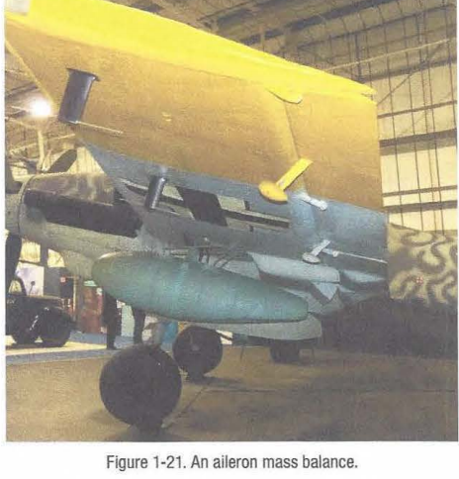

Slide 44
CONTROL SURFACE BIAS When a control surface is in the neutral position, is faired with the wing rudder or horizontal stabilizer and no effect on the aircrafts aerodynamic surfaces. Some aircraft are designed with control surface bias. This means that a control surface is not naturally in the neutral position. It is designed to impart a force on the airfoil at all times. The force is generally used to counter balance a design imbalance and alter the aircraft's aerodynamics for easy hands off flight. This means that when the aircraft is flying straight and level, the control surface bias has effect but all trim position gauges on the flight deck indicate zero trim.

Slide 45
HIGH LIFT DEVICES Aircraft wings contain devices that are designed to increase the lift produced by the wing with the devices deployed during certain phases of flight. FLAPS Flaps are one such high lift device found on most aircraft. They are usually inboard on the wings' trailing edges adjacent to the fuselage. Leading edge flaps are also common. They extend forward and down from the inboard wing leading edge. The flaps are lowered to increase the camber of the wings and provide greater lift and control at slow speeds. They enable landing at slower speeds and shorten the amount of runway required for takeoff and landing. The amount that the flaps extend and the angle they form with the wing can be selected from the cockpit. Typically, flaps can extend up to 45-so·. Figure 1-22 shows various aircraft with flaps in the extended position

Slide 46
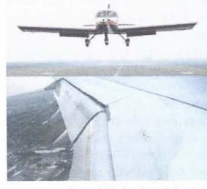

Slide 47
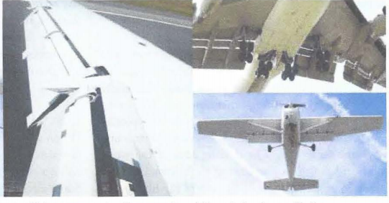

Slide 48
Flaps are usually constructed of materials and with techniques used on the other airfoils and control surfaces of a particular aircraft. Aluminum skin and structure flaps are the norm on light aircraft. Heavy and high performance aircraft flaps may also be aluminum, but the use of composite structures is also common. There are various kinds of flaps. Plain flaps form the trailing edge of the wing when the flap is in the retracted position. (Figure 1-23A) The airflow over the wing continues over the upper and lower surfaces of the flap, making the trailing edge of the flap essentially the trailing edge of the wing. The plain flap is hinged so that the trailing edge can be lowered. This increases wing camber and provides greater lift.

Slide 49
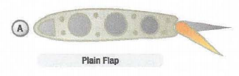

Slide 50
A split flap is normally housed under the trailing edge of the wing. (Figure 1-23B) It is usually just a braced flat metal plate hinged at several places along its leading edge. The upper surface of the wing extends to the trailing edge of the flap. When deployed, the split flap trailing edge lowers away from the trailing edge of the wing. Airflow over the top of the wing remains the same. Airflow under the wing now follows the camber created by the lowered split flap, increasing lift.

Slide 51
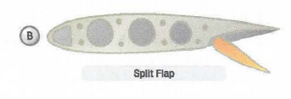

Slide 52
Fowler flaps not only lower the trailing edge of the wing when deployed but also slide aft, effectively increasing the area of the wing. (Figure 1-23C) This creates more lift via the increased surface area, as well as the wing camber. When stowed, the fowler flap typically retracts up under the wing trailing edge similar to a split flap. The sliding motion of a fowler flap can be accomplished with a worm drive and flap tracks. An enhanced version of the fowler flap is a set of flaps that actually contains more than one aerodynamic

Slide 53
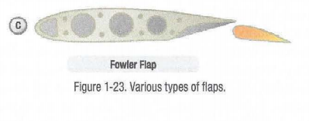

Slide 54
surface. Figure 1-24 shows a triple slotted flap. In this configuration, the flap consists of a fore flap, a mid flap, and an aft flap. When deployed, each flap section slides aft on tracks as it lowers. The flap sections also separate leaving an open slot between the wing and the fore flap, as well as between each of the flap sections. Air from the underside of the wing flows through these slots. The result is that the laminar flow on the upper surfaces is enhanced. The greater camber and effective wing area increase overall lift. Heavy aircraft often have leading edge flaps that are used in conjunction with the trailing edge flaps. (Figure 1-25) They can be made of machined magnesium or can have an aluminum or composite structure.

Slide 55
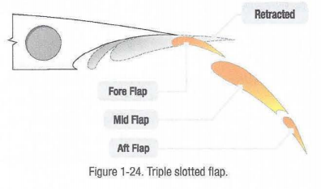

Slide 56
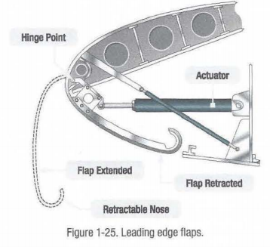

Slide 57
While they are not installed or operate independently, their use with trailing edge flaps can greatly increase wing camber and lift. When stowed, leading edge flaps retract into the leading edge of the wing. The differing designs of leading edge flaps essentially provide the same effect. Activation of the trailing edge flaps automatically deploys the leading edge flaps, which are driven out of the leading edge and downward, extending the camber of the wing. Figure 1-26 shows a Krueger flap, recognizable by its flat midsection.

Slide 58
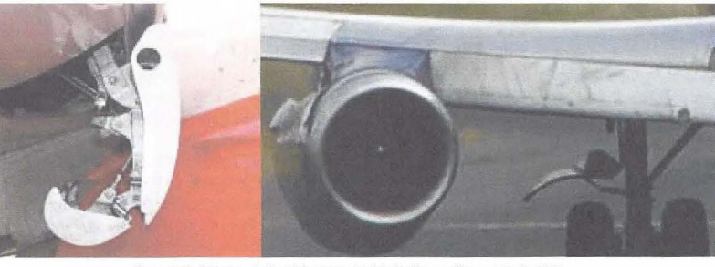

Slide 59
FLAPERONS Some aircraft are equipped with flaperons. (Figure 1-27) Flaperons are ailerons which can also act as flaps. Flaperons combine both aspects of flaps and ailerons. In addition to controlling the bank angle of an aircraft like conventional ailerons, flaperons can be lowered together to function much the same as a dedicated set of flaps. 1he pilot retains separate controls for ailerons and flaps. A mixer is used to combine the separate pilot inputs into this single set of control surfaces called flaperons. Many designs that incorporate flaperons mount the control surfaces away from the wing to provide undisturbed airflow at high angles of attack and/or low airspeeds.

Slide 60
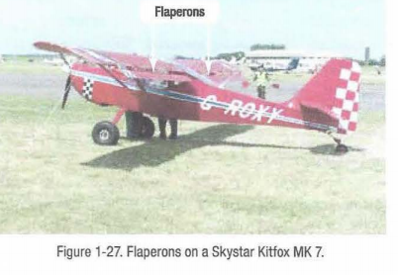

Slide 61
SLATS Another leading edge device which extends wing camber is a slat. Slats can be operated independently of the flaps with their own switch in the cockpit. Slats not only extend out of the leading edge of the wing increasing camber and lift, but most often, when fully deployed leave a slot between their trailing edges and the leading edge of the wing. (Figure 1-28) This increases the angle of attack at which the wing will maintain its laminar airflow, resulting in the ability to fly the aircraft slower and still maintain control.

Slide 62
SLOTS A fixed device mounted to extend the leading edge of the wing forward and downward is known as a slot or cuff. (Figure 1-29) It essentially increases the camber of the wing and allows the aircraft to fly at slower speeds and higher angles of attack. Moreover, slots reduce the stall speed of the aircraft by mixing high speed air flow exiting the slot with boundary layer air. The result is a delay in boundary layer separation. However, slots increase drag. The benefits of good low speed handling characteristics when weighed against the increased drag that a slot causes at higher speeds limits the use of slots. Full span slots span the full wing from root to tip. They are commonly used on STOL (short takeoff and

Slide 63
landing) aircraft. Partial span slots are positioned on the outboard section of the wing leading edge. This increases the angle of attack at which the outboard wing stalls and ensures that the wing root stalls first. When the wing root stalls first, stall characteristics are docile. Recovry is easier because the partial span slots maintain air flow over the ailerons during the stall.

Slide 64
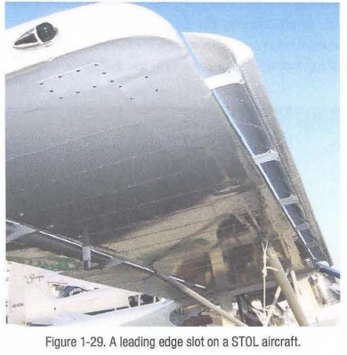

Slide 65
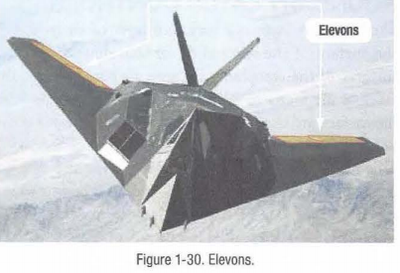

Slide 66
ELEVONS AND RUDDERVATORS Elevons perform the combined functions of the ailerons and the elevator. (Figure 1-30) They are typically used on aircraft that have no true separate empennage such as a delta wing or flying wing aircraft. They are installed on the trailing edge of the wing. When moved in the same direction, the elevons cause a pitch adjustment. When moved in opposite directions, the aircraft rolls. Elevons may also move differentially in the same direction causing adjustments to roll and pitch. The control yoke or stick activated elevon movement through a mechanical or electronic mixing device. A ruddervator combines the action of the rudder and elevator. (Figure 1-31)

Slide 67
This is possible on aircraft with V-tail empennages where the traditional horizontal and vertical stabilizers do not exist. Instead, two stabilizers angle upward and outward from the aft fuselage in a "V" configuration. Each contains a movable ruddervator built into the trailing edge. Movement of the ruddervators can alter the movement of the aircraft around the horizontal and/or vertical axis.

Slide 68
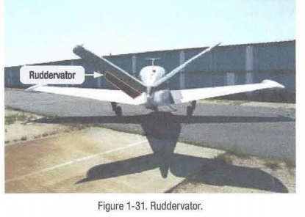

Slide 69
DRAG INDUCING DEVICES SPOILERS Spoilers are unique in that they may be fully deployed on both wings to act as speed brakes. The reduced lift and increased drag can quickly reduce the speed of the aircraft in flight. Spoilers are sometimes called lift dumpers.
SPEED BRAKES Dedicated speed brake panels similar to flight spoilers in construction can be found on the upper surface of the wing trailing edge of heavy and high performance aircraft. They are designed specifically to increase drag and reduce the speed of the aircraft when deployed. These speed brake panels do not operate differentially with the ailerons at low speed like the spoilers.
A speed brake control lever in the cockpit can deploy all spoiler and speed brake surfaces fully when operated. Often, speed brakes surfaces

Slide 70
are rigged to deploy on the ground automatically when engine thrust reversers are activated. The location of speed brake panels is visible in Figure 1-8.
BOUNDARY LAYER CONTROLS The boundary layer is a very thin layer of air lying over the surface of the wing and, for that matter, all other surfaces of the aero plane. Because air has viscosity, this layer of air tends to adhere to the wing. As the wing moves forward through the air, the boundary layer at first flows smoothly over the streamlined shape of the airfoil. This flow is called the laminar layer. As the boundary layer approaches the center of the wing, it begins to lose speed due to skin friction and it becomes thicker and turbulent. Here it is called the turbulent layer.

Slide 71
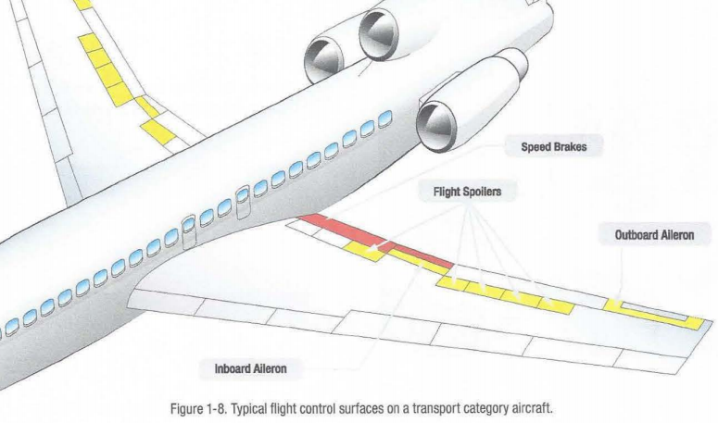

Slide 72
The point at which the boundary layer changes from laminar to turbulent is called the transition point. Where the boundary layer becomes turbulent, drag due to skin friction is relatively high. As speed increases, the transition point tends to move forward. As the angle of attack increases, the transition point also tends to move forward. With higher angles of attack and further thickening of the boundary layer, the turbulence becomes so great the air breaks away from the surface of the wing. At this point, the lift of the wing is destroyed and a condition known as a stall has occurred. In Figure 1-32, view A shows a normal angle of attack and the airflow staying in contact with the wing. View B shows an extreme angle of attack and the airflow separating and becoming turbulent on the top of the wing. In view B, the wing is in a stall.

Slide 73
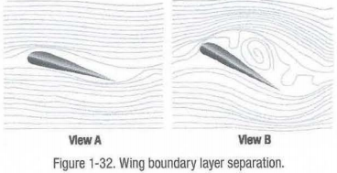

Slide 74
VORTEX GENERATORS Vortex generators are small airfoil sections usually attached to the upper surface of a wing. (Figure 1-33) They are designed to promote positive laminar airflow over the wing and control surfaces.
Usually made of aluminum and installed in a span wise line or lines, the vortices created by these devices swirl downward assisting maintenance of the boundary layer of air flowing over the wing. They can also be found on the fuselage and empennage. Figure 1-34 shows the unique vortex generators on a Symphony SA-160 wing.

Slide 75
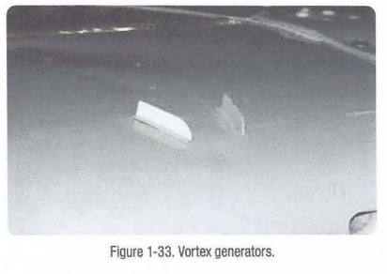

Slide 76
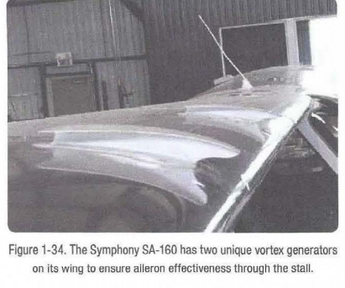

Slide 77
WING FENCE A chord wise barrier on the upper surface of the wing, called a wing fence or stall fence, is used to halt the span wise flow of air along the wing. During low speed flight, this can maintain proper chord wise airflow reducing the tendency for the wing to stall. Usually made of aluminum, the fence is a fixed structure most common on swept wings, which have a natural span wise tending boundary air flow. (Figure 1-35)

Slide 78
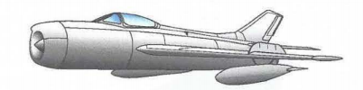

Slide 79
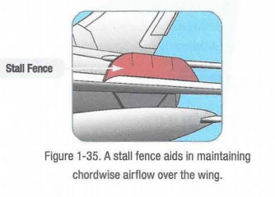

Slide 80
STALL WEDGES A stall wedge or stall strip is a fixed wedge shaped strip attached span wise to the wing leading edge. (Hgure 1-36) It is located on the inboard section of the wing at such a point that it causes the boundary airflow to become turbulent as the angle of attack increases to a certain point. This purposeful destruction of the boundary airflow as the angle of attack increases causes the root of the wing to stall first. Thus, airflow over the outboard wing section and over the ailerons is preserved during the stall making it easier to recover.

Slide 81
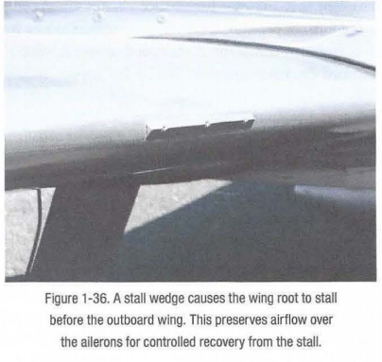

Slide 82
SAWTOOTH LEADING EDGE A few aircraft have a saw tooth leading edge where, rather than being a smooth continuous surface, the leading edge juts out slightly at a point(s) determined to be beneficial by design engineers. The purpose of the saw tooth wing is to utilize the vortex created by an inboard section of the wing to improve boundary layer flow over an outboard section. This increases lift and resistance to stall. Saw tooth wing leading edges are most common on high performance military aircraft.

Slide 83
WINGTIP VORTICES Wingtip vortices are caused by the air beneath the wing, which is at the higher pressure, flowing over the wingtip and up toward the top of the wing. The end result is a spiral or vortex that trails behind the wingtip anytime lift is being produced. This vortex is also referred to as wake turbulence, and is a significant factor in determining how closely one aero plane can follow behind another on approach to land. The wake turbulence of a large aero plane can cause a smaller aero plane, if it is following too closely, to be thrown out of control. Vortices from the wingtip as well as the inboard edge of the ailerons and from the horizontal stabilizer are visible on the MD-11 shown in Figure 1-37.

Slide 84
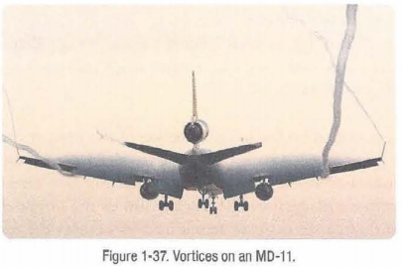

Slide 85
Up wash and downwash refer to the effect an airfoil has on the free airstream. Up wash is the deflection of the oncoming airstream, causing it to flow up and over the wing.
Downwash is the downward deflection of the airstream after it has passed over the wing and is leaving the trailing edge. This downward deflection is what creates the action and reaction described under lift and Newton's third law.

Slide 86
WING LET A winglet is an obvious vertical upturn of the wing's tip resembling a vertical stabilizer. (Figure 1-38) It is an aerodynamic device designed to reduce the drag created by wing tip vortices in flight. Usually made from aluminum or composite materials, winglets can be designed to optimize performance at a desired speed. They use the flow of air from under the wing to create thrust thereby reducing induced drag. Significant fuel savings are also achieved.

Slide 87
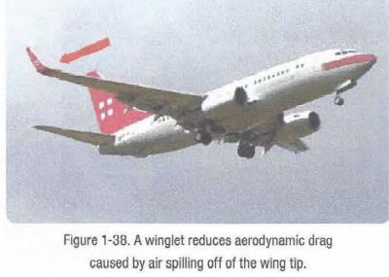

Slide 88
HIGH SPEED FLIGHT
SPEED OF SOUND
Sound, in reference to aero planes and their movement through the air, is nothing more than pressure disturbances in the air. It is like dropping a rock in the water and watching the waves flow out from the center. As an aero plane flies through the air, every point on the aero plane that causes a disturbance creates sound energy in the form of pressure waves. These pressure waves flow away from the aero plane at the speed of sound, which at standard day temperature of 59"F, is 761 mph.
The speed of sound in air changes with temperature, increasing as temperature increases. Figure 1-39 shows how the speed of sound changes with altitude.

Slide 89
MACH NUMBER, SUBSONIC, TRANSONIC AND SUPERSONIC FLIGHT In high speed flight and/or high altitude flight, the measurement of speed is expressed in terms of a "Mach number"- the ratio of the true airspeed of the aircraft to the speed of sound in the same atmospheric conditions. An aircraft traveling at the speed of sound is traveling at Mach 1.0. Aircraft speed regimes are defined approximately as follows:
• Subsonic-Mach numbers below 0.75
• Transonic-Mach numbers from 0.75 to 1.20
• Supersonic-Mach numbers from 1.20 to 5.00
• Hypersonic-Mach numbers above 5.00

Slide 90
When an aero plane is flying at subsonic speed, all of the air flowing around the aero plane is at a velocity of less than the speed of sound (known as Mach 1). Keep in mind that the air accelerates when it flows over certain parts of the aero plane, like the top of the wing, so an aero plane flying at 500 mph could have air over the top of the wing reach a speed of 600 mph. How fast an aero plane can fly and still be considered in subsonic flight varies with the design of the wing, but as a Mach number, it will typically be just over Mach 0.8.
When an aero plane is flying at transonic speed, part of the aero plane is experiencing subsonic airflow and part is experiencing supersonic airflow. Over the top of the wing the velocity of the air will reach Mach 1

Slide 91
and a shock wave will form. 1he shock wave forms 90 degrees to the airflow approximately halfway between the leading and trailing edge of the wing. It is known as a normal shock wave. Stability problems can be encountered during transonic flight, because the shock wave can cause the airflow to separate from the wing. The shock wave also causes the center of lift to shift aft, causing the nose to pitch down. The speed at which the shock wave forms is known as the critical Mach number. When an aero plane is flying at supersonic speed, the entire aero plane is experiencing supersonic airflow. At this speed, the shock wave which formed on top of the wing during transonic flight has moved all the way aft and has attached itself to the wing trailing edge. Supersonic speed is from Mach 1.20 to 5.0. If an aero plane flies taster than Mach 5, it is said to be in hypersonic flight.

Slide 92
SHOCKWAVE
Sound coming from an aero plane is the result of the air being disturbed as the aero plane moves through it, and the resulting pressure waves that radiate out from the source of the disturbance. For a slow moving aero plane, the pressure waves travel out ahead of the aero plane, traveling at the speed of sound. When the speed of the aero plane reaches the speed of sound, however, the pressure waves (sound energy) cannot get away from the aero plane. At this point the sound energy starts to pile up, initially on the top of the wing, and eventually attaching itself to the wing leading and trailing edges. This piling up of sound energy is called a shock wave.

Slide 93
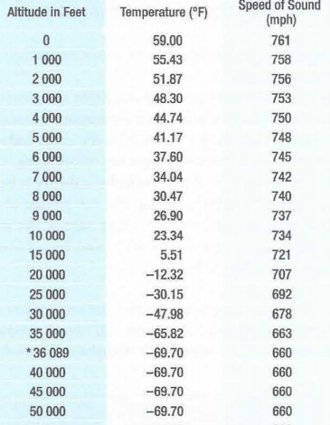

Slide 94
If the shock waves reach the ground, and cross the path of a. person, they will be heard as a sonic boom. Figure 1-40A shows a wing in slow speed flight, with many disturbances on the wing generating sound pressure waves that are radiating outward. Figure 1-40B is the wing of an airplane in supersonic flight, with the sound pressure waves piling up toward the wing leading edge.

Slide 95
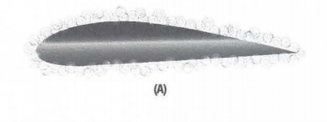

Slide 96
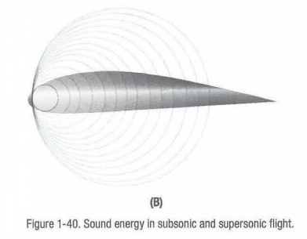

Slide 97
Normal Shock Wave
When an aero plane is in transonic flight, the shock wave that forms on top of the wing, and eventually on the bottom of the wing, is called a normal shock wave. If the leading edge of the wing is blunted, instead of being rounded or sharp, a normal shock wave will also form in front of the wing during supersonic flight. Normal shock waves form perpendicular to the airstream. The velocity of the air behind a normal shock wave is subsonic, and the static pressure and density of the air are higher. Figure 1-41 shows a normal shock wave forming on the top of a wing.

Slide 98
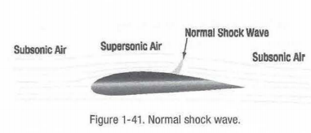

Slide 99
Oblique Shock Wave An aero plane that is designed to fly supersonic will have very sharp edged surfaces, in order to have the least amount of drag. When the aero plane is in supersonic flight, the sharp leading edge and trailing edge of the wing will have shock waves attach to them. These shock waves are known as oblique shock waves. Behind an oblique shock wave the velocity of the air is lower, but still supersonic, and the static pressure and density are higher. Figure 1-42 shows an oblique shock wave on the leading and trailing edges of a supersonic airfoil.

Slide 100
Expansion Wave Earlier in the discussion of high speed aerodynamics, it was stated that air at supersonic speed acts like a compressible fluid. For this reason, supersonic air, when given the opportunity, wants to expand outward. When supersonic air is flowing over the top of a wing, and the wing surface turns away from the direction of flow, the air will expand and follow the new direction. At the point where the direction of flow changes, an expansion wave will occur. Behind the expansion wave the velocity increases, and the static pressure and density decrease. An expansion wave is not a shock wave. Figure 1-42 shows an expansion wave on a supersonic airfoil.

Slide 101
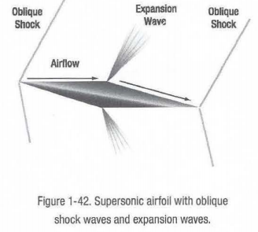

Slide 102
CRITICAL MACH NUMBER While flights in the transonic and supersonic ranges are common occurrences for military aircraft, civilian jet aircraft normally operate in a cruise speed range of Mach 0.7 to Mach 0.90.
TI1e speed of an aircraft in which airflow over any part of the aircraft or structure under consideration first reaches (but does not exceed) Mach 1.0 is termed "critical Mach number" or "Mach Crit." Thus, critical Mach number is the boundary between subsonic and transonic flight and is largely dependent on the wing and airfoil design. Critical Mach number is an important point in transonic flight. When shock waves form on the aircraft, airflow separation followed by buffet and aircraft control difficulties can occur. Shock waves, buffet, and airflow separation take place above critical Mach number.

Slide 103
A jet aircraft typically is most efficient when cruising at or near its critical Mach number.
At speeds 5-10 percent above the critical Mach number, compressibility effects begin. Drag begins to rise sharply. Associated with the "drag rise" are buffet, trim and stability changes, and a decrease in control surface effectiveness. This is the point of "drag divergence." (Figure 1-43)

Slide 104
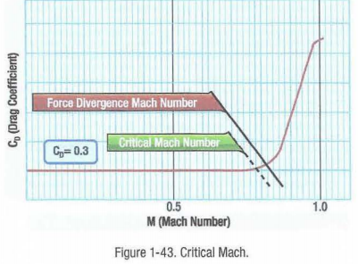

Slide 105
AFFECTS OF SWEEPBACK ON CRITICAL MACH NUMBER
Most of the difficulties of transonic flight are associated with shock wave induced flow separation. Therefore, any means of delaying or alleviating the shock induced separation improves aerodynamic performance. One method is wing sweepback. Sweepback theory is based upon the concept that it is only the component of the airflow perpendicular to the leading edge of the wing that affects pressure distribution and formation of shock waves. (Figure 1-44) On a straight wing aircraft, the airflow strikes the wing leading edge at 90 degree, and its full impact produces pressure and lift. A wing with sweepback is struck by the

Slide 106
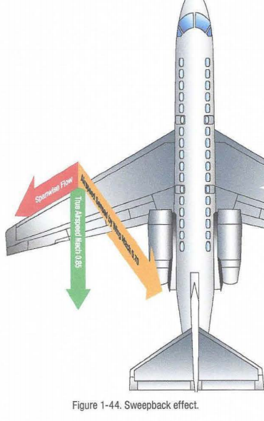

Slide 107
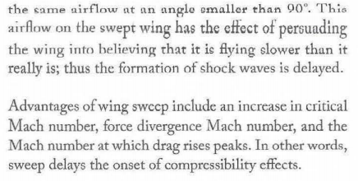

Slide 108
The Mach number, which produces a sharp change in drag coefficient, is termed the 11 force divergence" Mach number and, for most airfoils, usually exceeds the critical Mach number by 5 to 10 percent. At this speed, the airflow separation induced by shock wave formation can create significant variations in the drag, lift, or pitching moment coefficients.
In addition to the delay of the onset of compressibility effects, sweep back reduces the magnitude in the changes of drag, lift or moment coefficients. In other words, the use of sweepback "softens" the force divergence.

Slide 109
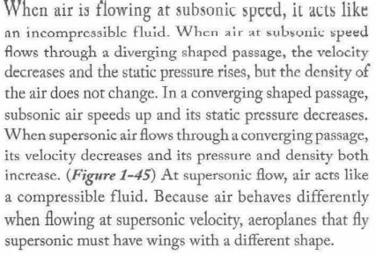
COMPRESSIBILITY EFFECT

Slide 110
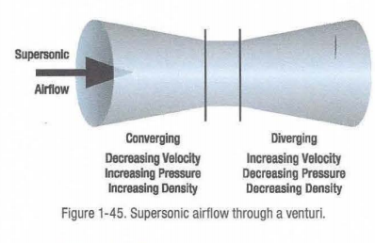

Slide 111
As stated previously, a pressure wave builds up in front of the aircraft as it approaches Mach 1. However, some localized airflow over the wings reaches Mach 1 before the aircraft reaches this speed. Compressibility buffeting is experience as the airflow is no longer smooth over these areas. Violent vibration can occur causing possible damage to the aircraft and control surfaces as well as a loss of control of the aircraft.
AERODYNAMIC HEATING One of the problems with aero planes and high speed flight is the heat that builds up on the aero plane's surface because of air friction. When the SR-71 Blackbird aero plane is cruising at Mach 3.5, skin temperatures on its surface range from 450.F to over 1 ooo·F.

Slide 112
To withstand this high temperature, the aero plane was constructed of titanium alloy, instead of the traditional aluminum alloy. The supersonic transport Concorde was originally designed to cruise at Mach 2.2, but its cruise speed was reduced to Mach 2.0 because of structural problems that started to occur because of aerodynamic heating. If aero planes capable of hypersonic flight are going to be built in the future, one of the obstacles that will have to be overcome is the stress on the aero plane's structure caused by heat.

Slide 113
AREA RULE When designing an aircraft for transonic flight, it must be streamlined to keep drag to a minimum. Area rule is technique for doing so. Using area rule, design engineers consider the area of successive cross section slices of the entire aircraft (not just the fuselage) and shape the total cross sectional area of each slice so that together, they produce an streamlined shape. Use of area rule reduces drag, especially where the wings and fuselage come together.

Slide 114
ENGINE INTAKE AIRFLOW OF HIGH SPEED AIRCRAFT Engine intake airflow on subsonic aircraft must be kept below the critical Mach number. The shape of the engine intake is designed so that air arrives at the first stage of compression at a designed speed for maximum efficiency. This is typically around .5 Mach. A divergent duct cross section slows airflow to the intake on subsonic aircraft. A convergent duct increases intake airflow speed. On supersonic aircraft, the opposite is true. Regardless, engine intake airflow is controlled through the shape of the intake duct and duct air valves operated at particular speeds to result in the proper intake air speed.

Slide 115
AIRWORTHINESS REQUIREMENTS FOR STRUCTURAL STRENGTH
Requirements for airworthiness are set by EASA as well as the certifying authority in the country of manufacture if it is a non EASA country. The goal is to only allow aircraft meeting established minimum standards to fly in an attempt to safeguard aircrews and the general public. EASA Part 25, also known as Certification Standards 25 (CS25), states the requirement for structural airworthiness for aircraft with maximum total weight above 5 700 kg. Aircraft not meeting these standards cannot obtain a certificate of airworthiness. The standards are far reaching and specific. Examples of structurally related topics in CS25 are those of strength, control and maintainability. Other requirements for weights, ventilation, factors of safety and even door operation are included. Specific component performance standards such as the effect of tabs and high lift device as well as stability and stall characteristics are also specified. The result is a body of airframe structural requirements to be included on all manufactured aircraft in excess of 5 700 kg.

Slide 116
STRUCTURAL
CLASSIFICATION
Aircraft structure is divided into three categories for
the purposes of assessing damage and the application of
repair protocol that are suitable for the structure under
consideration. Manufacturer manuals designate which
category a structure falls under and the technician
is required to repair and maintain that structure in
accordance with rules specified for the category under
which it falls. The three categories for structure are:
primary, secondary and tertiary.

Slide 117
PRIMARY STRUCTURE
Primary structure is any portion of the aircraft structure
that, if it fails, on the ground or in flight, would likely
cause any of the following:
• A loss of control of the aircraft.
• Catastrophic structural collapse.
• Injury to occupants.
• Power unit failure.
• Unintentional operation.
• Inability to operate a service.

Slide 118
Some examples of primary structure are wings spars, engine mounts, fuselage frames, and main floor structural members. Within the primary structure are elements called principle structural elements (PSE's). These elements are those which carry flight, ground and pressurization loads. Primary structure may also be represented as a structurally significant item or SSI. These elements are specified in a supplemental structural inspection document. Due to their structural importance, they may require special inspection and have specific repair limitations.
SECONDARY STRUCTURE
Secondary structure is all non primary structure portions of the aircraft which have integral structural importance and strength exceeding design requirements. These structures weakening without risk of failure such as those described for primary structure. Prominent examples of secondary structure are wing ribs, fuselage stringers and specified sections of the aircraft skin.

Slide 119
TERTIARY STRUCTURE
Tertiary structure is the remaining structure. Tertiary structures are lightly stressed structures that are fitted to the aircraft for various reasons. Fairings, fillets, various support brackets, etc. are examples of tertiary structure.
DAMAGE TOLERANT CONCEPTS
FAIL SAFE
Fail safe means the structure has been evaluated, usually by the manufacturer, to assure that catastrophic failure is not probable after fatigue failure or obvious partial failure of a single, principal structural element. It is designed so that the aircraft may continue to operate safely until the defect is detected in a scheduled maintenance check. Manufacturer testing and fatigue analysis is used when developing fail safe structural elements. The elements are considered damage tolerant.

Slide 120
SAFE LIFE
Safe life structural elements are those which have a very low risk of unacceptable degradation or failure for a stated amount of time. The fatigue capability of the structure is learned through testing. The stresses applied while in service are designed to be significantly lower. Also, the calculated time in service before failure is greatly reduced so that failure of the structure before its safe life is highly unlikely. The affects of corrosion, wear and fatigue are considered when operating under the safe life design principle.
DAMAGE TOLERANCE
Designing aircraft with fail safe principles can be somewhat unreliable. Accidents have occurred that prove this. Engineering improvements to a fail safe structure typically come with the extra penalty of

Slide 121
adding weight. Thus, the damage tolerant concept of engineering is favored.
By distributing loads over a larger area and designing multiple load paths for carrying loads, a structure can be damage tolerant. The structure retains its integrity and the damage does not worsen in service between inspections
when the damage can be detected and repaired. Thus, Damage tolerance means that the structure has been evaluated to ensure that should serious fatigue, corrosion, or accidental damage occur within the operational life of the aeroplane, the remaining structure can withstand reasonable loads without failure or excessive structural deformation until the damage is detected.

Slide 122
STATION IDENTIFICATION AND ZONAL LOCATION SYSTEMS
STATION NUMBERING
Even on small, light aircraft, a method of precisely locating each structural component is required. Various numbering systems are used to facilitate the location of specific wing frames, fuselage bulkheads, or any other structural members on an aircraft. Most manufacturers use some system of station marking. For example, the nose of the aircraft may be designated "zero station," and all other stations are located at measured distances in inches behind the zero station. Thus, when a blueprint reads "fuselage frame station 137," that particular frame station can be located 137 inches behind the nose of the aircraft. To locate structures to the right or left of the center line of an aircraft, a similar method is employed. Many manufacturers consider the center line of the aircraft to be

Slide 123
a zero station from which measurements can be taken to the right or left to locate an airframe member. This is often used on the horizontal stabilizer and wings. The applicable manufacturer's numbering system and abbreviated designations or symbols should always be reviewed before attempting to locate a structural member. They are not always the same. The following list includes location
designations typical of those used by many manufacturers. Fuselage stations (Fus. Sta. or FS) are numbered in inches from a reference or zero point known as the reference datum. (Figure 2-1) The reference datum is an imaginary vertical plane at or near the nose of the aircraft from which all fore and aft distances are
measured. The distance to a given point is measured in inches parallel to a center line extending through the aircraft from the nose through the center of the tail cone. Some manufacturers may call the fuselage station a body station, abbreviated BS.

Slide 125
Buttock line or butt line (BL) is a vertical reference plane down the center of the aircraft from which measurements left or right can be made. (Figure 2-2)
Water line (WL) is the measurement of height in inches perpendicular from a horizontal plane usually located at the ground, cabin floor, or some
other easily referenced location. (Figure 2-3)
Aileron station (AS) is measured outboard from, and parallel to, the inboard edge of the aileron, perpendicular to the rear beam of the wing.
Flap station (KS) is measured perpendicular to the rear beam of the wing and parallel to, and outboard from, the inboard edge of the flap.
Nacelle station (NC or Nac. Sta.) is measured either forward of or behind the front spar of the wing and perpendicular to a designated water line.

Slide 126
In addition to the location stations listed above, other measurements are used, especially on large aircraft. Thus, there may be horizontal stabilizer stations (HSS), vertical stabilizer stations (VSS) or powerplant stations (PPS). (Figure 2-4) In every case, the manufacturer's terminology and station location system should be consulted before locating a point on a particular aircraft.

Slide 136
ACCESS AND INSPECTION PANELS
Knowing where a particular structure or component is located on an aircraft needs to be combined with gaining access to that area to perform the required
inspections or maintenance. To facilitate this, access and inspection panels are located on most surfaces of the aircraft. Small panels that are hinged or removable allow inspection and servicing. Large panels and doors allow components to be removed and installed, as well as human entry for maintenance purposes. The underside of a wing, for example, sometimes contains dozens of small panels through which control cable components can be monitored and fittings greased. Various drains and jack points may also be on the underside of the wing. The upper surface of the wings typically have fewer access panels because a smooth surface promotes better laminar airflow, which causes lift .

Slide 137
On large aircraft, walkways are sometimes designated on the wing upper surface to permit safe navigation by mechanics and inspectors to critical structures and components located along the wing's leading and trailing edges. Wheel wells and special component bays are places where numerous components and accessories are grouped together for easy maintenance access.
Panels and doors on aircraft are numbered for positive identification. On large aircraft, panels are usually numbered sequentially containing zone and sub zone
information in the panel number. Designation for a left or right side location on the aircraft is often indicated in the panel number. This could be with an "L" or "R," or panels on one side of the aircraft could be odd numbered and the other side even numbered. The manufacturer's maintenance manual explains the panel numbering system and often has numerous diagrams and tables showing the location of various components and under which panel they may be found. Each manufacturer is entitled to develop its own panel numbering system.

Slide 138
STRUCTURAL STRESSES
Aircraft structural members are designed to carry a load or to resist stress. In designing an aircraft, every square inch of wing and fuselage, every rib, spar, and
even each metal fitting must be considered in relation to the physical characteristics of the material of which it is made. Every part of the aircraft must be planned to carry the load to be imposed upon it. The determination of such loads is called stress analysis. Although planning the design is not the function of

Slide 139
the aircraft technician, it is, nevertheless, important that the technician understand and appreciate the stresses involved in order to avoid changes in the
original design through improper repairs. The term "stress" is often used interchangeably with the word "strain." While related, they are not the same thing. External loads or forces cause stress. Stress is a material's internal resistance, or counterforce, that opposes deformation. The degree of deformation of a material is strain. When a material is subjected to a load or force, that material is deformed, regardless of how strong the material is or how light the load is.
There are five major stresses to which all aircraft are
subjected: (Figure 2-6)
• Tension • Shear
• Compression • Bending • Torsion

Slide 145
Tension is the stress that resists a force that tends to pull something apart. {Figure 2-6.A) The engine pulls the aircraft forward, but air resistance tries to hold it back. The result is tension, which stretches the aircraft. The tensile strength of a material is measured in pounds per square inch (psi) and is calculated by dividing the load (in pounds) required to pull the material apart by its cross sectional area (in square inches).
Compression is the stress that resists a crushing force. (Figure 2-6B) The compressive strength of a material is also measured in psi. Compression is the stress that tends to shorten or squeeze aircraft parts.
Torsion is the stress that produces twisting. (Figure 2-6C) While moving the aircraft forward, the engine also tends to twist it to one side, but other aircraft components hold it on course. Thus, torsion is created. The torsion strength of a material is its resistance to twisting or torque.

Slide 146
Shear is the stress that resists the force tending to cause one layer of a material to slide over an adjacent layer. (Figure 2-6D) Two riveted plates in tension subject the rivets to a shearing force. Usually, the shearing strength of a material is either equal to or less than its tensile or compressive strength. Aircraft parts, especially screws, bolts, and rivets, are often subject to a shearing force.
Bending stress is a combination of compression and tension. The rod in Figure 2-6E has been shortened (compressed) on the inside of the bend and stretched on the outside of the bend. A single member of the structure may be subjected to a combination of stresses. In most
cases, the structural members are designed to carry end loads rather than side loads. They are designed to be subjected to tension or compression rather than bending.

Slide 147
HOOP STRESS
Hoop stress is the stress on the airframe structural components caused by pressurization. All transport category aircraft are pressurized. A circumferential
load is experience in hoop stress. The structural fuselage framework resists this load with the aid of the stressed skin.
Note that axial loads in the fuselage are also partial resisted by the stres sed skin construction as well as the longitudinal structural members such as
longhorns and stringers.
MTOE REF.LETTER NO-DGCA/CAR-147(B)/28

Slide 148
METAL FATIGUE
Metal fatigue is experienced by a component or structural member when a load is repeatedly applied and released or applied and reversed. This cycling weakens the material over time even though the load applied may be well below that which causes damage in a single application.
All materials have an elastic limit. If applied loads do not exceed this limit, the material should be unaffected by the load and returns to its original state when
the load is removed. However, an aircraft in flight constantly experiences varying loads. Over time, these small load changes cause fatigue in the form of minute cracks in the metal structure. Each tiny, seemly

Slide 149
inconsequential crack exposes new material to the elements. This mayweaken the material through corrosion. Additionally, when a multitude of tiny fissures
combine, larger significant cracks may develop and weaken the metal to the point of failure.
Aircraft structure is tested at the manufacturer to determine a limit not to be exceeded for an aircraft in service. Often, fatigue testing is accomplished on full scale fatigue rigs which subject the elements to cycles of loading and unloading or reversal well beyond that which will be experienced in service by the aircraft. A fatigue index is applied and the aircraft is monitor

Slide 150
throughout its service life. If its fatigue life limit is consumed, an aircraft may be reevaluated to perceive its actual condition. If the loading cycles and environmental exposure of the structure was not as harsh as calculated,
it is possible to extend the service life of the aircraft. An increased in inspection frequency and/or strengthening modification(s) may be required to do so. Fatigue characteristics vary with the type of metal and how it is worked. The thickness of the material and type and number of fastener hole can alter the fatigue life. Aging aircraft are monitored and treated by technicians to protect against corrosion which accelerates metal fatigue.

Slide 151
DRAINAGE AND VENTILATION PROVISIONS
DRAINAGE
The collection of water and other fluids in the many cavities found on an aircraft can lead to corrosion and could present a fire hazard. Drainage and ventilation
are used to address this issue. There are two types of drains, internal and external.
External drains have openings to the exterior of the aircraft. They are found on the wings, empennage and fuselage as well as engine nacelles. An external drain
dumps the fluid overboard,. In unpressurized aircraft the drains may remain open at all times. Drain valves are used in pressurized sections of aircraft so that they
may remain sealed during pressurization. Typically located along the aircraft keel, some external drains use the pressurizing air to hold the valve closed. A rubber flapper type valve, a plunger type valve or a normally open spring loaded valve are closed by pressurization air. When depressurized, such as when the aircraft is
on the ground, the drain valves open.

Slide 152
Leveling compound is sometimes used to build up a low area near a drain valve to ensure that no fluid is trapped and it flows out the drain orifice. 'This is typically a waterproof rubber like sealant without structural characteristics.
Some fluids accrue during flight and need to be drained. Galley and lavatory drain masts must be heated to prevent ice formation and blockage caused by cold temperatures at high altitude. A drain mast is nothing more than an airfoil shaped projection designed to guide the fluid overboard away from the skin of the aircraft. Most have electric resistance heating elements or use hot air from the pneumatic system to combat icing.
Internal drain paths are required to direct fluid to the external drain sites. Tubes, channels, dams and internal drain holes are all common. The design of structural members often includes considerations that prevent :fluids from being trapped.

Slide 153
VENTILATION
Any cavity in the aircraft structure that may experience the presence of a flammable vapor or water must be ventilated to permit the vapor to evaporate. If necessary, vent pipes are used provide an escape route for the vapor. Some highly susceptible areas, such as an engine nacelle, may even contain ram air inlets and exit points to enable a full flow of fresh air through the cavity. The technician should ensure that all openings designed for ventilation are unobstructed.

Slide 154
SYSTEM INSTALLATION PROVISIONS
In addition to designing functioning support systems for operation of the aircraft, dcsign engineers must also make the system components .fit into the aircraft.
Depending on the system and components, provisions for access and servicing must also be: addressed. Items that receive regular maintenance such as filters, fluid

Slide 155
level checks, bearing lubrication, etc. must be located so that technicians can easily access them. Line replaceable units (LRU's) must be able to be quickly uninstalled and installed. Aircraft maintenance is a significant expense for the operator. Anything that can be done to locate system components for easy access for maintenance saves time and lowers the cost of operating the aircraft. Modern airliner designers often group the components of a various systems in a single bay for easy access.
Air conditioning, for example, may have its several
key components mounted next to each other in an air conditioning bay. The hydraulic reservoir, pumps and filters may all be located in a different bay or in the wheel well area. Avionics and electronics are frequently mounted in an avionics bay. Not only are the "black boxes" easily accessible but environmental conditions can be better controlled than if the units were spread throughout the aircraft.

Slide 156
LIGHTENING STRIKE PROTECTION AND BONDING
Precautions are taken to ensure safe and continuous operation of an aircraft should it happen to be struck by lightening. A single lightening strike may contain 100 000 amperes of current. It must not be allowed to build up or arc from one point on the structure to another. Aircraft use the predominantly aluminum structure as a ground path for operation of electrical devices.
Most components are therefore mounted to structure or attached to the structure witl1 bonding straps. This ensures that all components are at the same potential
level electrically and that equal, low resistance paths for current flow exist. (Figure 2-7) Not only are electrical components bonded to aircraft structure but different parts of the aircraft structure are bonded together as well Hinged flight controls, for example, have a bond strap between the movable control surface and the main airframe structure.

Slide 158
As an aircraft flies throughout the air, its surface can become highly charged with static electricity. Static dischargers, or wicks, are installed on aircraft to reduce radio receiver interference. This interference is caused by corona discharge emitted from the aircraft as a result of precipitation static. Corona occurs in short pulses which produce noise at the radio frequency spectrum. Static dischargers are normally mounted on the trailing edges of the control surfaces, wing tips and the vertical stabilizer. They discharge precipitation static at points a critical distance away from avionics antennas where there is little or no coupling of the static to cause interference or noise. Flexible and semi flexible dischargers are attached to the aircraft structure by metal screws, rivets, or epoxy. The connections should be checked periodically for security. A resistance measurement from the mount to
the airframe should not exceed 0.1 ohm. Inspect the condition of all static dischargers in accordance with manufacturer's instructions.

Slide 160
When lightning strikes an aircraft with all bonding devices in tact and working, there is no difference in potential from one part of the aircraft to another. The electrical energy dissipates over the entire surface of the aircraft and returns to the atmosphere through the static wicks. Note that all bonding straps should be inspected periodically to ensure that no potential is allow to build so that lightning is dissipated in this manner.
Composite materials used to construct modern aircraft are not naturally conductive. To achieve the same static and lightening protection as an aluminum aircraft, conductive wires or layering of conductive material into composite components during layup ensures even distribution of electrical charges when all bonding procedures are followed.

Slide 161
CONSTRUCTION METHODS FUSELAGE
The fuselage is the main structure or body of the fixed wing aircraft. It provides space for cargo, controls, accessories, passengers, and other equipment. In single engine aircraft, the fuselage houses the powerplant. In
multi engine aircraft, the engines may be either in the fuselage, attached to the fuselage, or suspended from the wing structure. There are two general types of
fuselage construction: truss and monocogue.
TRUSS TYPE
A truss is a rigid framework made up of members, such as beams, struts, and bars to resist deformation by applied loads. The truss framed fuselage is generally covered with fabric. The truss type fuselage frame is usually constructed of steel tubing welded together in such a manner that all members of the truss can carry both tension and compression loads. (Figure 2-9)

Slide 163
In some aircraft, principally the light, single engine models, truss fuselage frames may be constructed of aluminum alloy and may be riveted or bolted into one piece, with cross bracing achieved by using solid rods or tubes.
STRESSED SKIN FUSELAGE
MONOCOQUE TYPE
The monocoque (single shell) fuselage relies largely on the strength of the skin or covering to carry the primary loads. The design is called stressed skin and may be divided into two classes:
1. Monocoque
2. Semimonocoque

Slide 164
Different portions of the same fuselage may belong to either of the two classes, but most modern aircraft are considered to be of semimonocoque type construction.
The true monocoque construction uses formers, frame assemblies, and bulkheads to give shape to the fuselage. (Figure 2-10) The heaviest of these structural
members, bulkheads, are partition type walls that typically span the entire fuselage diameter often with an opening for access through the partition. They are located at intervals to carry concentrated loads and at points where fittings are used to attach other units such as wings, powerplants, and stabilizers. Since no other bracing members are present, the skin must carry the primary stresses and keep the fuselage rigid. Thus, the biggest problem involved in monocoque
construction is maintaining enough strength while keeping the weight within allowable limits.

Slide 166
SEMIMONOCOQUE TYPE
To overcome the strength/weight problem of monocoque construction, a modification called semimonocoque construction was developed. It also consists of frame assemblies, bulkheads, and formers as used in the monocoque design but, additionally, the skin is reinforced by longitudinal members called longerons. Longerons usually extend across several frame members and help the skin support primary bending loads. They are typically made of aluminum alloy either of a single piece or a built up construction.
Stringers are also used in the sernimonocoque fuselage. These longitudinal members are typically more numerous and lighter in weight than the longerons. They come in a variety of shapes and are usually made from single piece aluminum alloy extrusions or formed aluminum. Stringers have some rigidity but are chiefly used for giving shape and for attachment of the skin. Stringers and longerons together prevent tension and compression from bending the fuselage. (Figure 2-11)

Slide 168
Other bracing between the longerons and stringers can also be used. Often referred to as web members, these additional support pieces may be installed vertically or diagonally. It must be noted that manufacturers use different nomenclature to describe structural members. For example, there is often little difference between some rings, frames, and formers.
One manufacturer may call the same type of brace a ring or a frame. Manufacturer instructions and specifications for a specific aircraft are the best guides.
The semimonocoque fuselage is constructed primarily of alloys of aluminum and magnesium, although steel and titanium are sometimes found in areas of high temperatures. Individually, no one of the aforementioned components is strong enough to carry the loads imposed during flight and landing. But, when combined, those components form a strong, rigid framework. This is accomplished with gussets, rivets, nuts and bolts, screws, and even friction stir welding. A gusset is a type of connection bracket that adds strength. (Figure 2-12)

Slide 170
To summarize, in semirnonocoque fuselages, the strong, heavy longerons hold the bulkheads and formers, and these, in turn, hold the stringers, braces, web
members, etc. All are designed to be attached together and to the skin to achieve the full strength benefits of semimonocoque design. It is important to recognize that the metal skin or covering carries part of the load. The fuselage skin thickness can vary with the load carried and the stresses sustained at a particular location. The advantages of the semimonocoque fuselage are many. The bulkheads, frames, stringers, and longerons facilitate the design and construction of a streamlined fuselage that is both rigid and strong. Spreading loads
among these structures and the stressed skin means no single piece is failure critical.
This means that a sernirnonocoque fuselage, because of its stressed skin construction, may withstand considerable damage and still be strong enough to hold together.

Slide 171
BEAMS FLOOR STRUCTURES
In addition to the structural members already mentioned, additional beams, floor structural members and various other reinforcement members are also used to construct an aircraft. A beam may be installed laterally or longitudinally. Beams typically support the floor of the flight deck and the passenger compartment. They are situated to provide secure attachment of the floor panels and also the seats tracks into which the passenger seats are secured. The floor itself is typically made up of numerous honeycomb constructed panels that are screwed to the floor support structure. Flight deck floor panels may be constructed from sheet metal.

Slide 172
STRUTS AND TIES
Struts and ties are also used in aircraft structure. A strut is a bar or rod shaped reinforcement designed to resist compression loads. A tie is a rod or beam designed to take a tensile load. Both are used as needed to reinforce the aircraft structure throughout the fuselage to carry the loads experienced.
METHODS OF SKINNING
Attached to the outside of the aircraft structure is the aircraft skin, be it stressed or not. Simple, light aircraft generally have skin made from sheet aluminum which is formed to fit, wrapped and riveted to the structural members. Larger, more complex and heavier aircraft used heavier material to form the aircraft skin. This is to transfer and carry the greater loads experience during high performance flight. Some simple sheet metal skin may be found. However, various skin thickness are used to meet the design loads which vary
by location around the aircraft.

Slide 173
Since in many areas the skin thickness varies, machining the skin, including integrally formed stringers and risers, from a solid billet of material has become a standard practice. By milling the skin out of a single piece of material, the skin thickness may be varied precisely to meet design requirements. Maximum strength is achieved with minimum weight and no excess. (Figure 2-13)
Another process used in skinning a large aircraft is chemical etching. Etching of thicker skin material to form thinner material with supporting raised patterns of material are produced without any stress. Skin with a "waffie plate" pattern is produced this way.
MTOE REF.LETTER NO-DGCA/CAR-147(B)/28

Slide 175
DOUBLERS
A simpler way to reinforce an area of skin on the aircraft which receives greater loads than can easily be carried by a single sheet of material is to create a doubler for that area. A doubler is simply a second, reinforcing layer of skin material used to strengthening the load caring capacity of the skin. It has the advantage of being inexpensive and is able to be shaped for a specific area identified as needing reinforcement. Doublers are also used in sheet metal repair work.

Slide 176
WING, EMPENNAGE AND ENGINE ATTACHMENT
The wings, empennage and engines must be attached to the fuselage. The type of attachment varies with the aircraft design. Typically, special pins or bolts are used. Wings and empennage structure is often constructed with load carrying main members called spars. Attach lugs securely fitted to these spars mate with lugs that are fitted to strengthened sections of the fuselage and mounting pins or bolts are passed through both lugs and secured. Figure 2-14 shows the internal fuselage structure of what is considered the center section of the horizontal stabilizer on a Boeing 737. Its lugs are mated with the lugs on the horizontal stabilizer front spar (each side, top and bottom) and attached with bolts.

Slide 177
Various wing and empennage attach methods exist including a single piece structure that passes through the f uselage making it basically non removable.
Configurations where numerous smaller bolts and permanent fasteners are used to attach wings and empennage airfoils are also common. Strength and spreading the load throughout the fuselage attach structure is achieved with any of these methods. Engine attachments vary widely on aircraft depending on where the engines are located and the size and design of the aircraft and engine. A typical arrangement found on transport aircraft is to extend support structure forward and down from the wing spars. The structure is called a pylon. Figure 2 -15 is a rough cutaway drawing of a turbofan engine pylon. It is built to be very strong to support the engine. Attached to the pylon structure are engine mounts to which the engine is bolted or visa versa.

Slide 178
The engine mounts on most turbofan engines, for example, perform the basic functions of supporting the engine and transmitting the loads imposed by the engine to the pylon and aircraft structure. Most turbine engine mounts are made of stainless steel, and are typically located as illustrated in Figure 2-16. Some engine mounting systems use two mounts to support the forward end of the engine and a single mount at the rear end. The mounting arrangement depends on the position of the engine and the pylon structure. Figure 2-17 illustrates the pylon and the side engine mount configuration for a rear engine aircraft.

Slide 183
ALIGNMENT AND SYMMETRY
The position or angle of the main structural components is related to a longitudinal datum line parallel to the aircraft center line and a lateral datum line parallel to a line joining the wing tips. Before checking the position or angle of the main components, the aircraft must be jacked and leveled.
Small aircraft usually have fixed pegs or blocks attached to the fuselage parallel to or coincident with the datum lines. A spirit level and a straight edge are rested across the pegs or blocks to check the level of the aircraft. This method of checking aircraft level also applies to many of the larger types of aircraft. However, the grid method is sometimes used on large aircraft. The grid plate is a permanent fixture installed on the aircraft floor or supporting structure. (Figure 2-19)

Slide 187
When the aircraft is to be leveled, a plumb bob is suspended from a predetermined position in the ceiling of the aircraft over the grid plate. The adjustments to the jacks necessary to level the aircraft are indicated on the grid scale. The aircraft is level when the plumb bob is suspended over the center point of the grid. Certain precautions must be observed in all instances when jacking an aircraft. Normally, rigging and alignment checks should be performed in an enclosed hangar.

Slide 188
If this cannot be accomplished, the aircraft should be positioned with the nose into the wind.
The weight and loading of the aircraft should be exactly as described in the manufacturer's manual. In all cases, the aircraft should not be jacked until it is determined that the maximum jacking weight (if applicable) specified by the manufacturer is not exceeded.
With a few exceptions, the dihedral and incidence angles of conventional modern aircraft cannot be adjusted. Some manufacturers permit adjusting the wing angle of incidence to correct for a wing heavy condition. The dihedral and incidence angles should be checked after hard landings or after experiencing abnormal flight loads to ensure that the components are not distorted and that the angles are within the specified limits.
There are several methods for checking structural alignment and rigging angles. Special rigging boards that incorporate, or on which can be placed, a special
instrument (spirit level or inclinometer) for determining the angle are used on

Slide 189
some aircraft. On a number of aircraft, the alignment is checked using a transit and plumb bobs or a theodolite and sighting rods. The particular equipment to use is usually specified in the manufacturer's maintenance manual.
When checking alignment, a suitable sequence should be developed and followed to be certain that the checks are made at all the positions specified. The alignment checks specified usually include:
• Wing dihedral angle
• Wing incidence angle
• Verticality of the fin
• Engine alignment
• A symmetry check
• Horizontal stabilizer incidence
• Horizontal stabilizer dihedral

Slide 190
CHECKING DIHEDRAL
The dihedral angle should be checked in the specified positions using the special boards provided by the aircraft manufacturer. If no such boards are available, a straight edge and a inclinometer can be used. The methods for
checking dihedral are shown in Figure 2-20.
It is important that the dihedral be checked at the positions specified by the manufacturer. Certain portions of the wings or horizontal stabilizer may
sometimes be horizontal or, on rare occasions, anhydral angles may be present.

Slide 192
CHECKING INCIDENCE
Incidence is usually checked in at least two specified positions on the surface of the wing to ensure that the wing is free from twist. A variety of incidence boards are used to check the incidence angle. Some have stops at the forward edge, which must be placed in contact with the leading edge of the wing. Others are equipped with location pegs which fit into some specified part of the structure. The purpose in either case is to ensure that the board is fitted in exactly the position intended. In most instances, the boards are kept clear of the wing contour by short extensions attached to the board. A typical incidence board is shown in Figure2-21.
When used, the board is placed at the specified locations on the surface being checked. If the incidence

Slide 193
angle is correct, a inclinometer on top of the board reads zero, or within a specified tolerance of zero. Modifications to the areas where incidence boards are located can affect the reading. For example, if leading edge de-icer boots have been installed, the position of a board having a leading edge stop is affected.

Slide 195
CHECKING FIN VERTICALITY
After the rigging of the horizontal stabilizer has been checked, the verticality of the vertical stabilizer relative to the lateral datum can be checked. The measurements are taken from a given point on either side of the top of the fin to a given point on the left and right horizontal stabilizers. (Figure 2-22) The measurements should be similar within prescribed limits.
When it is necessary to check the alignment of the rudder hinges, remove the rudder and pass a plumb bob line through the rudder hinge attachment holes. The line should pass centrally through all the holes. It should be noted that some aircraft have the leading edge of the vertical fin offset to the longitudinal center line to counteract engine torque.

Slide 197
CHECKING ENGINE ALIGNMENT
Engines are usually mounted with the thrust line parallel to the horizontal longitudinal plane of symmetry. However, this is not always true when the engines are mounted on the wings. Checking to ensure that the position of the engines, including any degree of offset is correct, depends largely on the type of mounting. Generally, the check entails a measurement from the center line of the mounting to the longitudinal center line of the fuselage at the point specified in the applicable manual. (Figure 2-23)

Slide 198
SYMMETRY CHECK
The principle of a typical symmetry check is illustrated in Figure 2-23. The precise figures, tolerances, and checkpoints for a particular aircraft are found in
the applicable service or maintenance manual. On small aircraft, the measurements between points are usually taken using a steel tape. When measuring long distances, it is suggested that a spring scale be used with the tape to obtain equal tension. A five pound pull is usually sufficient.
On large aircraft, the positions at which the dimensions are to be taken are usually chalked on the floor. This is done by suspending a plumb bob from the checkpoints and marking the floor immediately under the point of each plumb bob. The measurements are then taken between the centers of each marking.

Slide 200
11.3 -Airframe Structures –Aeroplanes
FUSELAGE
CONSTRUCTION
The majority of modern aircraft are constructed using a semi-monocoque construction. With this method, the skin is stressed and is supported on the inside by numerous structural elements such as bulkheads, frames, longerons and stringers. Generally, a fail safe design approach is used so that loads are spread through a variety of paths which allow partial failure without affecting the overall integrity of the aircraft structure.
Airline aircraft tend to have fuselages that are tubular with an oval cross section. The bulkheads and circumferential frames define the shape of the vessel while longerons aid in dispersing longitudinal loads.

Slide 201
Transverse beams are used to strengthen the structure and stringers are
included as a means for securely attaching the skin. Reinforced cavities are constructed onto the tubular fuselage vessel to incorporate the wings, landing gear and other equipment such as the APU. Cutouts for the doors and windows are reinforced locally to maintain proper load distribution around the openings.

Slide 202
PRESSURIZATION SEALING
The fuselage contains some areas that are pressurized during flight. These include the flight deck and passenger compartments as well as the baggage compartments. Pressure bulkheads are used to enclosed the pressurized areas at the fore and aft ends of the pressurized areas. The airframe structure in pressurized areas must be sealed to prevent the flow of gases and liquids through the numerous small gaps and cracks that exist. This is done with specified sealing compounds and through the use of weather stripping type seals. Typically, the area below the floor on a commercial passenger aircraft is unpressurized with the exception of the baggage compartments. This requires that the cabin floor be sealed as well as the wall structure and top of the fuselage circumference.

Slide 203
Sealing of structure is done during assembly by the manufacturer. Many fasteners are installed "wet" which means they are coated with wet sealant that flows to fill
the gaps around the fastener and fastener head. Sealant may also be applied between structural members being joined. (Figure 3-1) Sealant specification depends upon factors such as location, resistant effects required against certain fluids and temperatures to be experienced. The manufacturer's maintenance manual details the specific sealant to be used in different areas as well as the
application methods to be followed. Note that many areas of the aircraft structure are sealed for other reasons than pressurization such as wing and body sections to contain fuel and surface skin panels to provide aerodynamic efficiency. Sealant is also used in corrosion prevention.

Slide 205
ATTACHMENTS
Attached to the fuselage are wings, stabilizers and in some cases, engine pylons and landing gear assemblies. Attach points vary widely in location and method. Without exception, the structure in the area of major component attachment must be reinforced to transmit loads from these attached assemblies to the fuselage.
WINGS
Wings are attached either above or below the fuselage structure. The fuselage may be notched or cut out to accept a center wing section. Strong fuselage frames
or bulkheads are used in the attach area to carry the loads from the wings and to transfer the loads to the remainder of the fuselage through longhorns and beams.
Fittings or lugs mounted on the frame mate with fittings or lugs mounted on the forward and aft wing spar for attachment with bolts or other fasteners.

Slide 206
STABILIZERS
The vertical and horizontal stabilizers are attached similar to the wings. The fuselage main frame structure is build stronger in the attach area. The vertical .fin attachment is typically by bolts through fittings on a frame member or bulkhead. (Figure 3-2) The attach fittings on the stabilizer are usually on the front and rear spars. Some horizontal stabilizers are attached directly to the vertical stabilizer so no additional attach points to the fuselage are needed other that those for the vertical stabilizer. Other horizontal stabilizers are attached to the fuselage frames that are strengthened in the attach areas. Forward and rear spars of the tailplane section usually support the fitting that mate with the fuselage frame fittings.

Slide 207
PYLONS
Fuselage attachments may also include engine pylons. The pylon structure contains the attachments for the engine mounts. Expect heavily built up frame members include pylon attach area. Most engine pylons attach and
extend out away from the fuselage at two points.

Slide 208
UNDERCARRIAGE
The undercarriage of the fuselage includes the wheel wells. The wheel wells are strong, structural, boxlike enclosures open on the bottom. They are framed by heavy structural members and webs. A bulkhead may form the forward and/ or aft wall of the wheel well. A keel beam may be used in the wheel well to strengthen the fuselage.
In both high and low-wing configurations, all or part of the gear retracts into the fuselage wheel well. The landing gear is mounted under the fuselage in many high wing aircraft. On low-wing aircraft the gear typically is attached to the wing spars and retracts into the wheel wells in the fuselage undercarriage.
On Boeing aircraft, it should be noted that the center section of the box wing structure is framed into the fuselage undercarriage along with the wheel wells.
Thus, the fuselage undercarriage structure is strong and designed to transmit forces throughout the entire airframe. Longerons and stringers extend from the
structure to carry loads fore and aft.

Slide 209
Transverse floor beams typically connect to the fuselage frame on both sides of the fuselage where wheel wells and wing sections do not exist. Upon these transverse members, longitudinal floor beams are attached. They combine with the longerons transfer loads through the structure while at the same time support the seats and the entire fuselage floor.
Landing gear attachment fittings vary with aircraft design. On the Boeing 737, for example, the nose landing gear attachment fittings are part of the wheel well structure. The main landing gear support beam and side strut attaches to the main fuselage frame member with fittings.

Slide 210
SEAT INSTALLATION
On airliners, seat attachment fittings consist of longitudinal tracks attached to the tops of floor beams and seats that contain strong lightweight frames with quick-release fasteners that fit into the track at any location. (Figure 3-3) With this system, operators adjust seat pitch, the fore and aft space between each row of seats, to configure the aircraft with more or fewer seat rows. Coach and first class seat frames lock into the same tracks. Typically, the seats are ganged together in the seat frame so that two, three or more seats have frame fittings that fit into two adjacent seat tracks.
Narrow body aircraft may have 4 longitudinal seat tracks into which two set of three seats fit in coach or two sets of two seats fit in first class. Wide body aircraft have additional tracks to accommodate three sections of seats across the width of the fuselage.

Slide 213
The seat track fastener method may also be used to install cabin partitions including galley installations. Note that flight attendant seats are often attached this type of partition. Flight crew seats are typically attached directly to the floor structure of the fiight deck.
CARGO LOADING SYSTEM
Large turbine powered aircraft are used to carry passengers, cargo, or both. Handling of cargo is often done with special cargo handling equipment such as tracks and rollers to move cargo fore and aft in the

Slide 214
aircraft fuselage. A ball-mat used in the entry area allows cargo to be maneuvered during loading and unloading. Many automated cargo handling systems exist.
These are predominately electric powered. Roller and drive systems are manufactured for installation into nearly any type of baggage compartment or main fuselage. Some systems utilize containers that can be pre-packed. Then, the entire container is loaded into the cargo area utilizing power lifting equipment. The aircraft-installed powered cargo system allows the load to be maneuvered once in the aircraft.
Note that seat track type fasteners are sometimes used as quick release attachments for webbing nets used to keep cargo from shifting during flight and ground operations.

Slide 215
DOORS AND EMERGENCY EXITS
There are different types of doors on an aircraft. Opemting mechanisms vary depending on the type of door. Cabin entry doors, cargo bay doors, and emergency exits are in the pressurized section of the fuselage. Equipment compartment access doors not in the pressurized portion of the vessel are another type of door.
CONSTRUCTION
Aircraft doors are constructed similarly to the fuselage. Vertical and horizontal aluminum structural members arc skinned on rhe outside and inside of the door for strength, Latchlng and locking mechanisms are installed within the structure. (Figure 3-4) On large aircraft, cabin entry doors open inward. With the help of collapsible top and bottom edges, they are then pushed through the door frame to the outside of the aircraft to permit unobstructed boarding. Newer Boeing doors simply move upward and open directly outward. Small cabin emergency exits (plug doors) open

Slide 216
inward. Cargo doors typically open outward. Proximity sensors and wiring for flight deck door position status information are installed in doors. An inflatable seal around the door perimeter or other type of sealing mechanism is included on all doors.

Slide 217
MECHANISMS
The design of aircraft doors can be broken down into two main types: plug doors and non-plug doors. Cabin entry doors are usually plug type doors. The size of the door is slightly larger than the door opening where the door "plugs" into the fuselage from the inside; so it can't go through the opening. This type of door contacts the door frame structure and seals around the entire perimeter of the door. The loads from pressurization and flight are evenly distributed and the fit becomes more secure when pressurized. Emergency exit doors are the same.
Plug type, cabin passenger entry doors are hinged to open into the cabin because they are slightly large than the door opening. When closing, the door moves outward and mates into the door frame. Pressurization inflates the silicon rubber door seal and further pushes the door outward. Adjustable stops and guide rollers
are mounted on the door around the perimeter face just inboard of the inflatable door seal to help align the door and make it seat properly when closed. It is adjusted to fit flush with the fuselage skin. (Figure 3-5)

Slide 219
Many cabin doors have gates at the top and/or bottom of the external skin structure. When the door mechanism is moved to open, the gates drop inward and make the door shorter. It can then be swung through the door opening and outside of the fuselage. Over wing emergency exits are small plug type doors or hatches. They are small enough to be unlatched and lifted out of the door opening by a single person. As such, the are no hinges and only a latching mechanism. The emergency exit doors are installed from inside the aircraft and can be opened from inside or outside the aircraft.
Cargo doors are non-plug type doors. They usually open outward to clear the door opening for loading and unloading. Since the cargo area is pressurized, a different means for securing and sealing the door is used than with a plug type door. For strength, large door structural members align with fuselage frame member.

Slide 220
When the door mechanism is moved to CLOSED, locking pins inside the door extend outward from the structural members and engage the fuselage frame structure via holes around the door frame. A bell crank with connecting links operates the pins. A mechanism for latching is included. A seal around the door perimeter seals the opening.

Slide 221
OPERATION AND SAFETY DEVICES
Note that the cabin entry doors and the baggage compartment doors, when closed, help strengthen the fuselage. On many aircraft, certain doors must be closed and latched in order to jack the aircraft without damaging the fuselage. Consult the manufacturers maintenance manual before towing or jacking an aircraft.
Cabin and cargo doors are required to open from both sides and have operating mechanisms incorporating an indicator for the user to know when a door is closed and latched. Cargo door are often powered in addition to being hand operated. Electric and hydraulic powered door systems exist.
A typical call warning system uses proximity switches or sensors to illuminate a warning on the flight deck when a door is not closed.

Slide 222
Cabin entry doors have fittings to attach an emergency inflatable slide. The gas-inflated slide stows at the bottom of the inside of the door structure. The door frame has fittings to receive a "girt bar" which activates the slide when the door is opened with the girt bar in the fittings. The girt bar is stowed on the door when operating the door normally.
WINDOWS AND WINDSCREEN ATTACHMENT
CONSTRUCTION
Most small and unpressurized aircraft have cabin windows constructed of a single pane of acrylic plastic or other clear plastic. The windshield is plastic as well. Pressurized, high performance and transport aircraft have two basic sets of windows: passenger

Slide 223
cabin windows and flight deck windows. On transport aircraft, passenger cabin windows are made of acrylic plastic or similar.
There are two layers of plastic in most windows – part of the fail safe design. A third non-structural pane mounted in the interior sidewall panel protects the middle window and reduces noise. Figure3-6 illustrates the typical arrangement of the passenger window panes. Cabin door windows are similar.
Flight deck windows on transport aircraft are constructed of laminations of tempered glass and plastic. The order and thickness of the lamination vary from aircraft to aircraft however, typically, the outer laminations are glass. A conductive lamination or embedded conductor is included to electrically heat the window assembly, especially if it is a forward facing window (windshield). The heated window is more resistant to impact breakage. It also anti-ices the windows. The window laminations are set in a sealed frame which is bolted into the fuselage structure. (Figure 3-7)

Slide 225
Both fixed and sliding windows are used on the flight deck. The sliding windows are located on the side of the control cabin and are used as emergency exits in addition to typical window usage during ground and flight operations. A pressurization switch prevents the windows from opening during flight. Windscreens are used in passenger transport aircraft to block weather from entering the cabin when an entry or service door is opened. They are strong, lightweight partitions of honeycomb construction. Some cabin windscreens incorporate storage compartments. (Figure 3-8)

Slide 227
ATTACHMENT
Passenger cabin windows are fixed plug type windows. They are installed from inside the aircraft between fuselage frame members with a single seal that accepts both the middle and outer window panes. (Figure 3-9) Retaining clips hold the assembly in place against the window frame in the fuselage skin. The middle and outer window panes are each able to withstand the forces of pressurization so if one breaks or is damaged, cabin pressurization is not lost. As stated, flight deck window assemblies are bolted to the fuselage structure. Windscreens use the longitudinal seat track installed on the cabin floor for attachment. Support is also given by attachment to a ceiling or wall bracket.

Slide 229
WINGS CONSTRUCTION
The wings of an aircraft are designed to lift it int the air. Their particular design for any given aircraft depends on a number of factors, such as size, weight, use of the aircraft, desired speed in flight and at landing, and desired rate of climb. The wings of aircraft are designated left and right, corresponding to the left and right sides of the operator when seated in the cockpit. (Figure3-10)
Most often, wings are of full cantilever design. This means they are built so that no external bracing is needed. They are supported internally by structural members assisted by the skin of the aircraft. Some smaller and special purpose aircraft wings use external struts or wires to assist in supporting the wing and carrying the aerodynamic and landing loads. Wing support cables and struts are generally made from steel. Many struts and their attach fittings have fairings to reduce drag. Short, nearly vertical supports called jury struts are found on struts that attach to the wings a great distance from the fuselage.

Slide 230
This serves to subdue strut movement and oscillation caused by the air flowing around the strut in flight. Figure 3-11 shows samples of wings using external bracing, also known as semi-cantilever wings. Cantilever wings built with no external bracing are also shown.
Aluminum is the common material from which to construct wings and it is the most common material for wing construction on transport aircraft. Modern aircraft are tending toward lighter and stronger materials throughout the airframe and in wing construction.
Wings made entirely of carbon fiber or other composite materials exist, as well as wings made of a combination of materials for maximum strength to weight performance.

Slide 233
The internal structures of most wings are made up of spars and stringers running span-wise and ribs and formers or bulkheads running chord-wise (leading edge
to trailing edge). The spars are the principle structural members of a wing. 1hey support all distributed loads, as well as concentrated weights such as the fuselage, landing gear, and engines. The skin, which is attached to the wing structure, carries part of the loads imposed during flight. It also transfers the stresses to the wing ribs. The ribs, in turn, transfer the loads to the wing spars. (Figure 3-12)
In general, wing construction is based on one of three fundamental designs:
1. Monospar
2. Multispar
3. Boxbeam
Modification of these basic designs may be adopted by various manufacturers. The monospar wing incorporates only one main span-wise or longitudinal member in its construction. Ribs or bulkheads supply the necessary contour or shape to the airfoil.

Slide 234
Although the strict monospar wing is not common, this type of design modified by the addition of false spars or light shear webs along the trailing edge for support of control surfaces is sometimes used. The multi-spar wing incorporates more than one main longitudinal member in its construction. To give the wing contour, ribs or bulkheads are usually included. Air transport category aircraft often utilize box beam wing construction. The box beam type of wing construction uses two main longitudinal members with connecting bulkheads to furnish additional strength and to give contour to the wing. (Figure 3-13) A corrugated sheet may be placed between the bulkheads and the smooth outer skin so that the wing can better carry tension and compression loads. In some cases, heavy longitudinal stiffeners are substituted for the corrugated sheets. A combination of corrugated sheets on the upper surface of the wing and stiffeners on the lower surface is also sometimes used.

Slide 238
WING SPARS
Spars are the principal structural members of the wing. They correspond to the longerons of the fuselage. They run parallel to the lateral axis of the aircraft, from the fuselage toward the tip of the wing, and are usually attached to the fuselage by wing fittings, plain beams, or a truss. Spars may be made of metal, wood, or composite materials depending on the design criteria
of a specific aircraft.
Most wing spars are basically rectangular in shape with the long dimension of the cross-section oriented up and down in the wing. Currently, most manufactured aircraft have wing spars made of solid extruded aluminum or aluminum extrusions riveted together to form the spar. The increased use of composites and the combining of materials should make airmen vigilant for wings spars made from a variety of materials.

Slide 239
A spar may be constructed completely from composite material. Figure 3-14 shows examples of metal wing spar cross-sections.
In anI-beam spar, the top and bottom of the I-beam are called the caps and the vertical section is called the web. The entire spar can be extruded from one piece of metal but often it is built up from multiple extrusions or formed angles. The web forms the principal depth portion of the spar and the cap strips (extrusions, formed angles, or milled sections) are attached to it. Together, these members carry the loads caused by wing bending, with the caps providing a foundation for attaching the skin. Although the spar shapes in Figure 3-14 are typical, actual wing spar configurations assume many forms. For example, the web of a spar may be a plate or a truss as shown in Figure 3-15

Slide 242
It could be built up from light weight materials with vertical stiffeners employed for strength. (Figure 3-16)
It could also have no stiffeners but might contain flanged holes for reducing weight but maintaining strength. Some metal and composite wing spars retain the I-beam concept but use a sine wave web. (Figure 3-17)
Additionally, fail-safe spar web design exists. Fail-safe means that should one member of a complex structure fail, some other part of the structure assumes the load of the failed member and permits continued operation.
A spar -with fail safe construction is shown in Figure 3-18. Tilis spar is made in two sections. The top section

Slide 243
consists of a cap riveted to the upper web plate. The lower section is a single extrusion consisting of the lower cap and web plate. These two sections are spliced together to form the spar. If either section of this type of spar breaks, the other section can still carry the load. This is the fail-safe feature. As a rule, a wing has two spars.
One spar is usually located near the front of the wtng, and the other about two thirds of the distance toward the wing's trailing edge. Regardless of type, the spar is the most important part of the wing. When other structural members of the wing are placed under load, most of the resulting stress is passed on to the wing spar. False spars are commonly used in wing design. They are longitudinal members like spars but do not extend the entire span-wise length of the wing. Often, they are used as hinge attach points for control surfaces, such as an aileron spar.

Slide 247
WING RIBS
Wing ribs are the structural crosspieces that combine with spars and stringers to make up the framework of the wing. They usually extend from the wing leading edge to the rear spar or to the trailing edge of the wing. The ribs give the wing its cambered shape and transmit the load from the skin and stringers to the spars. Similar ribs are also used in ailerons, elevators, rudders, and stabilizers. A wing rib may also be referred to as a plain rib or a main
rib. Wing ribs with specialized locations or functions are given names that reflect their uniqueness. For example, ribs that are located entirely forward of the front spar that are used to shape and strengthen the wing leading edge are called nose ribs or false ribs. False ribs are ribs that do not span the entire wing chord, which is the distance from the leading edge to the trailing edge of the wing.

Slide 248
Wing butt ribs may be found at the inboard edge of the wing where the wing attaches to the fuselage. Depending on its location and method of attachment, a butt rib may also be called a bulkhead rib or a compression rib if it is designed to receive compression loads that tend to force the wing spars together. Figure 3-19 illustrates the basic structural components of a wing.

Slide 250
WING ROOTS AND TIPS
At the inboard end of the wing spars is some form of wing attach fitting as illustrated in Figure 3-19. These provide a strong and secure method for attaching the wing to the fuselage. The interface between the wing and fuselage is often covered with a fairing to achieve smooth · airflow in this area. The fairing(s) can be removed for access to the wing attach fittings. (Figure 3-20)
The wing tip is often a removable unit, bolted to the outboard end of the wing panel. One reason for this is the vulnerability of the wing tips to damage, especially during ground handling and taxiing. Figure 3-21 shows a removable wing tip for a large aircraft wing. Others are different. The wing tip assembly is of aluminum

Slide 253
alloy construction. The wing tip cap is secured to the tip with countersunk screws and is secured to the inter spar structure at four points with %-inch diameter bolts.
To prevent ice from forming on the leading edge of the wings of large aircraft, hot air from an engine is often channeled through the leading edge from wing root to wing tip. A louver on the top surface of the wingtip allows this warm air to be exhausted overboard. Wing position lights are located at the center of the tip and are not directly visible from the cockpit. As an indication that the
wing tip light is operating, some wing tips are equipped with a Lucite rod to transmit the light to the leading edge.

Slide 254
WING SKIN
The skin on many wings is designed to carry part of the flight and ground loads in combination with the spars and ribs. This is known as a stressed-skin design.
The all-metal, full cantilever wing section illustrated in Figure 3-22 shows the structure of one such design.

Slide 256
The lack of extra internal or external bracing requires that the skin share some of the load. Notice the skin is stiffened to aid with this function.
The wing skin on an aircraft may be made from a wide variety of materials such as fabric, wood, or aluminum. Most transport and high performance aircraft use
aluminum and composites to skin the wings. When using aluminum, a single thin sheet of material is not always employed. Chemically milled aluminum skin
can provide skin of varied thicknesses. The wing skin is stronger and carries more of the loads where it is milled thicker, usually near the wing root.
When milled thin, standard loading takes place and the milled skin may transition to sheet aluminum skin. On aircraft with stressed-skin wing design, honeycomb structured wing panels are often used as skin.

Slide 257
A honeycomb structure is built up from a core material resembling a bee hive's honeycomb which is laminated or sandwiched between thin outer skin sheets. Figure 3-23 illustrates honeycomb panes and their components. Panels formed like this are lightweight and very strong. They have a variety of uses on the aircraft, such as floor panels, bulkheads, and control surfaces, as well as wing skin panels. Figure 3-24 shows the locations of honeycomb construction wing panels on a jet transport aircraft.
A honeycomb panel can be made from a wide variety of materials. A luminum core honeycomb with an outer skin of aluminum is common. But honeycomb in which the core is an Arimid® fiber and the outer sheets are coated Phenolic® is common as well. In fact, a myriad of other material combinations such as those
using fiberglass, plastic, Nomex®, Kevlar®, and carbon fiber all exist. Each honeycomb structure possesses unique characteristics depending upon the materials, dimensions, and manufacturing techniques employed. Figure 3-25 shows an entire wing leading edge formed from honeycomb structure.

Slide 261
FUEL STORAGE
Fuel is often carried inside the wings of a stressed-skin aircraft The joints in the wings are sealed with a special fuel resistant sealant enabling fuel to be stored direcdy inside the structure. This is known as wet wing design and the wing fuel tanks are known as integral fuel tanks. Alternately, a fuel-carrying bladder or tank can be fitted inside a wing. Figure 3-26 shows a wing section with a box beam structural design such as one that might be found in a transport category aircraft. This structure increases strength while reducing weight. Proper sealing of the structure allows fuel to be stored in the box sections ofthe wing. An integral fuel tank requires little change in structure of the wing although it is engineered to accept the fuel load. Wing structures that incorporate bladder or rigid fuel tanks installation must be formed into a supported box structure to accept the tank. The advantage of a bladder tank is that a smaller opening in the wing surface is required to insert the tank and thus, much of the wing structure can remain unaltered.

Slide 263
ATTACHMENTS
Various components and structure are attached to the wings depending on the configuration of the aircraft. 1he following sections discuss the typical attachments as they relate to wing structure.
LANDING GEAR
On many aircraft, the landing gear is attached to the wings. Specifically, the main gear attach point is the wing spar(s) or a framework that is attached to the spars. Landing gear must be strong enough to withstand the forces oflanding when the aircraft is fully loaded. Wings spars are sufficiently strong because their function is to support the entire weight of the aircraft while in flight. Adaptive, built-up structure at the spar attach point may be used for strength and for mounting the gear such that it can be retracted into a recessed wheel well in the wing or fuselage. Wheel wells must be included so that the gear can be retracted to reduce drag. The wheel wells are strong, structural, box-like enclosures open on the bottom of the fuselage.

Slide 264
They are framed by heavy structural members and webs. A bulkhead may form the forward and/ or aft wall of a wheel well. Wing wheel well construction includes
framing a suitable space between the spars for the gear when retracted. The framework may have provisions for door attachment fittings, hinges and latches.
PYLONS
Engine pylons and nacelles may also attach to the wings. The pylon structure is built out and forward from the wing spars on most aircraft. The pylon structural members are often also called spars with an upper, middle and lower spar possible. (Figure J-27) Addition bracing and frame members are iududed. The entire pylon structure is constructed strong enough to attach the engine mounts to it. It transfers the thrust developed by the engines to the airframe through the wing spars.

Slide 265
A streamlined enclosure called a nacelle is attached to the pylon to house the engine and its components. The nacelle usually presents a round or elliptical profile to the wind to reduce aerodynamic drag. It contains a firewall between the engine and the pylon and wing structure. Occasionally the pylon also supports the landing gear structure when the gear is attached to it and retracts into the nacelle. (Figure 3-28)

Slide 267
CONTROL SURFACES
Control surfaces also attach to the wing, typically at the trailing edge. The wing rear spar contains the attach points for the ailerons. Alternately, a false spar or similar reinforced structure may be built off of the spar for attachment of the ailerons.
HIGH LIFT/DRAG DEVICES
High lift and drag devices are attached to the wing structure at the front and rear spars. This including leading and trailing edge flaps, slats, spoilers and speed brakes. The wing spars are used to anchor these devices since the loads created by their use must be transferred to the entire aircraft through the wing structure.
Figure 3-29 illustrates various lift and drag devices in the retracted position that are attached to the wings.

Slide 269
STABILIZERS
CONSTRUCTION
Fixed surfaces that help stabilize the aircraft in flight are known as stabilizers. On most aircraft designs these consist of a horizontal stabilizer and a vertical stabilizer located at the aft end of the fuselage known as the empennage. The structure of the stabilizers is very similar to that which is used in wing construction. Figure 3-30 shows a typical vertical stabilizer. Notice the use of spars, ribs, stringers, and skin like those found in a wing. They perform the same functions shaping and supporting the stabilizer and transferring stresses.
Bending, torsion, and shear created by air loads in flight pass from one structural member to another. Each member absorbs some of the stress and passes the remainJer to the others. Ultimately, the spar transmits any overloads to the fuselage. A horizontal stabilizer is built the same way.

Slide 270
CONTROL SURFACE ATTACHMENT
Similar to wing aileron attachment, the rudder and elevator attach to the stabilizer structure at the rear spar. On most aircraft this will be with hinges or fittings that allow the back and forth movement of the surface.

Slide 271
FLIGHT CONTROL SURFACES
CONSTRUCTION AND ATTACHMENT
Flight control surface construction may resemble the wing construction of the aircraft in question. Spars, ribs and skin are all used. Epoxy reinforced composite
construction and honeycomb core construction covered with aluminum skin is common as well. Flight control surface construction is guided by the requirement that the flight control be light in weight. They have minimal structure aft of the front spar where honeycomb core sections are common. Aluminum skin bonded with adhesive to the tapered honeycomb forms the trailing edge of the airfoil.
A rear spar, false spar or similar structure may be built into the trailing edge of the flight control in there area where a trim tab is attached. Hinge fittings attached to this structure are used to mount the tab.

Slide 272
BALANCING
Flight control "flutter" is of great concern in that it can result in loss of control of the aircraft. Balancing a flight control eliminates flutter. Two common methods of balancing exist; mass balancing and aerodynamic balancing.
MASS BALANCING
Mass balancing is accomplished by adding mass balance weights to the leading edge of the control. This moves the center of gravity of the flight control forward and makes the part of the control behind the hinge line as light as possible to eliminate flutter.
AERODYNAMIC BALANCING
Aerodynamic balancing is accomplished by setting the hinge into the control surface so that when deflected from neutral, the part of the surface forward of the
hinge line projects into the airstream. The force of the air on the forward portion of the control surface keeps it from fluttering.

Slide 273
PRINCIPLES OF BALANCING OR RE-BALANCING
The principles that are essential in the balancing or re-balancing of the control surfaces are not too difficult to understand if some simple comparison is used. For example, a seesaw that is out of balance may be compared to a control surface that does not have balance weights installed, as in figure 2-76. From this illustration, it is easy to understand how a control surface is naturally tail (trailing edge) heavy.
It is this out-of-balance condition that can cause a damaging flutter or buffeting of an aircraft and therefore must he eliminated. This is best accomplished by adding weights either inside or on the leading edge of the tabs, ailerons, or in the proper location on the balance panels. When this is done properly, a balanced condition exists and can be compared to the seesaw with a child sitting on the short end of the plank. The effects of moments on control surfaces can he
easily understood by a closer observation and study of a seesaw and two children of different weights

Slide 274
seated in different positions thereon. Figure 2-77 illustrates a seesaw with an 80-lb. child seated at a distance of 6 ft. from the fulcrum point of the seesaw. The weight of the child tends to rotate the seesaw in a clockwise direction until it touches the ground. To bring the seesaw into a level or balanced condition, a child is placed on the opposite end of the seesaw. The child must be placed at a
point equal to the moment of the child on the left side of the seesaw.
Assume that the child is placed a distance of 8 ft. to the right of the fulcrum point. A simple formula can be used to determine the exact weight that the child must have to balance or bring the seesaw into a leveled condition.

Slide 277
To produce a balanced condition of the seesaw (or control surface), the counterclockwise moment must equal the clockwise moment. Moment is found by multiplying weight times distance. Therefore, the formula to balance the seesaw is:
Wz X Dz = W1 X D1.
W 2 would be the unknown weight of the second child. D2 would be the distance (in feet) from the fulcrum that the second child is seated ( 8). W 1
would be the weight of the first child ( 80 lbs.). D1 would be the distance (in feet) from the fulcrum that the first child is seated ( 6).
Finding the weight of the second child is now a simple matter of substitution and solving the formula as follows:
W2 X D2 = W1 X D1
W2 X 8 = 80 lbs. X 6
w2 = 480 lbs.

Slide 278
w2 = 480 lbs.
8
wll = 60 lbs.
So the weight of the second child would have to be 60 lbs. To prove the formula:
60 lbs. X 8 ft. = 80 lbs. X 6 ft.
480 ft. lbs. = 480 ft. lbs.
This would result in a balanced condition of the seesaw since the counterclockwise moments around the fulcrum are equal to the clockwise moments around the fulcrum.
The same effect is obtained in a control surface by the addition of weigh. Since most of the repairs to control surface are aft of the hinge center line, resulting in a trailg-edge-heavy condition, the weight is added forward of the hinge center line. The correct re-balance weight must be calculated and installed in the proper position.

Slide 279
Re-balancing of Movable Surfaces
The material in this section is presented for familiarization purposes only, and should not be used when re-balancing a control surface. Explicit instructions
for the balancing of control surfaces are given in the service and overhaul manuals for the specific aircraft and must be followed closely. Any time repairs on a control surface add weight fore or aft of the hinge center line, the control
surface must be re-balanced. Any control surface that is out of balance will be unstable and will not remain in a streamlined position during normal flight. For example, an aileron that is trailing-edge heavy will move down when the wing deflects upward, and up when the wing deflects downward. Such a condition can cause unexpected and violent maneuvers of the aircraft. In extreme cases, fluttering and buffeting may develop to a degree that could cause the complete loss of the aircraft.

Slide 280
Re-balancing a control surface concerns both Nose down static and dynamic balance. A control surface that is statically balanced will also be dynamically balanced.
Static Balance
Static balance is the tendency of an object to remain stationary when supported from its own center of gravity. There are two ways in which a control surface may be out of static balance. They are called underbalance and overbalance. When a control surface is mounted on a balance stand, a downward travel of the trailing edge below the horizontal position indicates underbalance. Some manufacturers indicate this condition with a plus ( +) sign. Figure 2-78A illustrates the under· balarice condition of a control surface.
An upward movement of the trailing edge, above the horizontal position (figure 2-78B) , indicates overbalance. This is designated by a minus (-) sign. These signs show the need for more or less weight in the correct area to achieve a balanced control surface as shown in figure 2-78C. A tail-heavy condition (static underbalance) causes undesirable flight performance and is not usually allowed. Better flight operations are gained by nose heaviness static overbalance. Most manu facturers advocate the existence of nose-heavy control
surfaces.

Slide 281
RE-BALANCING PROCEDURES
Requirements
Repairs to a control surface or its tabs generally increase the weight aft of the binge center line, requiring static re-balancing of the control surface system as well as the tabs. Control surfaces to be re- balanced should be removed from the aircraft and supported, from their own points, on a suitable stand, jig, or fixture (figure 2-79).
Trim tabs on the surface should be seeured in the neutral position when the control surface is mounted on the stand. The stand must be level and be located in an area free of air currents. The control surface must be permitted to rotate freely about the hinge points without binding. Balance condition is determined by the behavior of the trailing edge when the surface is suspended from its
hinge points. Any excessive friction would result in a false reaction as to the overbalance or underbalance of the surface.

Slide 284
When installing the control surface in the stand or jig, a neutral position should be established with the chord line 9f the surface in a horizontal position (figure 2-80). Use a bubble protractor to determine the neutral position before continuing balancing procedures. Sometimes a visual check is all that is needed to determine whether the surface ·is balanced or unbalanced.
Any trim tabs or other assemblies that are to remain on the surface during balancing procedures should be in place. If any assemblies or parts must
be removed before balancing, they should be removed.
METHODS
At the present time, four methods of balancing (re-balancing) control surfaces are in use by the various manufacturers of aircraft. The four methods are commonly called the calculation method,

Slide 285
scale method, trial weight (trial and error) method, and component method.
The calculation method of balancing a control surface is directly related to the principles of balancing discussed previously. It has one advantage over the other methods in that it can be performed without removing the surface from the aircraft.
In using the calculation method, the weight of the material from the repair area and the weight of the materials used to accomplish the repair must be known. Subtracting the weight removed from the weight added will give the resulting net gain in the \mount added to the surface.
The distance from the hinge center line to the center of the repair area is then measured in inches. This distance must be determined to the nearest one-hundredth of an inch (figure 2-81).
The next step is to multiply the distance times the net weight of the repair. This will result in an in.-lbs. (inch-pounds) answer. If the in.-lbs. result of the calculations is within specified tolerances, the control surface will be balanced.

Slide 288
If it is not within specified limits, consult the manufacturer's service manuals for the needed weights, material to use for weights, design for manufacture, and
installation locations for addition of the weights. The scale method of balancing a control surface requires the use of a scale that is graduated in hundredths of a pound. A support stand and balancing jigs for the surface are also required. Figure 2-82 illustrates a control surface mounted for rebalancing purposes. Use of the scale method requires the removal of the control surface from the
aircraft.

Slide 290
NACELLES/PYLONS
CONSTRUCTION
Nacelles and pylons may be attached to wings or the fuselage. The pylon extends the airframe structure allowing an engine to be mounted far enough away from the airframe so that hot engine and engine exhaust temperatures do not damage the airframe.
The pylon is the structure off of which the nacelle is built to house the engine. Inside the nacelle enclosure, the engine mounts attach to the pylon structure or
a nacelle bulkhead. Pylons make access for engine maintenance and engine replacement easier. They also safely distance the engine from the airframe in case of fire or explosion. The framework of a nacelle usually consists of structural members similar to those of the fuselage. Lengthwise members, such as longerons and stringers, combine with horizontal/vertical members, such as rings, formers, and bulkheads, to give the

Slide 291
nacelle its shape and structural integrity. The exterior of a nacelle is covered with a skin or fitted with components inside. Both are usually made of sheet aluminum or magnesium alloy with stainless steel or titanium alloys being used in high-temperature
Areas such as around the exhaust exit. Regardless of the material used, the skin is typically attached to the framework with rivets. The exterior of a nacelle is covered with a skin or fitted with a cowling which can be opened to access the engine and components inside. Both are usually made of sheet aluminum or magnesium alloy. Stainless steel or titanium alloys are used in high-temperature areas, such as around the exhaust exit. Regardless of the material used, the skin is typically attached to the framework with rivets.

Slide 292
The exterior of a nacelle is covered with a skin or fitted with a cowling which can be opened to access the engine and components inside. Both are usually
made of sheet aluminum or magnesium alloy. Stainless steel or titanium alloys are used in high-temperature areas, such as around the exhaust exit. Regardless of the material used, the skin is typically attached to the
framework with rivets.

Slide 293
FIREWALLS
A firewall is incorporated into the nacelle to isolate the engine compartment from the rest of the aircraft. A firewall is basically a stainless steel or titanium bulkhead that contains a fire in the confines of the nacelle rather than letting it spread throughout the airframe.
ENGINE MOUNTS
Engine mounts are also found in the nacelle. These are the structural assemblies to which the engine is fastened. They are usually constructed from chrome/molybdenum steel tubing in light aircraft and forged chrome/nickel/
molybdenum assemblies in larger aircraft. 3.20

