Slide 1
Sperfinishing Processes

Slide 2
Superfinishing – Sub-topics:
Introduction
Grinding
Lapping
Honing
Sperfinishing
Buffing
Barrel Tumbling
Burnishing
Powder coating
Polishing

Slide 3
GRINDING

Slide 4
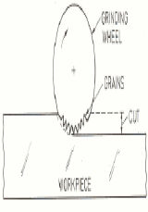
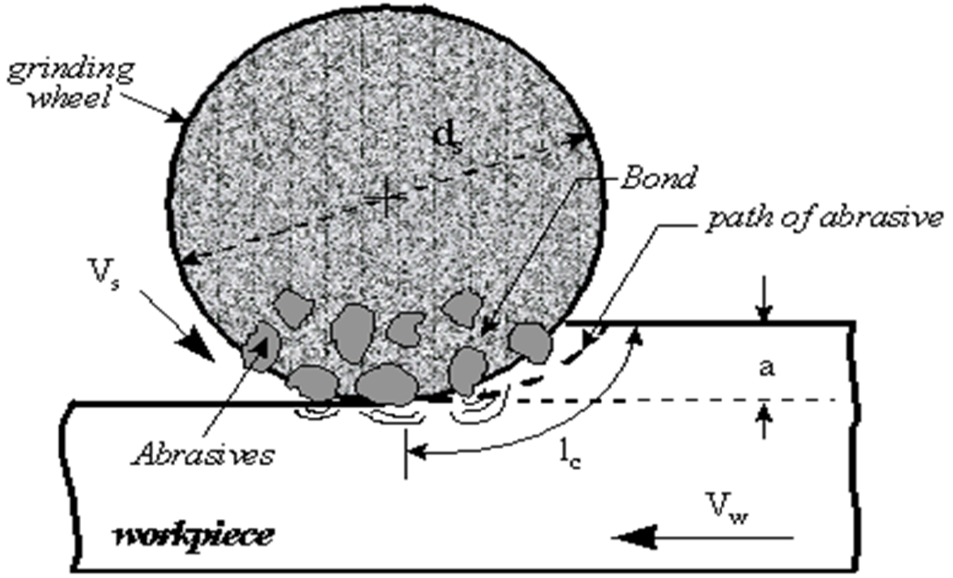
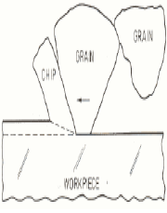
Grinding:
Definition:
Grinding is a process of material removal caused by the mechanical and thermal action of irregularly shaped abrasive particles bonded together and shaped into the form of a grindingwheel.
Grinding process

Slide 5
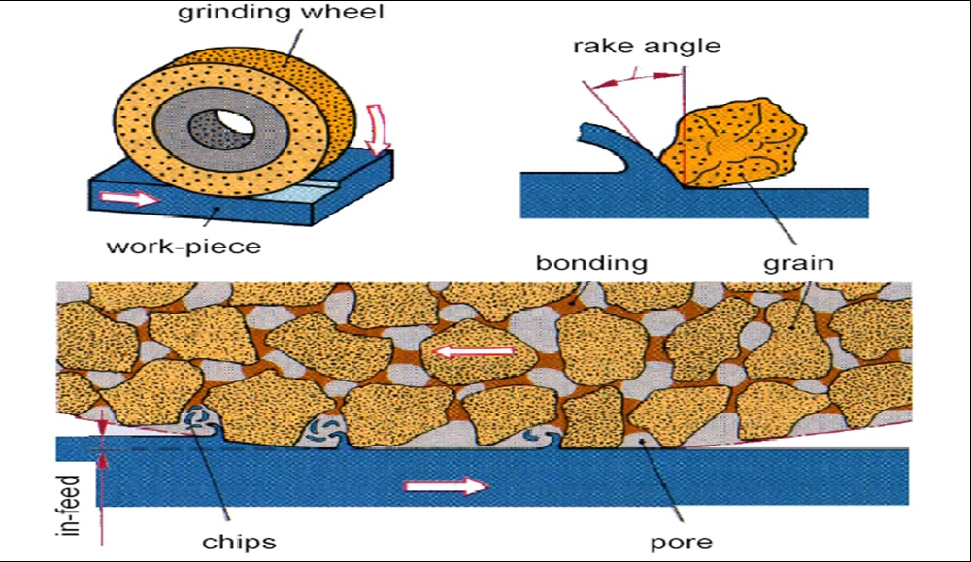
Grinding:
Random point machining with a bonded hard abrasive particles with specific geometry and usually in a form of bonded wheel.

Slide 6
Advantages of grinding:
Dimensional accuracy
Good surface finish
Good form and locational accuracy applicable to both hardened and unhardened material

Slide 7
Applications of grinding:
Grinding is the most important abrasive machiningof hard materials.
Generally a finishing operation achieving the surface finish of 0.0025mm and very close tolerancewith low cutting forces.
Surface finishing
Slitting and parting
Descaling, deburring
Stock removal (abrasive milling) finishing of flat as well as cylindrical surface
Grinding of tools and cutters and resharpening of the same.

Slide 8
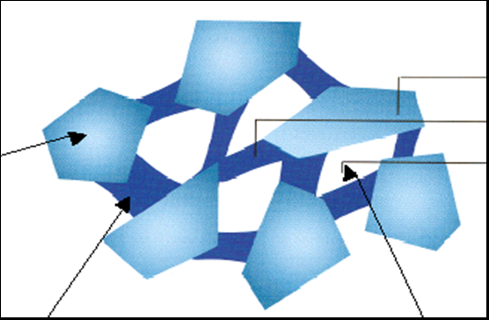
Grinding procrss:
Conventionally grinding is characterized as low material removal process capable of providing both high accuracy and high finish.
Due to advent of advanced grinding machines and grinding wheels has elevated the status of grinding to abrasive machining where high accuracy and high finish as well as high material emoval rate is achieved on unhardened material.
Hard abrasive grits (Al2O3, SiC, CBN or diamond) are held together with a bond (glass, resin, rubber or metal) leaving some pores to absorb the chips and allow ingress of coolant.
Abrasive
Grains,
Bond, Voids

Slide 9
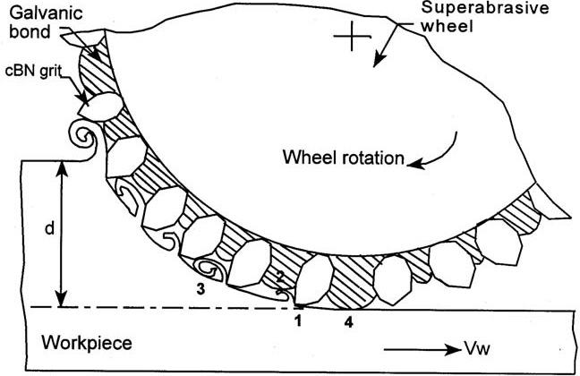
Grinding process (Cont..)
Grinding wheel and workpiece interaction:
The grinding wheel work piece inter action is shown in the figure, can be divided into the following:
  1. Grit-workpiece (forming chips)
  2. Chip-bond
3. Chip workpiece
4. Bond-work piece.
Except the grit workpiece interaction which produce chips, remaining three are undesirable as they increase the grinding force and power required for grinding.

Slide 10
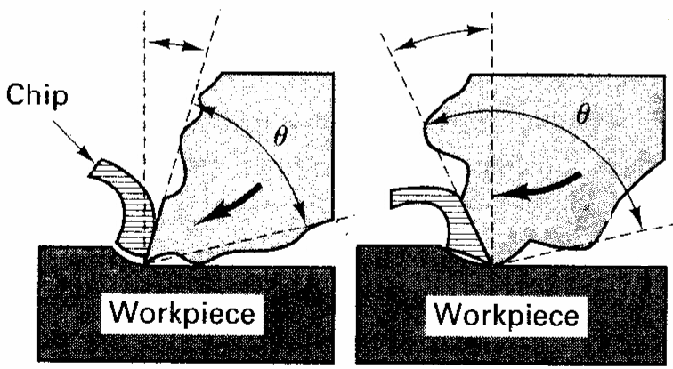
Grinding process (Cont..)
Therefore, efforts should always be made to maximize grit-workpiece interaction leading to chip formationand minimize the rest for best utilization of the avaikable power.
The importance of the grit shape can be easily realized because it determines the grit geometry e.g. rake and clearance angle as illustrated in Fig. It appears that the grits do not have definite geometry unlike a cutting tool andthegritrake may vary from +45 to -60º or more.
Fig. Variation in rake angle with grits of different shape

Slide 11
Grinding process (Cont..)
Grit with favourable geometry can produce chip in shear mode. the grits having large negative rake angle or rounded cutting edge do not form chips but may rub or may cut groove by pluoughing leading to a lateral flowof the workpiece material as illustrated in Fig.
Fig. Grits engage shearing, ploughing and rubbing

Slide 12
Specification of grinding wheel:
A grinding wheel requires two types of specification
(a) Geometrical specification
(b) Compositional specification
Geometrical specification
This is decided by the type of grinding machine and the grinding operation to be performed in the workpiece.
This specification mainly includes wheel diameter, width and depth of rim and the bore diameter.
The wheel diameter, for example can be as high as 400mm in high efficiency grinding or as small as less than 1mm in internal grinding.
The width of the wheel may be less than an mm in dicing and slicing applications.
Standard wheel configurations for conventional and superabrasive grinding wheels are shown in Fig. on next slide.

Slide 13
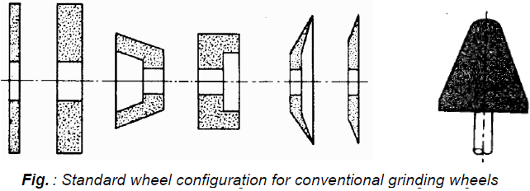
Standard configuration of grinding wheels:

Slide 14
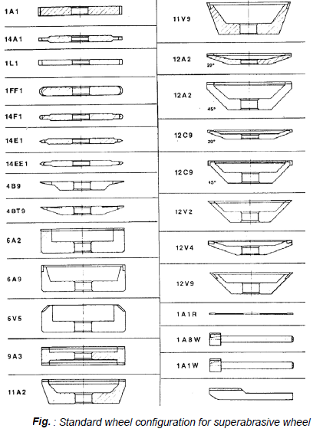
Standard configuration of superabrasive grinding wheels:

Slide 15
Grinding Wheels: Compositional specifications
Parameters :
  Type of abrasive material
  Size of grains
  Bonding material
  Wheel grade(relative hardness, strength of bond)
  Wheel structure.
  Other than these parameters, the wheel manufacturer may add their own identification code prefixing or suffixing (or both) the standard code.

Slide 16
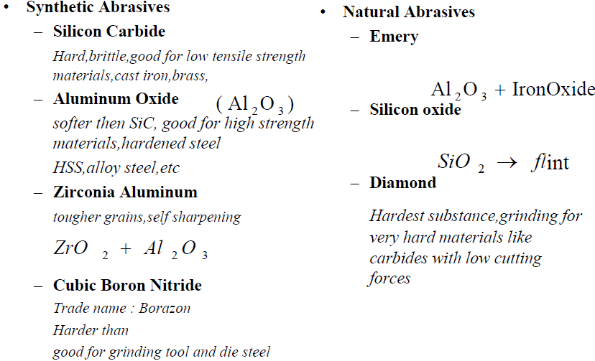
Types of Abrasives materials of GrindingWheels:

Slide 17
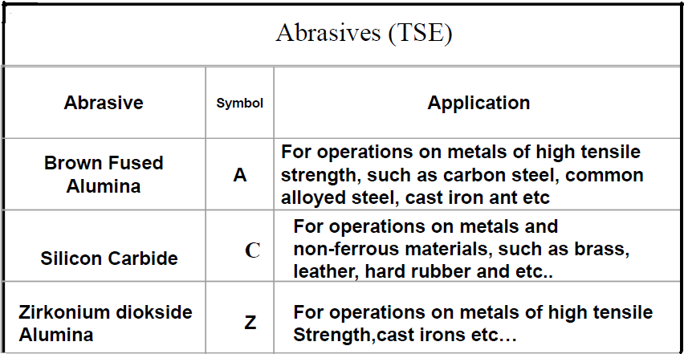
Types of Abrasives materials of GrindingWheels:

Slide 18
Types of abrasives(cont..):
Aluminium oxide may have variation in properties arising out of differences in chemical composition and structure associated with the manufacturing process.
Pure Al2O3 grit with defect structure like voids leads to unusually sharp free cutting action with low strength and is advantageous in fine tool grinding operation, and heat sensitive operations on hard, ferrous materials.
Regular or brown aluminium oxide (doped with TiO2) possesses lower hardness and higher toughness than the white Al2O3 and is recommended heavy duty grinding to semi finishing.
Al2O3 alloyed with chromium oxide (<3%) is pink in colour.

Slide 19
Types of abrasives(cont..):
Monocrystalline Al2O3 grits make a balance between hardness and toughness and are efficient in medium pressure heat sensitive operation on ferrous materials.
Microcrystalline Al2O3 grits of enhanced toughness are practically suitable for stock removal grinding. Al2O3 alloyed with zirconia also makes extremely tough grit mostly suitably for high pressure, high material removal grinding on ferrous material and are not recommended for precision grinding. Microcrystalline sintered Al2O3 grit is the latest development particularly known for its toughness and self sharpening characteristics.

Slide 20
Types of abrasives(cont..):
Silicon carbide
Silicon carbide is harder than alumina but less tough. Silicon carbide is also inferior to Al2O3 because of its chemical reactivity with iron and steel.
Black carbide containing at least 95% SiC is less hard but tougher than green SiC and is efficient for grinding soft nonferrous materials.
Green silicon carbide contains at least 97% SiC. It is harder than black variety and is used for grinding cemented carbide.

Slide 21
Types of abrasives(cont..):
Diamond:
Diamond grit is best suited for grinding cemented carbides, glass, sapphire, stone, granite, marble, concrete, oxide, non-oxide ceramic, fiber reinforced plastics, ferrite, graphite.
Natural diamond grit is characterized by its random shape, very sharp cutting edge and free cutting action and is exclusively used in metallic, electroplated and brazed bond.
Monocrystalline diamond grits are known for their strength and designed for particularly demanding application. These are also used in metallic, galvanic and brazed bond.
Polycrystalline diamond grits are more friable than monocrystalline one and found to be most suitable for grinding of cemented carbide with low pressure. These grits are used in resin bond.

Slide 22
Types of abrasives(cont..):
cBN (cubic boron nitride):
Diamond though hardest is not suitable for grinding ferrous materials because of its reactivity. In contrast, cBN the second hardest material, because of its chemical stability is the abrasive material of choice for efficient grinding of HSS, alloy steels, HSTR alloys.
Presently cBN grits are available as monocrystalline type with medium strength and blocky monocrystals with much higher strength. Medium strength crystals are more friable and used in resin bond for those applications where grinding force is not so high. High strength crystals are used with vitrified, electroplated or brazed bond where large grinding force is expected.
Microcrystalline cBN is known for its highest toughness and auto sharpening character and found to be best candidate for HEDG and abrasive milling. It can be used in all types of bond.

Slide 23
Grain Size of abrasives in Grinding wheels:
Mainly it is the average size of the abrasive particles. Smaller the grain,smoother the surface obtained.
    Coarse grains:Good for soft materails, produces rough surface
    Fine grains:Good for hard materials, produces smooth surface.
Mesh number and their description
  Mesh number:
6 -24 coarse
30 -60 medium
70 –180 fine
220 –600 very fine

Slide 24
Grain Size of abrasives in Grinding wheels (Cont..):
Grit size
The grain size affects material removal rate and the surface quality of workpiece in grinding.
Large grit- big grinding capacity, rough workpiece surface.
Fine grit- small grinding capacity, smooth workpiece surface

Slide 25
Bonding Materials of Grinding wheels:
Vitrified bond –most common type bond, baked clay and ceramic materials, strong and rigid.
Silicate bond –sodium silicate (low temp.) water glass hardened by baking, softer than vitrifeid bond.
Rubber bond–consists of hard vulcanized rubber.
Resinoid bond-thermosetting resin materials.
Shellac bond -strong but not rigid, for smooth finishes on hard surfaces.
Metallic bond –used for grinding wheels with diamond grains.

Slide 26
Types of Bonds of Grinding wheels (Cont..):
Vitrified bond
Vitrified bond is suitable for high stock removal even at dry condition. It can also be safely used in wet grinding. It can not be used where mechanical impact or thermal variations are like to occur. This bond is also not recommended for very high speed grinding because of possible breakage of the bond under centrifugal force.
Resin bond
Conventional abrasive resin bonded wheels are widely used for heavy duty grinding because of their ability to withstand shock load. This bond is also known for its vibration absorbing characteristics and finds its use with diamond and cBN in grinding of cemented carbide and steel respectively. Resin bond is not recommended with alkaline grinding fluid for a possible chemical attack leading to bond weakening. Fiberglass reinforced resin bond is used with cut off wheels which requires added strength under high speed operation.

Slide 27
Types of Bonds of Grinding wheels (Cont..):
Shellac bond
At one time this bond was used for flexible cut off wheels. At present use of shellac bond is limited to grinding wheels engaged in fine finish of rolls.
Oxychloride bond
It is less common type bond, but still can be used in disc grinding operation. It is used under dry condition.
Rubber bond
Its principal use is in thin wheels for wet cut-off operation. Rubber bond was once popular for finish grinding on bearings and cutting tools.

Slide 28
Types of Bonds of Grinding wheels (Cont..):
Metal bond
It is extensively used with superabrasive wheels. Extremely high toughness of metal bonded wheels makes these very effective in those applications where form accuracy as well as large stock removal is desired.
Electroplated bond
This bond allows large (30-40%) crystal exposure above the bond without need of any truing or dressing. This bond is specially used for making small diameter wheel, form wheel and thin superabrasive wheels. Presently it is the only bond for making wheels for abrasive milling and ultra high speed grinding.
Brazed bond
This is relatively a recent development, allows crystal exposure as high 60-80%. In addition grit spacing can be precisely controlled. This bond is particularly suitable for very high material removal either with diamond or cBN wheel. The bond strength is much greater than provided by electroplated bond. This bond is expected to replace electroplated bond in many applications.

Slide 29
Grade (or strength of bond):
Indicates the magnitude of force to pull out a grain from the bonding matrix.
Hard wheels
Large force required to remove a grain
Good for grinding soft materials
Soft wheels
Small force required to remove a grain
Good for grinding hard materials
A,B,C,D,E,F,G,H,I,J,K,L,M,N,O,P,R,S,T,U,V,W,X,Y,Z
soft medium hard

Slide 30
Explanation of Grinding Wheel Grade

Slide 31
Grinding Wheel Structure (or grain spacing):
Number of cutting edges per unit area of wheel face.
Open wheel produces rough surface.
Good for grinding soft and ductile materials.
Dense Wheel produces fine surface
Good for grinding hard materials.
Wheel structure
The grinding wheel consists of abrasive grains, bond and voids.
Structure is the proportion by volume of these three elements and usually determined by the abrasive grain percentage.

Slide 32
Structure (or grain spacing):
Structure is the Number of cutting edges per unit area of wheel face.
Open wheel
Produces rough surface
Good for grinding soft and ductile materials
Dense wheel
Produces fine surface
Good for grinding hard materials
1,2,3,4,5,6,7,8,9,10,11,12,13,14,15
dense open

Slide 33
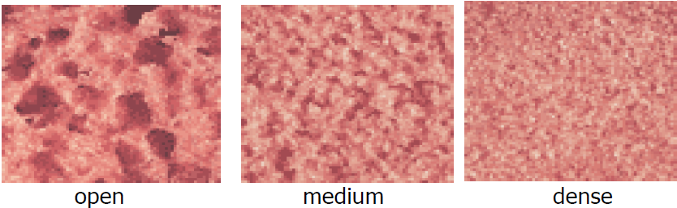
Grinding Wheel Structure (or grain spacing):

Slide 34
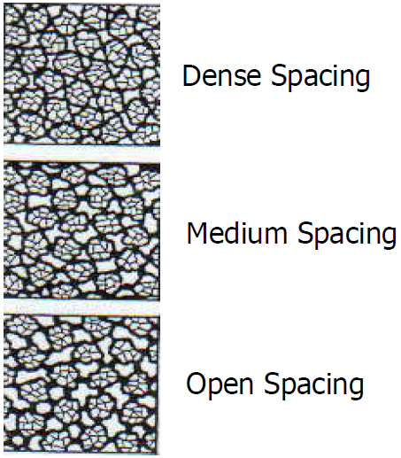
Explanation of Grinding Wheel structure:

Slide 35
Marking system for conventional Grinding Wheel:
Marking system for conventional grinding wheel:
The standard marking system for conventional abrasive wheel can be as follows:
51 A 60 K 5 V 05, where
  • The number ‘51’ is manufacturer’s identification number indicating exact kind of abrasive used.
  • The letter ‘A’ denotes that the type of abrasive is aluminium oxide. In case of silicon carbide the letter ‘C’ is used.
  • The number ‘60’ specifies the average grit size in inch mesh. For a very large size grit this number may be as small as 6 where as for a very fine grit the designated number may be as high as 600.

Slide 36
Marking system for conventional Grinding Wheel:
  • The letter ‘K’ denotes the hardness of the wheel, which means the amount of force required to pull out a single bonded abrasive grit by bond fracture. The letter symbol can range between ‘A’ and ‘Z’, ‘A’ denoting the softest grade and ‘Z’ denoting the hardest one.
  • The number ‘5’ denotes the structure or porosity of the wheel. This number can assume any value between 1 to 20, ‘1’ indicating high porosity and ‘20’ indicating low porosity.
  • The letter code ‘V’ means that the bond material used is vitrified. The codes for other bond materials used in conventional abrasive wheels are B (resinoid), BF (resinoid reinforced), E(shellac), O(oxychloride), R(rubber), RF (rubber reinforced), S(silicate)
  • The number ‘05’ is a wheel manufacturer’s identifier.

Slide 37
Marking system for Superabrasive Grinding Wheel:
Marking system for superabrasive grinding wheel is somewhat different as illustrated below
R D 120 N 100 M 4, where
  • The letter ‘R’ is manufacture’s code indicating the exact type of superabrasive used.
  • The letter ‘D’ denotes that the type of abrasive is diamond. In case of cBN the letter ‘B’ is used.
  • The number ‘120’ specifies the average grain size in inch mesh. However, a two number designation (e.g. 120/140) is utilized for controlling the size of superabrasive grit.
  The two number designation of grit size along with corresponding designation in micron is given in table.

Slide 38
Marking system for Superabrasive Grinding Wheel:
  Like conventional abrasive wheel, the letter ‘N’ denotes the hardness of the wheel. However, resin and metal bonded wheels are produced with almost no porosity and effective grade of the wheel is obtained by modifying the bond formulation.
  • The number ‘100’ is known as concentration number indicating the amount of abrasive contained in the wheel.
  The number ‘100’ corresponds to an abrasive content of 4.4 carats/cm³. For diamond grit, ‘100’ concentration is 25% by volume. For cBN the corresponding volumetric concentration is 24%.
• The letter ‘M’ denotes that the type of bond is metallic.

Slide 39
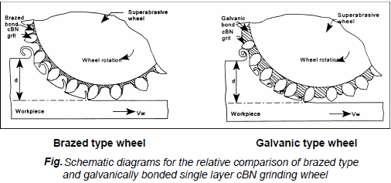
Marking system for Superabrasive Grinding Wheel:
  The other types of bonds used in superabrasive wheels are resin, vitrified or metal bond, which make a composite structure with the grit material.
  The another type of superabrasive wheel with both diamond and cBN is also manufactured where a single layer of superabrasive grits are bonded on a metal perform by a galvanic metal layer or a brazed metal layer as illustrated in Fig.

Slide 40
Selection of grinding wheels:
Selection of grinding wheel means selection of composition of the grinding wheel and this depends upon the following factors:
  1) Physical and chemical characteristics of the work material
  2) Grinding conditions
  3) Type of grinding (stock removal grinding or form finish grinding)

Slide 41
Truing of grinding wheel:
Truing is the act of regenerating the required geometry on the grinding wheel, whether the geometry is a special form or flat profile. Therefore, truing produces the macro-geometry of the grinding wheel.
Truing is also required on a new conventional wheel to ensure concentricity with specific mounting system. In practice the effective macro-geometry of a grinding wheel is of vital importance and accuracy of the finished workpiece is directly related to effective wheel geometry.
Truing tools:
There are four major types of truing tools:
Steel cutter:
These are used to roughly true coarse grit conventional abrasive wheel to ensure freeness of cut.

Slide 42
Truing tools:
Vitrified abrasive stick and wheel:
It is used for off hand truing of conventional abrasive wheel. These are used for truing resin bonded superabrasive wheel.
Steel or carbide crash roll:
It is used to crush-true the profile on vitrified bond grinding wheel.
Diamond truing tool:
Single point diamond truing tools
The single point diamond truing tools for straight face truing are made by setting a high quality single crystal into a usually cylindrical shank of a specific diameter and length by brazing or casting around the diamond.
During solidification contraction of the bonding metal is more than diamond and latter is held mechanically as result of contraction of metal around it. Some application of single point diamond truing tool is illustrated in Fig.

Slide 43
Truing tools:
Fig Application of single point diamond truing tool

Slide 44
Truing tools:
Multi stone diamond truing tool:
In this case the truing tool consists of a number of small but whole diamonds, some or all of which contact the abrasive wheel at the same time.
The diamond particles are surface set with a metal binder and it is possible to make such tool with one layer or multilayer configuration.
Normal range of diamond used in this tool is from as small as about 0.02 carat to as large as of 0.5 carat.
These tools are suitable for heavy and rough truing operation. Distribution pattern of diamond in this tool shown in Fig.

Slide 45
Multi stone diamond truing tool:
Fig Diamond distribution pattern of diamond particles in multi-stone diamond

Slide 46
Truing tools:
Impregnated diamond truing tools:
This wheel truing tool consists of crushed and graded diamond powder mixed with metal powder and sintered.
The diamond particles are not individually set in a pattern but are distributed evenly throughout the matrix in the same way that an abrasive wheel consists of abrasive grains and bonding agent.
The size of diamond particles may vary from 80-600 microns.
By using considerably smaller diamond grit and smaller diamond section it is possible to true sharp edge and fine grit grinding wheel.

Slide 47
Truing tools:
The use of crushed diamond product ensures that there are always many sharp points in use at the same time and these tools are mainly used in fine grinding, profile grinding, thread grinding, cylindrical grinding and tool grinding.
Truing action of an impregnated diamond tool is shown schematically in Fig.
Fig. Impregnated diamond truing tools

Slide 48
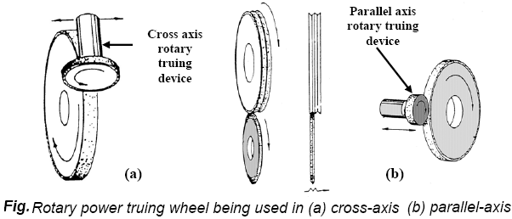
Truing tools:
Rotary powered diamond truing wheels:
Rotary powered truing devices (Fig.) are the most widely recommended truing tool in long run mass production and are not ideally suited for those wheels with large diameters (greater than 200 mm).
These devices can be pneumatic, hydraulic or electrically powered. Rotary powered truing device can be used in cross axis and parallel axis mode. Basically there are three types of truing wheels.

Slide 49
Truing tools:
Surface set truing wheels
Here the diamond particles are set by hand in predetermined pattern. A sintered metal bond is used in this case. These truing wheels are designed for high production automated operations.
Impregnated truing wheels
In this case impregnated diamond particles are distributed in a random pattern to various depths in a metal matrix. This type of roll finds its best applications (i.e. groove grinding) where excess wheel surfaces must be dressed of.
Electroplated truing tool
In this truing wheel diamond particles are bonded to the wheel surface with galvanically deposited metal layer. Main advantage of this technique is that no mould is necessary to fabricate the diamond truing wheel unlike that of surface set or impregnated truing wheels.

Slide 50
Truing tools:
Diamond form truing blocks
Diamond form truing block can be either diamond impregnated metal bond or electroplated, as shown in Fig.
Brazed type diamond truing block has also come as an alternative to electroplated one.
They can be as simple as flat piece of metal plated with diamond to true a straight faced wheel or contain an intricate form to shape the grinding wheel to design profile.
Truing block can eliminate the use of self propelled truing wheels and are used almost exclusively for horizontal spindle surface grinder to generate specific form.

Slide 51
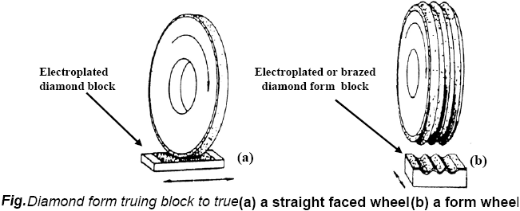
Truing tools:

Slide 52
Dressing:
Dressing is the conditioning of the wheel surface which ensures that grit cutting edges are exposed from the bond and thus able to penetrate into the work-piece material.
Also, in dressing attempts are made to splinter the abrasive grains to make them sharp and free cutting and also to remove any residue left by material being ground. Dressing therefore produces micro-geometry.
The structure of micro-geometry of grinding wheel determine its cutting ability with a wheel of given composition.
Dressing can substantially influence the condition of the grinding tool.
Truing and dressing are commonly combined into one operation for conventional abrasive grinding wheels, but are usually two distinctly separate operation for super abrasive wheel.

Slide 53
Dressing:
Dressing of super-abrasive wheel
Dressing of the super-abrasive wheel is commonly done with soft conventional abrasive vitrified stick, which relieves the bond without affecting the super-abrasive grits.
However, modern technique like electrochemical dressing has been successfully used in metal bonded super-abrasive wheel.
The wheel acts like an anode while a cathode plate is placed in front of the wheel working surface to allow electrochemical dissolution.
Electro discharge dressing is another alternative route for dressing metal bonded super-abrasive wheel. In this case a dielectric medium is used in place of an electrolyte.
Touch-dressing, a new concept differs from conventional dressing in that bond material is not relieved. In contrast the dressing depth is precisely controlled in micron level to obtain better uniformity of grit height resulting in improvement of work-piece surface finish.

Slide 54
Grinding Machines:
Grinding Machines are also regarded as machine tools.
A distinguishing feature of grinding machines is the rotating abrasive tool.
Grinding machine is employed to obtain high accuracy along with very high class of surface finish on the work-piece.
Advent of new generation of grinding wheels and grinding machines, characterized by their rigidity, power and speed enables one to go for high efficiency deep grinding (often called as abrasive milling) of not only hardened material but also ductile materials.

Slide 55
Grinding Machines:
Conventional grinding machines can be broadly classified as:
(a) Surface grinding machine
(b) Cylindrical grinding machine
(c) Internal grinding machine
(d) Tool and cutter grinding machine

Slide 56
Surface grinding machine:
This machine may be similar to a milling machine used mainly to grind flat surface. However, some types of surface grinders are also capable of producing contour surface with formed grinding wheel.
Basically there are four different types of surface grinding machines characterized by the movement of their tables and the orientation of grinding wheel spindles as follows:
• Horizontal spindle and reciprocating table
• Vertical spindle and reciprocating table
• Horizontal spindle and rotary table
• Vertical spindle and rotary table

Slide 57
Surface grinding machine:
Horizontal spindle reciprocating table grinder
Figure illustrates this machine with various motions required for grinding action.
A disc type grinding wheel performs the grinding action with its peripheral surface.
Both traverse and plunge grinding can be carried out in this machine as shown in Fig.

Slide 58
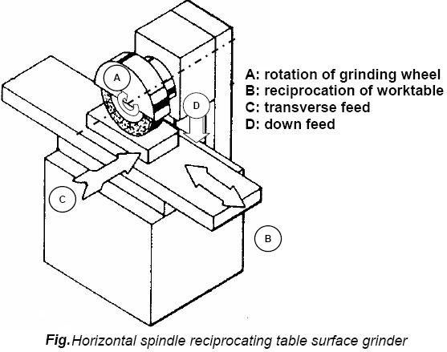
Horizontal spindle reciprocating table grinder

Slide 59
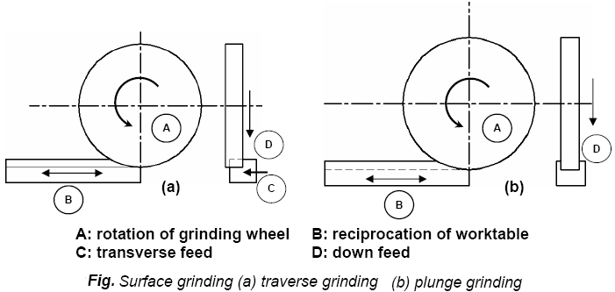
Horizontal spindle reciprocating table grinder

Slide 60
Vertical spindle reciprocating table grinder:
This grinding machine with all working motions is shown in Fig.
The grinding operation is similar to that of face milling on a vertical milling machine.
In this machine a cup shaped wheel grinds the work-piece over its full width using end face of the wheel as shown in Fig.
This brings more grits in action at the same time and consequently a higher material removal rate may be attained than for grinding with a peripheral wheel.

Slide 61
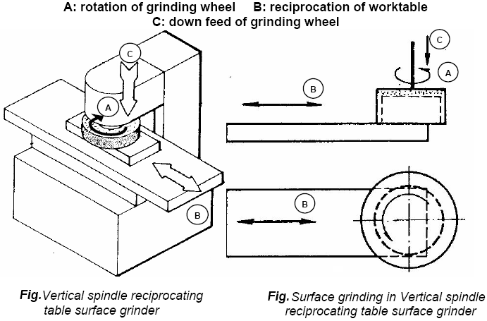
Vertical spindle reciprocating table grinder:

Slide 62
Horizontal spindle rotary table grinder:
Surface grinding in this machine is shown in Fig.
In principle the operation is same as that for facing on the lathe.
This machine has a limitation in accommodation of work-piece and therefore does not have wide spread use.
By swiveling the worktable, concave or convex or tapered surface can be produced on individual part as illustrated in Fig.

Slide 63
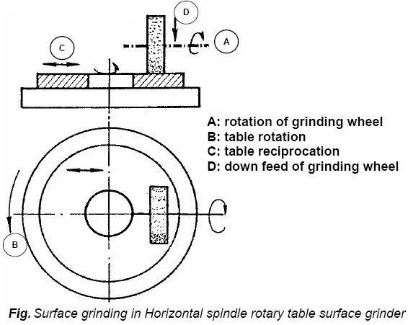
Horizontal spindle rotary table grinder:

Slide 64
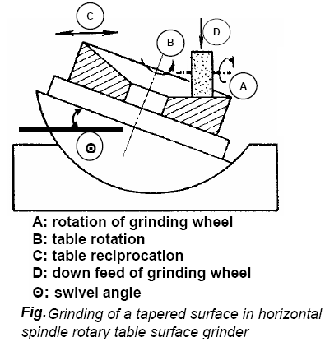
Horizontal spindle rotary table grinder:

Slide 65
Vertical spindle rotary table grinder:
The principle of grinding in this machine is shown in Fig.
The machine is mostly suitable for small work-pieces in large quantities.
This primarily production type machine often uses two or more grinding heads thus enabling both roughing and finishing in one rotation of the work table.

Slide 66
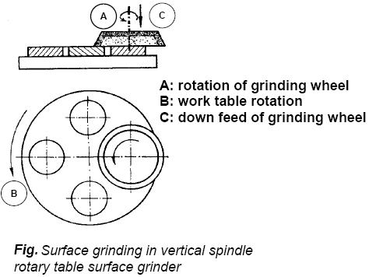
Vertical spindle rotary table grinder:

Slide 67
Creep feed grinding machine:
This machine enables single pass grinding of a surface with a larger down-feed but slower table speed than that adopted for multi-pass conventional surface grinding.
This machine is characterized by high stiffness, high spindle power, re-circulating ball screw drive for table movement and adequate supply of grinding fluid.
A further development in this field is the creep feed grinding centre which carries more than one wheel with provision of automatic wheel changing.
A number of operations can be performed on the work-piece.
It is implied that such machines, in the view of their size and complexity, are automated through CNC.

Slide 68
High efficiency deep grinding machine:
The concept of single pass deep grinding at a table speed much higher than what is possible in a creep feed grinder has been technically realized in this machine.
This has been made possible mainly through significant increase of wheel speed in this new generation grinding machine.

Slide 69
Cylindrical grinding machine:
This machine is used to produce external cylindrical surface.
The surfaces may be straight, tapered, steps or profiled. Broadly there are three different types of cylindrical grinding machine as follows:
1. Plain centre type cylindrical grinder
2. Universal cylindrical surface grinder
3. Centreless cylindrical surface grinder

Slide 70
Plain centre type cylindrical grinder:
Figure illustrates schematically this machine and various motions required for grinding action.
The machine is similar to a centre lathe in many respects. The workpiece is held between head stock and tailstock centres.
A disc type grinding wheel performs the grinding action with its peripheral surface.
Both traverse and plunge grinding can be carried out in this machine as shown in Fig.

Slide 71
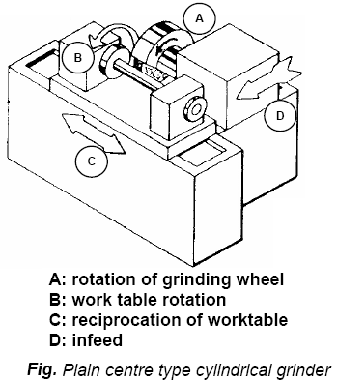
Plain centre type cylindrical grinder:

Slide 72
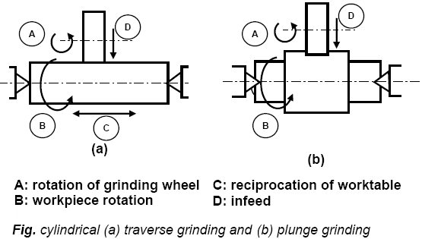
Plain centre type cylindrical grinder:

Slide 73
Universal cylindrical surface grinder:
Universal cylindrical grinder is similar to a plain cylindrical one except that it is more versatile.
In addition to small worktable swivel, this machine provides large swivel of head stock, wheel head slide and wheel head mount on the wheel head slide.
This allows grinding of any taper on the workpiece. Universal grinder is also equipped with an additional head for internal grinding.
Schematic illustration of important features of this machine is shown in Fig.

Slide 74
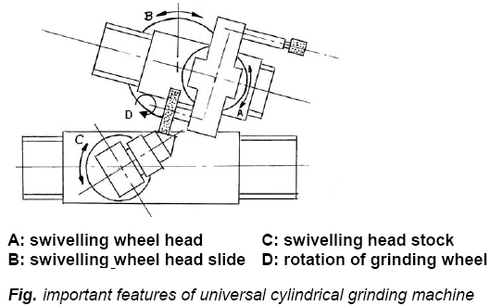
Universal cylindrical surface grinder:

Slide 75
Special application of cylindrical grinder:
Principle of cylindrical grinding is being used for thread grinding with specially formed wheel that matches the thread profile.
A single ribbed wheel or a multi ribbed wheel can be used as shown in Fig.
Roll grinding is a specific case of cylindrical grinding wherein large workpieces such as shafts, spindles and rolls are ground.
Crankshaft or crank pin grinders also resemble cylindrical grinder but are engaged to grind crank pins which are eccentric from the centre line of the shaft as shown in Fig.
The eccentricity is obtained by the use of special chuck.

Slide 76
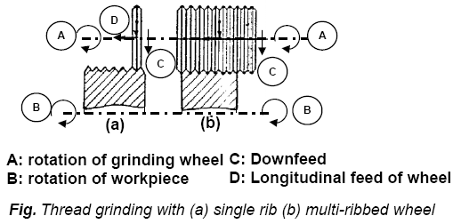
Special application of cylindrical grinder:

Slide 77
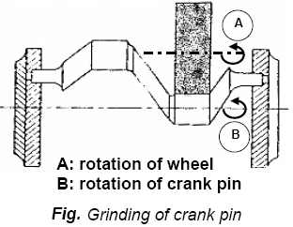
Special application of cylindrical grinder:

Slide 78
Special application of cylindrical grinder:
Cam and camshaft grinders are essentially subsets of cylindrical grinding machine dedicated to finish various profiles on disc cams and cam shafts.
The desired contour on the workpiece is generated by varying the distance between wheel and workpiece axes.
The cradle carrying the head stock and tail stock is provided with rocking motion derived from the rotation of a master cam that rotates in synchronization with the workpiece.
Newer machines however, use CNC in place of master cam to generate cam on the workpiece.

Slide 79
External centreless grinder:
This grinding machine is a production machine in which out side diameter of the workpiece is ground.
The workpiece is not held between centres but by a work support blade.
It is rotated by means of a regulating wheel and ground by the grinding wheel.
In through-feed centreless grinding, the regulating wheel revolving at a much lower surface speed than grinding wheel controls the rotation and longitudinal motion of the workpiece.
The regulating wheel is kept slightly inclined to the axis of the grinding wheel and the workpiece is fed longitudinally as shown in Fig.

Slide 80
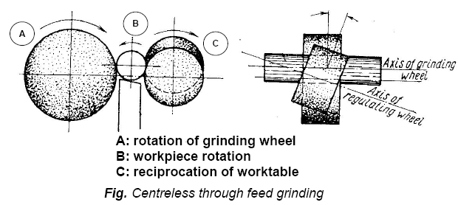
External centreless grinder:

Slide 81
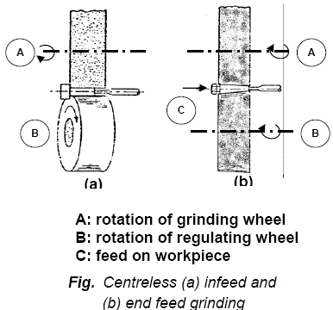
External centreless grinder:
Parts with variable diameter can be ground by Centreless infeed grinding as shown in Fig. The operation is similar to plunge grinding with cylindrical grinder.
End feed grinding shown in Fig. (b) is used for workpiece with tapered surface.
The grinding wheel or the regulating wheel or both require to be correctly profiled to get the required taper on the workpiece.

Slide 82
Tool post grinder:
A self powered grinding wheel is mounted on the tool post or compound rest to provide the grinding action in a lathe.
Rotation to the workpiece is provided by the lathe spindle.
The lathe carriage is used to reciprocate the wheel head.

Slide 83
Internal grinding machine:
This machine is used to produce internal cylindrical surface. The surface may be straight, tapered, grooved or profiled.
Broadly there are three different types of internal grinding machine as follows:
1. Chucking type internal grinder
2. Planetary internal grinder
3. Centreless internal grinder

Slide 84
Chucking type internal grinder:
Figure illustrates schematically this machine and various motions required for grinding action.
The workpiece is usually mounted in a chuck.
A magnetic face plate can also be used.
A small grinding wheel performs the necessary grinding with its peripheral surface.
Both transverse and plunge grinding can be carried out in this machine as shown in Fig.

Slide 85
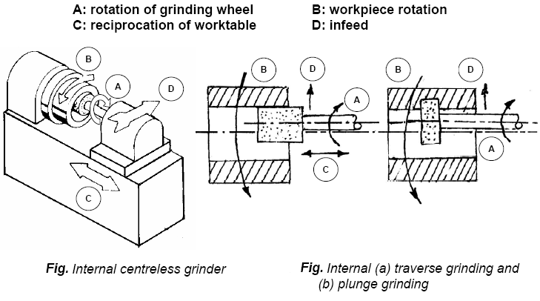
Chucking type internal grinder:

Slide 86
Planetary internal grinder:
Planetary internal grinder is used where the workpiece is of irregular shape and can not be rotated conveniently as shown in Fig.
In this machine the workpiece does not rotate.
Instead, the grinding wheel orbits the axis of the hole in the workpiece.

Slide 87
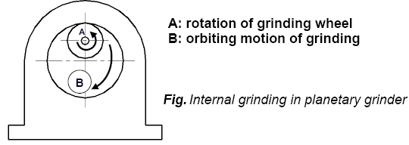
Planetary internal grinder:

Slide 88
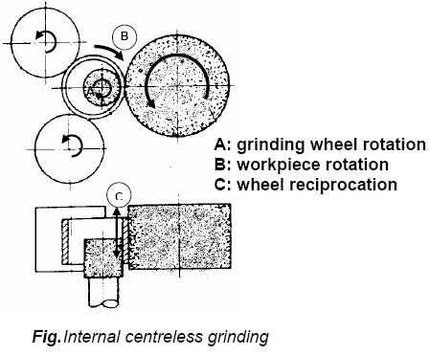
Centreless internal grinder:
This machine is used for grinding cylindrical and tapered holes in cylindrical parts (e.g. cylindrical liners, various bushings etc).
The workpiece is rotated between supporting roll, pressure roll and regulating wheel and is ground by the grinding wheel as illustrated in Fig.

Slide 89
Tool and cutter grinder machine:
Tool grinding may be divided into two subgroups: tool manufacturing and tool resharpening.
There are many types of tool and cutter grinding machine to meet these requirements.
Simple single point tools are occasionally sharpened by hand on bench or pedestal grinder.
However, tools and cutters with complex geometry like milling cutter, drills, reamers and hobs require sophisticated grinding machine commonly known as universal tool and cutter grinder.
Present trend is to use tool and cutter grinder equipped with CNC to grind tool angles, concentricity, cutting edges and dimensional size with high precision.

Slide 90
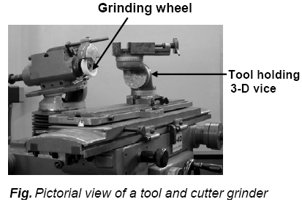
Tool and cutter grinder machine:

Slide 91
Super finishing processes:
To ensure reliable performance and prolonged service life of modern machinery, its components require to be manufactured not only with high dimensional and geometrical accuracy but also with high surface finish.
The surface finish has a vital role in influencing functional characteristics like wear resistance, fatigue strength, corrosion resistance and power loss due to friction.
Unfortunately, normal machining methods like turning, milling or even classical grinding can not meet this stringent requirement.

Slide 92
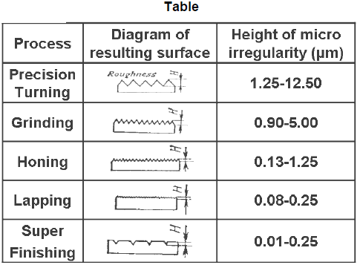
Super finishing processes:
Table illustrates gradual improvement of surface roughness produced by various processes ranging from precision turning to super finishing including lapping and honing.
Therefore, super-finishing processes like lapping, honing, polishing, burnishing are being employed to achieve and improve the above-mentioned functional properties in the machine component.

Slide 93
Lapping:
Lapping is regarded as the oldest method of obtaining a fine finish. Lapping is basically an abrasive process in which loose abrasives function as cutting points finding momentary support from the laps. Figure 30.1 schematically represents the lapping process. Material removal in lapping usually ranges from .003 to .03 mm but many reach 0.08 to 0.1mm in certain cases.
Characteristics of lapping process:
Use of loose abrasive between lap and the workpiece.
Usually lap and workpiece are not positively driven but are guided in contact with each other
Relative motion between the lap and the work should change continuously so that path of the abrasive grains of the lap is not repeated on the workpiece.

Slide 94
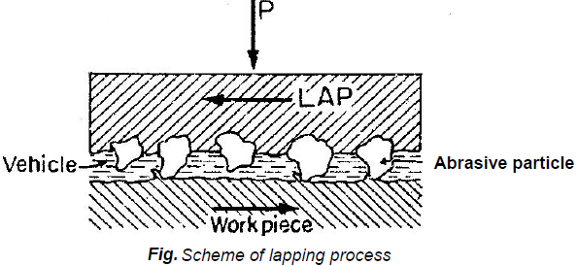
Lapping (Cont..):
Cast iron is the mostly used lap material.
The soft steel, copper, brass, hardwood as well as hardened steel and glass are also used.
Abrasives of lapping:
• Al₂O₃ and SiC, grain size 5~100μm
• Cr₂O₃, grain size 1~2 μm
• B₄C₃, grain size 5-60 μm
• Diamond, grain size 0.5~5 V
Vehicle materials for lapping
• Machine oil
• Rape oil
• grease

Slide 95
Lapping (Cont..):
Technical parameters affecting lapping processes are:
• unit pressure
• the grain size of abrasive
• concentration of abrasive in the vehicle
• lapping speed .
Lapping is performed either manually or by machine. Hand lapping is done with abrasive powder as lapping medium, whereas machine lapping is done either with abrasive powder or with bonded abrasive wheel.

Slide 96
Lapping (Cont..):
Laps in the form of ring made of closed grain cast iron are used for manual lapping of external cylindrical surface.
The bore of the ring is very close to size of the workpiece however, precision adjustment in size is possible with the use of a set screw as illustrated in Fig.(a).
To increase range of working, a single holder with interchangeable ring laps can also be used. Ring lapping is recommended for finishing plug gauges and machine spindles requiring high precision.
External threads can be also lapped following this technique. In this case the lap is in the form of a bush having internal thread.

Slide 97
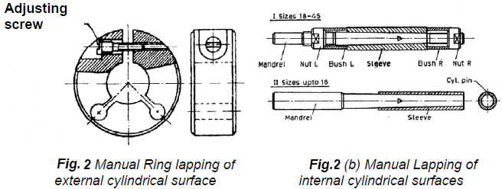
Lapping (Cont..):
Solid or adjustable laps, which are ground straight and round, are used for lapping holes.
For manual lapping, the lap is made to rotate either in a lathe or honing machine, while the workpiece is reciprocated over it by hand. Large size laps are made of cast iron, while those of small size are made of steel or brass.
This process finds extensive use in finishing ring gauges.

Slide 98
Lapping (Cont..):
Lapping Machine:
Machine lapping is meant for economic lapping of batch qualities.
In machine lapping, where high accuracy is demanded, metal laps and abrasive powder held in suitable vehicles are used.
Bonded abrasives in the form wheel are chosen for commercial lapping.
Machine lapping can also employ abrasive paper or abrasive cloth as the lapping medium.
Production lapping of both flat and cylindrical surfaces are illustrated in Fig. (a) and (b).

Slide 99
Lapping (Cont..)
In this case cast iron plate with loose abrasive carried in a vehicle can be used.
Alternatively, bonded abrasive plates may also be used. Centreless roll lapping uses two cast iron rolls, one of which serves as the lapping roller twice in diameter than the other one known as the regulating roller.
During lapping the abrasive compound is applied to the rolls rotating in the same direction while the workpiece is fed across the rolls.
This process is suitable for lapping a single piece at a time and mostly used for lapping plug gauges, measuring wires and similar straight or tapered cylindrical parts.

Slide 100
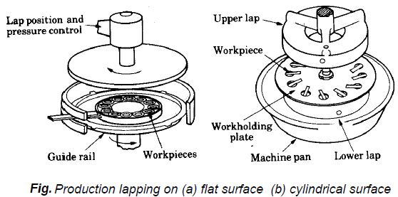
Lapping (Cont..)

Slide 101
Lapping (Cont..)
Centreless lapping is carried out in the same principle as that of centreless grinding.
The bonded abrasive lapping wheel as well as the regulating wheel are much wider than those used in centreless grinding.
This technique is used to produce high roundness accuracy and fine finish, the workpiece requires multi-pass lapping each with progressively finer lapping wheel.
This is a high production operation and suitable for small amount of rectification on shape of workpiece.
Therefore, parts are to be pre-ground to obtain substantial straightness and roundness.
The process finds use in lapping piston rings, shafts and bearing races.

Slide 102
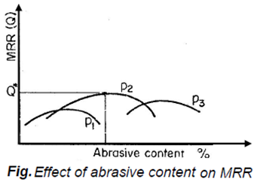
Lapping (Cont..)
Machines used for lapping internal cylindrical surfaces resembles honing machines used with power stroke. These machines in addition to the rotation of the lap also provide reciprocation to the workpiece or to the lap. The lap made usually of cast iron either solid or adjustable type can be conveniently used.

Slide 103
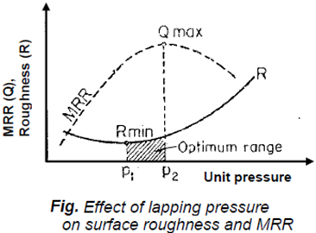
Lapping (Cont..)
Figure shows that to maximize the MRR (material removal rate) an optimum lapping pressure and abrasive concentration in the vehicle have to be chosen.
The effect of unit pressure on MRR and surface roughness is shown in Fig.
It is shown in the same figure that unit pressure in the range of p₁-p₂ gives the best values for MRR and roughness of the lapped surface.

Slide 104
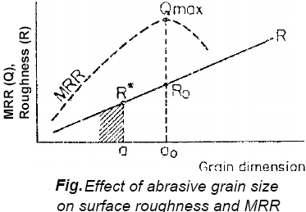
Lapping (Cont..)
The variation in MRR and surface roughness with grain size of abrasive are shown in Fig.
It appears that grain size corresponding to permissible surface roughness and maximum MRR may be different.
Primary consideration is made on the permissible surface roughness in selecting abrasive grain size.

Slide 105
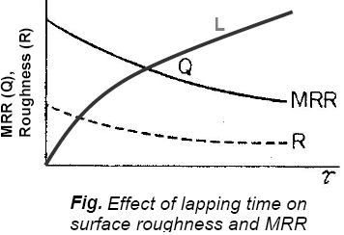
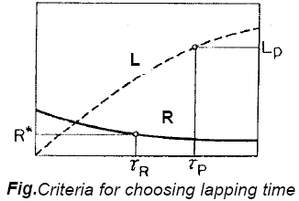
Lapping (Cont..)
The dependence of MRR, surface roughness and linear loss (L) of workpiece dimension is shown in first fig.
Lapping conditions are so chosen that designed surface finish is obtained with the permissible limit of linear loss of workpiece dimension as shown in second Fig.

Slide 106
Honing

Slide 107
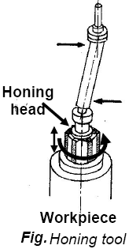
Honing:
Honing is a finishing process, in which a tool called hone carries out a combined rotary and reciprocating motion while the workpiece does not perform any working motion.
Most honing is done on internal cylindrical surface, such as automobile cylindrical walls.
The honing stones are held against the workpiece with controlled light pressure. The honing head is not guided externally but, instead, floats in the hole, being guided by the work surface (Fig.).

Slide 108
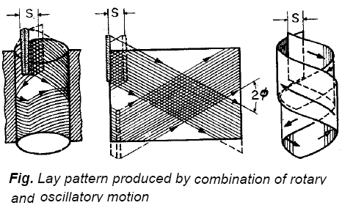
Honing (Cont..)
It is desired that
1. honing stones should not leave the work surface
2. stroke length must cover the entire work length.
In honing rotary and oscillatory motions are combined to produce a cross hatched lay pattern as illustrated in Fig.
The honing stones are given a complex motion so as to prevent every single grit from repeating its path over the work surface.

Slide 109
Honing (Cont..)
The critical process parameters are:
1. rotation speed
2. oscillation speed
3. length and position of the stroke
4. honing stick pressure.
With conventional abrasive honing stick, several strokes are necessary to obtain the desired finish on the work piece.
With introduction of high performance diamond and cBN grits it is now possible to perform the honing operation in just one complete stroke.
Advent of precisely engineered microcrystalline cBN grit has enhanced the capability further.

Slide 110
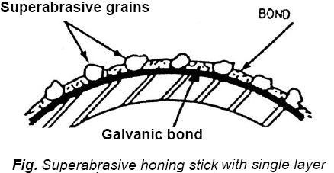
Honing (Cont..)
Honing stick with microcrystalline cBN grit can maintain sharp cutting condition with consistent results over long duration.
Super-abrasive honing stick with monolayer configuration (Fig.), where a layer of cBN grits are attached to stick by a galvanically deposited metal layer, is typically found in single stroke honing application.

Slide 111
Honing (Cont..)
With the advent of precision brazing technique, efforts can be made to manufacture honing stick with single layer configuration with a brazed metal bond.
Like brazed grinding wheel such single layer brazed honing stick are expected to provide controlled grit density, larger grit protrusion leading to higher material removal rate and longer life compared to what can be obtained with a galvanically bonded counterpart.
The important parameters that affect material removal rate (MRR) and surface roughness (R) are:
(i) unit pressure, p
(ii) peripheral honing speed, Vc
(iii) honing time, T

Slide 112
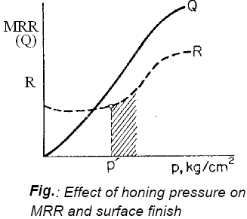
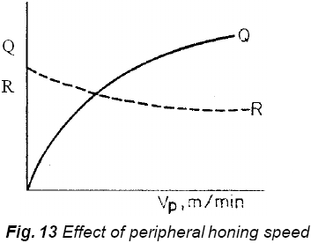
Honing (Cont..)
The variation of MRR (Q) and R with unit pressure is shown in Fig. It is evident from the graph that the unit pressure should be selected so as to get minimum surface roughness with highest possible MRR.
Figure shows that an increase of peripheral honing speed leads to enhancement of material removal rate and decrease in surface roughness.

Slide 113
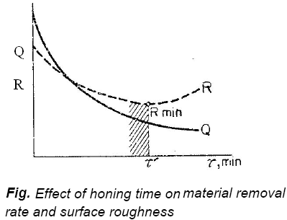
Honing (Cont..)
Figure shows that with honing time T, MRR decreases. On the other hand, surface roughness decreases and after attaining a minimum value again rises. The selection of honing time depends very much on the permissible surface roughness.

Slide 114
Superfinishing

Slide 115
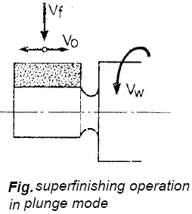
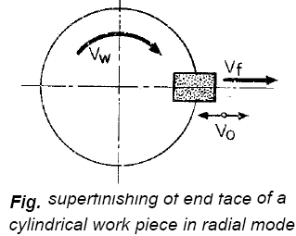
Superfinishing:
First Fig. illustrates superfinishing end-face of a cylindrical workpiece.
In this both feeding and oscillation of the superfinishing stone is given in the radial direction.
Second Fig. shows the superfinishing operation in plunge mode.
In this case the abrasive stone covers the section of the workpiece requiring superfinish.
The abrasive stone is slowly fed in radial direction while its oscillation is imparted in the axial direction.

Slide 116

Superfinishing (Cont..):
Superfinishing can be effectively done on a stationary workpiece as shown in first Fig.
In this the abrasive stones are held in a disc which oscillates and rotates about the axis of the workpiece.
Second Fig. shows that internal cylindrical surfaces can also be superfinished by axially oscillating and reciprocating the stones on a rotating workpiece.

Slide 117
Buffing

Slide 118
Buffing:
Introduction
Buffing is a final operation to improve the polish of a metal and to bring out the maximum luster.
Buffing is a frequent operation prior to plating.
In buffing, the rubbing action is more gentle than the vigorous and aggressive cutting action employed in polishing.
Buffing removes negligible amounts of metal. The size of the work is changed very little, sometimes, 0 0025 to 0 0075 mm.
Basically, buffing flows or smears the surface metal. It takes the peaks and flows them into valleys. This gives a mirror-like polish.
Buffing does not maintain flatness or roundness. It is used only to obtain very smooth reflective surfaces.
Buffing is usually confined to the non-ferrous metals, such as aluminum, copper, brass and zinc alloy die castings, stainless steel, chromium and nickel plate, etc.

Slide 119
Buffing (Cont..):
Principle of operation
The surface to be buffed may be a die casting or stamping which does not require any preparatory treatment except cleaning.
Buffing may be done by holding the workpiece in hand and bringing it into contact with a revolving buffing wheel.
The operator presses the part against the charged buff with considerable pressure.
This heavy pressure gives fast action and also heats up the work.
The temperature may rise from 90° to 150°C, which will not usually warp the work but does require careful handling.
Some operators, while buffing, hold the hot workpiece with the help of a rag or apron.
This practice is highly dangerous since if the rag or apron is picked up by the revolving machine, the consequences could be more serious. Instead put the job down and wait for it to cool.

Slide 120
Buffing (Cont..):
There is no work-rest or guard but a leather receptacle can be fitted below and behind the buffing wheel with advantage.
For buffing, the work should be held firmly against the periphery of the buffing wheel at a point on its front underside.
A buffed surface is produced in two distinct steps :
(i) Cutting down. (ii) Coloring.
During the initial finishing stage of cutting down, minute sur­face irregularities are reduced or entirely eliminated. It is during the final stage of buffing (coloring) that the ultimate reflective, highly lustrous surface is produced.

Slide 121
Buffing (Cont..):
Equipment
The buffing machine (usually called a buffing lathe) resembles an offhand grinding machine.
It has usually two arbors which are of 32 to 50 mm diameter.
Two flanges are mounted on the arbor to hold 75 to 150 mm thick buffing wheels (like grinding wheels on the offhand grinding machine).
Buffing wheels are made of cloth (cotton, wool, flannel or muslin) or fibre firmly sewed together in 6 to 13 mm thick sections.
These sections are closely pressed together by the flanges on the buffing machine arbor.
Buffing wheels or buffs are usually 300 to 750 mm in diameter and rotate at 1000 to 3000 RPM.

Slide 122
Buffing (Cont..):
The buffing wheel is charged by pressing the abrasive stick against the (cloth) wheel periphery until the wheel is thoroughly coated.
The abrasive stick is made up with a heavy grease or wax base.
The so called abrasives which have almost no cutting ability are, red rouge (ferric oxide) or green rouge (chromium oxide) for soft metals, aluminum oxide for hard metals, etc.
Applications of buffing
Automobile, motor cycle and bicycle parts,
Sporting items, tools and store fixtures,
Commercial and residential hardware,
Household utensils and appliances etc.

Slide 123
Barrel Tumbling

Slide 124
Barrel Tumbling:
Tumbling, is a finishing process known as mass finishing method.
Mass finishing involves the finishing of parts in bulk by a mixing action inside a container, usually in the presence of an abrasive media.
The mixing causes the parts to rub against the media and each other to achieve the desired finishing action.
Mass finishing methods are used for deburring, descaling, deflashing, polishing, radiusing, burnishing, and cleaning.
The parts include stampings, castings, forgings, extrusions, and machined parts. Even plastic and ceramic parts are sometimes subjected to these mass finishing operations to achieve desired finishing results.
The parts processed by this method are usually small and are therefore uneconomical to finish individually.

Slide 125

Barrel Tumbling (Cont..):
Processes and Equipment:
Tumbling (also called barrel finishing and tumbling barrel finishing) involves the use of a horizontally oriented barrel of hexagonal or octagonal cross-section in which parts are mixed by rotating the barrel at s speed of 10-50 rev/min.
Finishing is performed by a "landslide" action of the media and parts as the barrel revolves.
As shown in Fig. the contents rise in the barrel due to rotation, followed by a tumbling down of the top layer due to gravity.

Slide 126
Barrel Tumbling (Cont..):
This cycle of rising and tumbling occurs continuously and, over time, subjects all of the parts to the same desired finishing operation.
Because only the top layer of parts is being finished at any moment, barrel finishing is a relatively slow process compared to other mass finishing methods.
It often takes several hours of tumbling to complete the processing.
Other drawbacks of barrel finishing include high noise levels and large floor space requirements.
Media Most of the media in these operations arc abrasive; however, some media perform non-abrasive finishing operations such as burnishing and surface hardening. The media may be natural or synthetic materials Natural media include corundum, granite, limestone, and even hardwood.

Slide 127

Barrel Tumbling (Cont..):
The problem with these materials is that they are generally softer (and therefore wear more rapidly) and non-uniform in size (and sometimes clog in the work parts).
Synthetic media can be made with greater consistency, both in size and hardness.
These materials include A1₂0₅ and SIC compacted into a desired shape and size using a bonding material such as a polyester resin The shapes for these media include spheres, cones, angle-cut cylinders and other regular geometric forms, as in Figure a)

Slide 128
Barrel Tumbling (Cont..):
Steel is also used as a mass finishing medium in shapes such as those shown in Figure (b) for burnishing, surface hardening, and light deburring operations.
The shapes shown in Figure come in various sizes.
Selection of media is based on part size and shape, as well as finishing requirements.
In most mass finishing processes, a compound is used with the media.
The mass finishing compound is a combination of chemicals for specific functions such as cleaning, cooling, rust inhibiting (of steel parts and steel media), and enhancing brightness and color of the parts (especially in burnishing).

Slide 129
Burnishing

Slide 130

Burnishing:
The burnishing process consists of pressing hardened steel rolls or balls into the surface of the workpiece and imparting a feed motion to the same.
Ball burnishing of a cylindrical surface is illustrated in Fig.

Slide 131

Burnishing (Cont..):
During burnishing considerable residual compressive stress is induced in the surface of the workpiece and thereby fatigue strength and wear resistance of the surface layer increase.

Slide 132
Burnishing (Cont..)
The surface of the component is cold worked by a hard and highly polished roller or series of rollers; this process is used on various flat, cylindrical, or conical surfaces (Fig. ).
Roller burnishing improves surface finish by removing scratches, tool marks, and corrosion resistance is also improved, since corrosive products residues cannot be entrapped.
Roller burnishing is used to improve the mechanical properties of surfaces, as well as the shape and surface finish of components.

Slide 133
Burnishing (Cont..):
It can be used either singly or in combination with other finishing processes, as grinding, honing, and lapping.
Soft and ductile, as well as very hard, metals can be roller burnished.
Typical applications of roller burnishing in hydraulic-system components, seals, valves, spindles, and fillets on shafts.
Cylindrical surfaces are burnished by a similar process, called ballizing, or ball burnishing, in which a smooth ball slightly larger than the bore diameter pushed through the length of the hole.

Slide 134
Powder Coating

Slide 135



Powder Coating :
Powder coating is a finishing technology where a decorative and highly protective coating can be applied to a wide range of products.
The process involves spraying finely ground, electro-statically charged particles of pigment and resin onto a surface to be coated.
The charged powder particles adhere to the electrically grounded surfaces and then are heated and fused into a smooth coating in a curing oven.

Slide 136

Powder Coating (Cont..):
Merits of Powder Coating:
Superior Appearance
Mechanical Resistance Properties
Corrosion Resistance
Solvent Resistance
Highly durable: chip, scratch, fade and wear resistant
Ready to use and require
no mixing, Solvents,
or catalysts

Slide 137

Powder Coating (Cont..):
Liquid Finishes Vs. Powder Coating:
Solvents necessitate venting, filtering, and solvent recovery systems that is not necessary in powder coating.
Liquid Spray Coating achieve material usage of 20-85% while powder coating has a Material usage of 95-98%
Liquid overspray is lost in filters
while 99% of Powder overspray
is collected and reused

Slide 138

Powder Coating (Cont..):
Types of Powders:
Thermoplastic:
    Powder melts and flows to form a film.
    Continues to have the same chemical composition when it solidifies
    Will re-melt when heated.
    Thick coating surface and not in same market as liquid paint.
    Examples
        Polyethylene
        Polypropylene
        PVC

Slide 139
Powder Coating (Cont..):
Types of Powders:
Thermoset:
    Powder melt flow and cross-link chemically to products
    Cured coatings have different chemical structures than the basic resigns.
    Will not re-melt when reheated
    Can produce thin paint like coating of 0.001 – 0.003 inch thick.
    Examples
        Epoxy
        Hydroxyl polyester (urethane)
        Acrylic Urethane

Slide 140

Powder Coating (Cont..):
Surface preparation:
The basis of any good coating is preparation.
The vast majority of powder coating failures can be traced to a lack of a suitable preparation.
The preparation treatment is different for different materials.
In general, for all applications the preparation treatment for aluminum is as follows:
.

Slide 141
Powder Coating (Cont..):
Surface preparation (Cont..):
Oils and greases are removed in weak alkali or neutral detergent solutions and the surface is etched to remove heavy oxides.
After rinsing, the aluminum is dipped into a chromate or phosphate solution to form a conversion coating on the aluminum.
This film is chemically attached to the aluminum.
After rinsing the aluminum is finally rinsed in demineralised water.
Some non-chrome, dried in place pretreatment is beginning to come onto the market; currently, these are not recommended for exterior applications.

Slide 142
Powder Coating (Cont..):
Surface preparation (Cont..):
The conversion coating has two functions:
  It presents a surface to the powder which favors adhesion more than the oxides that form very readily on aluminum surfaces, and
  It reduces the incidence of under film corrosion, which may occur at holidays in the coating.
The use of demineralised water reduces the presence of chemical salts on the aluminium surface. These salts have been found to cause filiform corrosion in humid conditions.

Slide 143
Surface preparation (Cont..):
For steel the preparation for interior applications may be:
      Clean
      Rinse
      Derust
      Rinse
      Iron Phosphate
      Rinse
      Acidulated Rinse

Slide 144


Powder Coating (Cont..):
Powder coating Process:

Slide 145
Powder Coating (Cont..):
Powder coating Process:
The powder is applied with an electrostatic spray gun to a part that is at earth (or ground) potential.
Before the powder is sent to the gun it is fluidized to separate the individual grains of powder and so improve the electrostatic charge that can be applied to the powder and so that the powder flows more easily to the gun.
Because the powder particles are electro-statically charged, the powder wraps around to the back of the part as it passes by towards the air off-take system.

Slide 146
Powder Coating (Cont..):
By collecting the powder, which passes by the job, and filtering it, the efficiency of the process can be increased to 95% material usage.
The powder will remain attached to the part as long as some of the electrostatic charge remains on the powder. To obtain the final solid, tough, abrasion resistant coating the powder coated items are placed in an oven and heated to temperatures that range from 160 to 210 degrees C (depending on the powder).
Under the influence of heat a thermosetting powder goes through 4 stages to full cure.

Slide 147
Powder Coating (Cont..):
Powder coating guns
There are at east three types of electrostatic guns in use:
1. Corona charging guns where electric power is used to generate the electrostatic charge. Corona guns are either internal or external charging.
2. Tribo charging guns where the electrostatic charge is generated by friction between the powder and the gun barrel.
3. "Bell" charging guns where the powder is charged by being "flung" from the perimeter of the "bell“
Not all powder is applied using guns. One system makes use of electrostatic tunnels.

Slide 148
Powder Coating (Cont..):
How is color introduced?
Color is added to powder coatings during the manufacturing process, i.e. before the powder reaches the powder coater.
There is little that can be done to change the color consistently, once the powder leaves the manufacturing plant.
Curing
When a thermo-set powder is exposed to elevated temperature, it begins to melt, flows out, and then chemically reacts to form a higher molecular weight polymer in a network-like structure. This cure process, called cross-linking, requires a certain temperature for a certain length of time in order to reach full cure and establish the full film properties for which the material was designed. Normally the powders cure at 200°C (390°F) for 10 minutes.
The curing schedule could vary according to the manufacturer's specifications.
The application of energy to the product to be cured can be accomplished by convection cure ovens or infrared cure ovens.

Slide 149
Polishing:
Introduction:
Polishing is generally done after grinding with a solid abrasive wheel and is followed by buffing.
Polishing differs from grinding, in that, an almost negligible amount of stock is actually removed.
Polishing is done by (the cutting action of millions of small abrasive grains adhering to) an endless belt or flexible wheel.

Slide 150
Polishing (Cont..):
The purpose of polishing :
To remove
Scratches
Tool marks and
Other similar irregularities (defects) produced on the work surface from previous machining operations ,
To improve the surface finish, dimensional accuracy is not to be closely controlled.

Slide 151
Polishing (Cont..):
Metals are polished to improve their appearance and as a protection against oxidation.
The complete polishing sequence usually involves several steps, first to remove the initial scratches and defects from the work and then to gradually impart the final surface condition.
The general practice is to polish the work with a succession of wheels set up with different grain sizes.
The progression is from a coarse abrasive grit to a fine grit.

Slide 152
Polishing (Cont..):
Equipment
Polishing is done on abrasive belt machines i.e. on bench or floor-stand-type machines equipped with a polishing wheel. Because most abrasive belts and polishing wheels are flexible, they will readily conform to the shape of the work- piece.
Polishing wheels are made up of disks of cotton cloth, , canvas, leather, felt etc., glued or sewed together to provide the required face width and are often reinforced with metal side plates.
These wheels are coated with glue or a cold cement and immediately rolled in a trough containing abrasive grains.
After drying, a second application of glue and abrasive may be given.

Slide 153
Polishing (Cont..):
When the wheel is dry, the hard abrasive coated surface is cracked by striking diagonally across the wheel face with an iron bar.
This action breaks up the layer of glue and abrasive into small areas that provide flexibility and good polishing action to the wheel.
Aluminum oxide and silicon carbide of various grit sizes are used as abrasives.
Polishing wheels operate at a speed between 1000 and 1500 m per minute.
In some cases, belt is preferred over wheels, because a belt may have from 3-4 times the abrasive surface of a setup wheel, due to its long length, the belt cuts cooler.
Set- up wheels, however, will continue to be used for complex shapes that belts cannot handle narrow grooves are an example.

Slide 154
Polishing (Cont..):
Operation
Depending upon the number of pieces 1o be polished, the polishing may be done by hand or on machine.
Hand polishing resembles hand grinding. The work is held in the hand and then applied to the rotating polishing wheel (mounted on floor stand) or to the moving endless belt.
Machine polishing is substituted for hand polishing for some work to reduce handling time and to make process more economical.
Rotary polishing machines are high production units that greatly speed up some polishing operations. On such machines parts are held in fixtures mounted on a turntable. The parts are automatically rotated into contact with one or more revolving polishing wheels.

Slide 155
Polishing (Cont..):
Applications of polishing process:
Cutlery and small hand tools (such as screw drivers, hammer-heads, axes, hatchets and wrenches).
Internal work on tools and dies,
Bicycle parts,
Golf-club heads,
Parts for fountain pens,
Jet engine turbine blades,
Sole plates for electric irons etc

Slide 160
Topic 1 Completed
THANKS

