Slide 1
11.1 Introduction
Six activities and their sequence for almost every manufactured products
Design
Material selection
Process selection
Manufacture
Inspection and evaluation
Feedback for redesign

Slide 2
Materials Processing
Science and Technology
Materials are converted into useful shapes with required structures and properties that are optimized for the intended service environment

Slide 3
Producing Processes
Four basic categories
Casting processes
Material removal processes
Deformation processes
Consolidation processes
Decisions based on investigation of all alternatives and limitations.

Slide 4
Shape-Producing Processes
Figure 11-1 The four materials processing families, with subgroups and typical processes.

Slide 5
11.2 Introduction to Casting
Casting process
Make mold cavity
Melt material
Heat melt material to a proper temperature
Modify its chemical makeup
Pour molten material into a mold
Solidify
Remove mold
Clean up product
Casting can produce a large variety of parts

Slide 6
The Casting Industry
The most common materials cast are gray iron, ductile iron, aluminum alloys, and copper alloys
35% of the market is in automotive and light truck manufacturing
160 pounds of iron casting and 250 pounds of cast aluminum for each passenger car and light truck in 2005
Castings are used in applications ranging from agriculture to railroad equipment and heating and refrigeration

Slide 7
Advantages of Casting
Complex shapes
Parts with hollow sections or cavities
Very large parts
Intricate shaping of metals that are difficult to machine
Different mold materials can be used
Sand, metal, or ceramics
Different pouring methods

Slide 8
Basic Requirements of Casting Processes
Six basic steps of casting
1. Making mold cavity with desired shape and size of the part
Construct a pattern
Take shrinkage into account
Single-use or permanent mold
2. Melting process
Molten material at the proper temperature
3. Pouring process
Proper rate for pouring molten metal into the mold to ensure casting quality

Slide 9
Six Basic Steps of Casting
4. Solidification process
Avoid porosity and voids
Control shrinkage
5. Mold removal
Single-use molds: broken away from the casting
Permanent molds: must be designed so that removal does not damage the part
6. Cleaning, finishing, and inspection operations

Slide 10
11.3 Casting Terminology
Figure 11-2 Cross section of a typical two-part sand mold, indicating various mold components and terminology.

Slide 11
Cross Section of a Mold
Figure 11-2

Slide 12
Cross Section of a Mold
Figure 11-2

Slide 13
Casting Terminology
Pattern- approximate duplicate of the part to be cast
Molding material- material that is packed around the pattern to provide the mold cavity
Flask- rigid frame that holds the molding aggregate
Cope- top half of the pattern
Drag- bottom half of the pattern
Core- sand or metal shape that is inserted into the mold to create internal features

Slide 14
Casting Terminology
Mold cavity- combination of the mold material and cores
Riser-additional void in the mold that provides additional metal to compensate for shrinkage
Gating system- network of channels that delivers the molten metal to the mold
Pouring cup- portion of the gating system that controls the delivery of the metal
Sprue- vertical portion of the gating system
Runners- horizontal channels
Gates- controlled entrances

Slide 15
Casting Terminology
Parting line- separates the cope and drag
Draft- angle or taper on a pattern that allows for easy removal of the casting from the mold
Casting- describes both the process and the product when molten metal is poured and solidified

Slide 16
11.4 The Solidification Process
Molten material is allowed to solidify into the final shape
Casting defects occur during solidification
Gas porosity
Shrinkage
Two stages of solidification
Nucleation
Growth

Slide 17
Nucleation
Stable particles form the liquid metal
Occurs when there is a net release of energy from the liquid
Amount of under-cooling is the difference between the melting point and the temperature at which nucleation occurs
Each nucleation event produces a grain
Nucleation is promoted (more grains) for enhanced material properties
Inoculation or grain refinement is the process of introducing solid particles to promote nucleation

Slide 19
Grain Growth
Grain growth occurs as the heat of fusion is extracted from the liquid
Direction, rate, and type of growth can be controlled
How to remove the fusion heat from liquid
Control rates of nucleation and growth for the size and shape of the crystals
Faster cooling rates generally produce finer grain sizes

Slide 20
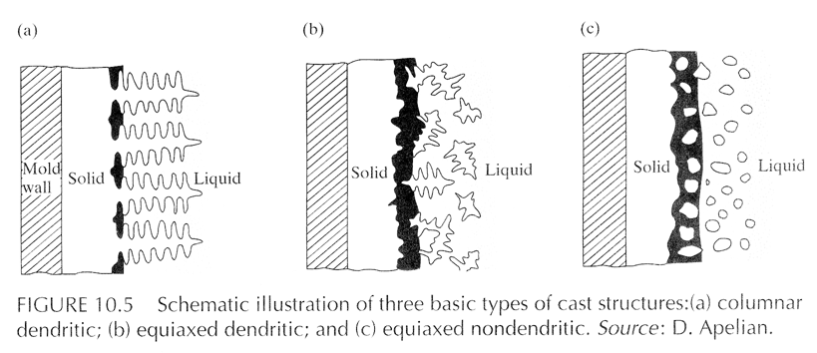
Grain Growth

Slide 23
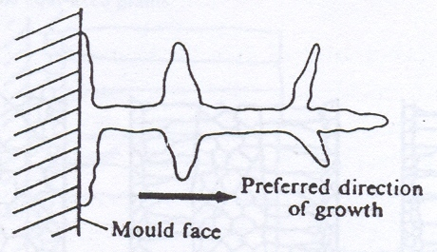
Dendrite formation
In alloys, such as Fe-C, freezing and solidification occurs over wide range of temp. There is no fine line of demarcation exists between the solid and liquid metal.
Here, ‘start of freezing’ implies that grain formation while progressing towards the center does not solidify the metal completely but leaves behind the islands of liquid metals in between grains which freeze later and there is multidirectional tree like growth.

Slide 25
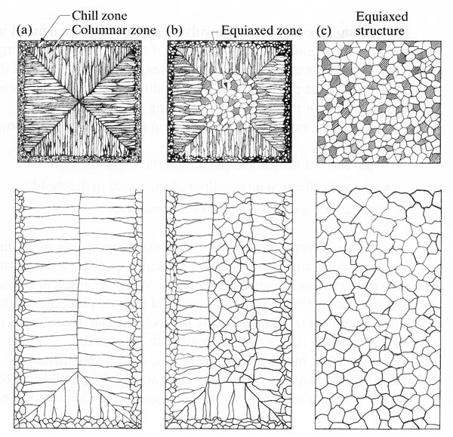
Cast structures
Schematic illustration of three cast structures solidified in a square mold:
(a) pure metals;
(b) solid solution alloys; and
© structure obtained by using nucleating agents.
Source: G. W. Form, J. F. Wallace, and A. Cibula

Slide 26
Cooling Curves for a Pure Metal
Useful for studying the solidification process
Cooling rate is the slope of the cooling curve
Solidification can occur over a range of temperatures in alloys
Beginning and end of solidification are indicated by changes in slope
Figure 11-3 Cooling curve for a pure metal or eutectic-composition alloy (metals with a distinct freezing point), indicating major features related to solidification.

Slide 27
Cooling Curves for an Alloy
Figure 11-4 Phase diagram and companion cooling curve for an alloy with a freezing range. The slope changes indicate the onset and termination of solidification.

Slide 28
Prediction of Solidification Time: Chvorinov’s Rule
Ability to remove heat from a casting is related to the surface area through which the heat is removed to the environment
Chvorinov’s Rule:
t_{s}=B(V/A)^{n} , where n=1.5 to 2.0
t_{s} is the time from pouring to solidification
B is the mold constant
V is the volume of the casting
A is the surface area through which heat is removed

Slide 30
Cast Structure
Three distinct regions or zones
Chill zone
Rapid nucleation occurs when the molten metal comes into contact with the cold walls of the mold
Forms a narrow band of randomly oriented crystals on the surface of a casting
Columnar zone (least desirable)
Rapid growth perpendicular to the casting surface
Long and thin
Highly directional
Equiaxed zone
Crystals in the interior of the casting
Spherical, randomly oriented crystals

Slide 31
Cast Structure
Three distinct regions or zones
Chill zone
Rapid nucleation occurs when the molten metal comes into contact with the cold walls of the mold
Forms a narrow band of randomly oriented crystals on the surface of a casting
Columnar zone (least desirable)
Rapid growth perpendicular to the casting surface
Long and thin
Highly directional
Equiaxed zone
Crystals in the interior of the casting
Spherical, randomly oriented crystals

Slide 32
Cast Structure
Figure 11-5 Internal structure of a cast metal bar showing the chill zone at the periphery, columnar grains growing toward the center, and a central shrinkage cavity.

Slide 33
Molten Metal Problems
Chemical reactions can occur between molten metal and its surroundings
Reactions can lead to defects in the final castings
Metal oxides may form when molten metal reacts with oxygen
Dross or slag is the material that can be carried with the molten metal during pouring and filling of the mold
Affects the surface finish, machinability, and mechanical properties

Slide 34
Molten Metal Problems
Gas porosity
Gas that is not rejected from the liquid metal may be trapped upon solidification
Several techniques to prevent gas porosity
Prevent the gas from initially dissolving in the liquid
Melting can be done in a vacuum
Melting can be done in environments with low-solubility gases
Minimize turbulence
Vacuum degassing removes the gas from the liquid before it is poured into the castings
Gas flushing- passing inert gases or reactive gases through the liquid metal

Slide 35
Molten Metal Problems
Figure 11-7 (Below) The maximum solubility of hydrogen in aluminum as a function of temperature.
Figure 11-6 Two types of ladles used to pour castings. Note how each extracts molten material from the bottom, avoiding transfer of the impure material from the top of the molten pool.

Slide 36
Fluidity and Pouring Temperature
Metal should flow into all regions of the mold cavity and then solidify
Fluidity is the ability of a metal to flow and fill a mold
Affects the minimum section thickness, maximum length of a thin section, fineness of detail, ability to fill mold extremities
Dependent on the composition, freezing temperature, freezing range, and surface tension
Most important controlling factor is pouring temperature

Slide 37
The Role of the Gating System
Gating system delivers the molten metal to the mold cavity
Controls the speed of liquid metal flow and the cooling that occurs during flow
Rapid rates of filling can produce erosion of the mold cavity
Can result in the entrapment of mold material in the final casting
Cross sectional areas of the channels regulate flows

Slide 38
Gating Systems
Proper design minimizes turbulence
Turbulence promotes absorption of gases, oxidation, and mold erosion
Choke- smallest cross-sectional area in the gating system
Runner extensions and wells- used to catch and trap the first metal to enter the mold and prevent it from entering the mold cavity
Filters- used to trap foreign material

Slide 39
Gating System
Figure 11-9 Typical gating system for a horizontal parting plane mold, showing key components involved in controlling the flow of metal into the mold cavity.

Slide 40
Filters
Figure 11-10 Various types of ceramic filters that may be inserted into the gating systems of metal castings.

Slide 41
Solidification Shrinkage
Most metals undergo noticeable volumetric contraction when cooled
Three principle stages of shrinkage:
Shrinkage of liquid as it cools from the solidification temperature
Solidification shrinkage as the liquid turns into solid
Solid metal contraction as the solidified metal cools to room temperature
Figure 11-11 Dimensional changes experienced by a metal column as the material cools from a superheated liquid to a room-temperature solid. Note the significant shrinkage that occurs upon solidification.

Slide 42
Solidification Shrinkage
Amount of liquid metal contraction depends on the coefficient of thermal contraction and the amount of superheat
As the liquid metal solidifies, the atomic structure normally becomes more efficient and significant amounts of shrinkage can occur
Cavities and voids can be prevented by designing the casting to have directional solidification
Hot tears can occur when there is significant tensile stress on the surface of the casting material

Slide 43
Risers and Riser Design
Risers are reservoirs of liquid metal that feed extra metal to the mold to compensate for shrinkage
Risers are designed to conserve metal
Located so that directional solidification occurs from the extremities of the mold toward the riser
Should feed directly to the thickest regions of the casting
Yield: the weight of the casting divided by the weight of metal in the pour (i.e. the casting, gating systems, and all associated risers)
A good shape for a riser is one that has a longer freezing time.

Slide 44
Risers and Riser Design
Calculate V/A for different shapes of risers
Assume V = 1 (cubic ft.)
1) For cubic (a =b = c=1):
V = 1 x 1 x 1= 1
A= 6 x (1 x 1) =6
(V/A)=1/6=0.1667
2) For sphere (D = 1.2407):
V=pD³/6=3.1416x1.2407³/6=1
A=pD²= 3.1416x1.2407²=4.8360
(V/A)=1/4.8360=0.2068
3) For Cylinder (assume D=H, then D=1.0839)
V = pD²H/4=3.1416x1.0839³=1
A = pDH +2(pD²/4)=px1.0839²+1.5709x1.0839² =5.5363
(V/A)=1/5.5363=0.1806

Slide 45
Risers and Riser Design
Blind risers - contained entirely within the mold cavity
Open risers – are exposed to the air
Live (or Hot) risers - receive the last hot metal that enters the mold
Dead (or Cold) risers – receive metal that has already flowed through the mold cavity
Top risers – sit on top of a casting
Side risers – located adjacent to the mold cavity, displaced along the parting line.

Slide 46
Risers and Riser Design
Figure 11-13 Schematic of a sand casting mold, showing a) an open-type top riser and b) a blind-type side riser. The side riser is a live riser, receiving the last hot metal to enter the mold. The top riser is a dead riser, receiving metal that has flowed through the mold cavity.
Riser must be separated from the casting upon completion so the connection area must be as small as possible

Slide 47
Riser Aids
Riser’s performance may be enhanced by speeding the solidification of the casting (chills) or slowing down the solidification (sleeves or toppings)
External chills
Masses of high-heat capacity material placed in the mold
Absorb heat and accelerate cooling in specific regions
Internal chills
Pieces of metal that are placed in the mold cavity and promote rapid solidification
Ultimately become part of the cast part

Slide 48
Calculation of Riser Size
from Chvorinov’s rule:
t_{s}=B(V/A)^{n}, where n=1.5 to 2.0
Minimum size of a riser:
T_{riser} =1.25 T_{casting} ,
assume n=2, then
(V/A)²_{riser} =1.25 (V/A)²_{casting}
For a side Cylindrical Riser with Diameter D and Height H:
Volume: V = pD²H/4
Area: A = pDH + 2(pD²/4)

Slide 49
11.5 Patterns
Two basic categories for casting processes
Expendable mold processes (Chapter 12)
Permanent mold processes (Chapter 13)
Patterns are made from wood, metal, foam, or plastic
Dimensional modification are incorporated into the design (allowances)
Shrinkage allowance is the most important
Pattern must be slightly larger than the desired part

Slide 50
Dimensional Allowances
Typical allowances
Cast iron 0.8-1.0%
Steel 1.5-2.0%
Aluminum 1.0-1.3%
Magnesium 1.0-1.3%
Brass 1.5%
Shrinkage allowances are incorporated into the pattern using shrink rules
Thermal contraction might not be the only factor for determining pattern size
Surface finishing operations (machining, etc.) should be taken into consideration

Slide 51
Pattern Removal
Parting lines are the preferred method
Damage can be done to the casting at corners or parting surfaces if tapers or draft angles are not used in the pattern
Factors that influence the needed draft
Size and shape of pattern
Depth of mold cavity
Method used to withdraw pattern
Pattern material
Mold material
Molding procedure

Slide 52
Design Considerations
Figure 11-14 Two-part mold showing the parting line and the incorporation of a draft allowance on vertical surfaces.
Figure 11-15 Various allowances incorporated into a casting pattern.

Slide 53
11.6 Design Considerations in Castings
Location and orientation of the parting line is important to castings
Parting line can affect:
Number of cores
Method of supporting cores
Use of effective and economical gating
Weight of the final casting
Final dimensional accuracy
Ease of molding

Slide 54
Design Considerations
Figure 11-17 (Right) Elimination of a dry-sand core by a change in part design.
Figure 11-16 (Left) Elimination of a core by changing the location or orientation of the parting plane.

Slide 55
Design Considerations
It is often desirable to minimize the use of cores
Controlling the solidification process is important to producing quality castings
Thicker or heavier sections will cool more slowly, so chills should be used
If section thicknesses must change, gradual is better
If they are not gradual, stress concentration points can be created
Fillets or radii can be used to minimize stress concentration points
Risers can also be used

Slide 56
Parting Line and Drafts
Figure 11-18 (Top left) Design where the location of the parting plane is specified by the draft. (Top right) Part with draft unspecified. (Bottom) Various options to produce the top-right part, including a no-draft design.

Slide 57
Section Thicknesses
Figure 11-19 (Above) Typical guidelines for section change transitions in castings.
Figure 11-20 a) The “hot spot” at section r₂ is cause by intersecting sections. B) An interior fillet and exterior radius lead to more uniform thickness and more uniform cooling.

Slide 58
Design Modifications
Hot spots are areas of the material that cool more slowly than other locations
Function of part geometry
Localized shrinkage may occur
Figure 11-21 Hot spots often result from intersecting sections of various thickness.

Slide 59
Design Modifications
Parts that have ribs may experience cracking due to contraction
Ribs may be staggered to prevent cracking
An excess of material may appear around the parting line
The parting line may be moved to improve appearance
Thin-walled castings should be designed with extra caution to prevent cracking

Slide 60
Design Modifications
Figure 11-23 Using staggered ribs to prevent cracking during cooling.

Slide 61
Casting Designs
May be aided by computer simulation
Mold filling may be modeled with fluid flow software
Heat transfer models can predict solidification

Slide 62
Summary
Examine every aspects of casting processes for a successful casting
Consider a variety of processes to improve castings during the design phase
Minimize cracking and defects

Slide 63
