Slide 1
Forming & Shaping Processes

Slide 2
Introduction to Metal Forming:
Definition of Metal Forming:
Forming can be defined as the process in which the desired size and shape of the object are obtained through plastic deformation of material.
The stresses induced during the process are greater than yield strength but should be less than the fracture strength.
Different types of loading may be used depending on the process.
  Tensile
  Compressive
  Shear
  Bending

Slide 3
Classification of Forming Processes:
(Classification Based on the type of force applied on to the work piece as it is formed into shape).
• Direct-compression-type processes
• Indirect-compression processes
• Tension type processes
• Bending processes
• Shearing processes

Slide 4
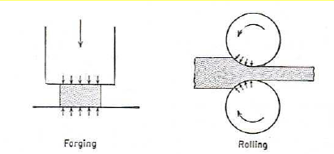
• Direct-compression type processes:
The applied force is normal to the direction of the metal flow in compression, i.e., forging and rolling processes.

Slide 5
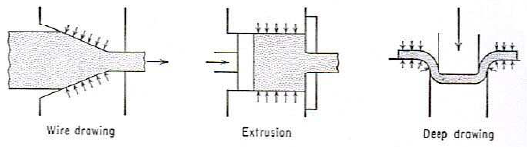
• Indirect-compression type processes:
The primary forces are frequently tensile, with indirect compressive forces developed by the reaction of the work piece.
The metal flow is therefore under the combined stress state, i.e., extrusion, wiredrawing, tube drawing.

Slide 6
• Tension type processes:
The applied force is tensile, i.e., stretch forming.
• Bending processes:
The applied force involves the application of bending moments to the sheet.

Slide 7
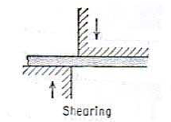
• Shearing processes:
The applied force involves the application of shearing forces of sufficient magnitude to rupture the metal in the plane of shear.

Slide 8
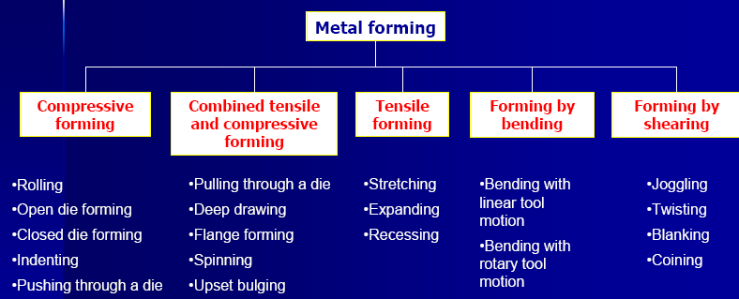
Classification of metal forming by subgroups:

Slide 9
Mechanics of metal working:
• Metal working occurs due to plastic deformation which is
associated with analysis of complex stress distribution require
simplification.
Only (large) plastic strain is considered while elastic strain is very small and can be neglected. Strain hardening is often neglected. Metal is considered to be isotropic and homogeneous.
Normally plastic deformation is not uniform and also have frictions, but we need to simplify the stress analysis in order to determine the force required to produce a given amount of deformation to obtain a product in a required geometry.
For under standing of metal working and simple analysis, theory of plasticity be understood.

Slide 10
Elements of the theory of elasticity & plasticity:
• Introduction
• The flow curve
• True stress and true strain
• Yielding criteria for ductile materials
• Combined stress tests
• Anisotropy in yielding

Slide 11
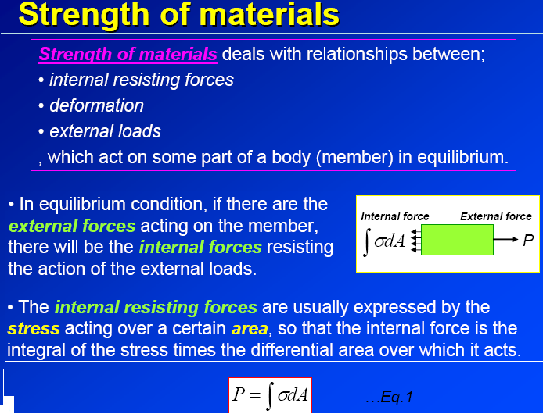

Slide 12
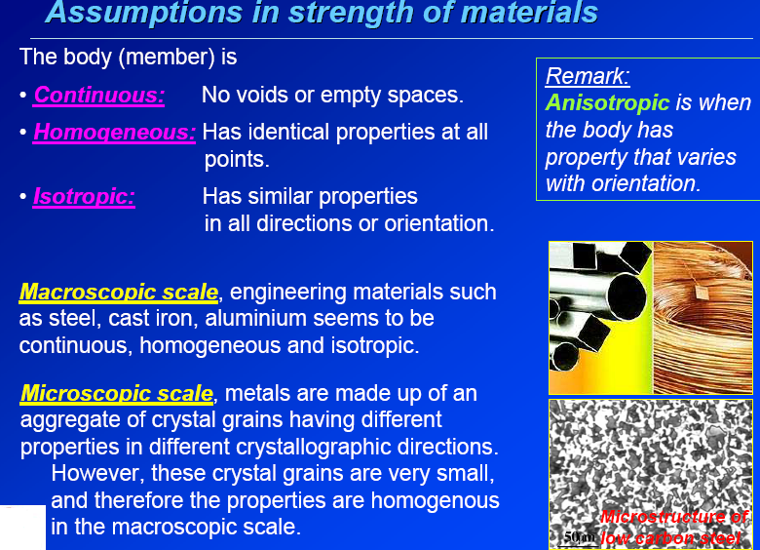

Slide 13
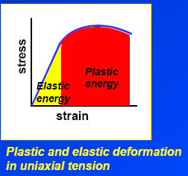
Introduction:
• Plastic deformation is a non reversible process where Hooke’s law is no longer valid.
• One aspect of plasticity in the viewpoint of structural design is that it is concerned with predicting the maximum load, which can be applied to a body without causing excessive yielding.
• Another aspect of plasticity is about the plastic forming of metals where large plastic deformation is required to change metals into desired shapes.

Slide 14
The flow curve & Its interpretation:
• True stress-strain curve for typical ductile materials, i.e., aluminum, show that the stress - strain relationship follows up the Hooke’s law up to the yield point, σ_{o}.
• Beyond σ_{o}, the metal deforms plastically with strain-hardening. This cannot be related by any simple constant of proportionality.
• If the load is released from straining up to point A, the total strain will immediately decrease from ε₁ to ε₂. by an amount of σ/E.
• The strain ε₁-ε₂ is the recoverable elastic strain. Also there will be
a small amount of the plastic strain ε₂-ε₃ known as anelastic behavior which will disappear by time. (neglected in plasticity theories.)
Typical true stress-strain curves for a ductile metal.

Slide 15
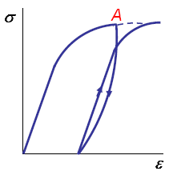
• Usually the stress-strain curve on unloading from a plastic strain will not be exactly linear and parallel to the elastic portion of the curve.
• On reloading the curve will generally bend over as the stress pass through the original value from which it was unloaded.
• With this little effect of unloading and loading from a plastic strain, the stress-strain curve becomes a continuation of the hysteresis behavior. (but generally neglected in plasticity theories.)
Stress-strain curve on unloading from a plastic strain.

Slide 16
• If specimen is deformed plastically beyond the yield stress in tension (+), and then in compression (-), it is found that the yield stress on reloading in compression is less than the original yield stress.
• The dependence of the yield stress on b loading path and direction is called the Bauschinger effect. (however it is neglected in plasticity theories and it is assumed that the yield stress in tension and compression are the same).
Bauschinger effect

Slide 17

• A true stress – strain curve provides the stress required to cause the metal to flow plastically at any strain it is often called a ‘flow curve’.
• A mathematical equation that fit to this curve from the beginning of the plastic flow to the maximum load before necking is a power expression of the type, Hollomon's equation Eq.1 Ludwik's equation, includes the yield stress:
Where K is the stress at ε = 1.0, n is the strain – hardening exponent (slope of a log-log plot of Eq.1)
Note: higher σ_{o} greater elastic region, but less ductility
Typical true stress-strain curves for a ductile metal.

Slide 18
Idealized flow curves:
Due to considerable mathematical complexity concerning the theory of plasticity, the idealized flow curves are therefore utilized to simplify the mathematics.
1) Rigid ideal plastic material : no elastic strain, no strain hardening.
2) Perfectly plastic material with an elastic region, i.e., plain carbon steel.
3) Piecewise linear (strain-hardening material) : with elastic region and strain hardening region more realistic approach but complicated mathematics.

Slide 19
True stress True stress and true strain:
• The engineering stress – strain curve is based entirely on the original dimensions of the specimen This cannot represent true deformation characteristic of the material.
• The true stress – strain curve is based on the instantaneous specimen dimensions.
Engineering stress-strain and true stress-strain curves.

Slide 20
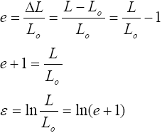
The true strain:
According to the concept
of unit linear strain, Eq. 2
This satisfies for elastic strain where L is very small, but not for plastic strain.
Definition: True strain or natural strain (first proposed by Ludwik) is the change in length referred to the instantaneous gauge length.
Hence the relationship between the true strain and the conventional linear strain becomes
Eq. 3 Eq. 4

Slide 21
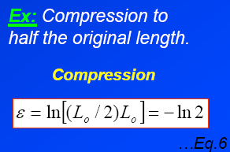
Comparison of true strain and conventional linear strain:
• In true strain, the same amount of strain (but the opposite sign) is produced in tension and compression respectively.

Slide 22
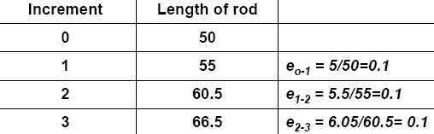
Total true strain and conventional strain:
The total conventional strain e:
The total conventional strain e is not equal to e + e + e .
…Eq.7
0-3
0-1
1-2
2-3
The total true strain ε
• The total true strain = the summation of the incremental true strains.
…Eq.8

Slide 23
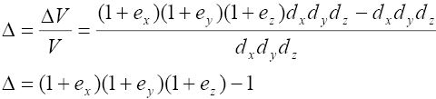

The volume strain:
According to the volume strain
…Eq.9
During plastic deformation, it is considered that the volume of a solid remain constant
But hence, …Eq.10
Due to the constant volume therefore,
…Eq.11

Slide 24
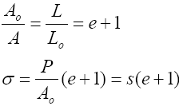
The true stress:
Definition: the true stress is the load divided by the instantaneous area.
True stress Engineering stress
Relationship between the true stress and the engineering stress
Since But
Hence, Eq.12

Slide 25
Example:
A tensile specimen with a 12 mm initial diameter and 50 mm gauge length reaches maximum load at 90 kN and fractures at 70 kN. The maximum diameter at fracture is 10 mm.
Determine engineering stress at maximum load (the ultimate tensile strength), true fracture stress, true strain at fracture and engineering strain at fracture.

Slide 26
HYDROSTATIC AND DEVIATOR COMPONENTS OF STRESS:
Similar to strain tensor, the total stress tensor can be divided into :
1) Hydrostatic or mean stress tensor, which involves only pure
tension or compression. Produce elastic volume changes.
2) Deviator stress tensor Which represents the shear stress in the
total state of stress. important in causing plastic deformation

Slide 27
DEVIATOR OF STRESS TENSOR:
Since the decomposition of the stress tensor is given by
Stress deviator involves shear stress. For example, referring
to a system of principal axes.
Where and are principal shearing stresses.

Slide 28
DEVIATOR OF STRESS TENSOR (CONT.):
• The principal values of the stress deviator are the roots of the cubic equation:
Where J1 , J2 , J3 are the invariants of the deviator stress tensor.

Slide 29
YIELDING CRITERIA FOR DUCTILE METALS:
Plastic yielding of the material subjected to any
external forces is of considerable importance in the field of plasticity.
For predicting the onset of yielding in ductile material, there are at present two generally accepted criteria,
Von Mises’ or Distortion-energy criterion
2) Tresca or Maximum shear stress criterion

Slide 30
VON MISES’ CRITERION:
Von Mises proposed that yielding occur when the second invariant of the stress deviator J₂ > critical value k₂.
For yielding in uniaxial tension,
…Eq.14
…Eq.13
Substituting k from Eq.14 in Eq.13, we then have the von Mises’yield criterion
…Eq.15
In pure shear, to evaluate the constant k, note,
where σo is the yield stress; when yields:
By comparing with Eq 14,
…Eq.16

Slide 31
Example:
Stress analysis of a spacecraft structural member gives the state of stress shown below. If the part is made from 7075-T6 aluminium alloy with σo = 500 MPa, will it exhibit yielding? If not, what is the safety factor?
From Eq. 16
The calculated σo = 224 MPa < the yield stress (500 MPa), therefore yielding will not occur.
Safety factor = 500/224 = 2.2.

Slide 32

TRESCA YIELD CRITERION:
Yielding occurs when the maximum shear stress reaches the value of the shear stress in the uniaxial-tension test,
Where is the algebraically largest and is the algebraically smallest principal stress
…Eq.17
For uniaxial tension,
and the shearing yield stress
Eq. 18
Therefore the maximum – shear stress criterion is given by
Eq. 19
In pure shear,
Eq. 20

Slide 33
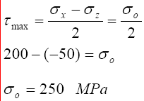
Example:
Use the maximum-shear-stress criterion to establish whether yielding will occur for the stress state shown in the previous example.
The calculated value of is less then the yield stress (500 MPa), therefore yielding will not occur.

Slide 34
Summation:
1) Von Mises’ yield criterion
Yielding is based on differences of normal stress, but independent of hydrostatic stress.
• Complicated mathematical equations.
• Used in most theoretical work.
2) Tresca yield criterion
• Less complicated mathematical equation
used in engineering design.
Note: the difference between the two criteria are approximately 1-15%.

Slide 36
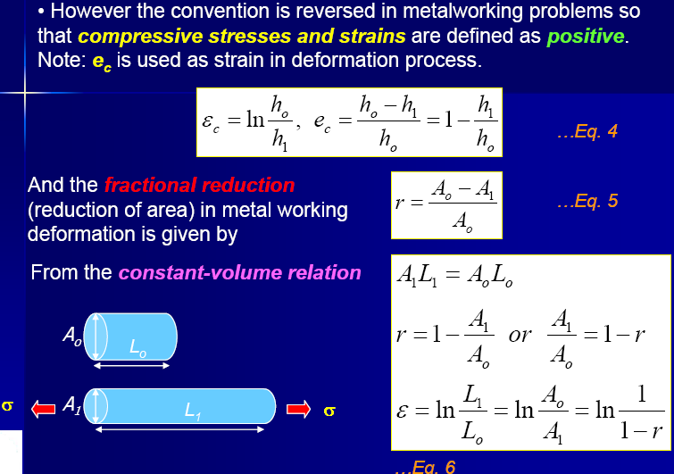

Slide 37
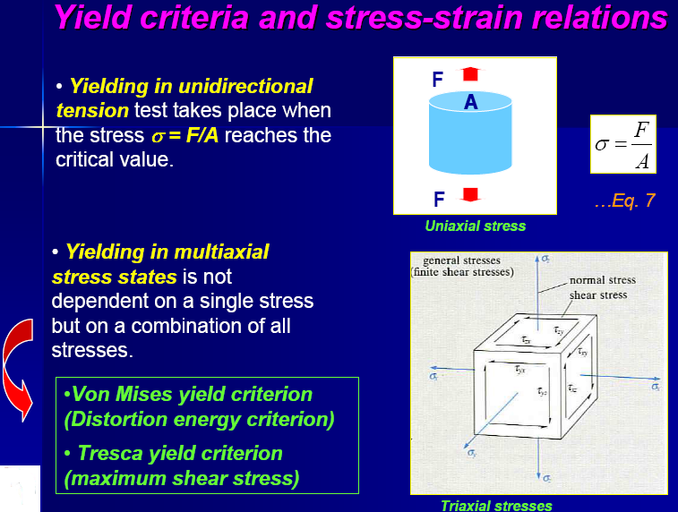

Slide 38
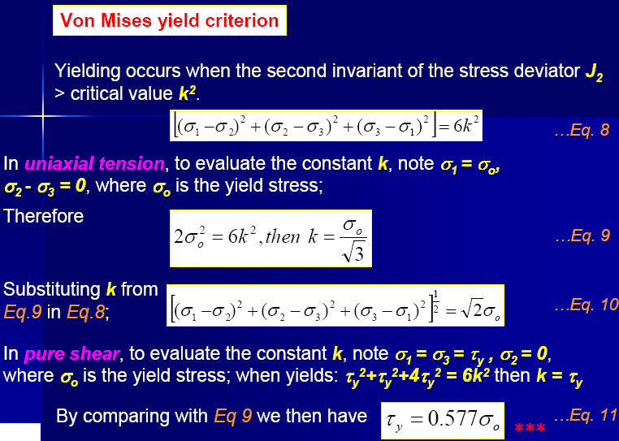

Slide 41
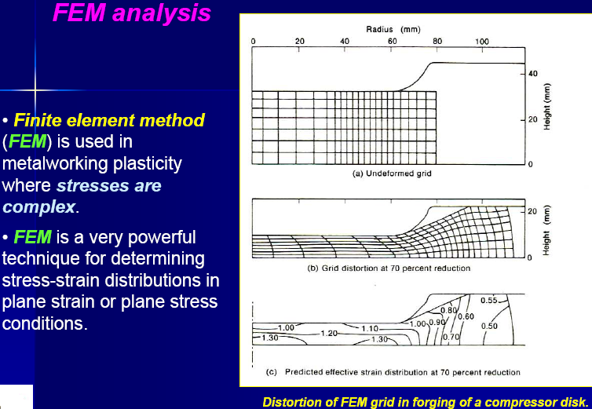

Slide 46
METAL WORKING PROCESSES BASED ON TEMPERATURES:
The methods used to mechanically shape metals into other
product forms are called Working Processes.
Hot working (0.6-0.8Tm) Cold working (< 0.3Tm)
Definition of Hot Working: deformation under conditions of temperature and strain rate such that recrystallization process take place simultaneously with the deformation.
Examples : rolling, forging, extrusion
Definition of Cold Working: deformation carried out under conditions where recovery processes are not effective.
Examples : rolling, forging, extrusion, wire/tube drawing, swaging, Coining.

Slide 47
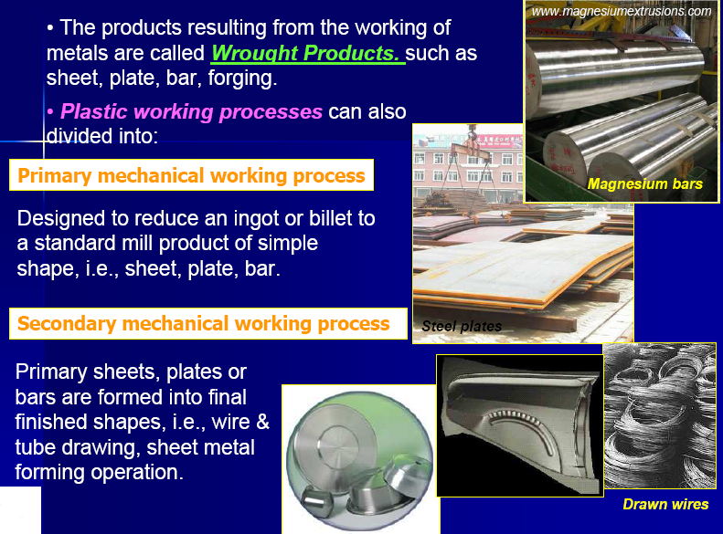

Slide 48
HOT WORKING:
Hot working involves deformation at temperatures where recrystallization can occur (0.6-0.8 Tm).
Examples of hot working temperatures for each metal.

Slide 49
EFFECTS OF TEMPERATURE ON METAL FORMING PROCESSES:

Slide 50
Recrystallization during hot working:
The minimum temperature at which reformation of the crystals occurs is called Recrystallization Temperature.
• Above the recrystallization temperature the kinetic energy of atoms increases and therefore they are able to attach themselves to the newly formed nuclei which in turn begin to grow into crystals. This process continues until all the distorted crystals have been transformed.
• Hot working results in grain refining.

Slide 51
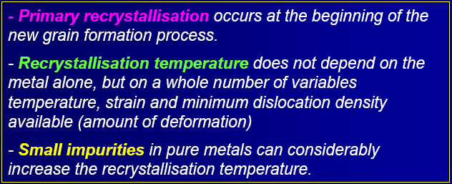
Recrystallization:
Primary recrystallization:

Slide 52
RECRYSTALLIZED GRAIN SIZE AND PRIOR PLASTIC STRAIN:
The greater the driving force (greater prior plastic deformation), the greater the number of nuclei that will form and the finer will be the final grain size.

Slide 53
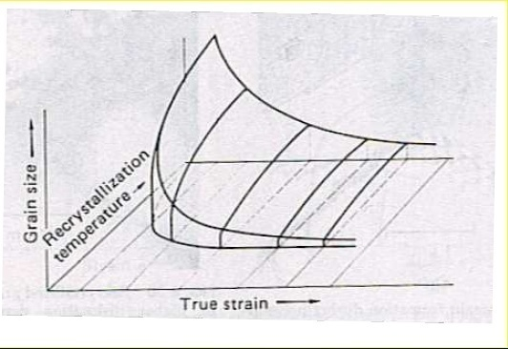
Effects of grain Effects of grain size and strain on recrystallization temperature:
Schematic of recrystallization diagram

Slide 54
Effects of grain Effects of grain size on properties:
Small grains make dislocations more difficult to move
• More slip plane, therefore, greater ductility

Slide 55
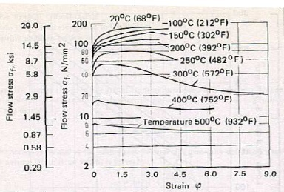
Effects of strain rate and temperature:
Flow stress of aluminum as a function of strain at different temperature
Flow curves of Cu Zn28

Slide 56
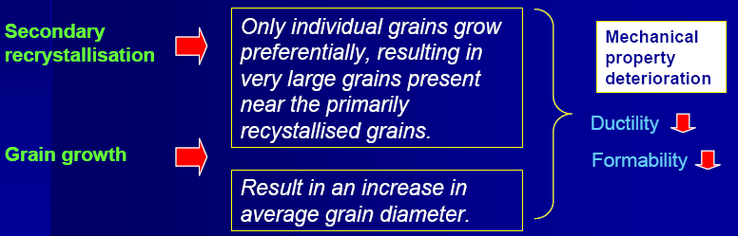
Secondary recrystallization and grain growth:
At higher temperature and longer annealing time, further grain growth processes take place in the primary recrystallization structure.
• The driving force energy from the energy gained by lowering the ratio of the grain boundary area to the enclosed volume.

Slide 57
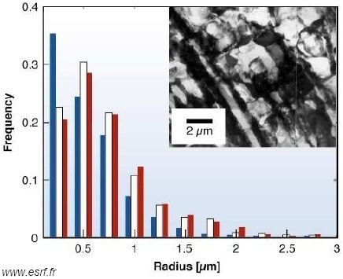
Recovery:
• Recovery is a thermally activated process, which results in lower density of dislocations or rearrangement of dislocation structure (as a consequence of strain hardening during deformation process).
• Recovery process includes annihilation of dislocation, polygonization of dislocation, dislocation climb.
• Certain amount of stored energy is released during annealing without an obvious change in optical microstructure.
Polygonization
Recovery of 38% cold-rolled aluminum showing different sizes of sub-grains.

Slide 58
Effect of recovery annealing on stress-strain diagram:
• Recovery process depends strongly on temperature.
• Increasing temperature (T ≥ 0.5Tm) during step tensile tests fig.
(b) reduces the yield stress, due to the rearrangement and reactions of dislocations during recovery.
Effect of recovery annealing on stress-strain diagram.

Slide 59

Static and dynamic changes of structure during hot forming:
• During plastic deformation, new dislocations and vacancies are
produced continuously, which leads to a new state of equilibrium
through dynamic recrystallization and dynamic recovery.
• These two processes take place in the forming zone during plastic deformation at corresponding stresses and strain rates.
Note:

Slide 60
Static and dynamic changes of structure during hot forming:
• Dynamic and static recovery
are strongly encouraged in metals with high stacking fault energy (easy for climb and cross slip) such as aluminum , α –Fe, ferritic alloys.
• Hot flow curve with a constant or slightly drop of yield stress are typical for dynamic recovery.
• On the contrary, the flow curves with dynamic recrystallization (after initial hardening) show a sudden drop in yield stress.
Schematic form of hot flow curves by
(a) dynamic recovery alone
(b) both dynamic recovery and recrystallization.

Slide 61
Advantages of hot working:
• Higher ductility – more deformation without cracking.
• Lower flow stress – less mechanical energy required for deformation.
• Pores seal up.
• Smaller grain size.
• Micro-segregation is much reduced or removed due to atomic diffusion, which is higher at high temperatures.
• Stronger, tougher and more ductile than as-cast metals due to breaking down and refinement of coarse columnar grains in the cast ingot.

Slide 62
Disadvantages of hot working:
• Surface reactions between the metal and the furnace atmosphere, i.e., oxidation (oxide scales), decaburisation in steels.
• Hot shortness, when the working temperature exceeds the melting temperature of constituent at grain boundaries such as FeS.
• Dimension tolerance is poor due to thermal expansion at high temperatures.
• Handling is more difficult (from furnace to machine).

Slide 63
Cold working:
Normally performed at room temperature but in general < 0.3Tm, where recovery is limited and recrystallization does not occur.
• Work hardening occurs (strength and hardness increase but ductility decreases).
• The extent of deformation is rather limited if cracks are to be avoid, therefore intermediate anneals that enable recrystallization are frequently used afterwards.
• The materials suitable for cold working should have a relatively low yield stress and a relatively high work hardening rate (determined primarily by its tensile properties).

Slide 64
Advantages of cold working:
No heating is required.
Strength, fatigue and wear properties are improved through strain hardening.
Provide fine grain size and good surface finish.
Superior dimensional control is achieved, so little, if any, secondary machining is required.
Easier handling (low operating temperatures).
Products possess better reproducibility and interchangeability.
Directional properties can be imparted.
Contamination problems are minimized.

Slide 65
Disadvantages of cold working:
Use high amount of deformation due to low operating temperatures, therefore, require soft materials.
• Equipment (rolls, dies, presses) is big and expensive.
• Reduced ductility, therefore, require subsequent annealing treatments.

Slide 66
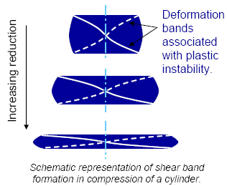
Effects of metallurgical structure on working processes:
The presence of preferred orientation causes anisotropy of mechanical properties, especially in rolled sheets.
• The development of texture is the formation of deformation bands or shear bands, which are regions of distortion where a portion of grains have rotated towards another orientation to accommodate the applied strain.

Slide 67
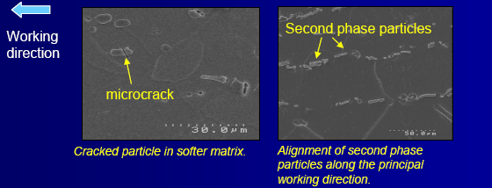
Example: Plastic working in two-phase alloys:
The plastic working characteristics of two-phase alloys depends on the microscopic distribution of the two phases.
• A high Vf of hard uniformly dispersed particles increases the flow stress and makes working difficult.
• Hard and massive particles tend to fracture on deformation with softer matrix.
• Second phase particles or inclusions will be distorted in the principal working direction (fibrous structure)- affect mechanical properties.
• Precipitation hardening during hot working results in high flow stress and lowered ductility.

Slide 68
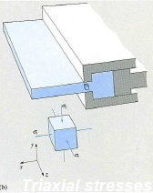
Effect of principal stresses Effect of principal stresses in metal working:
When there is no shear stresses acting on the planes giving the maximum normal stress acting on the planes.
• These planes are called the principal planes, and stresses normal to these planes are the principal stresses σ1, σ2 and σ3 which in general do not coincide with the Cartesian coordinate axes x, y, z. Directions of principal stresses are 1, 2 and 3.
Biaxial-plane stress condition
Two principal stresses, σ1 and σ2.
Triaxial-plane strain condition
Three principal stresses, σ1 , σ2 and σ3 , where σ1 > σ2 > σ3.

Slide 69
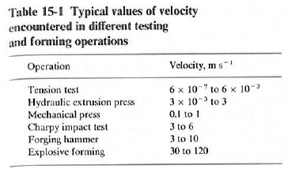
Effects of speed of deformation:
• High flow stress.
• Increased the temperature of the workpiece.
• improved lubrication at the tool-metal
interface.
Flow stress dependence on strain rate and temperature
Note:
    If the speed of deformation is too high, metal cracking is possible.
    Can cause plastic instability in cold working
    Can cause hot shortness in hot working

Slide 70
Effects of friction Effects of friction and lubrication:
Friction at tool-workpiece interface depends on geometry of the tooling and the geometry of the deformation, temperature, nature of metal, speed of deformation.
Die-workpiece interface (a) on the macroscale, (b) on the microscale.

Slide 71
Effects of friction and lubrication:
When two surfaces are brought into contact, the high spot (asperities) will come into contact.
• As we increase the load, the metal
at the asperities deform plastically
and produce sub-shear zone.
• The coefficient of friction is given
by
Where
μ = frictional coefficient
τ = the shearing stress at the interface
P = the load normal to the interface
F = the shearing force
Ar= summation of asperity areas in contact
p = the stress normal to the interface
Contact at asperities
overlap of deformation zones to produce subsurface shear zone.

Slide 72
Example : homogeneous compression of a flat circular disk:
Assumption: no barreling and small thickness, then the frictional conditions on the top and bottom faces of the disk are described by a constant coefficient of Coulomb friction;
Where
μ = frictional coefficient
τ = the shearing stress at the interface
p = the stress normal to the interface
Deformation pressure in compression as a function of u and a/h.

Slide 73
Example: friction in forging:
Functions of a metal working lubricant
- Reduces deformation load
- Increases limit of deformation before fracture
- Controls surface finish
- Minimizes metal pickup on tools
- Minimizes tool wear
- Thermally insulates the workpiece and the tools
- Cools the workpiece and/or tools

Slide 74
Workability or Formability:
Workability is concerned with the extent to which a material can be deformed in a specific metal working process without the formation of cracks (Surface or Internal).
Cracks which occur in metal working processes can be grouped into three broad categories:
1. Cracks at a free surface
2. Cracks that develop in a surface
where interface friction is high
3. Internal cracks.
Examples of cracks in metalworking
free surface crack
surface crack from heavy die friction in extrusion,
(c) centre burst or chevron cracks in a drawn rod.
Dependence of forming limit
Of mean normal stress σm.

Slide 75
Cold Formability:
Cold formability is a measure of the ability of a metal to endure deformation for Th < 0.2.
Greater the cold formability of a material, higher deformation & more complex shapes can be produced.
Factors affecting cold formability:
Material Properties: Strength, elastic modulus, ductility, cleanliness, microstructure & chemical composition, yield point, strain hardening, & grain size
Die properties
Shape of the part etc.

Slide 76
Hot Formability:
Hot formability is the measure of the ability of a metal to endure deformation without failure for Th > 0.5.
During hot working, the metal is dynamically recrystalized. The material properties in this region are temperature & rate dependent.
Material Properties that effect Hot Formability:
Yield strength, (ii) ductility,
modulus of elasticity, (iv) strain rate sensitivity,
(V) thermal expansion coefficient,
(vi) thermal conductivity & (vii) chemical composition.

Slide 77
Sheet Metal Formability:
Use of formability is to evaluate the capacity of a material to withstand the stretch / draw stresses of forming before splitting or failure occur.
Material properties that affect Sheet Metal Formability:
Ductility (ii) Yield strength
(iii) Elastic Modulus (iv) Discontinuous yielding
(v) Work hardening Rate (vi) Anisotropy
(vii) Grain Size (viii) Surface Finish

Slide 78
Effect of residual stresses:
Residual stresses is generated by non-uniform plastic deformation when external stresses are removed.
Ex: in rolling process, the surface grains in the sheet are
deformed and tend to elongate, while the grain in the centre
are unaffected.
Due to continuity of the sheet, the central fibres tend to restrain the surface fibres from elongating while the surface fibres tend to stretch the central fibres.
Inhomogeneous deformation in rolling of sheet,
resulting distribution of longitudinal residual stress over thickness of sheet.
Residual stress pattern consisting of high compressive stress at the surface and tensile stress in the centre.

Slide 79
Residual Stresses (Cont..):
  Small-diameter rolls tend to deform the metal more at its
  surface than in its bulk
  Large-diameter rolls tend to deform the metal more in its bulk than at its surface

Slide 80
Residual Stresses (Cont..):
Residual stresses are only elastic stresses. The maximum value which a residual stress can reach is the yield stress of the material.
• Residual stresses can be considered the same as ordinary applied stresses.
• Compressive residual stress can effectively subtracts from the applied tensile stresses.
• Metals containing residual stresses can be stress relieved by heating to a temperature where the yield strength of the material is the same or lower than the value of the residual stress such that the material can deform and release stress.
• However slow cooling is required otherwise residual stress can again develop during cooling.

Slide 81
Hydrostatic Pressure in Metal Working:
In metal working large plastic deformation without cracks or fracture is envisaged.
In metal testing it is observed that hydrostatic pressure or triaxial compressive stress resist fractureand increase the ductility, which prime requirement for metal working.
Hydrostatic pressure is utilized in many metal working operations, like wire drawing and extrusion, to produce very large plastic deformation which would not be possible in absence of high component of hydrostatic pressure.
Hydrostatic component of stress exert no shear stress, it cannot increase dislocation density in pile-up or squeeze them closer to gather, but close pores, if any.
It can influence crack propagation but not crack initiation.
Hydrostatic pressure at elevated temperature, hot isostatic pressing (HIP), is used commercially to close porosity in casting & powder metallurgy parts and improve the ductility & toughness.

Slide 82
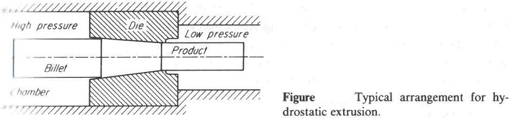
Hydrostatic Pressure in Metal Working (Cont..):
The presence of high hydrostatic pressure reduces the tensile stresses below the critical value for cracking, while at the same time the flow stress is is unaffected.
The figure shows elements of Hydrostatic Extrusion Process, in which the billet
is forced through the die by a high hydrostatic fluid pressure. The advantage of
this process are:
the elimination of the large drag friction force between the billet and the die or container wall and
achievement of of hydrodynamic lubrication in die.

Slide 83
Hydrostatic Pressure in Metal Working (Cont..):
Hydrostatic pressure may be used to advantage in working brittle materials such as bismuth or cast iron.
The beneficial effect of hydrostatic pressure may be achieved without the difficulty of employing high pressure equipment if the workpiece is encased with a metal of low flow stress compared with work piece.

Slide 84
Work hardening or Strain hardening:
Work hardening, also known as strain hardening, is the strengthening of a metal by plastic deformation.
This strengthening occurs because of dislocation movements within the crystal structure of the material.
Any material with a reasonably high melting point such as metals and alloys can be strengthened in this fashion.
Alloys not amenable to heat treatment, including low-carbon steel, are often work-hardened.
Some materials cannot be work-hardened at normal ambient temperatures, such as indium, however others can only be strengthened via work hardening, such as pure copper and aluminum.

Slide 85
Work hardening or Strain hardening (Cont..):
Work hardening may be desirable or undesirable depending on the context.
An example of undesirable work hardening is during machining when early passes of a cutter inadvertently work-harden the workpiece surface, causing damage to the cutter during the later passes.
An example of desirable work hardening is that which occurs in metalworking processes that intentionally induce plastic deformation to exact a shape change.
Metal in annealed state may be hammered, stretched and otherwise formed, progressing toward the desired final shape, but becoming harder and less ductile as work progresses.
If work continues beyond a certain hardness the metal will tend to fracture when worked and so it may be re-annealed periodically as the shape progresses.

Slide 86
Theory of strain hardening:
Before work hardening, the lattice of the material exhibits a regular, defect-free (no dislocations) pattern.
The defect-free lattice can be created or restored at any time by annealing.
As the material is work hardened it becomes increasingly saturated with new dislocations, and more dislocations are prevented from nucleating (a resistance to dislocation-formation develops).
This resistance to dislocation-formation manifests itself as a resistance to plastic deformation; hence, the observed strengthening.

Slide 87
Theory of strain hardening (Cont..):
In metallic crystals, irreversible deformation is usually carried out on a microscopic scale by defects called dislocations, which are created by fluctuations in local stress fields within the material culminating in a lattice rearrangement as the dislocations propagate through the lattice.
At normal temperatures the dislocations are not annihilated by annealing.
Instead, the dislocations accumulate, interact with one another, and serve as pinning points or obstacles that significantly impede their motion.
This leads to an increase in the yield strength of the material and a subsequent decrease in ductility.

Slide 88
Theory of strain hardening (Cont..):
Such deformation increases the concentration of dislocations which may subsequently form low-angle grain boundaries surrounding sub-grains.
Cold working generally results in a higher yield strength as a result of the increased number of dislocations and the Hall-Petch effect of the sub-grains, and a decrease in ductility.
The effects of cold working may be reversed by annealing the material at high temperatures where recovery and recrystallization reduce the dislocation density.
A material's work hardenability can be predicted by analyzing a stress-strain curve, or studied in context by performing hardness tests before and after a process.

Slide 89
Theory of strain hardening (Cont..):
Work hardening is a consequence of plastic deformation, a permanent change in shape. This is distinct from elastic deformation, which is reversible.
Most materials do not exhibit only one or the other, but rather a combination of the two, especially steels, which are well studied.
Work hardening occurs most notably for ductile materials such as metals.
Ductility is the ability of a material to undergo large plastic deformations before fracture (for example, bending a steel rod until it finally breaks).

Slide 90
Dislocations and lattice strain fields:
In materials science, dislocations are defined as line defects in a material's crystal structure.
They are surrounded by relatively strained (and weaker) bonds than the bonds between the constituents of the regular crystal lattice. This explains why these bonds break first during plastic deformation.
Like any thermodynamic system, the crystals tend to lower their energy through bond formation between constituents of the crystal.
Thus the dislocations interact with one another and the atoms of the crystal. This results in a lower but energetically favorable energy conformation of the crystal.
Dislocations are a "negative-entity" in that they do not exist: they are merely vacancies in the host medium which does exist. As such, the material itself does not move much. To a much greater extent visible "motion" is movement in a bonding pattern of largely stationary atoms.

Slide 91
Dislocations and lattice strain fields (Cont..):
The strained bonds around a dislocation are characterized by lattice strain fields. For example, there are compressively strained bonds directly next to an edge dislocation and tensilely strained bonds beyond the end of an edge dislocation.
These form compressive strain fields and tensile strain fields, respectively. Strain fields are analogous to electric fields in certain ways. Additionally, the strain fields of dislocations, obey the laws of attraction and repulsion.
The visible (macroscopic) results of plastic deformation are the result of microscopic dislocation motion. For example, the stretching of a steel rod in a tensile tester is accommodated through dislocation motion on the atomic scale.

Slide 92
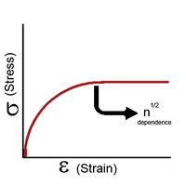
Dislocations and lattice strain fields (Cont..):
Increase of dislocations and work hardening:
Increase in the number of dislocations is a quantification of work hardening. Plastic deformation occurs as a consequence of work being done on a material; energy is added to the material.
In addition, the energy is almost always applied fast enough and in large enough magnitude to not only move existing dislocations, but also to produce a great number of new dislocations by jarring or working the material sufficiently enough. New dislocations are generated by Frank-Read source.
Figure : The yield stress of an ordered material has a half-root dependency on the number of dislocations present.

Slide 93
Dislocations and lattice strain fields (Cont..):
Yield strength is increased in a cold-worked material.
Using lattice strain fields, it can be shown that an environment filled with dislocations will hinder the movement of any one dislocation.
Because dislocation motion is hindered, plastic deformation cannot occur at normal stresses.
Upon application of stresses just beyond the yield strength of the non-cold-worked material, a cold-worked material will continue to deform using the only mechanism available: elastic deformation.
The regular scheme of stretching or compressing of electrical bonds (without dislocation motion) continues to occur, and the modulus of elasticity is unchanged.
Eventually the stress is great enough to overcome the strain-field interactions and plastic deformation resumes.

Slide 94
Dislocations and lattice strain fields (Cont..):
Due to strain hardening ductility of a work-hardened material is decreased.
Ductility is the extent to which a material can undergo plastic deformation, that is, it is how far a material can be plastically deformed before fracture.
A cold-worked material is, in effect, a normal material that has already been extended through part of its allowed plastic deformation.
If dislocation motion and plastic deformation have been hindered enough by dislocation accumulation, and stretching of electronic bonds and elastic deformation have reached their limit, a third mode of deformation occurs: fracture.

Slide 95
Quantification of work hardening:
The stress, τ, of dislocation is dependent on the shear modulus, G, the lattice constant, b, and the dislocation density,
where τ₀ is the intrinsic strength of the material with low dislocation density and α is a correction factor specific to the material.
As shown in Figure on earlier slide and the equation above, work hardening has a half root dependency on the number of dislocations.
The material exhibits high strength if there are either high levels of dislocations (greater than 10¹⁴ dislocations per m²) or no dislocations. A moderate number of dislocations (between 10⁷ and 10⁹ dislocations per m²) typically results in low strength.

Slide 96
Example:
For an extreme example, in a tensile test a bar of steel is strained to just before the distance at which it usually fractures.
The load is released smoothly and the material relieves some of its strain by decreasing in length.
The decrease in length is called the elastic recovery, and the end result is a work-hardened steel bar.
The fraction of length recovered (length recovered/original length) is equal to the yield-stress divided by the modulus of elasticity. (Here we discuss true stress in order to account for the drastic decrease in diameter in this tensile test.)
The length recovered after removing a load from a material just before it breaks is equal to the length recovered after removing a load just before it enters plastic deformation.

Slide 97
Example (Con..):
The work-hardened steel bar has a large enough number of dislocations that the strain field interaction prevents all plastic deformation.
Subsequent deformation requires a stress that varies linearly with the strain observed, the slope of the graph of stress vs. strain is the modulus of elasticity, as usual.
The work-hardened steel bar fractures when the applied stress exceeds the usual fracture stress and the strain exceeds usual fracture strain.
This may be considered to be the elastic limit and the yield stress is now equal to the fracture toughness, which is of course, much higher than a non-work-hardened-steel yield stress.

Slide 98
Example (Con..):
The amount of plastic deformation possible is zero, which is obviously less than the amount of plastic deformation possible for a non-work-hardened material.
Thus, the ductility of the cold-worked bar is reduced.
Substantial and prolonged cavitation can also produce strain hardening.
Additionally, jewelers will construct structurally sound rings and other wearable objects (especially those worn on the hands) that require much more durability (than earrings for example) by utilizing a material's ability to be work hardened.
While casting rings is done for a number of economical reasons (saving a great deal of time and cost of labor), a master jeweler may utilize the ability of a material to be work hardened and apply some combination of cold forming techniques during the production of a piece.

Slide 99
Empirical relations for strain hardening:
There are two common mathematical descriptions of the work hardening phenomenon.
Hollomon's equation is a power law relationship between the stress and the amount of plastic strain:
where σ is the stress, K is the strength index, ε_{p} is the plastic strain and n is the strain hardening index.
Ludwik's equation is similar but includes the yield stress:
If a material has been subjected to prior deformation (at low temperature) then the yield stress will be increased by a factor depending on the amount of prior plastic strain ε₀:
The constant K is structure dependent and is influenced by processing while n is a material property normally lying in the range 0.2–0.5.

Slide 100


Empirical relations for strain hardening (Cont..):
The strain hardening index can be described by:
This equation can be evaluated from the slope of a log(σ) - log(ε) plot.
Rearranging allows a determination of the rate of strain hardening at a given stress and strain:
Strain hardening exponent:
The strain hardening exponent (also called strain hardening index), noted as n, is a materials constant which is used in calculations for stress-strain behavior in work hardening.

Slide 101
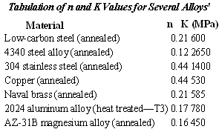
Empirical relations for strain hardening (Cont..):
In the formula σ = K ε ^{n}, σ represents the applied stress on the material, ε is the strain and K is the strength coefficient.
The value of the strain hardening exponent lies between 0 and 1.
A value of 0 means that a material is a perfectly plastic solid, while a value of 1 represents a 100% elastic solid.
Most metals have an n value between 0.10 and 0.50.

Slide 102
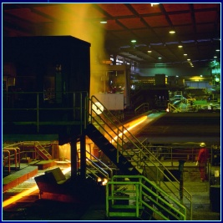
Rolling of metals

Slide 103
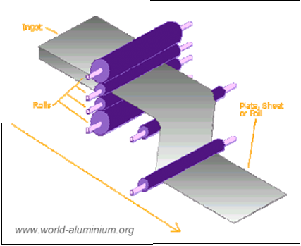
Introduction- Definition of rolling process:
Definition of Rolling :
The process of plastically deforming metal by passing it between rolls.
• Rolling is the most widely used forming process, which provides high production and close control of final product.
Rolling process
The metal is subjected to high compressive stresses as a result of the friction between the rolls and the Rolling process metal surface.
Rolling processes can be mainly divided into
1) hot rolling and
2) cold rolling.

Slide 104
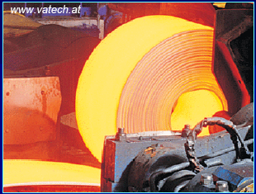
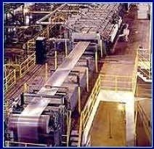
Introduction- Hot and cold rolling processes:
Hot rolling
• The initial breakdown of ingots into blooms and billets is generally done by hot-rolling.
This is followed by further hot-rolling into plate, sheet, rod, bar, pipe, rail.
Cold rolling
• The cold-rolling of metals has played a major role in industry by providing sheet, strip, foil with good surface finishes and increased mechanical strength with close control of product dimensions.

Slide 105
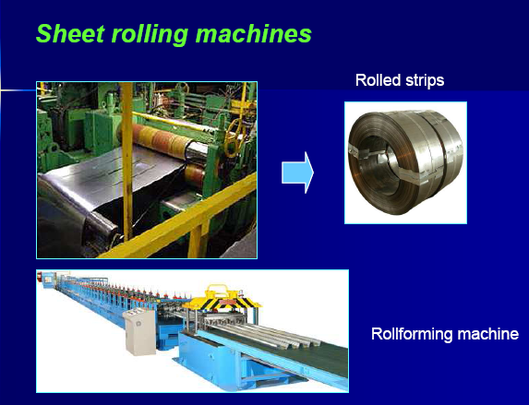

Slide 106
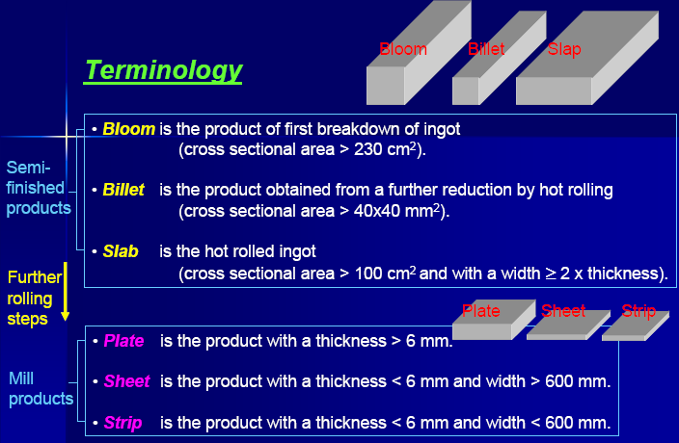

Slide 107
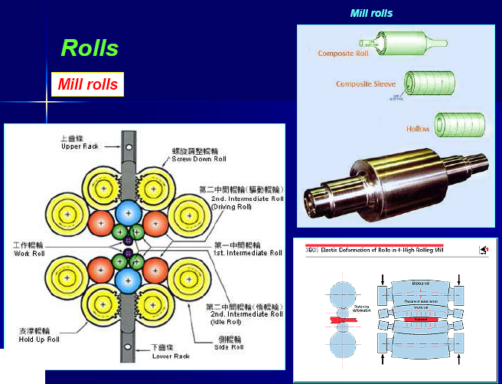

Slide 108
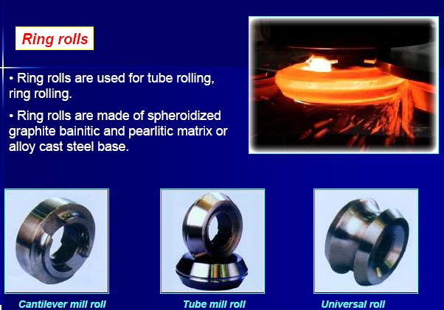

Slide 109
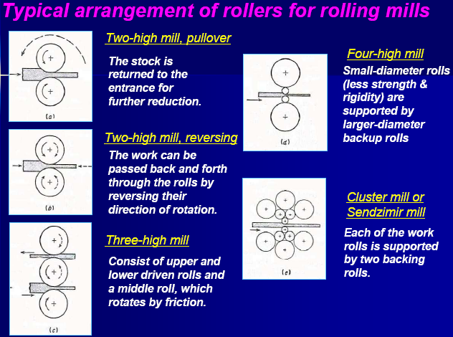

Slide 110
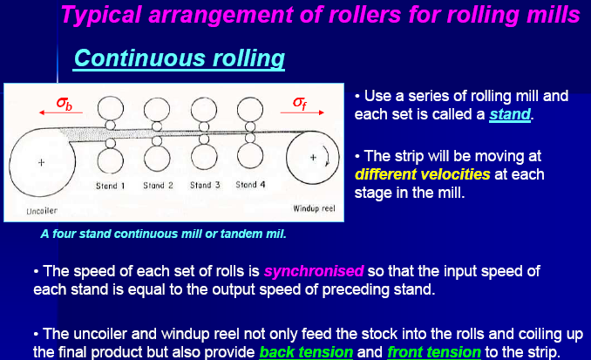

Slide 111
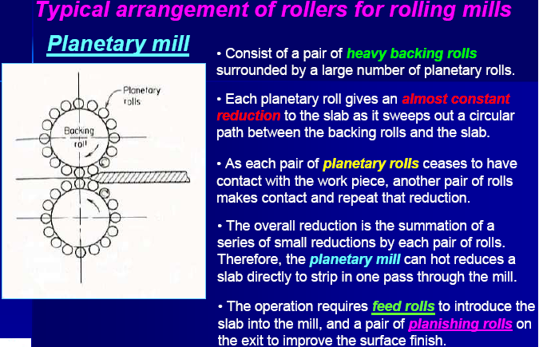

Slide 112
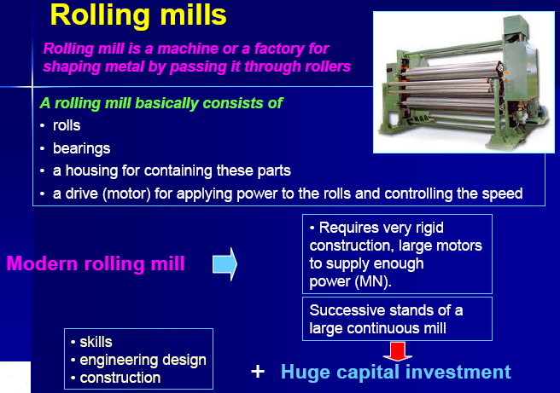

Slide 113
Different types of rolling processes:
Continuous rolling
Transverse rolling
Shaped rolling or section rolling
Ring rolling
Powder rolling
Continuous casting and hot rolling
Thread rolling

Slide 114
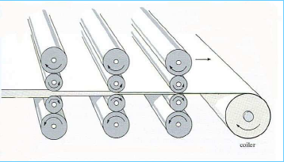

Conventional hot or cold-rolling:
The objective is to decrease the thickness of the metal with an increase in length and with little increase in width.
The material in the centre of the sheet is constrained in the z direction (across the width of the sheet) and the constraints of undeformed shoulders of material on each side of the rolls prevent extension of the sheet in the width direction.
This condition is known as plane strain. The material therefore gets longer and not wider.
Otherwise we would need the width of a football pitch to roll down a steel ingot to make tin plate!

Slide 115
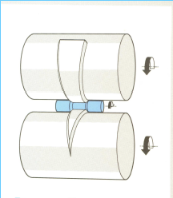
Transverse rolling:
Using circular wedge rolls.
Heated bar is cropped to length and fed in transversely between rolls.
Rolls are revolved in one direction.

Slide 116
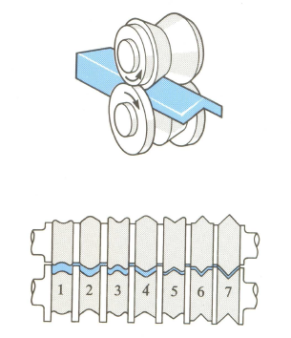
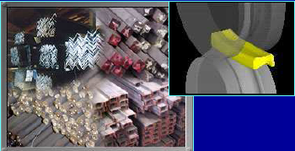
Shaped rolling or section rolling:
A special type of cold rolling in which flat slap is progressively bent into complex shapes by passing it through a series of driven rolls.
No appreciable change in the thickness of the metal during this process.
Suitable for producing molded sections such as irregular shaped channels and trim.

Slide 117
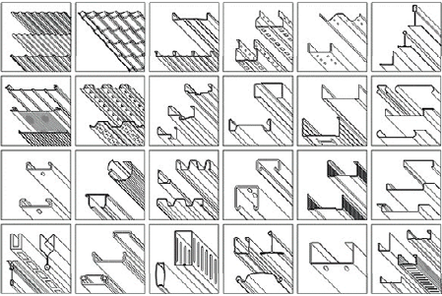
Shaped rolling or section rolling (Cont..):
A variety of sections can be produced by roll forming process using a series of forming rollers in a continuous method to roll the metal sheet to a specific shape
www.formtak.com
A variety of rolled sections
Applications:
- construction materials, - automotive parts
- household appliances - metal furniture,
door and window frames - other metal products.
- partition beam - ceiling panel
- roofing panels. - steel pipe

Slide 118
Roll pass sequence:

Slide 119
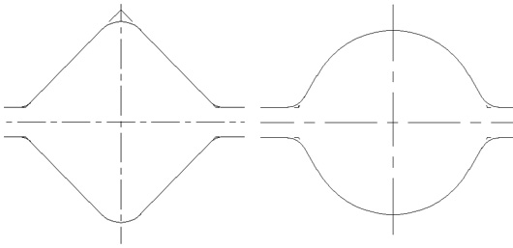
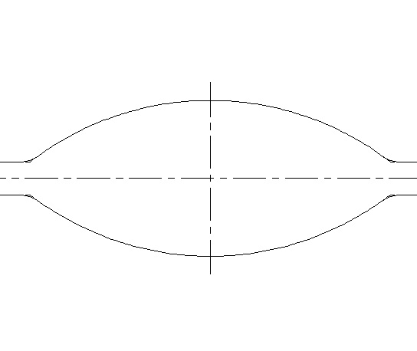
Roll pass sequence:
Terminology:
Two facing grooves form a ‘roll pass’, or simply a ‘pass’..
The distance between the barrels of two rolls is called the ‘nominal roll gap’, or ‘theoretical roll gap’.
Definite passes – those having two equal axes in an x, y plane (Squares, Rounds)
Intermediate passes – those having one axis larger than the other one (Rectangles – box, Diamonds, Ovals)

Slide 120

Roll pass sequence (Cont..):
Terminology (Cont..):
A definite bar into one intermediate pass, or an intermediate bar into one definite pass configures a ‘deformation’. For example, a square into an oval pass, or an oval into a square pass. A deformation can produce any type of bar
A definite bar into two passes (an intermediate pass followed by a definite pass, configures a ‘sequence’. A sequence only produces a definite bar.

Slide 121
Roll pass sequence (Cont..):
Terminology (Cont..):
Continuous rolling process - The long axis of the bar is brought between the rolls and is rolled in to a shape with equal axes, then this shape is rolled into a different shape with different axes, and so on. The reduction must be applied after a 90-degree rotation of the bar at each stand.

Slide 122


Roll pass sequence (Cont..):
Terminology (Cont..):
Traditional mills only use horizontal stands. The ovals are twisted to bring the long axis between the rolls.
To be precise, there is one deformation that needs special treatment: the square-into-oval. It needs rotating the square by 45°, which can be obtained (if we don't want to use twister guides) with a slight axial displacement of one roll in the stand that produces the square.

Slide 123

Roll pass sequence (Cont..):
Terminology (Cont..):
  The Mills: Continuous bar mill (CBM) structure consists of a number of independent stands. 'Independent' means that each stand has its own motor (and kinematic chain), whose rotational speed can be freely altered. If you don't want the bar to be twisted you use the HV mill configuration (with definite passes in vertical stands).
  From the roll pass design point of view, a CBM can be schematized as a succession of passes centered on the z-axis (when x,y is the plane containing the roll axes).

Slide 124
Number of passes required:
Billet Size | Area | Finished Size | Area of finished bar | Co-efficient of elongation | No. of passes
150 | 22500 | 12 | 113.1429 | 198.8636 | 20.78453
150 | 22500 | 16 | 201.1429 | 111.8608 | 18.52503
150 | 22500 | 20 | 314.2857 | 71.59091 | 16.77243
150 | 22500 | 22 | 380.2857 | 59.16604 | 16.02385
150 | 22500 | 25 | 491.0714 | 45.81818 | 15.01982
150 | 22500 | 28 | 616 | 36.52597 | 14.12972
150 | 22500 | 32 | 804.5714 | 27.9652 | 13.08094
150 | 22500 | 36 | 1018.286 | 22.09596 | 12.15586
150 | 22500 | 40 | 1257.143 | 17.89773 | 11.32834

Slide 125
Laws of Rolling:
First Law: The purpose of the rolling process is to start from a relatively short bar with a large section area, aiming to obtain a very long product with a small section area. Then, the first law to remember is that the volume (or the weight) is a constant: from a 1/2-ton billet you will obtain a 1/2-ton coil. Cross sectional area times bar length is a constant (this is not strictly true for CBMs: some weight will be lost with scale and crop ends; but we can afford to neglect that loss.)
Second Law: There is another, important law to remember: the flow is also a constant. Say that the exit bar from stand 1 has cross sectional area = 3467 sq mm and the finished round has cross-sectional area = 113 sq mm (hot bar dimensions). If the finished stand delivers at a speed of 12 mps, then stand 1 must 'run' at 0.39 mps: 0.3 x 3467 = 12 x 113. In this case the constant is about 1050, i.e., if you know the areas, you can immediately calculate the exit speeds. And, you have no problems in setting the speed at each stand, as each stand has its own independent motor.

Slide 126

Action & Reactions:
When rolling, we can identify one action and two reactions.
If we focus on a horizontal stand of a continuous mill for rounds, we see:
    - that the rolls apply a 'reduction' (vertically);
    - that this reduction produces a wanted 'elongation';
    that reduction produces a wanted 'spread' (sideways).
    Spread:
When the steel is compressed in the rolls it will obviously move in the direction of least resistance, so usually there is not only longitudinal flow but also some lateral flow.
This is called ‘Spread”. it is generally accepted that beyond a ratio width/height = 5, spread becomes negligible.
D_{h} – the absolute draught in the pass
ho – stock thickness before the pass. R – roll radius; f– coefficient of friction .
The coefficient of Spread, Beta is the ratio between exit and entry width and is normally > 1

Slide 127
Reduction and Elongation:
Reduction (with a coefficient of reduction Gamma)
Elongation (with a coefficient of elongation Lambda).
  Gamma (defined as ratio between exit and entry height) is always < 1. If we reduce a 100x10 flat to 8 mm (a 20% reduction), Gamma=0.8.
  Lambda (defined as ratio between exit and entry length, but more often as ratio between entry and exit section area) is always > 1. In the example above (100x10 reduced to 100x8) Lambda = 1000/800 = 1.25. Note that Beta = 1. (100/100 =1)
Beta, Gamma & Lamda: The rolling process can be synthesized by one equation: Beta x Gamma x Lambda = 1. Which is a mathematical way of saying that the volume is a constant.

Slide 128
Bar Dimensions & Formulae:
Hot & Cold Dimensions:
  Dimensions in mm refer to COLD bars. Corresponding hot bars have slightly larger dimensions due to the coefficient of linear expansion of steel, assumed to be 1.013.
Important Formulae:
Square Dimensions :A 90° square with side s and corner radius r has area: A=s^2-0.86*r^2 (1)
  and actual 'reduced' diagonal: d=s*√ (2)-0.83*r (2)
  Note: Square grooves generally have facing angles alpha = 90° only for larger squares. Generally, facing angle alpha is taken as 90° for s > 45 mm, 91° down to 25 mm and 92° for s <= 25 mm.
  In these cases the actual reduced diagonal has length:
  d=s/sin(alpha/2)+2*r*(1-1/(sin(alpha/2)) (3)

Slide 129


Important Formulae:
Oval Radius
  An oval pass is made of two circular arcs with facing concavities. Three dimensions are considered, referring either to pass or to bar:
    b_{1t} = theoretical oval width (pass, not physically measurable)
    b_{1r} = actual oval width (bar, physically measurable)
    max_{w} = maximum oval width (pass, physically measurable)
  If b_{1r} becomes > max_{w} , pass overfilled will be overfilled.
The Square Pass
Oval Pass

Slide 130
Roll Pass Sequence:
For commercial sections, grooved rolls are used.
The type of grooving done is decided by the final section desired.
The roll-pass sequence can be broadly categorized into three types.
Break down passes These are used for reducing the cross-sectional area nearer to what is desired. These would be the first to be present in the sequence.
Roughing passes In these passes also, the cross-section gets reduced, but along with it, the shape of the rolled material comes nearer to the final shape.
Finishing passes These arc the final passes, which give the required shape of the rolled section. Generally, the finishing pass follows a leader pass.

Slide 131

Roll Pass Sequence(Cont..):
Draught:
In order to design the roll-pass schedule, the first to be considered is the draught or elongation in each of the passes.
The total elongation can be calculated by dividing the initial area of the cross section by the final area of cross section of the rolled product.
Total elongation = (Initial crossectional area)/ Final crossectional area
The elongation can be defined as total for all the passes or that for each pass separately.
Draught of any given pass specifies the reduction achieved in the dimensions. Consider a rectangle, as shown in Fig. , as reduced from A * B to a * b mm.
Then Draught = A + B - (a + b)

Slide 132
Roll Pass Sequence(Cont..):
If we know the mean draught to be provided in each pass then the number of passes can be estimated.
But the draught provided in each pass also depends on
  The work material angle of bite,
  Roll strength
  Power of the rolling mill and
  The condition of the roll.
  The draughts of all the passes in the sequence are not same.
  In the initial passes, it is necessary to reduce as much cross-sectional area as possible.

Slide 133
Roll Pass Sequence(Cont..):
  This means that the main criterion for choosing the draught is therefore to be the angle of bite or the maximum size the rolls can pull under them.
  In rolling plain shapes such as plates or sheets or intermediate passes, it is the strength of the rolls or the available power of the motors, which limit the draught.
  For finishing passes, roll wear may be the limiting factor in deciding the draught.
  For sections of complex shapes such as rails, it is necessary to reduce the roll wear to a minimum to obtain accurate dimensions and good surface finish.
  The other reason for reducing draught in the later passes in hot rolling is the reduction in stock thickness which causes it to lose heat quickly and thus increases the rolling load. Similarly in cold rolling, the strain hardening of the stock material necessitates a reduction in draught in the succeeding passes.

Slide 134

Roll Pass Sequence(Cont..):
Break Down Passes:
The principal breakdown pass sequences are
    Box-pass series
    Diamond-square series
    Oval-square series
These breakdown pass series are schematically shorn in fig.

Slide 135
Roll Pass Sequence(Cont..):
Box-Pass Series:
Box passes are generally used for initial, medium and large sections of blooming and billeting.
The rolls of box pass series are stronger.
They can be used for different sizes by screwing down the top roll.
They provide for effective descaling and ensure uniform draught along the width of the bar.
The main problem with these are the smaller elongation (1.05 to 1.15) and inaccurate square produced because the side spread is cm controlled.
They are generally used for larger products.

Slide 136
Roll Pass Sequence(Cont..):
Diamond-square Series:
In this, the square produced in a larger roll is turned over by 90 degrees and passed through the diamond rolls, the output of which is again turned over by 90 degrees and put through smaller square rolls as shown in Fig. 7.11(b).
The advantages of this series are the slow cooling of the entire material, accurate squares that arc possible and larger elongations that can be achieved (1.20 to 1.45).
Because of these specific advantages, these are extensively used in the finishing passes of the comparatively smaller sections such as billets.

Slide 137
Roll Pass Sequence(Cont..):
The material being confined fully, these type of passes give a good stability and also uniform deformation of the material.
The two principles that are generally used in designing the diamond-square series is to keep the height of one pass equal to the width of the next pass or the height of one pass less than the width of the next pass.
The disadvantage with the series is that the roll gets weakened because of deep impression made into the rolls.

Slide 138
Roll Pass Sequence(Cont..):
Oval Square Series:
In this series the diamond is replaced by oval shape.
The stock after going through the oval pass, it turned over by 90 degrees into the square pass out of which is then turned over by 45 degrees to feed into the next oval pass.
The main advantage of this series is the large elongation that can be obtained (1.35 to 1.80) compared to the other break­down passes.
The main problems of this are the dif­ficulty to guide the stock in oval pass, the nonuniformity of the deformation along the width of the roll and higher-roll wear in oval pass.

Slide 139
Roll Pass Sequence(Cont..):
Oval Square Series:
When higher reductions are used, the material is likely to give rise to surface defect called fold because of the wearing of the oval pass at a point of maximum reduction, which cannot be eliminated.
The oval pass has some other variants as shown in Fig. main problems of this are the dif­ficulty to guide the stock in oval pass, the nonuniformity of the deformation along the width of the roll and higher-roll wear in oval pass.
When higher reductions are used, the material is likely to give rise to surface defect called fold because of the wearing of the oval pass at a point of maximum reduction, which cannot be eliminated.
The oval pass has some other variants as shown in Fig.

Slide 140

Roll Pass Sequence(Cont..):

Slide 141
Roll Pass Sequence(Cont..):
Roll-Pass Sequence design:
Designing roll passes is a fairly complex and skilled art.
Here, we will only refer to some salient points to be considered in the design of the roll passes.
Before deciding on the actual sequence, it is necessary to consider the requirements of the final product.
Since hot rolling is finished at a high temperature of the order of 900 to 1100 °C depending on the material, the dimension of the finishing pass should take into account the linear expansion of the metal to be used, at this temperature.

Slide 142
Roll Pass Sequence(Cont..):
Pass Schedule For Blooms :
The most normally used passes in blooming mills are the plain sectioned rolls or bull-head passes.
The main advantages of the bull-head passes are that the strength of the roll is not affected by any grooves; very good descaling of the stock in the initial pass itself, and higher draughts that can be achieved.
If bull-head passes are chosen as initial passes, then large-sized rolls can be applied.

Slide 143
Roll Pass Sequence(Cont..):
While deciding the number of passes, the other factor to be considered is the number of times the bar is turned over.
To increase the output of the mill, it is desirable that the bar be turned over as few times as possible.
To obtain high-quality blooms, it should be turned over as many times as possible, otherwise the stock is likely to form cracks and fissures, if reduced in only one direction.

Slide 144

Roll Pass Sequence(Cont..):
The draughting schedule of a typical blooming mill is presented in Table

Slide 145
Roll Pass Sequence(Cont..):
Rolling of Rounds:
The types of possible sequences for finishing passes for rolling round sections are presented in Fig.
Depending upon the starting stock size, the necessary break down passes, as explained earlier, are to be employed before this sequence.
The most generally used pass sequence for smaller rounds from 5 to 20 mm is the one shown in Fig. (a).
For higher size rounds of 20 to 100 mm, the pass sequence shown in (b) is used.

Slide 146
Roll Pass Sequence(Cont..):
Rolling of Rounds:
Because of the flat box pass incorporated, descaling is done effectively and also the leader pass (the one just before the finish pass) is universal for a number of (5 to 6) round of sizes.
The other advantage with this is that the edge pass (the one before the leader pass) causes a bulge in the material on the side, thereby decreasing the roll wear in the oval pass immediately after it.
Rounds requiring special steels and better quality are obtained by the rolling sequence shown in Fig. 7.13(c).
The main feature here is that all the passes shown are without any sharp comers thus maintaining uniform tem­perature throughout he material.
For obtaining exact round section special steel, the oval-oval sequence at shown in Fig, 7.13(d) is used.

Slide 147

Roll Pass Sequence(Cont..):
Rolling of Rounds:
Fig. Various pass sequences for rolling round sections.

Slide 148

Roll Pass Sequence(Cont..):
The handing of material in the oval passes is difficult and hence the vertical oval is slightly modified to improve the liability.
A typical sequence of roll passes to obtain a 12 mm rod from a billet of 100 * 100 mm is shown in Fig.

Slide 149
Roll Pass Sequence(Cont..):
Rolling of sections:
The rolling of structural section is more difficult because of the presence of flanges. Shapes with flange are generally rolled in closed passes.
A closed pass is one where the complete shape of the pass is in one roll, as shown in Fig. (a).
The open pass as shown in Fin. (b) is the one where part of the pass is present in each of the two rolls.
In these passes the deformation not uniform and also, the roll wear poses a serious problem.
When any appreciable roll wear is noticed the rolls are to be discarded because any restoration increases the paw size, thus changing the final dimensions.

Slide 150

Roll Pass Sequence(Cont..):

Slide 151

Roll Pass Sequence(Cont..):
Rolling of sections:
The types of pass sequences that are used for channel section are shown in Fig.
By the method called beam rolling, the flange section of large thickness are formed to aid in the feeding of the metal into the roll and also to reduce the cooling of the flange.
In the leader and final passes, these are rolled down to the final shape as shown in Fig. (a).
Pass sequence for rolling channel section.

Slide 152

Roll Pass Sequence(Cont..):
Rolling of sections:
In an alternative method called butterfly method, the chan­nel is considered as two angles.
The stock can be rolled into splayed (spreaded out) flanges in initial passes as shown in Fig. (b).
This method helps in obtaining flanges with no taper in sides, and also a sharp comer between the web and the inner flange face.
Pass sequence for rolling channel section.

Slide 153

Roll Pass Sequence(Cont..):
A different kind of splaying the flanges is shown in Fig. 7.16(c), which reduces the groove depth in rolls, reducing the weaken­ing effect.
This permits higher draught per pass and consequently less number of passes. Also, the wear is less in grooves because the surface speeds are more or less uniform at all points.
This has a favorable effect on the surface quality of channels produced. But, due to splaying, the width of the groove increases and conse­quently, it is not used for heavier sections.
Pass sequence for rolling channel section.

Slide 154

Roll Pass Sequence(Cont..):
Rolling of sections: Pass sequence for rolling channel section.

Slide 155
Rolling of sections:
The pass sequences used for rolling angles are presented in Fig.
In the sequence shown at Fig. 7.17(a), the flanges are initially flat but are gradually bent in the roughing and leader passes such that by the time the finishing pass comes, the flanges would have reached the 90 degree angle.
The main disadvantage with this sequence is the deep grooves in the rolls which change the working speed at various points in the pass, causing higher roll wear, higher power requirements and poor surface finish.

Slide 156

Roll Pass Sequence(Cont..):
Rolling of sections: Angle

Slide 157
Roll Pass Sequence(Cont..):
Rolling of sections:
The butterfly passes sequence shown in Fig. (b), which has the splayed sections as that of the channels in minimizing many of the above problems.
The universal pass sequence shown in Fig. (c) utilize a number of passes where the side spread is not controlled.
Hence the same rolls can be used for any size of angles required.
These are economical and therefore generally used for high production mills.

Slide 158
Forging

Slide 159


Forging: Introduction
Forging is the working of metal into a useful shape by hammering or pressing.
The oldest of the metalworking arts (primitive blacksmith).
Replacement of machinery occurred during early the Industrial revolution.
• Forging machines are now capable of making parts ranging in size of a bolt to a turbine rotor.
Most forging operations are carried out hot, although certain metals may be cold-forged.

Slide 160




Forging: Operations
Edging is used to shape the ends of the bars and to gather metal. The metal flow is confined in the horizontal direction but it is free to flow laterally to fill the die.
Drawing is used to reduce the cross-sectional area of the workpiece with concurrent increase in length.
Piercing and punching are used to produce holes in metals.

Slide 161




Forging: Operations (Cont..)
Fullering is used to reduce the cross-sectional area of a portion of the stock. The metal flow is outward and away from the centre of the fuller. i.e., forging of connecting rod for an internal combustion engine.
Fuller move fast and moves metal perpendicular to the face

Slide 162


Forging: Operations (Cont..)
Swaging is used to produce a bar with a smaller diameter (using concave dies).
Swaging provides a reduced round cross section suitable for tapping, threading, upsetting or other subsequent forming and machining operations.
Swaging is a special type of forging in which metal is formed by a succession of rapid hammer blows

Slide 163
Forging: Classification of forging processes
By equipment
1) Forging hammer or drop hammer forging
2) Press forging
By process
1) Open - die forging
2) Closed – die forging

Slide 164


Forging: Forming machines
There are four basic types of forging machines

Slide 165
Forging: Hammer and press forging processes
Forging hammers
There are two basic types of forging hammers used;
    Board hammer
    Power hammer
Forging presses
There are two basic types of forging presses available;
    Mechanical presses
    Hydraulic presses

Slide 166


Forging: Board hammer –forging hammer
The upper die and ram are raised by friction rolls gripping the board.
After releasing the board, the ram falls under gravity to produce the blow energy.
The hammer can strike between 60-150 blows per minute depending on size and capacity.
The board hammer is an energy restricted machine.
The blow energy supplied equal the potential energy due to the weight and the height of the fall.
This energy will be delivered to the metal workpiece to produce plastic deformation.

Slide 167

Forging: Forging hammer or drop hammer
Provide rapid impact blows to the surface of the metal.
Dies are in two halves
  Lower : fixed to anvil
  Upper : moves up and down with the TUP.
Energy (from a gravity drop) is adsorbed onto the metal, in which the maximum impact is on the metal surface.
Dies are expensive being accurately machined from special alloys (susceptible to thermal shock).
• Drop forging is good for mass production of complex shapes.

Slide 168

Forging: Example: Forging hammer or drop hammer
The energy supplied by the blow is equal to the potential energy due to the weight of the ram and the height of the fall.

Slide 169


Power hammer
Forging: Power hammer
•
Power hammer provides greater capacity, in which the ram is accelerated on the down-stroke by steam or air pressure in addition to gravity.
Steam or air pressure is also used to raise the ram on the upstroke.
The total energy supplied to the blow in a power drop hammer is given by
Where m = mass, v = velocity of ram at start of deformation, g = acceleration of gravity, p = air or steam pressure acting on ram cylinder on down-stroke, A = area of ram cylinder, H = height of the ram drop

Slide 170

Forging: Hydraulic press forging
Using a hydraulic press or a mechanical press to forge the metal, therefore, gives continuous forming at a slower rate.
Provide deeper penetration.
Better properties (more homogeneous).
• Equipment is expensive.

Slide 171

Forging: Example: Hydraulic Press forging
Hydraulic presses are load restricted machines in which hydraulic pressure moves a piston in a cylinder.
The full press load is available at any point during the full stroke of the ram.
Therefore, hydraulic presses are ideally suited for extrusion-type forging operation.
Due to slow speed, contact time is longer at the die-metal interface, which causes problems such as heat lost from workpiece and die deterioration.
Also provide close-tolerance forging.
Hydraulic presses are more expensive than mechanical presses and hammers.

Slide 172


Forging: Mechanical press forging
Crank press translates rotary motion into reciprocating linear motion of the press slide.
The ram stroke is shorter than in a hammer or hydraulic press.
Presses are rated on the basis of the force developed at the end of the stroke.
The blow press is more like squeeze than like the impact of the hammer, therefore, dies can be less massive and die life is longer than with a hammer.
• The total energy supplied during the stroke of a press is given by
Where I is moment of inertia of the flywheel ω is angular velocity, ω_{o}-original, ω_{f-}after deformation, rad.s-1

Slide 173

Forging: Typical values of velocity for different forging equipment

Slide 174

Forging: Closed and open die forging processes

Slide 175

Forging: Open-die forging
Open-die forging is carried out between flat dies or dies of very simple shape.
The process is used for mostly large objects or when the number of parts produced is small.
Open-die forging is often used to pre-form the workpiece for closed-die forging.

Slide 176

Forging: Closed-die forging (or impression-die forging)
The workpiece is deformed between two die halves which carry the impressions of the desired final shape.
The workpiece is deformed under high pressure in a closed cavity.
Normally used for smaller components
The process provide precision forging with close dimensional tolerance.
Closed dies are expensive.

Slide 177


Forging: Closed-die forging operation

Slide 178

Forging: Functions of flash
The flash serves two purposes:
Acts as a ‘safety value’ for excess metal.
Builds up high pressure to ensure that the metal fills all recesses of the die cavity.
Remark: It is necessary to achieve complete filling of the forging cavity without generating excessive pressures against the die that may cause it to fracture.

Slide 179

Forging: Example: Die set and forging steps for the manufacturing of an automobile engine connecting rod

Slide 180
Forging: Closed-die design
Usually the deformation in closed-die forging is very complex and the design of the intermediate steps to make a final precision part requires considerable experience and skill.
The design of a part for production by closed-die forging involves the prediction of
    Workpiece volume and weight
    Number of pre-forming steps and their configuration
    Flash dimensions in performing and finishing dies the load and energy requirement for each forging operation, for example; the flow stress of the materials, the fictional condition, the flow of the material in order to develop the optimum geometry for the dies.

Slide 181

Forging: Shape classification
The degree of difficulty increases as the geometry moves down and toward the right.
Simple parts are symmetry shape, or parts with circular, square and similar contours.

Slide 182

Forging: Shape classification
More complicated parts have pronounced longitudinal axis and are curved in several planes.

Slide 183

Forging: Preform design
Pre-form design is the most difficult and critical step in forging design.
Proper preform design assures defect-free flow, complete die fill, and minimum flash loss.
Metal flow consists only of two basic types
  extrusion (flow parallel to the direction of the die motion)
  upsetting ( flow perpendicular to the direction of the die motion).
However both types of metal flow occur simultaneously.
We need to identify the neutral surface since metal flows away from the neutral surface in a direction perpendicular to the die motion.

Slide 184

Forging: Metal flow in forging
Finite element analysis was originally developed to model the elastic deformation of complex structures but recently has been extended to cover large plastic deformation under real stress system.
It is a numerical modeling technique that involves splitting the whole of a body into a series of simple geometrical elements that are joined together at points (nodes) where both equilibrium (lower bound) and compatibility (upper bound) requirement are established.

Slide 185

Forging: General considerations for preform design
Area of each cross section = area in the finished cross section
Concave radii of the preform > radii on the final forging part.
Cross section of the preform should be higher and narrower than the final cross section, so as to accentuate upsetting flow and minimize extrusion flow.
Shape with thin and long sections or projections (ribs and webs) are more difficult to process because they have higher surface area per unit volume increasing friction and temperature effects.

Slide 186

Forging: General rules of closed-die design
The die set should be designed for smooth metal flow – symmetry dies (spherical or blocklike) are the easier than thin and long section.
Shape changes in section are to be avoided.
Dies should be designed for the minimum flash to do the job.
Generous fillet dimensions should be allowed, therefore, forging dies must be tapered or drafted to facilitate removal of the finished piece.
Draft allowance is approximately 3-5o outside and 7-10o inside.
Dies with inclined angles should have counterlock to prevent the dies from sliding apart from each other due to side thrust.

Slide 187
Forging: Die materials
Required properties:
Thermal shock resistance
Thermal fatigue resistance
High temperature strength
High wear resistance
High toughness and ductility
High hardenability
High dimensional stability during hardening
High machinability

Slide 188

Forging: Die materials
Note:
Carbon steels with 0.7-0.85% C are appropriate for small tools and flat impressions.
Medium-alloyed tool steels for hammer dies.
Highly alloyed steels for high temperature resistant dies used in presses and horizontal forging machines.
Die materials: alloyed steels (with Cr,
Mo, W, V), tool steels, cast steels or cast iron. (Heat treatments such are nitriding or chromium plating are required to improve die life)

Slide 189

Forging: Die materials
Common steels used for forging dies

Slide 190

Forging: Die materials
Die life can be increased by
1) Improving die materials such as using composite die or
2) Using surface coating or self-lubricating coatings.
http://www.eere.energy.gov/industry/supporting_industries/pdfs/innovative_die_materials.pdf
Ultra hard surface coatings
Ultra hard surface coating on die surface is used to
Improve die life.
Reduce energy input.
Reduce die-related uptime and downtime.
Reduce particulate emission from lubricants.

Slide 191
Forging: Die failures
Different types of die failure:
Different parts of dies are liable to permanent deformation and wear resulting from mechanical and thermal fatigue.
Important factors:
    Shape of the forging,
    Die materials,
    How the workpiece is heated,
    Coating of die surface,
    The operating temperature (should not exceed the annealing temperature).

Slide 192

Forging: Die failures (Cont..)
Different types of die failure (Cont..)

Slide 193


Forging: Calculation of forging loads
The total energy required for deformation process;
Efficiency of a given deformation process η is
Note: redundant work = work that does not contribute to shape change of the workpiece
The calculation for forging load can be divided into three cases according to friction:
  In the absence of friction
  Low friction condition (lower bound analysis or sliding condition)
  High friction condition (sticky friction condition)

Slide 194

Forging: Calculation of forging loads

Slide 195

Forging: Calculation of forging loads

Slide 196

Forging: Low friction condition (Lower bound analysis)
By considering the equilibrium of forces acting on the workpiece at any instant of deformation.
For example, if we consider the effect of friction on an upset forging operation in plane strain condition (rigid-plastic behavior, see Fig).
To calculate the total forming load, we have to determine the local stresses needed to deform each element of a workpiece of height h and width 2a.
In plane strain condition, as the workpiece is reduced in height, it expands laterally and all deformation is confined in the x-y plane.
This lateral expansion causes frictional forces to act in opposition to the movement.
• Assuming that there is no redundant work and the material exhibits rigid-plastic behavior, and all stress on the body are compressive.

Slide 197

Forging: Low friction condition (Lower bound analysis)
Consider the force acting on a vertical element of unit length and width dx.
The element is at some distance x from the central ‘no-slip’ point, in this case to the right.
The vertical force acting on the element is stress area dx y × =σ
If the coefficient of friction for the die-workpiece interface is μ, the magnitude of the friction force will be μσydx.
The frictional force acts at both ends of the element so the total horizontal force from the right is 2μσydx.
Acting on the left will be the force σxh and from the right the force (σx+dσx)h.
The horizontal compressive stress σx varies from a maximum at the centre of the workpiece to zero at the edge and changes by dσx across the element width dx.

Slide 198

Forging: Low friction condition (Lower bound analysis)

Slide 199

Forging: Low friction condition (Lower bound analysis)

Slide 200

Forging: Low friction condition (Lower bound analysis)

Slide 201

Forging: Low friction condition (Lower bound analysis)

Slide 202

Forging: Low friction condition (Lower bound analysis)

Slide 203

Example:
The flash has high deformation resistance than in the die (due to much higher a/h ratio), therefore the material completely fills the cavity rather than being extruded sideward out of the die.

Slide 204


Forging: High friction condition (sticky friction)
In the situation where the friction force is high, the stress acting on the metal is
Under these conditions, the forming load is dependent on the flow stress of the material and the geometry of the workpiece.
For example: if the a/h ratio is high, say a/h = 8, then p = 5σ’_{o}. The local stress on the tooling can therefore be very high indeed and 5σ’_{o} is probably high enough to deform the tooling in most cold forming operation.
Solutions:
Reducing μ to ensure that sticking friction conditions do not apply.
Changing the workpiece geometry.
Reducing σ’_{o} by increasing the temperature.

Slide 205

Forging: High friction condition (sticky friction)

Slide 206

Forging: High friction condition (sticky friction)

Slide 207

Forging: High friction condition (sticky friction)

Slide 208

Effect of forging on microstructure:
The formation of a grain structure in forged parts is elongated in the direction of the deformation.
• The metal flow during forging provides fibrous microstructure (revealed by etching). This structure gives better mechanical properties in the plane of maximum strain but (perhaps) lower across the thickness.
• The workpiece often undergo re-crystallisation, therefore, provide finer grains compared to the cast dendritic structure resulting in improved mechanical properties.

Slide 209

Forming textures:
Redistribution of metal structures occurring during forming process involves two principle components;
1) redistribution of inclusions and
2) crystallographic orientation of the grains
Redistribution
during forming of
(a) soft inclusions
(b) hard inclusions

Slide 210

Forming textures:

Slide 211
Residual stresses in forging:
The residual stress produced in forgings as a results of inhomogeneous deformation are generally small because the deformation is normally carried out well into the hot-working region.
However, appreciable residual stresses and warping can occur on the quenching of steel forgings in heat treatment.
Large forgings are subjected to the formation of small cracks, or flakes at the centre of the cross section. This is associated with the high hydrogen content usually present in steel ingots of large size, coupled with the presence of residual stresses.
Finite element analysis is used to predict residual stresses in forgings.

Slide 212

Typical forging defects:
Incomplete die filling.
Die misalignment.
Forging laps.
Incomplete forging penetration- should forge on the press.
Microstructural differences resulting in pronounced property variation.
Hot shortness, due to high sulphur concentration in steel and nickel.

Slide 213

Typical forging defects:
Pitted surface, due to oxide scales occurring at high temperature stick on the dies.
Buckling, in upsetting forging. Subject to high compressive stress.
Surface cracking, due to temperature differential between surface and centre, or excessive working of the surface at too low temperature.
Micro-cracking, due to residual stress.

Slide 214

Typical forging defects:
Flash line crack, after trimming-occurs more often in thin workpieces. Therefore should increase the thickness of the flash.
Cold shut or fold , due to flash or fin from prior forging steps is forced into the workpiece.
• Internal cracking, due to secondary tensile stress.

Slide 215
Extrusion

Slide 216

Introduction to extrusion:
Extrusion is the process by which a block/billet of metal is reduced in cross section by forcing it to flow through a die orifice under high pressure.
In general, extrusion is used to produce cylindrical bars or hollow tubes or for the starting stock for drawn rod, cold extrusion or forged products.
Most metals are hot extruded due to large amount of forces required in extrusion. Complex shape can be extruded from the more readily extrudable metals such as aluminum.
* The products obtained are also called extrusion.

Slide 217

Introduction to extrusion (Cont..):
The reaction of the extrusion billet with the container and die results in high compressive stresses which are effective in reducing cracking of materials during primary breakdown from the ingot.
This helps to increase the utilization of extrusion in the working of metals that are difficult to form like stainless steels, nickel-based alloys, and other high-temperature materials.
Similar to forging, lower ram force and a fine grained recrystallised structure are possible in hot extrusion.
However, better surface finish and higher strengths (strain hardened metals) are provided by cold extrusion.

Slide 218

Extrusion products:

Slide 219
Classification of extrusion processes:
There are several ways to classify metal extrusion processes;
By direction
  Direct / Indirect extrusion
  Forward / backward extrusion
By operating temperature
  Hot / cold extrusion
By equipment
  Horizontal and
  vertical extrusion

Slide 220


Direct and indirect extrusions:
1) Direct extrusion:
The metal billet is placed in a container and driven through the die by the ram.
The dummy block or pressure plate, is placed at the end of the ram in contact with the billet.
Friction is at the die and container wall requires higher pressure than indirect extrusion.
2) Indirect Extrusion
The hollow ram containing the die is kept stationary and the container with the billet is caused to move.
Friction at the die only (no relative movement at the container wall) requires roughly constant pressure.
Hollow ram limits the applied load.

Slide 221

Forward and backward extrusion:
Extrusion can also be divided to:
1) Forward extrusion
Metal is forced to flow in the same direction as the punch.
The punch closely fits the die cavity to prevent backward flow of the material.
2) Backward extrusion
Metal is forced to flow in the direction opposite to the punch movement.
Metal can also be forced to flow into recesses in the punch, see Fig.

Slide 222


Cold extrusion:
Cold extrusion is the process done at room temperature or slightly elevated temperatures.
This process can be used for most materials-subject to designing robust enough tooling that can withstand the stresses created by extrusion.
No oxidation takes place.
Good mechanical properties due to severe cold working as long as the temperatures created are below the recrystallization temperature.
Good surface finish with the use of proper lubricants.

Slide 223



Hot extrusion:
Hot extrusion is done at fairly high temperatures, approximately 50 to 75 % of the melting point of the metal. The pressures can range from 35-700 Mpa (5076 - 101,525 psi).
The most commonly used extrusion process is the hot direct process. The cross-sectional shape of the extrusion is defined by the shape of the die.
Due to the high temperatures and pressures and its detrimental effect on the die life as well as other components, good lubrication is necessary. Oil and graphite work at lower temperatures, whereas at higher temperatures glass powder is used.

Slide 224

Tube extrusion:
Tubes can be produced by extrusion by attaching a mandrel to the end of the ram. The clearance between the mandrel and the die wall determines the wall thickness of the tube.
Tubes are produced either by starting with a hollow billet or by a two step extrusion in which a solid billet is first pierced and then extruded.

Slide 225

Impact extrusion:
Produce short lengths of hollow shapes, such as collapsible toothpaste tubes or spray cans.
Requires soft materials such as aluminum, lead, copper or tin are normally used in the impact extrusion.
A small shot of solid material is placed in the die and is impacted by a ram, which causes cold flow in the material. It may be either direct or indirect extrusion and it is usually performed on a high speed mechanical press.
Although the process is generally performed cold, considerable heating results from the high speed deformation.
* Small objects, soft metal, large numbers, good tolerances*.

Slide 226

Extrusion of Wire Sheathing:
Extrusion was originally applied to the making of lead pipe and later to the lead sheathing on electrical cable.

Slide 227
Extrusion equipments (Presses,, dies and tools)
Extrusion equipment mainly includes presses, dies and tooling.
1) Presses
    Most extrusions are made with hydraulic presses.
    These can be classified based on the direction of travel of the ram.
      1) Horizontal presses
      2) Vertical presses
    2) Extrusion dies
    Die design, Die materials
    3) Tools
    Typical arrangement of extrusion tools.

Slide 228


Horizontal extrusion presses:
(15- 50 MN capacity or up to 140 MN)
Used for most commercial extrusion of bars and shapes.
Disadvantages:
Deformation is non-uniform due to different temperatures between top and
Bottom parts of the billet.
600 Tonne, DUISBURG, HYDRAULIC EXT PRESS

Slide 229

Vertical extrusion presses (3- 20 MN capacity)
Chiefly used in the production of thin-wall tubing.
Advantages:
Easier alignment between the press ram and tools.
Higher rate of production.
Require less floor space than horizontal presses.
Uniform deformation, due to uniform cooling of the billet in the container.
Requirements:
Considerable headroom to make extrusions of appreciable length.
A floor pit is necessary.

Slide 230
Ram speed:
Require high ram speeds in high-temperature extrusion due to heat transfer problem from billet to tools.
Ram speeds of 0.4-0.6 m s-1 for refractory metals requires a hydraulic accumulator with the press.
Ram speeds of a few mm s-1 for aluminum and copper due to hot shortness requires direct-drive pumping systems to maintain a uniform finishing temperature.

Slide 231

Die design:
Die design is at the heart of efficient extrusion production.
Dies must withstand considerable amount of stresses, thermal shock, and oxidation.

Slide 232

Die materials:
Dies are made from highly alloy tools steels or ceramics (zirconia, Si3N4 ). (for cold extrusion offering longer tool life and reduced lubricant used, good wear resistance).
Wall thickness as small as 0.5 mm (on flat dies) or 0.7 mm (on hollow dies) can be made for aluminum extrusion.
Heat treatments such as nitriding are required (several times) to increase hardness (1000-1100 Hv or 65-70 HRC).
This improves die life. Avoiding unscheduled press shutdown.
There are two general types of extrusion dies:
1) Flat-faced dies
2) Dies with conical entrance angle.

Slide 233

Types of Dies:

Slide 234

Typical arrangement of extrusion tooling:
The die stack consists of the die, which is supported by a die holder and a bolster, all of which are held in a die head.
The entire assembly is sealed against the container on a conical seating surface by pressure applied by a wedge.
A liner is shrunk in a more massive container to withstand high pressures.
The follower pad is placed between the hot billet and the ram for protection purpose. Follower pads are therefore replaced periodically since they are subject to many cycles of thermal shock.

Slide 235
Hot extrusion:
The principal variables influencing the force required to cause extrusion;
  Type of extrusion (direct / indirect)
  2) Extrusion ratio
  3) Working temperature
  4) Deformation
  5) Frictional conditions at the die and the container wall.

Slide 236

The force required to cause extrusion:
The rapid rise in pressure during initial ram travel is due to the initial compression of the billet to fill the extrusion container.
For direct extrusion, the metal begins to flow through the die at the maximum pressure, the breakthrough pressure.
As the billet extrudes through the die the pressure required to maintain flow progressively decreases with decreasing length of the billet in the container.
At the end of the stroke, the pressure rises up rapidly and it is usual to stop the ram travel so as to leave a small discard in the container.
• For indirect extrusion, extrusion pressure is ~ constant with increasing ram travel and represent the stress required to deform the metal through the die.
• Since hollow ram is used in indirect extrusion, size of the extrusions and extrusion pressure are limited.

Slide 237

Extrusion ratio:

Slide 238

The velocity of the extruded product & Extrusion force

Slide 239
Effects of temperature on hot extrusion:
Decreased flow stress or deformation resistance due to increasing extrusion temperature.
Use minimum temperature to provide metal with suitable plasticity.
The top working temperature should be safely below the melting point or hot-shortness range.
Oxidation of billet and extrusion tools.
Softening of dies and tools.
Difficult to provide adequate lubrication.

Slide 240
Effects of temperature on hot extrusion (Cont..):
The temperature of the workpiece in metal working depends on;
1) The initial temperature of the tools and the materials
2) Heat generated due to plastic deformation
3) Heat generated by friction at the die/material interface (highest)
4) Heat transfer between the deforming material and the dies and surrounding environment.
Note: Working temperature in extrusion is normally higher than used in forging and rolling due to relatively large compressive stresses in minimizing cracking.

Slide 241

Effects of temperature on hot extrusion (Cont..):

Slide 242
Ram speed, extrusion ratio and temperature:
A tenfold increase in the ram speed results in about a 50% increase in the extrusion pressure.
Low extrusion speeds lead to greater cooling of the billet.
The higher the temperature of the billet, the greater the effect of low extrusion speed on the cooling of the billet.
Therefore, high extrusion speeds are required with high-strength alloys that need high extrusion temperature.
The selection of the proper extrusion speed and temperature is best determined by trial and error for each alloy and billet size.

Slide 243

Relationships between extrusion ratio, temperature and pressure
For a given extrusion pressure, extrusion ratio R increases with increasing Extrusion temperature.
For a given extrusion temperature, a larger extrusion ratio R can be obtained with a higher extrusion pressure.
Relationships between extrusion speed and heat dissipation
Extrusion speeds, heat dissipation
Extrusion speeds , heat dissipation, allowable extrusion ratio

Slide 244

Deformation in extrusion, lubrication and defects:
(a) Low container friction and a well-lubricated billet – nearly homogeneous deformation.
b) Increased container wall friction producing a dead zone of stagnant metal at corners which undergoes little deformation.
Essentially pure elongation in the centre and extensive shear along the sides of the billet. The latter leads to redundant work.
c) For high friction at the container-billet interface, metal flow is concentrated toward the centre and an internal shear plane develops – due to cold container. In the sticky friction, the metal will separate internally along the shear zone. A thin skin will be left in a container and a new metal surface is obtained.
d) Low container friction and a well lubricated billet in indirect extrusion.
Patterns of metal deformation in extrusion

Slide 245


Hot extrusion lubricants:
Low shear strength.
Stable enough to prevent breakdown at high temperature.
Molten glass is the most common lubricant for steel and nickel based alloys (high temp extrusion).
Graphite-based lubricants are also be used at high extrusion temperature.
Ugine-Sejournet process

Slide 246

Extrusion defects:
1) Inhomogeneous deformation in direct extrusion provide the dead zone along the outer surface of the billet due to the movement of the metal in the centre being higher than the periphery.
After 2/3 of the billet is extruded, the outer surface of the billet (normally with oxidized skin) moves toward the centre and extrudes to the through the die, resulting in internal oxide stringers. - transverse section can be seen as an annular ring of oxide.
If lubricant film is carried into the interior of the extrusion along the shear bands, this will show as longitudinal laminations in a similar way as oxide.
Solutions:
Discard the remainder of the billet (~30%) where the surface oxide begins to enter the die not economical.
Use a follower block with a smaller diameter of the die to scalps the billet and the oxidized layer remains in the container (in brass extrusion).

Slide 247

Extrusion defects (Cont..):
2) Surface cracking, ranging from a badly roughened surface to repetitive transverse cracking called fir-tree cracking, see Fig. This is due to longitudinal tensile stresses generated as the extrusion passes through the die.
In hot extrusion, this form of cracking usually is inter-granular and is associated with hot shortness.
The most common case is too high ram speed for the extrusion temperature.
At lower temperature, sticking in the die land and the sudden building up of pressure and then breakaway will cause transverse cracking.

Slide 248

Extrusion defects (Cont..):
3) Centre burst or chevron cracking, see Fig, can occur at low Extrusion ratio due to low frictional conditions on the zone of deformation at the extrusion die.
Centre burst or chevron cracks
High friction (at a the tool-billet interface) a sound product.
Low friction centre burst.

Slide 249

Extrusion defects (Cont..):
4) Variations in structure and properties within the extrusions due to non-uniform deformation for example at the front and the back of the extrusion in both longitudinal and transverse directions.
Regions of exaggerated grain growth, see Fig, due to high hot working temperature.

Slide 250

Extrusion defects (Cont..):
5) Hot shortness (in aluminum extrusion).
High temperatures generated cause incipient melting, which causes cracking.

Slide 251

Analysis of the extrusion process:

Slide 252

Analysis of the extrusion process (Cont..):

Slide 253

Analysis of the extrusion process (Cont..):

Slide 254

Analysis of the extrusion process (Cont..):

Slide 255

Variation of local strain rate:
Using the technique of visio-plasticity to map out the distribution of strain and strain rate and to calculate the variation of temperature and flow stress within the extrusion.
There are local maxima near the exit from the die on the surface, and along the centre line of the extrusion.

Slide 256

Variation of local strain rate (Cont..):

Slide 257

Variation of local strain rate (Cont..):

Slide 258

Example:

Slide 259

Example (Cont..):

Slide 260

Cold extrusion and cold forming:
Cold extrusion is concerned with the cold forming from rod and bar stock of small machine parts, such as spark plug bodies, shafts, pins and hollow cylinders or cans.
Cold forming also includes other processes such as upsetting, expanding and coining.
Precision cold-forming can result in high production of parts with good dimensional control and good surface finish.

Slide 261




Cold extrusion and cold forming (Cont..):
Because of extensive strain hardening, it is often possible to use cheaper materials with lower alloy content.
The materials should have high resistance to ductile fracture and the design of the tooling to minimize tensile stress concentrations.

Slide 262

Hydrostatic extrusion:
The billet in the container is surrounded with fluid media, is also called hydrostatics medium.
The billet is forced through the die by a high hydrostatic fluid pressure.
The rate, with which the billet moves when pressing in the direction of the die, is thus not equal to the ram speed, but is proportional to the displaced hydrostatics medium volume.
The billet should may have large length-to-diameter ratio and may have an irregular cross section.

Slide 263

Advantages and disadvantages in hydrostatic extrusion:
Advantages:
Eliminating the large friction force between the billet and the container wall, extrusion pressure vs ram travel curve is nearly flat.
Possible to use dies with a very low semi-cone angle (α ~ 20 º)
Achieving of hydrodynamic lubrication in the die.
Limitations:
Not suitable for hot-working due to pressurized liquid.
A practical limit on fluid pressure of around 1.7 GPa currently exists because of the strength of the container.
The liquid should not solidify at high pressure this limits the obtainable extrusion ratios, Mild steel R should be less than 20:1, Aluminum R can achieve up to 200:1.

Slide 264

Augmented hydrostatic extrusion:
Due to the large amount of stored energy in a pressurized liquid, the control of the extrusion on the exit form die maybe a problem.
This is however solved by augmented hydrostatic extrusion in which the axial force is applied either to the billet or to the extrusion.
The fluid pressure is kept at less than the value required to cause extrusion and the balance is provided by the augmenting force much better control over the movement of the extrusion.

Slide 265



Extrusion of tubing
To produce tubing by extrusion from a solid billet, the ram may also be fitted with a piercing mandrel. As the ram moves forward, the metal is forced over the mandrel and through the hole in the die, causing a long hollow tube. Just like toothpaste, only hollow.
If the billets are hollow, a rod that matches the diameter of the cast hole in the billet (but slightly smaller than the hole in the die at the opposite end of the chamber) are used.
Note: the bore of the hole will become oxidized resulting in a tube with an oxidized inside surface.
Anodized aluminum
extrusions: square tubing.

Slide 266

Extrusion tubing with a porthole die:
The metal is forced to flow into separate streams and around the central bridge, which supports a short mandrel.
The separate streams of metal which flow through the ports are brought together in a welding chamber surrounding the mandrel, and the metal exits from the die as a tube.
Since the separate metal streams are jointed within the die, where there is no atmosphere contamination, a perfectly sound weld is obtained.
Porthole extrusion is used to produce hollow unsymmetrical shapes in aluminum alloys.

Slide 267

Production of seamless pipe and tubing:
Extrusion is suited for producing seamless pipe and tubing, especially for metals which are difficult to work.
The red-hot billet is rotated and drawn by rolls over a piercing rod, or mandrel. The action of the rolls causes the metal to flow over and about the mandrel to create a hollow pipe shell.
After reheating, the shell is moved forward over a support bar and is hot rolled in several reducing/sizing stands to the desired wall thickness and diameter.

Slide 268

Production of seamless pipe and tubing (Cont..):
(a)The Mannesmann mill is used for the rotary piercing of steel and copper billets using two barrel-shape driven rolls, which are set at an angle to each other. The axial thrust is developed as well as tation to the billet.
(b)The plug rolling mills drive the tube over a long mandrel containing a plug.
(c) The three-roll piercing machine produces more concentric tubes with smoother inside and outside surface.
(d)The reeling mill burnishes the outside and inside surfaces and removes the slight oval shape, which is usually one of the last steps in the production of pipe or tubing.

Slide 269
Wire & Tube Drawing Processes

Slide 270




Introduction to wire drawing:
Wire drawing involves reducing the diameter of a rod or wire by passing through a series of drawing dies or plates.
The subsequent drawing die must have smaller bore diameter than the previous drawing die.

Slide 271


Introduction to Tube drawing:
Tube drawing involves reducing the cross section and wall thickness through a draw die.
The cross section can be circular, square hexagonal or in any shapes.

Slide 272
Introduction to Drawing:
Drawing operations involve pulling metal through a die by means of a tensile force applied to the exit side of the die.
The plastic flow is caused by compression force, arising from the reaction of the metal with the die.
Starting materials: hot rolled stock (ferrous) and extruded (nonferrous).
Material should have high ductility and good tensile strength.
Bar wire and tube drawing are usually carried out at room temperature, except for large deformation, which leads to considerable rise in temperature during drawing.
The metal usually has a circular symmetry (but not always, depending on requirements).

Slide 273

Rod and wire drawing:
Reducing the diameter through plastic deformation while the volume remains the same.
Same principals for drawing bars, rods, and wire but equipment is different in sizes depending on products.
Rods relatively larger diameter products.
Wires small diameter products < 5 mm diameter.

Slide 274


Rod drawing:
Rods which can not be coiled, are produced on draw benches.
  Machine capacity :
  1 MN draw-bench
  30 m of runout
  150-1500 mm.s⁻¹ draw speed

Slide 275

Wire drawing die:
Conical drawing die:
Shape of the bell causes hydrostatic pressure to increase and promotes the flow of lubricant into the die.
The approach angle – where the actual reduction in diameter occurs, giving the half die angle α.
The bearing region produces a frictional drag on the wire and also remove surface damage due to die wear, without changing dimensions.
The back relief allows the metal to expand slightly as the wire leaves the die and also minimizes abrasion if the drawing stops or the die is out of alignment.
The die nib made from cemented carbide or diamond is encased for protection in a thick steel casing.

Slide 276


Example of wiredrawing dies:

Slide 277

Example of wiredrawing dies:

Slide 278



Drawing die materials:
Cemented carbides are the most widely used for drawing dies due to their superior strength, toughness, and wear resistance.
Most drawing dies are cemented carbide or industrial diamond (for fine wires).
Polycrystalline Diamond (PCD) used for wire drawing dies – for fine wires. Longer die life, high resistance to wear, cracking or bearing. img.tradekey.com
Cemented carbide is composed of carbides of Ti, W, Ni, Mo, Ta, Hf.

Slide 279

Wire drawing equipment:
The wire is first passed through the overhead loop and pulley, brought down and then inserted through the die of the second drum and drawn through this die for further reduction.
Thus, the wire is drawn through all the wire drawing drums of the set in a continuous manner to get the required finished diameter of the wire. Speed of each draw block has to be synchronized to avoid slippage between the wire and the block.
The drawing speed ~ up to 10 m.s⁻¹ for ferrous drawing
~ up to 30 m.s⁻¹ for nonferrous drawing.

Slide 280



Wire drawing process
Wire drawing process.
Cu and Sn are used as lubricants for high strength materials. Or conversion
coating such as sulphates or oxalates.
Oils and greases for wire drawing
Mulsifiable oils for wet wire drawing.
Soap for dry drawing.
Bull block drawing allows the generation of long lengths.

Slide 281
Example: Drawing of stainless wire:
Stainless steels: 304, 304L, 316, 316L
Applications: redrawing, mesh weaving, soft pipe, steel rope, filter elements, making of spring. • Larger diameter stainless wire is first surface examined, tensile and hardness tested, diameter size measured.
Surface preparation by pickling in acid (ferrictic and martensitic steels) and basic solutions (austenitic steels).
The prepared skin is then coated with lubricant.
Cold drawing is carried out through diamond dies or tungsten carbide dies till the desired diameter is obtained.
Cleaning off oil/lubricant is then carried out and the wire is heat-treated (annealing at about 1100oC or plus skin pass).

Slide 282



Example: Drawing of stainless wire:

Slide 283

Stepped-cone multiple-pass wiredrawing:
More economical design.
Use a single electrical motor to drive a series of stepped cones.
The diameter of each cone is designed to produce a peripheral speed equivalent to a certain size reduction.

Slide 284

Heat treatments:
Nonferrous wire / low carbon steel wire Tempering (ranging from dead soft to full hard). This also depends on the metal and the reduction involved.
Steels (C content > 0.25%) normally 0.3-0.5% require Patenting heat treatment before being drawn. Patented wire have improved reduction of area up to 90% due to the formation of very fine pearlite.

Slide 285

Defects in rod and wiredrawing:
Defects in the starting rod (seams, slivers and pipe).
Defects from the deformation process, i.e., centre burst or chevron cracking (cupping).
This defect will occur for low die angles at low reductions.
For a given reduction and die angle, the critical reduction to prevent fracture increases with the friction.

Slide 286

Analysis of wire drawing:
From the uniform-deformation energy
method, a draw stress is given by
(This however ignore friction, transverse stress and redundant deformation.)
Consider the problem of strip drawing of a wide sheet, (Dieter p. 509)
A wide strip is being drawn through a frictionless die with a total included angle of 2α.
Plane strain condition is applied (no strain in the width direction.)

Slide 287



Analysis of wire drawing (Cont..):
The equilibrium of forces in the x direction is made up of two components.
The equilibrium of forces in the x direction is made up of two components
1) Due to the change in longitudinal stress with x increasing positively to the left.
2) Due to the die pressure at the two interfaces.
Taking the equilibrium of force in the x direction and neglect dσ_{x}dh

Slide 288



Analysis of wire drawing (Cont..):
We shall now consider the problem of strip drawing where a Coulomb friction coefficient μ exists between the strip and the die.
The equilibrium now includes 2μpdx.
Taking equilibrium of forces in the x direction Eq.2 then becomes.
Since h = 2x tan α, and dh = 2 dx tan α , then 2dx = dh/tan α
We now have

Slide 289



Analysis of wire drawing (Cont..):
Since the yield condition for plane strain is σx + p = σ’_{o} and B = μ cot α, the differential equation for strip drawing is
If B and σ’_{o} are both constant, Eq.4 can be integrated directly to give the draw stress σ_{xa}.
For wiredrawing conducted with conical dies,

Slide 290



Analysis for wiredrawing with friction by Johnson and Rowe
The surface area of contact between the wire and the die is given by
Is the mean normal pressure on this area.
P_{d} is the draw force.
Balancing the horizontal components of the frictional force and the normal pressure.

Slide 291


Analysis for wiredrawing with friction by Johnson and Rowe
In the absence of friction, B = 0 and
The draw stress with friction is given by

Slide 292




Example:
Determine the draw stress to produce a 20% reduction in a 10-mm stainless steel wire. The flow stress is given by σ_{o} = 1300ε0.30 (MPa). The die angle is 12º and μ = 0.09.
From Eq.9 ~ 20% difference

Slide 293


Example (Cont..):
If the wire is moving through the die at 3 m.s-1, determine the power required to produce the deformation.
Drawing force
Power

Slide 294


Example (Cont..):
If redundant work is included in Eq.9, the expression becomes
Where φ is a factor for the influence of redundant work, which can be defined as
Where φ = the redundant work factor.
ε* = the ‘enhanced strain’ corresponding to the yield stress of the metal, which has been homogeneously deformed to a strain ε.

Slide 295

Procedure for determining redundant deformation of drawn wire
The flow curve of a drawn wire is superimposed on the flow curve for the annealed metal.
The origin of the curve for the drawn metal is displaced along the strain axis = drawing reduction,
Due to redundant work, the yield stress of the drawn metal is above the basic flow curve .
To determine φ, the flow curve for the drawn metal is moved to the right to ε* where the curves coincide.

Slide 296


Procedure for determining redundant deformation of drawn wire
Based on deformation-zone geometry For drawing of round wire
Where α = the approach semi-angle, in radians r = the drawing reduction. Commercially, α is in the range 6 to 10o and r of about 20%. and the redundant work φ is related to by where
= h/L = mean thickness / the length of the deformation zone. For strip, s is based on a plane-strain reduction r_{s} = 1-(h₁/h₀).
For wire or rod, w is based on an axi-symmeteric reduction r_{w} = 1-(d1/d0)

Slide 297


Procedure for determining redundant deformation of drawn wire
Based on deformation-zone geometry
Where α = the approach semi-angle, in radians
r = the drawing reduction
Commercially, α is in the range 6 to 10o and r of about 20%, and the redundant work φ is related to ∆ by
where
∆= h/L = mean thickness / the length of the deformation zone
For strip, ∆_{s} is based on a plane-strain reduction r_{s} = 1-(h₁/h₀)
For wire or rod, ∆_{w} is based on an axisymmeteric reduction r_{w} = 1-(d₁/d₀)

Slide 298



The effect of die angle on the total energy required to cause deformation
Ideal work of plastic deformation U_{P} independent of die angle α.
The summation of U_{p}, U_{f} and U_{r} gives the total energy U_{T}.
This has a minimum at some optimum die angle α*.
Components of total energy of deformation

Slide 299


Development of limit on drawability:
For steady-state wiredrawing σ_{xa} can be expressed most simply by
Where the efficiency of the deformation process, η = U_{p}/U_{T}
At a given strain ε = ln (A_{b}/A_{a}) draw stress σ_{xa} and the flow stress σ_{ε}.
As the material is being deformed through the die, strain hardening occurs and if the material is severely strain-hardened necking fracture.
The drawing limit is reached when σ_{d} = σ_{ε}

Slide 300





Development of limit on drawability:
If the material follows a power-law hardening relationship σε = Kε^{n}, then
Substituting the criterion for the maximum drawing strain in a single pass, that is, σ_{d} = σ_{ε},
Since ε = ln (A_{b}/A_{a}),
And by the definition of the reduction r = 1- (A_{a}/A_{b})
For repeated reductions through a series of dies, n 0, r

Slide 301



Example:
From previous example, a 10 mm stainless steel wire is
drawn using a die angle = 12o, μ = 0.09, and flow stress is given by σ_{o}= 1300σ^{0.30}. Determine the largest possible reduction.
A better estimate is to let σ_{xa} = σ_{o} at ε = 0.71, i.e. σ_{xa} = 1173 MPa
To a first approximation the limit on drawing reduction occurs when σ_{xa} = σ.
Note: in the case of no friction/
redundant work, η = 1, no strain
hardening (n = 0), we have

Slide 302



Tube-drawing processes:
Following the hot forming process, tubes are cold drawn using dies, plugs or mandrels to the required shape, size, tolerances and mechanical strength.
Provides good surface finishes.
Increase mechanical properties by strain hardening.
Can produce tubes with thinner walls or smaller diameters than can be obtained from other hot forming methods.
Can produce more irregular shapes.

Slide 303


Classification of tube drawing processes:
There are three basic types of tube-drawing processes.
Sinking
Plug drawing
- Fixed plug
- Floating plug
Mandrel drawing.

Slide 304

Tube sinking:
The tube, while passing through the die, shrinks in outer radius from the original radius R_{o} to a final radius R_{of}.
No internal tooling (internal wall is not supported), the wall
then thicken slightly.
Uneven internal surface.
The final thickness of the tube depends on original diameter of the tube, the die diameter and friction between tube and die.
Lower limiting deformation.

Slide 305

Fixed plug drawing:
Use cylindrical / conical plug to control size/shape of inside diameter.
Use higher drawing loads than floating plug drawing.
Greater dimensional accuracy than tube sinking.
Increased friction from the plug limit the reduction in area (seldom > 30%).
Can draw and coil long lengths of tubing.

Slide 306

Floating plug drawing:
A tapered plug is placed inside the tube.
As the tube is drawn the plug and the die act together to reduce both the outside/inside diameters of the tube.
Improved reduction in area than tube sinking (~ 45%).
Lower drawing load than fixed plug drawing.
Long lengths of tubing is possible.
Tool design and lubrication can be very critical.

Slide 307


Moving mandrel drawing:
Draw force is transmitted to the metal by the pull on the exit section and by the friction forces acting along the tube –mandrel interface.
Minimised friction.
V_{mandrel} = V_{tube}
The mandrel also imparts a smooth inside finish surface of the tube.
Mandrel removal disturbs dimensional tolerance.

Slide 308

Example: schematic alternate pass reduction schedule for tube making

Slide 309

Analysis of tube-drawing:
The greatest part of deformation occurs as a reduction in wall thickness.
The inside diameter is reduced by a small amount equal to dimensions of the plug or mandrel inserted before drawing.
There is no hoop strain and the analysis can be based on plane-strain conditions.
For tube drawing with a plug, the draw stress can be expressed by
Where, μ1 = friction coefficient between tube and die wall.
μ2 = friction coefficient between tube and plug.
α = semi die angle of the die.
β = semi cone angle of the plug.

Slide 310

Analysis of tube-drawing (Cont..):
The stresses in tube sinking have been analysed by Sachs and Baldwin.
Assumption: the wall thickness of the tube remains constant.
The draw stress at the die exit is similar to wiredrawing.
The cross sectional area of the tube is related to the mid-radius r and the wall thickness h by A ~ 2πrh.
Where σ’’_{o} ~ 1.1σ_{o} to account for the complex stresses in tube sinking.

Slide 311

Residual stresses in rod, wire and tubes
Two distinct types of residual-stress patterns in cold-drawn rod and wire:

Slide 312

Residual stresses in rod, wire and tubes (Cont..)
Effects of semi die angle and reduction per pass on longitudinal residual stress in cold-drawn brass wire (by Linicus and Sachs)
At a given reduction, α longitudinal stress
Maximum values of longitudinal residual stress ~ 15-35% reduction in area.

Slide 313
Defects in cold drawn products:
Longitudinal scratches (scored die, poor lubrication , or abrasive particles)
Slivers (swarf drawn into the surface).
Long fissures (originating in ingot).
Internal cracks (pre-existing defects in starting material or ruptures in the centre due to overdrawing).
Corrosion induced cracking due to internal residual stresses.

Slide 314
Cold working Processes

Slide 315
Cold working Processes:
Shearing
Cold Drawing
Squeezing
Blanking
Piercing
Deep drawing
Coining
Embossing.

Slide 316

Shearing:
Definition:
Shearing is cutting materials without producing chips.
Cold shearing methods are sorted according to the shape of the blades (Figure).
In the kind of shearing used predominantly in industry, the material is cut by two blades with a large edge angle β.

Slide 317

Shearing:
Shearing process flow (Figure)
The punch touches the sheet. The blades press into the material until the pressure generated overcomes the shear resistance. Starting at the die block, a crack begins to form (known as an advancing crack).
The cracking, which sets off the separation of the material, propagates through the sheet, splitting the material.

Slide 318
Shearing:
Classifications of Shearing Processes:
Slitting
Piercing
Blanking
Notching
Shaving
Trimming
Cutoff
Dinking

Slide 319

Shearing:
Shearing:
Shearing process used to cut rolls of sheet metal into several rolls of narrower width.
Used to cut a wide coil of metal into a number of narrower coils as the main coil is moved through the slitter.

Slide 320

Shearing:
Blanking:
During which a metal workpiece is removed from the primary metal strip or sheet when it is punched.
punch-out: workpiece remaining
strip: scrap

Slide 321

Shearing:
Piercing:
Punch-out: scrap
Remaining strip: workpiece

Slide 322

Shearing:
Lancing:
Partly cutting along a line whose two ends do not meet.
Perforating:
Piercing a large number of closely spaced holes.
Notching:
Same as piercing, edge of the strip or blank forms part of the punch-out perimeter

Slide 323

Shearing:
Nibbling:
Produces a series of overlapping slits/notches.
Shaving:
Finishing operation in which a small amount of metal is sheared away from the edge of an already blanked part.
Can be used to produce a smoother edge

Slide 324


Shearing:
Trimming:
Cutting off of protruding unwanted part or fins or edge.
Cutoff:
Punch and die operation used to separate a stamping or other product from a strip or stock

Slide 325

Shearing:
Dinking:
Used to blank shapes from low-strength materials such as rubber, fiber and cloth

Slide 326

Cold Rod or Bar Drawing:
For sheet metal, it refers to the forming of parts where plastic form occurs over a curved axis.
For wire, rod, or tubing, it refers to the process of reducing the cross section of the material by pulling it through a die.
If the product cannot be bent or coiled conveniently, straight-pull draw benches are employed on finite-length stock.
Rod, Bar and Tube Drawing:
Rod or bar drawing

Slide 327

Cold Tube Drawing:
Tube Drawing:
Can be used to produce high quality tubing where the product requires the smooth surfaces, thin walls, accurate dimension and added strength.

Slide 328

Cold Wire Drawing:
Wire Drawing:
Involves smaller diameter material product.

Slide 329

Cold Spinning:
Spinning:
A cold-forming operation in which a rotating disk of sheet metal is shaped over a male form or mandrel

Slide 330
Squeezing:
Classifications of Squeezing Processes:
Rolling
Cold Forging
Staking
Sizing
Swaging
Coining
Burnishing
Peening
Extrusion
Hubbing
Thread Rolling
Riveting

Slide 331


Squeezing:
Rolling:
Process used in sheets, strips, bars, and rods to obtain products that have smooth surfaces and accurate dimensions; most cold-rolling is performed on four-high or cluster-type rolling mills

Slide 332


Squeezing processes:
SWAGING:
The forging process that reduces/increases the diameter, tapers, rods or points round bars or tubes by external hammering.
COLD FORGING:
The cold forging process in which slugs of material are squeezed into shaped die cavities to produce finished parts of precise shape and size.

Slide 333

Squeezing processes:
COLD EXTRUSION:
The cold extrusion process which is commonly used to make collapsible tubes such as toothpaste tubes, cans usually using soft materials such as aluminum, lead, tin. Usually a small shot of solid material is placed in the die and is impacted by a ram, which causes cold flow in the material.

Slide 334


Squeezing processes:
SIZING:
The process of squeezing all or selected areas of forgings, ductile castings, or powder metallurgy products to achieve a desired thickness or precision.
RIVETING:
The process where a head is formed on the shrank end of a fastener to permanently join sheets or plates of material.

Slide 335

Squeezing processes:
STAKING:
The process of permanently joining parts together when one part protrudes through a hole in the other; a shaped punch is driven into the end of the protruding piece where a deformation is formed causing a radial expansion, mechanically locking the two pieces together

Slide 336

Squeezing processes:
COINING:
process where metal while it is confined in a closed set of dies; used to produce coins, medals, and other products where exact size and fine details are required, and thickness varies about a well-defined average

Slide 337

Squeezing processes:
PEENING:
The process where the surface of the metal is blasted by shot pellets; the mechanical working of surfaces by repeated blows of impelled shot or a round-nose tool.
BURNISHING:
The process by which a smooth hard tools is rubbed on the metal surface and flattens the high spots by applying compressive force and plastically flowing the material

Slide 338




Squeezing processes:
HUBBING:
Process used to form recessed cavities in various types of female tooling dies. This is often used to make plastic extrusion dies in an economical manner.
THREAD ROLLING:
Process is used for making external threads; in this process, a die, which is a hardened tool with the thread profile, is pressed on to a rotating workpiece

