Slide 1
FORMING AND SHAPING PROCESS
Prepared by
DARSHAN K BHATT

Slide 2
Introduction to Metal Forming
Definition of Metal Forming:
Forming can be defined as the process in which the desired size and shape of the object are obtained through plastic deformation of material.
The stresses induced during the process are greater than yield strength but should be less than the fracture strength.
Different types of loading may be used depending on the process.
  Tensile
  Compressive
  Shear
  Bending

Slide 3
Metal Forming Processes
Metal Forming Processes
Sheet Metal-working:
Also called “Press-working”.
Cold working processes.
Use set of punch and die.
Performed on metal sheets, strips and coils.
Surface area / volume is large.
Bulk Deformation:
Compressive deformation force.
Significant deformations.
Massive shape changes.
Starting work shapes include billets and rectangular bars.
Surface area / volume is small.

Slide 4
Classification of Forming Processes
(Classification Based on the type of force applied on to the work piece as it is formed into shape).
• Direct-compression-type processes
• Indirect-compression processes
• Tension type processes
• Bending processes
• Shearing processes

Slide 5
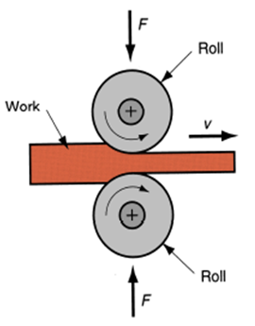
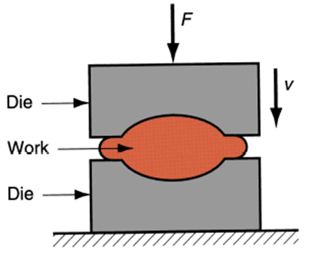
Direct-compression type processes
Bulk Deformation process
The applied force is normal to the direction of the metal flow in compression, i.e., forging and rolling processes.
Rolling
Forging

Slide 6
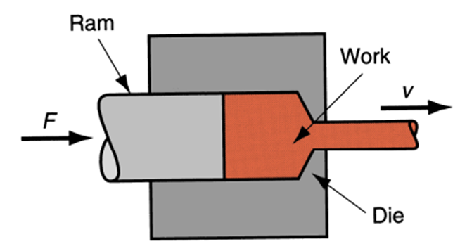
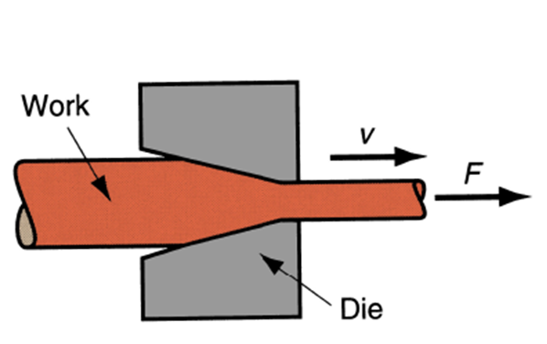
Indirect-compression type processes
Bulk Deformation process
The primary forces are frequently tensile, with indirect compressive forces developed by the reaction of the work piece.
The metal flow is therefore under the combined stress state, i.e., extrusion, wiredrawing, tube drawing
Extrusion
Drawing

Slide 7
Tension type processes
Sheet metal forming
The applied force is tensile, i.e., stretch forming.

Slide 8
Bending processes
Sheet metal forming
The applied force involves the application of bending moments to the sheet.

Slide 9
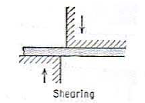
Shearing processes
The applied force involves the application of shearing forces of sufficient magnitude to rupture the metal in the plane of shear.

Slide 10
Mechanics of metal working
• Metal working occurs due to plastic deformation which is associated with analysis of complex stress distribution require simplification.
Only (large) plastic strain is considered while elastic strain is very small and can be neglected. Strain hardening is often neglected. Metal is considered to be isotropic and homogeneous.
For under standing of metal working and simple analysis, theory of plasticity be understood.

Slide 11
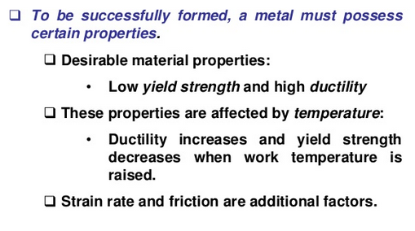
Material Properties in Metal Forming

Slide 12
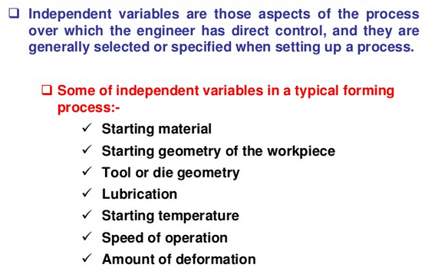
Independent variables in Metal Forming

Slide 13
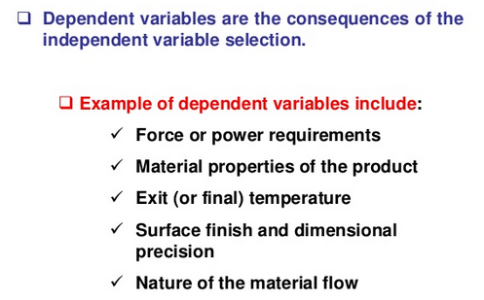
Dependent variables in Metal Forming

Slide 14
Elements of the theory of elasticity & plasticity
Introduction
• The flow curve
• True stress and true strain
• Yielding criteria for ductile materials
• Combined stress tests
• Anisotropy in yielding

Slide 15
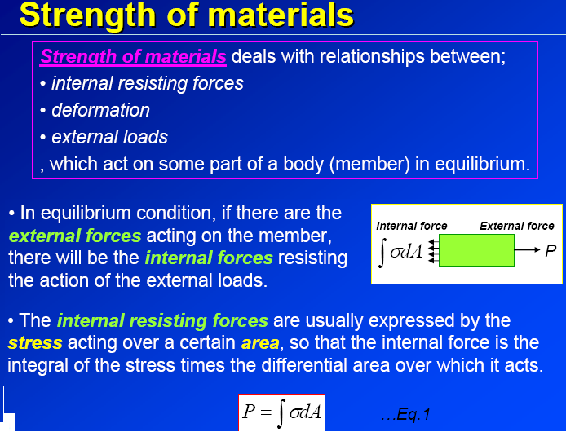

Slide 16
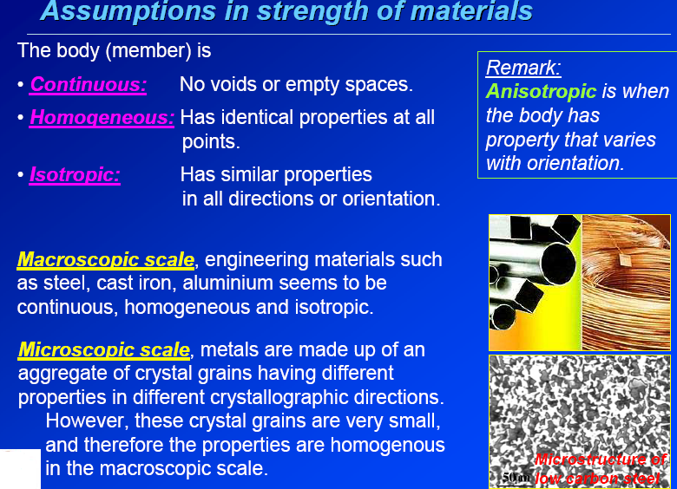

Slide 17
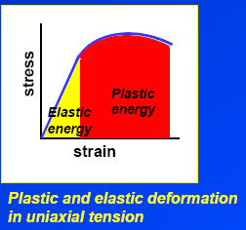
Introduction
Plastic deformation is a non reversible process where Hooke’s law is no longer valid.
One aspect of plasticity in the viewpoint of structural design is that it is concerned with predicting the maximum load, which can be applied to a body without causing excessive yielding.
Another aspect of plasticity is about the plastic forming of metals where large plastic deformation is required to change metals into desired shapes.

Slide 18
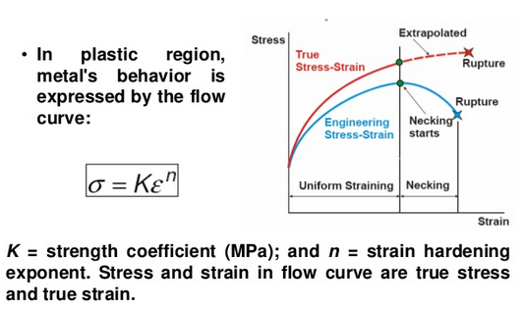
Material Behavior in Metal Forming

Slide 19
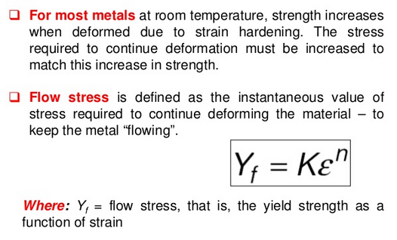
Flow Stress

Slide 20
True stress and true strain
The engineering stress – strain curve is based entirely on the original dimensions of the specimen This cannot represent true deformation characteristic of the material.
• The true stress – strain curve is based on the instantaneous specimen dimensions.

Slide 21
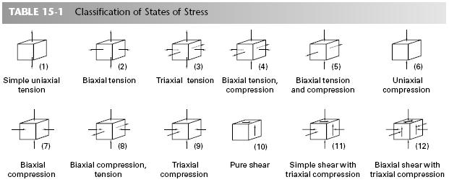
States of Stress

Slide 22
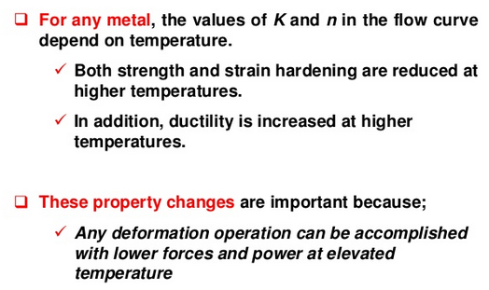
Temperature in Metal Forming

Slide 23
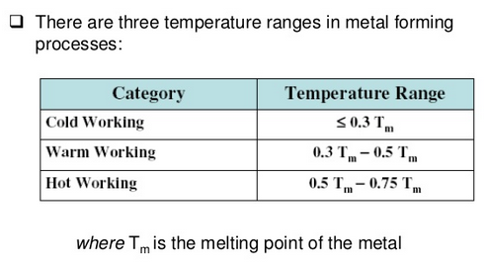
Temperature ranges in Metal Forming

Slide 24
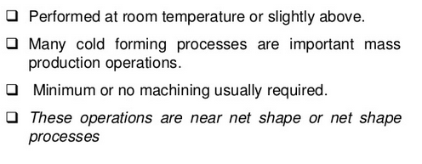
Cold Working

Slide 25
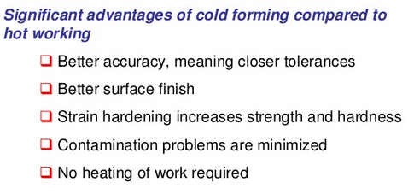
Advantages of cold working

Slide 26
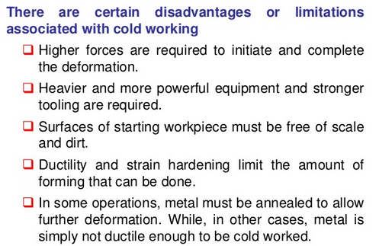
Disadvantages of cold working

Slide 27
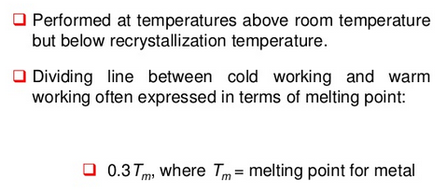
Worm working

Slide 28
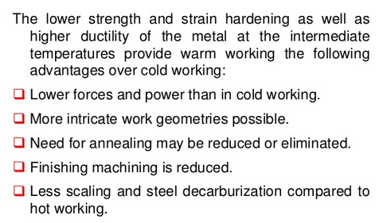
Advantages of worm working

Slide 29
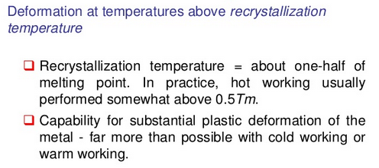
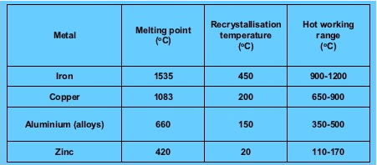
Hot working

Slide 30
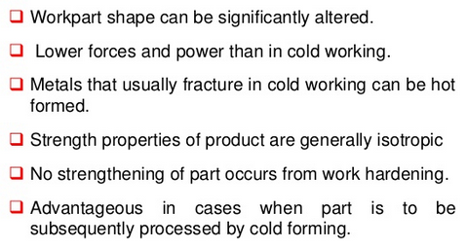
Advantages of hot working

Slide 31
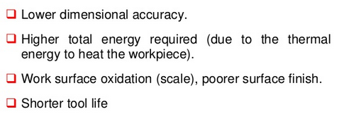
Disadvantages of hot working

Slide 32
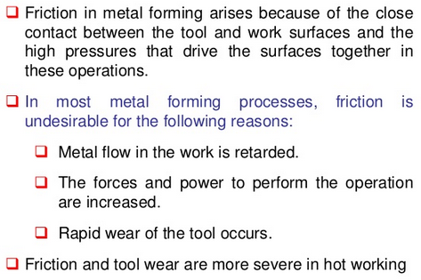
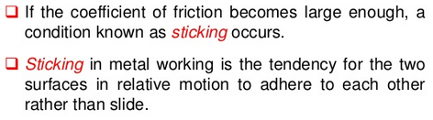
Friction in Metal working

Slide 33
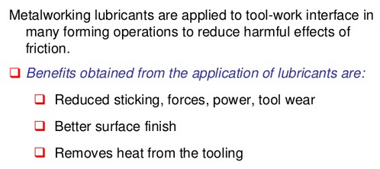
Lubrication in metal forming

Slide 34
ROLLING PROCESS

Slide 35
Rolling Process
“The process of plastically deforming metals by pressing it between rolls”
“The process of reducing the thickness or The process of reducing the thickness or changing the cross section of a long Work piece by compressive forces applied work piece by compressive forces applied through a set of rolls”
Rolling is the most widely used forming process, which provides high production and closed control of final product.
The metal is subjected to high compressive stress as a result of the friction between rolls and the metal surface.

Slide 36
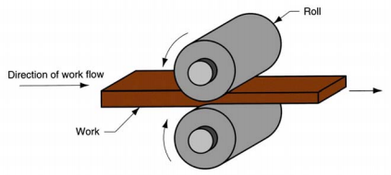
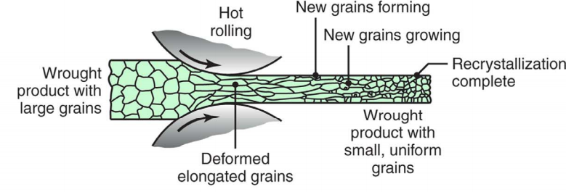
Principle of Rolling Process

Slide 37
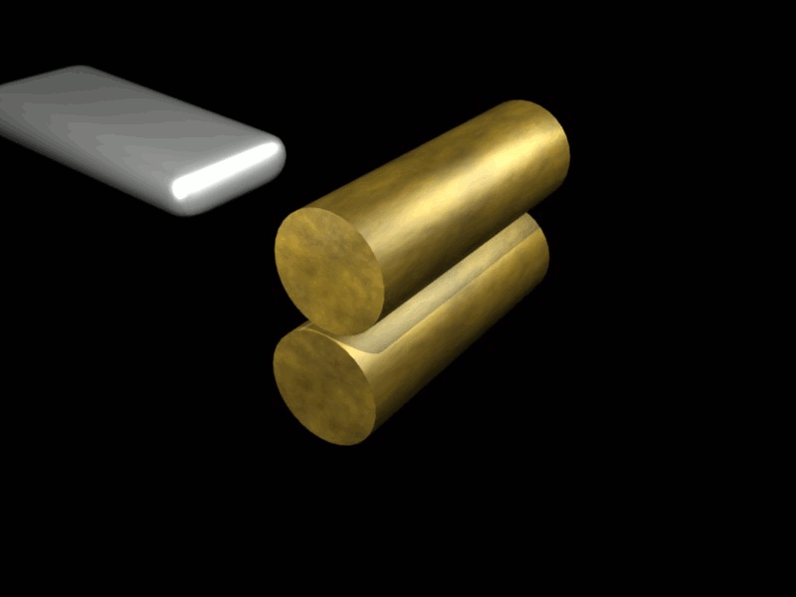
Principle of Rolling Process
The gap between the rotating rolls is less than the thickness of the entering bar therefore a friction force is necessary in order to bite the bar and to pull it through the rolls.
A metal bar passing through the rotating rolls is squeezed, and it elongates while its cross section area decreases.

Slide 38
Principle of Rolling Process
A machine used for rolling metal is called rolling mill.
A typical rolling mill consists of a pair of rolls driven by an electric motor transmitting a torque through a gear and pair of cardans. The rolls are equipped with bearings and mounted in a stand with a screw-down mechanism.
Rotating rolls perform two main functions:
Pull the work into the gap between them by friction Pull the work into the gap between them by friction between work part and rolls between work part and rolls
Simultaneously squeeze the work to reduce its cross section section

Slide 39
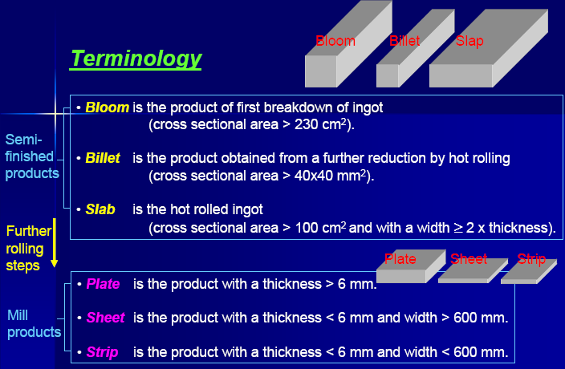
Product terminology in rolling

Slide 40
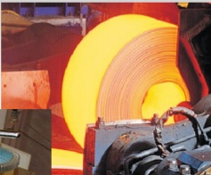
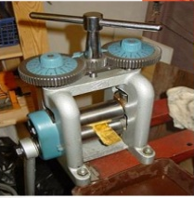
Forms
Cold Rolling
Hot Rolling

Slide 41
Types of Rolling
Based on work piece geometry:
Flat rolling -- used to reduce thickness of a rectangular cross section
Shape rolling -- square cross section is formed into a shape.
Based on work temperature :
Hot Rolling – most common due to the large amount of deformation required
Cold rolling – produces finished sheet and plate stock

Slide 42
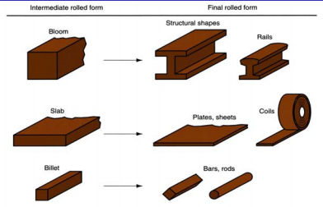
Rolled Products Made of Steel

Slide 43
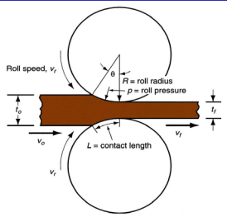
Diagram of Flat rolling
Draft = Amount of thickness reduction
Where, d = draft;
to = starting thickness;
tf = final thickness
Reduction = Draft expressed as a fraction of starting stock thickness:
where r = reduction

Slide 44
Shape Rolling
Accomplished by passing work through rolls that have the reveres of desired shape
Products include:
Construction shapes such as I -beams, L--beams, and U- channels.
Rails for railroad tracks
Round and square bars and rods

Slide 45
Rolling Mills
Equipment is massive and expensive.
Rolling mill configurations:
Two- high: two opposing rolls
Three- high: work passes through rolls in both directions
Four -high: backing rolls support smaller work rolls
Cluster mill: multiple backing rolls on smaller rolls
Tandem rolling mill: sequence of two--high mills

Slide 46
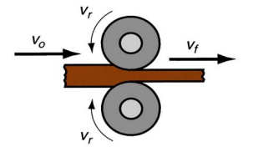
Two -High Rolling Mill

Slide 47
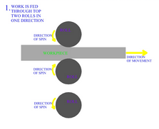
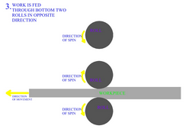
Three -High Rolling Mill

Slide 48
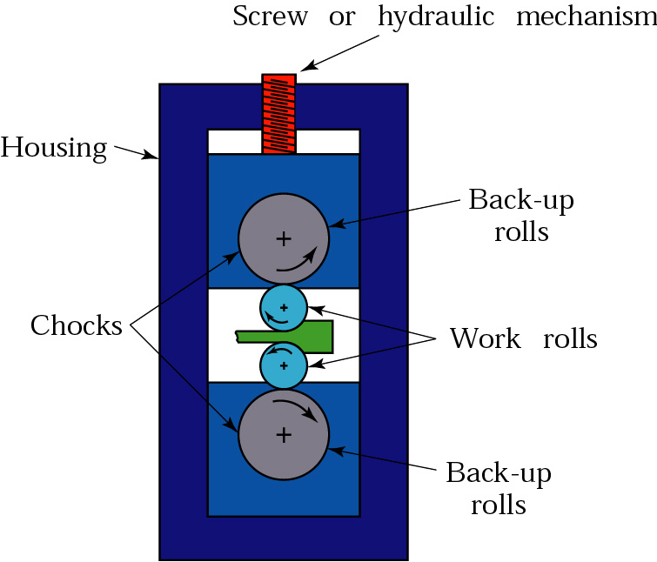
Four -High Rolling Mill

Slide 49
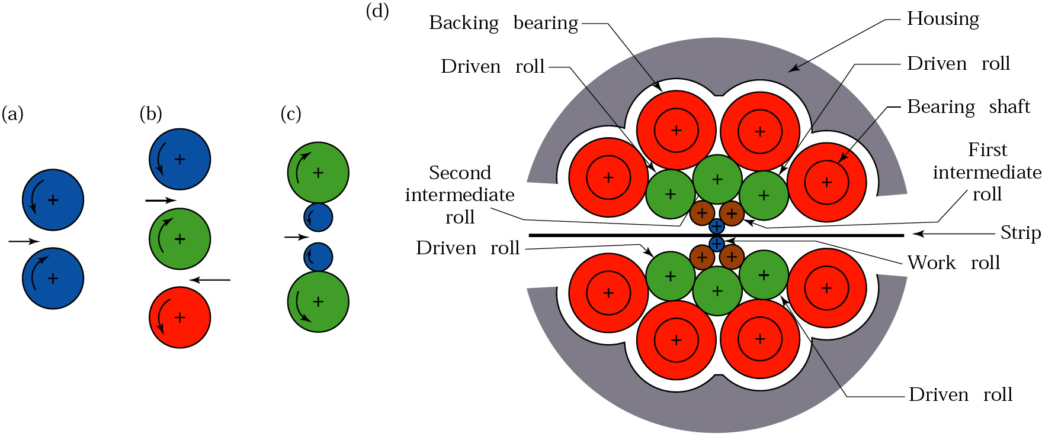
Cluster Rolling Mill

Slide 50
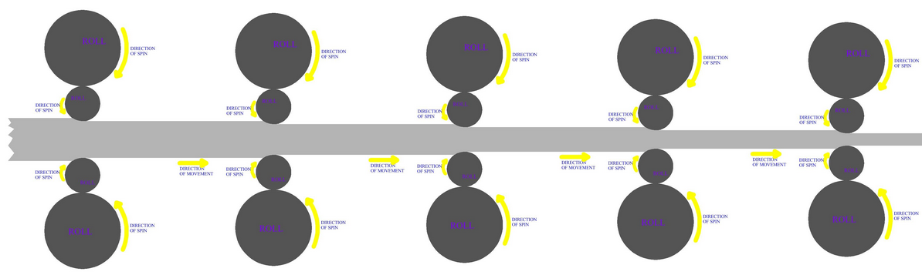
Tandem Rolling Mill

Slide 51
Shape Rolling operations

Slide 52
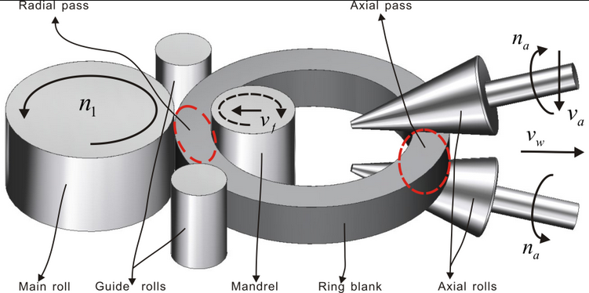
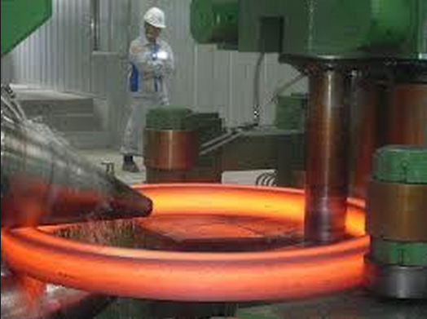
Ring Rolling

Slide 53
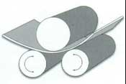
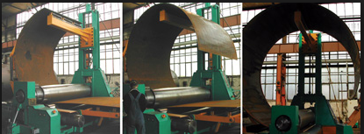
Three Roller Bending

Slide 54
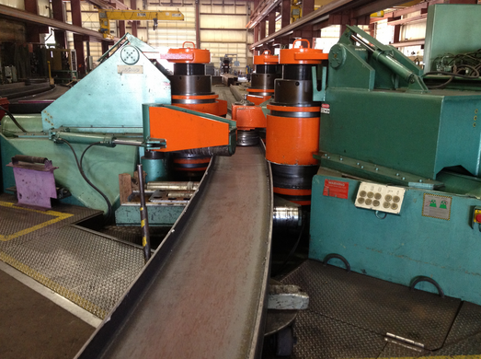
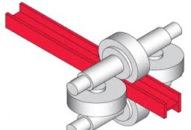
I-Beam Rolling

Slide 55
Laws of Rolling
The purpose of the rolling process is to start from a relatively short bar with a large section area, aiming to obtain a very long product with a small section area.
Then, the first law to remember is that the volume (or the weight) is a constant:
From a 1/2-ton billet you will obtain a 1/2-ton coil.
Cross sectional area times bar length is a constant (this is not strictly true for CBMs: some weight will be lost with scale and crop ends; but we can afford to neglect that loss.)

Slide 56
Roll Pass Sequence
For commercial sections, grooved rolls are used.
The type of grooving done is decided by the final section desired.
The roll-pass sequence can be broadly categorized into three types:
Break down passes: These are used for reducing the cross-sectional area nearer to what is desired. These would be the first to be present in the sequence.
Roughing passes: In these passes also, the cross-section gets reduced, but along with it, the shape of the rolled material comes nearer to the final shape.
Finishing passes: These arc the final passes, which give the required shape of the rolled section. Generally, the finishing pass follows a leader pass.

Slide 57
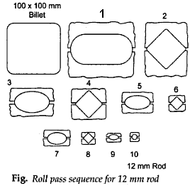
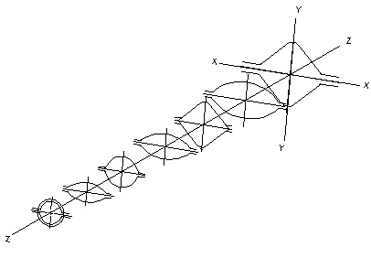
Roll Pass Sequence

Slide 58

Rolling of Rounds
Various pass sequences for rolling round sections

Slide 59
FORGING PROCESS

Slide 60
FORGING
Forging is a manufacturing process involving the shaping of metal using localized compressive forces.
Forging is often classified according to the temperature at which it is performed: "cold", "warm", or "hot" forging.
Forged parts can range in weight from less than a kilogram to 580 metric tons.
Forged parts usually require further processing to achieve a finished part.

Slide 61
FORGING
There are many different kinds of forging processes available, however they can be grouped into three main classes;
Drawn out: length increases, cross-section decreases
Upset: length decreases, cross-section increases
Squeezed in closed compression dies: produces multidirectional flow

Slide 62
FORGEABILITY
Forgeability is generally defined as the capacity of a material to undergo deformation without cracking.
The greater the deformation prior to cracking, greater will be the Forgeability.
The metals are classified in order of their Forgeability.
The limit up to which the material can be forged is cracking.
Al and Mg can be forged easily than Ti.

Slide 63
Classification of Forging Process
By Equipment:
Forging Hammer or Drop Hammer
Press Forging
By Process:
Open Die Forging
Closed Die Forging

Slide 64

FORGING MACHINES
There are four basic types of forging machines;

Slide 65

Forging hammer or Drop hammer
Provide rapid impact blows to the surface of the metals.
Dies are in two halves;
Lower : Fixed to anvil
Upper : moves up and down with TUP
The Drop hammer is energy restricted machine.
The blow energy supplied equal to the potential energy due to the weight and height of the fall
The hammer can strike between 60-150 blows per minute depending upon the size and capacity.

Slide 66

HYDRAULIC PRESS FORGING

Slide 67

OPEN DIE FORGING

Slide 68


Slide 69

Open-die forging
Open-die forging is carried out between flat dies or dies of very simple shape.
The process is used for mostly large objects or when the number of parts produced is small.
Open-die forging is often used to pre-form the work piece for closed-die forging.

Slide 70

Closed-die forging (or impression-die forging)
The work piece is deformed between two die halves which carry the impressions of the desired final shape.
The work piece is deformed under high pressure in a closed cavity.
Normally used for smaller components
The process provide precision forging with close dimensional tolerance.
Closed dies are expensive.

Slide 71


Forging: Closed-die forging operation

Slide 72

Forging: Functions of flash
The flash serves two purposes:
Acts as a ‘safety value’ for excess metal.
Builds up high pressure to ensure that the metal fills all recesses of the die cavity.
Remark: It is necessary to achieve complete filling of the forging cavity without generating excessive pressures against the die that may cause it to fracture.

Slide 73

Typical forging defects
Incomplete die filling.
Die misalignment.
Forging laps.
Incomplete forging penetration- should forge on the press.
Micro-structural differences resulting in pronounced property variation.
Hot shortness, due to high

Slide 74

Typical forging defects
Pitted surface, due to oxide scales occurring at high temperature stick on the dies.
Buckling, in upsetting forging. Subject to high compressive stress.
Surface cracking, due to temperature differential between surface and centre, or excessive working of the surface at too low temperature.
Micro-cracking, due to residual stress.

Slide 75

Typical forging defects
Flash line crack, after trimming-occurs more often in thin work pieces. Therefore should increase the thickness of the flash.
Cold shut or fold , due to flash or fin from prior forging steps is forced into the work piece.
• Internal cracking, due to secondary tensile stress.

Slide 76

Extrusion

Slide 77
Extrusion
Extrusion is the process by which a block/billet of metal is reduced in cross section by forcing it to flow through a die orifice under high pressure.
In general, extrusion is used to produce cylindrical bars or hollow tubes or for the starting stock for drawn rod, cold extrusion or forged products.
Most metals are hot extruded due to large amount of forces required in extrusion. Complex shape can be extruded from the more readily extrudable metals such as aluminum.
* The products obtained are also called extrusion.

Slide 78

Extrusion products

Slide 79
Classification of extrusion processes
There are several ways to classify metal extrusion processes;
By direction
  Direct / Indirect extrusion
  Forward / backward extrusion
By operating temperature
  Hot / cold extrusion
By equipment
  Horizontal and
  vertical extrusion

Slide 80

Direct extrusions
1) Direct extrusion:
The metal billet is placed in a container and driven through the die by the ram.
The dummy block or pressure plate, is placed at the end of the ram in contact with the billet.
Friction is at the die and container wall requires higher pressure than indirect extrusion.

Slide 81

Indirect Extrusion
2) Indirect Extrusion
The hollow ram containing the die is kept stationary and the container with the billet is caused to move.
Friction at the die only (no relative movement at the container wall) requires roughly constant pressure.
Hollow ram limits the applied load.

Slide 82

Forward and backward extrusion
Extrusion can also be divided to:
1) Forward extrusion
Metal is forced to flow in the same direction as the punch.
The punch closely fits the die cavity to prevent backward flow of the material.
2) Backward extrusion
Metal is forced to flow in the direction opposite to the punch movement.
Metal can also be forced to flow into recesses in the

Slide 83


Cold extrusion
Cold extrusion is the process done at room temperature or slightly elevated temperatures.
This process can be used for most materials-subject to designing robust enough tooling that can withstand the stresses created by extrusion.
No oxidation takes place.

Slide 84


Hot extrusion
Hot extrusion is done at fairly high temperatures, approximately 50 to 75 % of the melting point of the metal. The pressures can range from 35-700 Mpa (5076 - 101,525 psi).
The most commonly used extrusion process is the hot direct process. The cross-sectional shape of the extrusion is defined by the shape of the die.

Slide 85


Horizontal extrusion presses
(15- 50 MN capacity or up to 140 MN)
Used for most commercial extrusion of bars and shapes.
Disadvantages:
Deformation is non-uniform due to different temperatures between top and
Bottom parts of the billet.

Slide 86

Vertical extrusion presses (3- 20 MN capacity)
Chiefly used in the production of thin-wall tubing.
Advantages:
Easier alignment between the press ram and tools.
Higher rate of production.
Require less floor space than horizontal presses.
Uniform deformation, due to uniform cooling of the billet in the container.

Slide 87

Production of seamless pipe and tubing
Extrusion is suited for producing seamless pipe and tubing, especially for metals which are difficult to work.
The red-hot billet is rotated and drawn by rolls over a piercing rod, or mandrel. The action of the rolls causes the metal to flow over and about the mandrel to create a hollow pipe shell.
After reheating, the shell is moved forward over a support bar and is hot rolled in several reducing/sizing stands to the desired wall thickness and diameter.

Slide 88

Production of seamless pipe and tubing

Slide 89

Wire & Tube Drawing Processes
Drawing operations involve pulling metal through a die by means of a tensile force applied to the exit side of the die.
The plastic flow is caused by compression force, arising from the reaction of the metal with the die.
Material should have high ductility and good tensile strength.
Bar wire and tube drawing are usually carried out at room temperature, except for large deformation, which leads to considerable rise in temperature during drawing.

Slide 90


Introduction to wire drawing
Wire drawing involves reducing the diameter of a rod or wire by passing through a series of drawing dies or plates.
The subsequent drawing die must have smaller

Slide 91


Introduction to Tube drawing
Tube drawing involves reducing the cross section and wall thickness through a draw die.
The cross section can be circular, square hexagonal or in any shapes.

Slide 92


Rod drawing
Rods which can not be coiled, are produced on draw benches.
  Machine capacity :
  1 MN draw-bench
  30 m of run out
  150-1500 mm.s⁻¹ draw speed

Slide 93


Wire drawing process
Cu and Sn are used as lubricants for high strength materials. Or conversion
coating such as sulphates or oxalates.
Oils and greases for wire drawing
Mulsifiable oils for wet wire drawing.
Soap for dry drawing.
Bull block drawing allows the generation of long lengths.

Slide 94

Stepped-cone multiple-pass wiredrawing
More economical design.
Use a single electrical motor to drive a series of stepped cones.
The diameter of each cone is designed to produce a peripheral speed equivalent to a certain size reduction.

Slide 95
Cold working Processes

Slide 96
Cold working Processes
Shearing
Cold Drawing
Squeezing
Blanking
Piercing
Deep drawing
Coining
Embossing.

Slide 97

Shearing
Definition:
Shearing is cutting materials without producing chips.
Cold shearing methods are sorted according to the shape of the blades (Figure).
In the kind of shearing used predominantly in industry, the
material is cut by two blades with a large edge angle β.

