Slide 1
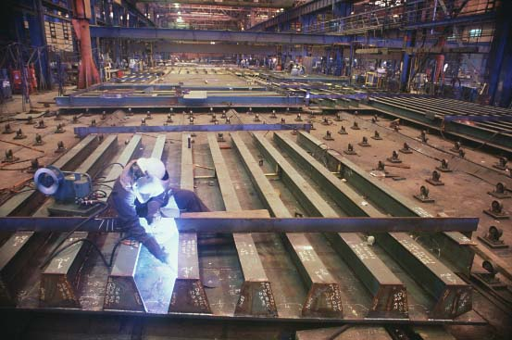
Metal Joining Process
Prepared by,
Darshan K Bhatt

Slide 2
A Brief History of Welding
Late 19th Century
Scientists/engineers apply advances in electricity to heat and/or join metals (Le Chatelier, Joule, etc.)
Early 20th Century
Prior to WWI welding was not trusted as a method to join two metals due to crack issues
1930’s and 40’s
Industrial welding gains acceptance and is used extensively in the war effort to build tanks, aircraft, ships, etc.
Modern Welding
the nuclear/space age helps bring welding from an art to a science

Slide 3
Types of Welding
Fusion Welding
Pressure Welding
Homogeneous
Heterogeneous
Friction Welding
Gas Welding
Brazing
Soldering
Electroslag
MIG
High Energy Beam
TIG
Shielded Metal Arc – “Stick”
Electric Arc

Slide 4
Classification of welding process

Slide 5
Welding Processes
Fusion Welding
Involves melting and solidification
Solid phase welding
Explosive welding
Diffusion welding
Friction welding

Slide 6
Fusion welding
Most commonly used process
Heat source: electric arc, gas flame, laser
Filler metal
From electrode, rod, wire, powder, flux
Independently added filler
No filler (Autogenous welding)

Slide 7
Weld
The AWS definition for welding process is “ A materials joining process which produce coalescence of materials by heating them to suitable temperature with or without he application of pressure or by the application of pressure alone and with or without use of filler metal”.
Filler (if used) has a melting temperature similar to the parts being joint.

Slide 8
Weldability
The capacity of material to be welded under the imposed fabrication condition into a specific, suitably designed structure and to perform satisfactorily in intended service.

Slide 9
Weldability of a Metal
Metallurgical Capacity
Parent metal will join with the weld metal without formation of deleterious constituents or alloys
Mechanical Soundness
Joint will be free from discontinuities, gas porosity, shrinkage, slag, or cracks
Serviceability
Weld is able to perform under varying conditions or service (e.g., extreme temperatures, corrosive environments, fatigue, high pressures, etc.)

Slide 10
Factor affecting weldability
Design
Physical properties
Solidification of weld metal
Dilution
Chemical properties
Contaminant gases
Gas metal reaction
Metallurgical properties
Service environment

Slide 11
Fusion Welding Principles
Base metal is melted
Filler metal may be added
Heat is supplied by various means
Oxyacetylene gas
Electric Arc
Plasma Arc
Laser

Slide 12
Fusion Welding principle
ELECTRODE COATING
CORE WIRE
WELDING ATMOSPHERE
ARC STREAM
ARC POOL
SOLIDIFIED SLAG
PENETRATION DEPTH
WELD
BASE METAL

Slide 13
Fusion weld structure

Slide 14
Thermal HAZ region

Slide 15
HAZ structure

Slide 16
Weld Metal Protection
During fusion welding, the molten metal in the weld “puddle” is susceptible to oxidation
Must protect weld puddle (arc pool) from the atmosphere
Methods
Weld Fluxes
Inert Gases
Vacuum

Slide 17
Weld Fluxes
Typical fluxes
SiO₂, TiO₂, FeO, MgO, Al₂O₃
Produces a gaseous shield to prevent contamination
Act as scavengers to reduce oxides
Add alloying elements to the weld
Influence shape of weld bead during solidification

Slide 18
Inert Gases
Argon, helium, nitrogen, and carbon dioxide
Form a protective envelope around the weld area
Used in
MIG
TIG
Shield Metal Arc

Slide 19
Vacuum
Produce high-quality welds
Used in electron beam welding
Nuclear/special metal applications
Zr, Hf, Ti
Reduces impurities by a factor of 20 versus other methods
Expensive and time-consuming

Slide 20
Types of Fusion Welding
Oxyacetylene Cutting/Welding (Gas cutting / welding)
Shielded Metal Arc (“SMAW”)
Metal Inert Gas (MIG)
Tungsten Inert Gas (TIG)

Slide 21
Gas Welding
Sound weld is obtained by selecting proper size of flame, filler material and method of moving torch
The temperature generated during the process is 3300⁰c
When the metal is fused, oxygen from the atmosphere and the torch combines with molten metal and forms oxides, results defective weld
Fluxes are added to the welded metal to remove oxides
Common fluxes used are made of sodium, potassium. Lithium and borax.
Flux can be applied as paste, powder, liquid, solid coating or gas.

Slide 22
GAS WELDING EQUIPMENT...

Slide 23
GAS WELDING EQUIPMENT...
1. Gas Cylinders
Pressure
Oxygen – 125 kg/cm2
Acetylene – 16 kg/cm2
2. Regulators
Working pressure of oxygen 1 kg/cm2
Working pressure of acetylene 0.15 kg/cm2
Working pressure varies depends upon the thickness of the work pieces welded.
3. Pressure Gauges
4. Hoses
5. Welding torch
6. Check valve
7. Non return valve

Slide 24
Gas Cylinders
Two large steel cylinders, capable to withstand high pressure are needed to keep oxygen and acetylene separately.
Cylinders are painted with different colors : oxygen cylinder in black color and acetylene cylinder in maroon or red color.
Oxygen is filled at pressure to 2000 pound per square inch (PSI).
Large weight of acetylene is kept dissolved in acetone.
Acetylene cylinder should not be exposed to higher temperature for safety reasons.

Slide 25
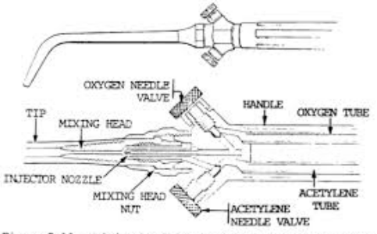
Welding Torch

Slide 26
Welding Rods
These are also called filler metals. Filler metal is typically in the form of rod, 90 mm long and diameter ranging from 1.6 mm to 9.5 mm.
Composition of filler metal must be same as that of base metal. Two types of welding rods are generally available.
One is coated welding rods, which have coating of flux.
Others are bare welding rods having no coating of flux.
Different types of welding rods are used for welding of different metals. Some examples are given below.

Slide 27
Gas (Oxyacetylene) Welding
Flame formed by burning a mix of acetylene (C₂H₂) and oxygen
Fusion of metal is achieved by passing the inner cone of the flame over the metal
Oxyacetylene can also be used for cutting metals
TORCH TIP
2300 deg F
Inner Cone: 5000-6300 deg F
Combustion Envelope 3800 deg F

Slide 28
Flames
The flame can be divided in to three zones. Zone ‘1’ is very near to the outlet of torch, where oxygen reacts with acetylene and burning of two gases takes place.
Zone ‘2’ produces carbon monoxide and hydrogen in ratio 2 : 1 by volume.
This zone gives the highest temperature of Welding the flame
Zone ‘3’ is the outermost zone of the flame.
Temperature of this zone is comparatively low.
This zone converts CO to CO2 and H2O vapours.

Slide 29
Types of Flames
Oxygen is turned on, flame immediately changes into a long white inner area (Feather) surrounded by a transparent blue envelope is called Carburizing flame (3000⁰c)
Addition of little more oxygen give a bright whitish cone surrounded by the transparent blue envelope is called Neutral flame (It has a balance of fuel gas and oxygen) (3200⁰c)
Used for welding steels, aluminium, copper and cast iron
If more oxygen is added, the cone becomes darker and more pointed, while the envelope becomes shorter and more fierce is called Oxidizing flame Has the highest temperature about 3400⁰c
Used for welding brass and brazing operation

Slide 30
Types of Flames

Slide 31
GAS CUTTING
Ferrous metal is heated in to red hot condition and a jet of pure oxygen is projected onto the surface, which rapidly oxidizes
Oxides having lower melting point than the metal, melt and are blown away by the force of the jet, to make a cut
Fast and efficient method of cutting steel to a high degree of accuracy
Torch is different from welding
Cutting torch has preheat orifice and one central orifice for oxygen jet
PIERCING and GOUGING are two important operations
Piercing, used to cut a hole at the centre of the plate or away from the edge of the plate
Gouging, to cut a groove into the steel surface

Slide 32
Arc welding
Electric arc welding is one of the fusion welding processes in which coalescence of the metal is achieved by the heat from an electric arc between an electrode and work piece.
Electric arc is generated when electrode is brought into contact with the work and is then quickly separated by a short distance approximately 2 mm.
The circuit operates at low voltage and high current so arc is established in the gap due to thermoionic emission from electrode (Cathode) to work piece (Anode).
This arc produces at temperature of the order of 5500°C or higher.

Slide 33
Arc welding

Slide 34
Shielded Metal Arc (Stick)
An electric arc is generated between a coated electrode and the parent metal
The coated electrode carries the electric current to form the arc, produces a gas to control the atmosphere and provides filler metal for the weld bead
Electric current may be AC or DC. If the current is DC, the polarity will affect the weld size and application

Slide 35
Metal arc welding

Slide 36
Arc Welding Equipments
Facilitator Equipment Welding
(a) Power source (welding machine)
(b) Electrode holder
(c) Work table
(d) Cables (for connection)
(e) Finishing devices like chipping, hammer, wire brush, etc.
Consumable Equipment
(a) Electrode
(b) Flux
(c) Workpiece
(d) Filler metal
Protecting Equipment
(a) Welding shields
(b) Goggles
(c) Screens
(d) Gloves
(e) Apron

Slide 37
Welding Power Sources
Shielded metal arc welding may utilize either alternating current (AC) or direct current (DC).
Whether to use an AC, DC, or AC/DC power source depends on the type of welding to be done and the electrodes used.

Slide 38
Factors affecting power source
1. Electrode Selection - Using a DC power source allows the use of a greater range of electrode types. While most of the electrodes are designed to be used on AC or DC, some will work properly only on DC.
2. Metal Thickness - DC power sources may be used for welding both heavy sections and light gauge work. Sheet metal is more easily welded with DC because it is easier to strike and maintain the DC arc at low currents.
5. Arc Blow - When welding with DC, magnetic fields are set up throughout the weldment. In weldments that have varying thickness and protrusions, this magnetic field can affect the arc by making it stray or fluctuate in direction. This condition is especially troublesome when welding in corners. AC seldom causes this problem because of the rapidly reversing magnetic field produced.

Slide 39
Factors affecting power source
3. Distance from Work - If the distance from the work to the power source is great, AC is the best choice since the voltage drop through the cables is lower than with DC. Even though welding cables are made of copper or aluminum (both good conductors), the resistance in the cables becomes greater as the cable length increases. In other words, a voltage reading taken between the electrode and the work will be somewhat lower than a reading taken at the output terminals of the power source. This is known as voltage drop.

Slide 40
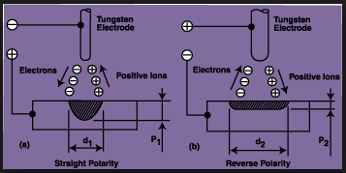
Factors affecting power source
Electrode negative (-) produces welds with shallow penetration; however, the electrode melt-off rate is high.
Electrode positive (+)produces welds with deep penetration and a narrower weld bead.

Slide 41
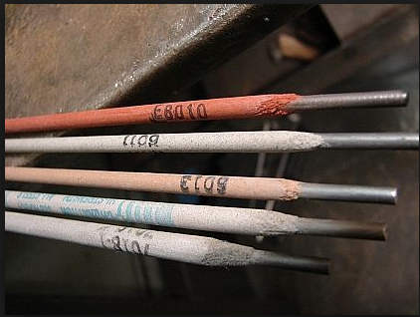
Electrode
The electrode rod is made of a material that is compatible with the base material being welded and is covered with a flux that gives off vapors that serve as a shielding gas and provide a layer of slag, both of which protect the weld area from atmospheric contamination.

Slide 42
Electrode Designation
To designate the electrode two basic standards are used,
AWS standard: Rods are commonly known by their AWS (American Welding Society) name, so it's a useful standard to decode. We'll use E7018 rods as an example:
ISO standard: The European coding system has recently been amended and is now an International Standard ISO 2560 which is basically the same as EN499.

Slide 43
AWS standard
E7018:
E | Electrode: E just means the electrode is for MMA welding and has a flux coating.
70 | Tensile Strength (in ksi): The minimum tensile strength measured in kilo-pounds(force) per square inch. In our example 70 ksi would be 70,000 psi pounds(force) per square inch, or 480 N/mm².
1 | Welding Positions: All position Flat and horizontal position
8 | Flux Coating and Current: 0 - High cellulose sodium (Cellulosic)- DC+ 1 - High cellulose potassium - AC or DC+ or DC- 2 - High titania sodium (Rutile) - AC or DC- 3 - High titania potassium (Rutile) - AC or DC+ 4 - Iron powder titania (Rutile) - AC or DC- or DC+ -------- 8 - Iron powder low hydrogen (Basic) - AC or DC+

Slide 44
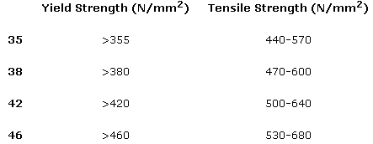
ISO standard
In the ISO standard E7018 rods are known as E46 4 B 32 H5.
E | Electrode E just means the electrode is for MMA welding and has a flux coating.
46 | Yield Strength (in N/mm²) Multiply this number by 10 for the minimum yield strength in N/mm². In our example 46 will represent a minimum yield strength of 460N/mm² This is not directly equivalent to the tensile strength in the AWS standard. Yield Strength is where the metal starts to deform plastically (when it doesn't spring back to it's original form after the load is released). Tensile Strength is when the metal breaks.

Slide 45
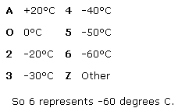
ISO standard
4 - Minimum Impact Temperature at 46J
This represents the temperature at which the weld material becomes brittle.

Slide 46
ISO standard
3 - Current Type and Recovery
'Recovery' is the weight of weld metal deposited in the weld relative to the weight of the core wire. Over 100% means that the weld will weigh more than the weight of the core wire. In other words the coating contains iron powder (or in some rods other alloys).
2 - Welding Positions
H - Hydrogen content

Slide 47
B - Rod Flux Coating
AAcid A type of rutile characterised by very smooth arc but with minimal penetration and prone to moisture pick up. good on very thin sheet.
CCellulosic (E6010) An organic coating containing Cellulose with good penetration, high deposition, and easily removed slag, but high hydrogen content.
BBasic (E7018 or E7016) These chemically basic (alkali) coatings contain calcium carbonate or calcium fluoride. They are normally used for Low Hydrogen rods.
RRutile (E6013) In welding rod coatings it provides slag cover, arc stability (it ionizes easily) and helps the fast freeze ability of positional rods.
RCRutile Cellulosic (E6013) Most rutiles contain some cellulose to improve the penetration, otherwise the same as R.

Slide 48
Inert Gas Welding
For materials such as Al or Ti which quickly form oxide layers, a method to place an inert atmosphere around the weld puddle had to be developed

Slide 49
Metal Inert Gas (MIG)
Uses a consumable electrode (filler wire made of the base metal)
Inert gas is typically Argon
CONSUMABLE ELECTRODE
DRIVE WHEELS
POWER SOURCE
SHIELDING GAS
ARC COLUMN
BASE METAL
PUDDLE

Slide 50
Tungsten Inert Gas (MIG)
Tungsten electrode acts as a cathode
A plasma is produced between the tungsten cathode and the base metal which heats the base metal to its melting point
Filler metal can be added to the weld pool
TUNGSTEN ELECTRODE
(CATHODE)
TUNGSTEN ELECTRODE
POWER SOURCE
+ +
+ +
SHIELDING GAS
ARC COLUMN
- - -
BASE METAL
PUDDLE
BASE METAL (ANODE)

Slide 51
Resistance Welding process
Electric resistance welding (ERW) refers to a group of welding processes that produce coalescence of faying surfaces where heat to form the weld is generated by the electrical resistance of material combined with the time and the force used to hold the materials together during welding.
Spot welding
Seam welding

Slide 52
Spot Welding
Spot welding is a resistance welding method used to join two or more overlapping metal sheets, studs, projections, electrical wiring hangers, some heat exchanger fins, and some tubing.
Usually power sources and welding equipment are sized to the specific thickness and material being welded together.
The thickness is limited by the output of the welding power source and thus the equipment range due to the current required for each application.
Usually, two copper electrodes are simultaneously used to clamp the metal sheets together and to pass current through the sheets.

Slide 53
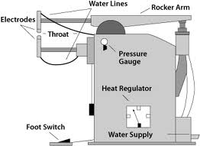
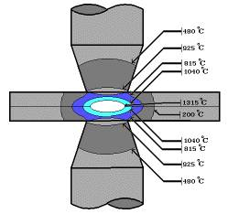
Spot Welding

Slide 54
Seam Welding
Resistance seam welding is a process that produces a weld at the faying surfaces of two similar metals.
The seam may be a butt joint or an overlap joint and is usually an automated process.
It differs from butt welding in that butt welding typically welds the entire joint at once and seam welding forms the weld progressively, starting at one end.
Like spot welding, seam welding relies on two electrodes, usually made from copper, to apply pressure and current.
The electrodes are disc shaped and rotate as the material passes between them.

Slide 55
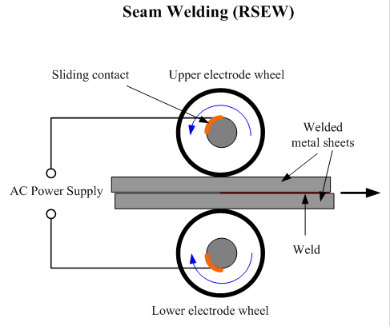
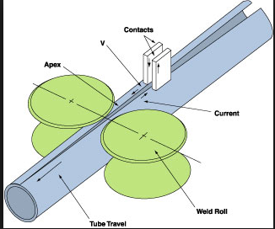
Seam Welding

Slide 56
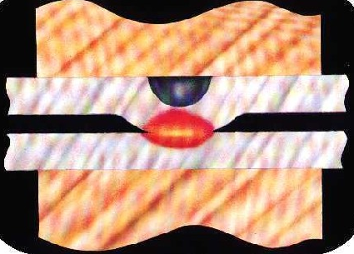
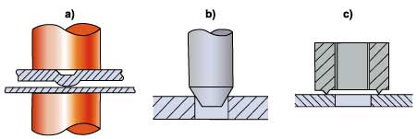
Projection Welding Process
“Projection welding is an electric resistance welding process that produces welds by the heat obtained from the resistance to the flow of the welding current. The resulting welds are localized at predetermined points by projections, embossments, or intersections”.
a. Embossed
b. Stud-to-Plate
c. Annular

Slide 57
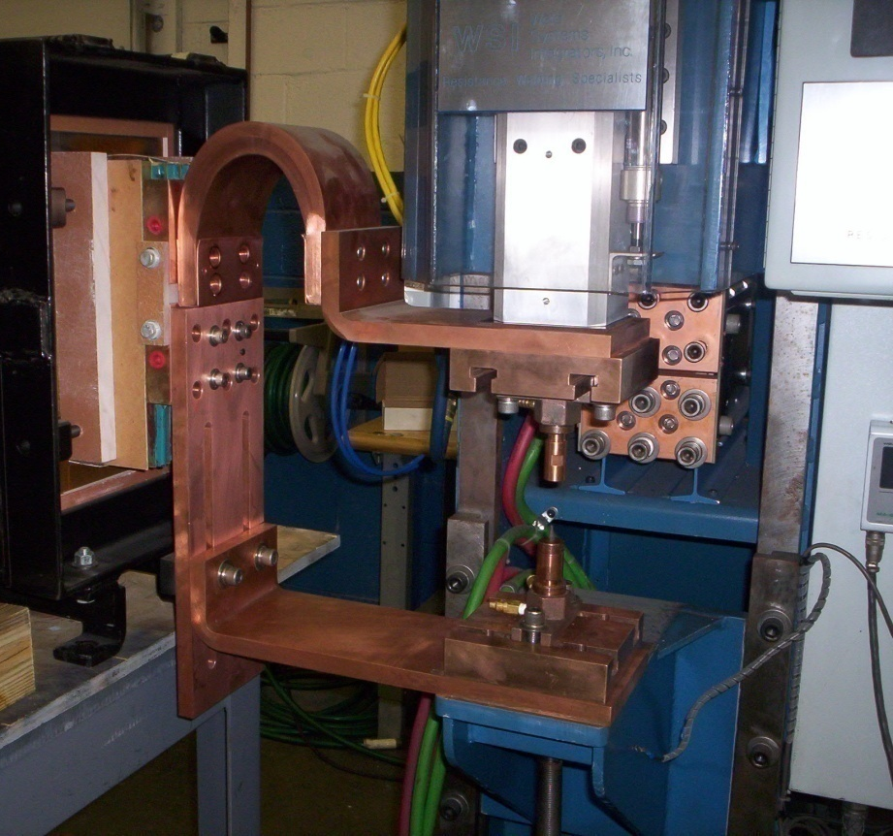
Projection Welding Process

Slide 58
Welding Positions
INCREASING DIFFICULTY
FLAT
HORIZONTAL
OVERHEAD
VERTICAL

Slide 59
Weld Defects
Undercuts/Overlaps
Grain Growth
A wide ΔT will exist between base metal and HAZ. Preheating and cooling methods will affect the brittleness of the metal in this region
Blowholes
Are cavities caused by gas entrapment during the solidification of the weld puddle. Prevented by proper weld technique (even temperature and speed)

Slide 60
Weld Defects
Inclusions
Impurities or foreign substances which are forced into the weld puddle during the welding process. Has the same effect as a crack. Prevented by proper technique/cleanliness.
Segregation
Condition where some regions of the metal are enriched with an alloy ingredient and others aren’t. Can be prevented by proper heat treatment and cooling.
Porosity
The formation of tiny pinholes generated by atmospheric contamination. Prevented by keeping a protective shield over the molten weld puddle.

Slide 61
Residual Stresses
Rapid heating and cooling results in thermal stresses detrimental to joint strength.
Prevention
Edge Preparation/Alignment – beveled edges and space between components to allow movement
Control of heat input – skip or intermittent weld technique
Preheating – reduces expansion/contraction forces (alloys) and removes moisture from the surface
Peening – help metal stretch as it cools by hitting with a hammer. Use with care since it may work harden the metal
Heat Treatment – “soak” the metal at a high temperature to relieve stresses
Jigs and Fixtures – prevent distortion by holding metal fixed
Number of Passes – the fewer the better.

Slide 62
Joint Design
BUTT JOINT
FILLET JOINT
STRAP JOINT
CORNER JOINT
LAP JOINT

Slide 63
Generalized Welding Symbol
FAR SIDE DETAILS
Field weld symbol
Weld Geometry
D
L1-L2
Electrode
Material
Weld all-around for pipes, etc.
D
L1-L2
ARROW SIDE DETAILS
D = Weld Depth (usually equal to plate thickness)
L1 = Weld Length
L2 = Distance between centers for stitched welds
The Field Weld Symbol is a guide for installation. Shipyards
normally do not use it, except in modular construction.

Slide 64
Example Welding Symbol
Geometry symbol for V-groove
One-sided welds are max 80% efficient
Two sided are 100% efficient
1/2
1/2
1/2” 1/2”

Slide 65
Weld Symbols (Butt Joints)
Backing

Slide 66
Weld Symbol (Fillet Joints)

Slide 67
Weld Symbol (Corner Joints)

Slide 68
Non - Conventional Welding Process

Slide 69
Thermit Welding (TW)
FW process in which heat for coalescence is produced by superheated molten metal from the chemical reaction of thermit
Thermit = mixture of Al and Fe₃O₄ fine powders that produce an exothermic reaction when ignited
Also used for incendiary bombs
Filler metal obtained from liquid metal
Process used for joining, but has more in common with casting than welding

Slide 70
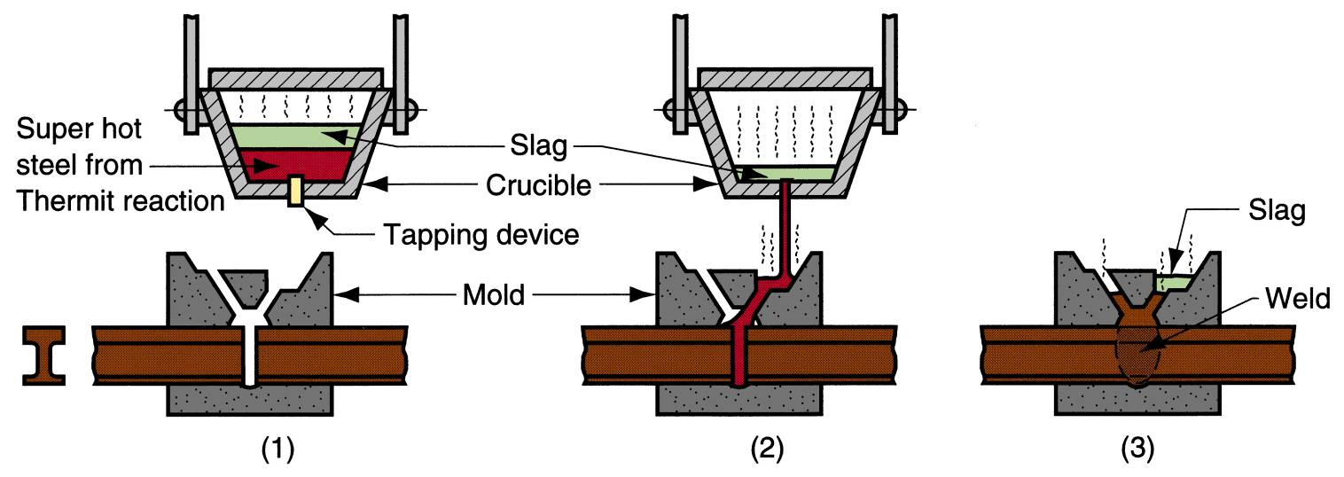
Thermit Welding (TW)
Thermit welding: (1) Thermit ignited; (2) crucible tapped, superheated metal flows into mold; (3) metal solidifies to produce weld joint.

Slide 71
TW Applications
Joining of railroad rails
Repair of cracks in large steel castings and forgings
Weld surface is often smooth enough that no finishing is required

Slide 72
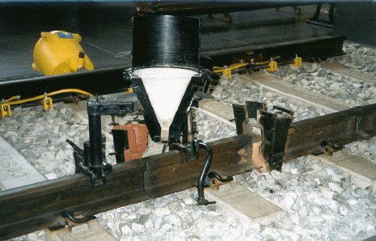

Slide 73
Laser Welding
• Photons transmit energy and heat
• Energy intensity up to 109 Watts/cm2
• Depth to width of hole up to 50x
• Automatic controllers needed
• 90% efficiency
• Reflectors don’t weld easily

Slide 74
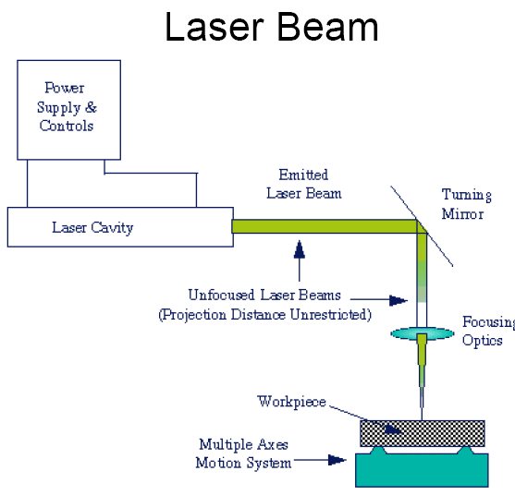
Laser Welding

Slide 75
Electron Beam Welding
Electrons strike surface and generate heat
Best performed in a vacuum
Work piece must be a conductor
Magnetic fields affect beam
Current to 1/2 A
Power to 100 kW
X-rays produced

Slide 76
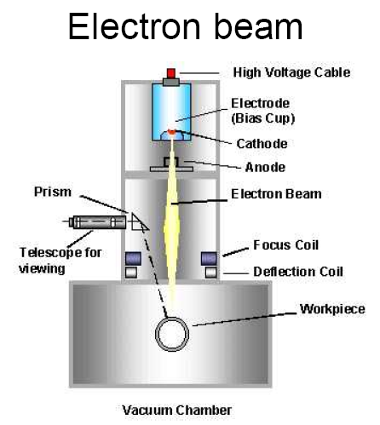
Electron Beam Welding

Slide 77
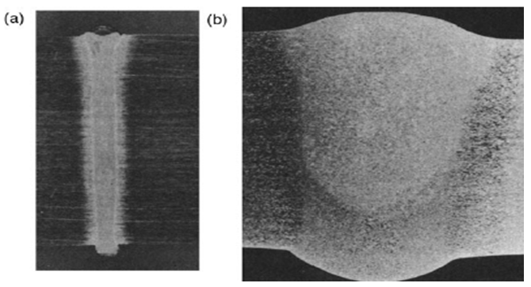
Weld Comparison
Size of weld beads in
(a) electron-beam or laser-beam welding
(b) conventional arc welding.

Slide 78
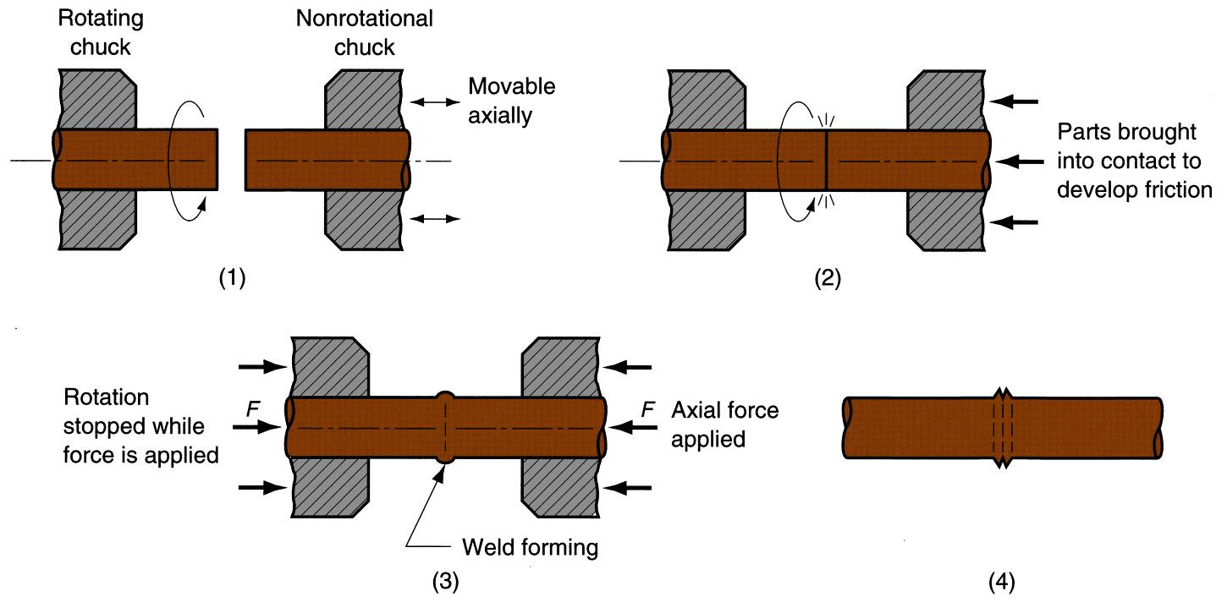
Friction Welding
Friction welding (FRW): (1) rotating part, no contact; (2) parts brought into contact to generate friction heat; (3) rotation stopped and axial pressure applied; and (4) weld created.

Slide 79
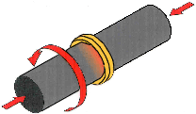
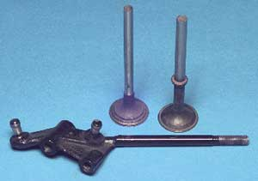
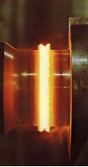
Friction Welding

Slide 80
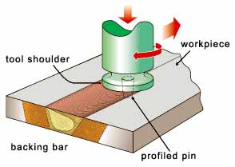
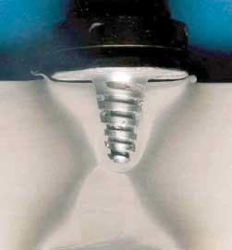
Friction Stir Welding

Slide 81
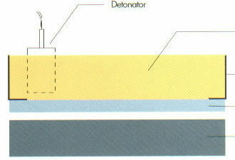
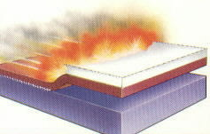
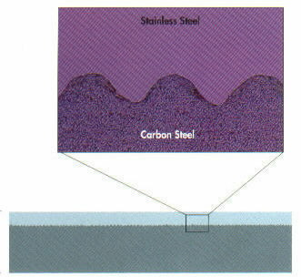
Explosive Welding

