Slide 1
Royalty Accounting
Prepared By: Vishal Goel

Slide 2
Introduction
The owner of an asset (e.g. mines, quarries, patent, copyright, etc), as a business arrangement, may allow other party (lessee, licencee, publisher, etc) the right to use that asset against some consideration.
Such consideration is calculated with reference to the quantity produced or sold.
This payment to the owner by the user of the asset is termed as Royalty.
Royalty is the amount of consideration paid by a party to the owner of the asset in return for the right to use that asset.

Slide 3
For example, when a publisher publishes a book, he makes a payment to the author which is based on the number of copies sold known as royalty.
The following are some of cases where one party paid to another in the form of Royalty:
1. where the owner of a mine allows another the right to extract minerals from land;
2. where right such as patents or copyrights are licensed in favour of another;
3. where an author, artist or designer gives exclusive rights to another to copy the work.

Slide 4
Common terms Used in Connection with Accounting for Royalty
1. Minimum Rent / Dead Rent
A contract is entered into between the landlord and the lessee for payment of royalty, usually calculated upon the quantum of production or sale at a certain stipulated rate.
So, if there is little or no production or sale, the landlord would receive little or no royalty at all, thus affects the monetary interest of the landlord as well as the lessee.
It is normally not acceptable to the owner, since sale or production mostly depends on the capacity of the person to whom the rights have been given.
To avoid such a situation, the landlord and the lessee agreed upon a minimum periodical amount that the landlord will receive from the lessee, even if the actual royalty as calculated on the basis of actual production or sale is less than such minimum amount.
This assured and mutually agreed periodical minimum amount is known as “Minimum Rent”.

Slide 5
Example: Suppose royalty per ton of production is Rs 10 and the minimum (annual) rent is Rs 4,00,000.
Now, the actual production is 35,000 tons, then actual royalty would become Rs 3,50,000. In this case the minimum rent of Rs 4,00,000 will have to be paid by the lessee.
On the other hand, if the actual production is 46,000 tons, then the actual royalty would become Rs 4,60,000. In this case Rs 4,60,000 will have to be paid by the lessee.
Thus, as there is a stipulation for minimum rent, then either the minimum rent or the actual royalty whichever is more shall have to be paid by the lessee.
The minimum rent is also called dead rent, certain rent, fixed rent, etc.

Slide 6
2. Short workings / Redeemable Dead Rent
Short workings is the amount by which the minimum rent exceeds the actual royalty. It is the difference between Actual Rent and Minimum Rent.
In the above example, the short workings is Rs 50,000 (Rs 4,00,000 - Rs 3,50,000).
Where there is short workings in any period the lessee is liable to pay the minimum rent and, in effect, short workings becomes the part of the minimum rent and not represented by the use of rights.
The question of short workings will arise only when there is a stipulation for minimum rent in the agreement.

Slide 7
3. Excess working
It refers to the amount by which the actual royalty exceeds the minimum rent. In the above example, the excess workings is Rs 60,000 (Rs 4,60,000 -Rs 4,00,000) if the production is 46,000 tons.
4.Ground Rent / Surface Rent
It refers to the fixed yearly or half-yearly rent payable by the lessee to the landlord in addition to the minimum rent.
5.Recoupment of Short workings
Generally, the royalty agreement contains a provision for carrying forward of short workings with a view to adjust it in the future.
In the subsequent years, such short working is adjusted against the surplus royalty.
This process of adjustment is called recoupment of short workings.
The right of recoupment of short workings enables the lessee to recover the excess payment, made in the earlier years to meet the condition of payment of minimum rent.

Slide 8
5.Recoupment of Short workings
A time is usually agreed upon the number of years for which such short workings can be recouped.
This time limit for recoupment of short workings may be fixed or fluctuating. If the short workings cannot be recouped within the specified time, they lapse and are charged to Profit and Loss Account in the year when that specified time limit for recoupment ends.
i) Fixed right:
When the lessee can recoup shortworkings within a certain period from the date of the lease it is known as fixed right. For example, short workings can be recouped within three years from the date of the lease. So, after three years from the date of the lease the short workings cannot be recouped.
ii) Fluctuating right :
In this type of agreement, lessee can recoup short workings of any year during the next following year(s). For example, shor tworkings can be recouped in the year subsequent to the year of short workings.

Slide 9
6. Strike and Lockout, etc :
If agreement so provides, the minimum rent may be proportionately reduced in the event of strike and / or lockout.
So special entry is required for the same except the adjustment of minimum rent for that particular year.

Slide 10
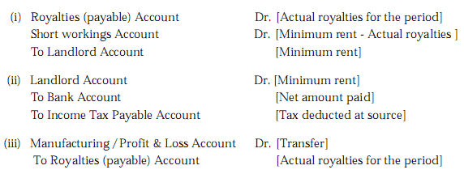
Accounting Entries in the Books of the Lessee/Licencee/Publisher etc.
1. Where a minimum rent exists with right to recoup short workings
(a) Where the actual royalty is less than the minimum rent

Slide 11
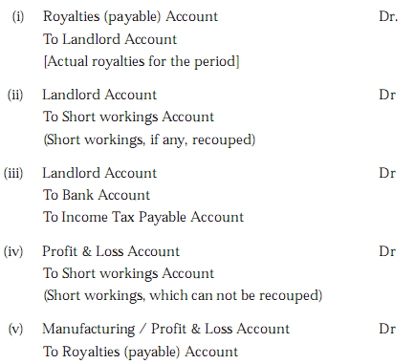
b) Where the actual royalty is more than the minimum rent:
Important Points to note:
1. When the royalty agreement does not contain a clause for minimum rent, the question of short workings and its recoupment does not arise.
2. The landlord is always entitled to get either the minimum rent or the actual royalty whichever is higher subject to any adjustment for short workings recouped.

Slide 12
Illustration 1
The Bihar Coal Co. Ltd. holds a lease of coal mines for a period of twelve years, commencing from 1st April 2002.
According to the lease, the company is to pay Rs 7.50 as royalty per ton with a minimum rent of Rs 150,000 per year.
Short workings can, however, be recovered out of the royalty in excess of the minimum rent of the next two years only.
For the year of a strike the minimum rent is to be reduced to 60%.
The output in tons for the 6 years ending 31st March,2008 is as under:
2002-03 : 10,000; 2003-04 : 12,000; 2004-05:25,000; 2005-06: 20,000; 2006-07: 50,000; and 2007-08: 15,000 (strike).
Write up the necessary Ledger Accounts in the books of Bihar Coal Co. Ltd.

Slide 13
Illustration 2 :
SKG Oil. Ltd. holds a lease of Oil field for a period of twenty years, commencing from 1st April 2002.
According to the lease, the company is to pay Rs 20.00 as royalty per ton with a minimum rent of Rs 250,000 per year.
Short workings can, however, be recovered out of the royalty in excess of the minimum rent of the 1st four years from the date of operation.
The output in tons for the 6 years ending 31st March,2008 is as under: 2002-03: Nil; 2003-04: 12,000; 2004-05: 15,000; 2005-06: 20,000; 2006-07: 22,000; and 2007-08 : 11,000.
Write up the necessary Ledger Accounts in the books of SKG Oil Ltd.

Slide 14
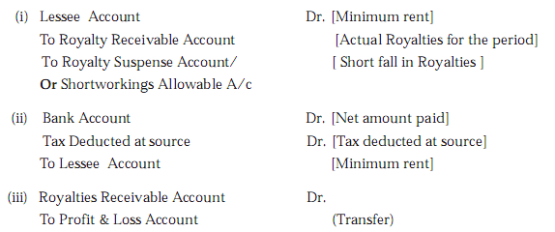
Accounting Entries in the Books of the Landlord / Lessor
1. Where a minimum rent exists with right to recoup short workings
(a) Where the actual royalty is less than the minimum rent

Slide 15
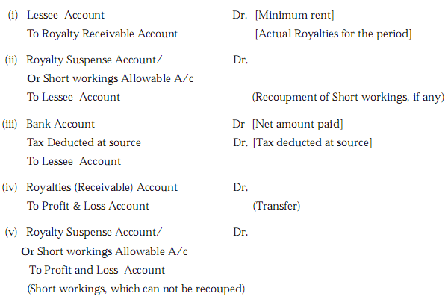
(b) Where the actual royalty is more than the minimum rent:

Slide 16
SUB-LEASE
In some cases the lessee transfers a part to its right of lease to an another party to complete the work under lease with terms and condition as agreed between himself and that party.
In these cases, there are three parties, viz. Landlord, lessee and sub-lessee. So far accounting entries are concern, the status of lessee with the sub-lessee is like a landlord.

Slide 17
Accounting Entries
a> In the books of Landlord:
Same as before. Payment to landlord will depend on the total production /sell made by lessee as well as sub-lessee.
b> In the books of the Lessee. In this book both royalty payable and receivable account to be opened since he has two status. He has to maintain, if any, both short workings and Royalty suspense account.
c> In the books of sub-lessee.
In this case the entry will be from the view point of lessee in normal cases as explained earlier.

Slide 18
Illustration 4 :
On 1.4.2003 Mayami got a mining lease and from that date a part of the mine was sub-leased to Pathan. The terms of payment and the production of 5 years are as below.
In case of strike, royalty earned will discharge all liabilities for the year only. Show ledger accounts in the books of Mayami.
Particulars) | Lessee | Sub-Lessee
Royalty (Rs./Tonne) | 2.00 | 3.00
Dead Rent per annum (Rs.) | 15,000 | 10,000
Short working recoverable (Years | 3 | 2
Production (Year ended ….. 31.3)
2004 | 1,000 | 1,000
2005 | 3,000 | 2,000
2006 | 12,000 | 5,000
2007 | 9,000 | 2,000 (Strike)
2008 | 5,000 | 12,000

Slide 19
Illustration 5.
The following information has been obtained from the books of a lesee relating to the years 2005-06 to 2008-09 : Payments to Landlord (after tax deducted @ 20% at Source) :
2005-06 Rs. 12,000
2006-07 Rs. 12,000
2007-08 Rs. 2,000
2008-09 Rs. 19,200
Short-working recovered : 2006-07 Rs. 2,500
2007-08 Rs. 1,000
Short-working recovered : 2007-08 Rs. 500
Balance of Short-working Account forward on April 1, 2005 Rs. 800 (which are in 2005–06). According to the terms of agreement short-working is recoverable within the next two years following the year in which short-working arises.
You are required to show the necessary accounts in the books of the lessee for the four years ended 31st March 2009.

Slide 20
Illustration 6.
A fire occurred in the office premises of lessee in the evening of 31.3.2009 destroying most of the books and records. From the documents saved, the following information is gathered :
Short-working recovered :
2006-07 Rs. 2,000 (towards short-workings which arose in 2003-04)
2008-08 Rs. 4,000 (including Rs. 1,000 for short-working 2004-05)
2008-09 Rs. 1,000
Short-working lapsed :
2005-06 Rs. 1,500
2006-07 Rs. 1,800
2008-09 Rs. 1,000
A sum of Rs. 25,000 was paid to the landlord in 2005-06. The agreement of Royalty contains a clause of Minimum Rent payable for fixed amount and recoupment of short-workings within 3 years following the year in which Short-workings arise.
Information as regards payments to landlord subsequent to the year 2005-06 is not four years ended 31.3.2009.

