Slide 1
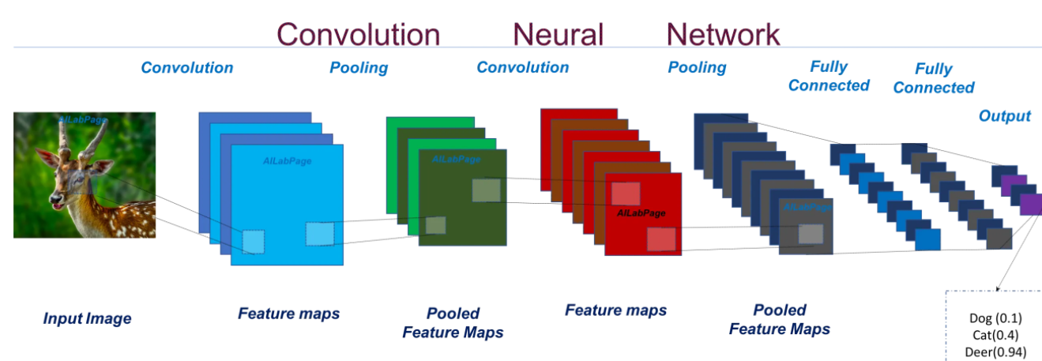
Prof. Sejal Thakkar
Convolutional neural network (CNN)

Slide 2
Convolutional neural network (CNN)
convolutional neural networks came into the public consciousness through a hackathon (the ImageNet competition in 2012).
These neural networks have caught inspiration like fire since then, expanding into various research areas. Here are just a few popular computer vision applications where CNNs are used:
Facial recognition systems
Analyzing and parsing through documents
Smart cities (traffic cameras, for example)
Recommendation systems, among other use cases

Slide 4
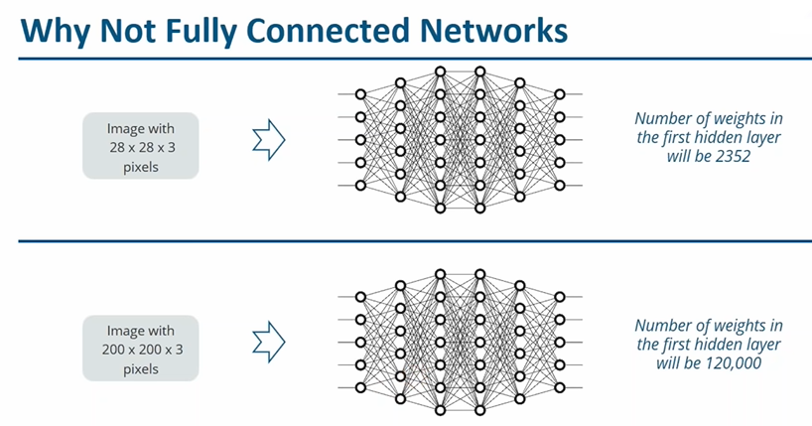

Slide 8
The convolutional neural network can be broken down into two parts: The convolution layers: Extracts features from the input The fully connected (dense) layers: Uses data from convolution layer to generate output

Slide 15
Convolution Layer You know how we look at images and identify the object’s shape and edges? A convolutional neural network does this by comparing the pixel values. Below is an image of the number 8 and the pixel values for this image. Take a look at the image closely. You would notice that there is a significant difference between the pixel values around the edges of the number. Hence, a simple way to identify the edges is to compare the neighboring pixel value.

Slide 16
Convolution is often represented mathematically with an asterisk * sign. If we have an input image represented as X and a filter represented with f, then the expression would be:
Z = X * f

Slide 17
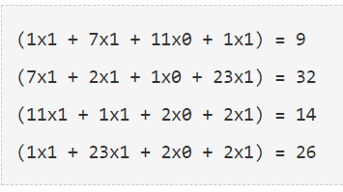
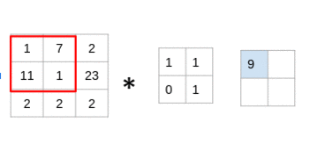
Let us understand the process of convolution using a simple example. Consider that we have an image of size 3 x 3 and a filter of size 2 x 2:

Slide 18
Look at that closely – you’ll notice that the filter is considering a small portion of the image at a time. We can also imagine this as a single image broken down into smaller patches, each of which is convolved with the filter. In the above example, we had an input of shape (3, 3) and a filter of shape (2, 2). Since the dimensions of image and filter are very small, it’s easy to interpret that the shape of the output matrix is (2, 2). But how would we find the shape of an output for more complex inputs or filter dimensions? There is a simple formula to do so:

Slide 19
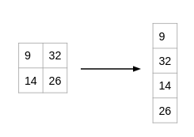
Fully Connected Layer So far, the convolution layer has extracted some valuable features from the data. These features are sent to the fully connected layer that generates the final results. The fully connected layer in a CNN is nothing but the traditional neural network! The output from the convolution layer was a 2D matrix. Ideally, we would want each row to represent a single input image. In fact, the fully connected layer can only work with 1D data. Hence, the values generated from the previous operation are first converted into a 1D format.

Slide 21
Once the data is converted into a 1D array, it is sent to the fully connected layer. All of these individual values are treated as separate features that represent the image. The fully connected layer performs two operations on the incoming data – a linear transformation and a non-linear transformation.
We first perform a linear transformation on this data. The equation for linear transformation is:
Z = W^{T}.X + b
Here, X is the input, W is weight, and b (called bias) is a constant. Note that the W in this case will be a matrix of (randomly initialized) numbers. Can you guess what would be the size of this matrix?

Slide 22
Considering the size of the matrix is (m, n) – m will be equal to the number of features or inputs for this layer. Since we have 4 features from the convolution layer, m here would be 4. The value of n will depend on the number of neurons in the layer. For instance, if we have two neurons, then the shape of weight matrix will be (4, 2):

Slide 43
Dropout
Dropout is an approach used for regularization in neural networks. It is a technique where randomly chosen nodes are ignored in network during training phase at each stage. This dropout rate is usually 0.5 and dropout can be tuned to produce best results and also improves training speed. This method of regularization reduces node-to-node interactions in the network which leads to learning of important features and also helps in generalizing new data better.

Slide 47
CNN Architectures
Classic network architectures (included for historical purposes)
LeNet-5
AlexNet
VGG 16
Modern network architectures
Inception
ResNet
ResNeXt
DenseNet

Slide 48
VGG NET
1) VGG 16
2) VGG 19

Slide 49
VGG is an acronym for the Visual Geometric Group from Oxford University and VGG-16 is a network with 16 layers proposed by the Visual Geometric Group. These 16 layers contain the trainable parameters and there are other layers also like the Max pool layer but those do not contain any trainable parameters. This architecture was the 1st runner up of the Visual Recognition Challenge of 2014 i.e. ILSVRC-2014 and was developed by Simonyan and Zisserman.

Slide 50
The VGG research group released a series of the convolution network model starting from VGG11 to VGG19. The main intention of the VGG group on depth was to understand how the depth of convolutional networks affects the accuracy of the models of large-scale image classification and recognition. The minimum VGG11 has 8 convolutional layers and 3 fully connected layers as compared to the maximum VGG19 which has 16 convolutional layers and the 3 fully connected layers. The different variations of VGGs are exactly the same in the last three fully connected layers. The overall structure includes 5 sets of convolutional layers, followed by a MaxPool. But the difference is that as the depth increases that is as we move from VGG11 to VGG19 more and more cascaded convolutional layers are added in the five sets of convolutional layers.

Slide 51
VGG 16

Slide 54
Features of VGG-16 network
Features of VGG-16 network
Input Layer: It accepts color images as an input with the size 224 x 224 and 3 channels i.e. Red, Green, and Blue.
Convolution Layer: The images pass through a stack of convolution layers where every convolution filter has a very small receptive field of 3 x 3 and stride of 1. Every convolution kernel uses row and column padding so that the size of input as well as the output feature maps remains the same or in other words, the resolution after the convolution is performed remains the same.
Max pooling: It is performed over a max-pool window of size 2 x 2 with stride equals to 2, which means here max pool windows are non-overlapping windows.
Not every convolution layer is followed by a max pool layer as at some places a convolution layer is following another convolution layer without the max-pool layer in between.
The first two fully connected layers have 4096 channels each and the third fully connected layer which is also the output layer have 1000 channels, one for each category of images in the imagenet database.
The hidden layers have ReLU as their activation function.

