Slide 1
Hire Purchase and Instalment System

Slide 2
Introduction
It is not always possible by a purchaser to meet up the higher demand for goods due to immediate cash payment.
To meet this demand the concept of Hire purchase is very popular in the market.

Slide 3
Under this system the purchaser (Hirer) pays the entire amount in staggered way viz. monthly, quarterly or yearly with some interest.
Under this system the goods are sold with the following conditions.
Possession of goods is delivered to a hirer but the title to the goods (Ownership) are transferred only when the agreed sum( Hire Purchase price) is paid by the hirer.
Such hirer has a right to terminate the agreement at any time before the property so passes.
That means he has the option to return the goods in which case he need not pay installments falling due thereafter.
However, the hirer cannot recover the sums already paid as such sums legally represent hire charges of the goods in question.

Slide 4
The hire-purchaser, during that period of possession of goods, cannot damage, destroy, pledge or sell such goods.
He is supposed to take all such care of goods as a prudent person does in his own goods.
In case of Installment sale, it is not only the possession of goods but also the ownership in goods is transferred to the buyer immediately at the time of agreement.
Further, in installment system if the buyer stops the payment of dues, then He does not have the right of seizing his goods.

Slide 5
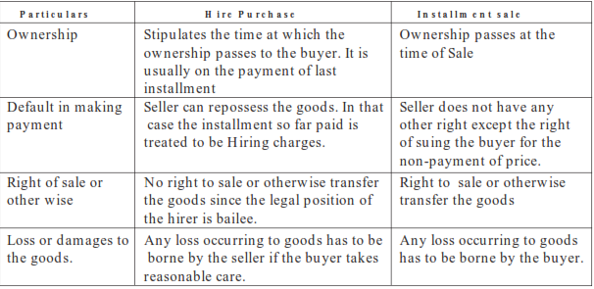
Differences between installment sale and hire-purchase

Slide 6
SITUATION I : WHEN RATE OF INTEREST, TOTAL CASH PRICE AND INSTALLMENTS ARE GIVEN
Illustration 1 : X purchases a car on hire-purchase system on 1.1.07. The total cash price of the car is Rs. 4,50,000 payable Rs. 90000 down and three installments of Rs. 1,70,000, Rs. 1,50,000 and Rs. 1,08,460 payable at the end of first, second and third year respectively. Interest is charged at 10% p.a.
You are required to calculate interest paid by the buyer to the seller each year.

Slide 7
SITUATION II : WHEN RATE OF INTEREST AND INSTALLMENTS ARE GIVEN BUT TOTAL CASH PRICE IS NOT GIVEN
X purchased a T.V on hire-purchase system. As per terms he is required to pay Rs. 3000 down,
Rs. 4000 at the end of first year, Rs. 3000 at the end of second year, and Rs. 5000 at end of third year. Interest is charged at 12% p.a.
You are required to calculate total cash price of T.V and interest paid with each install ment.

Slide 8
SITUATION III: -WHEN ONLY INSTALLMENTS ARE GIVEN, BUT CASH PRICE AND RATE OF INTEREST ARE NOT GIVEN
Illustration 3 :
X & Co. purchased a Motor car on April 1, 2007 on hire-purchase paying Rs. 60,000 cash down and balance in four annual installments of Rs. 55,000, Rs. 50,000.,Rs. 45000 and Rs. 40,000 each Installment comprising equal amount of cash price at the end of each accounting period.
You are required to calculate total cash price and amount of interest in each Installment.

Slide 9
SITUATION IV: WHEN REFERENCE TO ANNUITY TABLE RATE OF INTEREST AND INSTALLMENTS ARE GIVEN BUT TOTAL CASH PRICE IS NOT GIVEN.
In such questions the reference to annuity table gives the present value of the annuity for a number of years at a certain rate of interest.
This present worth is equal to total cash price.
Therefore, with the help of annuity tables the total cash price of the total installments given can be calculated and then question can be solved by the first method.

Slide 10
Accounting treatment. Accounting treatment in the books of buyer and seller
The following methods are followed:
(1) Cash Price Method
(2) Interest Suspense Method
Cash Price Method:
Under this method, we will have to prepare the following ledger accounts:
(i) H.P. Asset Account.
(ii) Hire Vendor Account.

Slide 11
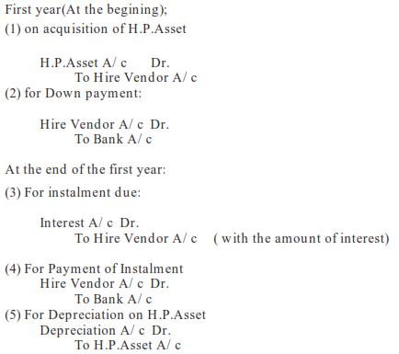
Accounting Entries:

Slide 12
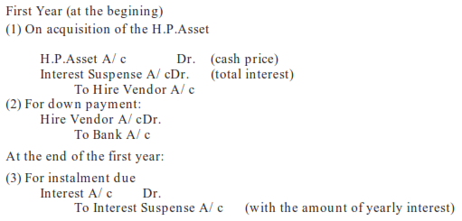
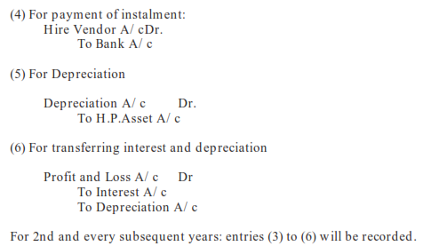
Interest Suspense Method:

Slide 13
In the Books of Vendor
Goods which are sold under HP system may be classified into two categories.
They are
(A) Items of large value and long life which buyers treat as fixed assets and
(B) Small consumer items which are purchased by general public such as radios, TV sets, tape
recorders, fans, washing machines, etc.
The buyers of such items being general public do not make any accounting entries. The accounting methods depend on the nature of goods sold.
Let us discuss the accounting treatment for large items.
(A) Large items: In the case of hire-purchase sales there are three components in the selling
price as shown below:
(1) Cost Price
+ (2) Gross Profit = Cash Price
+ (3) Interest = Hire-Purchase sales price.
The accounting methods generally recognize gross profit at the point of sale. Regarding interest
there are two methods.
(1) Sales Method.
(2) Interest Suspense Method.

Slide 14
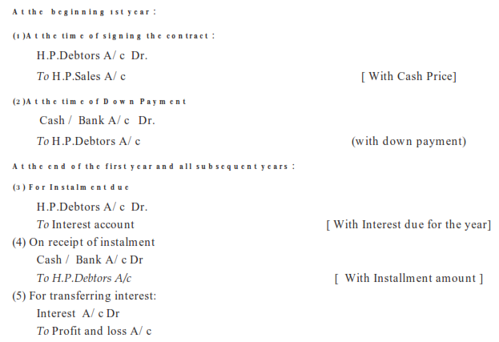
Sales Method :
Under this method, interest is recognized only when the instalment is due.
Accounting Entries:

Slide 15
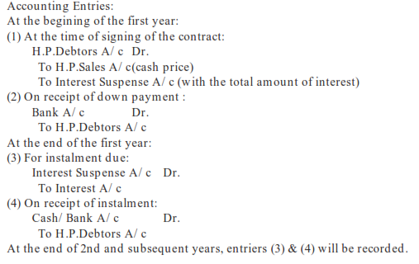
Interest Suspense Method :
In this method the total interest is credited to interest suspense account and is transferred to interest account proper at the end of each accounting period.

Slide 16
DEFAULT AND REPOSSESSION
When hirer is in default in making payments in time, the owner takes back the possession of goods. There are two possibilities:
(a) Complete repossession When seller takes back the possession of complete goods.
Accounting treatment in this case is as follows:
Books of Purchaser
1. All entries, except the entry for payment, are passed as usual up to the date of
default.
2. Buyer closes the account of seller by debiting his account. The same amount will be
credited to asset account.
3. Any balance left in asset account is closed by transferring to profit and loss account.
Books of Seller
1. All entries, except the entry for payment, are passed as usual up to the date of
default.
2. Seller closes purchaser’s account by crediting his account (by the amount credit given)
and debiting goods returned account (a new account).
3. Goods returned account, as opened, is further debited with expenses incurred on repair of the goods and credited with actual resale price. Any balance in this account, being profit or loss on resale, is transferred to profit and loss account.

Slide 17
Illustration 4 :
X purchased a truck for Rs. 2,80,000, payment to be made Rs. 91,000 down and 3 installments of Rs. 76,000 each at the end of each year. Rate of interest is charged at 10% p.a. Buyer depreciates assets at 15% p.a. on written down value method.
Because of financial difficulties, X, after having paid down payment and first installment to the end of 1st year could not pay second installment and seller took possession of the truck. Seller, after spending Rs. 9,200 on repairs of the asset sold for Rs. 150,000. Show the relevant accounts in the books of the purchaser & the vendor.

Slide 18
b) Partial Repossession - When seller takes possession of only part of the total asset sold to buyer.
In this case accounting entries in the books of both the parties are similar to those done in the first case. The additional precautions to be taken are as follows:
(i) Both buyer and seller do not close seller’s and buyer’s account in their respective
books. The entry is passed with the agreed value of the asset which is taken away by
the seller. The basis for finding out the value of asset taken away is given in the question.
(ii) The buyer finds out the value of asset still left with him using the normal rate of
depreciation. He keeps the asset account open. This account shows the balance of that
asset which is left to him by the seller
(iii) After crediting the asset account (in buyer’s books) with the value of asset taken away by the seller (with such value as agreed upon) and after keeping the balance of the asset left [normal value as calculated in (ii) above], the difference shown by the asset account represents either profit or loss on default. This difference is transferred to profit and loss account.

Slide 19
Illustration 5 :
Z Ltd. purchased seven trucks on hire purchase on 1st July, 2005. The cash purchase price of each truck was Rs 1,00,000.
The company has to pay 20% of the cash purchase price at the time of delivery and the balance in five half yearly instalment starting from 31st December, 2005 with interest at 5% per annum at half yearly rest.
On the Company's failure to pay the instalment due on 30th June 2006, it was agreed that the Company would return 3 trucks to the vender and the remaining four would be retained.
The vendor agreed to allow him a credit for the amount paid against these 3 trucks less 25%.
Show the relevant Accounts in the books of the purchase and vendor assuming the books are closed in June every year and depreciation @ 20% p.a. is charged on Trucks. Vendor after spending Rs. 2,000 on repairs sold away all the three trucks for Rs. 80,000.

Slide 20
Illustration 6 :
HT Ltd. purchased three electric motors costing Rs. 10,000 each from KM Ltd on 1st January, 2004 on the hire purchase system.
The terms were : Payment on delivery Rs 2,500 for each motor and balance of the principal amount by 3 equal instalments plus interest at 15% per annum to be paid at the end of each year.
HT. Ltd writes off 25% depreciation each year on the diminishing balance method. HT. Ltd failed to pay the last instalment. KM. Ltd repossessed two motors adjusting values against the amount due.
The repossession was done on 1st January, 2007 on the basis of 40% depreciation on the diminishing balance method.
You are required to:
(a) Write up the ledger accounts in the books of H.T. Ltd showing the above transactions upto 1.1.2007, and
(b) Show the disclosure of the balance arising from the above in the Balance Sheet of H.T. Ltd an on 31st December 2006.

Slide 21
Illustration 7 :
On 1.1.2004, B & Co. bought 5 computers from Chirag Computers on hire-purchase. The cash price of each computer was Rs 20,000.
It was agreed Rs 30,000 each at the end of each year. The Vendor charges interest @ 10% p.a. The buyer depreciates computers at 20% p.a. on the diminishing balance method.
B & Co. paid cash down of Rs. 5,000 each and two instalments but failed to pay the last instalment. Consequently, the Computers Co. repossessed three sets, leaving two sets with the buyer and adjusting the value of 3 sets against the amount due.
The sets repossessed were valued on the basis of 30% depreciation p.a. on the written down value. The sets repossessed were sold by the Chirag Computers for Rs 30,000 after necessary rapairs amounting to Rs 5,000 on 30th June 2007.
Required : Open the necessary ledger account in the books of both the parties.

Slide 22
Thanks

