Slide 1
Partnership: Dissolution

Slide 2
DISSOLUTION OF A FIRM
Whenever a reconstitution takes place within a Partnership in the form of admission, retirement or death of a Partner, the existing partnership is dissolved.
The Partnership firm, may however, continue, if the remaining partners desire so.

Slide 3
But if the partnership firm is discontinued for any reason, that is called Dissolution of the firm.
Dissolution of Firm – when does it take place [in accordance with the Indian Partnership Act of 1932]
1. By Mutual consent of all the partners or in accordance with a contract made by them [Section 40]
2. By Notice – given in writing, by any partner to all other partners if the Partnership is at will [Section 43].
3. On the happening of any one of the following events : [Section 42] : (i) expiry of the term, where the Partnership was constituted for a fixed term; (ii) completion of the adventure for which the firm was constituted; (iii) Death of a partner, (iv) Adjudication of a Partner as insolvent.
4. Compulsory Dissolution [Section 41]
(i) Where all the partners or all but one are adjudged insolvent.
(ii) If any event occurs making it unlawful for the business of the firm to be carried on.
5. Dissolution by Court: According to Section 44 of the Indian Partnership Act the court, at the suit of a partner, may dissolve a firm on any one of the grounds namely –
(i) insanity of a partner ;
(ii) permanent incapability of a partner to do his duties ;
(iii) if a partner is guilty of misconduct that might affect prejudicially the carrying on of
the business ;
(iv) If a partner willfully or persistently commits breach of agreement ;
(v) If a partner transfers all his shares to a third party or has allowed his share to be
charged under the Provisions of Rule 49 of order XXI of the First Schedule to the
Code of Civil Procedure, 1908 ;

Slide 4
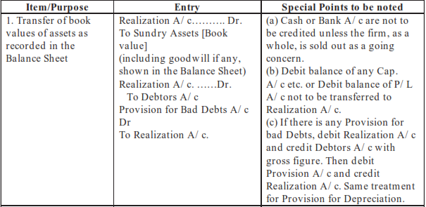
[A] Realization of Assets and Payment of liabilities

Slide 6
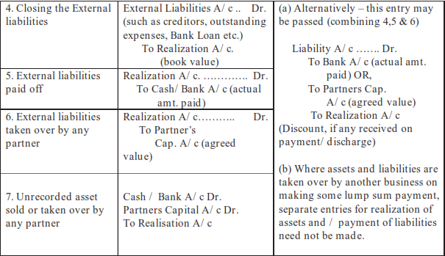

Slide 7
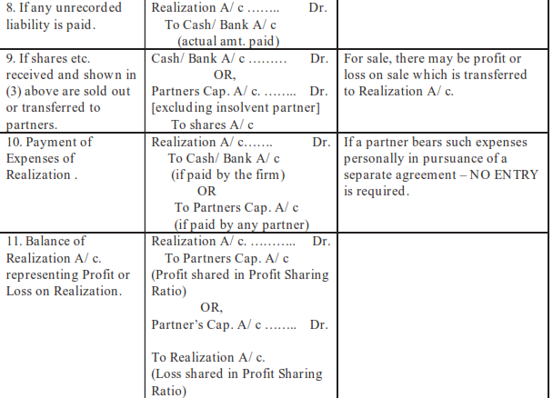

Slide 8
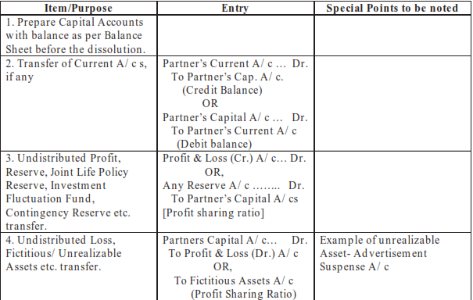
[B] Settlement of Partners Dues – through Capital Accounts

Slide 9
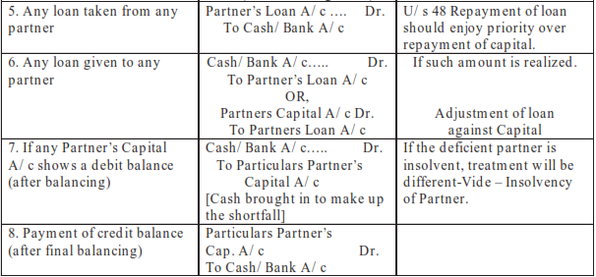

Slide 10
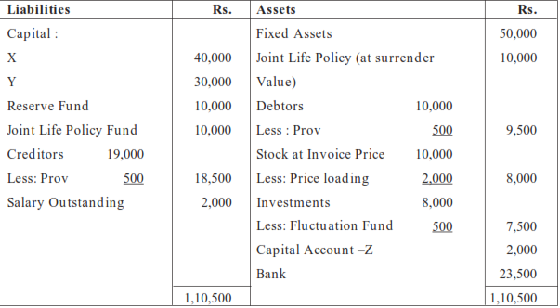
Ex-1/P306
X, Y and Z sharing profits & Losses in the ratio of 2 : 2: 1 agreed upon dissolution of their partnership on 31st December, 2007 on which date their Balance Sheet was as under :
Investments were taken over by X at Rs. 6,000, creditors of Rs. 10,000 were taken over by Y who has agreed to settle account with them at Rs. 9,900. Remaining creditors were paid Rs. 7,500. Joint Life Policy was surrendered and Fixed Assets realized Rs. 70,000, Stock and Debtors realized Rs. 7,000 and Rs. 9,000 respectively. One customer, whose account was written off as bad, now paid Rs. 800 which is not included in Rs. 9,000 mentioned above. There was an unrecorded asset estimated at Rs. 3,000, half of which as handed over to an unrecorded liability of Rs. 5,000 in settlement of claim of Rs 2,500 and the remaining half was sold in the market which realized Rs. 1,300. Y took over the responsibility of completing the dissolution and he is granted a salary of Rs. 400 per month. Actual expenses amounted to Rs. 1,100. Dissolution was completed and final payments were made on 30 April, 2008.
You are required to prepare the Realization Account, Capital Account and Bank Account.

Slide 11
Garner Vs.Murray Rule : (The third partner who became insolvent was Mr. Wilkins)
The deficiency of the insolvent partner shall be taken over by the solvent partners. The following steps are taken:
(a) The loss on realisation shall be shared between all the partners (including the insolvent partner) in their profit-sharing ratio.
(b) The solvent partners shall bring in cash equal to the amount of loss suffered by them.
Cash A/c Dr.
To Solvent Partners Capital A/c
(c) The deficiency of the insolvent partner shall be taken over by the solvent partners in their capital contribution ratio ( fixed or fluctuating capitals)
Solvent Partners Capital A/c Dr.
To Insolvent Partner’s Capital A/c

Slide 12
Indian Partnership Act,1932
As per the Indian Partnership Act,1932, the deficiency of the insolvent partner is shared as
follows:
(a) The loss on realisation shall be shared between all the partners (including the insolvent partner) in their profit-sharing ratio.
(b) The deficiency of the insolvent partner shall be taken over by the solvent partners in their capital contribution ratio ( fixed or fluctuating capitals)
Solvent Partners Capital A/c Dr.
To Insolvent Partner’s Capital A/c
Note: As per Indian Partnership Act, the solvent partners shall not bring in cash, their share
of loss on realisation.

Slide 13
