Slide 1
OVERVIEW OF COST ACCOUNTING
Chapter 1- Overview of cost account

Slide 2
Topics
Financial accounting
Classification of account
Objectives and functions of cost accounting
Meaning of Cost
Methods of costing
Techniques of costing
Cost ascertainment and cost estimation
Classifications of cost
Special costs for management decision making
Elements of cost
Steps of installation of a costing system
Advantages of cost accounting
Limitations or objections against cost accounting
Essentials of a good cost accounting system

Slide 3
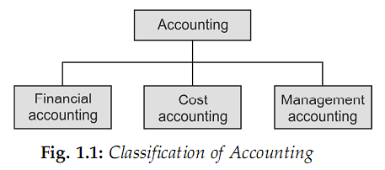
CLASSIFICATION OF ACCOUNTING
Financial Accounting: It is defined as ‘the art of recording, classifying and summarizing in a significant manner and in terms of money, transactions and events, which are in part at least, of a financial character and interpreting the results thereof.’
Cost Accounting: ‘Cost accounting is the process of accounting for costs from the point at which expenditure is incurred or committed to the establishment of its ultimate relationship with cost centres and cost units. In its widest usage, it embraces the preparation of statistical data, the application of cost control methods and ascertainment of profitability of activities carried out or planned.’
3. Management Accounting: (CIMA), London has defined management accounting as ‘the presentation of accounting information in such a way as to assist management in the creation of policy and in the day-to-day operations of an undertaking.’

Slide 4
Financial Accounting
The functions of financial accounting are concerned with that of bookkeeping, i.e. maintenance of records of costs, debtors, and creditors, etc.
As per the company law requirements, the company has to maintain the accounts for their adoption by the shareholders in the Annual General Meeting.

Slide 5
Limitations of Financial Accounting
Financial accounting doesn’t aims at continuous reporting of financial data, which the cost accounting does
Financial accounts will not reveal the data by jobs, process, products, etc.
It provides only historical data, and it would be too late for any corrective action.
It does not provide data for adequate control over materials, labour, and overheads.
In financial accounting, there are no systems to set predetermined estimates, standards, or budgets.

Slide 6
Cost and Management Accounting
The Chartered Institute of Management Accountants, U.K. (CIMA) defines costing as ‘the technique and process of ascertaining costs.’
Costing is a tool to determine the cost of products or service.
Cost accounting – analysis and classification of costs or expenditure.
Cost accountancy – application of costing and cost accounting principles.

Slide 7
Cost Accounting and Management Accounting
To quote J. Batty, ‘Management Accountancy is the term used to describe the accounting methods, systems and techniques, which coupled with special knowledge and ability, assists management in its tasks of maximizing profits or minimizing losses.
Management Accountancy is the blending together into a coherent whole, financial accounting, cost accountancy and all aspects of financial management.’
Management Accounting is an extension of managerial aspects, of cost accounting.
Thus, it is the accounting to assist the management in planning and decision-making.

Slide 8
OBJECTIVES AND FUNCTIONS OF COST ACCOUNTING
Ascertainment of cost:
Cost control and cost reduction
Guide to business policy
Determination of selling price
In cost accounting, cost of each unit of production, job, process or department, etc., is ascertained. Not only actual costs incurred are ascertained but costs are also pre-determined for various purposes.
Cost accounting aims at improving profitability by controlling and reducing costs. For this purpose, various specialized techniques, like standard costing, budgetary control, inventory control, value analysis, etc., are used.
Cost accounting aims at serving the needs of the management in conducting the business with utmost efficiency. Cost data provide guidelines for various managerial decisions, like making or buying, selling below cost, utilization of idle plant capacity, introduction of a new product, etc.
Cost accounting provides cost information on the basis of which selling prices of products or services may be fixed. In periods of depression, cost accounting guides the firms in deciding the extent to which the selling prices may be reduced to meet the situation.

Slide 9
MEANING OF COST
According to Cambridge International Dictionary of English, cost means ‘the amount of money needed to buy, do or make something.’ Some other definitions of cost are given below:
1. Cost is ‘the amount of expenditure (actual or notional), incurred or attributable to a given thing.’ (CIMA, London)
2. A cost is the value of economic resources used as a result of producing or doing the things costed.’ (W M Harper)
3. ‘Cost is a measurement, in monetary terms, of the amount of resources used for the purpose of production of goods or rendering of services.’ (ICWA of India)
Cost Centre
Cost Unit
Cost Object

Slide 10
Cost Unit and Cost centre
A cost centre is a location, a person, or an item of equipment (or a group of these) for which costs may be ascertained and used for the purpose of cost control.
Cost unit is defined as a quantitative unit of a product, a service, or an item, in relation to which costs are measured.
A cost unit, simply stated, is a unit of finished product, service or time, or a combination of these in relation to which cost is ascertained and expressed.
Ex:-
Product | Cost unit
Cement | Per tone
Cable | Per MTR.

Slide 11
Types of Cost Centers
Personal (Sales manager, work managers) and impersonal cost (Region sales, Territory purchase) centre
Operation and process cost centre
Production, service and staff cost centre
Whatever may be the type of cost centre, it is determined by taking into consideration the following factors:
the value of the work to be performed,
the extent of cost control that can be exercised,
responsibilities to be identified, and
the uses of cost centre wise data by the costing department, etc.

Slide 12
Cost Object
Cost object is anything for which separate cost may be desired
Cost object is an entity or a part of an entity
The cost object changes according to decision needs of the management.
Ex: Product, Group of Product, Plant, division, Project etc.

Slide 13
Cost, Expense, and Loss
The term ‘cost’ is denoted by expense which is incurred after deriving the benefit.
When the cost is incurred before deriving the benefit, it is termed as deferred cost.
Expenses are defined as ‘all explicit costs which are deductible from revenue.’
When no benefit is derived by the incurrence of cost, it is termed as loss,

Slide 14
METHODS OF COSTING
Job order costing: Cost unit in job order costing is taken to be a job or work order for which costs are separately collected and computed.
Contract costing or terminal costing: The cost unit here is a ‘contract’ which is of a long duration and may continue over more than one financial year.
Batch costing: In this, cost of a batch or group of identical products is ascertained and therefore each batch of products is a cost unit for which costs are ascertained.
Process costing: This method is used in mass production industries manufacturing standardized products. Costs are accumulated for each process or department.
Operation costing: A process may consist of a number of operations and operation costing involves cost ascertainment for each operation instead of a process.
Single, output or unit costing: This method is used when production is uniform and consists of a single or two or three varieties of the same product.
Operating or service costing: It is used in undertakings which provide services instead of manufacturing products.

Slide 15
TECHNIQUES OF COSTING
Standard costing
Budgetary control
Marginal costing
Total absorption Marginal costing
In this technique, separation of costs into fixed and variable (marginal) is of special interest and importance. It is a traditional method of costing whereby total costs (fixed and variable) are charged to products.
Uniform costing
In this technique, separation of costs into fixed and variable (marginal) is of special interest and importance.
In this technique, standard cost is predetermined as target of performance, and actual performance is measured against the standard.
It is a technique applied to the control of total expenditure by comparing actual performance with planned performance.
In this technique, separation of costs into fixed and variable (marginal) is of special interest and importance.

Slide 16
CLASSIFICATIONS OF COST
Classification into Direct and Indirect Costs
Direct costs: Costs which are incurred for and conveniently identified with a particular cost object.
Indirect costs These are general costs and are incurred for the benefit of a number of cost object.
Classification into Fixed , Variable and Semi-variable Costs
Fixed costs : These remain constant over a specific range of activity for a specified period of time.
Variable costs :Cost that tend to vary in direct proportion to the volume of output.
Semi-variable or semi-fixed costs (mixed costs): These costs include both a fixed and a variable component.
Classification into Committed and Discretionary Costs
Committed costs: These are those costs that are incurred in maintaining physical facilities and managerial set up.
Discretionary costs: Costs which can be avoided by management decisions. Such costs are not permanent.

Slide 17
CLASSIFICATIONS OF COST(Contd.)
Classification into Product Costs and Period Costs
Product costs: These costs include all such costs that are involved in acquiring or making a product.
Period costs: These are those costs which are not necessary for production and are incurred even if there is no production.
Classification into Controllable and Non- controllable Costs
Controllable costs: Costs which may be directly regulated at a given level of management authority.
Non-controllable costs: Costs which cannot be influenced by the action of a specified member of an enterprise.
Classification into Historical Costs and Predetermined Costs
Historical costs: Costs which are ascertained after these have been incurred.
Predetermined costs: Future costs which are ascertained in advance of production.
Classification into Normal and Abnormal Costs
Normal cost: Cost which is incurred on expected lines at a given level of output.
Abnormal cost: Cost which is not normally incurred at a given level of output.

Slide 18
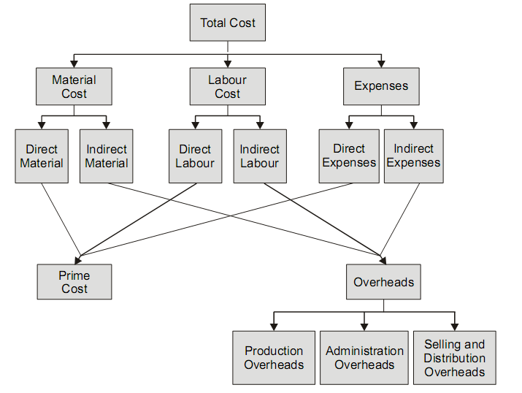
ELEMENTS OF COST

Slide 19
SPECIAL COSTS FOR MANAGEMENT DECISION MAKING
1. Relevant costs: Cost whose magnitude will be affected by decision being made.
2. Irrelevant costs: These are those costs that will not be affected by a decision.
3. Sunk Costs: A sunk cost is an expenditure made in the past that cannot be changed and over which management no longer has control.
4. Differential (or Incremental) Cost: This cost may be regarded as the difference in total cost resulting from a contemplated change.
5. Marginal Cost: Marginal cost is the additional cost of producing one additional unit. Marginal cost is the same thing as variable cost.
6. Imputed Costs: These are hypothetical costs which are specially computed outside the accounting system for the purpose of decision making.
7. Opportunity Cost: It is the sacrifice involved in accepting an alternative under consideration.
Replacement Cost: This is the cost at which there could be purchased an asset identical to that which is being replaced.
9. Out - of - pocket Cost (Explicit Cost and Implicit Cost ): These are those costs that involve cash outlays or require the utilization of current resources.
Future Cost: Relevant costs for decision making are predetermined or future costs.
Conversion Cost: It is the total cost of ‘converting’ a raw material into finished product.

Slide 20
COST ASCERTAINMENT AND COST ESTIMATION
Cost Ascertainment: Cost ascertainment is concerned with computation of actual costs incurred. It refers to the methods and processes employed in ascertaining costs.
The ascertainment of actual cost has very little utility because of the following reasons:
1. Actual costs cannot be used for the purpose of price quotations and filling tenders.
2. Actual cost has practically no utility for cost control purposes.
3. Actual costs are ineffective as means of measuring performance efficiency.
Cost Estimation: Cost estimation is the process of predetermining costs of goods or services. The costs are determined in advance of production and precede the operations.
Cost estimates may have the following uses:
Cost estimates are used in making price quotations and bidding for contracts.
Cost estimates are used in the preparations of budgets.
They help in evaluating performance.
They are used in preparing projected financial statements.
Cost estimates may serve as targets in controlling the costs.

Slide 21
ADVANTAGES OF COST ACCOUNTING
Advantages to Management: Reveals profitable and unprofitable activities, Helps in cost control, Helps in decision making, Guides in fixing selling prices, Helps in inventory control, Aids in formulating policies, Helps in cost reduction, Reveals idle capacity, Checks the accuracy of financial accounts, Prevents frauds and manipulation.
Advantages to Workers: Workers are benefited by introduction of incentive plans which are an integral part of a cost system bringing higher productivity and higher earnings for them.
Advantages to Society: An efficient cost system is bound to lower the cost of production, the benefit of which is passed on to the public at large, in the form of lower prices of products or services.
Advantages to Government Agencies and Others: A cost system produces ready figures for use by government, wage tribunals, chambers of commerce and industry trade unions, etc., for use in problems like price fixing, wage level fixing, settlement of industrial disputes, policy matters, etc.

Slide 22
LIMITATIONS OR OBJECTIONS AGAINST COST ACCOUNTING
It is unnecessary
It is expensive
It is inapplicable
It is a failure
Another argument sometimes put forward is that modern methods of costing are not applicable to many types of industry.
The failure of a costing system in some concerns is quoted as an argument against its introduction in other undertakings.
It is pointed out that installation of a costing system is quite expensive which only large concerns can afford. It is also argued that installation of the system will involve additional expenditure which will lead to a diminution of profits.
It is argued that maintenance of cost records is not necessary and involves duplication of work. It is based on the premise that a good number of concerns are functioning prosperously without any system of costing.

Slide 23
STEPS OF INSTALLATION OF A COSTING SYSTEM
1
2
3
4
5
6
7
8
9
10
Preliminary investigations should be made relating to technical aspects of the business.
The organization structure should be studied to ascertain scope of authority.
Methods of purchase, storage or issue of materials should be modified as required.
Methods of remunerating labour should be examined to introduce any incentive plans.
Forms and accounting records should be designed to involve minimum clerical labour.
The size and layout of the factory should be studied.
The system should be effective in cost control and cost reduction.
Costing system should be simple and easy to operate.
The installation and operation of the system should be economical.
The system should be introduced gradually.

Slide 24
ESSENTIALS OF A GOOD COST ACCOUNTING SYSTEM
Suitability
Specially designed system
Support of executives
Cost of the system
Clearly defined cost centres
The method of costing adopted should be suitable to the industry and serve the objectives of installing the system.
A readymade costing system cannot be suitable for every business. The cost accounting system should be tailor-made according to the requirements of a business.
If a costing system is to be successful, it must be fully supported by executives of various departments and everyone should participate in it.
The cost of installing and operating the system should be justified by the results produced.
In order to derive maximum benefits from a costing system, well-defined cost centres and responsibility centres should be identified within the organization.

Slide 25
ESSENTIALS OF A GOOD COST ACCOUNTING SYSTEM (Contd.)
Controllable costs
Integration with financial accounts
Continuous education
Prompt and accurate reports
Avoid unnecessary details
Resources should not be wasted on collecting and compiling cost data that is not required.
The cost accounting department should prepare accurate reports and promptly submit the same to appropriate level of management so that action may be taken without delay.
Well-trained and educated staff should be employed to operate the system. In order to educate the costing staff, written manuals and meetings, etc. should be arranged on a continuous basis.
There should be cooperation and coordination between cost accounting and financial accounting departments. In order to avoid duplication of accounts, cost and financial accounts may be integrated.
Controllable and non-controllable costs of each responsibility centre should be separately shown.

Slide 26
Financial Accounting vs. Cost Accounting
Purpose
Statutory requirement
Analysis of cost and profit
Periodicity
Control
Historical and predetermined cost
Format of presenting the information
Nature of Transaction recorded
Types of statement prepared

Slide 27
Thank You

