Slide 1
Subject Name : Alloy Design

Slide 2
1
1.1 Concept of alloy design
1.2 Steps in alloy design
1.3 Significance of alloy design.

Slide 3
1.1 Concept of alloy design
Introduction
Selection of appropriate materials for mechanical design is an ever-increasing challenge
-as performance demands continue to push the limits of the mechanical properties that can be achieved with available materials.
Also, the range of materials being considered for design applications continues to increase beyond a single material type.

Slide 4
For example,
-in automobile production,
-the weight/strength properties for
-steel, cast iron, aluminum, magnesium, metal-matrix composites, and many other materials
-are vitally important considerations
during the initial design process for the various production components
that are utilized in manufacturing and assembly.

Slide 5
Metals
Pros
• electrically, thermally conductive
• good strength & ductility
• high toughness
• magnetic
Cons
• dense
• low creep resistance
• low/moderate corrosion resistance
Polymers
Pros
• very ductile
• easy to form
• corrosion resistant
• high strength-to-weight ratio
Cons
• low stiffness & strength
• poor high temperature properties
Composites
• Metal Matrix
• Ceramic Matrix
• Polymer Matrix
Ceramics
Pros
• electrically, thermally insulating
• wear and corrosion resistant
• high strength & stiffness
• creep resistant
• low density
Cons
• difficult to form/machine
• very low toughness

Slide 6
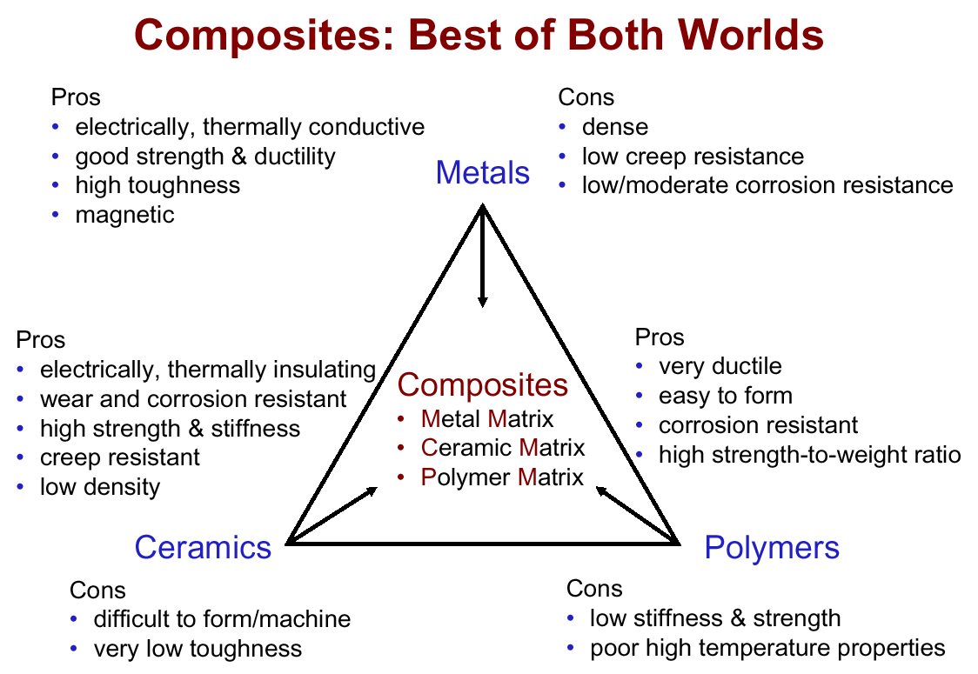

Slide 7
Motivation
Many of our modern technologies require materials with unusual combinations of properties that cannot be met by the conventional metal alloys, ceramics, and polymeric materials.
For example, aerospace, underwater, transportation applications.
For aircraft engineers, structural materials – low-density, strong and stiff, abrasion and impact resistant, not easily corroded. It’s a rather formidable combination of characteristics for conventional materials.

Slide 8
Purpose
With a knowledge of the various types of composites, as well as
an understanding of the dependence of their behaviors on the characteristics,
relative amounts,
geometry/distribution,
properties of the constituent phases,
it is possible to design materials with property combinations that are better than those found in the metal alloys, ceramics, and polymer materials.

Slide 9
GENERAL CONSIDERATIONS
Definition
‘‘Design’’(noun) refers to
-the plan, or
-arrangement of elements, or
-details in a physical entity, such as a material, a component, a finished product, or a machine.
‘‘Design’’ (verb)refers to
-the process
-by which the plan for the physical entity is created or improved.
Hence, design is both the plan and the process for making the plan.

Slide 10
B. Clients and Customers
Designs are created by clients to meet customer needs.
-The client is typically
-a manufacturing enterprise seeking to market and sell products,
-a developer or business seeking to
provide a service or facility, or
-a government authority responsible for providing physical infrastructure or military hardware.

Slide 11
Customers use the design and benefit from its functionality, appearance, ease of use, reliability, long life, safety, and so forth.
To be acceptable to the customer, the design must
-meet well-defined and clearly understood customer needs in a way
-that delights the customer and
-insures long-term, sustainable customer satisfaction.

Slide 12
C. Viewpoints
Industrial design is concerned
-with the external appearance of the design, and
-with how it interacts with the user.
Engineering design, on the other hand, is concerned
-with the ‘‘internals’’ of the design
-including how it works,
-the form, fit, and function of individual components and assemblies,
-material selection and properties, and
-cost.

Slide 13
Engineering Design
Engineering design typically involves the following design activities:
1. Clarify and define the requirements of the design problem to be solved.
2. Develop a working principle or physical concept for solving the design problem.
3. Determine the geometric arrangement (layout) of components and establish dimensional relationships between components.

Slide 14
4. Decide which components are standard and which need to be designed.
-A designed component is a unique part or assembly that must be defined as part of the design.
-A standard component, on the other hand, is a supplied or ‘‘off-the shelf ’’ component, such as an electric motor, light bulb, electrical connector, or mechanical fastener.

Slide 15
5. Select the general type of material (e.g., polymer, metal) and basic manufacturing process (e.g., casting, machining) to be used for each designed component, if not already determined.
6. Determine the configuration (i.e., size, shape, external and internal geometric features, etc.) of each designed component.
7. Select a specific material and manufacturing process for each designed component.

Slide 16
8. Establish dimensions and tolerances for each designed component.
9. Supply additional dimensions, tolerances, and detailed information required for manufacture and assembly of the components.
These activities proceed from the general to the specific and are typically performed in the order listed when developing a new design.

Slide 17
Identified Need
Planning & Requirement Definitions
Concept Design
Detail Design
Test & Validation
Release to Manufacturing
Typical Phases of Design

Slide 18
1.2 Steps in alloy design
A systematic approach to the alloy designing problem
-which is one of the typical ill-structured problems
-considered to be solvable only by inspirations of a genius metallurgist.

Slide 19
The procedure to design an alloy of required properties consists of two parts
-searching of a starting point(a root), and
-constructing a tree
in order to improve the properties of the material corresponding to the root by applying tactics.

Slide 20
The alloy designing problem comprises four sub-problems
(i) data processing of metal data
(ii) rearrangement of alloy developing strategies
(iii) synthetic decision based on the subproblems (i) & (ii)
(vi) verification of subproblems (iii) by experiments.
These sub-problems must be connected closely with one another by essential methods,
that is ,
-by the science-oriented method
and/or
-by the engineering-oriented method.

Slide 21
The number of combinations of parameters which describe alloys and conditions is enormous,
so that it is impossible to carry out exhaustive combinatorial or logical manipulations for all materials in designing required alloys.
Therefore it is necessary
-to reduce the number of materials and
-to restrict them to better materials with respect to the requirements imposed,
-so as to avoid combinatorial explosions.

Slide 22
This procedure of selecting better materials can be classified into two parts:
(i) selection of a starting material by placing thresholds of requirements,
(ii) improvements of the starting material by making use of tactics.

Slide 23
Experiment Design = Experiment + Design
(aka DOE or Design of Experiments)
Experiment means a test or series of tests…
“…a test or series of tests in which purposeful changes are made to the input variables of a process or system so that we may observe and identify reasons for changes that may be observed in the output response” [Montgomery]
Controllable factors
Inputs
Outputs
Process
Uncontrollable factors

Slide 24
Experiment is important in…
…new product design and formulation
…manufacturing process development
…process improvement
Objective: to develop a robust process, one minimally affected by external sources of variability.
Example:
What quenching process produces the hardest alloy?
Al alloy
Oil or salt water

Slide 25
Are these the only two quenching solutions?
Are there other factors that might affect hardness (e.g., bath temperature)?
How many samples of alloy should be tested in each bath?
How should the samples be assigned to the quenching baths, and in what order?
What method of data analysis should be used?
What differences in average hardness (as a result of the different baths) should be considered important?
Minimize uncontrollable factors (if you know them)
Identify the important controllable factors
Understand when differences are significant

Slide 26
Design of Experiments
Objective :-
To optimize a process or product by collecting analyzing and interpreting the data.
2) Effective Characterization, improvement with least number of trial experiments.
This methodology is used to –
To Plan & to analyze experiments.
To study effect of several factors simultaneously.
Establish cause and effect relationship between the process parameters
To identify the key factors that have greatest and least effect on product or process performance.
To establish the process region where the factors may operate by finding the sensitivity of the response to factors.
To improve the yield, performance and reliability.

Slide 27
Two level Factorial Experiment
2²
Factors
Levels*
Factors
Experimental Unit
Responses
Input
Variables
Output
*Levels arbitrarily called as 1)“ low “ ( -)
2) “ High “ (+)

Slide 28
Basic Terms
                Response – Measured at end of each experimental run.
                Factors ( Input Variables ) – They are independent variables which are in direct control of experimenter during the run.
                Experimental Run – Its one of those particular combination.
                Experimental Design (Design Matrix) – It is nothing but group of treatments combinations or collection of experiments to be run.
                Factor Space or Experimental Region – Defined by factor setting .

Slide 29
1.3 Significance of alloy design
Alloy design is a metallurgical problem in which
-a selection of basic elements are combined and fabricated
-resulting in an alloy, that displays the set of desired characteristics
-e.g., fracture toughness, stress corrosion cracking (SCC).

Slide 30
It is a combinatorially explosive problem dependent
-upon the choice and amounts of elemental constituents of the composition, and
-upon the selection, parameterization and sequencing of processing steps.
The quest for a new alloy is usually driven by new product requirements.
Once the metallurgical expert receives the set of requirements for a new alloy,
-he/she begins a search in the literature for an existing alloy that satisfy them.

Slide 31
If such an alloy is not known,
-the expert may draw upon experiential, heuristic, and theory-based knowledge
-in order to suggest a set of new alloys that might exhibit the desired characteristics.
A number of issues arise in the construction of a system to aid in the design of alloys.
Theoretically one should be able to determine the properties of an alloy from its microstructure.

Slide 32
Practically, the theories are incomplete,
-requiring the addition of experiential knowledge to fill gaps.
As a result, there exist
-multiple partial models of alloy design
-that relate:
  composition to alloy properties
  thermal-mechanical processing to alloy properties
  micro-structure to alloy properties
  composition to micro-structure, and
  thermal-mechanical processing to micro-structure.

Slide 33
2.1 Single Phase, Dual Phase and Multiphase
Materials
2.2 Effect of Matrix on properties of Materials
2.3 Effect of size, shape and distribution of
second phase on mechanical properties of
alloys.

Slide 34
2.1 Single Phase, Dual Phase and Multiphase
Materials
DEFINITIONS
System: The material under consideration, with its
immediate environment
Phase: Any portion of a system that is physically
homogeneous and bounded by a surface
Components: The pure elements or compounds that
make up the material under consideration
2 components: binary system
3 components: ternary; etc.

Slide 35
Examples of systems, phases, and components:
Water-ethanol solution:2 components
-(H₂ O & C ₂ H₅ OH)
-1 phase (solution)
Ice water :1 component (H₂ O)
-2 phases (ice & water)
Air
(dry & particulate-free) :many components
-1 phase

Slide 36
Equilibrium:
-A condition in which the characteristics of a system do not change with time
Phase diagram:
-a map that tells which phases are present in a system at equilibrium under specified conditions (e.g. of temperature, overall composition, pressure)

Slide 37
In materials science, the word "phase" usually refers to the particular arrangement of atoms in a material.
For example, the atoms in a piece of iron can form different arrangements, depending on its temperature and purity.
A piece of iron that contains a mixture of these phases could be called a two-phase material.
A fiber reinforced piece of plastic (FRP) could be called a two-phase or two-component material, one "phase" is the fibers, and the other "phase" is the plastic into which the fibers are embedded.

Slide 38
Solder is Tin and Lead.
When melted it's a single-phase liquid solution, but as solids they are insoluble in each other, so when it freezes it's microscopically a two-phase metal.
Sand and cement is a two-phase building material.
Epoxy-Fiberglass PC board is a two-phase material.
Everything you would consider a "composite material" has two or more phases in it.
Dual Phase (Two Phase) Materials:
-A material in which two different phases are present and grains or crystals of two different materials can be found.

Slide 39
Dual-phase steel (DPS) is a high-strength steel that has a ferrite and martensitic microstructure.
DUAL-PHASE STEELS are a new class of high-strength low alloy (HSLA) steels.
This class is characterized by a tensile strength value of approximately 550 MPa (80 ksi) and by a microstructure consisting of about 20% hard martensite particles dispersed in a soft ductile ferrite matrix.
The term dual phase refers to the predominance in the microstructure of two phases, ferrite and martensite
(Fig. 2.1 ).
However, small amounts of other phases, such as bainite, pearlite, or retained austenite, may also be present.

Slide 40
Their advantages are as follows:
-Low yield strength
-Low yield to tensile strength ratio
(yield strength / tensile strength = 0.5)
-High initial strain hardening rates
-Good uniform elongation
-A high strain rate sensitivity (the faster it is crushed the more energy it absorbs)
-Good fatigue resistance
Due to these properties DPS is often used for automotive body panels, wheels, and bumpers.

Slide 41
Multiphase (Polyphase ) materials:
- A material in which two or more phases are present.
Multiphase materials occur in many fields of natural and engineering science, industry, and daily life.
Biological materials such as blood or cell suspensions, pharmaceutical or food products, inorganic materials such as concrete, drilling mud, printing inks, and multicomponent metal melts.
Composite Materials
A multiphase material that is artificially made, and
The constituent phases must be chemically dissimilar and separated by a distinct interface.

Slide 42
Definitions and Nomenclature
Composite (c): A multi-phase material that exhibits a significant proportion of the properties of the constituent phases such that a better combination of desirable properties is realized.
Matrix (m): The continuous phase that surrounds the other constituents and binds them into a composite material.
Dispersed Phase: The discontinuous, or discrete phase that adds reinforcement to the composite.
Particle (p):A relatively short globular or spherical dispersed phase.
Fibre (f): A reinforcement, typically cylindrical, with a diameter smaller than its length.

Slide 43
TERMINOLOGY/CLASSIFICATION
• Composites:
--Multiphase material w/significant
proportions of ea. phase.
• Matrix:
--The continuous phase
--Purpose is to:
transfer stress to other phases
protect phases from environment
--Classification: MMC, CMC, PMC
metal
ceramic
polymer
• Dispersed phase:
--Purpose: enhance matrix properties.
MMC: increase σy, TS, creep resist.
CMC: increase Kc
PMC: increase E, σy, TS.
--Possible Classifications: Particle, fiber, structural
Reprinted with permission from
D. Hull and T.W. Clyne, An Introduction to Composite Materials, 2nd ed., Cambridge University Press, New York, 1996, Fig. 3.6, p. 47.

Slide 44
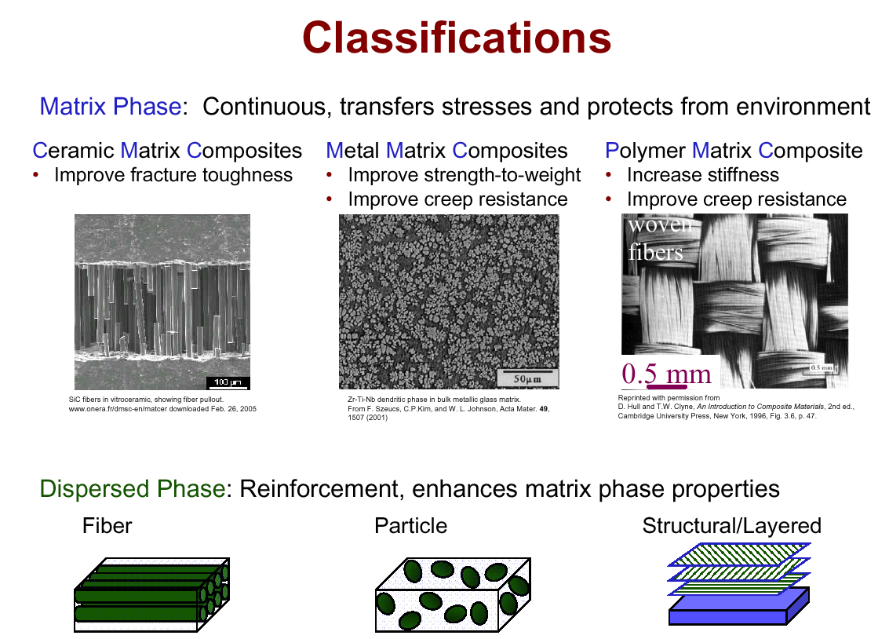

Slide 45
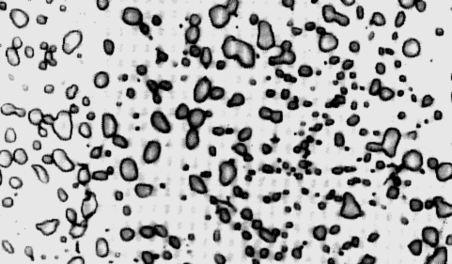
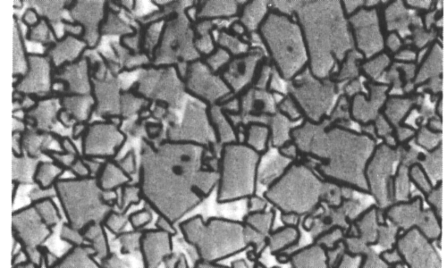
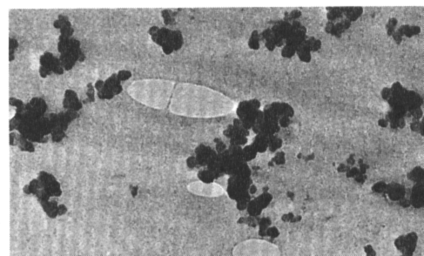
Composite Survey: Particle-I
Particle-reinforced
Fiber-reinforced
Structural
• Examples:
- Spheroidite
matrix:
particles:
Adapted from Fig. 10.19, Callister 7e. (Fig. 10.19 is copyright United States Steel Corporation, 1971.)
steel
ferrite (α)
cementite
(ductile)
(
Fe
3
C
)
(brittle)
60 μm
- WC/Co
matrix:
particles:
Adapted from Fig. 16.4, Callister 7e. (Fig. 16.4 is courtesy Carboloy Systems, Department, General Electric Company.)
cemented
cobalt
WC
carbide
(ductile)
(brittle,
V
m
:
hard)
5-12 vol%!
600 μm
Adapted from Fig. 16.5, Callister 7e. (Fig. 16.5 is courtesy Goodyear Tire and Rubber Company.)
- Automobile
matrix:
particles:
tires
rubber
C
(compliant)
(stiffer)
0.75 μm

Slide 46
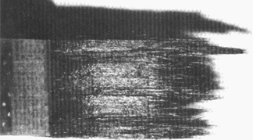
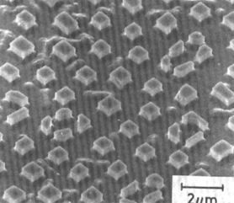
Composite Survey: Fiber
Particle-reinforced
Fiber-reinforced
Structural
• Aligned Continuous fibers
• Examples:
-- Metal: γ'(Ni3Al)-α(Mo)
by eutectic solidification.
-- Ceramic: Glass w/SiC fibers
formed by glass slurry
Eglass = 76 GPa; ESiC = 400 GPa.
matrix:
α
(Mo) (ductile)
(a)
fracture
surface
2 μm
From F.L. Matthews and R.L. Rawlings, Composite Materials; Engineering and Science, Reprint ed., CRC Press, Boca Raton, FL, 2000. (a) Fig. 4.22, p. 145 (photo by J. Davies); (b) Fig. 11.20, p. 349 (micrograph by H.S. Kim, P.S. Rodgers, and R.D. Rawlings). Used with permission of CRC
Press, Boca Raton, FL.
fibers:
γ
’ (Ni₃Al) (brittle)
(b)
From W. Funk and E. Blank, “Creep deformation of Ni3Al-Mo in-situ composites", Metall. Trans. A Vol. 19(4), pp. 987-998, 1988. Used with permission.

Slide 47
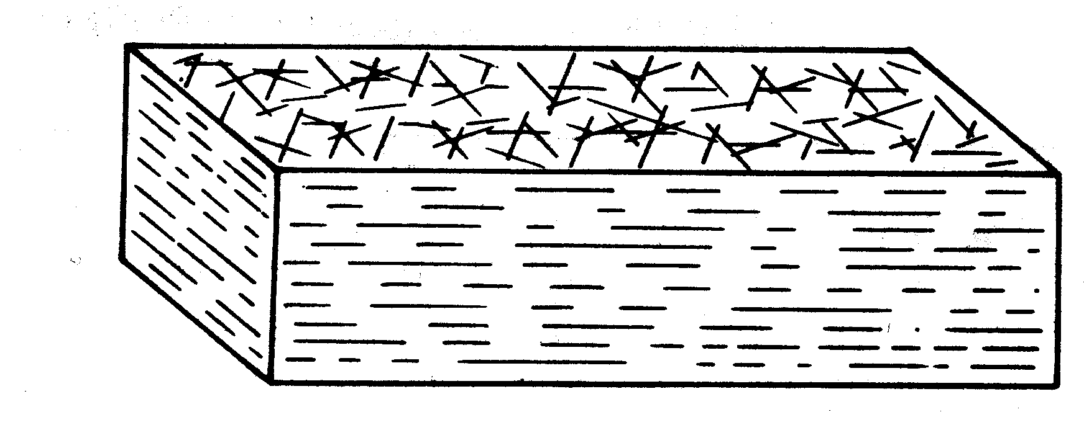
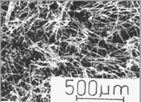
Composite Survey: Fiber
Particle-reinforced
Fiber-reinforced
Structural
• Discontinuous, random 2D fibers
• Example: Carbon-Carbon
-- process: fiber/pitch, then
burn out at up to 2500ºC.
-- uses: disk brakes, gas
turbine exhaust flaps, nose
cones.
C fibers:
very stiff
very
strong
(b)
C matrix:
less stiff
view onto plane
less strong
• Other variations:
-- Discontinuous, random 3D
-- Discontinuous, 1D
fibers lie
(a)
in plane
E_{c} = E_{m}V_{m} + KE_{f}V_{f}
efficiency factor:
-- random 2D: K = 3/8 (2D isotropy)
-- random 3D: K = 1/5 (3D isotropy)

Slide 48
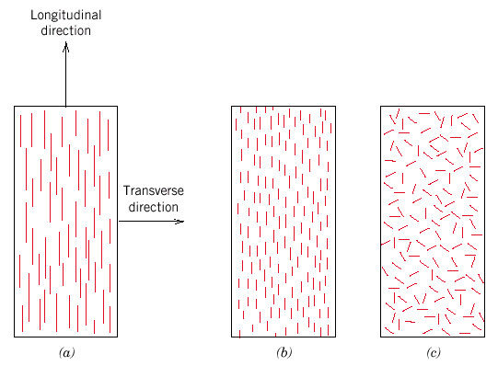
Fiber Alignment
Adapted from Fig. 16.8, Callister 7e.
aligned
continuous
aligned random
discontinuous

Slide 49
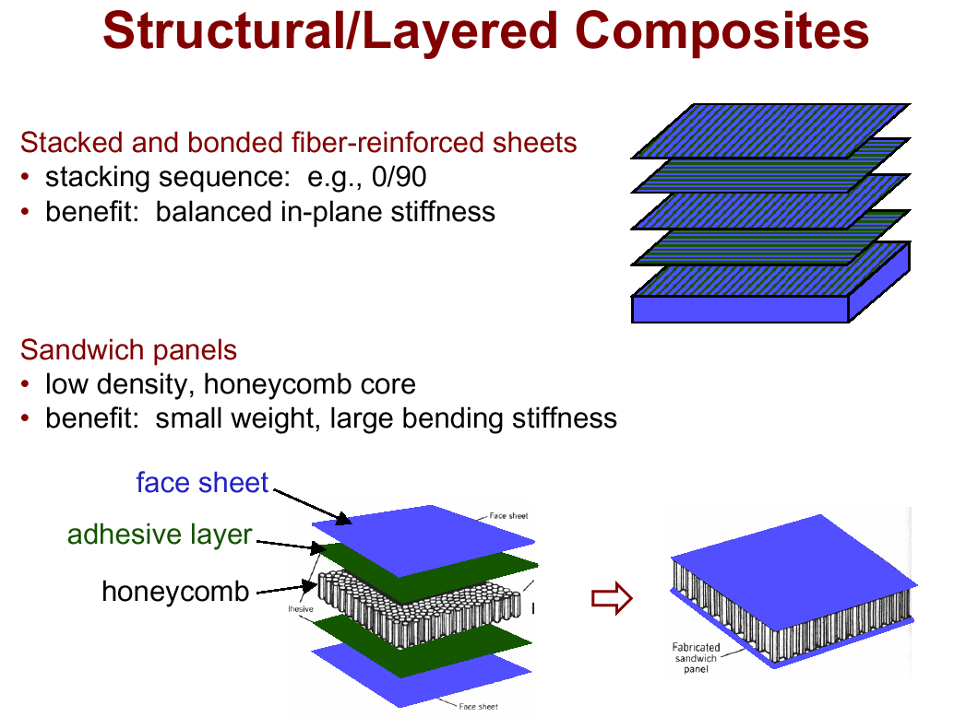

Slide 51
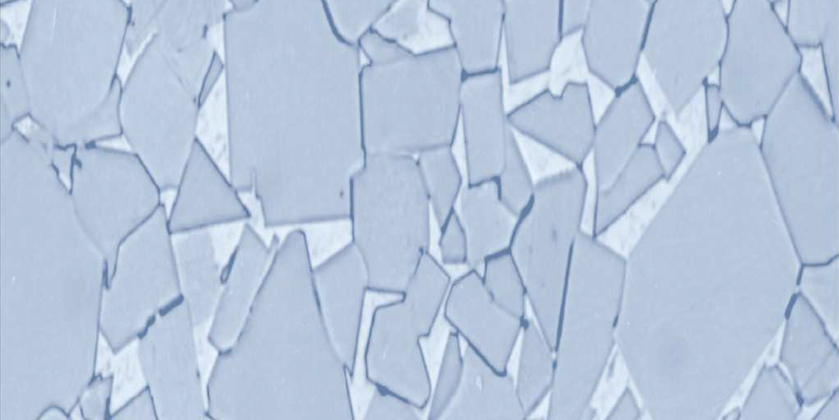

Fig. 2.2 Hardmetal composite
tungsten carbide
cobalt
5 μm

Slide 52
2.2 Effect of Matrix on Properties of materials
  Metal matrix composites (MMCs) are composed of an element or an alloy matrix in which a second phase is embedded and distributed to achieve some property improvement.
  Based on the size, shape and amount of the second phase, the composite property varies.
  Particulate reinforced composites, often called as discontinuously reinforced metal matrix composites, constitute 5 – 20 % of these new advanced materials.

Slide 53
  The microstructure of the processed composites
  influences and has a great effect on the
  mechanical properties.
  Generally, increasing the weight fraction of the reinforcement phase in the matrix leads to an increased stiffness, yield strength and ultimate tensile strength.
  However, the low ductility of particulate reinforced MMCs is the major drawback that prevents their usage as structural components in some applications.

Slide 54
Metal matrix composites have outstanding benefits due to the combined metallic and ceramic properties, thereby yielding improved physical and mechanical properties.
MMCs represent a new generation of engineering materials in which a strong ceramic reinforcement is incorporated into a metal matrix to improve its properties including specific strength, specific stiffness, wear resistance, corrosion resistance and elastic modulus.
MMCs combine metallic properties of matrix alloys (ductility and toughness) with ceramic properties of reinforcements (high strength and high modulus), leads to greater strength in shear and compression and higher service-temperature capabilities.

Slide 55
Thus, they have significant scientific, technological and commercial importance.
During the last decade, because of their improved properties, MMCs are being used extensively for high performance applications such as in aircraft engines and more recently in the automotive industries.
Aluminium oxide and silicon carbide powders in the form of fibers and particulates are commonly used as reinforcements in MMCs and the addition of these reinforcements to aluminum alloys has been the subject of a considerable amount of research work.

Slide 56
Aluminium oxide and silicon carbide reinforced aluminum alloy matrix composites are applied in the automotive and aircraft industries as engine pistons and cylinder heads, where the tribological properties of these materials are considered important.
Incorporation of hard second phase particles in the alloy matrices to produce MMCs has also been reported to be more beneficial and economical due to its high specific strength and corrosion resistance properties.

Slide 57
Functions of the matrix
  Transmit forces to and between fibers
  arrest cracks from spreading between fibers
    do not carry most of the load
  hold fibers in proper orientation
  protect fibers from environment and handling
    mechanical forces can cause cracks that allow environment to affect fibers
Demands on matrix
  Interlaminar shear strength
  Toughness
  Moisture/environmental resistance
  Temperature properties
  Cost

Slide 58
2.3 Effect of Size, Shape and Distribution of Second Phase on Mechanical Properties of Alloys:
Precipitation hardening, also called age hardening, is a heat treatment technique
-used to increase the yield strength of malleable materials, including most structural alloys of aluminium,magnesium, nickel and titanium, and some stainless steels.

Slide 59
It relies on changes in solid solubility with temperature to produce fine particles of an impurity phase, which impede the movement of dislocations, or defects in a crystal's lattice.
Since dislocations are often the dominant carriers of plasticity, this serves to harden the material.
The impurities play the same role as the particle substances in particle-reinforced composite materials.
precipitation in solids can produce many different sizes of particles, which have radically different properties

Slide 60
Metallic structures with highest strength, hardness and wear resistance are polyphase materials,
-i.e., they are composed of two or more phases in a well-controlled dispersion.
This microstructure is not usually obtained in the original casting or ingot.
It is formed by carefully controlled processing that involves hot working and heat treatment.
For example, the properties of a common aluminium alloy, 2014, used for structural members in aircraft can be controlled as discussed under.

Slide 61
“A general statement of the greatest importance for understanding the relationship between structure and properties, not only for metals but for all materials”
Properties of a material depend on the
-nature
-amount
-size
-shape
-distribution, and
-orientation
of the phases.
(Fig. 2.3)

Slide 62
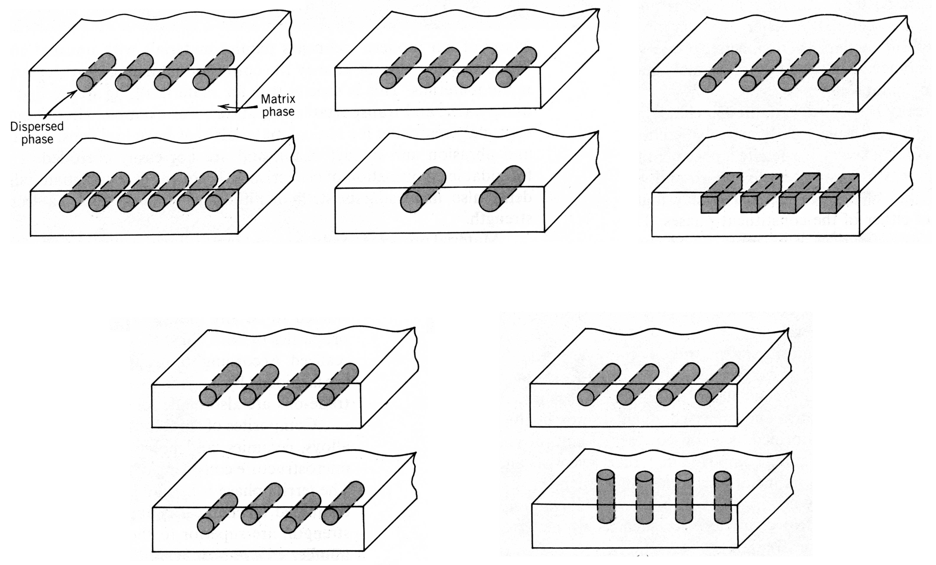
Fig 2.3 Character of Dispersed Phases
Concentration (V_{f})
Size
Shape
Distribution
Orientation

Slide 63
Nature of the phases.
-In the concrete slab, the individual properties of the concrete and the steel affect the overall strength of the slab.
-In the aluminium alloy 2014, two phases are involved : a solid solution of copper in aluminium and the intermetallic compound CuAl₂.The individual properties of each phase determine the characteristics of the alloy.
Amount of the phases.
-Just as the relative amounts of steel and concrete are important, so are the amounts of the two phases in the aluminium alloy.

Slide 64
Size of the phases.
-If there are only a few large steel reinforcing rods in the concrete slab, the structure is not so strong as it is when the same amount of steel is used in thinner bars.
-Similarly, a fine dispersion of CuAl₂ is preferred.
Shape of the phases.
-If the steel is in square bars, stress concentration occurs at the corners, causing cracking of the concrete; hence round bars are preferred.
-In the case of a precipitate in a microstructure, the properties obtained depend on whether the shape of the precipitate is spheroidal or plate-like.

Slide 65
Distribution of the phases.
-If the slab is to encounter bending stresses, the steel should be placed close to the surface rather than at the center.
-Similarly, in a microstructure, properties differ when a precipitate phase is localized at grain boundaries instead of being uniformly distributed.
Orientation of the phases.
-If the slab is to be used to resist typical traffic, a horizontal orientation of the steel is preferred.
-An aligned precipitate will also show directional mechanical properties.

Slide 66
These examples show that it is essential to understand the methods of controlling the development of polyphase structures.

